Slide 1
Stacked Ensembles of Information Extractors for Knowledge-Base Population
Nazneen Rajani
Raymond J. Mooney,
Vidhoon Vishwanathan and Yinon Bentor
University of Texas at Austin
Notes:
Stacking ensembles of IE for KBP

Slide 2
Knowledge-Base Population (KBP)
Annual evaluation of relation extraction from natural language documents organized by NIST.
English Slot Filling (ESF) task:
per: Barack Obama
country_of_birth
United States
spouse
Michelle Obama
children
Malia Obama
Sasha Obama
org: Microsoft
city_of_headquarters
Redmond
website
microsoft.com
subsidiaries
Skype
Nokia
Notes:
NIST annually conducts evaluation of relation extraction from natural language corpora. One of their tasks in this category is the English Slot filling task. There are a set of queries and a set of slots that you are supposed to fill in.
To give an example of the ESF task, suppose that the entity is Barack Obama and slot type is country_of_birth then the slot fill would be United States. Similarly for organization queries. So some slot types are single valued while some are list types

Slide 3
KBP Provenance
System’s must provide information on where the evidence for each slot fill is in the document corpus.
Given by:
Doc ID
Start Offset
End Offset
org: Microsoft
<eng-NG-31-1007> : Microsoft is a technology company headquartered in Redmond, Washington, that develops …
city_of_headquarters
Redmond
Doc ID
eng-NG-31-1007
Start Offset
48
End Offset
54
Notes:
Along with the slot fill the systems are also required to provide the provenance of the fill. The provenance consists of document ID along with the start and end offsets. The format in which systems provide provenance is docid, start…. i.e. passage within the document that the systems point to.

Slide 4
KBP Slot Filler Validation
Aim: Improve precision of individual systems.
Input is system outputs from the ESF task.
Output is filtered slot fills.
per: Barack Obama
country_of_birth
United States
spouse
Malia Obama
per: Barack Obama
country_of_birth
United States
spouse
NIL
filter
Notes:
Then we have the SFV task which focusses on improving precision of individual systems. The ip is the output from ESF task and output is the filtered slots. We can also improve recall for this task. Suppose for query Barack Obama we have following slot fills then if we did SFV we would replace spouse with NIL.

Slide 5
KBP Slot Filler Validation
Ensembling used to improve recall as well
per: Barack Obama
country_of_birth
United States
children
Malia Obama
per: Barack Obama
country_of_birth
United States
children
Malia Obama
Sasha Obama
union
per: Barack Obama
country_of_birth
United States
children
Sasha Obama

Slide 6
Ensembling
input
System 1
input
System 2
f( )
output
input
System N-1
input
System N
Notes:
Given a set of systems, is it possible to combine them in some way such that the output of the combination is better than each individual system

Slide 7
Stacking (Wolpert, 1992)
For a given proposed slot-fill, e.g. spouse(Barack, Michelle),
combine confidences from multiple systems:
System 1
conf 1
conf 2
System 2
L1 regularized linear SVM
System N-1
conf N-1
conf N
Accept?
System N
Notes:
For a given query and slot type we have a particular slot fill we have output confidences from each system, a lot of which are 0. You give it to a trained classifier then it would predict whether that slot fill for the particular relation is correct or no.

Slide 8
Stacking with Features
For a given proposed slot-fill, e.g. spouse(Barack, Michelle),
combine confidences from multiple systems:
System 1
conf 1
Slot Type
conf 2
System 2
L1 regularized linear SVM
System N-1
conf N-1
conf N
Accept?
System N
Notes:
We can also do stacking with features wherein we provide the slot type as a feature to the classifier so that it can better predict whether or not the the slot fill is correct. 40 slot types

Slide 9
Stacking with Features
For a given proposed slot-fill, e.g. spouse(Barack, Michelle),
combine confidences from multiple systems:
System 1
conf 1
Slot Type
Provenance
conf 2
System 2
L1 regularized linear SVM
System N-1
conf N-1
conf N
Accept?
System N
Notes:
Similarly we could also give provenance features to further improve the performance.

Slide 10
Document Provenance Feature
For a given query and slot, for each system, i, there is a feature DP_{i}:
N systems provide a fill for the slot.
Of these, n give same provenance docid as i.
DP_{i} = n/N is the document provenance score.
Measures extent to which systems agree on document provenance of the slot fill.
Notes:
First of all we do not have access to the actual corpus.
We have two provenance features, the first one is the document level provenance in which given a query and slot, for each system suppose capital N systems prove a fill and of these small n provide the same provenance docid, then Document provenance is given by n/N.
Reliability of slot fill based on document level provenance

Slide 11
Offset Provenance Feature
Degree of overlap between systems’ provenance strings (prov).
Uses Jaccard similarity coefficient.
For a given query and slot, for each system, i, there is a feature OP_{i} :
N systems provide a fill with same docid
Offset provenance for a system i is calculated as:
Systems with different docid have zero OP
Notes:
The second type of provenance feature is the Offset provenance which measures the degree of overlap between systems’ provenance strings
Statistical measure for this kind of similarity would be the Jaccard coefficient
intersection of the prov(i) with every other system that refers to the same document, divided by the union. You sum over all N systems and normalize by size of N

Slide 12
Offset Provenance Feature

Slide 13
Datasets
Ten Common Systems that participated both in 2013 and 2014 English Slot Filling (ESF) task:
LSV
IIRG
UMASS_IESL
Stanford
BUPT_PRIS
RPI_BLENDER
CMUML
NYU
Compreno
UWashington
2014 Slot Filler Validation (SFV) data
17 teams
65 systems
Notes:
Two datasets

Slide 15
Baselines
Union
Combine systems for maximizing recall
List valued slot fills => always included
Single valued slot fills => highest confidence
Notes:
We compare to various unsupervised baselines such as Union and as the name suggests you pool all the systems for maximizing recall.
Learn threshold on 2013 data that gives the best performance both on SFV and common systems datasets

Slide 16
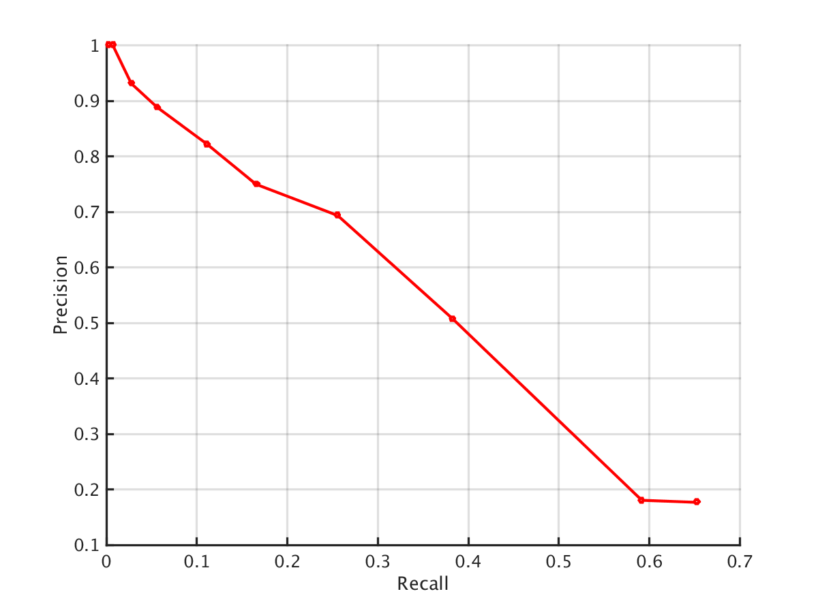
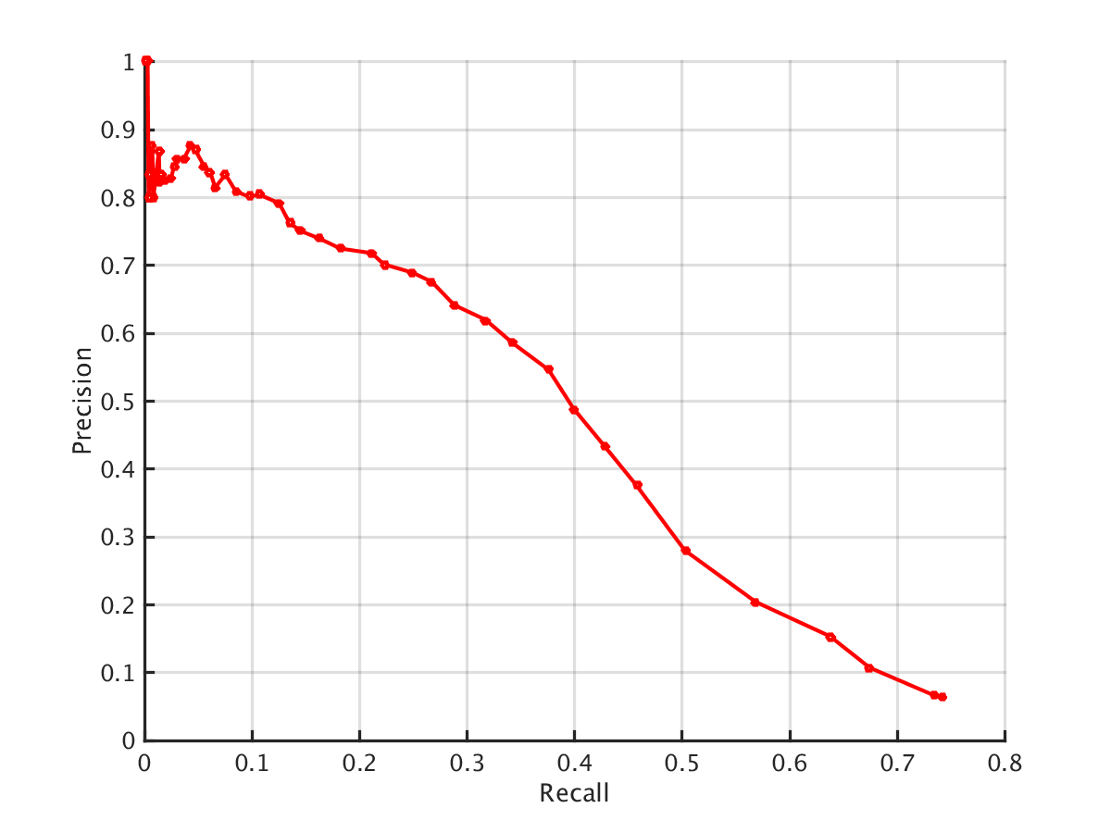
Baselines
Voting
Combine systems for maximizing F1
Vary threshold on #systems that must agree
Learn threshold on 2013 data
Common Systems Dataset (3)
SFV Dataset (10)

Slide 17
KBP English Slot Filling (ESF) Results
2014 Slot Filler Validation (SFV) Data
Baseline | Precision | Recall | F1
Union | 0.067 | 0.762 | 0.122
Voting | 0.641 | 0.288 | 0.397
Common systems for 2013 and 2014 ESF task
Approach | Precision | Recall | F1
Union | 0.176 | 0.647 | 0.277
Voting | 0.694 | 0.256 | 0.374
Best ESF system in 2014 (Stanford) | 0.585 | 0.298 | 0.395
Stacking | 0.606 | 0.402 | 0.483
Stacking + Relation | 0.607 | 0.406 | 0.486
Stacking + Provenance + Relation | 0.541 | 0.466 | 0.501
Notes:
As expected the Union has the highest recall and the voting has the highest precision.

Slide 18
Slot Filler Validation (SFV) Key
Assessment key for ESF has:
Human annotated slot fills
Pooled slot fills of systems
Slot filler validation key used by Sammons et al.(2014):
Only includes the correct pooled slot fills
We use this key to compare our approach to theirs
Notes:
The normal assessment key for English slot filling task has …..

Slide 19
KBP Slot Filler Validation Results
2014 Slot Filler Validation (SFV) Data
Baseline | Precision | Recall | F1
Union | 0.054 | 0.877 | 0.101
Voting | 0.637 | 0.406 | 0.496
Common systems for 2013 and 2014 ESF task
Approach | Precision | Recall | F1
Union | 0.177 | 0.922 | 0.296
Voting | 0.694 | 0.256 | 0.374
Best SFV system in 2014 (UIUC) | 0.457 | 0.507 | 0.481
Stacking | 0.613 | 0.562 | 0.586
Stacking + Relation | 0.613 | 0.567 | 0.589
Stacking + Provenance + Relation | 0.659 | 0.560 | 0.606

Slide 20
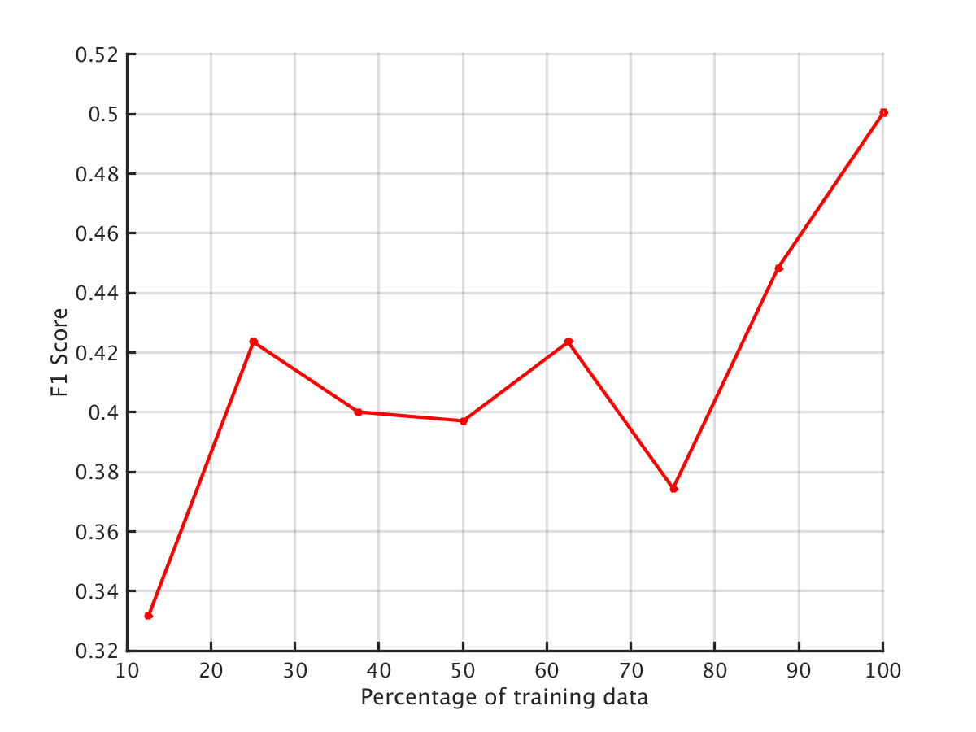
Learning Curve
Systems change each year.
Still useful to train on past data.
Notes:
KBP systems change year after year and so to have a better understanding we split the 2013 dataset into 10 and then train on each split and test on the 2014 dataset. As we keep adding more data this is the curve we obtain and as we can see that having more data definitely proves to be useful.

Slide 21
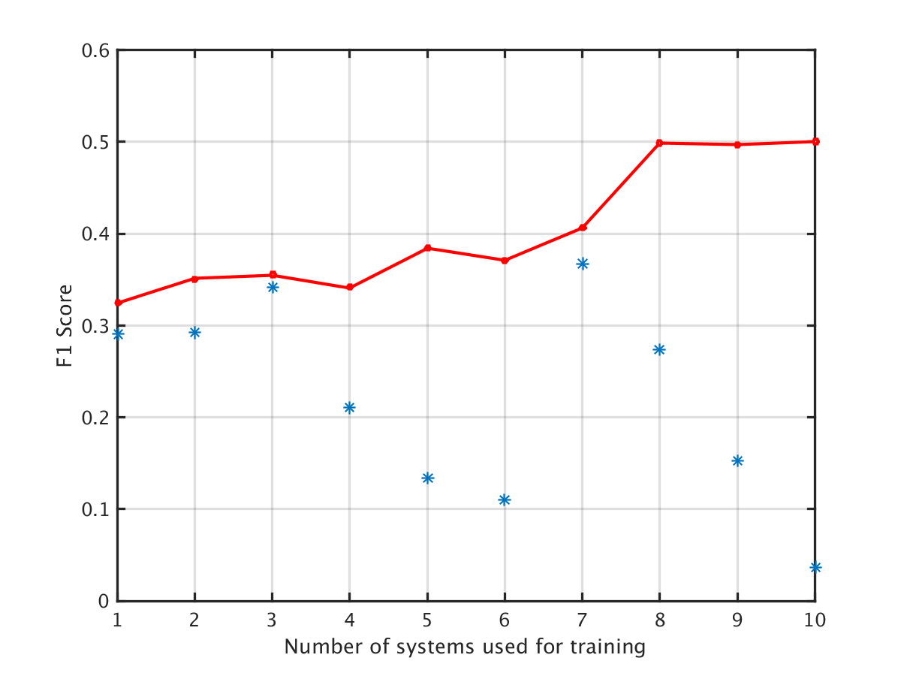
Incremental Training on Systems
Sort the common systems based on their performance.
Train the classifier adding one system at each step.
Test on 2014 data.
Notes:
We also experiment by sorting the systems from higher to lower based on the number of false positive they produce in the ensembling approach. And thereafter we train by adding one more system’s slot fills at each step and testing on 2014 data.
Upto 5 systems our approach is really conservative and even though it has high preicison the recall is very low. However from system 6 on wards our approach has higher recall. At step 7 we have the highest gain because the system added on step 7 provides approximately 25% of the total training data.

Slide 22
Conclusion
Stacked meta-classifier beats the best performing 2014 KBP ESF system by an F1 gain of 11 points.
Features that utilize provenance information improve stacking performance.
Ensembling has clear advantages but naive approaches such as voting do not perform as well.
Although systems change every year, there are advantages in training on past data.

Slide 23
Questions?

