Slide 1
Generating Question Relevant Captions to Aid Visual Question Answering
Jialin Wu, Zeyuan Hu, Raymond J. Mooney
Department of Computer Science
The University of Texas at Austin

Slide 2
Visual Question Answering
A complicated multimodal task involving high level knowledge of objects, attributes, relations, etc.
Does this boy have a full wetsuit on?
VQA
System
Yes
Necessary Knowledge:
Object level: [person, wetsuit]
Attribute level: [wetsuit is full, person is young]
Relational level: [wetsuit on person]
Notes:
Briefly introduce VQA task (change examples)

Slide 3
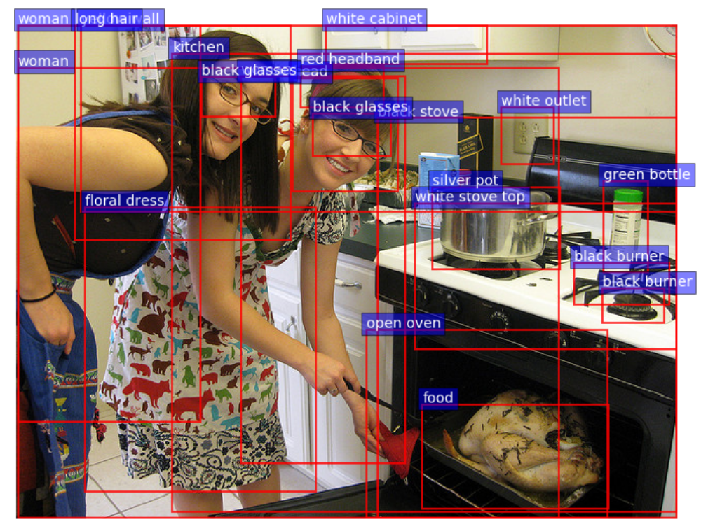
More Sophisticated Visual Features
CNN image features
one feature vector per image
Detecting Common Objects
N object vectors per image
Mining Attributes on Objects
N object vectors per image
Detecting relations
Potentially N(N-1) relation
vector per image
Notes:
CNN feature: fast but feature its self is not adequate,
Object and attribute features: medium but still OK , features have more representative power but still not enough for complicated questions
Relationship features, slow (n^2)

Slide 4
A Typical Current Method (Anderson et al., 2018)
Use detected features as “bottom up attention”
Learn a “top down attention” over these high-level features
$$q$$
Question
Word Embedding
GRU
Does this boy have a full wetsuit on?
Visual attention
$${ A}^{qv}$$
Answer Prediction
Yes
$$V$$
$$k×2048$$
$$k×2048$$
...
$$k$$
...
$$V^{q}$$
Image
CNN
$$k$$
Notes:
Change to high level flow

Slide 5
Leveraging Textual Captions for VQA
Less structural than visual features
A young man is on his surf board with
someone in the background
Objects: [man, surf board, background]
Attributes: [man is young]
Relationships: [surfer on surf board,
man with someone,
someone in background]
More diverse visual concepts
Man, young surfer, young man, boy
A man on a blue surfboard on top of some rough water.
A young surfer in a wetsuit surfs a small wave.
A young man rides a surf board on a small wave while a man swims in the background.
A young man is on his surf board with someone in the background.
A boy riding waves on his surf board in the ocean
Notes:
Textual captions can be a succinct and rich representation for image.

Slide 6
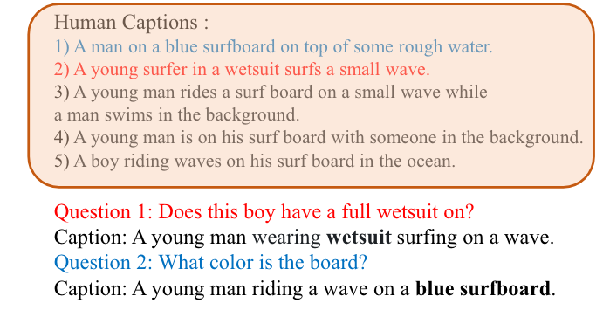
Generating Relevant Captions
For a visual question, some captions are relevant and some are not.
Relevant captions are more likely to encode necessary knowledge for VQA
Notes:
Question relevant intuitively helps more

Slide 7
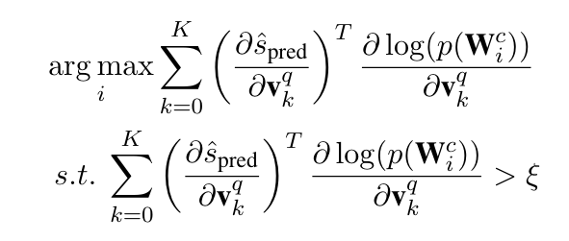
Collecting Relevant Training Captions
Intuition: Generated captions should focus more on the influential objects for the question. We use a gradient based method to model the influence.
We collect the captions with maximum inner-product of the objects’ influence score between the VQA and captioning objectives.
Notes:
How to collect training examples

Slide 8
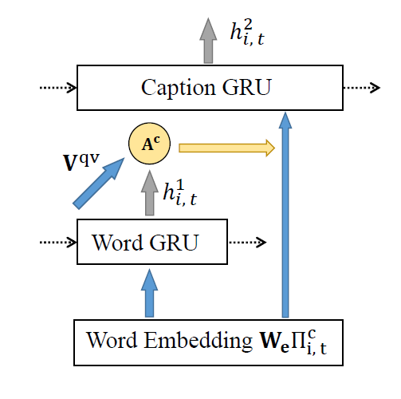
How to Use the Captions
Caption Embedding
A Word GRU combined with an
attention mechanism to identify important
words for the question and images.
A Caption GRU to encode sequential
information from the attended words.
Notes:
Caption embedding module

Slide 9
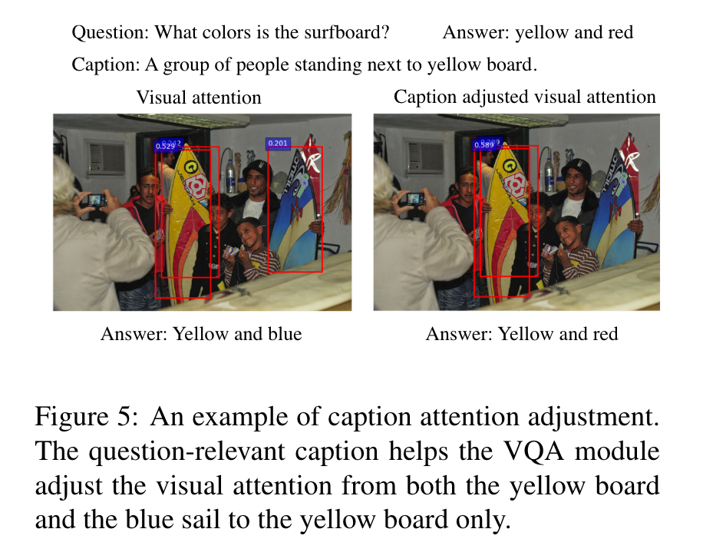
How to Use the Captions
Captions used to adjust visual attention.
Similar to visual attention, use caption features to compute an attention adjustment to add to the original visual attention.
Notes:
Use captions to adjust visual attention

Slide 10
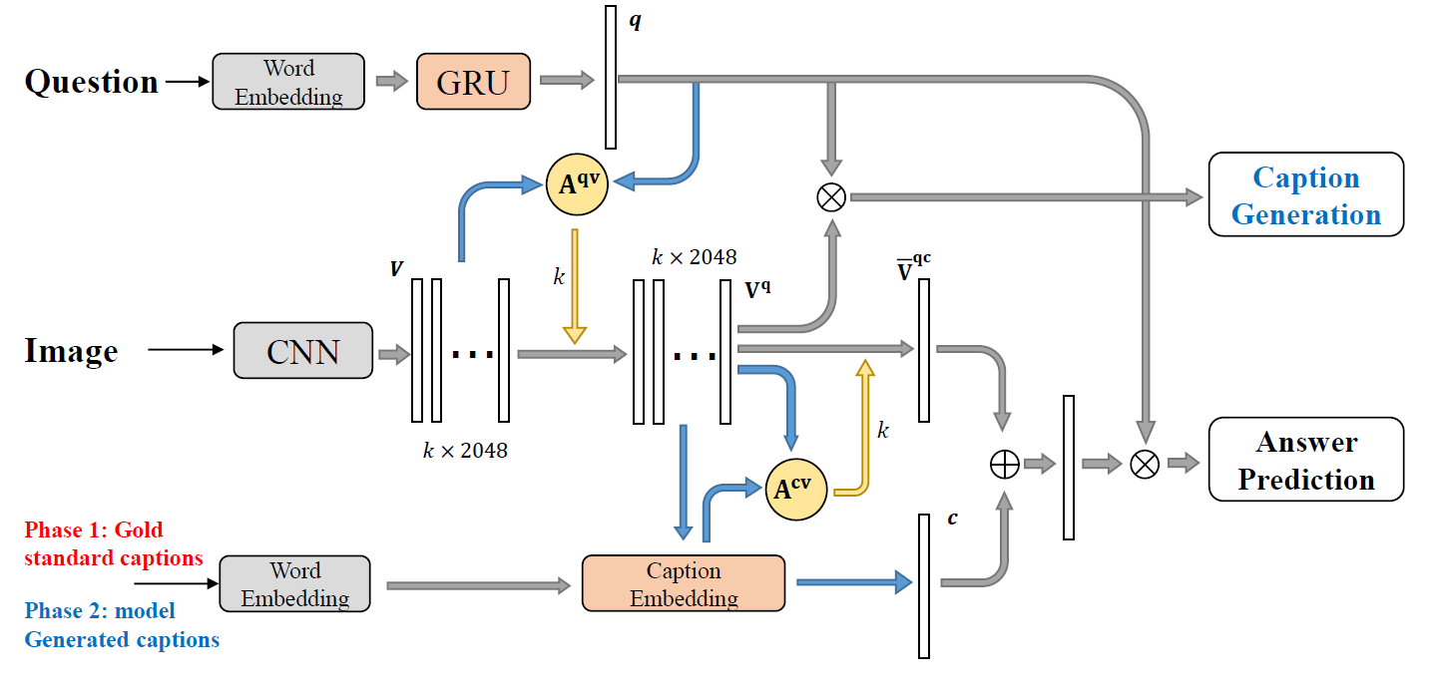
Model Overview
Visual attention
Caption attention
adjustment
⊗, ⊕ denotes element-wise multiplication and addition. Blue arrows denote fc layers and yellow arrows denote attention embedding.
Notes:
Model overview

Slide 11
Training
Phase 1: train VQA module with human captions.
Use all of 5 captions from COCO dataset
Use the standard binary cross entropy loss with soft scores as VQA loss
Phase 2: jointly train VQA and caption module with selected relevant human captions.
Use maximum likelihood estimation for training captioning module
Jointly minimizing VQA loss and captioning loss
Phase 3: Fine tune VQA module using generated captions.

Slide 12
Overall Results
VQA performance on VQA v2 Test-standard split

Slide 13
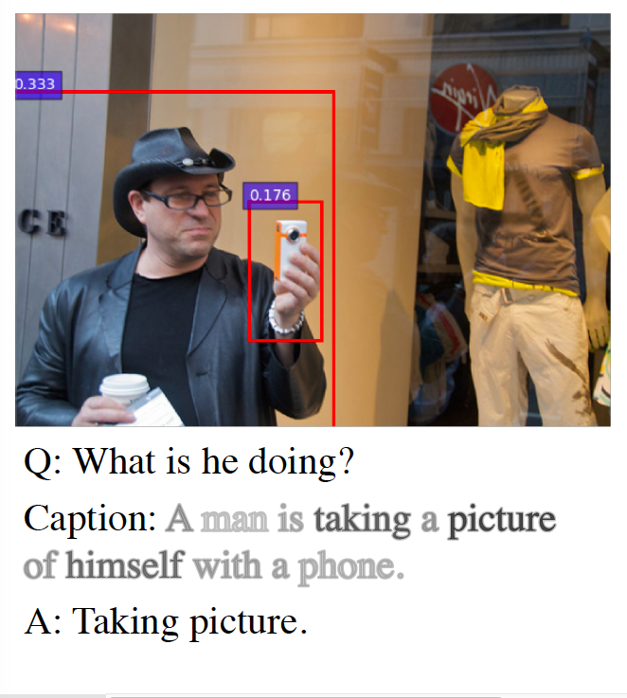
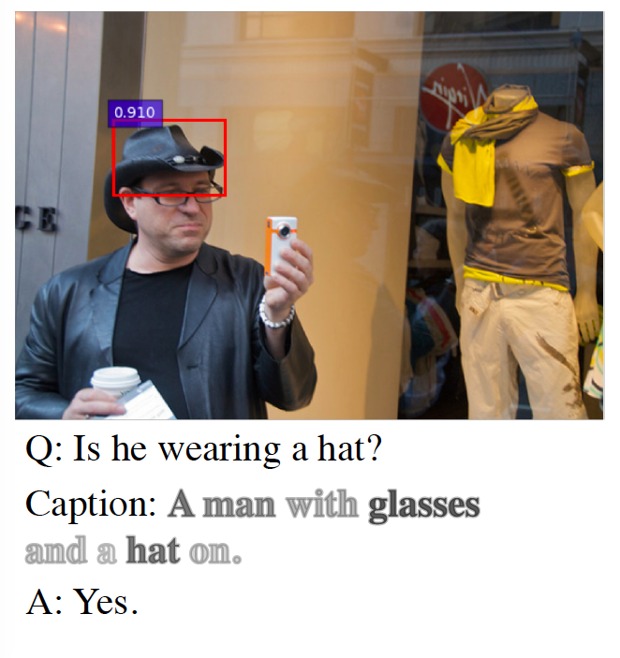
Some Examples
Notes:
Drop TV one, make three slides

Slide 14
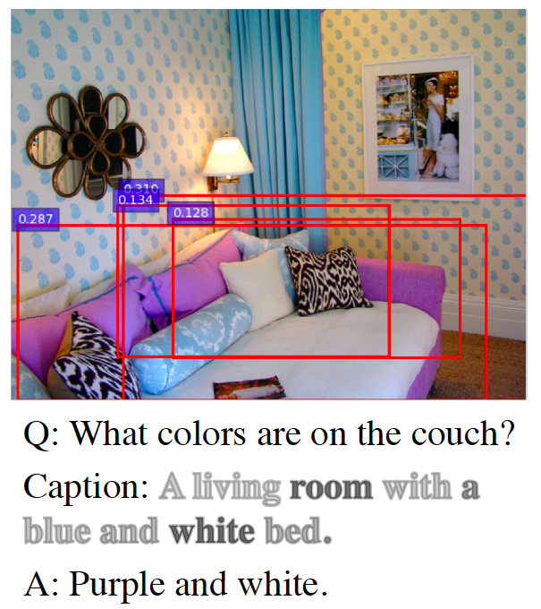
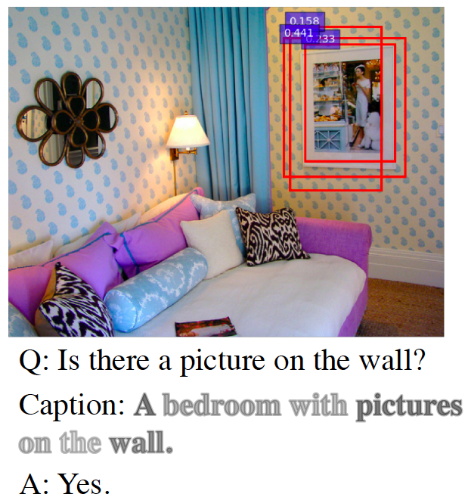
Some Examples
Notes:
Drop TV one, make three slides

Slide 15
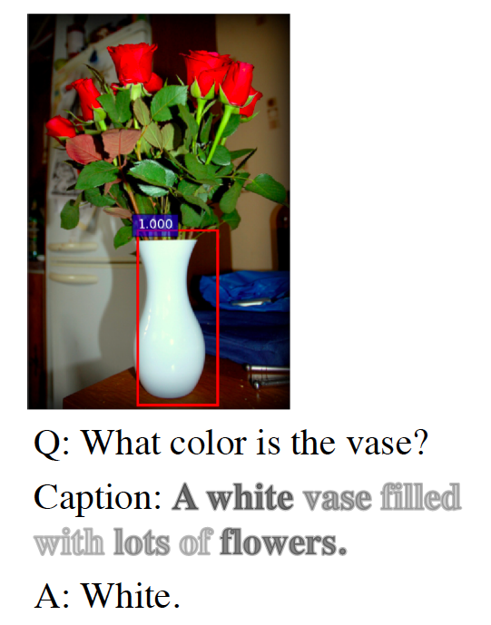
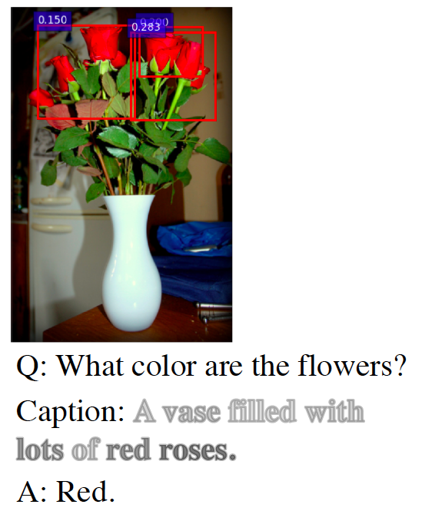
Some Examples
Notes:
Drop TV one, make three slides

Slide 16
Comparison Between Different Captions
Human captions help VQA the most.
Generated question relevant captions help VQA more than question-agnostic captions.

Slide 17
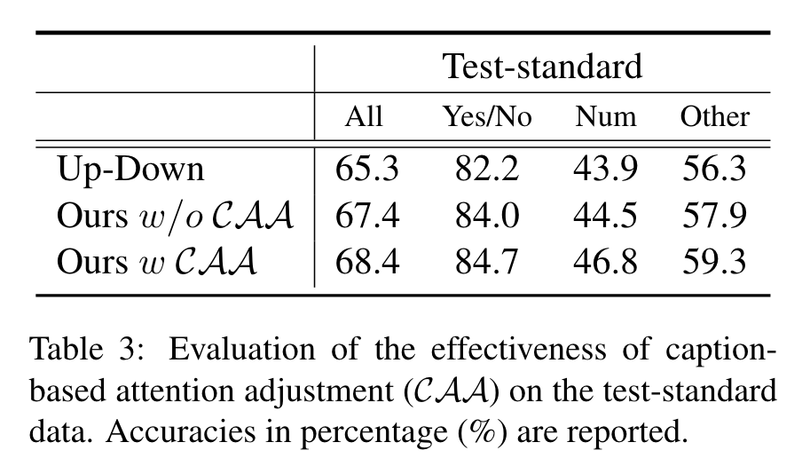
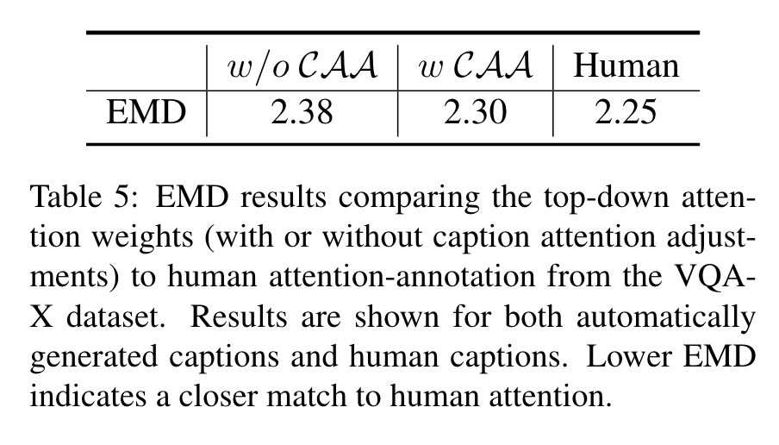
Effects of Adjusting Visual Attention
Better VQA performance
More human-like attention

Slide 18
Conclusions
General captions, even generated ones, can be used to improve VQA.
Question relevant captions improve VQA even more.

