Slide 1
Faithful Multimodal
Explanation for VQA
Jialin Wu
Raymond Mooney
Department of Computer Science
University of Texas at Austin

Slide 2
Visual Question Answering
(Agrawal, et al., 2016)
Answer natural language questions about an image.

Slide 3
Textual Explanations
Generate a natural-language sentence that justifies the answer (Hendricks et al. 2016).
Use an LSTM to generate an explanatory sentence given embeddings of:
  image
  question
  answer
Train this LSTM on human-provided explanatory sentences.

Slide 4
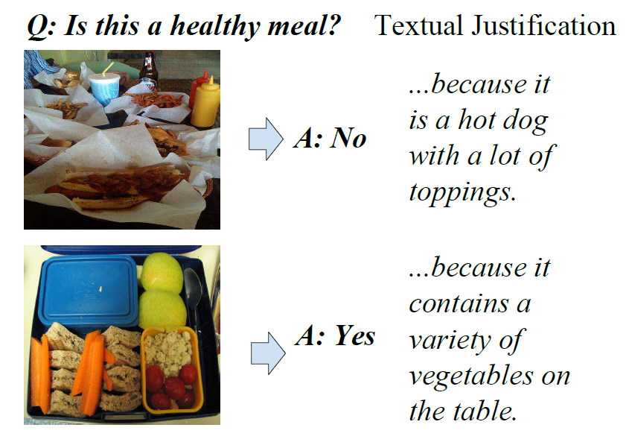
Sample Textual Explanations
(Park et al., 2018)

Slide 5
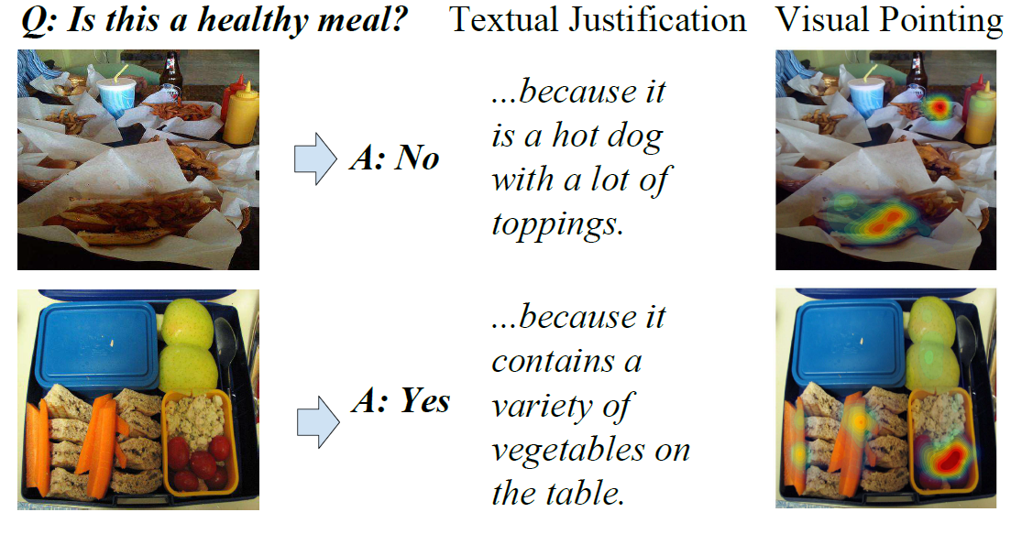
Multimodal Explanations
Combine both a visual and textual explanation to justify an answer to a question (Park et al., 2018).

Slide 6
Post Hoc Rationalizations
Previous textual and multimodal explanations for VQA (Park et al., 2018) are not “faithful” or “introspective.”
  They do not reflect any details of the internal processing of the network or how it actually computed the answer.
  They are just trained to mimic human explanations in an attempt to “justify” the answer and get humans to trust it.

Slide 7
Faithful Multimodal Explanations
We are attempting to produce more faithful explanations that actually reflect important aspects of the VQA system’s internal processing.
Focus explanation on including detected objects that are highly attended to during the VQA network’s generation of the answer.
Trained to generate human explanations, but explicitly biased to include references to these objects.

Slide 8
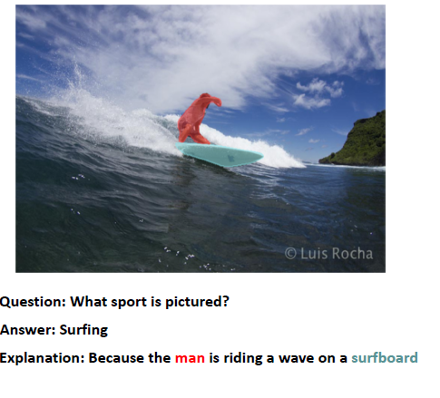
Sample Faithful Multimodal Explanation

Slide 9
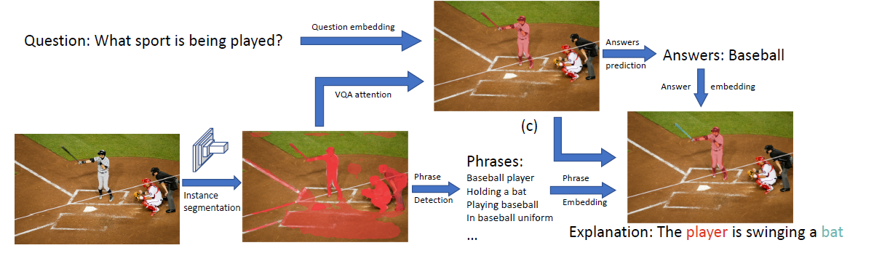
High-Level VQA Architecture

Slide 10
Textual Explanation Generator
We finally train an LSTM to generate an explanatory sentence from embeddings of the segmented objects.
Trained on supervised data to produce human-like textual explanations.
But, trained to encourage the explanation to cover the segments highly attended to by VQA to make it faithfully reflect the focus of the network that computed the answer.

Slide 11
Multimodal Explanation Generator
Words generated while attending to a particular visual segment are highlighted and linked to the corresponding segmentation in the visual explanation by depicting them both in the same color.

Slide 12
High-Level System Architecture

Slide 13
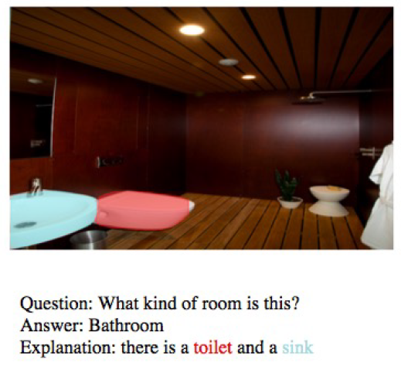
Sample Explanation

Slide 14
Evaluating Textual Explanations
Compare system explanation to “gold standard” human explanations using standard machine translations metrics for judging similarity of sentences.
Ask human judges on Mechanical Turk to compare system explanation to human explanation and judge which is better (allowing for ties).
  Report percentage of time algorithm beats or ties human.

Slide 15

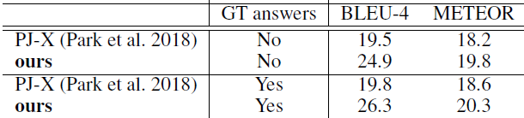


Textual Evaluation Results
Automated Metrics
Human Eval

Slide 16
Evaluating Multimodal Explanations
Ask human judges on Mechanical Turk to qualitatively evaluate the final multimodal explanations by answering two questions:
  “ How well do the highlighted image regions support the answer to the question?”
  “How well do the colored image segments highlight the appropriate regions for the corresponding colored words in the explanation?”

Slide 17
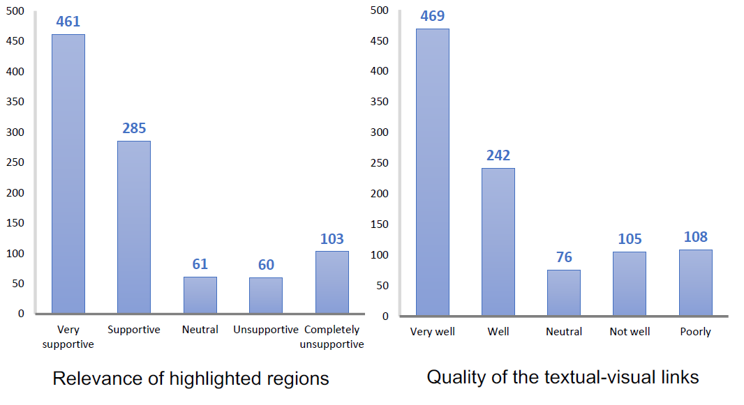
Multimodal Explanation Results

Slide 18
Conclusions
Multimodal explanations for VQA that integrate both textual and visual information are particularly useful.
Our approach that uses attention over high-level object segmentations to drive both VQA and human-like explanation is promising and superior to previous “post hoc rationalizations.”

