Slide 1
Evaluating the Robustness of Natural Language Reward Shaping Models to Spatial Relations
Antony Yun

Slide 2
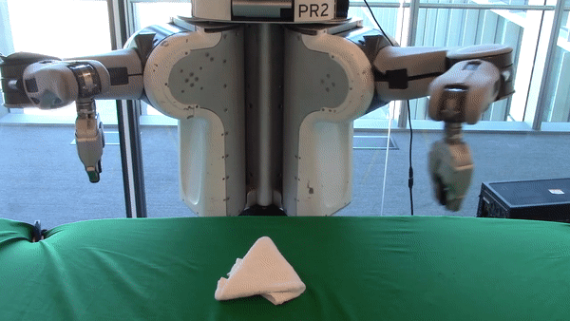
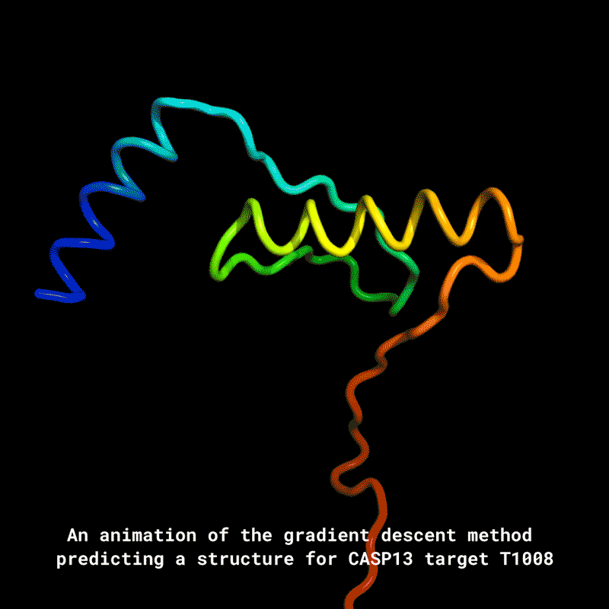
Successes of Reinforcement Learning
https://deepmind.com/blog/article/alphazero-shedding-new-light-grand-games-chess-shogi-and-go
https://bair.berkeley.edu/blog/2020/05/05/fabrics/ https://deepmind.com/blog/article/AlphaFold-Using-AI-for-scientific-discovery
Notes:
RL popular, especially with deep RL
chess, robotics, novel (protein)

Slide 3
My Work
Construct a challenge dataset in the Meta-World reward shaping domain that contains spatially relational language
Evaluate robustness of existing natural language reward shaping models

Slide 4
Outline
Background on Deep Learning, Reinforcement Learning
Natural language reward shaping
Our Dataset
Results

Slide 5
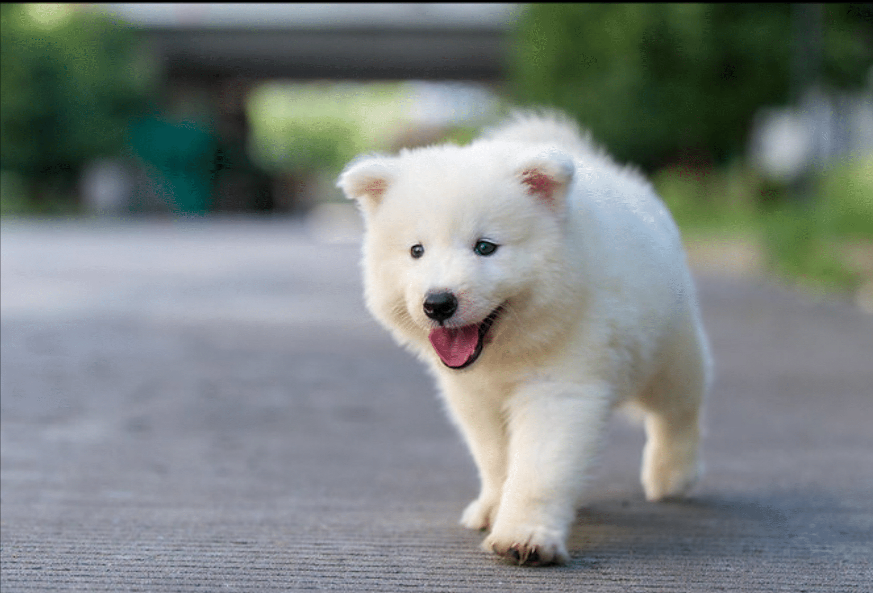
Background: Neural Networks
Function approximators
Trained with gradient descent
f( ) = [0.12, 0.05, …]
https://github.com/caoscott/SReC
Notes:
faster here

Slide 6
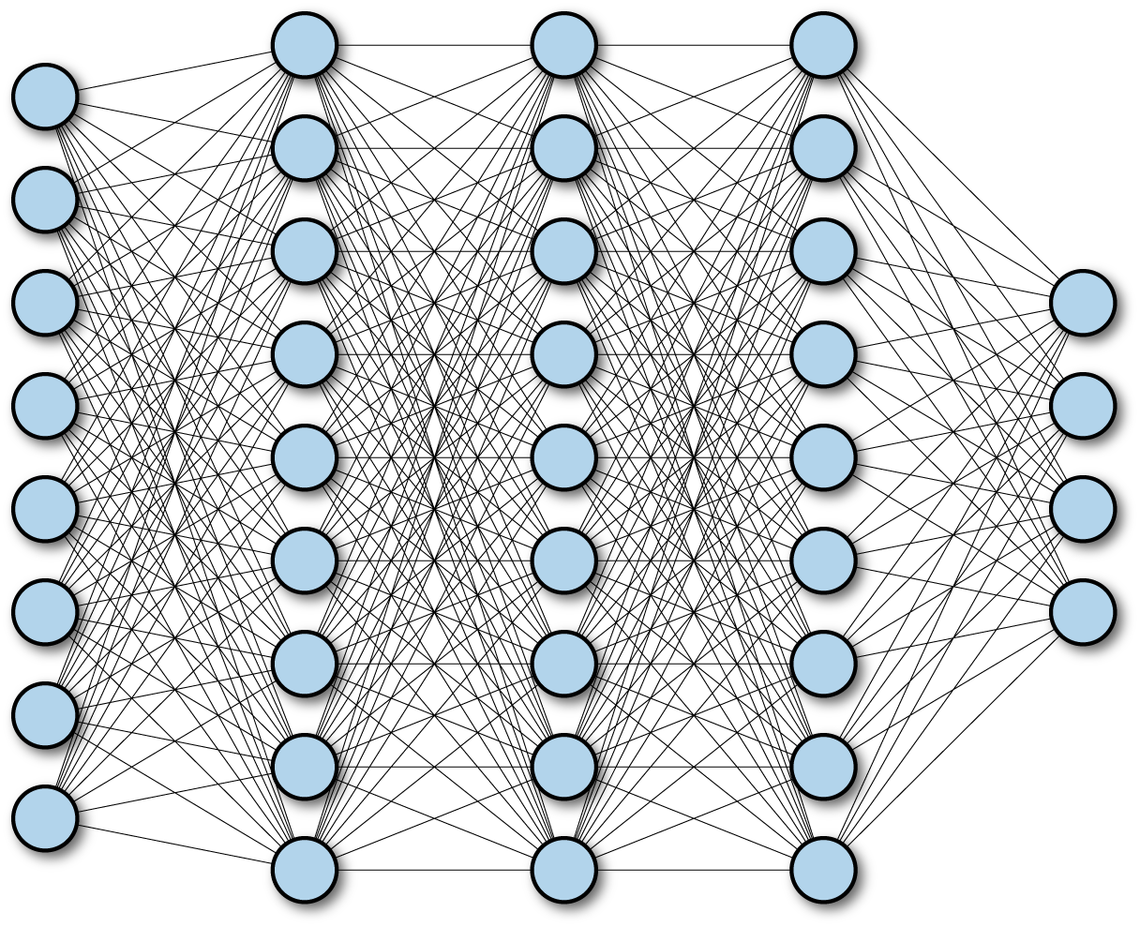
Background: Neural Networks
https://www.oreilly.com/library/view/tensorflow-for-deep/9781491980446/ch04.html
https://stanford.edu/~shervine/teaching/cs-230/cheatsheet-convolutional-neural-networks
https://www.researchgate.net/figure/Illustration-of-LSTM-block-s-is-the-sigmoid-function-which-play-the-role-of-gates-during_fig2_322477802
Notes:
higher level

Slide 7
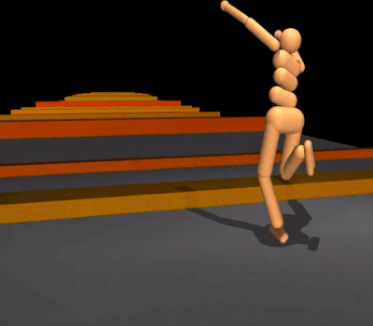
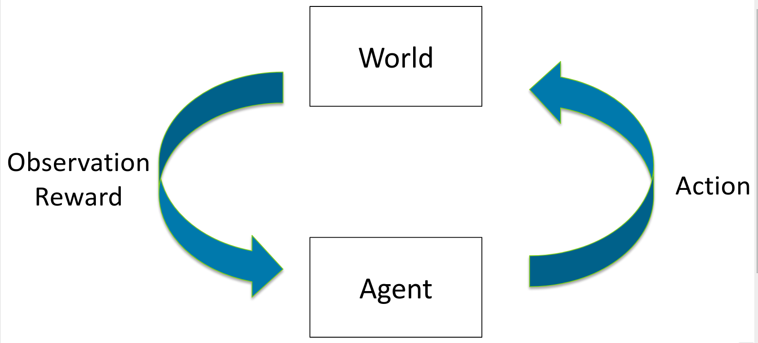
Background: Reinforcement Learning
Learn a policy by interacting with the environment
Optimize cumulative discounted reward
https://deepmind.com/blog/article/producing-flexible-behaviours-simulated-environments
http://web.stanford.edu/class/cs234/index.html

Slide 8
Background: Markov Decision Process (MDP)
S = states
A = actions
T = transition function
R = reward
𝛄 = discount factor

Slide 9
Background: Policy Based RL
Parameterized policy
Want optimal policy that maximizes expected reward
Learned by gradient descent on final reward
We use Proximal Policy Optimization (PPO)
[Schulman et al, 2017]

Slide 10
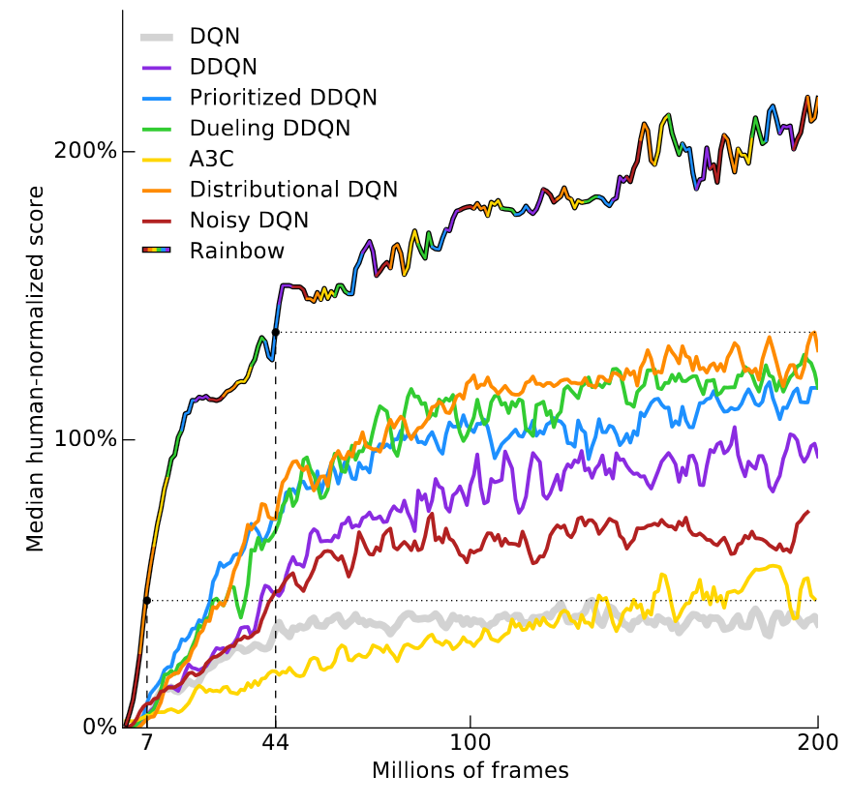
Challenges with RL
Sample inefficient
https://www.alexirpan.com/2018/02/14/rl-hard.html
Notes:
Atari tasks
*axes*

Slide 11
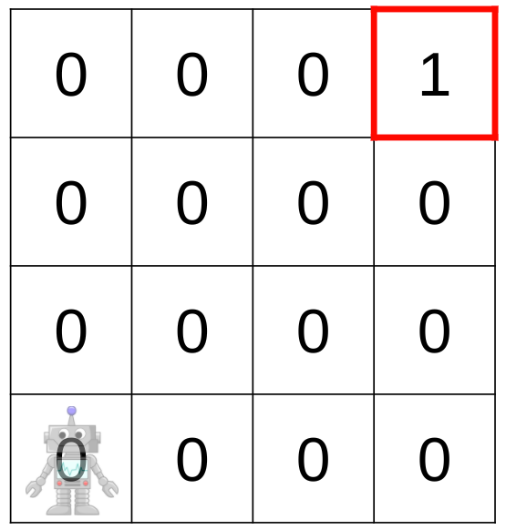
Challenges with RL
Sample inefficient
Good reward functions are hard to find
Sparse: easy to design
https://www.alexirpan.com/2018/02/14/rl-hard.html
Notes:
Atari tasks
*axes*

Slide 12
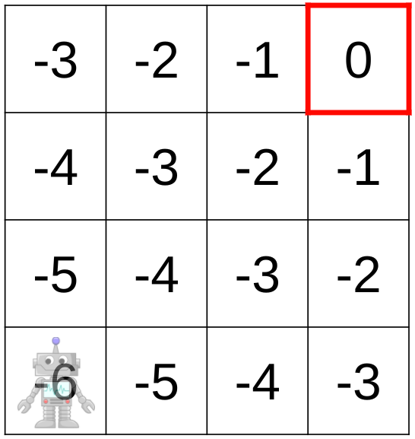
Challenges with RL
Sample inefficient
Good reward functions are hard to find
Sparse: easy to design
Dense: easy to learn
https://www.alexirpan.com/2018/02/14/rl-hard.html
Notes:
Atari tasks
*axes*

Slide 13
Background: Reward Shaping
Provide additional potential reward
Does not change the optimal policy
[Ng et al, 1999]

Slide 14
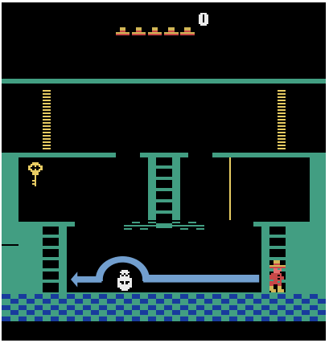
Prior Work: LEARN
Language-based shaping rewards for Montezuma's Revenge
Non-experts can express intent
60% improvement over baseline
"Jump over the skull while going to the left"
[Goyal et al, 2019]
Notes:
mention Atari
first multimodal shaping reward
sets the stage

Slide 15
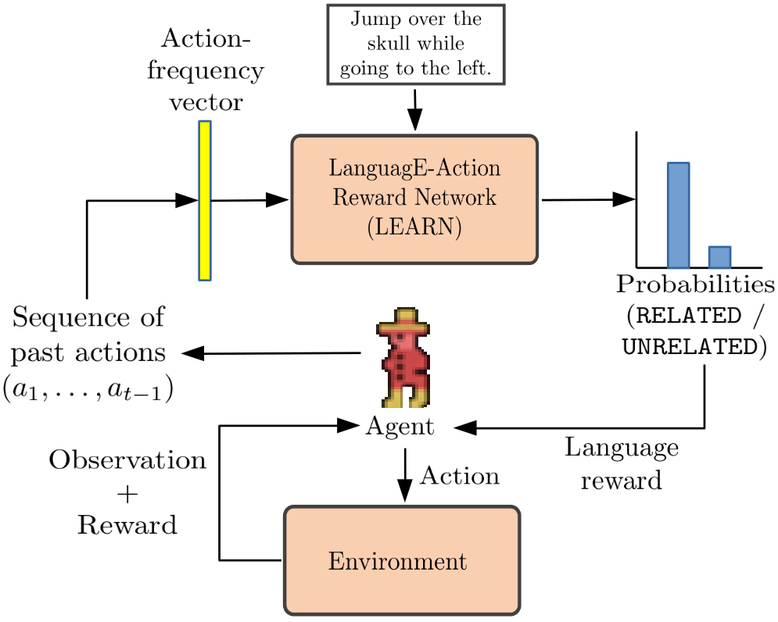
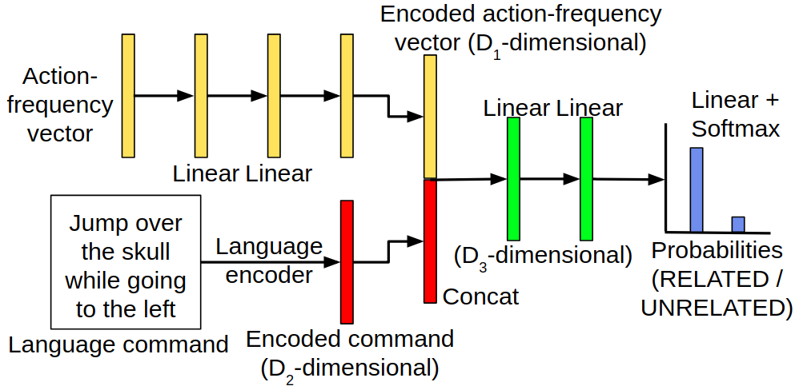
Prior Work: LEARN
[Goyal et al, 2019]
Notes:
Good results, but limited domain
Want visual, temporal information

Slide 16
Meta-World
Object manipulation domain involving grasping, placing, and pushing
Continuous action space, multimodal data, complex goal states
[Yu et al, 2019]

Slide 17
Dense Rewards in Meta-World
[Yu et al, 2019]
Notes:
less detail

Slide 18
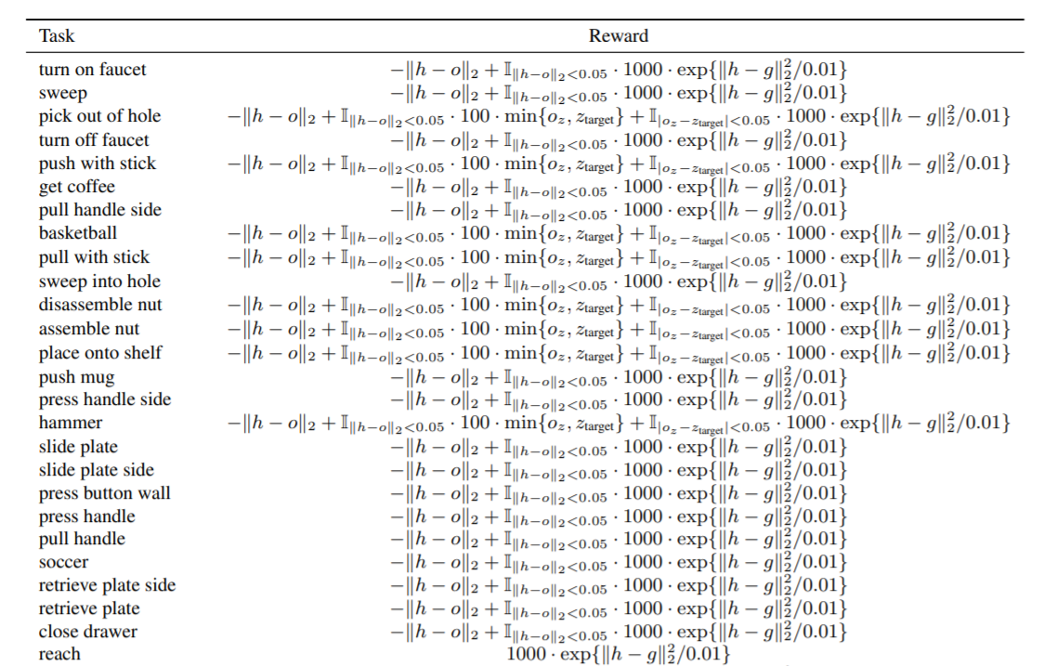
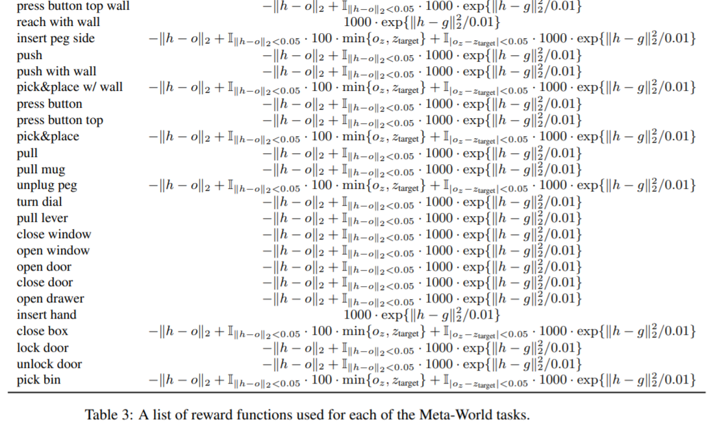
Dense Rewards in Meta-World
[Yu et al, 2019]

Slide 19
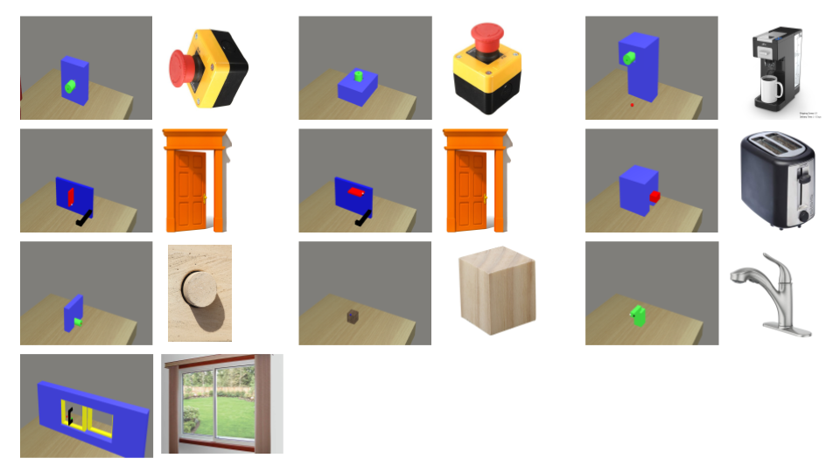
Pix2R Dataset
13 Meta-World tasks, 9 objects
100 scenarios per task
Videos generated using PPO on dense rewards
520 human-annotated descriptions from Amazon Mechanical Turk
Use video trajectories + descriptions to approximate dense reward
[Goyal et al, 2020]
Notes:
Task = object + action (open door)
Scenario = placement of objects in the env
Videos generated by dense reward

Slide 20
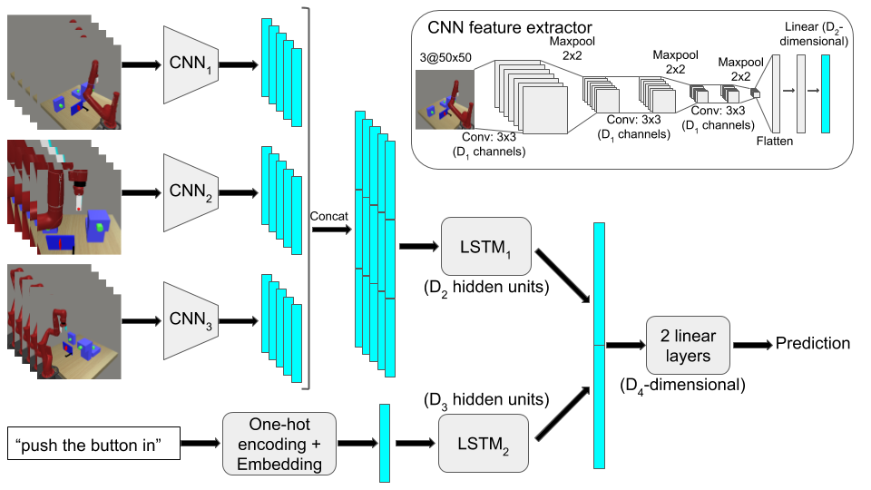
Pix2R Architecture
[Goyal et al, 2020]

Slide 21
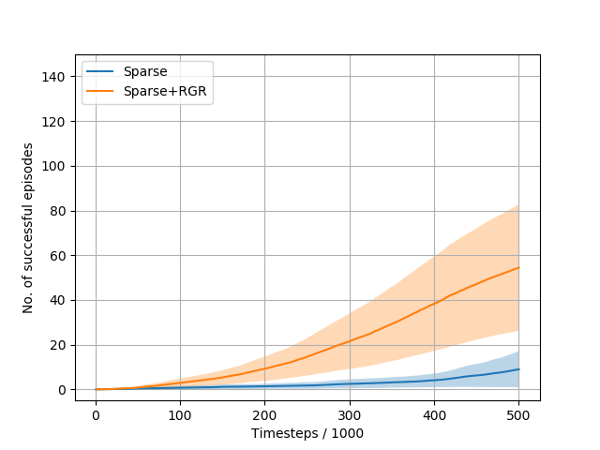
Pix2R Results
Adding shaping reward speeds up policy learning sparse rewards
Sparse + Shaping rewards perform comparably to Dense rewards
[Goyal et al, 2020]

Slide 22
Extending Pix2R Dataset
Each scenario has only one instance of each object
Descriptions use simplistic language
Goal: construct a dataset containing relational language
Probe whether model is learning multimodal semantic relationships or just identification
Motivate development of more robust models

Slide 23
Relational Data
"Turn on the coffee machine on the left"
"Press the coffee maker furthest from the button"

Slide 24
Video Generation
Target object + duplicate object + distractors
Train PPO with dense reward until success
6 tasks (button_top, button_side, coffee_button, handle_press_top, door_lock, door_unlock)
5 scenarios per task
30 total scenarios

Slide 25
Collecting Natural Language Descriptions
Amazon Mechanical Turk
‘Please ensure that the instruction you provide uniquely identifies the correct object, for example, by describing it with respect to other objects around it.’
At least 3 descriptions per scenario (131 total)
Manually create negative examples

Slide 26
Evaluation
Can Pix2R encode relations between objects?
Evaluate on test split of new data
6 scenarios, 3 descriptions, 5 runs each → 90 runs

Slide 27
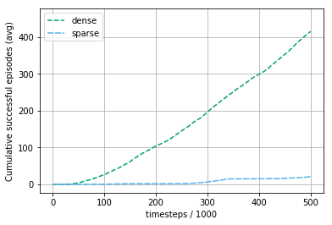
Baselines and Models
Sparse: PPO with binary reward
Dense: PPO with expert Meta-World reward

Slide 28
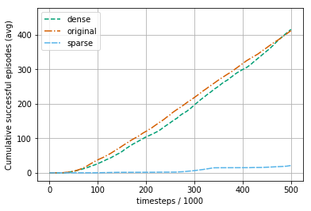
Baselines and Models
Sparse: PPO with binary reward
Dense: PPO with expert Meta-World reward
Original: PPO shaped by Pix2R trained on original dataset

Slide 29
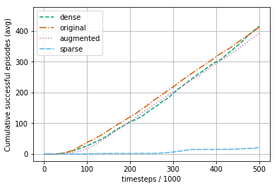
Baselines and Models
Sparse: PPO with binary reward
Dense: PPO with expert Meta-World reward
Original: PPO shaped by Pix2R trained on original dataset
Augmented: PPO shaped by Pix2R trained on combined dataset

Slide 30
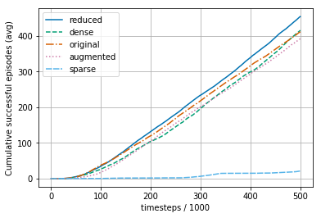
Baselines and Models
Sparse: PPO with binary reward
Dense: PPO with expert Meta-World reward
Original: PPO shaped by Pix2R trained on original dataset
Augmented: PPO shaped by Pix2R trained on combined dataset
Reduced: PPO shaped by Pix2R trained on original dataset, excluding relational descriptions

Slide 31
Results
All agents perform comparably, except sparse
Reduced even performs slightly better
Scenarios could be too simple
Inconclusive, further experimentation needed

Slide 32
Conclusion
Pix2R is robust to our specific challenge dataset
No immediately obvious shortcomings
Room for further probing through challenge datasets

Slide 33
Future Work
Improving our existing challenge dataset
Refine environment generation to create more challenging scenarios
Multi-stage AMT pipeline for higher quality annotations
Other challenge datasets
Can construct targeted, "adversarial" examples for any ML task

Slide 34
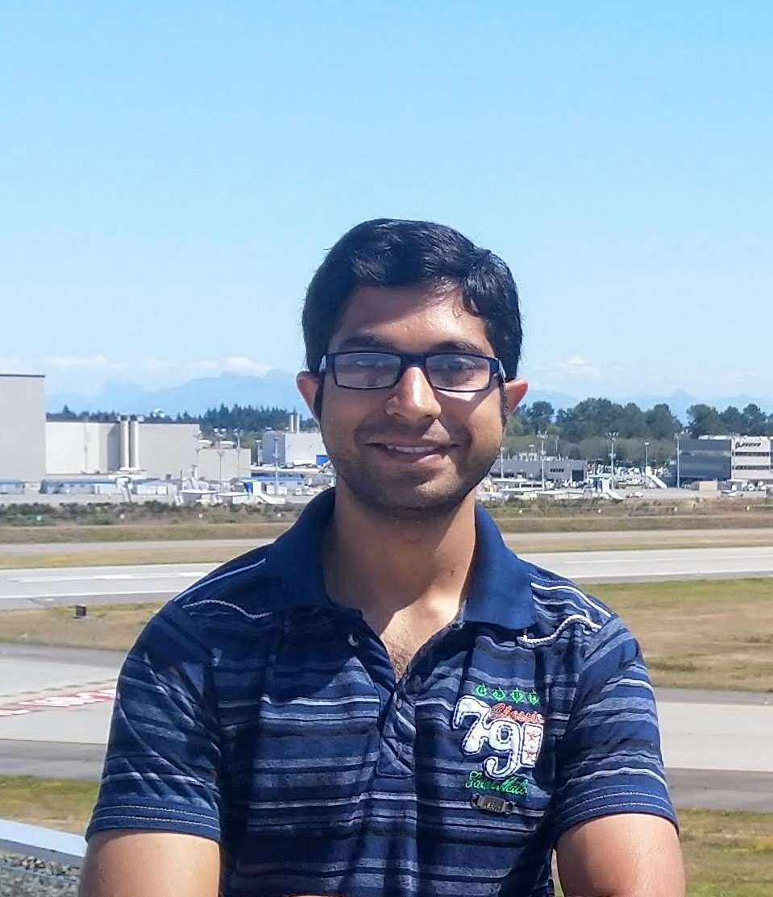
Acknowledgements
Dr. Ray Mooney
Prasoon Goyal

