Slide 1
CS324e - Elements of Graphics and Visualization
Color Histograms

Slide 2
Color Histogram
Plot number of pixels with given intensity
horizontal axis: intensity (0 - 255)
Vertical axis:
  number of pixels with given intensity
  or normalize to a percentage

Slide 3
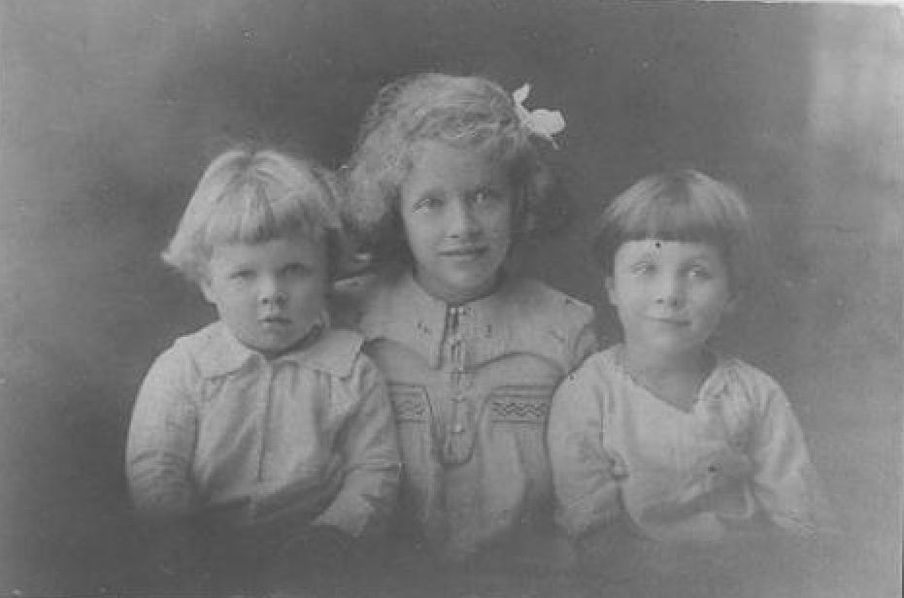
Sample Image

Slide 4
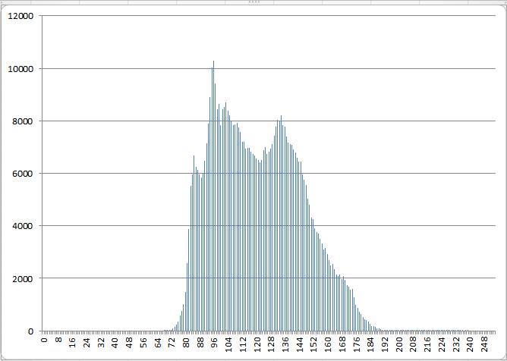
Histogram Of Grayscale

Slide 5
Histogram Equalization
Note the cluster in the middle
Not a lot of very bright or very dark pixels
Apply a Histogram Equalization filter to the image

Slide 6
Histogram Equalization
An algorithm to try and improve the local contrast of an image without altering overall contrast to a significant degree
Spread out the clumps of intensities to improve the contrast

Slide 7
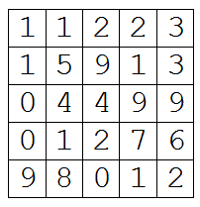
Histogram Equalization Example
Consider a color model with only 10 shades of gray 0 - 9
Consider a simple image with only 25 pixels

Slide 8
Histogram Equalization Example
Step 1: count the number of pixels with each intensity
intensity count
0 3
1 6
2 4
3 2
4 2
5 1
6 1
7 1 What must the sum of
8 1 counts be?
9 4

Slide 9
Histogram Equalization Example
Normalize the counts to fractions or percentages
intensity count fraction
0 3 3/25
1 6 6/25
2 4 4/25
3 2 2/25
4 2 2/25
5 1 1/25
6 1 1/25
7 1 1/25
8 1 1/25
9 4 4/25
Why divide by 25?

Slide 10
Histogram Equalization Example
Step 3: compute the cumulative distribution function CDF
  probability a pixel's intensity is less than or equal to the given intensity
  just a running total of the fractions / percentages from step 2

Slide 11
Histogram Equalization Example
Step 3:
intensity count fraction Cumulative Distribution
0 3 3/25 3/25
1 6 6/25 9/25 (3 + 6)
2 4 4/25 13/25 (3 + 6 + 4)
3 2 2/25 15/25
4 2 2/25 17/25
5 1 1/25 18/25
6 1 1/25 19/25
7 1 1/25 20/25
8 1 1/25 21/25
9 4 4/25 25/25

Slide 12
Histogram Equalization Example
Step 4: Scale Cumulative Distribution to intensity range
intensity count fraction CDF Scaled Intensity
0 3 3/25 3/25 0 (10 * 3 / 25 = 1 - 1 = 0)
1 6 6/25 9/25 3
2 4 4/25 13/25 4
3 2 2/25 15/25 5
4 2 2/25 17/25 6
5 1 1/25 18/25 6
6 1 1/25 19/25 7
7 1 1/25 20/25 7
8 1 1/25 21/25 7
9 4 4/25 25/25 9

Slide 13
Histogram Equalization Example
Step 5: The scaled intensities become a lookup table to apply to original image
intensity in original intensity in result
0 0
1 3
2 4
3 5
4 6
5 6
6 7
7 7
8 7
9 9

Slide 14
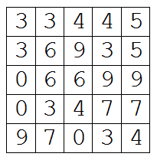
Histogram Equalization Example
Step 6: apply lookup table
original | 0 | 1 | 2 | 3 | 4 | 5 | 6 | 7 | 8 | 9
result | 0 | 3 | 4 | 5 | 6 | 6 | 7 | 7 | 7 | 9
0s stay 0
1s become 3
2s become 4
and so forth
original
result

Slide 15
Recall Actual Image

Slide 16
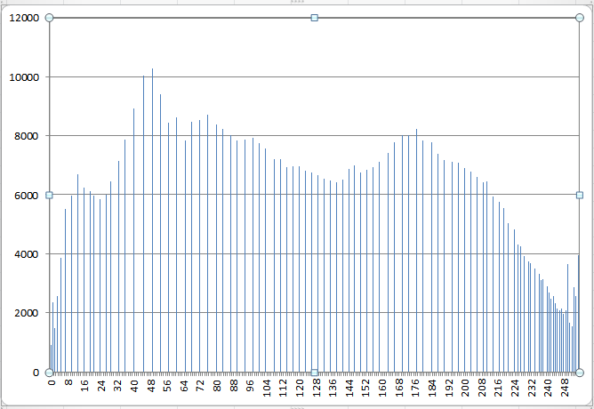
Resulting Histogram

Slide 17
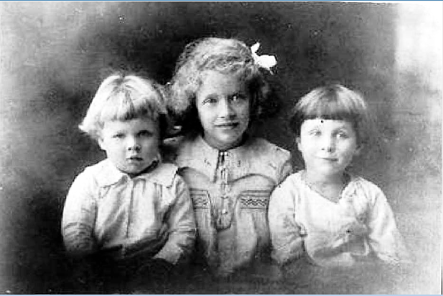
Resulting Image

Slide 18
Comparison

Slide 19
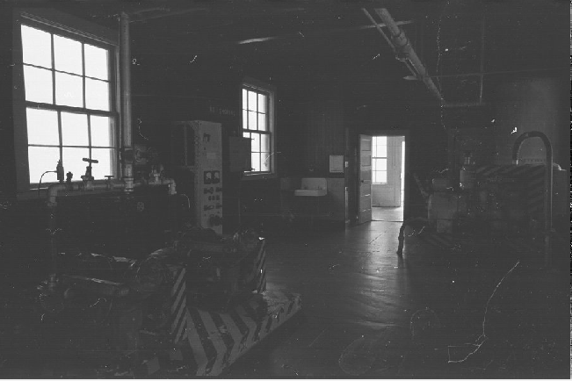
Example 2

Slide 20
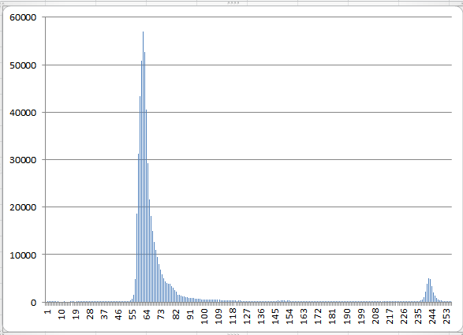
Original Histogram

Slide 21
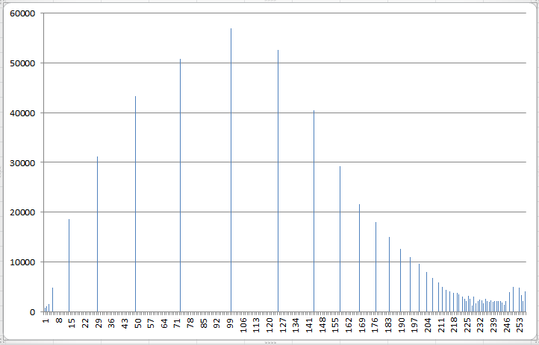
Resulting Histogram

Slide 22
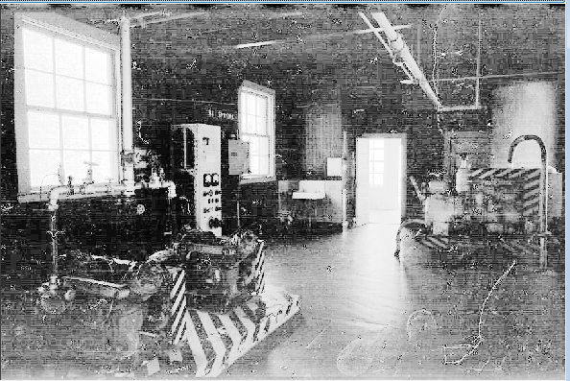
Resulting Image

Slide 23
Comparison

Slide 24
Histogram Equalization on Color Images
apply to color images
each channel (red, green, blue) treated as separate histogram
equalize each independently
can lead to radical color changes in result

Slide 25
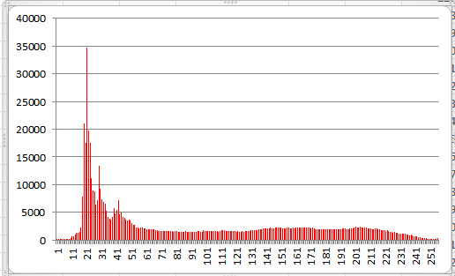
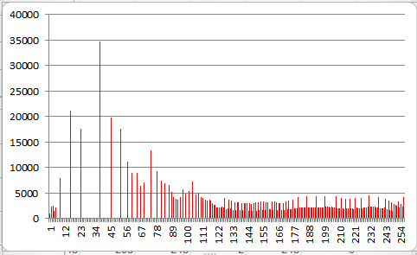
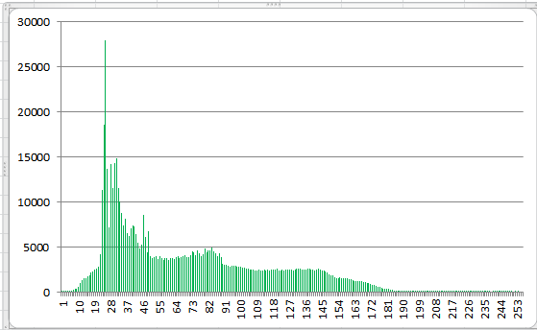
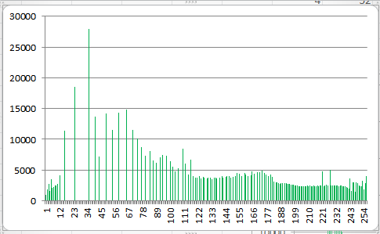
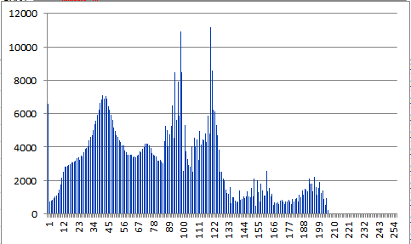
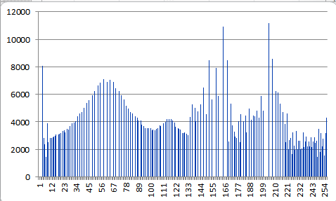
Histograms

Slide 26
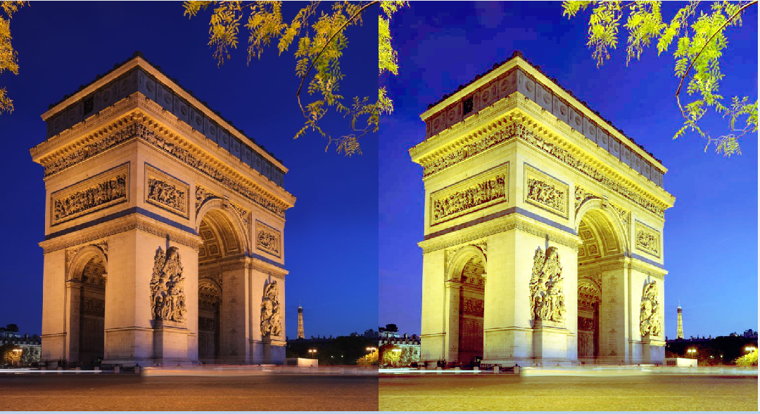
Example of Color Histogram Equalization

Slide 27
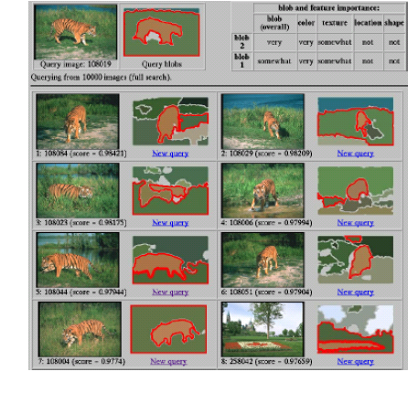
Color as a low-level cue for
Color Based Image Retreival
Blobworld system
Carson et al, 1999
Swain and Ballard, Color Indexing, IJCV 1991
Slides on CBIR from Kristen Grauman

Slide 28
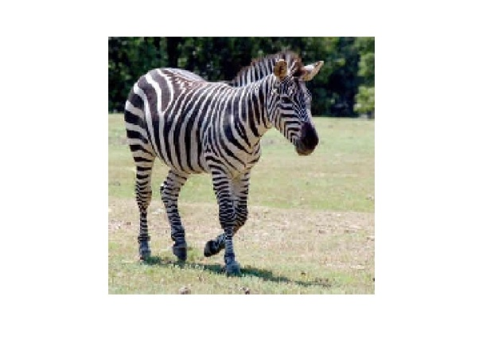
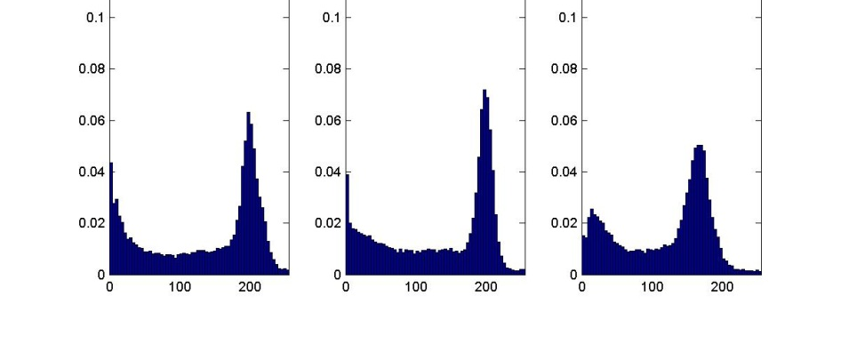
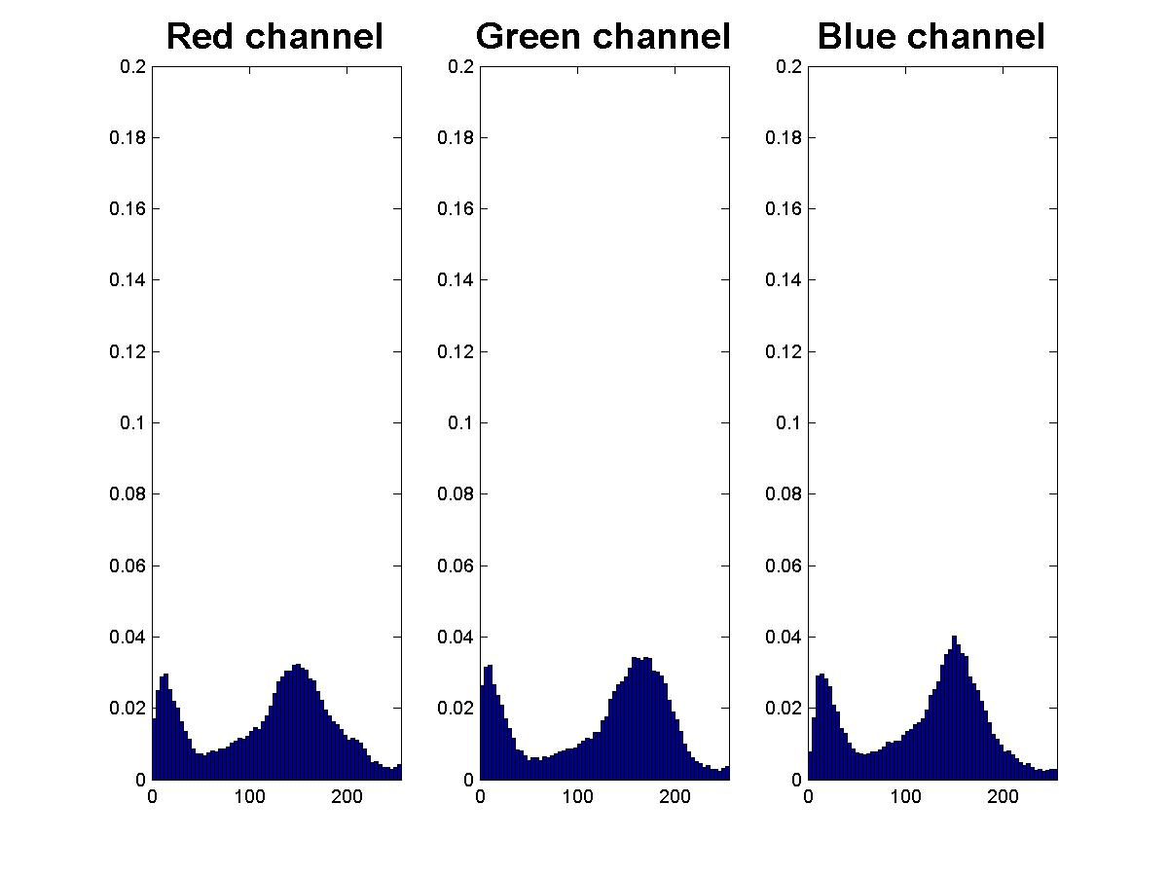
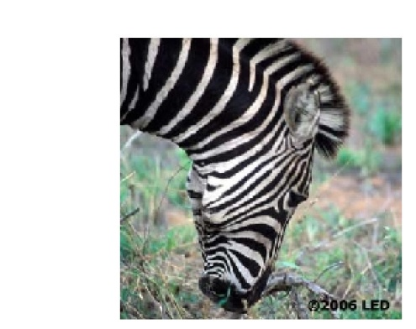
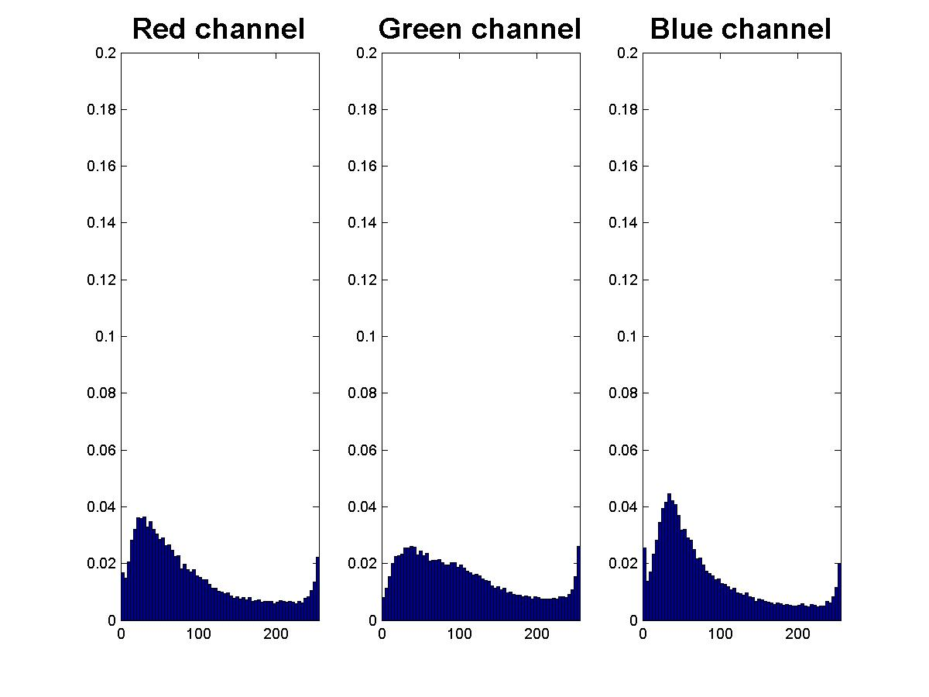
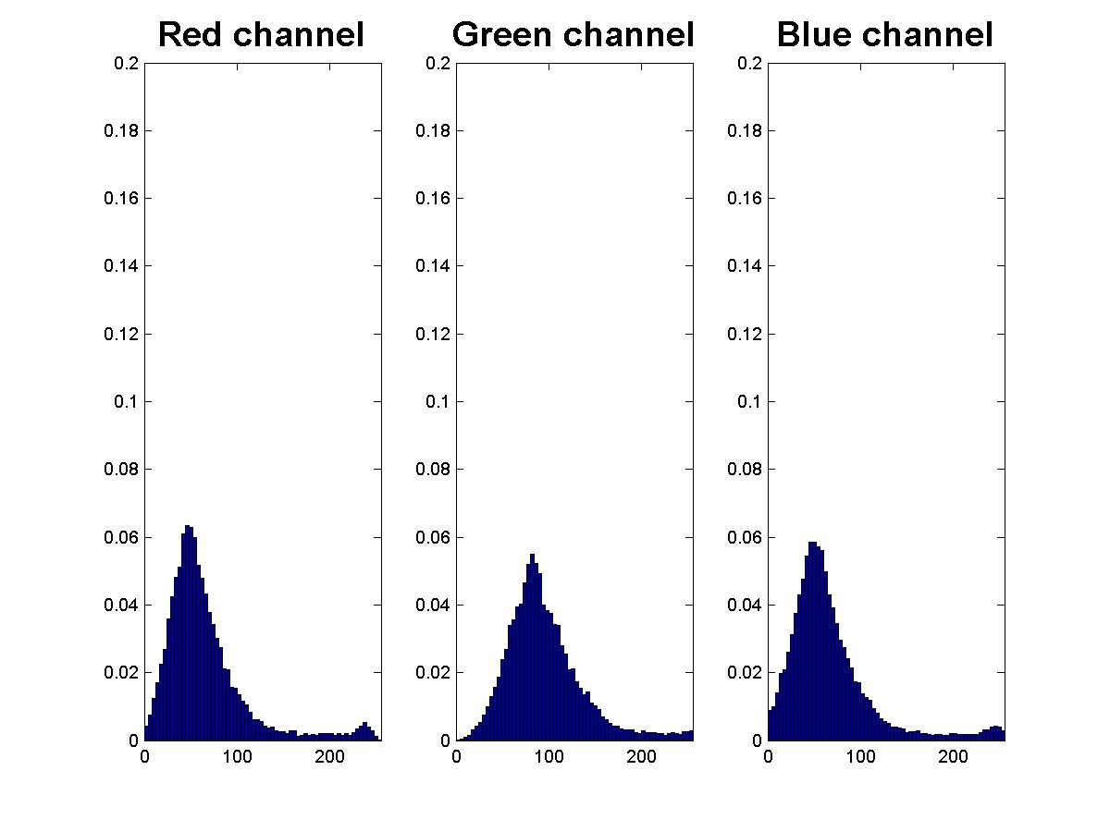
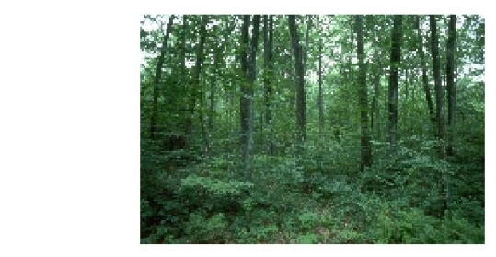
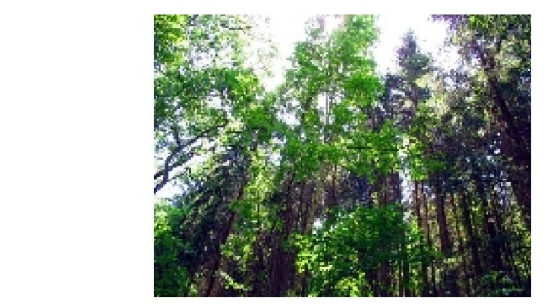
Color as a low-level cue for CBIR
Pixel counts
R
G
B
Color histograms: Use distribution of colors to describe image
No spatial info – invariant to translation, rotation, scale
Color intensity

Slide 29
Color-based image retrieval
Given collection (database) of images:
  Extract and store one color histogram per image
Given new query image:
  Extract its color histogram
  For each database image:
    Compute intersection between query histogram and database histogram
  Sort intersection values (highest score = most similar)
  Rank database items relative to query based on this sorted order

Slide 30
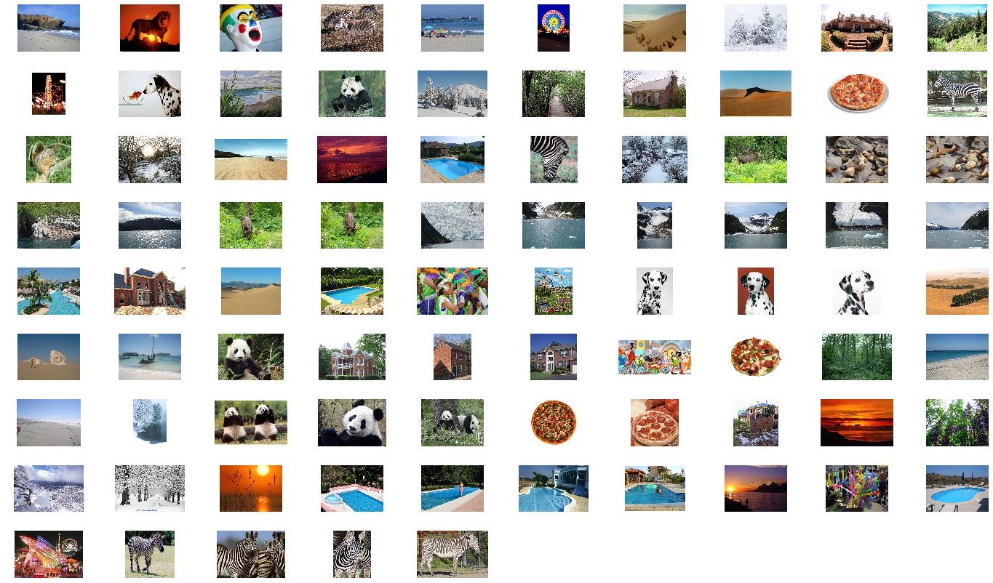
Example database
Color-based image retrieval

Slide 31
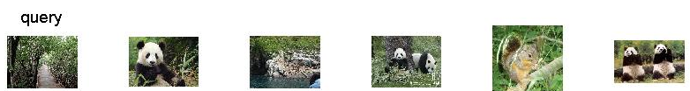
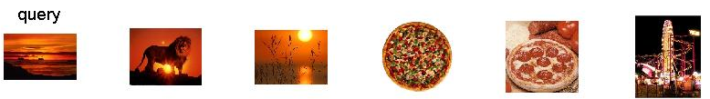
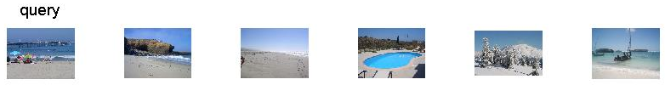
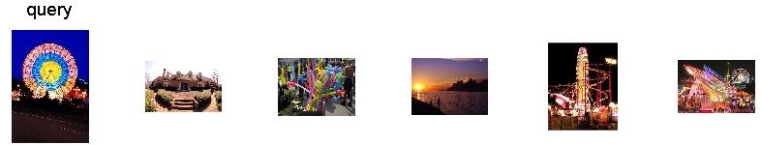
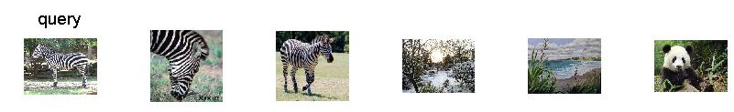
Example retrievals
Color-based image retrieval

Slide 32
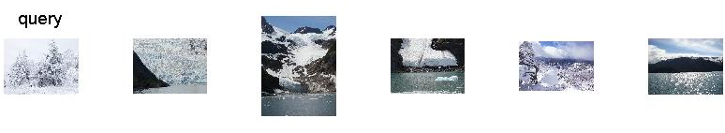
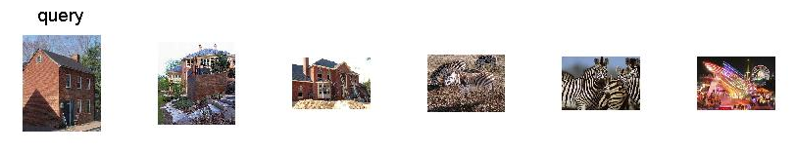
Example retrievals
Color-based image retrieval

Slide 33
