Slide 1
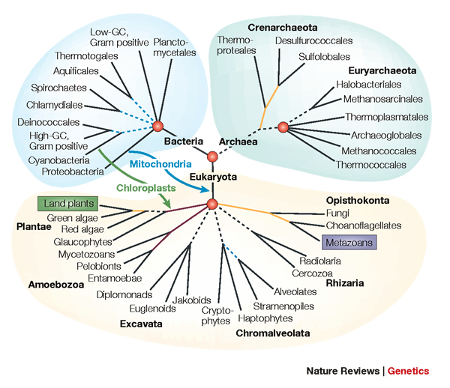
From Gene Trees to Species Trees
Tandy Warnow
The University of Texas at Austin

Slide 2




Phylogeny
(evolutionary tree)
Orangutan
Gorilla
Chimpanzee
Human
From the Tree of the Life Website,
University of Arizona

Slide 3
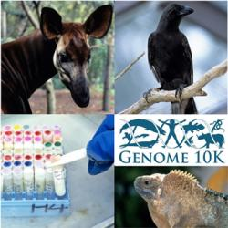
Phylogenomics
(Phylogenetic estimation from whole genomes)

Slide 4
Sampling multiple genes from multiple species
Orangutan
Gorilla
Chimpanzee
Human
From the Tree of the Life Website,
University of Arizona

Slide 5
Using multiple genes
gene 1
gene 3
S₁
TCTAATGGAA
S₂
GCTAAGGGAA
gene 2
S₁
TATTGATACA
S₃
TCTAAGGGAA
S₃
TCTTGATACC
S₄
TCTAACGGAA
S₄
GGTAACCCTC
S₄
TAGTGATGCA
S₇
TCTAATGGAC
S₅
GCTAAACCTC
S₇
TAGTGATGCA
S₈
TATAACGGAA
S₆
GGTGACCATC
S₈
CATTCATACC
S₇
GCTAAACCTC

Slide 6
Two competing approaches
gene 1 gene 2 . . . gene k
Species
. . .
Concatenation
Analyze
separately
. . .
Summary Method
Notes:
point out that supertree methods take overlaping trees and produce a tree, and that the whole process of first generating small trees and then applying a supertree method is often referred to as the “supertree approach”.

Slide 7
This talk
Species tree estimation from multiple genes
  Mathematical foundations
  Algorithms
  Data challenges
  New statistical questions
  Avian Phylogenomics

Slide 8
Questions
Is the model tree identifiable?
Which estimation methods are statistically consistent under this model?
How much data does the method need to estimate the model tree correctly (with high probability)?
What is the empirical performance of the method on data?

Slide 9
Statistical Consistency
error
Data

Slide 10
Statistical Consistency
error
Data
Data are sites in an alignment

Slide 11
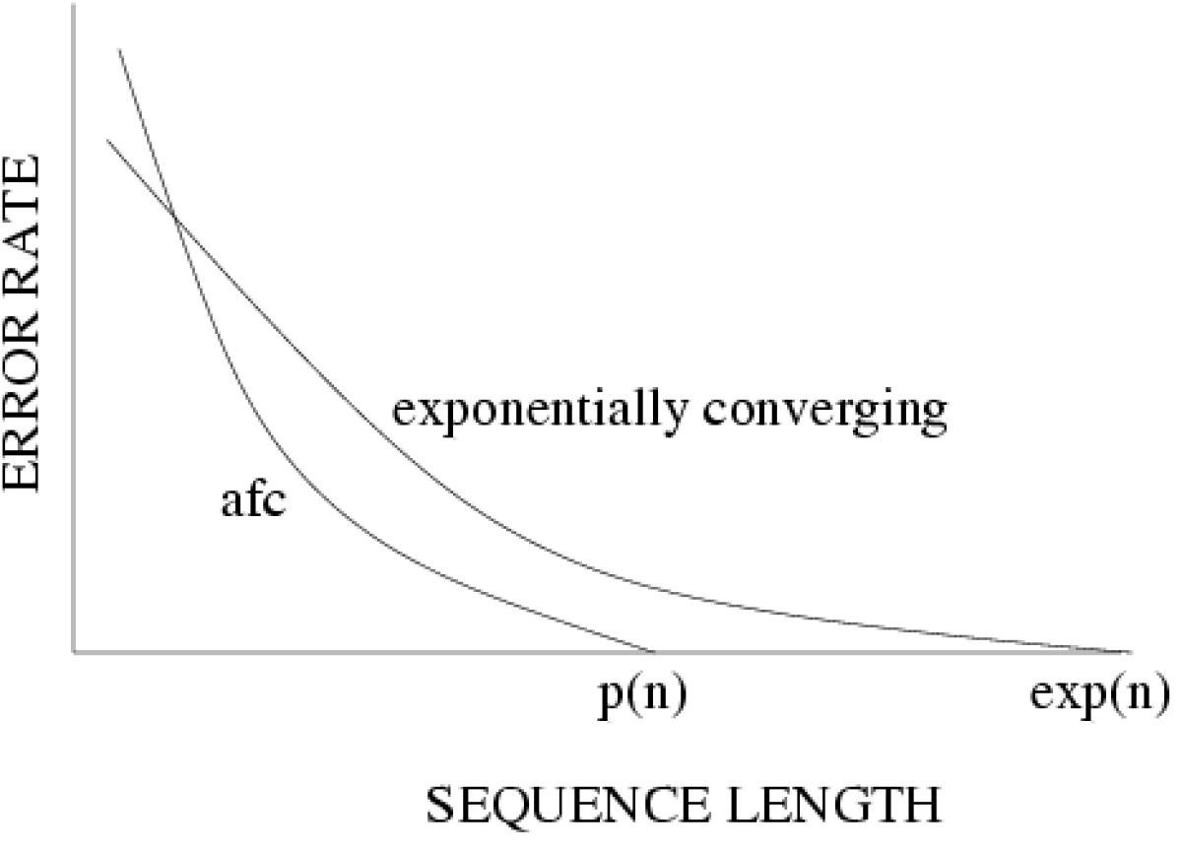
Statistical consistency, exponential convergence, and absolute fast convergence (afc)

Slide 12
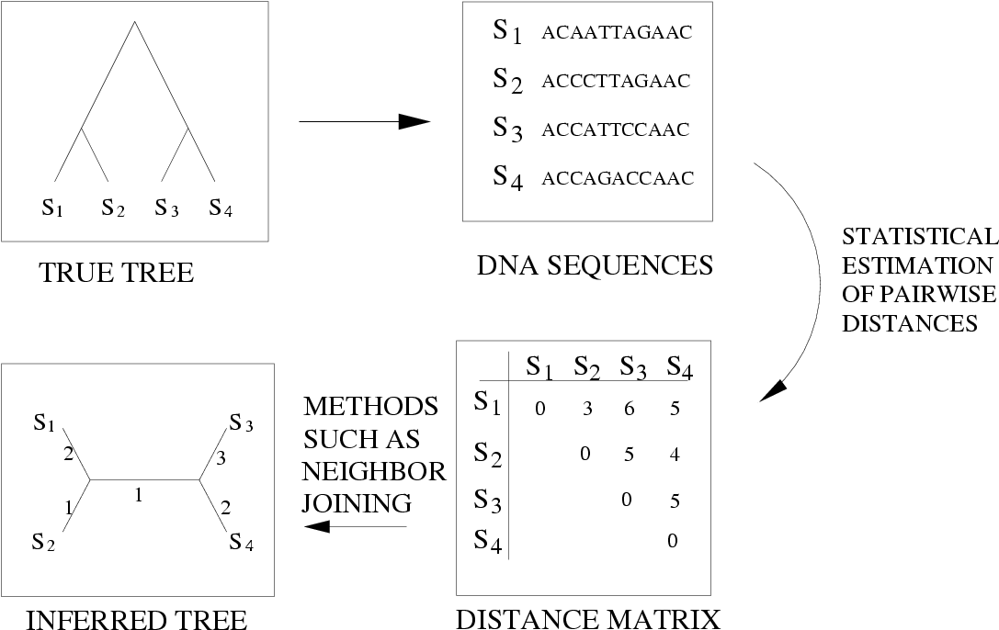
Neighbor Joining (and many other distance-based methods) are statistically consistent under Jukes-Cantor

Slide 13
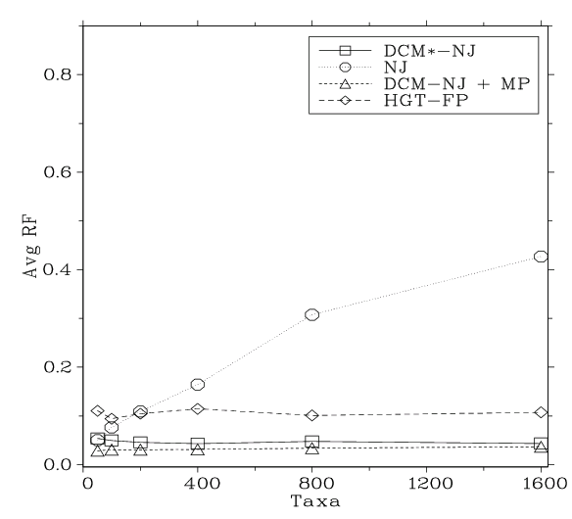
Neighbor Joining on large diameter trees
Simulation study based upon fixed edge lengths, K2P model of evolution, sequence lengths fixed to 1000 nucleotides.
Error rates reflect proportion of incorrect edges in inferred trees.
[Nakhleh et al. ISMB 2001]
0.8
NJ
0.6
Error Rate
0.4
0.2
0
0
400
800
1200
1600
No. Taxa

Slide 14
Questions
Is the model tree identifiable?
Which estimation methods are statistically consistent under this model?
How much data does the method need to estimate the model tree correctly (with high probability)?
What is the empirical performance of the method on data?

Slide 15
Answers?
We know a lot about which site evolution models are identifiable, and which methods are statistically consistent.
Some polynomial time afc methods have been developed, and we know a little bit about the sequence length requirements for standard methods.
Extensive studies show that even the best methods produce gene trees with some error.

Slide 16
In other words…
error
Data
Statistical consistency doesn’t guarantee accuracy w.h.p. unless the sequences are long enough.

Slide 17
Phylogenomics
(Phylogenetic estimation from whole genomes)
Why do we need whole genomes?
Will whole genomes make phylogeny estimation easy?
How hard are the computational problems?
Do we have sufficient methods for this?

Slide 18
Using multiple genes
gene 1
gene 3
S₁
TCTAATGGAA
S₂
GCTAAGGGAA
gene 2
S₁
TATTGATACA
S₃
TCTAAGGGAA
S₃
TCTTGATACC
S₄
TCTAACGGAA
S₄
GGTAACCCTC
S₄
TAGTGATGCA
S₇
TCTAATGGAC
S₅
GCTAAACCTC
S₇
TAGTGATGCA
S₈
TATAACGGAA
S₆
GGTGACCATC
S₈
CATTCATACC
S₇
GCTAAACCTC

Slide 19
Concatenation
gene 1
gene 2
gene 3
S₁
TCTAATGGAA
? ? ? ? ? ? ? ? ? ?
TATTGATACA
S₂
GCTAAGGGAA
? ? ? ? ? ? ? ? ? ?
? ? ? ? ? ? ? ? ? ?
S₃
TCTAAGGGAA
TCTTGATACC
? ? ? ? ? ? ? ? ? ?
S₄
TCTAACGGAA
GGTAACCCTC
TAGTGATGCA
S₅
? ? ? ? ? ? ? ? ? ?
GCTAAACCTC
? ? ? ? ? ? ? ? ? ?
S₆
? ? ? ? ? ? ? ? ? ?
GGTGACCATC
? ? ? ? ? ? ? ? ? ?
S₇
TCTAATGGAC
GCTAAACCTC
TAGTGATGCA
S₈
TATAACGGAA
? ? ? ? ? ? ? ? ? ?
CATTCATACC

Slide 20
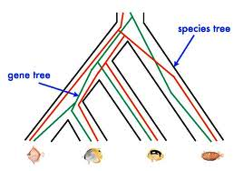
Red gene tree ≠ species tree
(green gene tree okay)

Slide 21








1KP: Thousand Transcriptome Project
Gene Tree Incongruence
G. Ka-Shu Wong
U Alberta
J. Leebens-Mack
U Georgia
N. Wickett
Northwestern
N. Matasci
iPlant
T. Warnow, S. Mirarab, N. Nguyen, Md. S.Bayzid
UT-Austin UT-Austin UT-Austin UT-Austin
1200 plant transcriptomes
More than 13,000 gene families (most not single copy)
Multi-institutional project (10+ universities)
iPLANT (NSF-funded cooperative)
Gene sequence alignments and trees computed using SATe (Liu et al., Science 2009 and Systematic Biology 2012)

Slide 22



Avian Phylogenomics Project
E Jarvis,
HHMI
MTP Gilbert,
Copenhagen
G Zhang,
BGI
T. Warnow
UT-Austin
S. Mirarab Md. S. Bayzid, UT-Austin UT-Austin
Gene Tree Incongruence
Plus many many other people…
Approx. 50 species, whole genomes
8000+ genes, UCEs
Gene sequence alignments computed using SATé (Liu et al., Science 2009 and Systematic Biology 2012)

Slide 23
Gene Tree Incongruence
Gene trees can differ from the species tree due to:
  Duplication and loss
  Horizontal gene transfer
  Incomplete lineage sorting (ILS)

Slide 24
Part II: Species Tree Estimation in the presence of ILS
Mathematical model: Kingman’s coalescent
“Coalescent-based” species tree estimation methods
Simulation studies evaluating methods
New techniques to improve methods
Application to the Avian Tree of Life

Slide 25
Species tree estimation: difficult, even for small datasets!
Orangutan
Gorilla
Chimpanzee
Human
From the Tree of the Life Website,
University of Arizona

Slide 26
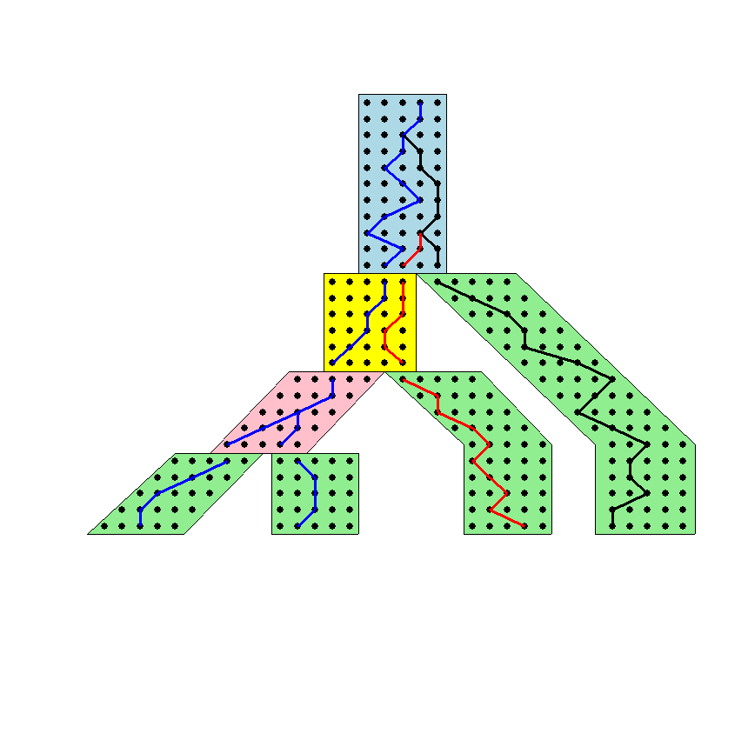




The Coalescent
Past
Gorilla and Orangutan
are not siblings in the
species tree, but they
are in the gene tree.
Present
Courtesy James Degnan

Slide 27
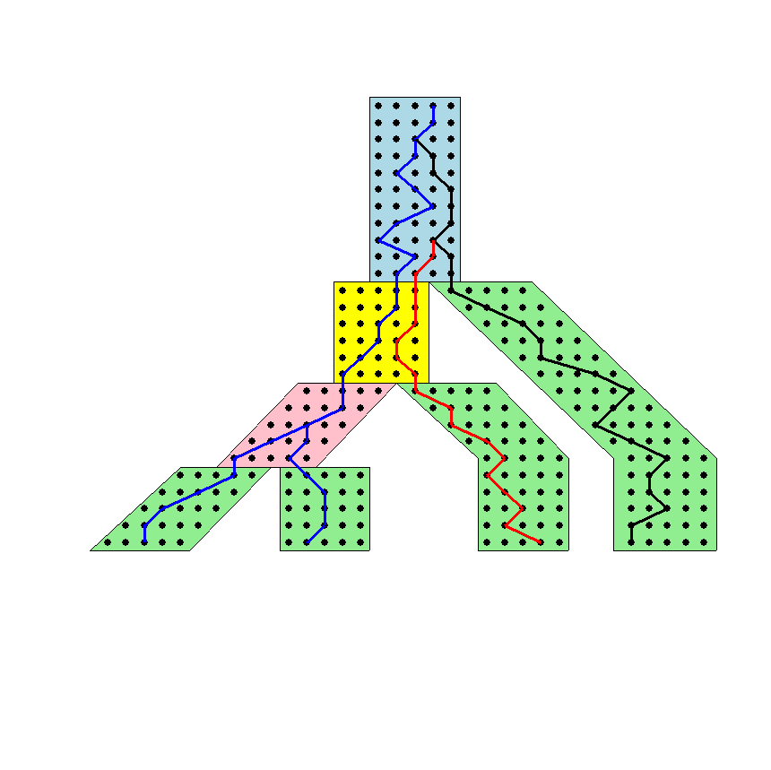
Gene tree in a species tree
Courtesy James Degnan

Slide 28
Lineage Sorting
Lineage sorting is a Population-level process, also called the “Multi-species coalescent” (Kingman, 1982).
The probability that a gene tree will differ from species trees increases for short times between speciation events or large population size.
When a gene tree differs from the species tree, this is called “Incomplete Lineage Sorting” or “Deep Coalescence”.

Slide 29
Questions
Is the model tree identifiable?
Which estimation methods are statistically consistent under this model?
How much data does the method need to estimate the model tree correctly (with high probability)?
What is the empirical performance of the method on data?

Slide 30
Key observation:
Under the multi-species coalescent model, the species tree defines a probability distribution on the gene trees
Courtesy James Degnan

Slide 31
Incomplete Lineage Sorting (ILS)
2000+ papers in 2013 alone
Confounds phylogenetic analysis for many groups:
  Hominids
  Birds
  Yeast
  Animals
  Toads
  Fish
  Fungi
There is substantial debate about how to analyze phylogenomic datasets in the presence of ILS.

Slide 32
Two competing approaches
gene 1 gene 2 . . . gene k
Species
. . .
Concatenation
Analyze
separately
. . .
Summary Method
Notes:
point out that supertree methods take overlaping trees and produce a tree, and that the whole process of first generating small trees and then applying a supertree method is often referred to as the “supertree approach”.

Slide 33
How to compute a species tree?
. . .
Notes:
point out that supertree methods take overlaping trees and produce a tree, and that the whole process of first generating small trees and then applying a supertree method is often referred to as the “supertree approach”.

Slide 34
MDC Problem (Maddison 1997)
Courtesy James Degnan
XL(T,t) = the number of extra lineages on the species tree T with respect to the gene tree t. In this example, XL(T,t) = 1.
MDC (minimize deep coalescence) problem:
  Given set X = {t₁,t₂,…,t_{k}} of gene trees find the species tree T
  that implies the fewest extra lineages (deep coalescences)
  with respect to X, i.e.,
  minimize MDC(T, X) = Σ_{i} XL(T,t_{i})

Slide 35
MDC Problem
MDC is NP-hard
Exact solution to MDC that runs in exponential time (Than and Nakhleh, PLoS Comp Biol 2009).
Popular technique, often gives good accuracy.
However, not statistically consistent under ILS, even if solved exactly!

Slide 36
Statistically consistent under ILS?
MDC – NO
Greedy – NO
Most frequent gene tree - NO
Concatenation under maximum likelihood – open
MRP (supertree method) – open
MP-EST (Liu et al. 2010): maximum likelihood estimation of rooted species tree – YES
BUCKy-pop (Ané and Larget 2010): quartet-based Bayesian species tree estimation –YES

Slide 37
Under the multi-species coalescent model, the species tree defines a probability distribution on the gene trees
Courtesy James Degnan
Theorem (Degnan et al., 2006, 2009): Under the multi-species coalescent model, for any three taxa A, B, and C, the most probable rooted gene tree on {A,B,C} is identical to the rooted species tree induced on {A,B,C}.

Slide 38
How to compute a species tree?
. . .
Techniques:
MDC?
Most frequent gene tree?
Consensus of gene trees?
Other?
Notes:
point out that supertree methods take overlaping trees and produce a tree, and that the whole process of first generating small trees and then applying a supertree method is often referred to as the “supertree approach”.

Slide 39
How to compute a species tree?
. . .
Theorem (Degnan et al., 2006, 2009): Under the multi-species coalescent model, for any three taxa A, B, and C, the most probable rooted gene tree on {A,B,C} is identical to the rooted species tree induced on {A,B,C}.
Notes:
point out that supertree methods take overlaping trees and produce a tree, and that the whole process of first generating small trees and then applying a supertree method is often referred to as the “supertree approach”.

Slide 40
How to compute a species tree?
. . .
. . .
Estimate species
tree for every
3 species
Theorem (Degnan et al., 2006, 2009): Under the multi-species coalescent model, for any three taxa A, B, and C, the most probable rooted gene tree on {A,B,C} is identical to the rooted species tree induced on {A,B,C}.
Notes:
point out that supertree methods take overlaping trees and produce a tree, and that the whole process of first generating small trees and then applying a supertree method is often referred to as the “supertree approach”.

Slide 41
How to compute a species tree?
. . .
. . .
Estimate species
tree for every
3 species
Theorem (Aho et al.): The rooted tree on n species can be computed from its set of 3-taxon rooted subtrees in polynomial time.
Notes:
point out that supertree methods take overlaping trees and produce a tree, and that the whole process of first generating small trees and then applying a supertree method is often referred to as the “supertree approach”.

Slide 42
How to compute a species tree?
. . .
. . .
Estimate species
tree for every
3 species
Combine
rooted
3-taxon
trees
Theorem (Aho et al.): The rooted tree on n species can be computed from its set of 3-taxon rooted subtrees in polynomial time.
Notes:
point out that supertree methods take overlaping trees and produce a tree, and that the whole process of first generating small trees and then applying a supertree method is often referred to as the “supertree approach”.

Slide 43
How to compute a species tree?
. . .
. . .
Estimate species
tree for every
3 species
Combine
rooted
3-taxon
trees
Theorem (Degnan et al., 2009): Under the multi-species coalescent, the rooted species tree can be estimated correctly (with high probability) given a large enough number of true rooted gene trees.
Theorem (Allman et al., 2011): the unrooted species tree can be estimated from a large enough number of true unrooted gene trees.
Notes:
point out that supertree methods take overlaping trees and produce a tree, and that the whole process of first generating small trees and then applying a supertree method is often referred to as the “supertree approach”.

Slide 44
How to compute a species tree?
. . .
. . .
Estimate species
tree for every
3 species
Combine
rooted
3-taxon
trees
Theorem (Degnan et al., 2009): Under the multi-species coalescent, the rooted species tree can be estimated correctly (with high probability) given a large enough number of true rooted gene trees.
Theorem (Allman et al., 2011): the unrooted species tree can be estimated from a large enough number of true unrooted gene trees.
Notes:
point out that supertree methods take overlaping trees and produce a tree, and that the whole process of first generating small trees and then applying a supertree method is often referred to as the “supertree approach”.

Slide 45
How to compute a species tree?
. . .
. . .
Estimate species
tree for every
3 species
Combine
rooted
3-taxon
trees
Theorem (Degnan et al., 2009): Under the multi-species coalescent, the rooted species tree can be estimated correctly (with high probability) given a large enough number of true rooted gene trees.
Theorem (Allman et al., 2011): the unrooted species tree can be estimated from a large enough number of true unrooted gene trees.
Notes:
point out that supertree methods take overlaping trees and produce a tree, and that the whole process of first generating small trees and then applying a supertree method is often referred to as the “supertree approach”.

Slide 46
Statistical Consistency
error
Data
Data are gene trees, presumed to be randomly sampled true gene trees.

Slide 47
Statistically consistent methods
Input: Set of estimated gene trees or alignments, one (or more) for each gene
Output: estimated species tree
  *BEAST (Heled and Drummond 2010): Bayesian co-estimation of gene trees and species trees given sequence alignments
  MP-EST (Liu et al. 2010): maximum likelihood estimation of rooted species tree
  BUCKy-pop (Ané and Larget 2010): quartet-based Bayesian species tree estimation

Slide 48
Statistically consistent methods under ILS
Quartet-based methods (e.g., BUCKy-pop (Ané and Larget 2010)) for unrooted species trees
MP-EST (Liu et al. 2010): maximum likelihood estimation of rooted species tree for rooted species trees
(and some others)

Slide 49
Results on 11-taxon datasets with weak ILS
*BEAST more accurate than summary methods (MP-EST, BUCKy, etc)
CA-ML: concatenated analysis) most accurate
Datasets from Chung and Ané, 2011
Bayzid & Warnow, Bioinformatics 2013

Slide 50
Results on 11-taxon datasets with strongILS
*BEAST more accurate than summary methods (MP-EST, BUCKy, etc)
CA-ML: (concatenated analysis) also very accurate
Datasets from Chung and Ané, 2011
Bayzid & Warnow, Bioinformatics 2013

Slide 51
*BEAST better than Maximum Likelihood
11-taxon weakILS datasets
17-taxon (very high ILS) datasets
*BEAST produces more accurate gene trees than ML on gene sequence alignments
11-taxon datasets from Chung and Ané, Syst Biol 2012
17-taxon datasets from Yu, Warnow, and Nakhleh, JCB 2011

Slide 52
Impact of Gene Tree Estimation Error on MP-EST
MP-EST has no error on true gene trees, but
MP-EST has 9% error on estimated gene trees
Similar results for other summary methods (e.g., MDC)
Datasets: 11-taxon 50-gene datasets with high ILS (Chung and Ané 2010).

Slide 53
Problem: poor gene trees
Summary methods combine estimated gene trees, not true gene trees.
The individual gene sequence alignments in the 11-taxon datasets have poor phylogenetic signal, and result in poorly estimated gene trees.
Species trees obtained by combining poorly estimated gene trees have poor accuracy.

Slide 54
Problem: poor gene trees
Summary methods combine estimated gene trees, not true gene trees.
The individual gene sequence alignments in the 11-taxon datasets have poor phylogenetic signal, and result in poorly estimated gene trees.
Species trees obtained by combining poorly estimated gene trees have poor accuracy.

Slide 55
Problem: poor gene trees
Summary methods combine estimated gene trees, not true gene trees.
The individual gene sequence alignments in the 11-taxon datasets have poor phylogenetic signal, and result in poorly estimated gene trees.
Species trees obtained by combining poorly estimated gene trees have poor accuracy.

Slide 56
TYPICAL PHYLOGENOMICS PROBLEM:
many poor gene trees
Summary methods combine estimated gene trees, not true gene trees.
The individual gene sequence alignments in the 11-taxon datasets have poor phylogenetic signal, and result in poorly estimated gene trees.
Species trees obtained by combining poorly estimated gene trees have poor accuracy.

Slide 57
Questions
Is the model species tree identifiable?
Which estimation methods are statistically consistent under this model?
How much data does the method need to estimate the model species tree correctly (with high probability)?
What is the empirical performance of the method on data?
What is the impact of error in the input data on the estimation of the model species tree?

Slide 58
Questions
Is the model species tree identifiable?
Which estimation methods are statistically consistent under this model?
How much data does the method need to estimate the model species tree correctly (with high probability)?
What is the empirical performance of the method on data?
What is the impact of error in the input data on the estimation of the model species tree?

Slide 59
Addressing gene tree estimation error
Get better estimates of the gene trees
Restrict to subset of estimated gene trees
Model error in the estimated gene trees
Modify gene trees to reduce error
“Bin-and-conquer”

Slide 60
Addressing gene tree estimation error
Get better estimates of the gene trees
Restrict to subset of estimated gene trees
Model error in the estimated gene trees
Modify gene trees to reduce error
“Bin-and-conquer”

Slide 61
Technique #1: Modify gene trees
Idea: Use statistical technique to identify unreliable aspects of the tree, and modify tree, to produce “constraint tree”.
Example:
Use bootstrapping to identify “low support edges”, and contract them.
The result is a unresolved tree, and you expect the true gene tree to be a refinement of the constraint tree.

Slide 62
MDC Problem (Maddison 1997)
MDC problem: Given set X = {t₁,t₂,…,t_{k}} of rooted binary gene trees on the same set S of leaves, find the species tree T that implies the fewest extra lineages, i.e., find T that minimizes MDC(T,X) = Σ_{i}XL(T,t_{i}).
MDC produces very accurate species trees if the gene
trees are highly accurate and there is not “too much” ILS.
Courtesy James Degnan
But MDC produces poor estimates of species trees if the gene trees have high error.
Sources of error:
root location
incorrect edges (due to insufficient sequence length)
“rogue taxa”

Slide 63
Technique #1: Modify gene trees
Identify and collapse edges with low support.
Unroot the tree.
Remove “rogue taxa”.
The result is a “constraint tree”: we expect the true gene tree to be obtained by
  Rooting
  Refining
  Adding in missing taxa

Slide 64
MDC*: Extending MDC
Input:
Set X of k gene trees (unrooted, not necessarily binary, not necessarily complete) on set S
Optional: set C of bipartitions on the taxon set
Output:
Species tree T (with Bipartitions(T) drawn from C), and
Set X* = {t*: t in X}, where each t* is a rooted binary tree that completes and refines t,
so as to minimize MDC(T,X*).
We use the set C to constrain the search space, in order to achieve faster running times.
If C is not provided, then there is no constraint on T.

Slide 65
Solving MDC*
Theorem (Yu, Warnow, and Nakhleh, 2011): When all gene trees have the same set of leaves, the optimal solution to constrained MDC* can be found in O(|C|²nk) time, where |S|=n and k is the number of gene trees, using dynamic programming. Thus, the optimal solution to MDC* can be found in O(2^{2n}nk).
Proof (sketch): The optimal solution can be computed by finding a maximum weight clique in a graph with vertex set C, and edges between compatible bipartitions. This can be found in O(|C|²nk) time, using the structure of the graph.
Theorem (Bayzid and Warnow, 2012): YWN 2011 correctly handles case where some gene trees can miss some species.

Slide 66
Solving MDC*
Theorem (Yu, Warnow, and Nakhleh, 2011): When all gene trees have the same set of leaves, the optimal solution to constrained MDC* can be found in O(|C|²nk) time, where |S|=n and k is the number of gene trees, using dynamic programming. Thus, the optimal solution to MDC* can be found in O(2^{2n}nk).
Proof (sketch): The optimal solution can be computed by finding a maximum weight clique in a graph with vertex set C, and edges between compatible bipartitions. This can be found in O(|C|²nk) time, using the structure of the graph.
Theorem (Bayzid and Warnow, 2012): YWN 2011 correctly handles case where some gene trees can miss some species.

Slide 67
Solving MDC*
Theorem (Yu, Warnow, and Nakhleh, 2011): When all gene trees have the same set of leaves, the optimal solution to constrained MDC* can be found in O(|C|²nk) time, where |S|=n and k is the number of gene trees, using dynamic programming. Thus, the optimal solution to MDC* can be found in O(2^{2n}nk).
Proof (sketch): The optimal solution can be computed by finding a maximum weight clique in a graph with vertex set C, and edges between compatible bipartitions. This can be found in O(|C|²nk) time, using the structure of the graph.
Theorem (Bayzid and Warnow, 2012): YWN 2011 correctly handles case where some gene trees can miss some species.

Slide 68
MDC vs. MDC*
Data: 11-taxon 50-gene datasets with high levels of ILS, 50 ML gene trees, Chung and Ané, Syst Biol
Phylo-exact solves MDC* optimally, with contracted gene trees based on 75% bootstrap support threshold
(Phylonet software)
Contracting low support edges improves accuracy.

Slide 69
MDC vs. MDC*
Data: 11-taxon 50-gene datasets with high levels of ILS, 50 ML gene trees, Chung and Ané, Syst Biol
Phylo-exact solves MDC* optimally, with contracted gene trees based on 75% bootstrap support threshold
(Phylonet software)
But not all methods are improved: In particular,
this technique does not help MP-EST.

Slide 70
Technique #2: Bin-and-Conquer?
Assign genes to “bins”, creating “supergene alignments”
Estimate trees on each supergene alignment using maximum likelihood
Combine the supergene trees together using a summary method
Variants:
Naïve binning (Bayzid and Warnow, Bioinformatics 2013)
Statistical binning (Mirarab, Bayzid, and Warnow, in preparation)

Slide 71
Technique #2: Bin-and-Conquer?
Assign genes to “bins”, creating “supergene alignments”
Estimate trees on each supergene alignment using maximum likelihood
Combine the supergene trees together using a summary method
Variants:
Naïve binning (Bayzid and Warnow, Bioinformatics 2013)
Statistical binning (Mirarab, Bayzid, and Warnow, in preparation)

Slide 72
Technique #2: Bin-and-Conquer?
Assign genes to “bins”, creating “supergene alignments”
Estimate trees on each supergene alignment using maximum likelihood
Combine the supergene trees together using a summary method
Variants:
Naïve binning (Bayzid and Warnow, Bioinformatics 2013)
Statistical binning (Mirarab, Bayzid, and Warnow, in preparation)

Slide 73
11-taxon 50-gene weakILS datasets

Slide 74
11-taxon strongILS with 50 genes

Slide 75
11-taxon strongILS with 100 genes
*BEAST did not converge on these datasets, even with 150 hours.
With binning, it converged in 10 hours.

Slide 76
Technique #2: Bin-and-Conquer?
Assign genes to “bins”, creating “supergene alignments”
Estimate trees on each supergene alignment using maximum likelihood
Combine the supergene trees together using a summary method
Variants:
Naïve binning (Bayzid and Warnow, Bioinformatics 2013)
Statistical binning (Mirarab, Bayzid, and Warnow, in preparation)

Slide 77
Statistical binning
Input: estimated gene trees with bootstrap support, and minimum support threshold t
Output: partition of the estimated gene trees into sets, so that no two gene trees in the same set are strongly incompatible.
Vertex coloring problem (NP-hard),
but good heuristics are available (e.g., Brelaz 1979)
However, for statistical inference reasons, we need balanced vertex color classes

Slide 78
Statistical binning
Input: estimated gene trees with bootstrap support, and minimum support threshold t
Output: partition of the estimated gene trees into sets, so that no two gene trees in the same set are strongly incompatible.
Vertex coloring problem (NP-hard),
but good heuristics are available (e.g., Brélaz 1979)
However, for statistical inference reasons, we need balanced vertex color classes

Slide 79
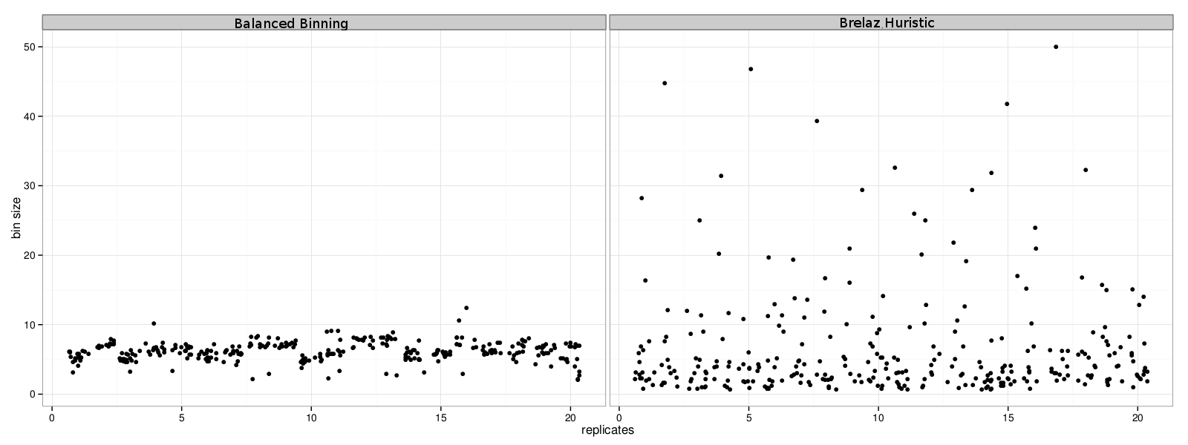
Balanced Statistical Binning
Mirarab, Bayzid, and Warnow, in preparation
Modification of Brélaz Heuristic for minimum vertex coloring.

Slide 80
Bin-and-Conquer?
Assign genes to “bins” (randomly)
Estimate trees on each supergene alignment using ML
Combine the supergene trees together using a summary method (e.g., MP-EST, BUCKy, etc.),
or
Run *BEAST on the new supergene alignments.
We call this technique “naïve binning”.

Slide 81
Statistical binning vs. unbinned
Mirarab, et al. in preparation
Datasets: 11-taxon strongILS datasets with 50 genes, Chung and Ané, Systematic Biology

Slide 82
Observations
Naïve binning improved the accuracy of summary methods such as MP-EST, BUCKy, etc.
Naïve binning did not impact the accuracy of *BEAST, but did speed it up – dramatically (150 hours without bins and 10 hours with bins).
Concatenation often has better accuracy than the statistically consistent methods.

Slide 83
Avian Phylogenomics Project
E Jarvis,
HHMI
MTP Gilbert,
Copenhagen
G Zhang,
BGI
T. Warnow
UT-Austin
S. Mirarab Md. S. Bayzid, UT-Austin UT-Austin
Gene Tree Incongruence
Plus many many other people…
Strong evidence for substantial ILS, suggesting need for
coalescent-based species tree estimation.
But MP-EST on full set of 14,000 gene trees was considered
unreliable, due to poorly estimated exon trees (very low phylogenetic
signal in exon sequence alignments).

Slide 84
Avian Phylogeny
GTRGAMMA Maximum likelihood analysis (RAxML) of 37 million basepair alignment (exons, introns, UCEs) – highly resolved tree with near 100% bootstrap support.
More than 17 years of compute time, and used 256 GB. Run at HPC centers.
Unbinned MP-EST on 14000+ genes: highly incongruent with the concatenated maximum likelihood analysis, poor bootstrap support.
Statistical binning version of MP-EST on 14000+ gene trees – highly resolved tree, largely congruent with the concatenated analysis, good bootstrap support
Statistical binning: faster than concatenated analysis, highly parallelized.
Avian Phylogenomics Project, in preparation

Slide 85
Avian Phylogeny
GTRGAMMA Maximum likelihood analysis (RAxML) of 37 million basepair alignment (exons, introns, UCEs) – highly resolved tree with near 100% bootstrap support.
More than 17 years of compute time, and used 256 GB. Run at HPC centers.
Unbinned MP-EST on 14000+ genes: highly incongruent with the concatenated maximum likelihood analysis, poor bootstrap support.
Statistical binning version of MP-EST on 14000+ gene trees – highly resolved tree, largely congruent with the concatenated analysis, good bootstrap support
Statistical binning: faster than concatenated analysis, highly parallelized.
Avian Phylogenomics Project, in preparation

Slide 86
Avian Simulation – 14,000 genes
MP-EST:
  Unbinned ~ 11.1% error
  Binned ~ 6.6% error
Greedy:
  Unbinned ~ 26.6% error
  Binned ~ 13.3% error
8250 exon-like genes (27% avg. bootstrap support)
3600 UCE-like genes (37% avg. bootstrap support)
2500 intron-like genes (51% avg. bootstrap support)

Slide 87
Avian Simulation – 14,000 genes
MP-EST:
  Unbinned ~ 11.1% error
  Binned ~ 6.6% error
Greedy:
  Unbinned ~ 26.6% error
  Binned ~ 13.3% error
8250 exon-like genes (27% avg. bootstrap support)
3600 UCE-like genes (37% avg. bootstrap support)
2500 intron-like genes (51% avg. bootstrap support)

Slide 88
Avian Phylogeny
GTRGAMMA Maximum likelihood analysis (RAxML) of 37 million basepair alignment (exons, introns, UCEs) – highly resolved tree with near 100% bootstrap support.
More than 17 years of compute time, and used 256 GB. Run at HPC centers.
Unbinned MP-EST on 14000+ genes: highly incongruent with the concatenated maximum likelihood analysis, poor bootstrap support.
Statistical binning version of MP-EST on 14000+ gene trees – highly resolved tree, largely congruent with the concatenated analysis, good bootstrap support
Statistical binning: faster than concatenated analysis, highly parallelized.
Avian Phylogenomics Project, in preparation

Slide 89
Avian Phylogeny
GTRGAMMA Maximum likelihood analysis (RAxML) of 37 million basepair alignment (exons, introns, UCEs) – highly resolved tree with near 100% bootstrap support.
More than 17 years of compute time, and used 256 GB. Run at HPC centers.
Unbinned MP-EST on 14000+ genes: highly incongruent with the concatenated maximum likelihood analysis, poor bootstrap support.
Statistical binning version of MP-EST on 14000+ gene trees – highly resolved tree, largely congruent with the concatenated analysis, good bootstrap support
Statistical binning: faster than concatenated analysis, highly parallelized.
Avian Phylogenomics Project, in preparation

Slide 90
To consider
Binning reduces the amount of data (number of gene trees) but can improve the accuracy of individual “supergene trees”. The response to binning differs between methods. Thus, there is a trade-off between data quantity and quality, and not all methods respond the same to the trade-off.
We know very little about the impact of data error on methods. We do not even have proofs of statistical consistency in the presence of data error.

Slide 91
Basic Questions
Is the model tree identifiable?
Which estimation methods are statistically consistent under this model?
How much data does the method need to estimate the model tree correctly (with high probability)?
What is the computational complexity of an estimation problem?

Slide 92
Additional Statistical Questions
Trade-off between data quality and quantity
Impact of data selection
Impact of data error
Performance guarantees on finite data (e.g., prediction of error rates as a function of the input data and method)
We need a solid mathematical framework for these problems.

Slide 93
Summary
DCM1-NJ: an absolute fast converging (afc) method, uses chordal graph theory and probabilistic analysis of algorithms to prove performance guarantees
MDC*: species tree estimation from multiple gene trees, uses graph theory to prove performance guarantees.
Binning: species tree estimation from multiple genes, suggests new questions in statistical estimation
All methods provide improved accuracy compared to existing methods, as shown on simulated and biological datasets.

Slide 94
Other Research in my lab
Method development for
Supertree estimation
Multiple sequence alignment
Metagenomic taxon identification
Genome rearrangement phylogeny
Historical Linguistics
Techniques:
Statistical estimation under Markov models of evolution
Graph theory and combinatorics
Machine learning and data mining
Heuristics for NP-hard optimization problems
High performance computing
Massive simulations

Slide 95
Research Agenda
Major scientific goals:
Develop methods that produce more accurate alignments and phylogenetic estimations for difficult-to-analyze datasets
Produce mathematical theory for statistical inference under complex models of evolution
Develop novel machine learning techniques to boost the performance of classification methods
Software that:
Can run efficiently on desktop computers on large datasets
Can analyze ultra-large datasets (100,000+) using multiple processors
Is freely available in open source form, with biologist-friendly GUIs

Slide 96

Warnow Laboratory
PhD students: Siavash Mirarab*, Nam Nguyen, and Md. S. Bayzid**
Undergrad: Keerthana Kumar
Lab Website: http://www.cs.utexas.edu/users/phylo
Funding: Guggenheim Foundation, Packard, NSF, Microsoft Research New England, David Bruton Jr. Centennial Professorship, and TACC (Texas Advanced Computing Center)
TACC and UTCS computational resources
* Supported by HHMI Predoctoral Fellowship
** Supported by Fulbright Foundation Predoctoral Fellowship

Slide 97
Mammalian Simulation Study
Observations:
Binning can improve accuracy, but impact depends on accuracy of estimated gene trees and phylogenetic estimation method.
Binned methods can be more accurate than RAxML (maximum likelihood), even when unbinned methods are less accurate.
Data: 200 genes, 20 replicate datasets, based on Song et al. PNAS 2012
Mirarab et al., in preparation

Slide 98
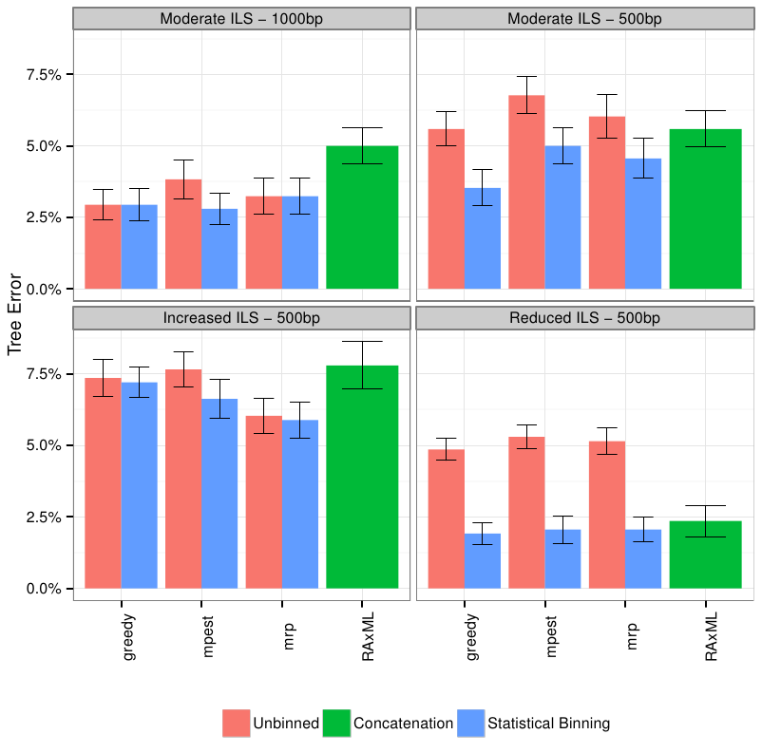
Mammalian simulation
Observation:
Binning can improve summary methods, but amount of improvement depends on: method,
amount of ILS, and accuracy of gene trees.
MP-EST is statistically consistent in the presence of ILS; Greedy is not, unknown for MRP
And RAxML.
Data (200 genes, 20 replicate datasets) based on Song et al. PNAS 2012

