Slide 1
MapReduce
With a heavy debt to:
Google Map Reduce OSDI 2004 slides
code.google.com

Slide 2
You are an engineer at: Hare-brained-scheme.com
Your boss, comes to your office and says:
“We’re going to be hog-nasty rich! We just need a program to search for strings in text files...”
Input: <search_term>, <files>
Output: list of files containing <search_term>

Slide 3
One solution
public class StringFinder {
int main(…) {
foreach(File f in getInputFiles()) {
if(f.contains(searchTerm))
results.add(f.getFileName());
}
}
System.out.println(“Files:” + results.toString()); }
“But, uh, marketing says we have to search a lot of files.
More than will fit on one disk…”

Slide 4
Another solution
Throw hardware at the problem!
Use your StringFinder class as is…
but get lots of disks!
“But, uh, well, marketing says it’s too slow…and besides, we need it
to work on the web…”

Slide 5
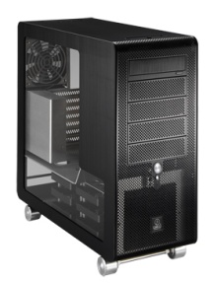
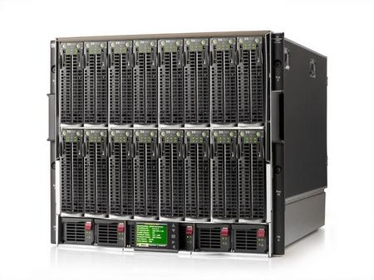
Third Time’s a charm
StringFinder
Indexed data
Web Server
Search
query
StringFinder
Indexed data
StringFinder
Indexed data
How do we distribute the searchable files on our machines?
2. What if our webserver goes down?
3. What if a StringFinder machine dies? How would you know it was dead?
4. What if marketing comes and says, “well, we also want to show pictures of the earth from space too! Ooh..and the moon too!”

Slide 6
StringFinder was the easy part!
You really need general infrastructure.
Many different tasks
Want to use hundreds or thousands of PC’s
Continue to function if something breaks
Must be easy to program…
MapReduce addresses this problem!

Slide 7
MapReduce
Programming model + infrastructure
Write programs that run on lots of machines
Automatic parallelization and distribution
Fault-tolerance
Scheduling, status and monitoring
Cool. What’s the catch?

Slide 8
MapReduce Programming Model
Input & Output: sets of <key, value> pairs
Programmer writes 2 functions:
map (in_key, in_value) -> list(out_key, intermediate_value)
Processes <k,v> pairs
Produces intermediate pairs
reduce (out_key, list(interm_val)) -> list(out_value)
Combines intermediate values for a key
Produces a merged set of outputs

Slide 9
Example: Counting Words…
map(String input_key, String input_value):
// input_key: document name
// input_value: document contents
for each word w in input_value: EmitIntermediate(w, "1");
reduce(String output_key,
Iterator intermediate_values):
// output_key: a word
// output_values: a list of counts
int result = 0;
for each v in intermediate_values:
result += ParseInt(v);
Emit(AsString(result));
MapReduce handles all the other details!

Slide 10
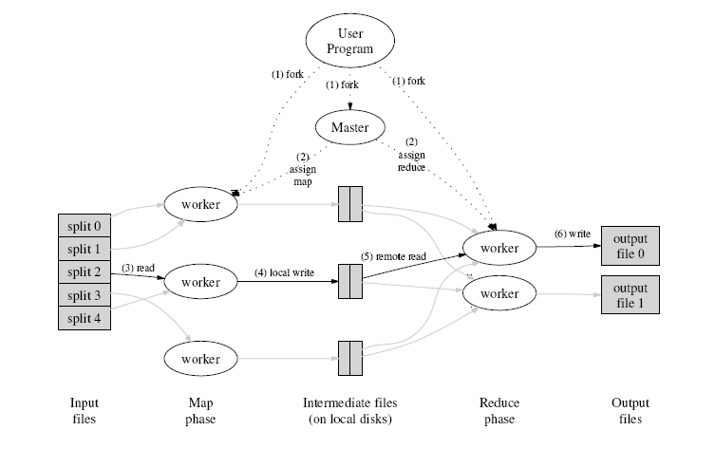
How does parallelization work?
INPUT
FILE(s)

Slide 11
All you have to do is…
Make all your programs into MapReduce algorithms…
Can we really make
any program this
way?
MapReduce is
Turing complete!

Slide 12
Your Project: A Search Engine
$> hadoop -j search.jar “out damned spot”
Search Complete
10 relevant files found
Terms: out, damned, spot
macbeth (MAX_RELEVANCE)
...Out, damned spot!...
...Like Valor's minion carved out his passage...
...What hands are here? Ha, they pluck out mine eyes!...
...MACBETH. Hang out our banners on the outward walls;...
...Lady Macbeth is carried out....
…

Slide 13
Search Engine Components
Use Hadoop (open source MapReduce)
5 pairs of Map/Reduce classes
Search Index: make the search fast
Summary Index: make summarizing fast
Search: the actual search
Winnow: choose the most relevant results
Present: generate some pretty output

Slide 14
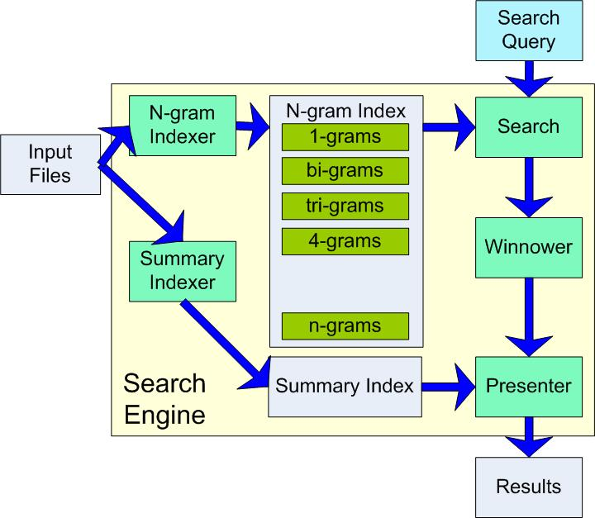
Search Engine Overview

Slide 15
Example: Indexing (2)
public void map() {
String line = value.toString();
StringTokenizer itr = new StringTokenizer(line);
if(itr.countTokens() >= N) {
while(itr.hasMoreTokens()) {
word = itr.nextToken()+“|”+key.getFileName();
output.collect(word, 1);
}
}
}
Input: a line of text, e.g. “mistakes were made” from myfile.txt
Output:
mistakes|myfile.txt
were|myfile.txt
made|myfile.txt

Slide 16
Example: Indexing (3)
public void reduce() {
int sum = 0;
while(values.hasNext()) {
sum += values.next().get();
}
output.collect(key, sum);
}
Input: a <term,filename> pair, list of occurrences (e.g. {1, 1,..1})
Output:
mistakes|myfile.txt 10
were|myfile.txt 45
made|myfile.txt 2

Slide 17
Have fun!
(Read the documentation!)

