Slide 1
CS395: Visual Recognition
Spatial Pyramid Matching
21st September 2012
Heath Vinicombe
The University of Texas at Austin

Slide 2


Goal
Given a number of categorized images, can we recognize the category of a test image
Method: ‘Spatial Pyramid Matching’ (SPM)
  Lazebnik, Schmid and Ponce
  Beyond Bags of Features: Spatial Pyramid Matching for Recognizing Natural Scene Categories
Drunk Polar Bear
Drunk Panda

Slide 3
Outline
SPM Method
Datasets
Results
Analysis
Conclusions
Discussion

Slide 4
Method - Summary
Extract Features
Compile Vocabulary
Generate Histograms
Compare Histograms
Kernel Matrix
Learning Algorithm

Slide 5
Method – Feature Extraction
Dense SIFT descriptor
  8 x 8 pixel grid, each patch 16 x 16 (overlapping)
  Advantage over sparse features for natural scenes
  Matlab code from Lazebnik [1]
  ~ 80s for 500 images
  [1] http://www.cs.illinois.edu/homes/slazebni/research/SpatialPyramid.zip

Slide 6
Method – Vocab Generation
K-Means Clustering
100 image subset of training data
200 word vocabulary
~ 130s

Slide 7
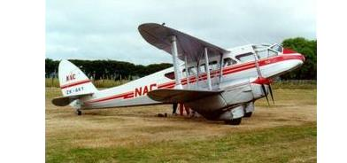
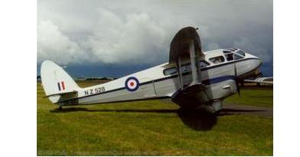
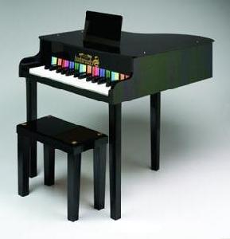
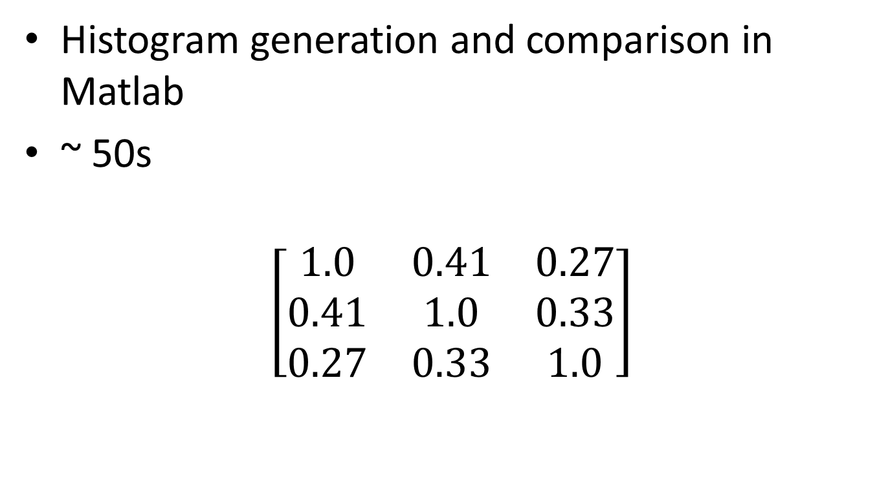
Method – Pyramid Matching
Histogram generation and comparison in Matlab
~ 50s
$$\left[\begin{matrix}1.0 & 0.41 & 0.27 \\ 0.41 & 1.0 & 0.33 \\ 0.27 & 0.33 & 1.0\end{matrix}\right]$$
Kernel Matrix

Slide 8
Method - Learning Algorithm
SVM
One vs All
Precomputed Kernel is input
Spider learning library collection for matlab [1]
~ 2s
  [1] http://people.kyb.tuebingen.mpg.de/spider/main.html

Slide 9
Summary of Runtimes
Component | Time(s)
SIFT Extraction | 80
Vocab Generation | 130
Pyramid Matching Kernel | 50
SVM | 2

Slide 10
Dataset- Details
Caltech 101 image database [1]
101 Classes, 50-800 images per class
This demo
  10 classes
  50 training per class
  20 test per class
  [1] http://www.vision.caltech.edu/Image_Datasets/Caltech101/

Slide 11
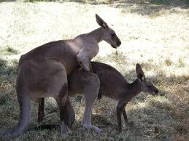
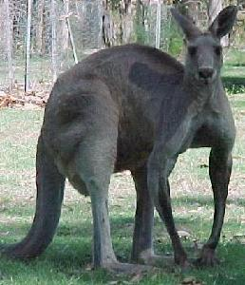
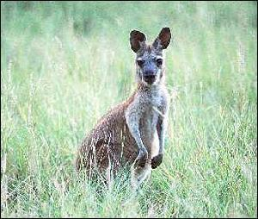

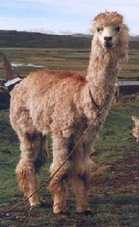
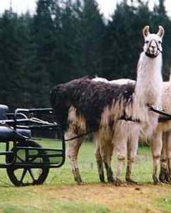
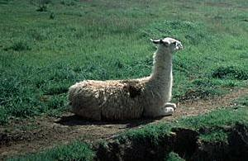

Dataset - Classes
Kangaroo
Llama

Slide 12
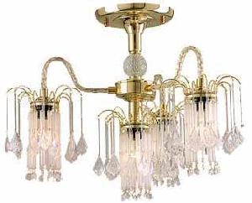
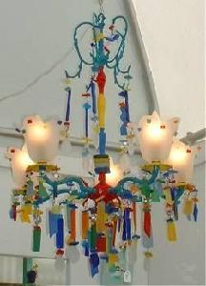
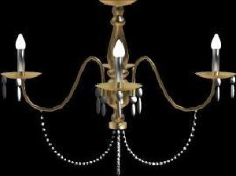
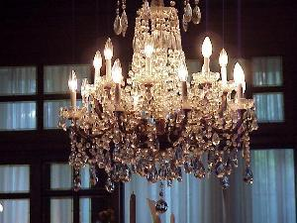
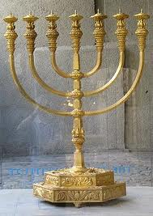

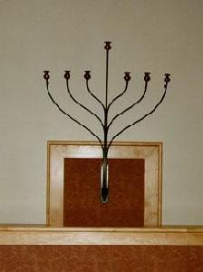
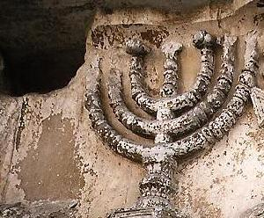
Dataset - Classes
Chandelier
Menorah

Slide 13
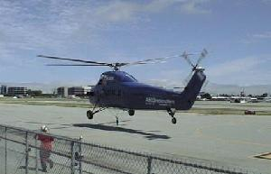
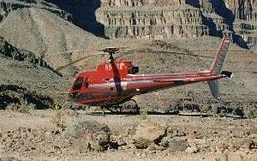
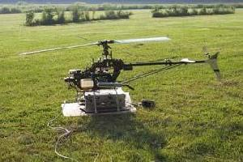
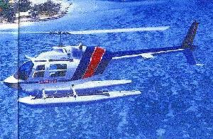
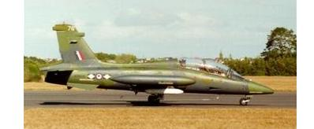
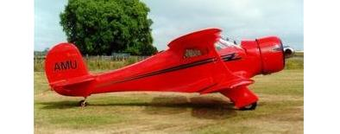
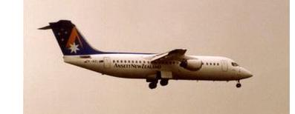
Dataset - Classes
Helicopter
Airplane

Slide 14

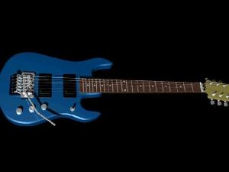
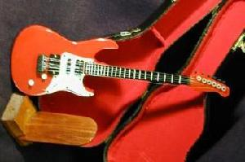
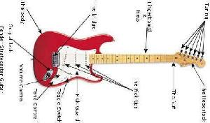
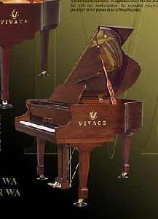

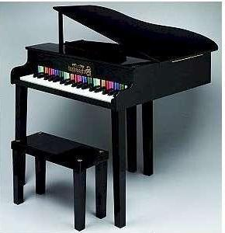
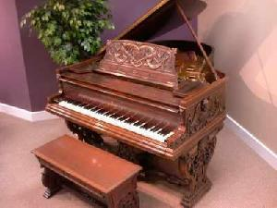
Dataset - Classes
Electric Guitar
Grand Piano

Slide 15

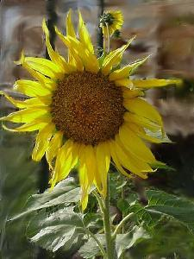
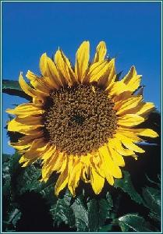
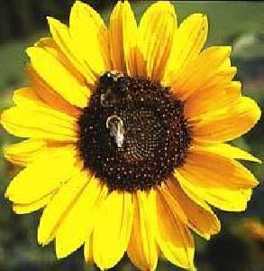
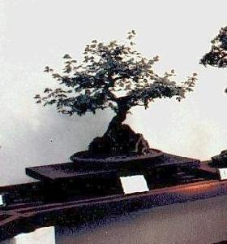
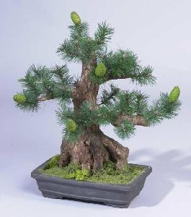
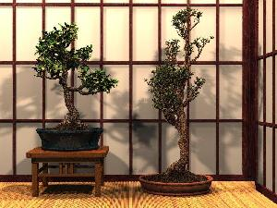
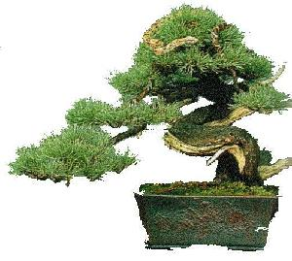
Dataset - Classes
Sunflower
Bonsai

Slide 16
Results – Success Rate
86% classification rate on test images (guessing = 10%)
100% for Electric Guitar
65-70% for Llamas and Kangaroos

Slide 17
Results – Confusion Matrix
Electric Guitar
Grand Piano
Menorah
Llama
Sunflower
Airplane
Kangaroo
Bonsai
Helicopter
Chandelier
Airplane
90 | 0 | 0 | 0 | 0 | 10 | 0 | 0 | 0 | 0
0 | 70 | 5 | 5 | 0 | 10 | 10 | 0 | 0 | 0
0 | 0 | 95 | 0 | 0 | 0 | 0 | 5 | 0 | 0
0 | 0 | 0 | 100 | 0 | 0 | 0 | 0 | 0 | 0
0 | 0 | 5 | 0 | 90 | 0 | 0 | 5 | 0 | 0
0 | 0 | 0 | 0 | 0 | 95 | 0 | 0 | 0 | 5
0 | 0 | 0 | 0 | 0 | 0 | 65 | 25 | 0 | 10
0 | 0 | 0 | 0 | 0 | 0 | 30 | 70 | 0 | 0
0 | 0 | 10 | 0 | 0 | 0 | 0 | 0 | 90 | 0
0 | 0 | 0 | 0 | 5 | 0 | 0 | 0 | 0 | 95
Bonsai
Chandelier
Electric Guitar
Grand Piano
Helicopter
Kangaroo
Llama
Menorah
Sunflower

Slide 18
Results – Score Matrix
Electric Guitar
Grand Piano
Menorah
Llama
Sunflower
Airplane
Kangaroo
Bonsai
Helicopter
Chandelier
Airplane
98 | 60 | 39 | 56 | 66 | 83 | 18 | 25 | 34 | 22
19 | 92 | 51 | 51 | 31 | 53 | 58 | 56 | 30 | 60
13 | 52 | 94 | 52 | 40 | 36 | 44 | 58 | 55 | 56
24 | 58 | 56 | 95 | 60 | 59 | 20 | 32 | 37 | 60
38 | 48 | 57 | 75 | 96 | 47 | 19 | 31 | 49 | 40
54 | 58 | 43 | 67 | 42 | 94 | 37 | 39 | 33 | 33
5 | 61 | 50 | 46 | 16 | 48 | 91 | 85 | 41 | 57
7 | 65 | 52 | 40 | 18 | 53 | 87 | 94 | 38 | 47
19 | 54 | 70 | 54 | 55 | 37 | 33 | 36 | 95 | 47
8 | 64 | 64 | 63 | 50 | 25 | 46 | 43 | 42 | 94
Bonsai
Chandelier
Electric Guitar
Grand Piano
Helicopter
Kangaroo
Llama
Menorah
Sunflower

Slide 19
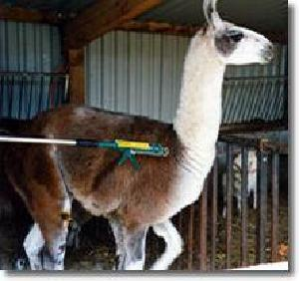
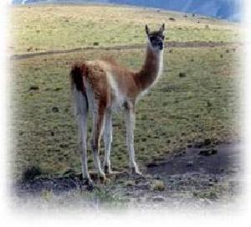
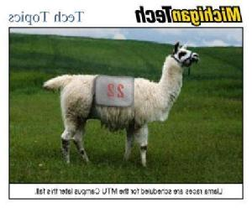
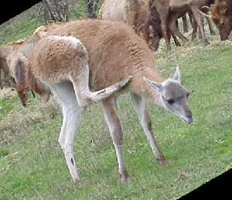
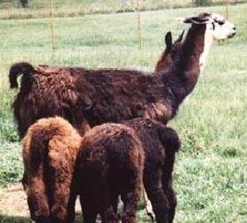
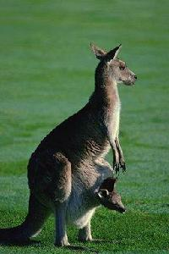
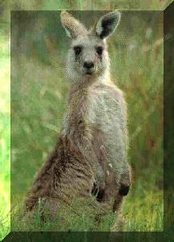
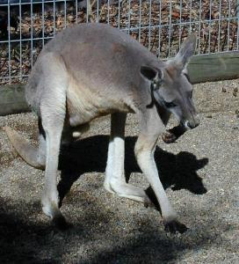
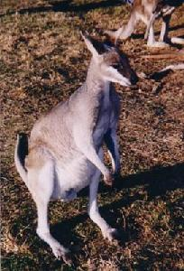
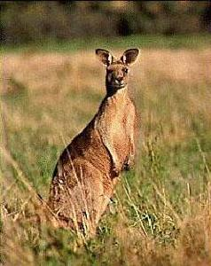
Results – Examples of misclassified
Llamas classified as Llamas
Llamas classified as Kangaroos
Kangaroos classified as Llamas
Kangaroos classified as Kangaroos

Slide 20
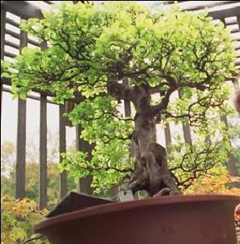

Results – 180 deg Rotation
Test images rotated 180 degrees
Previous support vectors
55% accuracy

Slide 21
Results – Confusion Matrix (180 deg)
Electric Guitar
Grand Piano
Menorah
Llama
Sunflower
Airplane
Kangaroo
Bonsai
Helicopter
Chandelier
Airplane
75 | 0 | 0 | 5 | 5 | 15 | 0 | 0 | 0 | 0
0 | 20 | 25 | 0 | 5 | 15 | 25 | 10 | 0 | 0
0 | 10 | 55 | 5 | 0 | 5 | 0 | 5 | 15 | 5
5 | 10 | 10 | 50 | 5 | 5 | 0 | 0 | 0 | 15
0 | 0 | 10 | 5 | 80 | 0 | 0 | 5 | 0 | 0
0 | 10 | 0 | 0 | 0 | 85 | 0 | 0 | 0 | 5
0 | 0 | 5 | 0 | 0 | 0 | 55 | 25 | 0 | 15
0 | 10 | 0 | 0 | 0 | 5 | 40 | 45 | 0 | 0
0 | 0 | 55 | 0 | 20 | 0 | 0 | 5 | 5 | 15
0 | 0 | 10 | 0 | 5 | 0 | 0 | 0 | 0 | 85
Bonsai
Chandelier
Electric Guitar
Grand Piano
Helicopter
Kangaroo
Llama
Menorah
Sunflower

Slide 22
Results – 90 deg Rotation
Test images rotated 90 degrees
Previous support vectors
31% accuracy

Slide 23
Results – Confusion Matrix (90 deg)
Electric Guitar
Grand Piano
Menorah
Llama
Sunflower
Airplane
Kangaroo
Bonsai
Helicopter
Chandelier
Airplane
0 | 0 | 95 | 5 | 0 | 0 | 0 | 0 | 0 | 0
0 | 10 | 35 | 5 | 0 | 0 | 25 | 15 | 0 | 10
0 | 30 | 25 | 20 | 0 | 15 | 0 | 5 | 0 | 5
0 | 0 | 50 | 20 | 0 | 0 | 0 | 0 | 15 | 15
0 | 0 | 60 | 10 | 30 | 0 | 0 | 0 | 0 | 0
0 | 0 | 75 | 0 | 0 | 5 | 10 | 0 | 5 | 5
0 | 0 | 5 | 5 | 0 | 0 | 60 | 15 | 0 | 15
0 | 5 | 0 | 0 | 0 | 0 | 35 | 60 | 0 | 0
0 | 0 | 35 | 15 | 15 | 15 | 0 | 5 | 5 | 10
0 | 0 | 0 | 0 | 5 | 0 | 0 | 0 | 0 | 95
Bonsai
Chandelier
Electric Guitar
Grand Piano
Helicopter
Kangaroo
Llama
Menorah
Sunflower

Slide 24
Results – Questions Raised
Why are some classes more affected by rotation?
Why does 90 deg have greater effect than 180 deg?
Why are so many Aeroplanes classified as Chandeliers?

Slide 25
Analysis – Questions Raised
Why are some classes more affected by rotation?
Why does 90 deg have greater effect than 180 deg?
Why are so many Aeroplanes classified as Chandeliers?

Slide 26

Analysis – Effect of Rotation

Slide 27
Analysis – Questions Raised
Why are some classes more affected by rotation?
Why does 90 deg have greater effect than 180 deg?
Why are so many Aeroplanes classified as Chandeliers?

Slide 28
Analysis – Symmetry
Many images have vertical symmetry

Slide 29
Analysis – Questions Raised
Why are some classes more affected by rotation?
Why does 90 deg have greater effect than 180 deg?
Why are so many Aeroplanes classified as Chandeliers?

Slide 30
Analysis – Aeroplane/Chandelier results
90% of Aeroplanes correctly classified
90 deg rotation – 95% of Aeroplanes incorrectly classified as Chandeliers

Slide 31
Analysis – Vocabulary Comparison of Aeroplane and Chandelier
Red dots = most common shared feature
Large histogram overlap of airplanes and chandeliers despite little visual similarity

Slide 32
Analysis – Comparison of 3L Pyramid and BoW
Bag of Words classifier effectively 0 levels Pyramid that does not use spatial information.
Orientation compared to training | 3 Level | Bag of Words (0 Level)
0 | 86% | 76.5%
180 degrees | 55% | 73.5%
90 degrees | 31% | 29.5%

Slide 33
Conclusions
86% Classification accuracy achieved
Runtime in order of a few minutes
SPM is sensitive to rotation, especially 90 deg
SPM performs better than BoW for correctly orientated images
Dense SIFT features sensitive to changes in image size

Slide 34
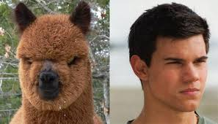

Discussion Points
Test examples outside training classes?
What explains the higher accuracy compared to Lazebnik paper?
How to improve the accuracy of SPM and BoW for 90 deg rotations?
Could colour information be used as features?

