Slide 1
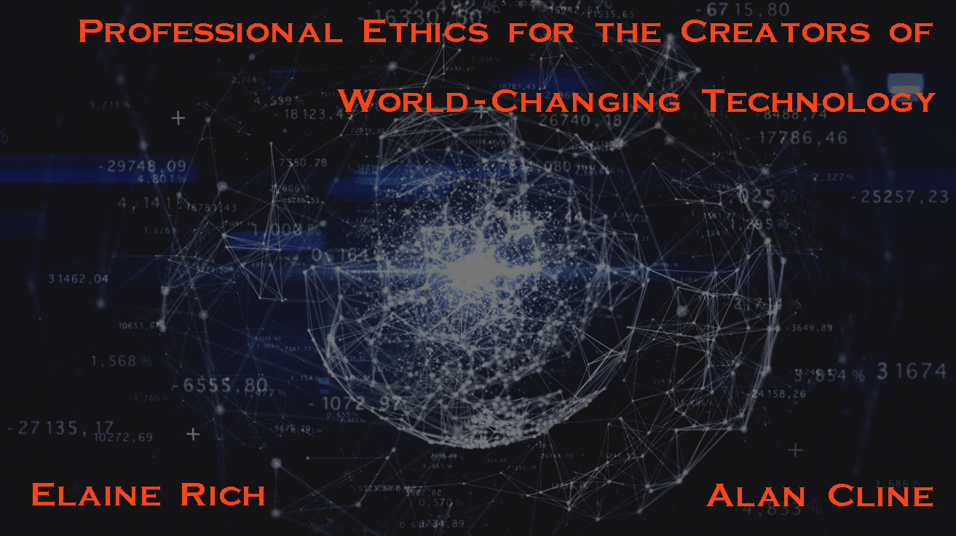
Notes:
EAR

Slide 2
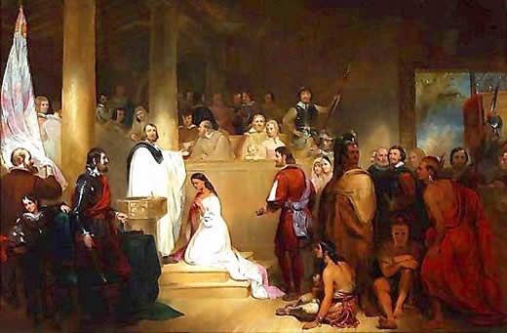
Who is this Person and Why Do We Care?
Notes:
John Rolfe (c. 1585 – 1622) AKC

Slide 3
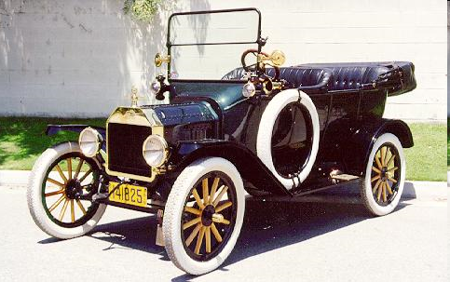
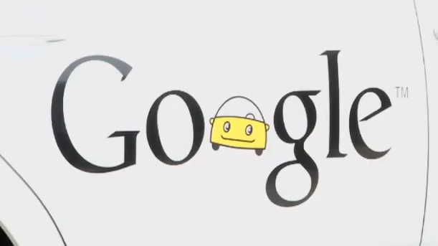
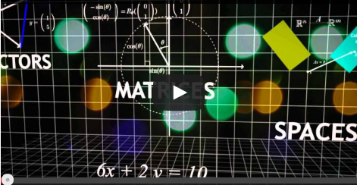
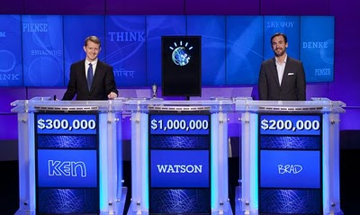

More Unintended Consequences
Notes:
Image from: http://www.musclecarclub.com/other-cars/classic/ford-model-t/ford-model-t.shtml EAR
Video for google car: http://www.youtube.com/watch?v=EAHdX2I4fuE
Van de Geijn and Myers Linear Algebra MOOC
http://blog.storyful.com/2016/04/12/five-tips-for-improving-facebook-discovery/#.V3asWbgrI2w

Slide 4

Professional Ethics
Your first job after graduation is system administrator for a 200 person
privately held manufacturing company.
The president/owner sends this message to the employees:
“I want to encourage each of you to make comments to me about any facet of our operation you care to. Your response should be made through our anonymizer program so that your identity will not be disclosed”
Notes:
https://blogs.gonzaga.edu/guswtech/the-suggestion-box/ AKC

Slide 5
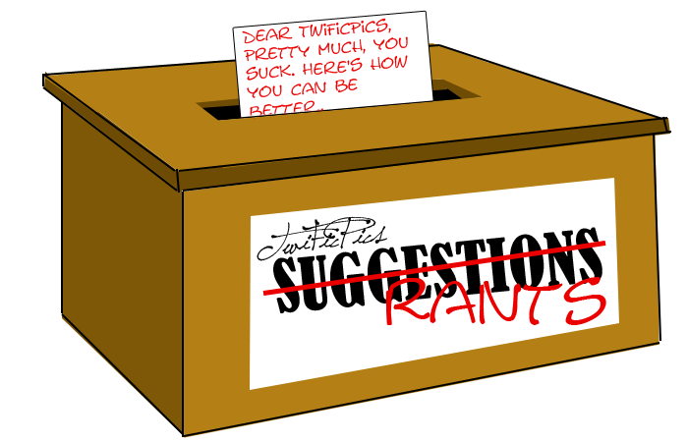
Professional Ethics
Your first job after graduation is system administrator for a 200 person
privately held manufacturing company.
The president/owner sends this message to the employees:
“I want to encourage each of you to make comments to me about any facet of our operation you care to. Your response should be made through our anonymizer program so that your identity will not be disclosed”
The president/owner finds one response saying:
“This company sucks. The only way I find to retaliate for the way I have been treated is sabotage. Every tenth part I turn out is defective.”
The president/owner insists that you examine the computer usage records to determine the identity of the alleged saboteur.
What should you do?
Notes:
http://yourforum.gr/InvisionBoard/index.php?showtopic=392745 AKC

Slide 6
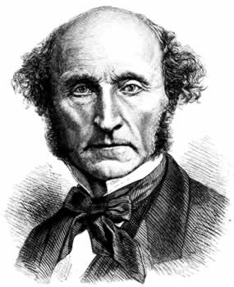
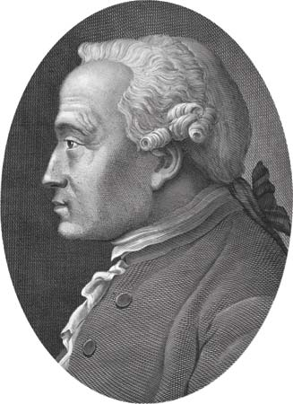
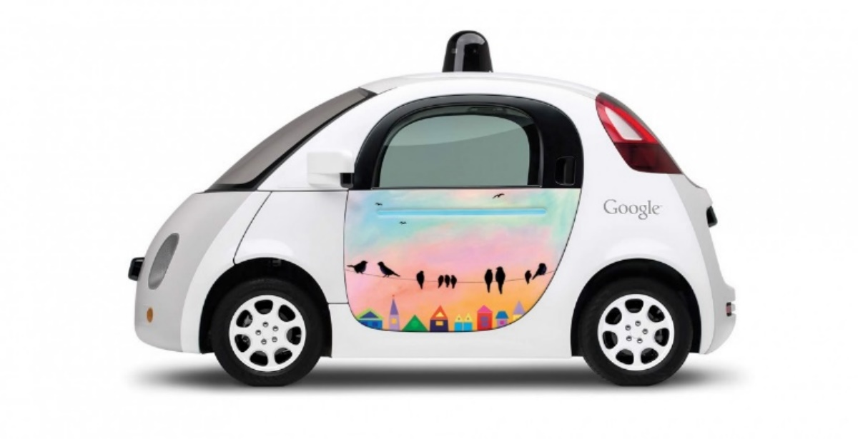
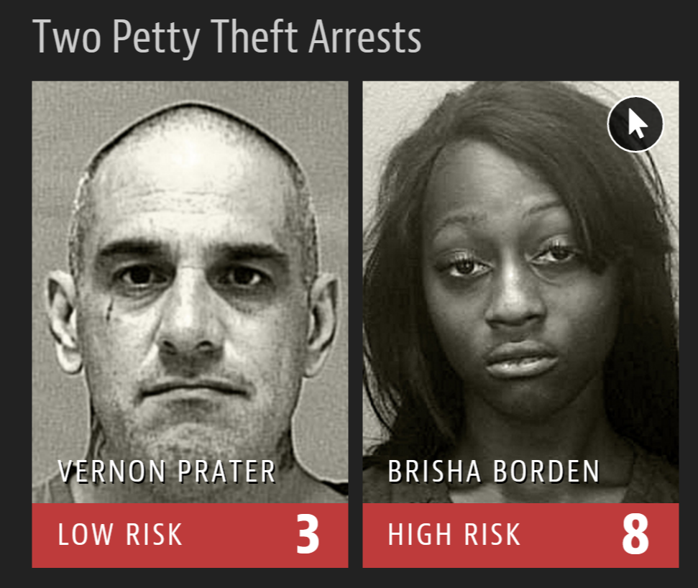
How can we can behave ethically?
How shall we program machines to do so?
Utilitarianism
Kant and Deontology
Notes:
Mill (hair sticking out): http://www.utilitarian.net/jsmill/ EAR
Kant: http://media-2.web.britannica.com/eb-media/69/99069-004-1D777F95.jpg

Slide 7
How can we can behave ethically?
Utilitarianism
Kant and Deontology
In situations that aren’t specifically tied to our technology.
In situations that are specifically tied to our technology.
Notes:
The first case isn’t special. Like keep your word, in the suggestion box example. But there are also cases that are special. Once we learn some frameworks, we can use them in both kinds of circumstances. EAR

Slide 8
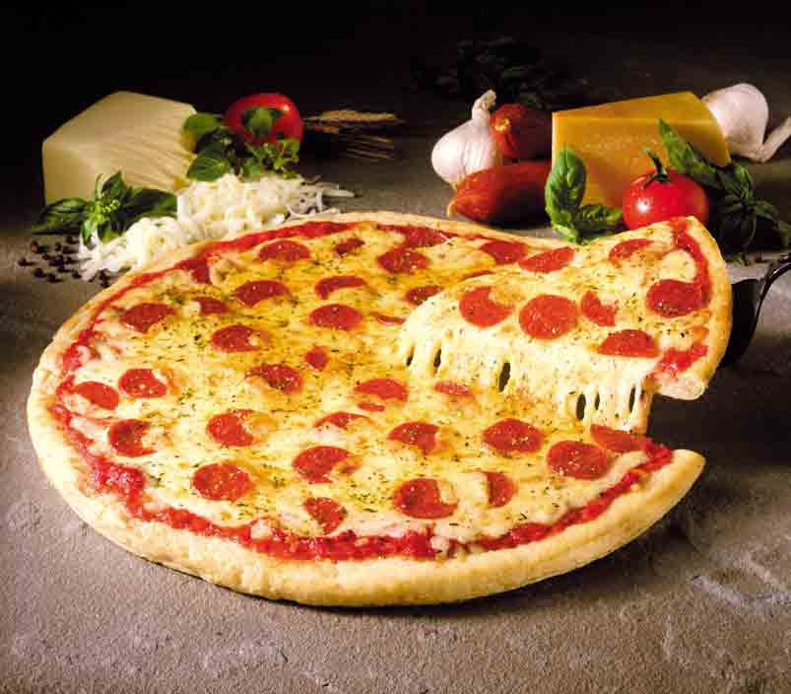
Privacy
http://www.aclu.org/pizza/
Notes:
We go through several important topics and look at them from the point of view of what is right. The first big one we discuss is privacy, despite the fact that most students recognize that they haven’t got any and they seem okay with that. First, talk about what is happening with privacy. EAR

Slide 9
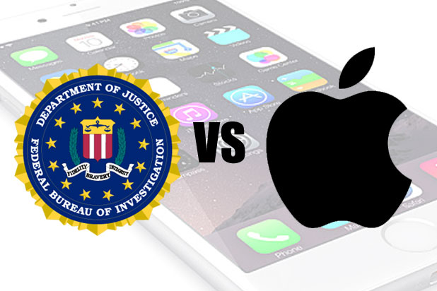
Technology and Rights Tradeoffs Security vs Privacy
Notes:
But often the issue is trading off rights in new ways. It’s not just what happens to one person or decisions that one person can make.
http://www.thewrap.com/fbi-admits-it-reset-san-bernardino-shooters-iphone-password/ EAR

Slide 10
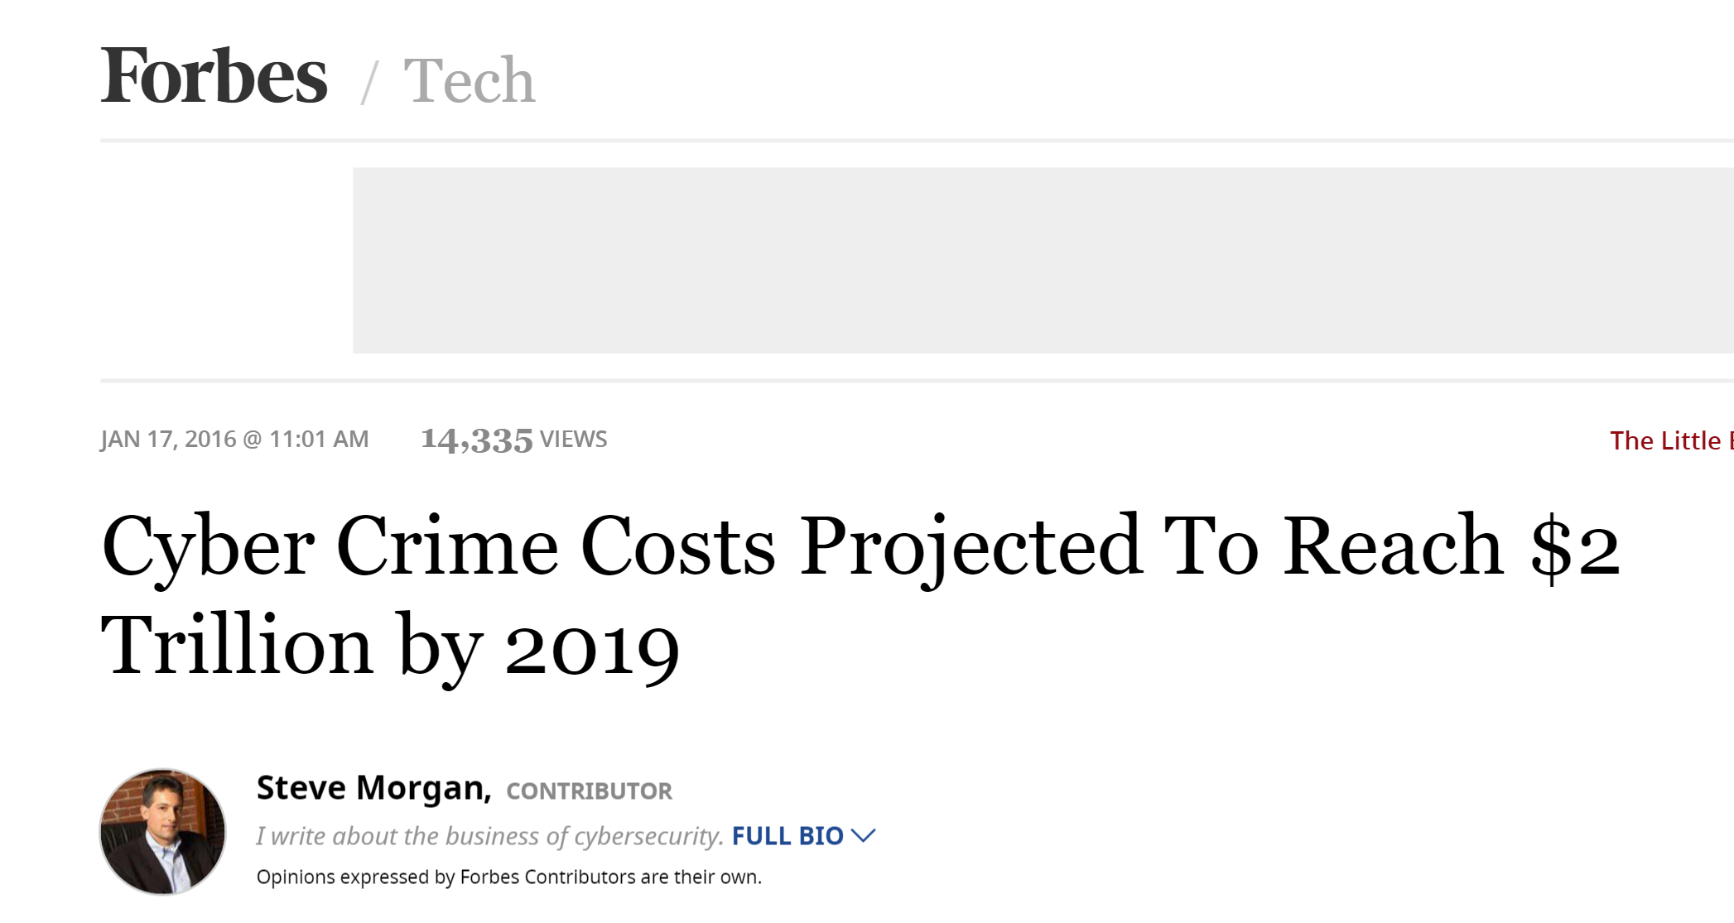
Cybercrime
Notes:
But we can’t ignore security of all sorts. AKC
http://www.forbes.com/sites/stevemorgan/2016/01/17/cyber-crime-costs-projected-to-reach-2-trillion-by-2019/#6d58302e3bb0

Slide 11
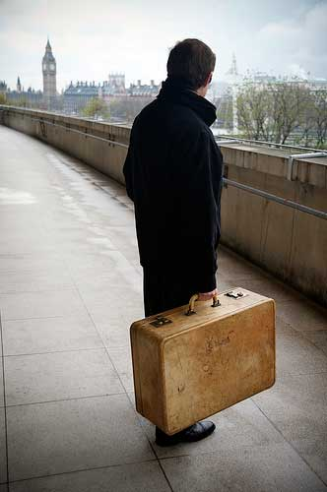

Vacuums and Muddles
No
Yes
Then
Now
Notes:
Or exactly what is some new thing. EAR
Article about US government using border entry as excuse to grab electronics and go through them:
http://www.nytimes.com/2013/09/10/business/the-border-is-a-back-door-for-us-device-searches.html?_r=0
Muddle: is the contents of your laptop like the stuff in your suitcase or the stuff in your head?
Old picture: http://www.hektoeninternational.org/Intercepted-letters.html
Laptop picture: http://www.freedigitalphotos.net/images/search.php?search=laptop

Slide 12

Vaccuums and Muddles
Warrant-less demands for cell location data:
Is raw location data protected by your right to privacy in the same way that the content of what you say on your phone is?
Conceptual muddle: what is cell location?
Policy vacuum: Can the police get it without a warrant?
Notes:
Note: conceptual muddle: what is cell location data (is it the same as cell call content data)?
Policy vaccuum: Can the police get it without a warrant? EAR

Slide 13

Protecting Sources
Policy vacuum: Must a blogger reveal sources? Is a blogger protected by shield laws?
Conceptual muddle:
http://www.wired.com/threatlevel/2010/04/too-much-media/
http://newjerseylawreview.blogspot.com/2011/06/blogger-must-reveal-sources-says-nj.html
Obsidian v Cox: https://en.wikipedia.org/wiki/Obsidian_Finance_Group,_LLC_v._Cox
Notes:
Muddle: Is every blogger a journalist? NJ Supreme Court says not journalist. Blogger must reveal sources. EAR
But the 9th Circuit, in reviewing Obsidian v Cox, said that first amendment defamation rules apply equally to the institutional press and individual speakers (2014).

Slide 14
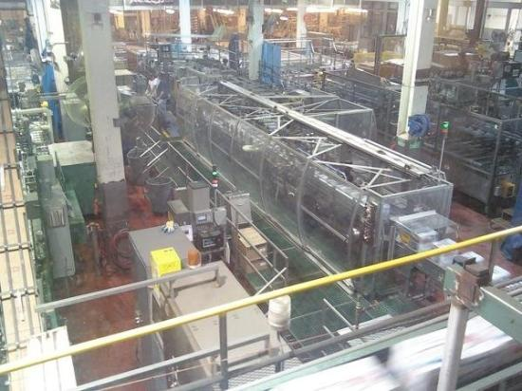
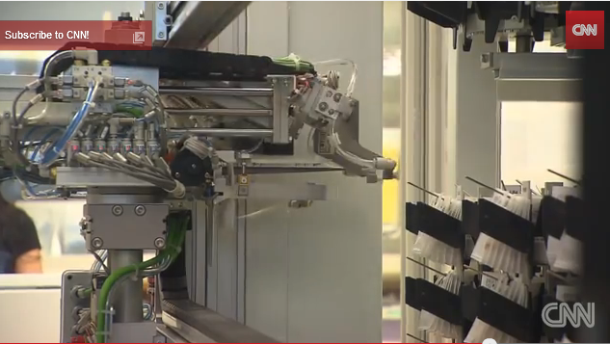

Coping with Change
Notes:
Fast change affects many aspects of society. Let’s look at one: jobs. EAR
Watson
Robotic pharmacist: https://www.youtube.com/watch?v=EQGSk3Lt9X0
Coors factory: Note no people. https://www.tripadvisor.com/LocationPhotoDirectLink-g33388-i23828601-Denver_Colorado.html
Google car: https://youtu.be/nBkQQ6czRJI

Slide 15
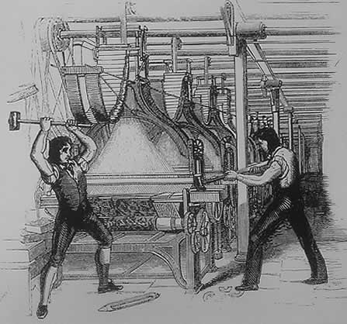
The Luddites
The Luddites, 1812
Notes:
Of course, technology has been replacing jobs for a long time. AKC

Slide 16
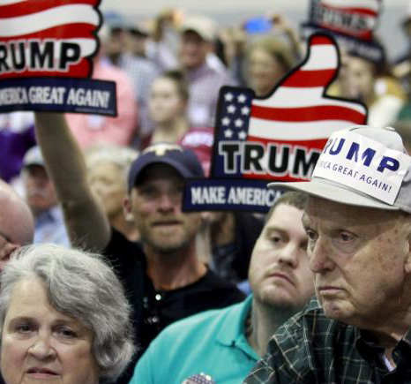
The Luddites
The Trumpites, 2016
Notes:
Of course, technology has been replacing jobs for a long time. AKC

Slide 17
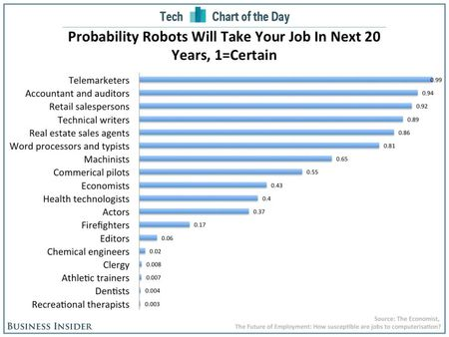
But Now It’s Faster and More Pervasive
Notes:
http://www.hrcapitalist.com/2014/01/probability-hr-jobs-will-be-lost-to-robots-in-the-next-20-years.html Jan, 2014.
There are lots of other projections like this. Differ in details. AKC

Slide 18
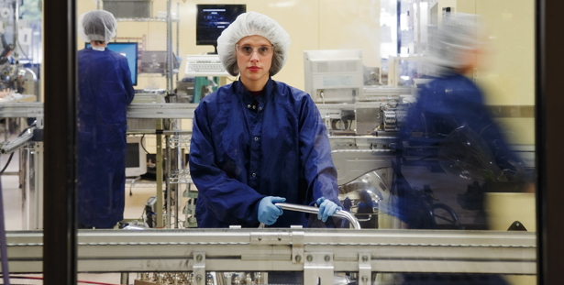
Maddie’s Job
Common practice:
Invest in a machine if you can earn back its cost in 2 years.
In the past decade, the flow of goods emerging from U.S. factories has risen by about a third.
Factory employment has fallen by roughly the same fraction.
Notes:
http://www.theatlantic.com/magazine/archive/2012/01/making-it-in-america/8844/ Standard is name of factory. AKC
Maddie is cheaper than a machine. It would be easy to buy a robotic arm that could take injector bodies and caps from a tray and place them precisely in a laser welder. Yet Standard would have to invest about $100,000 on the arm and a conveyance machine to bring parts to the welder and send them on to the next station. As is common in factories, Standard invests only in machinery that will earn back its cost within two years.
Interesting thing: If demand for product goes up and the factory can run more shifts, then, in fact, jobs for humans will disappear.

Slide 19
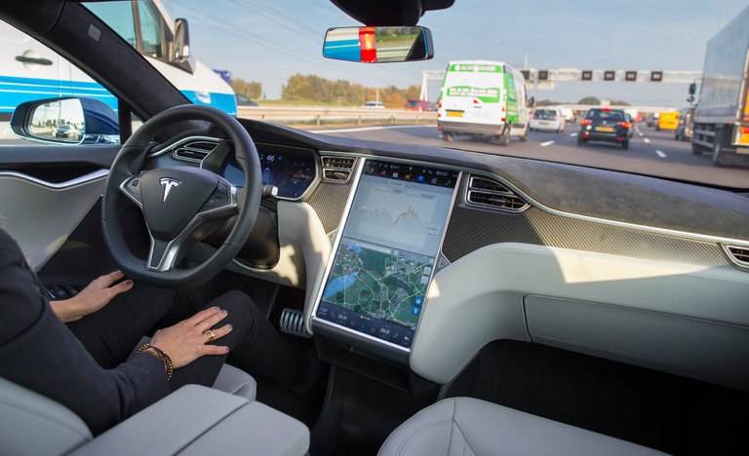
The Risk of Doing Nothing
Self-driving Tesla in accident: 1 person killed
Notes:
Speaking of one very disruptive technology: EAR
Back to how we should make decisions:
http://www.nytimes.com/2016/07/01/business/self-driving-tesla-fatal-crash-investigation.html?_r=0
We show people how to do expected value computations.

Slide 20
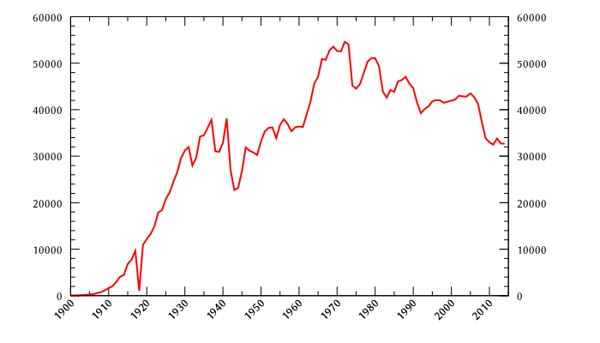
The Risk of Doing Nothing
Human driven cars: people killed per year
Notes:
https://en.wikipedia.org/wiki/List_of_motor_vehicle_deaths_in_U.S._by_year EAR
Why the decline even as passenger miles have increased? http://www.cnn.com/2011/US/04/01/traffic.fatalities/
Experts attribute the change to a variety of reasons, including changes to cars -- such as vehicle rollover protection -- and programs to change driver behavior -- such as campaigns addressing drunk driving, distracted driving and seat belt use. Laws aimed at young people also likely have had an impact, notably older minimum drinking ages and graduated drivers' licenses.

Slide 21
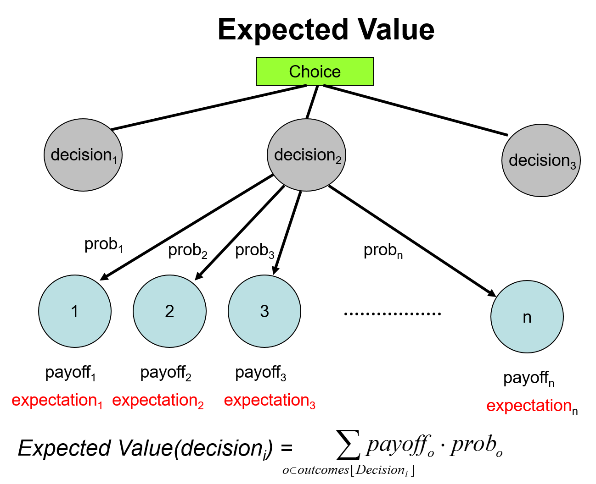
The Risk of Doing Nothing - How to Compare?
Notes:
Balance risks. AKC
In 2014, for car with drivers, 1.08 fatalities per 100M vehicle miles traveled.
As of March 2016, Google had test driven their fleet of vehicles, in autonomous mode, a total of 1,498,214 mi (Wikipedia) with no fatalities. Tesla said this was the first known death in over 130 million miles of Autopilot operation. Citation: http://www.pbs.org/newshour/rundown/driver-killed-in-self-driving-car-accident-for-first-time/

Slide 22
So much for how we should act ….
How should we program machines to act ….
Machine Ethics
Notes:
EAR

Slide 23
Algorithmic Bias
Notes:
http://www.nytimes.com/2016/06/26/opinion/sunday/artificial-intelligences-white-guy-problem.html?_r=0
https://www.propublica.org/article/machine-bias-risk-assessments-in-criminal-sentencing Yet Prater was the more seasoned criminal. And Borden did not reoffend. Prater did. EAR

Slide 24
Machine Ethics
https://youtu.be/nBkQQ6czRJI
A: Save the passengers.
B: Save others.
C: The only thing that matters is how many people.
Notes:
http://www.huffingtonpost.com/entry/driverless-cars-moral-dilemma_us_576c1bd0e4b0aa4dc3d4b557
EAR

Slide 25

Why Important and What Should You Do about It?
Notes:
http://gizmodo.com/why-californias-new-web-wide-delete-button-for-teens-w-1377730365 AKC
Why California’s new wide-wide delete button for teens won’t work.
Now all this sounds nice in theory, but more than anything, this law
is a testament to the fact that lawmakers (at least in California)
have no real idea how the internet actually works.

Slide 26
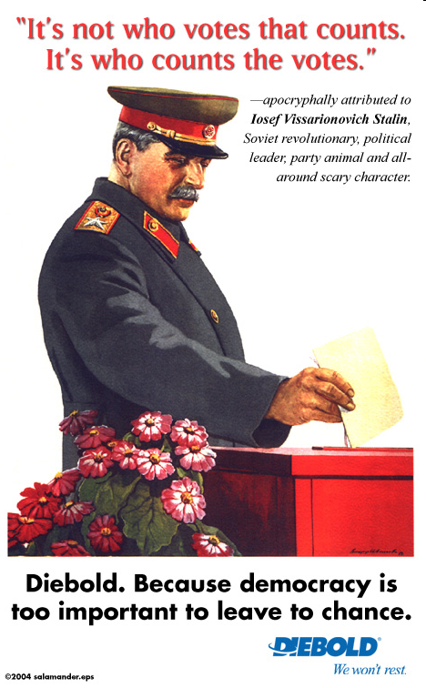
Why Important and What Should You Do about It?
Notes:
AKC

Slide 27
Why Important and What Should You Do about It?
Notes:
Back to this. One issue is whether it is even possible to create a backdoor that itself wouldn’t open up more vulnerabilities. Need technically competent people to work on answer. EAR

Slide 28
Why Important and What Should You Do about It?
Notes:
People who don’t understand the technology can long for the good old days. The only way that we can solve technologically induced problems, like widespread technical unemployment, is to recognize that they are happening before things have gotten completely crazy. It’s tech people who have to do that. EAR

Slide 29
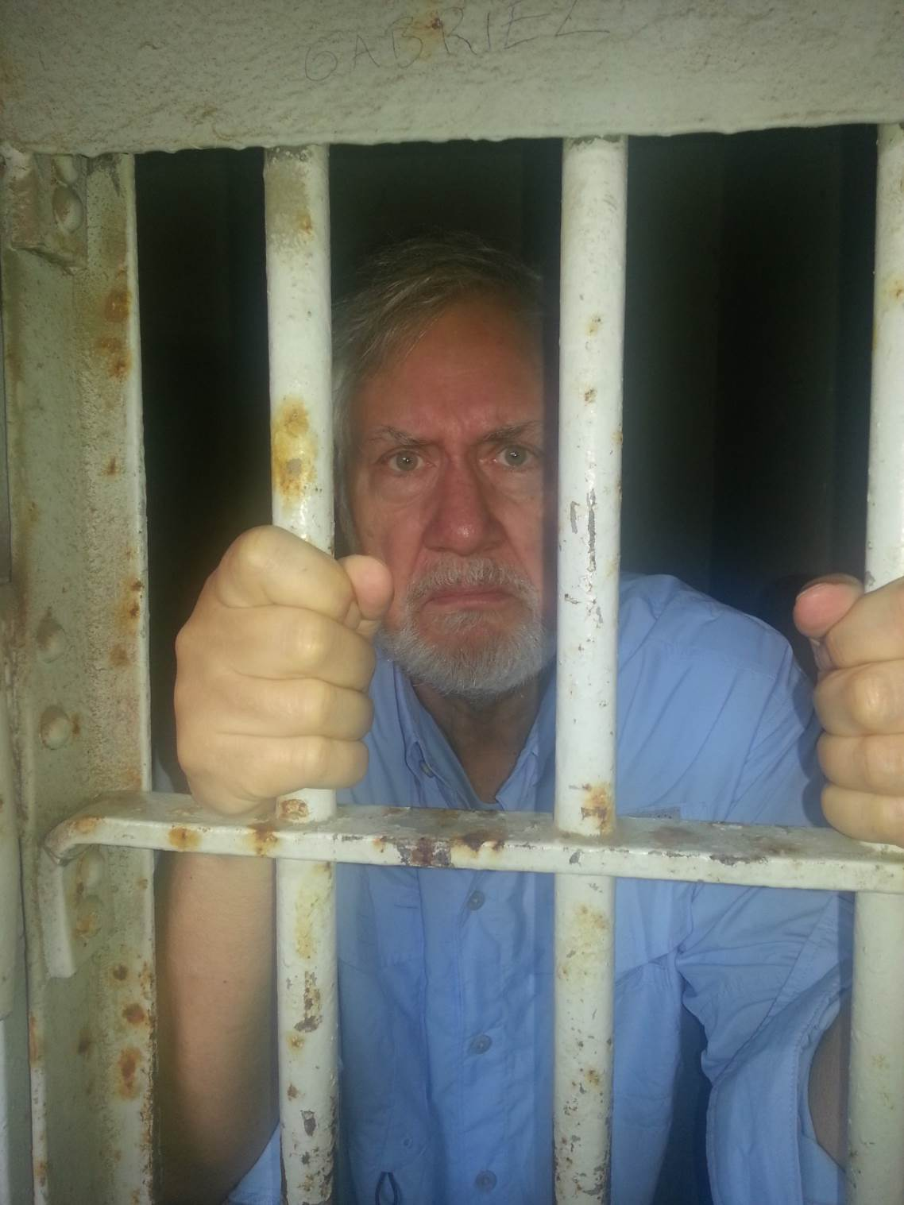
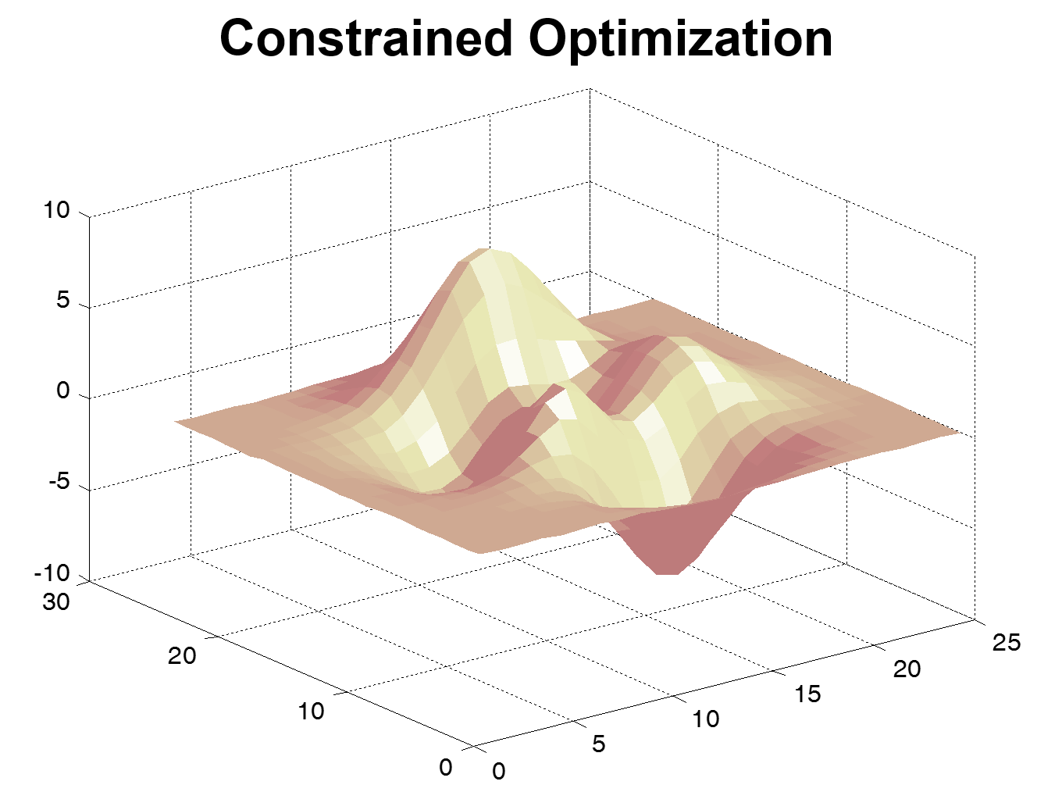
Ethical Frameworks Help Us Find Answers
and Mathematics
Kant and Deontology
Utilitarianism
Prisoner’s Dilemma
Notes:
We present philosophical approaches. AKC
Mill (hair sticking out): http://www.utilitarian.net/jsmill/
Kant: http://media-2.web.britannica.com/eb-media/69/99069-004-1D777F95.jpg
Utilitarianism is outcome based. How to compute outcomes?
Utilitarianism is optimization based. Deontological approaches impose constraints. So how does constrained optimization work?
How to behave in a world where other agents are rational? Prisoner’s dilemma.

Slide 30
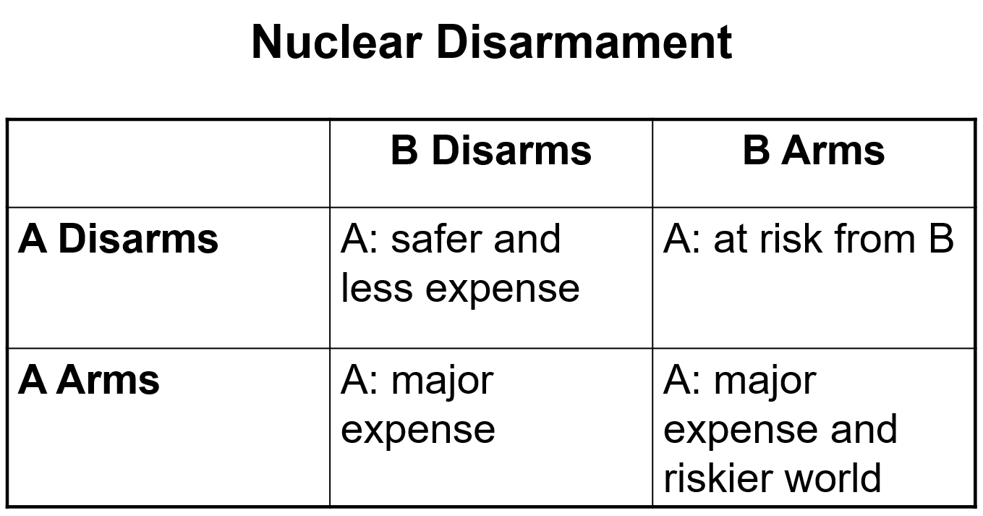
Ethical Frameworks Help Us Find Answers
and Mathematics
Kant and Deontology
Utilitarianism
Prisoner’s Dilemma
Notes:
We present philosophical approaches. AKC
Mill (hair sticking out): http://www.utilitarian.net/jsmill/
Kant: http://media-2.web.britannica.com/eb-media/69/99069-004-1D777F95.jpg
Utilitarianism is outcome based. How to compute outcomes?
Utilitarianism is optimization based. Deontological approaches impose constraints. So how does constrained optimization work?
How to behave in a world where other agents are rational? Prisoner’s dilemma.

Slide 31
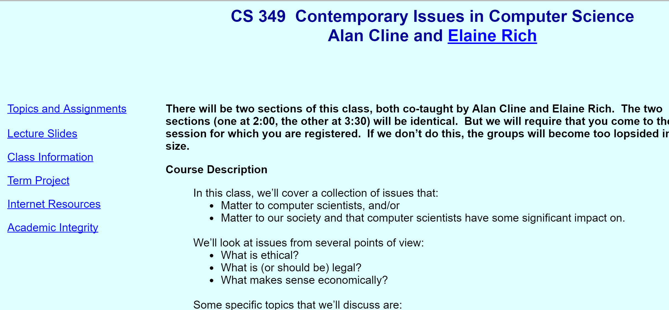
http://www.cs.utexas.edu/users/ear/cs349/
Notes:
Our class. Feel free to use any of our material. EAR

Slide 32
Example Essays
What I Have Lived For
What’s Right?
Income Disparity in the Face of Labor Displacement by Technology or What Happens When/If There Aren’t Any Jobs Left for People?
Notes:
AKC

Slide 33
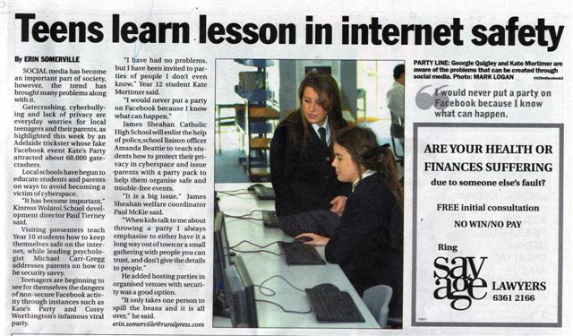
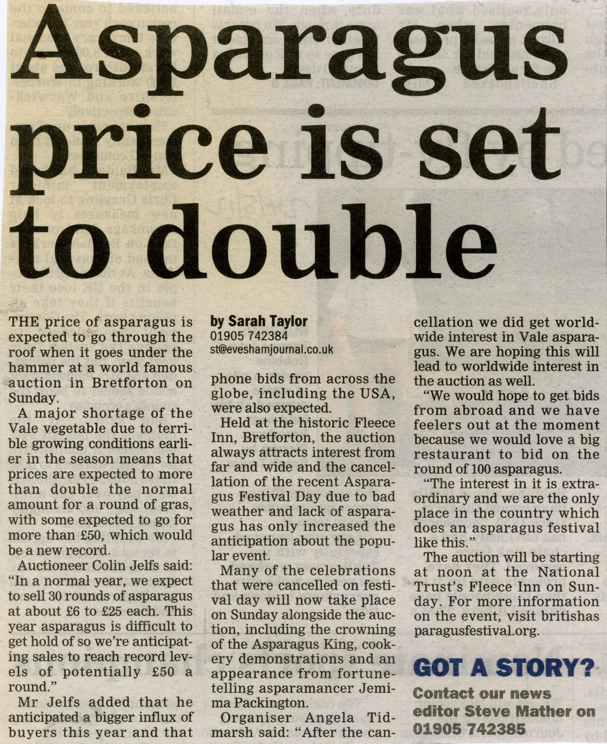
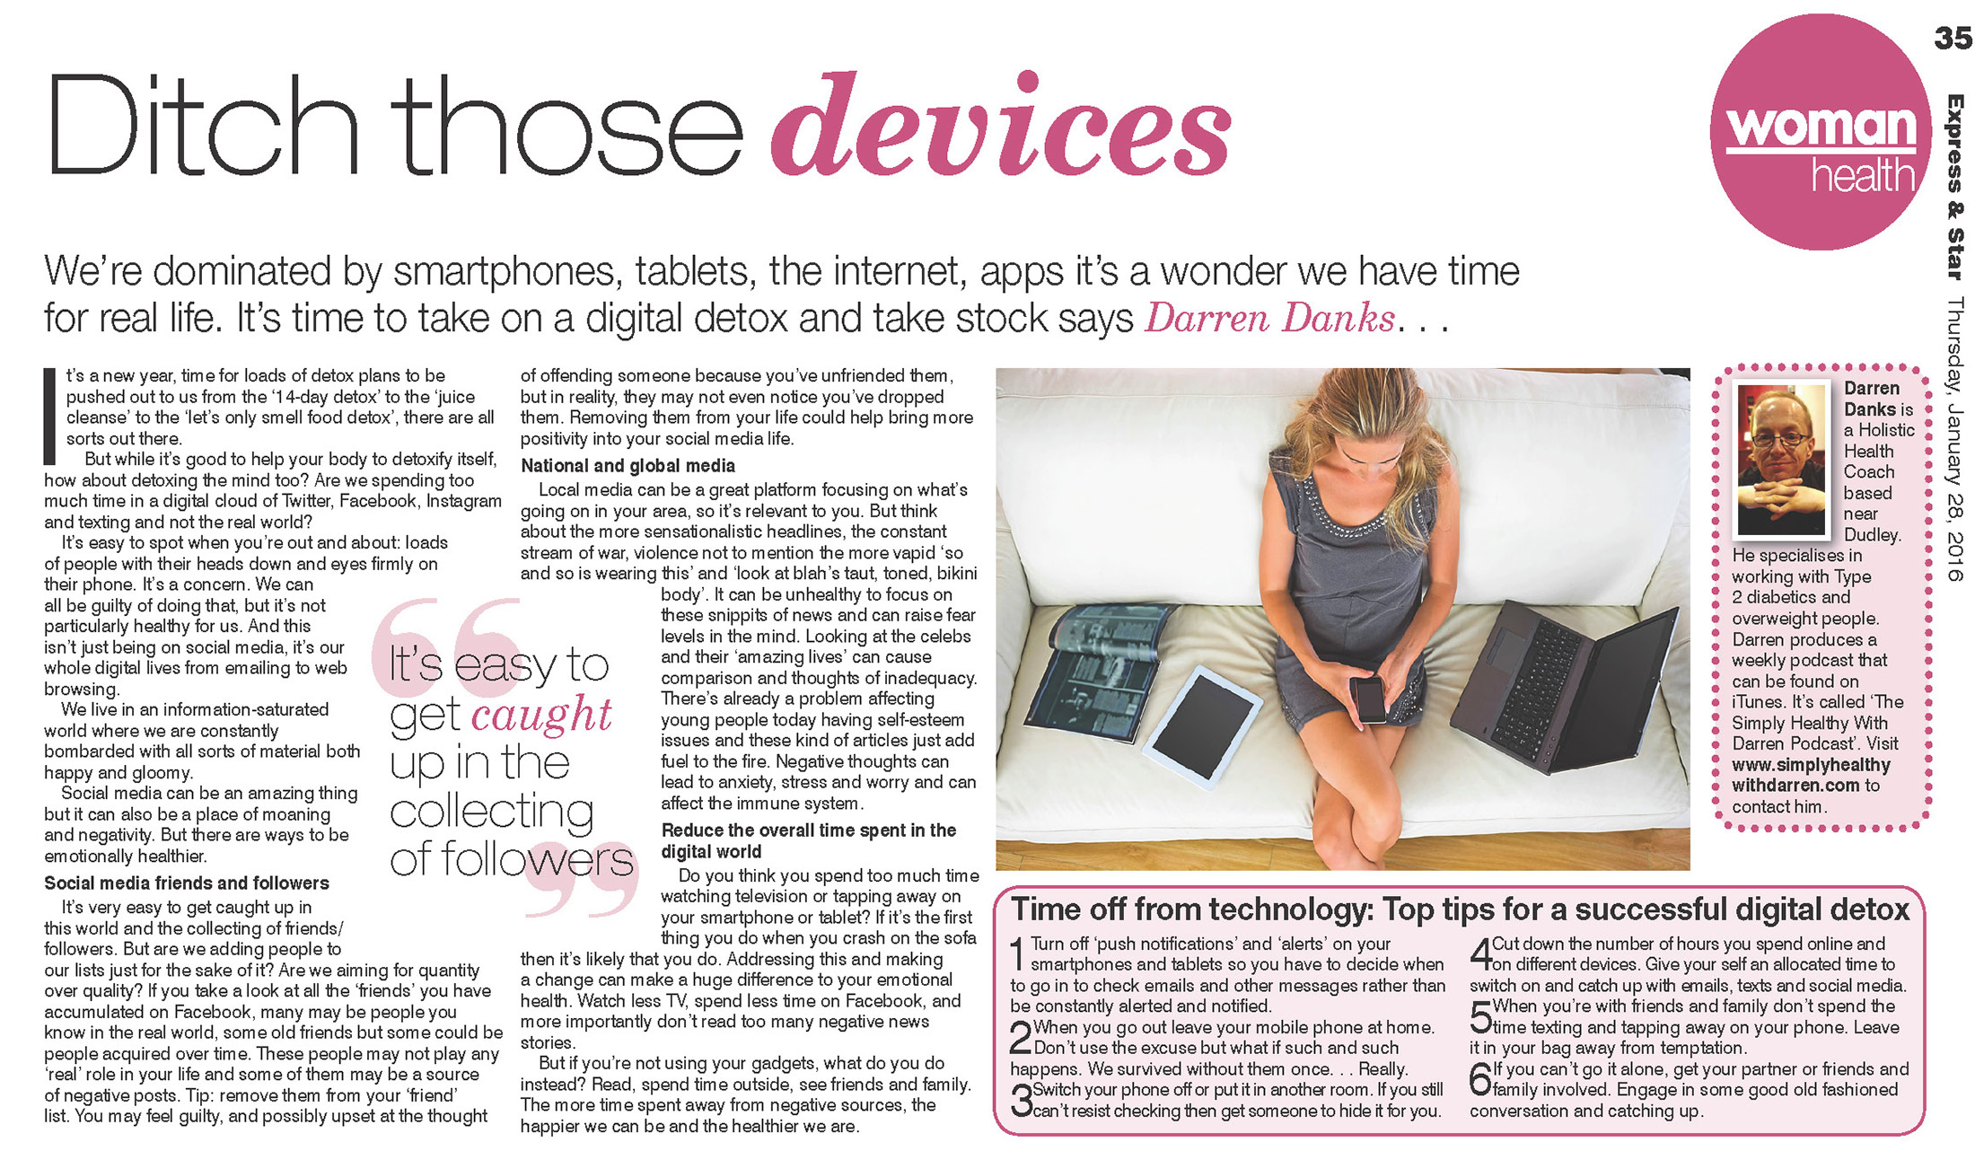
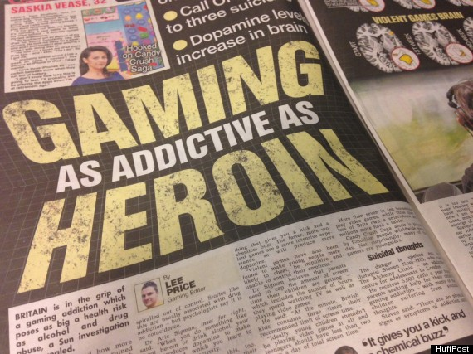
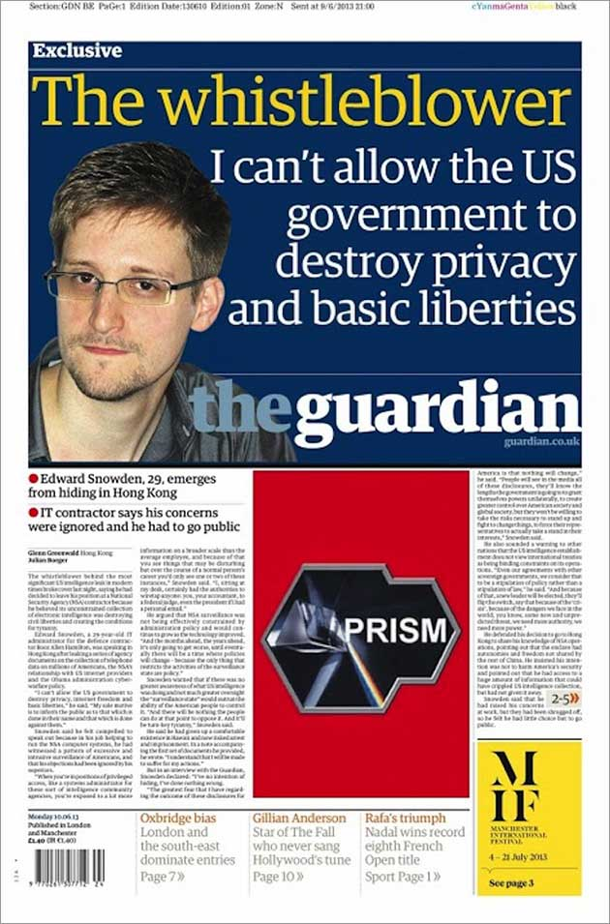
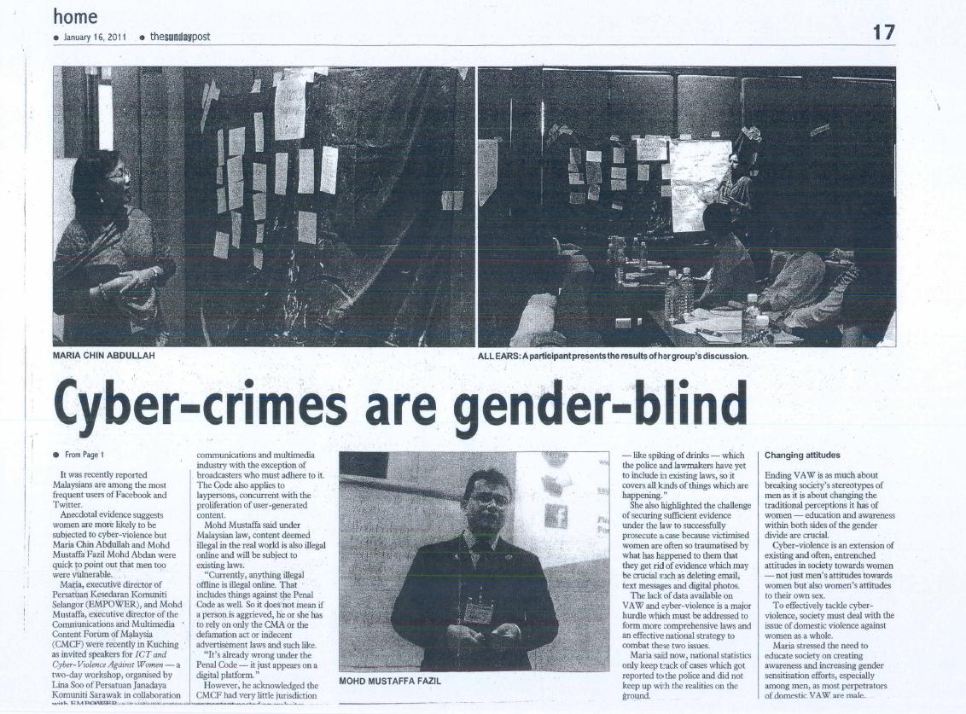
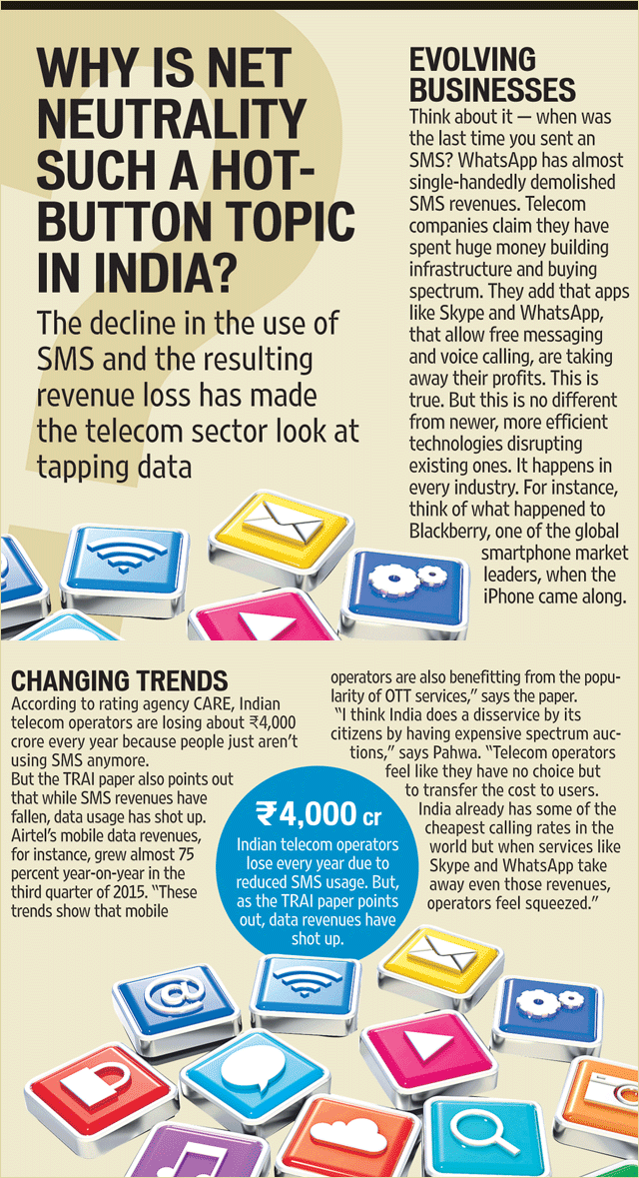
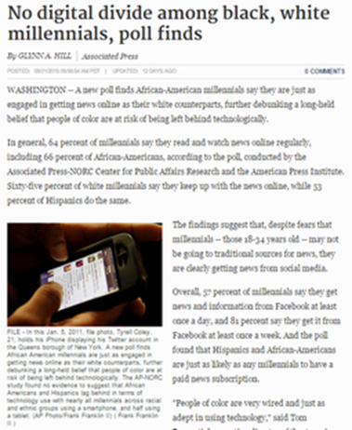
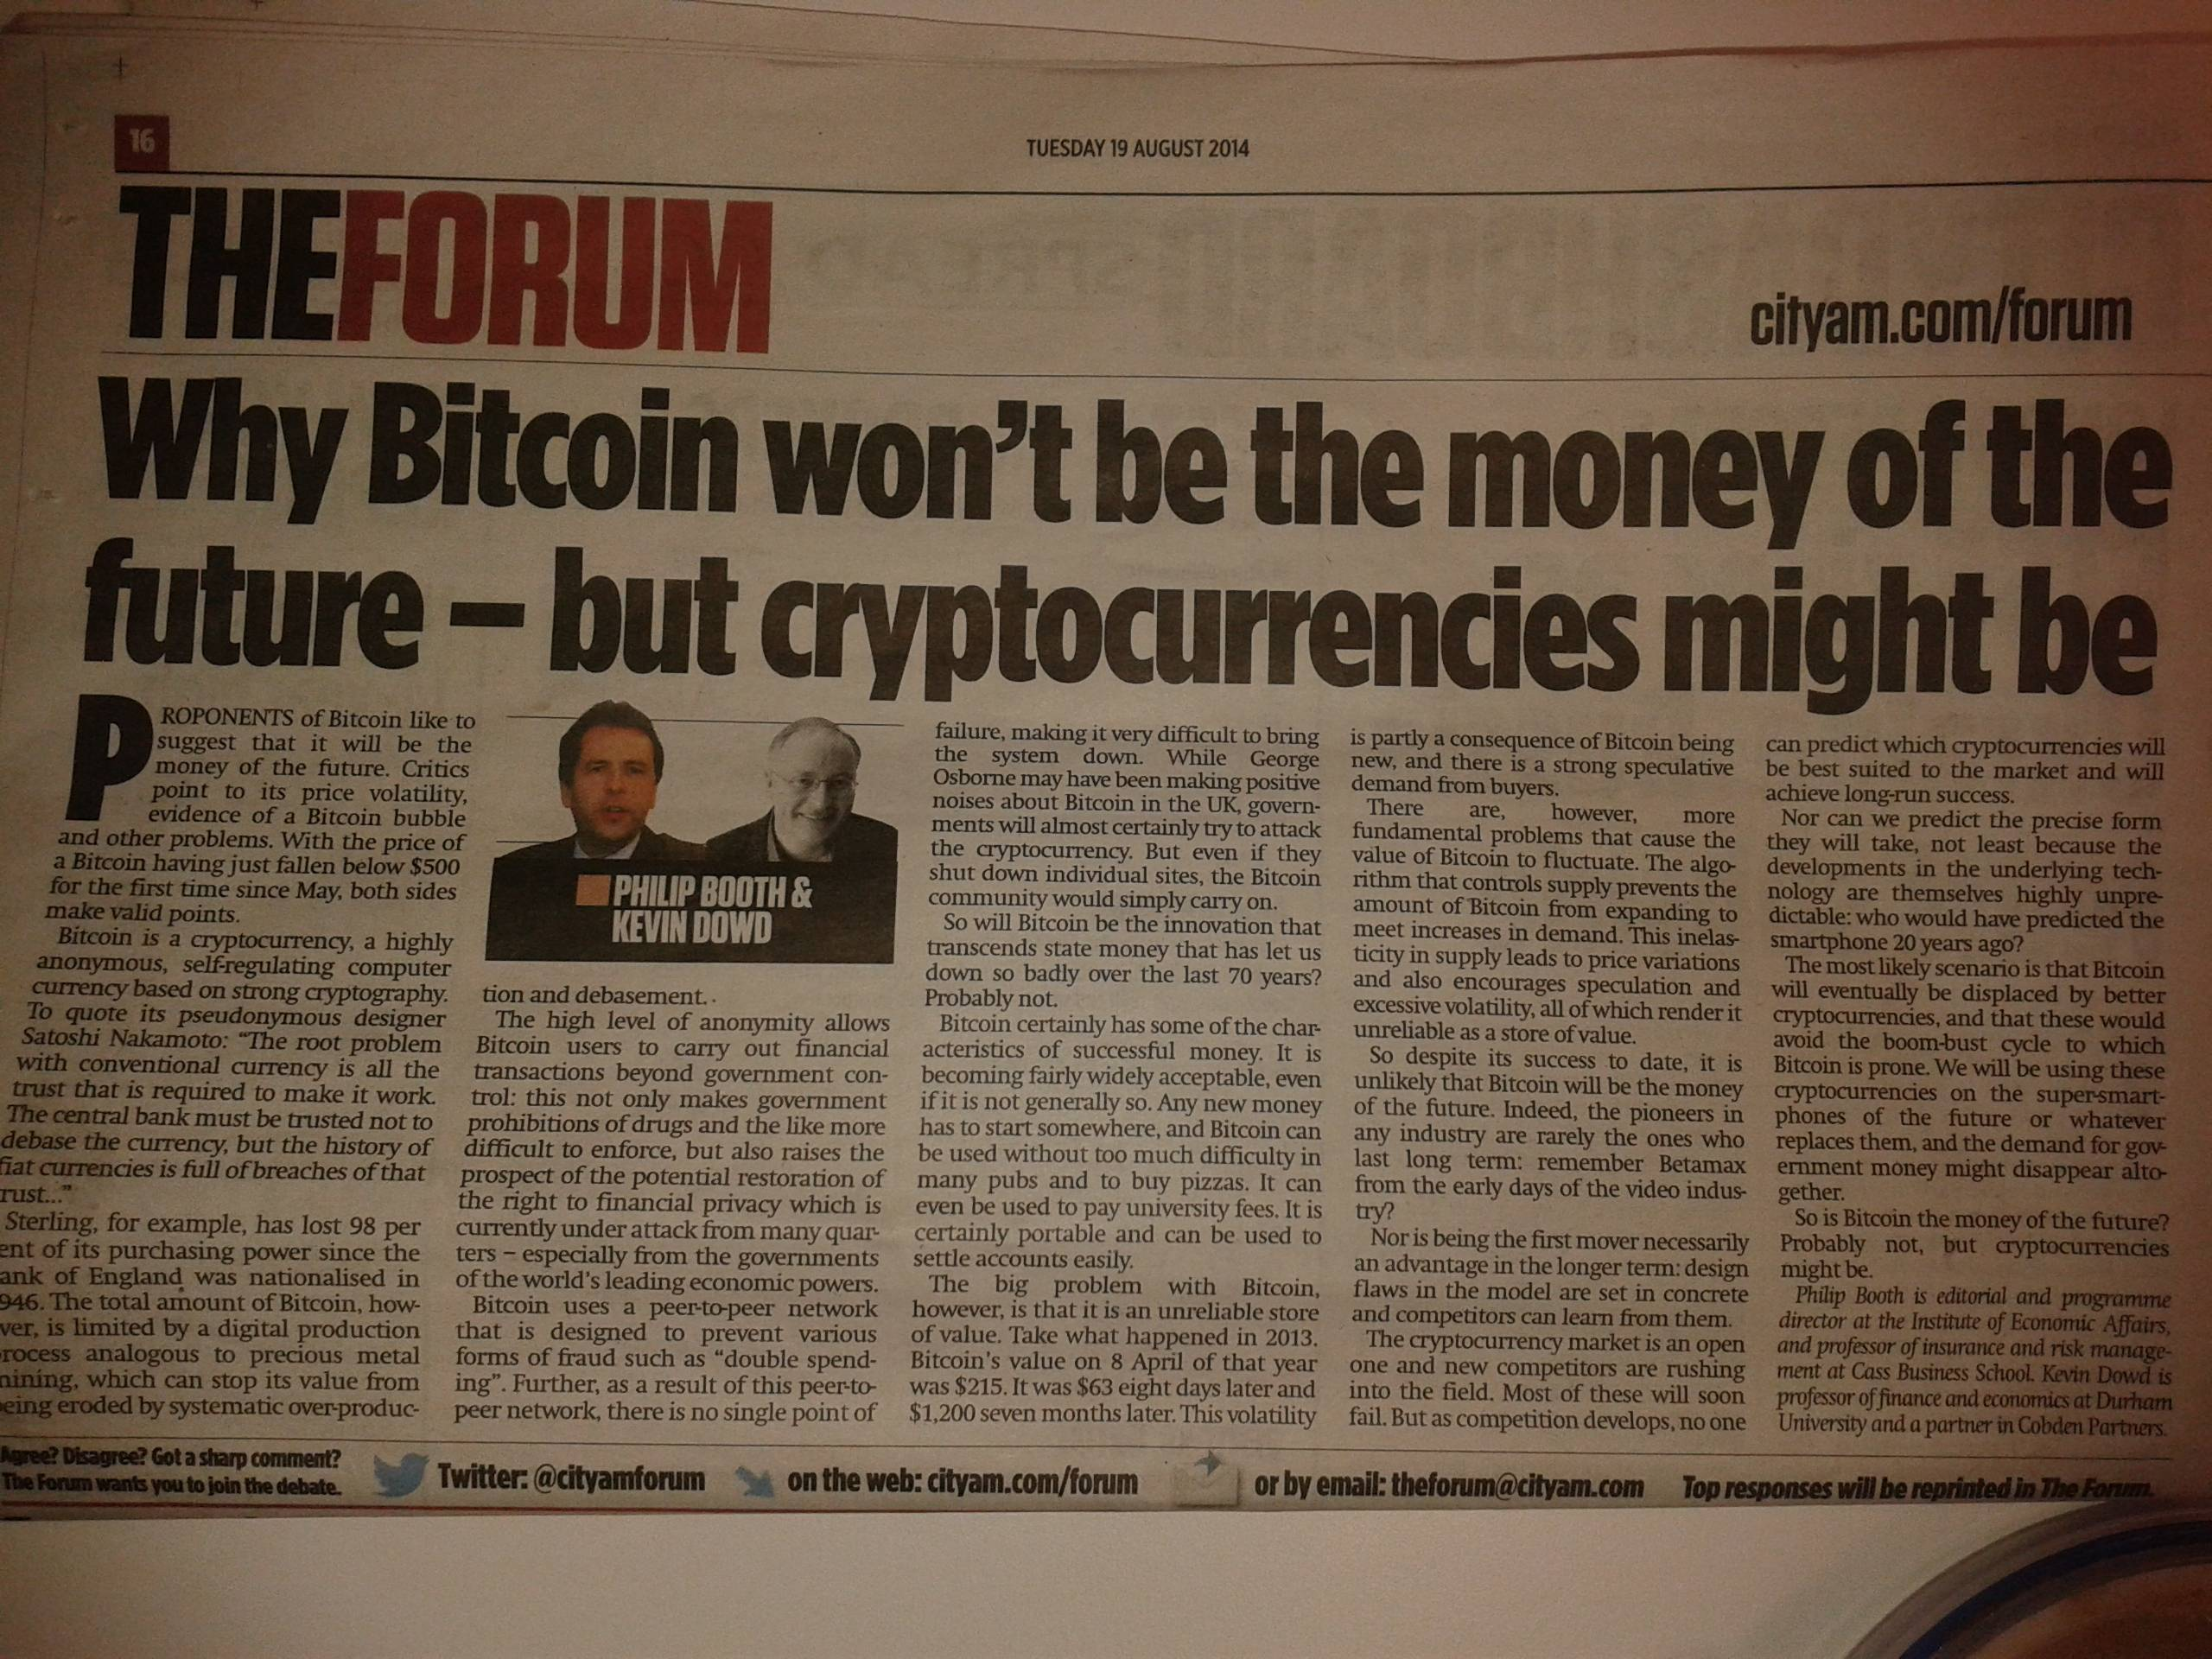
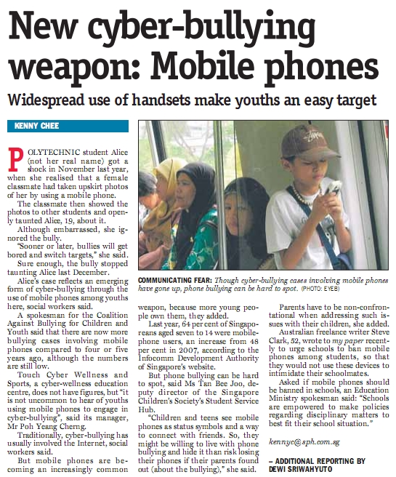
News Article Thursdays
Notes:
Asparagus price: http://archive.badsey.net/sites/default/files/archive_images/2587.jpg AKC
Ditch the devices: http://simplyhealthywithdarren.com/wp-content/uploads/2016/01/Newspaper-Jan2016-Digital-Detox.jpg
Internet safety: http://www.kws.nsw.edu.au/assets/images/KWS_in_the_news/Internet_Safety_article_CWD_1_May_2010.jpg
Cybercrimes: http://www.cmcf.my/sites/default/files/thesundaypost.JPG
Gaming addiction: http://i.huffpost.com/gen/1897457/thumbs/o-HUFFPOST-570.jpg?5
India and net neutrality: http://www.hindustantimes.com/Images/popup/2015/4/why_net_neutrality.gif
Snowdon: http://www.themorningnews.org/images/content/articles/edward-snowden-and-terra-infirma-11.jpg
Bitcoin: http://i.imgur.com/fb2WzN2.jpg
Cyberbullying: https://userscontent2.emaze.com/images/34d03171-dfee-43ac-b040-af3e72d2a2dc/9add30dc-b1f6-4552-99c7-0f3ebcfb797c.jpg
Digital divide: http://www.librarycity.org/wp-content/uploads/2015/09/Digital-divide-AP_thumb1.png

Slide 34
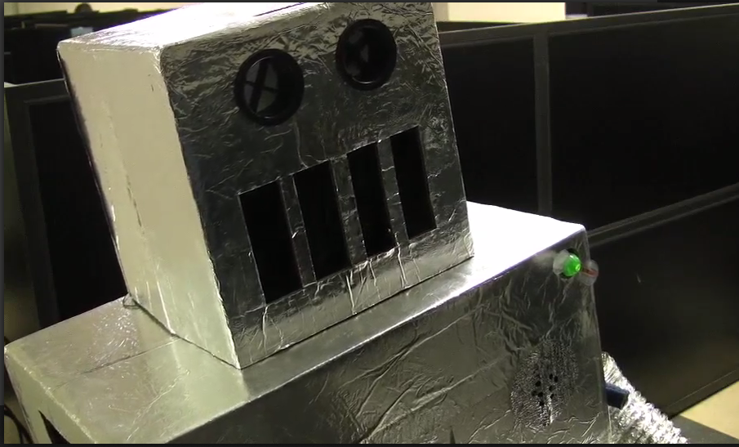
The Video Project
http://www.cs.utexas.edu/users/ear/cs349/VideosAsExamples/
Notes:
The picture is from James Fong, Am I a Real Boy? AKC

Slide 35


And the Oscar Goes to …
Notes:
AKC

