Slide 1
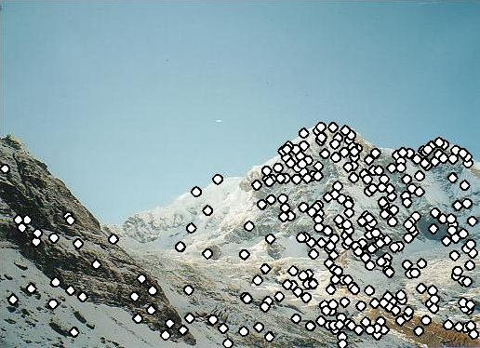
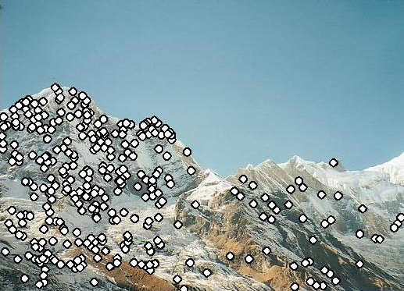
Local features and image matching
Wed March 2
Prof. Kristen Grauman
UT-Austin

Slide 2
Announcements
Reminder: Pset 2 due tomorrow
Reminder: Midterm exam is Wed March 9
  See practice exam handout from last time
My office hours today: 12:15-1:15

Slide 3
Last time
RANSAC for robust fitting
  Lines, translation
Image mosaics
  Fitting a 2D transformation
    Affine, Homography

Slide 4
Today
Mosaics wrap-up:
How to warp one image to the other, given H?
How to detect which features to match?

Slide 5
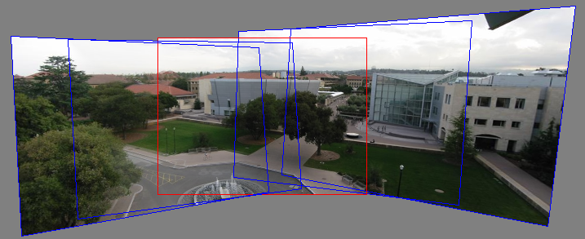
Motivation for feature-based alignment:
Image mosaics
Image from http://graphics.cs.cmu.edu/courses/15-463/2010_fall/

Slide 6
Projective Transformations
Projective transformations:
  Affine transformations, and
  Projective warps
Parallel lines do not necessarily remain parallel

Slide 7
How to stitch together a panorama (a.k.a. mosaic)?
Basic Procedure
  Take a sequence of images from the same position
    Rotate the camera about its optical center
  Compute transformation between second image and first
  Transform the second image to overlap with the first
  Blend the two together to create a mosaic
  (If there are more images, repeat)
…but wait, why should this work at all?
  What about the 3D geometry of the scene?
  Why aren’t we using it?
Source: Steve Seitz

Slide 8
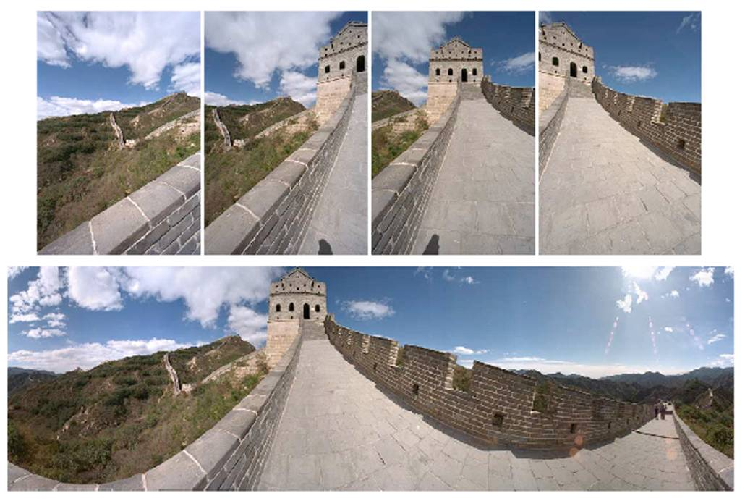
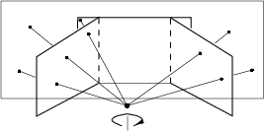
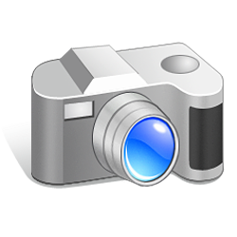
Mosaics
. . .
image from S. Seitz
Obtain a wider angle view by combining multiple images.

Slide 9
Image reprojection
Basic question
  How to relate two images from the same camera center?
    how to map a pixel from PP1 to PP2
PP2
Answer
  Cast a ray through each pixel in PP1
  Draw the pixel where that ray intersects PP2
Observation:
Rather than thinking of this as a 3D reprojection, think of it as a 2D image warp from one image to another.
PP1
Source: Alyosha Efros

Slide 10
Image reprojection: Homography
A projective transform is a mapping between any two PPs with the same center of projection
  rectangle should map to arbitrary quadrilateral
  parallel lines aren’t
  but must preserve straight lines
called Homography
PP2
PP1
p’
H
p
Source: Alyosha Efros

Slide 11
Homography
…
…
To compute the homography given pairs of corresponding points in the images, we need to set up an equation where the parameters of H are the unknowns…

Slide 12
Solving for homographies
p’ = Hp
Can set scale factor i=1. So, there are 8 unknowns.
Set up a system of linear equations:
Ah = b
where vector of unknowns h = [a,b,c,d,e,f,g,h]^{T}
Need at least 8 eqs, but the more the better…
Solve for h. If overconstrained, solve using least-squares:
>> help lmdivide

Slide 13
Homography
To apply a given homography H
  Compute p’ = Hp (regular matrix multiply)
  Convert p’ from homogeneous to image coordinates
p’
H
p

Slide 14
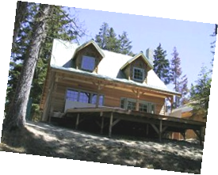
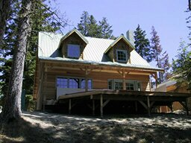
Image warping
T(x,y)
y
y’
x
x’
f(x,y)
g(x’,y’)
Given a coordinate transform and a source image f(x,y), how do we compute a transformed image g(x’,y’) = f(T(x,y))?
Slide from Alyosha Efros, CMU

Slide 15
Forward warping
T(x,y)
y
y’
x
x’
f(x,y)
g(x’,y’)
Send each pixel f(x,y) to its corresponding location
(x’,y’) = T(x,y) in the second image
Q: what if pixel lands “between” two pixels?
Slide from Alyosha Efros, CMU

Slide 16
Forward warping
T(x,y)
y
y’
x
x’
f(x,y)
g(x’,y’)
Send each pixel f(x,y) to its corresponding location
(x’,y’) = T(x,y) in the second image
Q: what if pixel lands “between” two pixels?
A: distribute color among neighboring pixels (x’,y’)
  Known as “splatting”
Slide from Alyosha Efros, CMU

Slide 17
Inverse warping
T⁻¹(x,y)
y
y’
x
x
x’
f(x,y)
g(x’,y’)
Get each pixel g(x’,y’) from its corresponding location
(x,y) = T⁻¹(x’,y’) in the first image
Q: what if pixel comes from “between” two pixels?
Slide from Alyosha Efros, CMU

Slide 18
Inverse warping
T⁻¹(x,y)
y
y’
x
x
x’
f(x,y)
g(x’,y’)
Get each pixel g(x’,y’) from its corresponding location
(x,y) = T⁻¹(x’,y’) in the first image
Q: what if pixel comes from “between” two pixels?
A: Interpolate color value from neighbors
  nearest neighbor, bilinear…
>> help interp2
Slide from Alyosha Efros, CMU

Slide 19





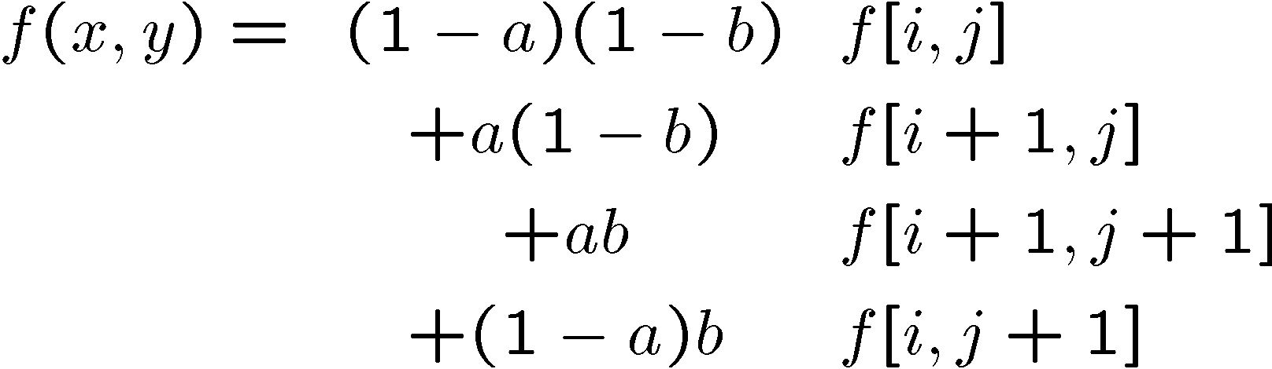
Bilinear interpolation
Sampling at f(x,y):
Slide from Alyosha Efros, CMU

Slide 20
Recap: How to stitch together a panorama (a.k.a. mosaic)?
Basic Procedure
  Take a sequence of images from the same position
    Rotate the camera about its optical center
  Compute transformation (homography) between second image and first using corresponding points.
  Transform the second image to overlap with the first.
  Blend the two together to create a mosaic.
  (If there are more images, repeat)
Source: Steve Seitz

Slide 21
Image warping with homographies
image plane in front
image plane below
black area
where no pixel
maps to
Source: Steve Seitz

Slide 22
Image rectification
p’
p

Slide 23
Analysing patterns and shapes
What is the shape of the b/w floor pattern?
Homography
The floor (enlarged)
Automatically
rectified floor
Slide from Antonio Criminisi

Slide 24
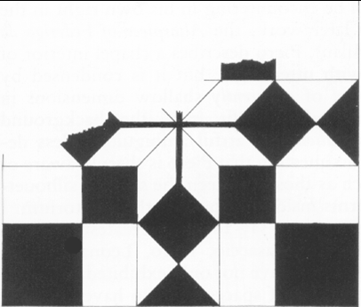
Analysing patterns and shapes
Automatic rectification
From Martin Kemp The Science of Art
(manual reconstruction)
Slide from Antonio Criminisi

Slide 25
Analysing patterns and shapes
What is the (complicated)
shape of the floor pattern?
Automatically rectified floor
St. Lucy Altarpiece, D. Veneziano
Slide from Criminisi

Slide 26
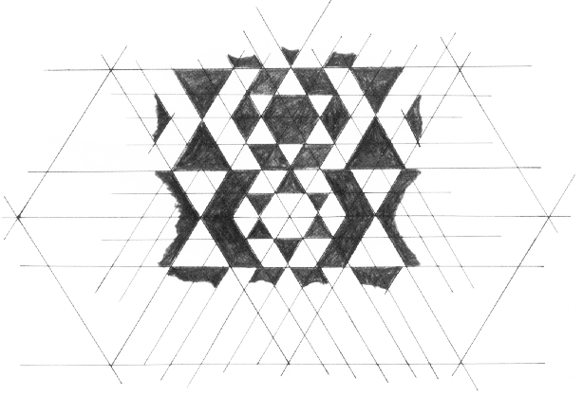
Analysing patterns and shapes
Automatic
rectification
From Martin Kemp, The Science of Art
(manual reconstruction)
Slide from Criminisi

Slide 27
Changing camera center
Does it still work?
synthetic PP
PP1
PP2
Source: Alyosha Efros

Slide 28
Recall: same camera center
real
camera
synthetic
camera
Can generate synthetic camera view
as long as it has the same center of projection.
Source: Alyosha Efros

Slide 29
…Or: Planar scene (or far away)
PP3
PP1
PP2
PP3 is a projection plane of both centers of projection, so we are OK!
This is how big aerial photographs are made
Source: Alyosha Efros

Slide 30
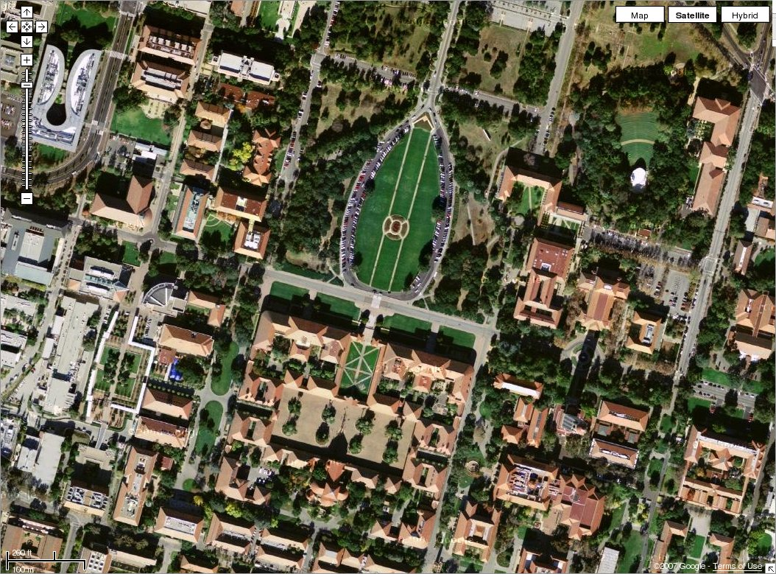

Slide 31
RANSAC for estimating homography
RANSAC loop:
1. Select four feature pairs (at random)
2. Compute homography H (exact)
3. Compute inliers where SSD(p_{i}’, Hp_{i})< ε
4. Keep largest set of inliers
5. Re-compute least-squares H estimate on all of the inliers
Slide credit: Steve Seitz

Slide 32
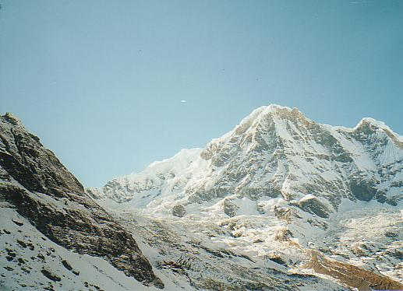
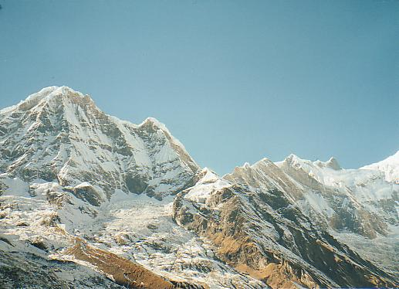
Robust feature-based alignment
Source: L. Lazebnik

Slide 33
Robust feature-based alignment
Extract features
Source: L. Lazebnik

Slide 34
Robust feature-based alignment
Extract features
Compute putative matches
Source: L. Lazebnik

Slide 35
Robust feature-based alignment
Extract features
Compute putative matches
Loop:
  Hypothesize transformation T (small group of putative matches that are related by T)
Source: L. Lazebnik

Slide 36
Robust feature-based alignment
Extract features
Compute putative matches
Loop:
  Hypothesize transformation T (small group of putative matches that are related by T)
  Verify transformation (search for other matches consistent with T)
Source: L. Lazebnik

Slide 37
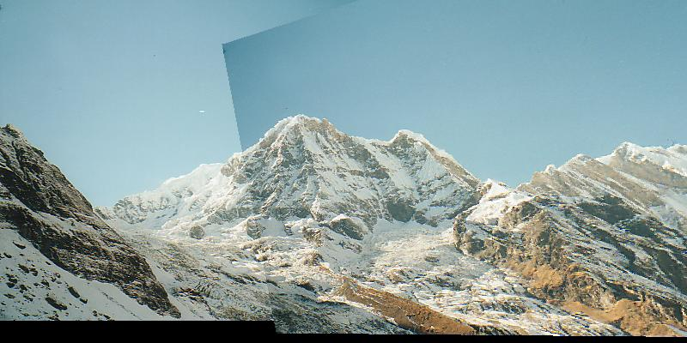
Robust feature-based alignment
Extract features
Compute putative matches
Loop:
  Hypothesize transformation T (small group of putative matches that are related by T)
  Verify transformation (search for other matches consistent with T)
Source: L. Lazebnik

Slide 38
Summary: alignment & warping
  Write 2d transformations as matrix-vector multiplication (including translation when we use homogeneous coordinates)
  Perform image warping (forward, inverse)
  Fitting transformations: solve for unknown parameters given corresponding points from two views (affine, projective (homography)).
  Mosaics: uses homography and image warping to merge views taken from same center of projection.

Slide 39
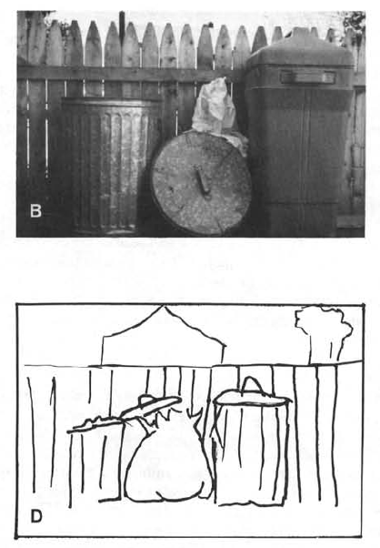
Boundary extension
Wide-Angle Memories of Close-Up Scenes, Helene Intraub and Michael Richardson, Journal of Experimental Psychology: Learning, Memory, and Cognition, 1989, Vol. 15, No. 2, 179-187

Slide 40
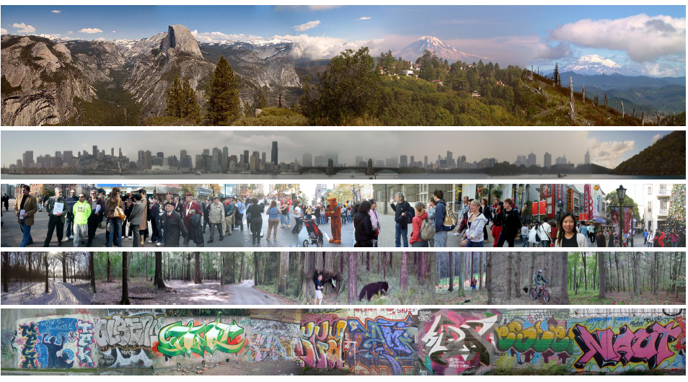
Creating and Exploring a Large Photorealistic Virtual Space
Josef Sivic, Biliana Kaneva, Antonio Torralba, Shai Avidan and William T. Freeman, Internet Vision Workshop, CVPR 2008.
http://www.youtube.com/watch?v=E0rboU10rPo

Slide 41
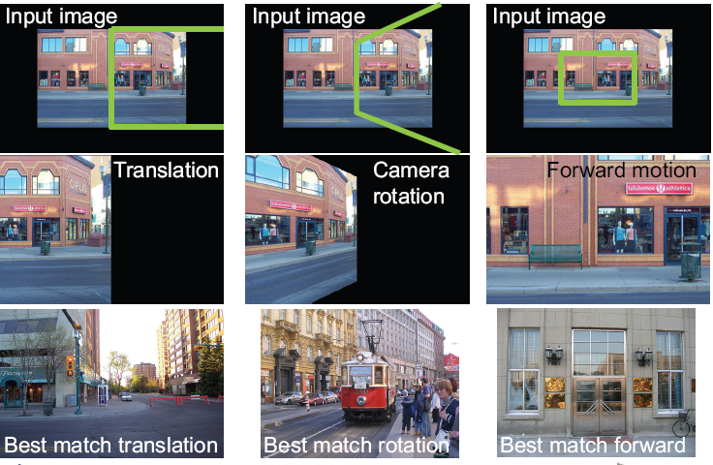
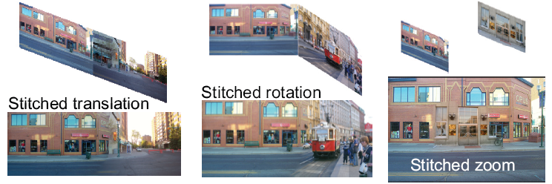
Creating and Exploring a Large Photorealistic Virtual Space
Current view, and desired view in green
Synthesized view from new camera
Induced camera motion

Slide 42
Today
Mosaics wrap-up:
How to warp one image to the other, given H?
How to detect which features to match?

Slide 43
Detecting local invariant features
Detection of interest points
  Harris corner detection
  Scale invariant blob detection: LoG
(Next time: description of local patches)

Slide 44
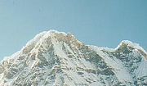

Local features: main components
Detection: Identify the interest points
Description:Extract vector feature descriptor surrounding each interest point.
Matching: Determine correspondence between descriptors in two views
Kristen Grauman

Slide 45
Local features: desired properties
Repeatability
  The same feature can be found in several images despite geometric and photometric transformations
Saliency
  Each feature has a distinctive description
Compactness and efficiency
  Many fewer features than image pixels
Locality
  A feature occupies a relatively small area of the image; robust to clutter and occlusion

Slide 46
Goal: interest operator repeatability
We want to detect (at least some of) the same points in both images.
Yet we have to be able to run the detection procedure independently per image.
No chance to find true matches!
Notes:
46

Slide 47
Goal: descriptor distinctiveness
We want to be able to reliably determine which point goes with which.
Must provide some invariance to geometric and photometric differences between the two views.
?

Slide 48
Local features: main components
Detection: Identify the interest points
Description:Extract vector feature descriptor surrounding each interest point.
Matching: Determine correspondence between descriptors in two views

Slide 49
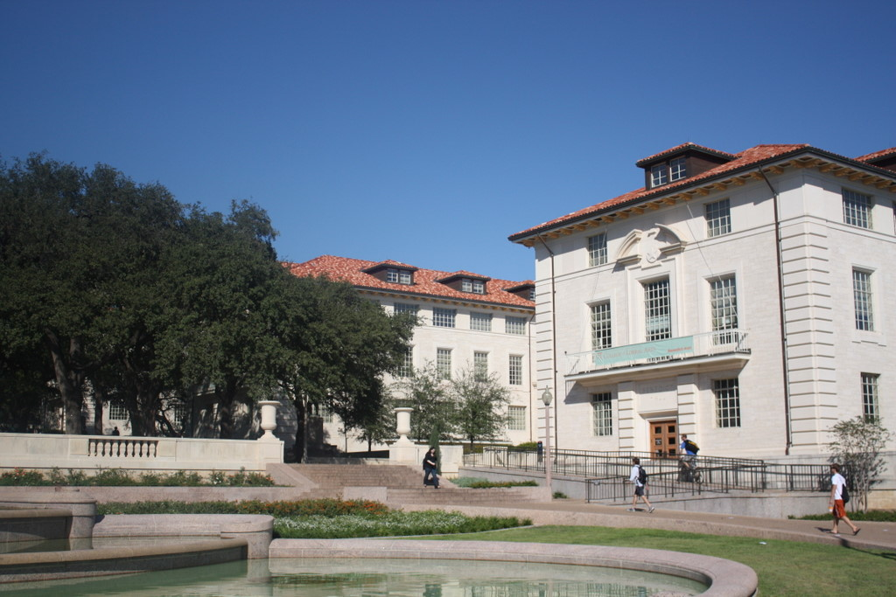
What points would you choose?

Slide 50

Corners as distinctive interest points
We should easily recognize the point by looking through a small window
Shifting a window in any direction should give a large change in intensity
“flat” region:
no change in all directions
“edge”:
no change along the edge direction
“corner”:
significant change in all directions
Slide credit: Alyosha Efros, Darya Frolova, Denis Simakov

Slide 51
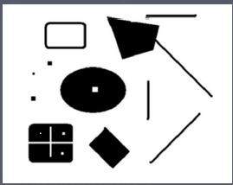
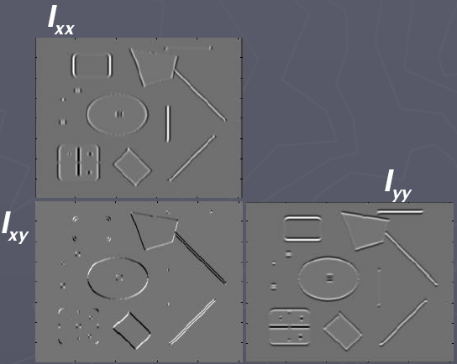
Corners as distinctive interest points
2 x 2 matrix of image derivatives (averaged in neighborhood of a point).
Notation:

Slide 52
What does this matrix reveal?
First, consider an axis-aligned corner:

Slide 53
What does this matrix reveal?
First, consider an axis-aligned corner:
This means dominant gradient directions align with x or y axis
Look for locations where both λ’s are large.
If either λ is close to 0, then this is not corner-like.
What if we have a corner that is not aligned with the image axes?

Slide 54
What does this matrix reveal?
Since M is symmetric, we have
The eigenvalues of M reveal the amount of intensity change in the two principal orthogonal gradient directions in the window.

Slide 55
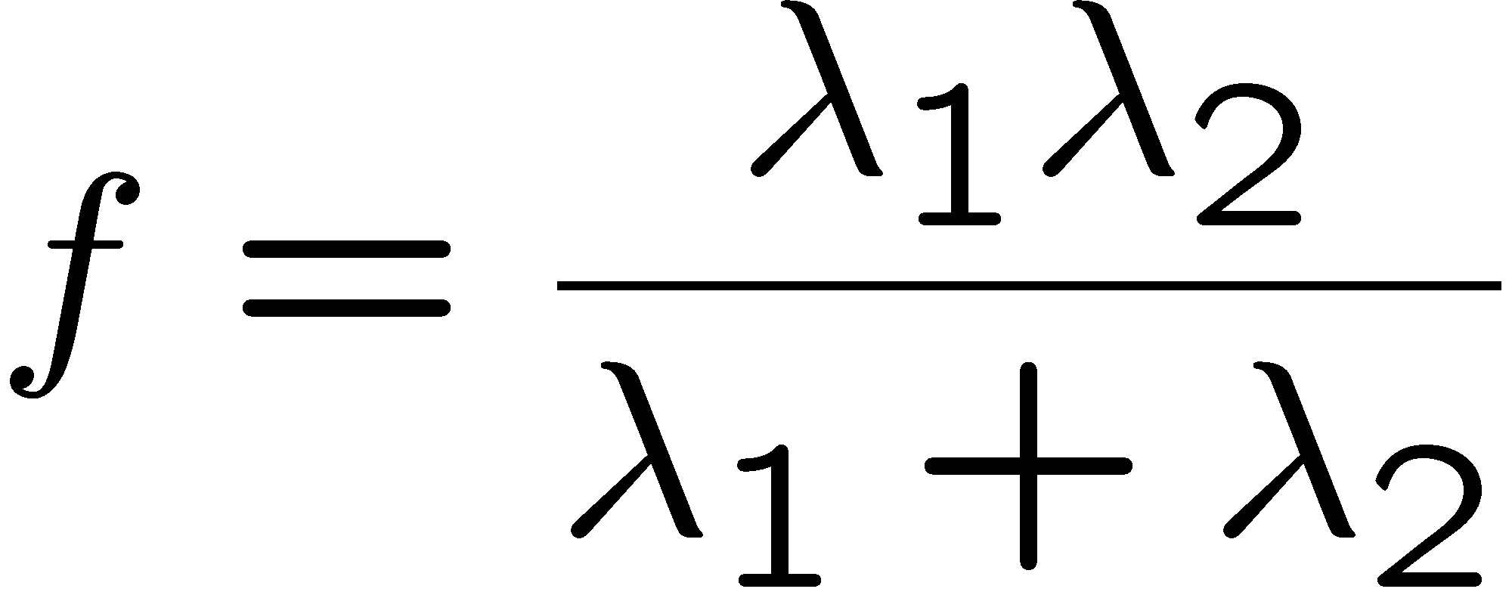
Corner response function
“edge”:
“corner”:
“flat” region
λ₁ >> λ₂
λ₁ and λ₂ are large,
λ₁ ~ λ₂;
λ₁ and λ₂ are small;
λ₂ >> λ₁

Slide 56
Harris corner detector
Compute M matrix for each image window to get their cornerness scores.
Find points whose surrounding window gave large corner response (f> threshold)
Take the points of local maxima, i.e., perform non-maximum suppression
Notes:
56

Slide 57
Example of Harris application
Kristen Grauman

Slide 58
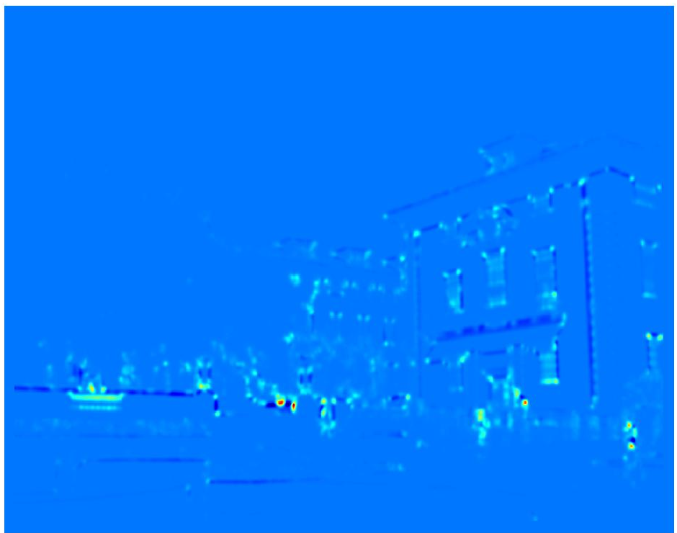
Example of Harris application
Compute corner response at every pixel.
Kristen Grauman

Slide 59
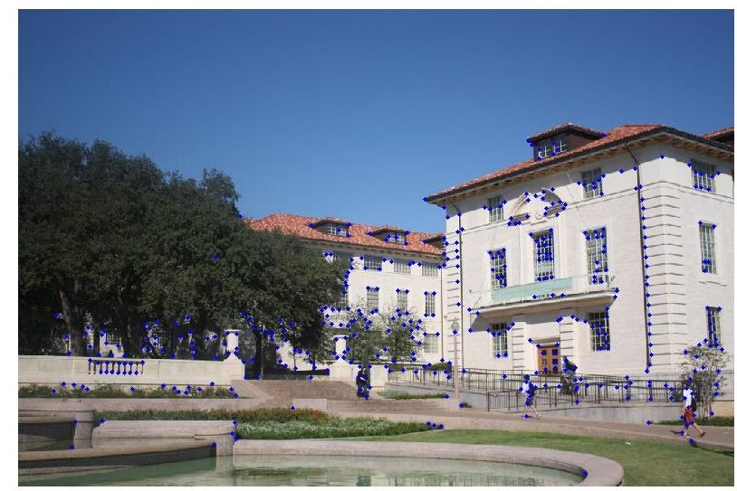
Example of Harris application
Kristen Grauman
Notes:
Only non-maxes exceeding average (thresholded)

Slide 60
Properties of the Harris corner detector
Rotation invariant?
Scale invariant?
Yes

Slide 61
Properties of the Harris corner detector
Rotation invariant?
Scale invariant?
Yes
No
All points will be classified as edges
Corner !

Slide 62
Summary
Image warping to create mosaic, given homography
Interest point detection
  Harris corner detector
  Next time:
    Laplacian of Gaussian, automatic scale selection

