Slide 1
Image formation
Monday March 21
Prof. Kristen Grauman
UT-Austin

Slide 2
Announcements
Reminder: Pset 3 due March 30
Midterms: pick up today

Slide 3
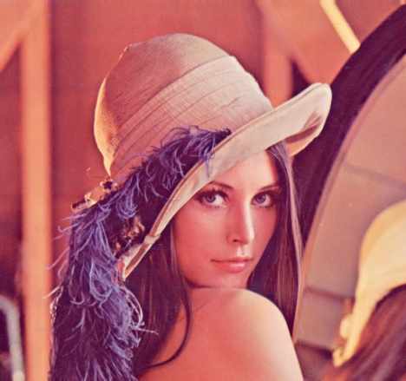
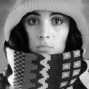

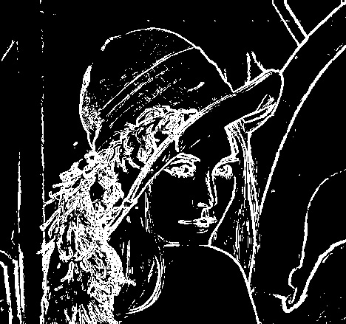


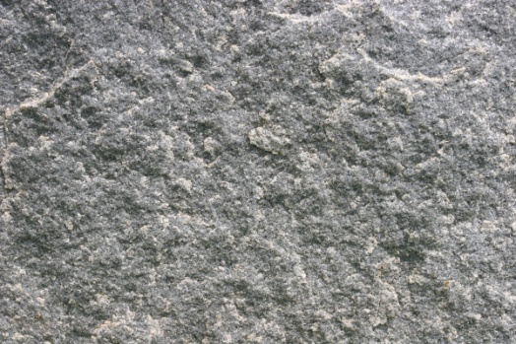
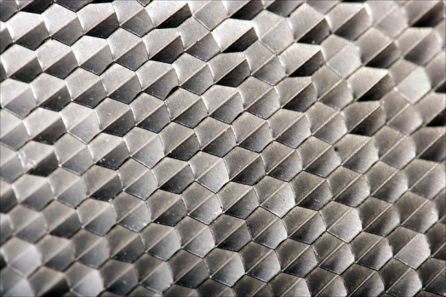
Recap: Features and filters
Transforming and describing images; textures, colors, edges
Kristen Grauman

Slide 4
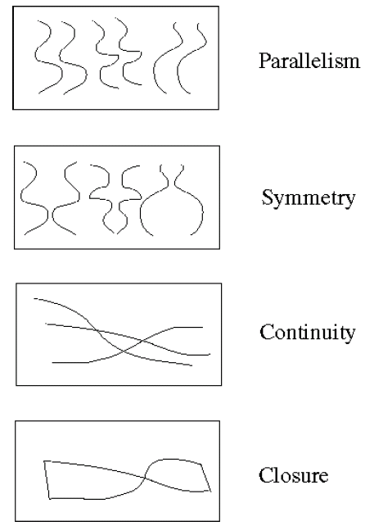
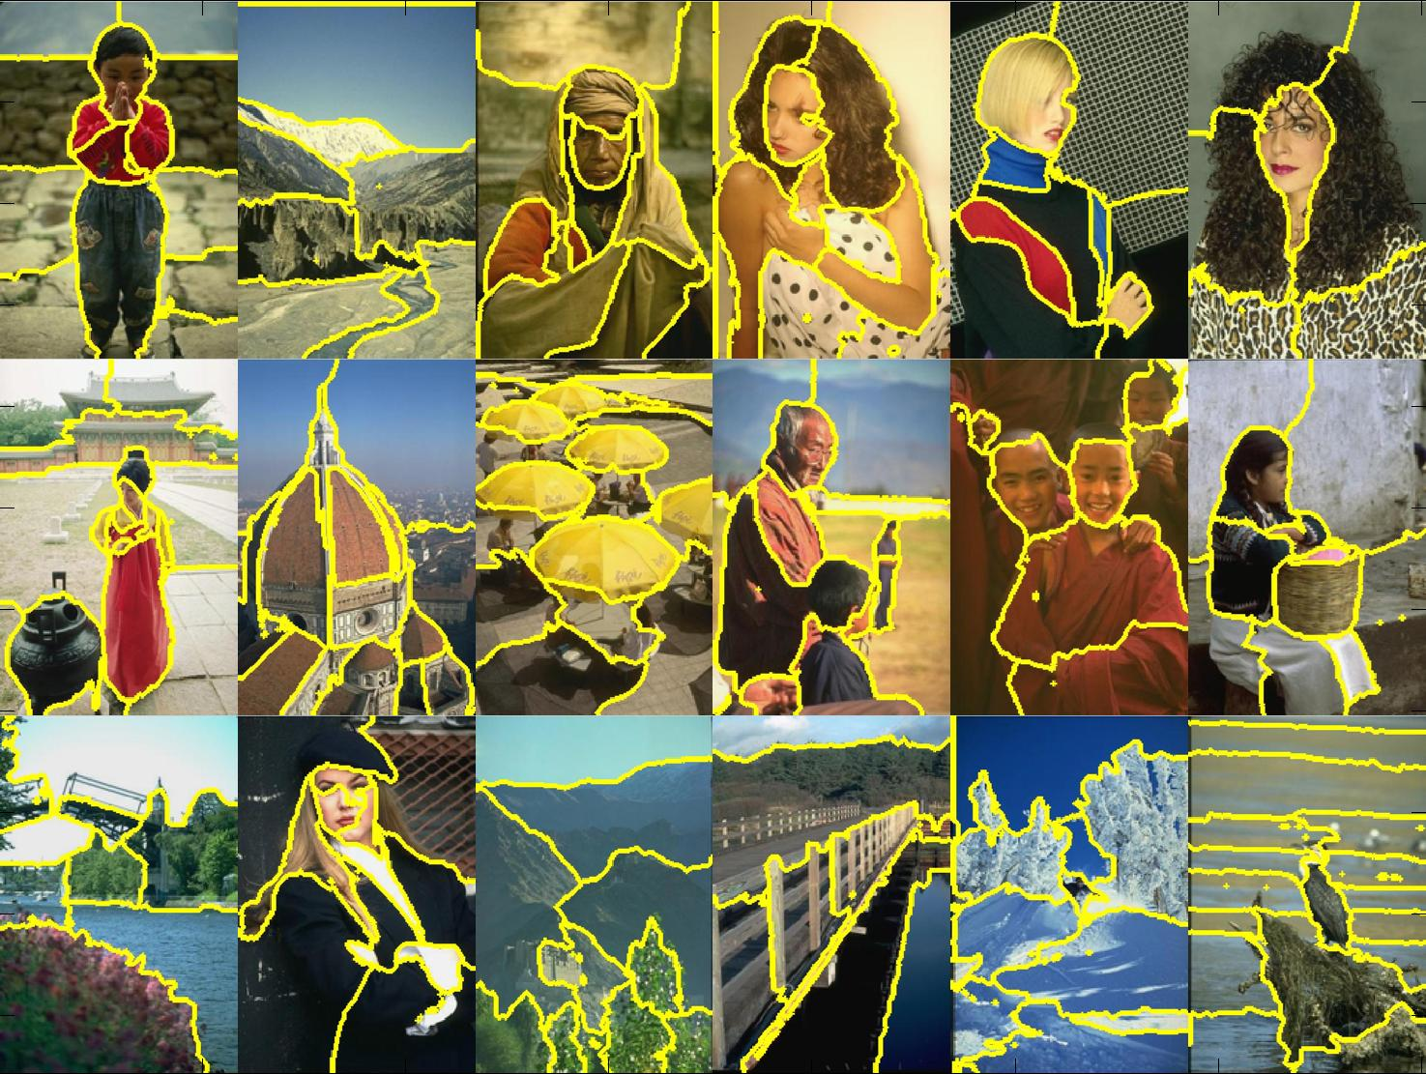
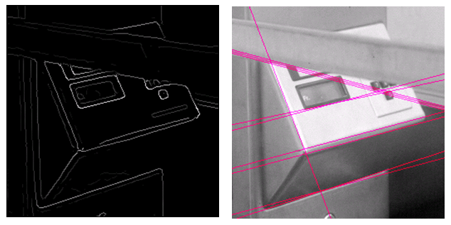
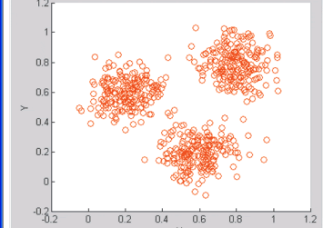
Recap: Grouping & fitting
Clustering, segmentation, fitting; what parts belong together?
[fig from Shi et al]
Kristen Grauman

Slide 5
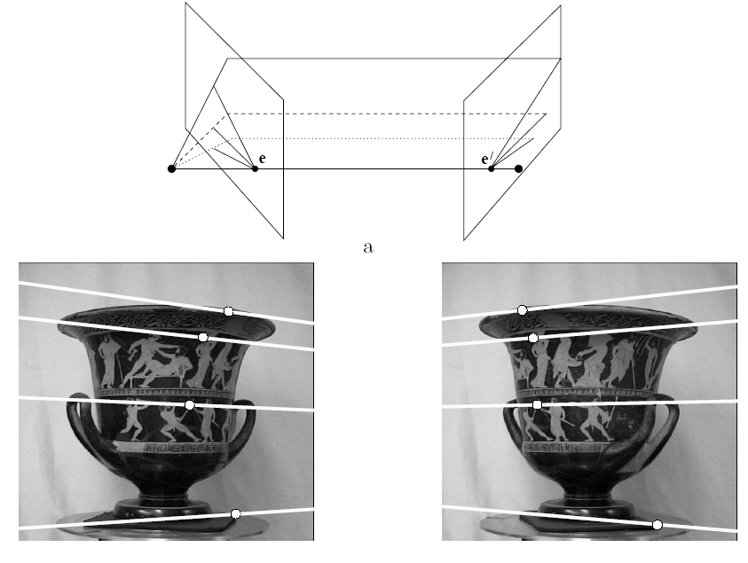
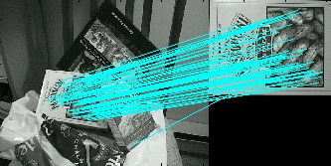
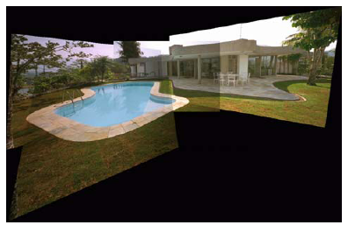
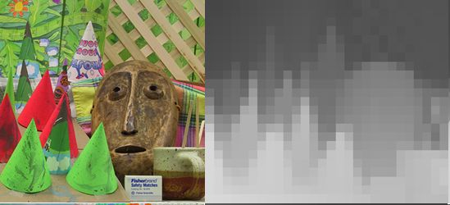
Multiple views
Multi-view geometry, matching, invariant features, stereo vision
Lowe
Hartley and Zisserman
Kristen Grauman

Slide 6
Plan
Today:
  Local feature matching btwn views (wrap-up)
  Image formation, geometry of a single view
Wednesday: Multiple views and epipolar geometry
Monday: Approaches for stereo correspondence

Slide 7
Previously
Local invariant features
  Detection of interest points
    Harris corner detection
    Scale invariant blob detection: LoG
  Description of local patches
    SIFT : Histograms of oriented gradients
  Matching descriptors

Slide 8
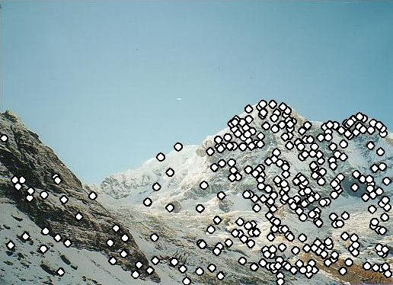


Local features: main components
Detection: Identify the interest points
Description:Extract vector feature descriptor surrounding each interest point.
Matching: Determine correspondence between descriptors in two views
Kristen Grauman

Slide 9

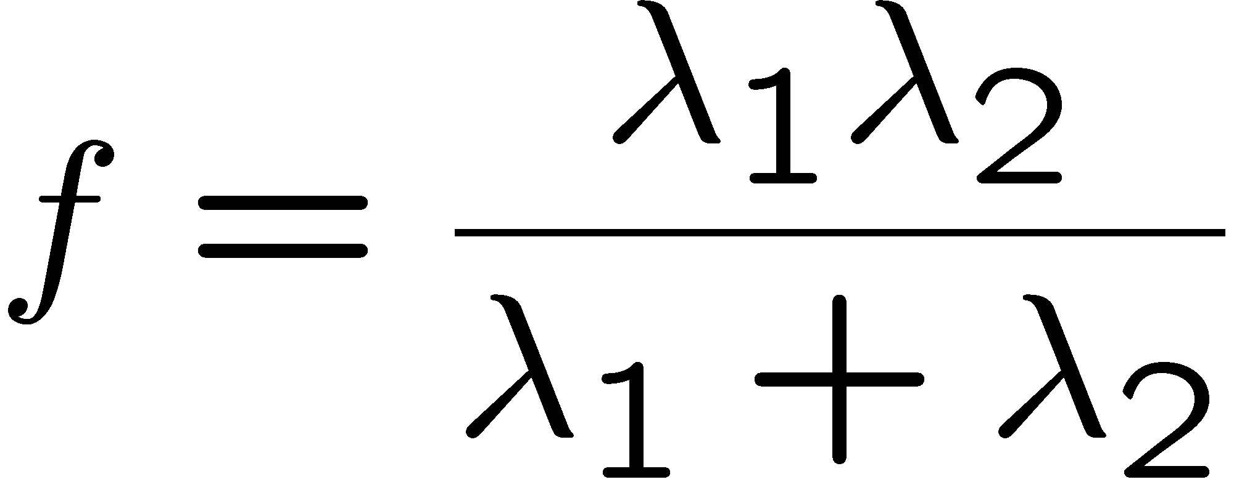
Recall: Corners as distinctive interest points
“edge”:
“corner”:
“flat” region
λ₁ >> λ₂
λ₁ and λ₂ are large,
λ₁ ~ λ₂;
λ₁ and λ₂ are small;
λ₂ >> λ₁
One way to score the cornerness:

Slide 10
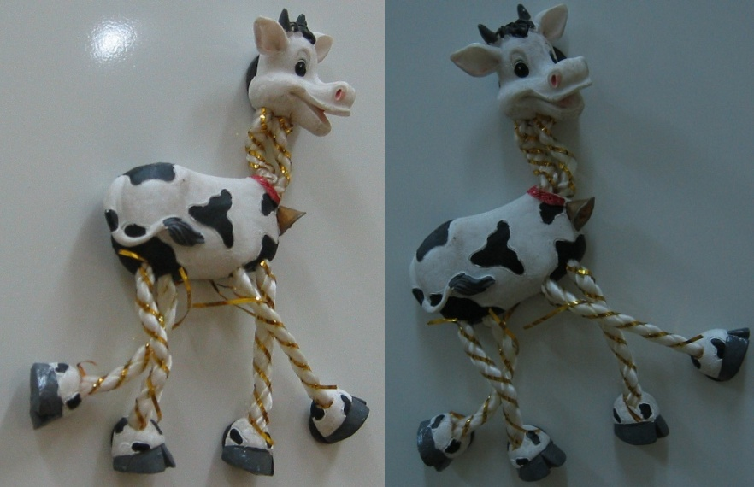
Harris Detector: Steps

Slide 11
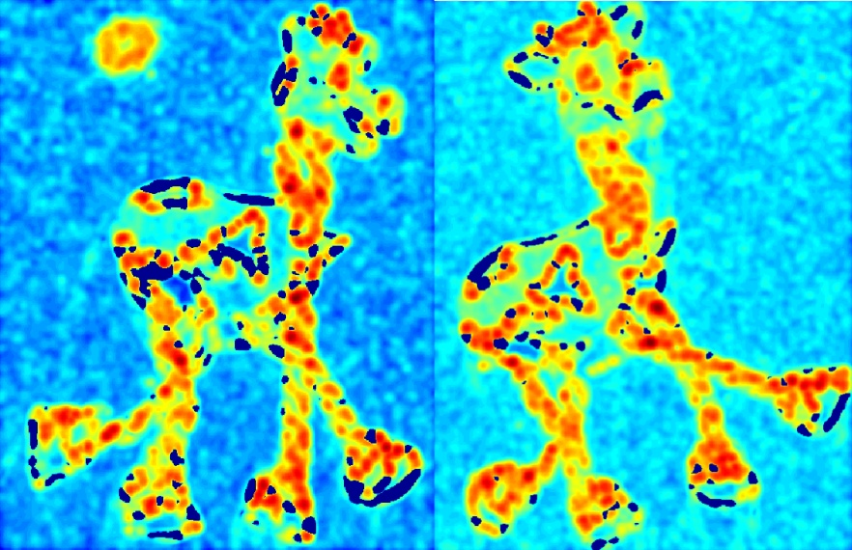
Harris Detector: Steps
Compute corner response f

Slide 12

Harris Detector: Steps

Slide 13
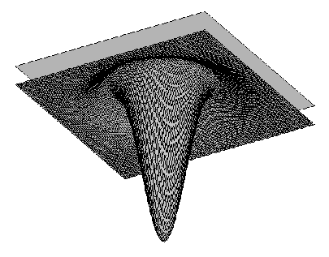

Blob detection in 2D: scale selection
Laplacian-of-Gaussian = “blob” detector
filter scales
img2
img1
img3

Slide 14
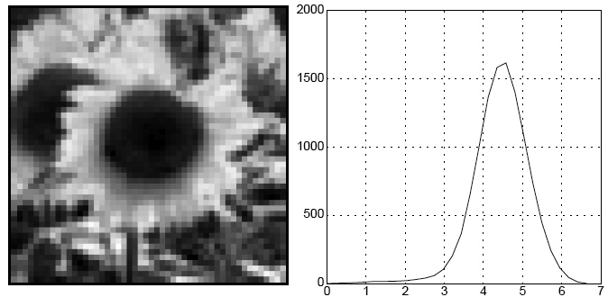
Blob detection in 2D
We define the characteristic scale as the scale that produces peak of Laplacian response
characteristic scale
Slide credit: Lana Lazebnik

Slide 15
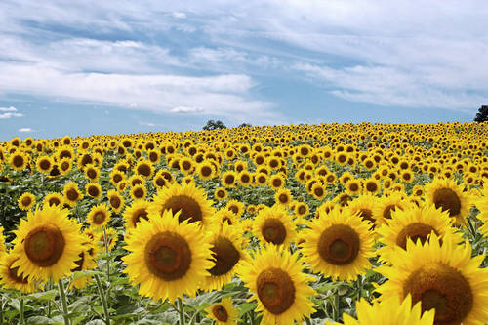
Example
Original image at ¾ the size
Kristen Grauman

Slide 16
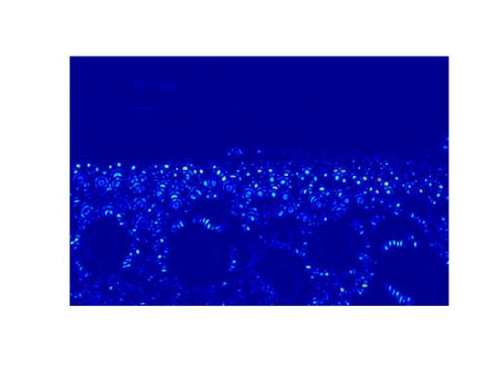
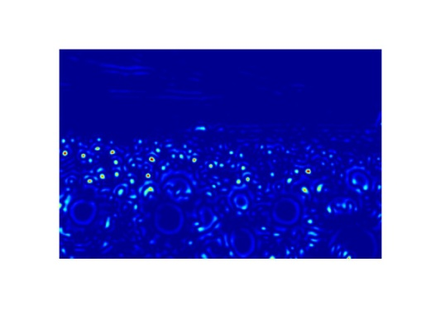
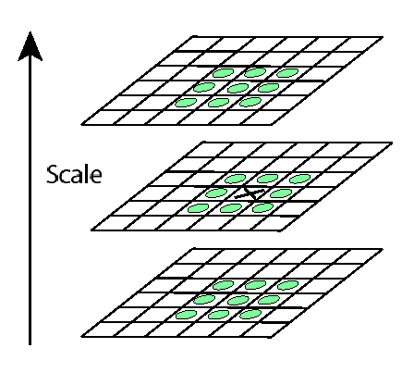
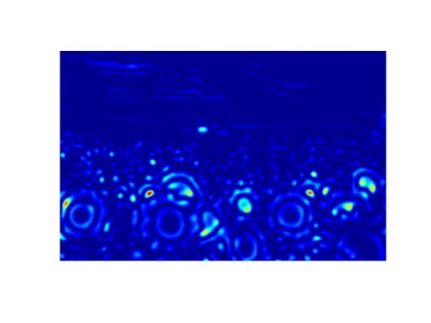
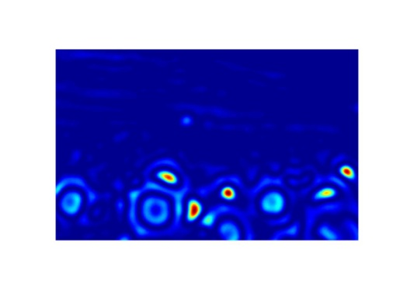
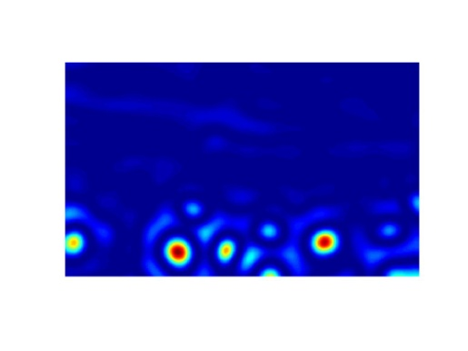
Scale invariant interest points
Interest points are local maxima in both position and scale.
σ5
σ4
scale
σ3
σ2
⇒ List of
(x, y, σ)
σ1
Squared filter response maps
Kristen Grauman

Slide 17
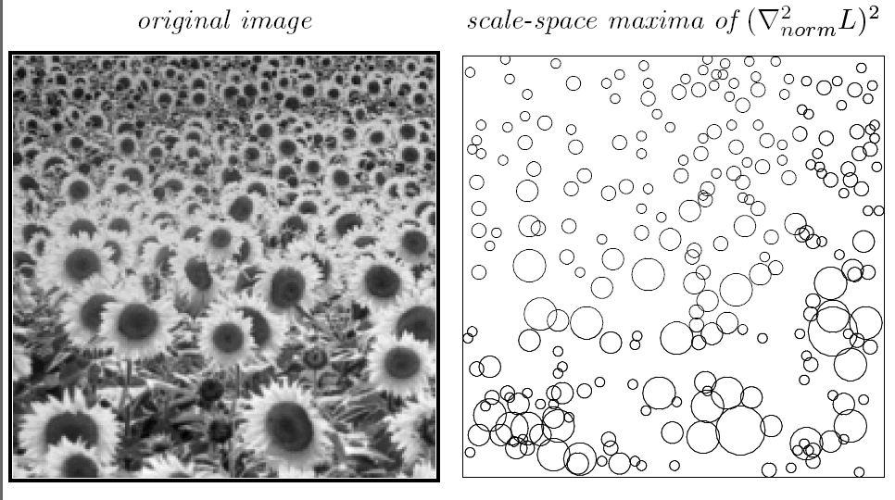
Scale-space blob detector: Example
T. Lindeberg. Feature detection with automatic scale selection. IJCV 1998.

Slide 18
Local features: main components
Detection: Identify the interest points
Description:Extract vector feature descriptor surrounding each interest point.
Matching: Determine correspondence between descriptors in two views
Kristen Grauman

Slide 19
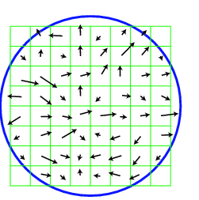
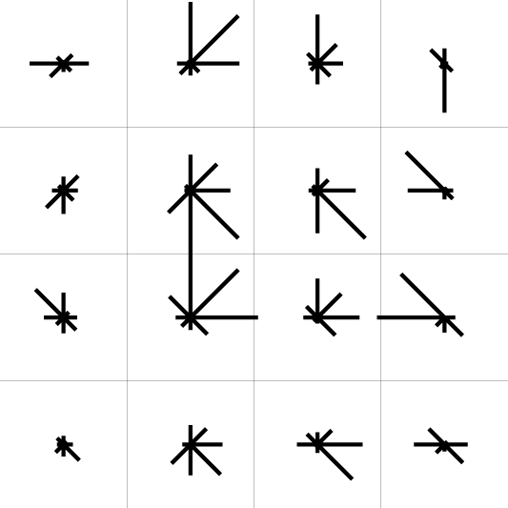
SIFT descriptor [Lowe 2004]
Use histograms to bin pixels within sub-patches according to their orientation.
0
2
π
Why subpatches?
Why does SIFT have some illumination invariance?
Kristen Grauman

Slide 20
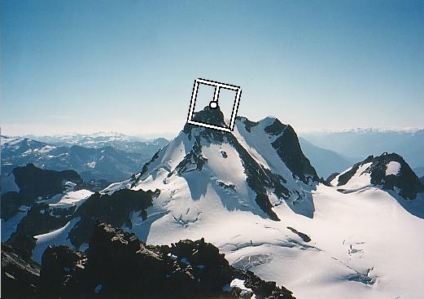
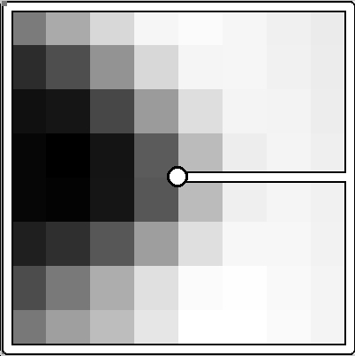
Making descriptor rotation invariant
CSE 576: Computer Vision
Rotate patch according to its dominant gradient orientation
This puts the patches into a canonical orientation.
Image from Matthew Brown

Slide 21
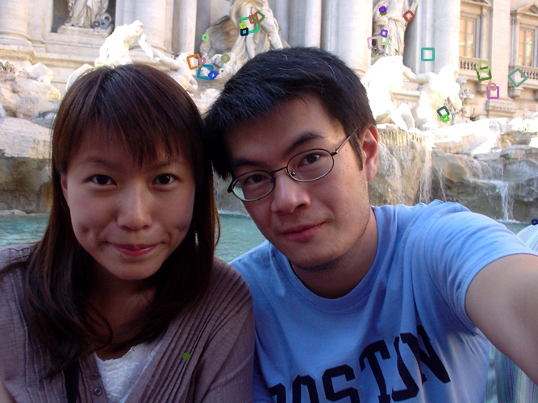
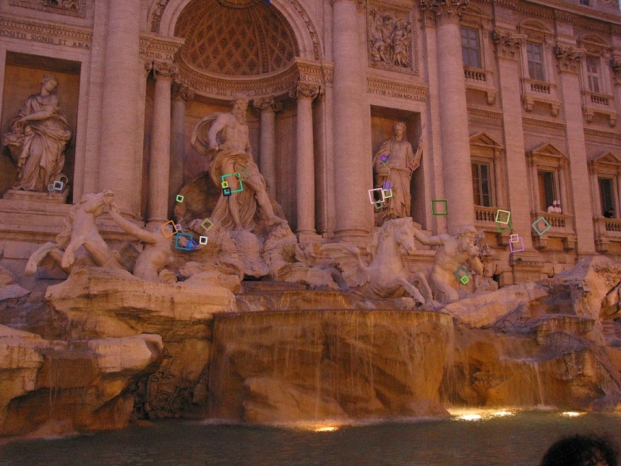
SIFT descriptor [Lowe 2004]
Extraordinarily robust matching technique
  Can handle changes in viewpoint
    Up to about 60 degree out of plane rotation
  Can handle significant changes in illumination
    Sometimes even day vs. night (below)
  Fast and efficient—can run in real time
  Lots of code available
    http://people.csail.mit.edu/albert/ladypack/wiki/index.php/Known_implementations_of_SIFT
Steve Seitz

Slide 22
SIFT properties
Invariant to
  Scale
  Rotation
Partially invariant to
  Illumination changes
  Camera viewpoint
  Occlusion, clutter

Slide 23
Local features: main components
Detection: Identify the interest points
Description:Extract vector feature descriptor surrounding each interest point.
Matching: Determine correspondence between descriptors in two views
Kristen Grauman

Slide 24
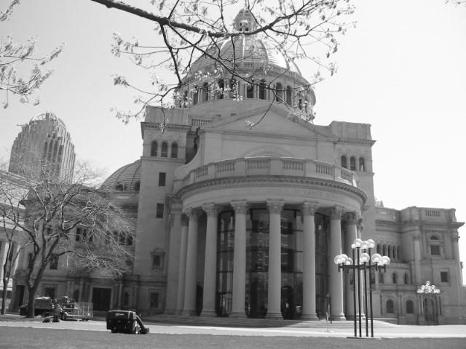
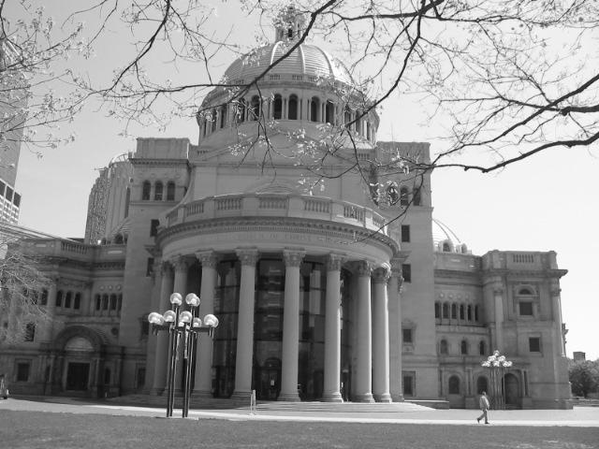
Matching local features
Kristen Grauman

Slide 25
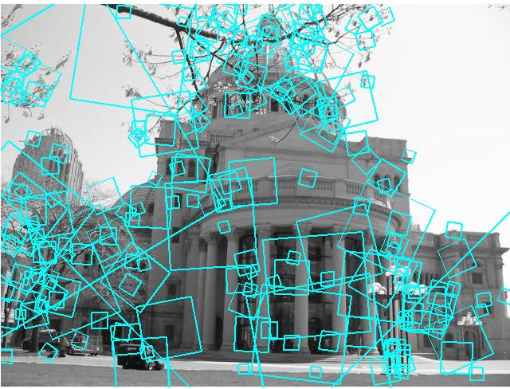
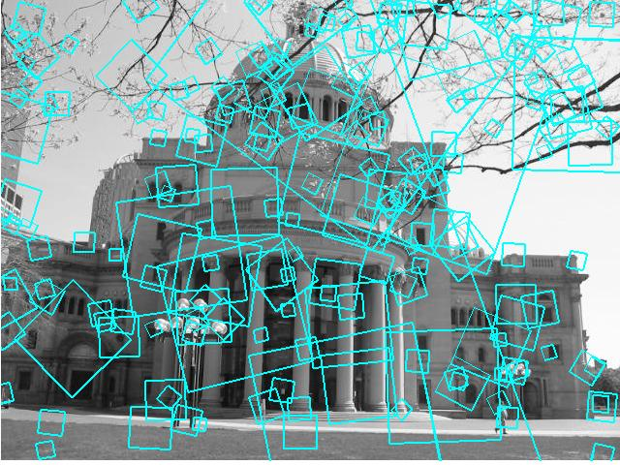
Matching local features
?
Image 1
Image 2
To generate candidate matches, find patches that have the most similar appearance (e.g., lowest SSD)
Simplest approach: compare them all, take the closest (or closest k, or within a thresholded distance)
Kristen Grauman

Slide 26
Ambiguous matches
?
?
?
?
Image 1
Image 2
At what SSD value do we have a good match?
To add robustness to matching, can consider ratio : distance to best match / distance to second best match
If low, first match looks good.
If high, could be ambiguous match.
Kristen Grauman

Slide 27
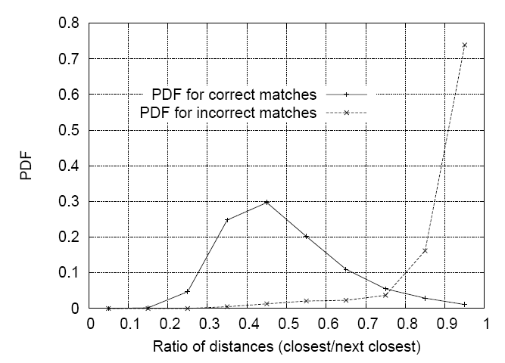
Matching SIFT Descriptors
Nearest neighbor (Euclidean distance)
Threshold ratio of nearest to 2nd nearest descriptor
Lowe IJCV 2004
Derek Hoiem

Slide 28
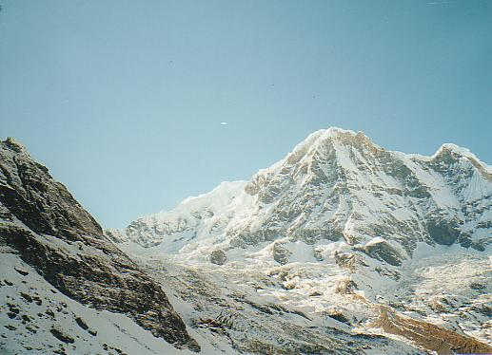
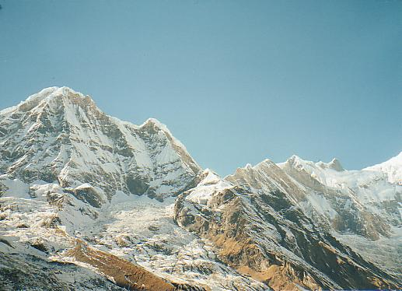
Recap: robust feature-based alignment
Source: L. Lazebnik

Slide 29
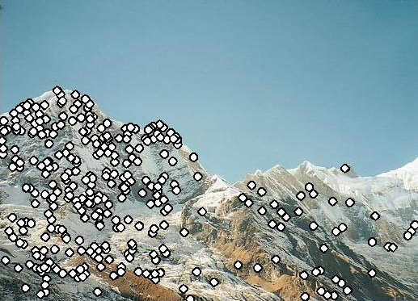
Recap: robust feature-based alignment
Extract features
Source: L. Lazebnik

Slide 30
Recap: robust feature-based alignment
Extract features
Compute putative matches
Source: L. Lazebnik

Slide 31
Recap: robust feature-based alignment
Extract features
Compute putative matches
Loop:
  Hypothesize transformation T (small group of putative matches that are related by T)
Source: L. Lazebnik

Slide 32
Recap: robust feature-based alignment
Extract features
Compute putative matches
Loop:
  Hypothesize transformation T (small group of putative matches that are related by T)
  Verify transformation (search for other matches consistent with T)
Source: L. Lazebnik

Slide 33
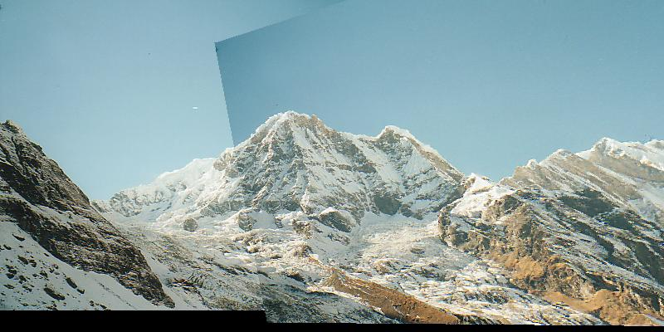
Recap: robust feature-based alignment
Extract features
Compute putative matches
Loop:
  Hypothesize transformation T (small group of putative matches that are related by T)
  Verify transformation (search for other matches consistent with T)
Source: L. Lazebnik

Slide 34
Applications of local invariant features
Wide baseline stereo
Motion tracking
Panoramas
Mobile robot navigation
3D reconstruction
Recognition
…

Slide 35
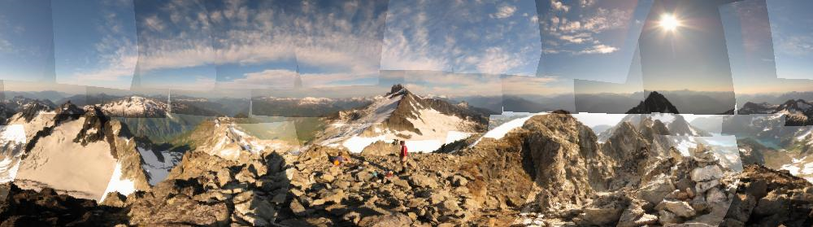
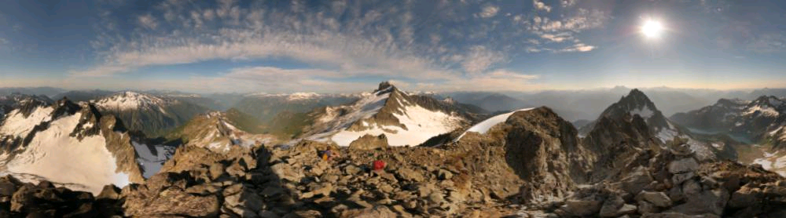
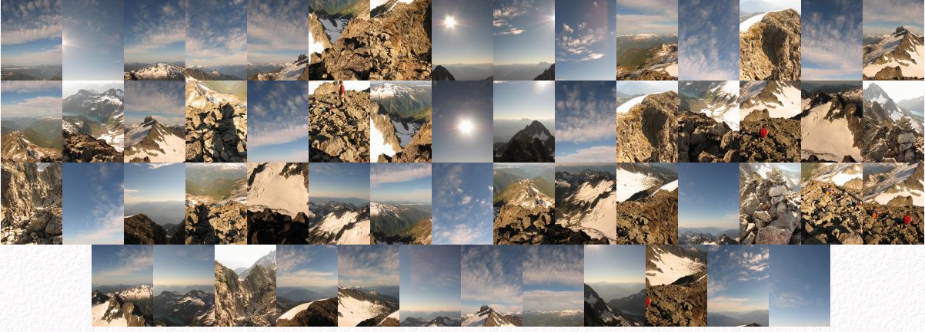
Automatic mosaicing
http://www.cs.ubc.ca/~mbrown/autostitch/autostitch.html

Slide 36
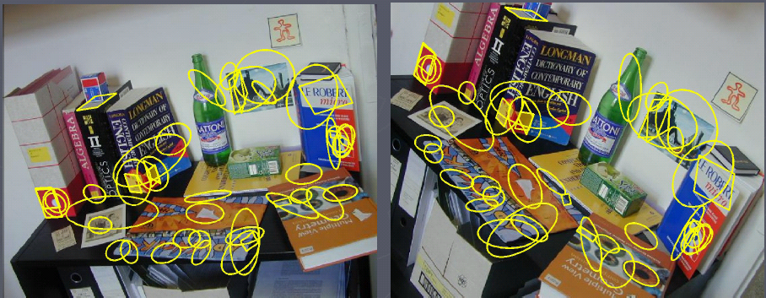
Wide baseline stereo
[Image from T. Tuytelaars ECCV 2006 tutorial]

Slide 37
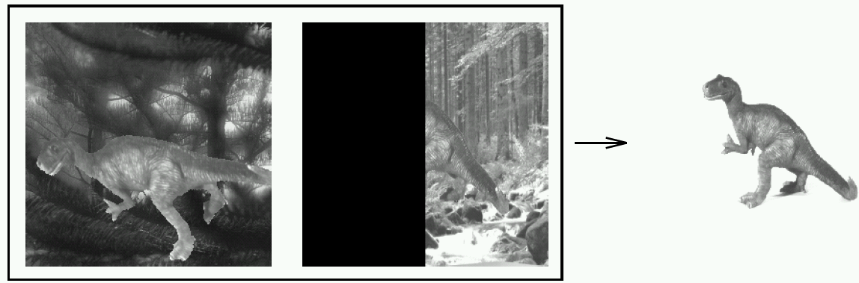
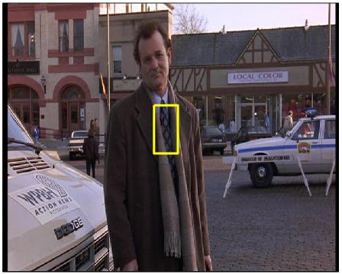
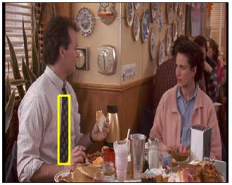
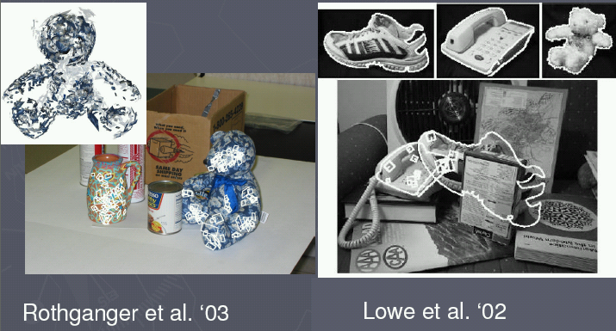
Recognition of specific objects, scenes
Schmid and Mohr 1997
Sivic and Zisserman, 2003
Rothganger et al. 2003
Lowe 2002
Kristen Grauman

Slide 38
Plan
Today:
  Local feature matching btwn views (wrap-up)
  Image formation, geometry of a single view
Wednesday: Multiple views and epipolar geometry
Monday: Approaches for stereo correspondence

Slide 39
Image formation
How are objects in the world captured in an image?

Slide 40
Physical parameters of image formation
Geometric
  Type of projection
  Camera pose
Optical
  Sensor’s lens type
  focal length, field of view, aperture
Photometric
  Type, direction, intensity of light reaching sensor
  Surfaces’ reflectance properties

Slide 41
Image formation
Let’s design a camera
  Idea 1: put a piece of film in front of an object
  Do we get a reasonable image?
Slide by Steve Seitz

Slide 42
Pinhole camera
Add a barrier to block off most of the rays
  This reduces blurring
  The opening is known as the aperture
  How does this transform the image?
Slide by Steve Seitz

Slide 43

Pinhole camera
Pinhole camera is a simple model to approximate imaging process, perspective projection.
Image plane
Virtual image
pinhole
If we treat pinhole as a point, only one ray from any given point can enter the camera.
Fig from Forsyth and Ponce

Slide 44

Camera obscura
In Latin, means ‘dark room’
"Reinerus Gemma-Frisius, observed an eclipse of the sun at Louvain on January 24, 1544, and later he used this illustration of the event in his book De Radio Astronomica et Geometrica, 1545. It is thought to be the first published illustration of a camera obscura..."
Hammond, John H., The Camera Obscura, A Chronicle
http://www.acmi.net.au/AIC/CAMERA_OBSCURA.html

Slide 45


Camera obscura
Jetty at Margate England, 1898.
An attraction in the late 19th century
Around 1870s
http://brightbytes.com/cosite/collection2.html
Adapted from R. Duraiswami

Slide 46


Camera obscura at home
http://blog.makezine.com/archive/2006/02/how_to_room_sized_camera_obscu.html
Sketch from http://www.funsci.com/fun3_en/sky/sky.htm

Slide 47

Perspective effects

Slide 48

Perspective effects
Far away objects appear smaller
Forsyth and Ponce

Slide 49

Perspective effects

Slide 50

Perspective effects
Parallel lines in the scene intersect in the image
Converge in image on horizon line
Image plane
(virtual)
pinhole
Scene

Slide 51
Projection properties
Many-to-one: any points along same ray map to same point in image
Points → points
Lines → lines (collinearity preserved)
Distances and angles are not preserved
Degenerate cases:
  – Line through focal point projects to a point.
  – Plane through focal point projects to line
  – Plane perpendicular to image plane projects to part of the image.

Slide 52


Perspective and art
Use of correct perspective projection indicated in 1st century B.C. frescoes
Skill resurfaces in Renaissance: artists develop systematic methods to determine perspective projection (around 1480-1515)
Raphael
Durer, 1525

Slide 53


Perspective projection equations
3d world mapped to 2d projection in image plane
Image plane
Focal length
Optical axis
Camera frame
‘
’
Scene / world points
‘’
Scene point
Image coordinates
Forsyth and Ponce

Slide 54




Homogeneous coordinates
Is this a linear transformation?
Trick: add one more coordinate:
  no—division by z is nonlinear
homogeneous image
coordinates
homogeneous scene
coordinates
Converting from homogeneous coordinates
Slide by Steve Seitz

Slide 55
Perspective Projection Matrix
Projection is a matrix multiplication using homogeneous coordinates:
divide by the third coordinate to convert back to non-homogeneous coordinates
Slide by Steve Seitz

Slide 56



Weak perspective
Approximation: treat magnification as constant
Assumes scene depth << average distance to camera
Image plane
World points:

Slide 57




Orthographic projection
Given camera at constant distance from scene
World points projected along rays parallel to optical access

Slide 58
Physical parameters of image formation
Geometric
  Type of projection
  Camera pose
Optical
  Sensor’s lens type
  focal length, field of view, aperture
Photometric
  Type, direction, intensity of light reaching sensor
  Surfaces’ reflectance properties

Slide 59


Pinhole size / aperture
How does the size of the aperture affect the image we’d get?
Larger
Smaller

Slide 60
Adding a lens
focal point
f
A lens focuses light onto the film
  Rays passing through the center are not deviated
  All parallel rays converge to one point on a plane located at the focal length f
Slide by Steve Seitz

Slide 61
Pinhole vs. lens

Slide 62

Cameras with lenses
F
focal point
optical center
(Center Of Projection)
A lens focuses parallel rays onto a single focal point
Gather more light, while keeping focus; make pinhole perspective projection practical

Slide 63

Thin lens equation
How to relate distance of object from optical center (u) to the distance at which it will be in focus (v), given focal length f?

Slide 64



Thin lens equation
$$\frac{y^{′}}{y}=\frac{v}{u}$$
$$y$$
$$y′$$
How to relate distance of object from optical center (u) to the distance at which it will be in focus (v), given focal length f?

Slide 65



Thin lens equation
$$\frac{y^{′}}{y}=\frac{v}{u}$$
$$y$$
$$\frac{y^{′}}{y}=\frac{(v−f)}{f}$$
$$y′$$
How to relate distance of object from optical center (u) to the distance at which it will be in focus (v), given focal length f?

Slide 66
Thin lens equation
$$\frac{y^{′}}{y}=\frac{v}{u}$$
$$y$$
$$\frac{y^{′}}{y}=\frac{(v−f)}{f}$$
$$y′$$
Any object point satisfying this equation is in focus

Slide 67




Focus and depth of field
Image credit: cambridgeincolour.com

Slide 68

Focus and depth of field
Depth of field: distance between image planes where blur is tolerable
Thin lens: scene points at distinct depths come in focus at different image planes.
(Real camera lens systems have greater depth of field.)
“circles of confusion”
Shapiro and Stockman

Slide 69



Focus and depth of field
How does the aperture affect the depth of field?
A smaller aperture increases the range in which the object is approximately in focus
Flower images from Wikipedia http://en.wikipedia.org/wiki/Depth_of_field
Slide from S. Seitz

Slide 70

Field of view
Angular measure of portion of 3d space seen by the camera
Images from http://en.wikipedia.org/wiki/Angle_of_view

Slide 71

Field of view depends on focal length
As f gets smaller, image becomes more wide angle
  more world points project onto the finite image plane
As f gets larger, image becomes more telescopic
  smaller part of the world projects onto the finite image plane
from R. Duraiswami

Slide 72


Field of view depends on focal length
Smaller FOV = larger Focal Length
Slide by A. Efros

Slide 73

Digital cameras
Film → sensor array
Often an array of charge coupled devices
Each CCD is light sensitive diode that converts photons (light energy) to electrons
camera
CCD array
optics
frame grabber
computer

Slide 74
Summary
Image formation affected by geometry, photometry, and optics.
Projection equations express how world points mapped to 2d image.
  Homogenous coordinates allow linear system for projection equations.
Lenses make pinhole model practical.
Parameters (focal length, aperture, lens diameter,…) affect image obtained.

Slide 75
Next time
Geometry of two views
scene point
image plane
optical center

