Slide 1
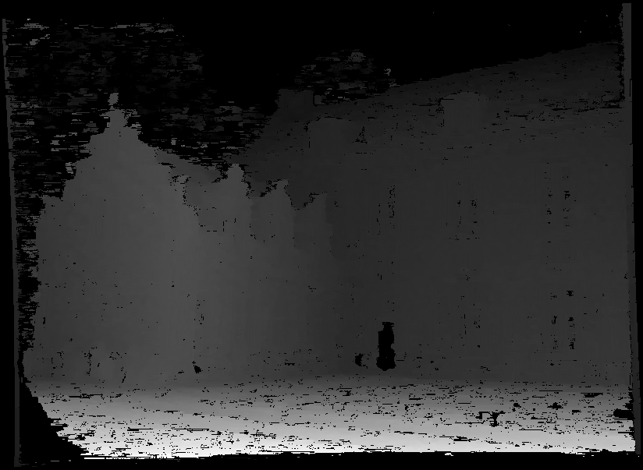
Stereo:
Epipolar geometry
Wednesday March 23
Kristen Grauman
UT-Austin

Slide 2
Announcements
Reminder: Pset 3 due next Wed, March 30

Slide 3
Last time
Image formation affected by geometry, photometry, and optics.
Projection equations express how world points mapped to 2d image.
Parameters (focal length, aperture, lens diameter,…) affect image obtained.

Slide 4

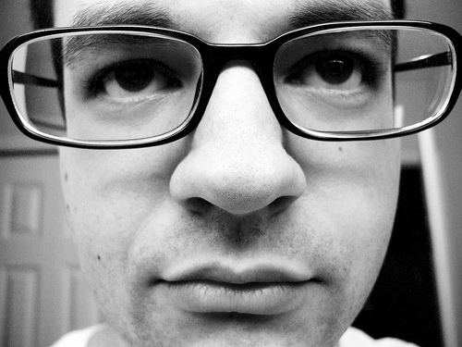
Review
How do the perspective projection equations explain this effect?
flickr.com/photos/lungstruck/434631076/
http://www.mzephotos.com/gallery/mammals/rabbit-nose.html

Slide 5

Miniature faking
In close-up photo, the depth of field is limited.
http://en.wikipedia.org/wiki/File:Jodhpur_tilt_shift.jpg

Slide 6

Miniature faking

Slide 7
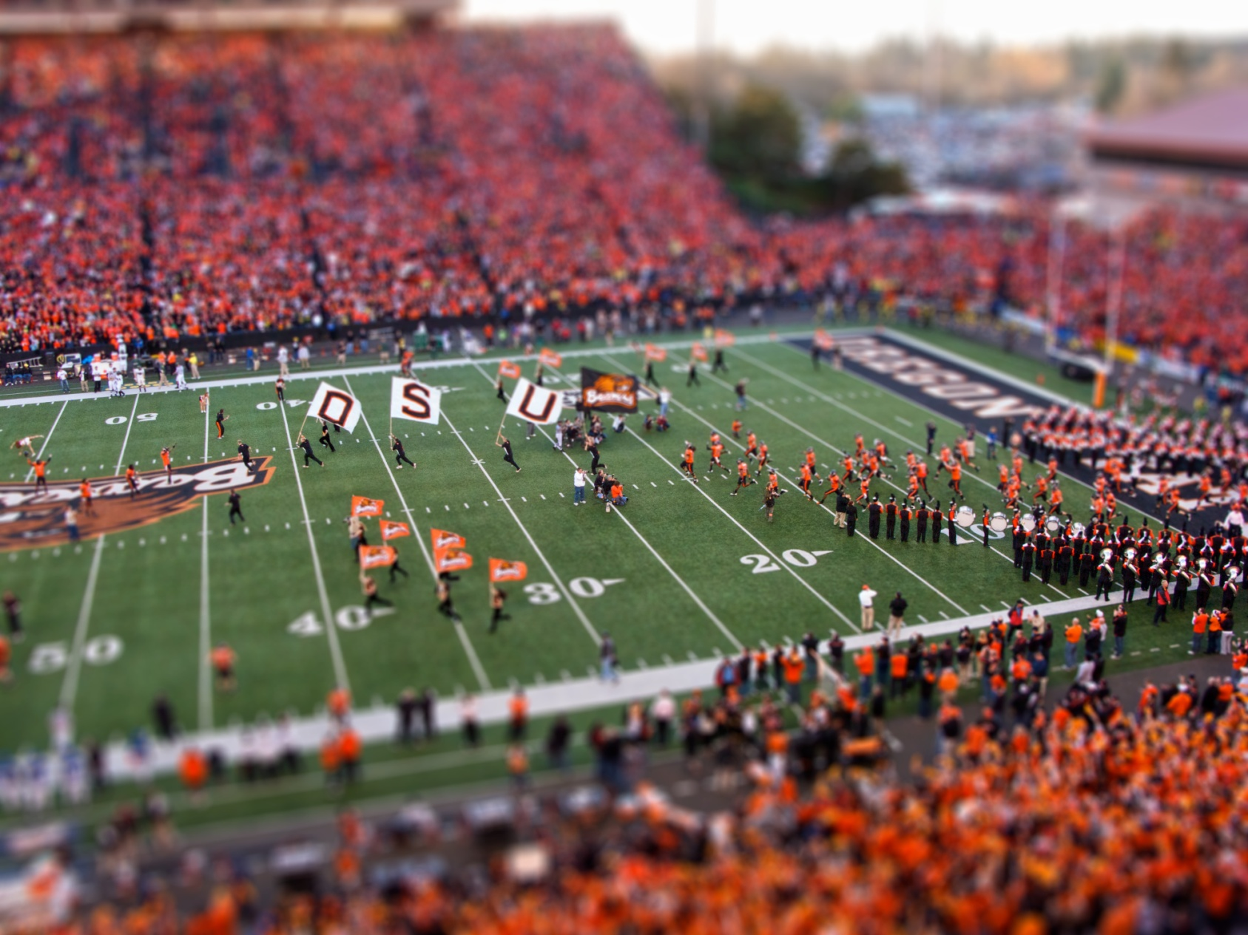
Miniature faking
http://en.wikipedia.org/wiki/File:Oregon_State_Beavers_Tilt-Shift_Miniature_Greg_Keene.jpg

Slide 8
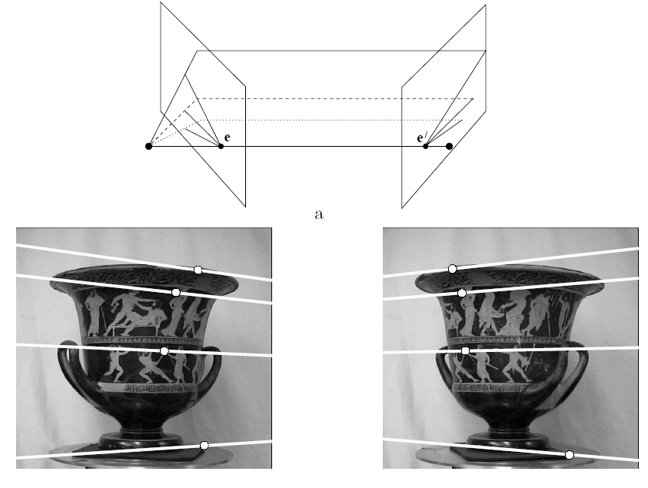
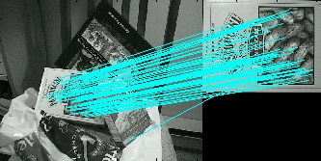
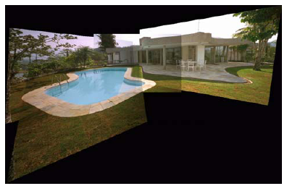
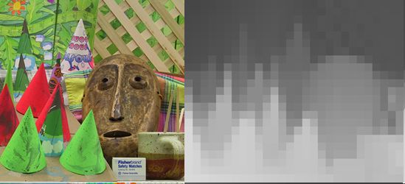
Multiple views
Multi-view geometry, matching, invariant features, stereo vision
Lowe
Hartley and Zisserman

Slide 9
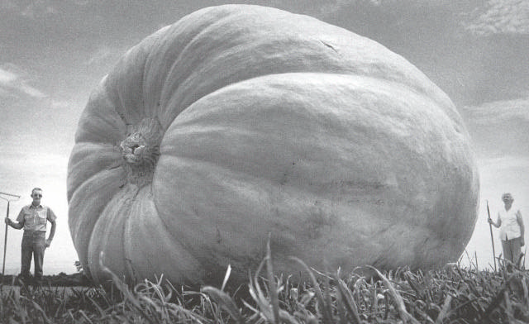
Why multiple views?
Structure and depth are inherently ambiguous from single views.
Images from Lana Lazebnik

Slide 10
Why multiple views?
Structure and depth are inherently ambiguous from single views.
P1
P2
P1’=P2’
Optical center

Slide 11
What cues help us to perceive 3d shape and depth?

Slide 12
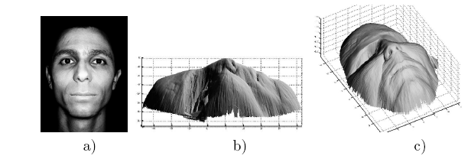
Shading
[Figure from Prados & Faugeras 2006]
Notes:
12

Slide 13
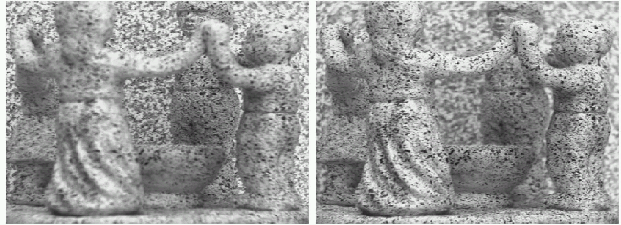
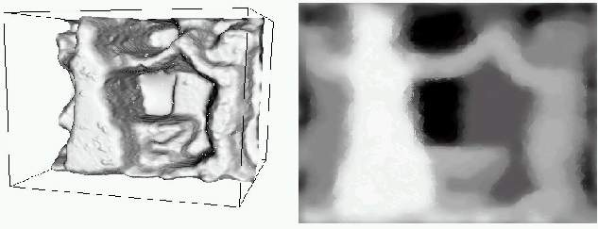
Focus/defocus
Images from same point of view, different camera parameters
3d shape / depth estimates
[figs from H. Jin and P. Favaro, 2002]

Slide 14
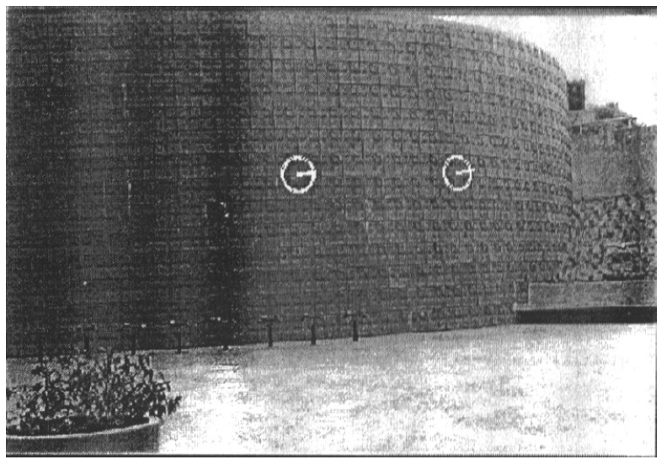
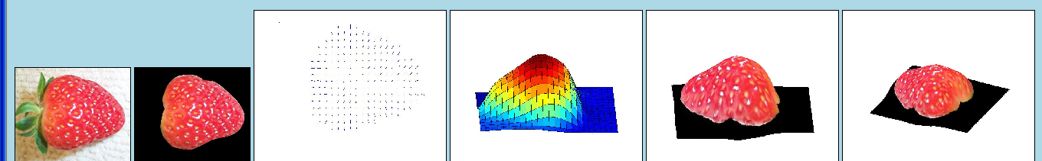
Texture
[From A.M. Loh. The recovery of 3-D structure using visual texture patterns. PhD thesis]
Notes:
14

Slide 15

Perspective effects
Image credit: S. Seitz

Slide 16
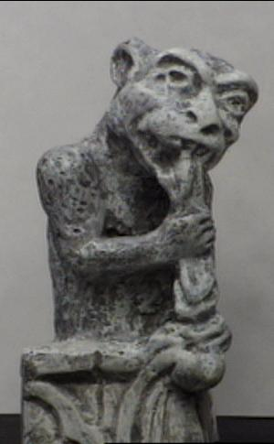
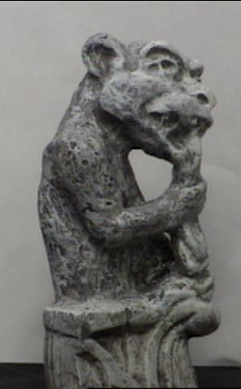
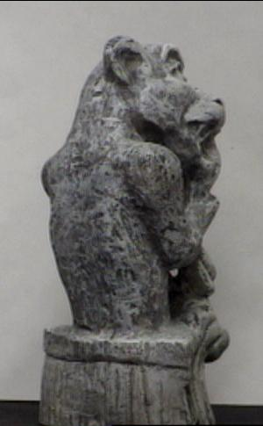
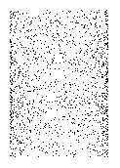
Motion
Figures from L. Zhang
http://www.brainconnection.com/teasers/?main=illusion/motion-shape

Slide 17
Estimating scene shape
“Shape from X”: Shading, Texture, Focus, Motion…
Stereo:
  shape from “motion” between two views
  infer 3d shape of scene from two (multiple) images from different viewpoints
Main idea:
scene point
image plane
optical center
Notes:
17

Slide 18
Outline
Human stereopsis
Stereograms
Epipolar geometry and the epipolar constraint
  Case example with parallel optical axes
  General case with calibrated cameras

Slide 19
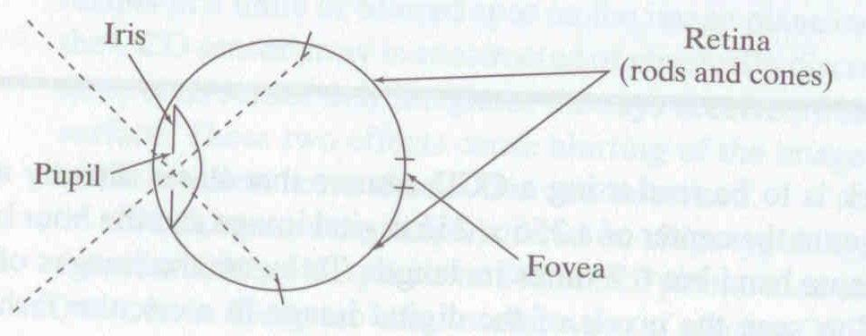
Human eye
Rough analogy with human visual system:
Pupil/Iris – control amount of light passing through lens
Retina - contains sensor cells, where image is formed
Fovea – highest concentration of cones
Fig from Shapiro and Stockman

Slide 20
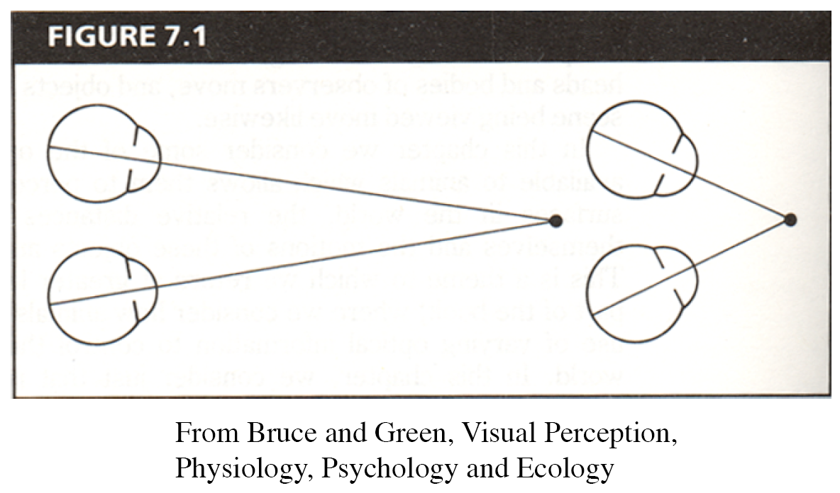
Human eyes fixate on point in space – rotate so that corresponding images form in centers of fovea.
Human stereopsis: disparity
Notes:
20

Slide 21
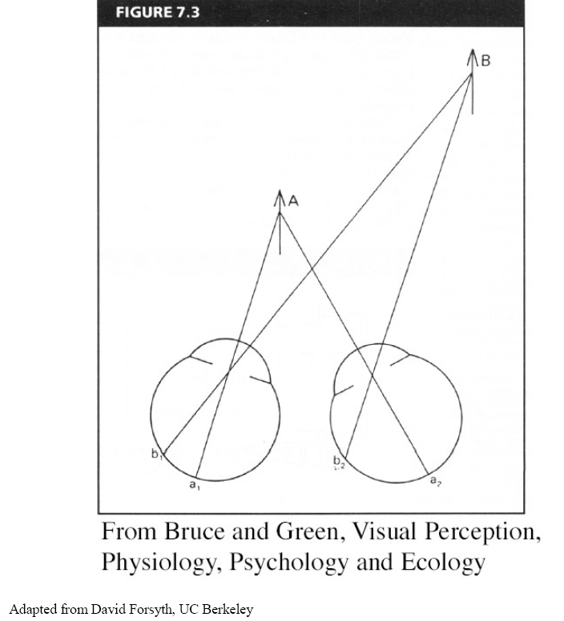
Human stereopsis: disparity
Disparity occurs when eyes fixate on one object; others appear at different visual angles
Notes:
21

Slide 22
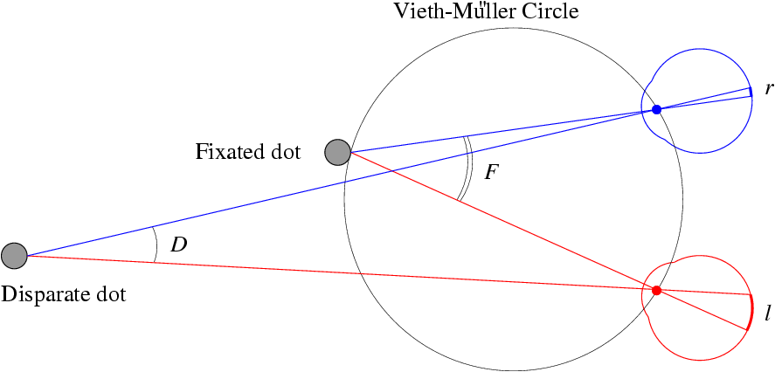
Human stereopsis: disparity
d=0
Disparity: d = r-l = D-F.
Forsyth & Ponce
Notes:
22

Slide 23
Random dot stereograms
Julesz 1960: Do we identify local brightness patterns before fusion (monocular process) or after (binocular)?
To test: pair of synthetic images obtained by randomly spraying black dots on white objects
Notes:
23

Slide 24
Random dot stereograms
Forsyth & Ponce
Notes:
24

Slide 25
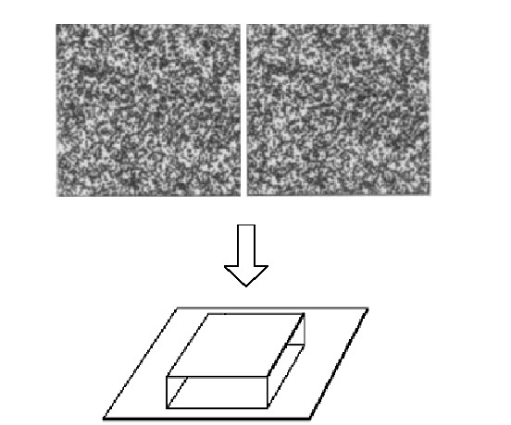
Random dot stereograms
Notes:
25

Slide 26
Random dot stereograms
When viewed monocularly, they appear random; when viewed stereoscopically, see 3d structure.
Conclusion: human binocular fusion not directly associated with the physical retinas; must involve the central nervous system
Imaginary “cyclopean retina” that combines the left and right image stimuli as a single unit
Notes:
26

Slide 27
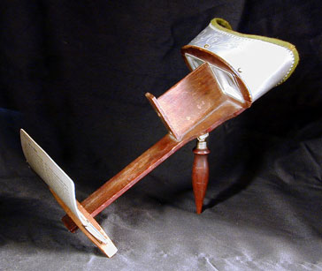
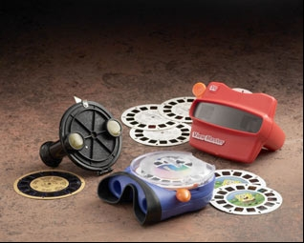
Stereo photography and stereo viewers
Take two pictures of the same subject from two slightly different viewpoints and display so that each eye sees only one of the images.
Image from fisher-price.com
Invented by Sir Charles Wheatstone, 1838

Slide 28
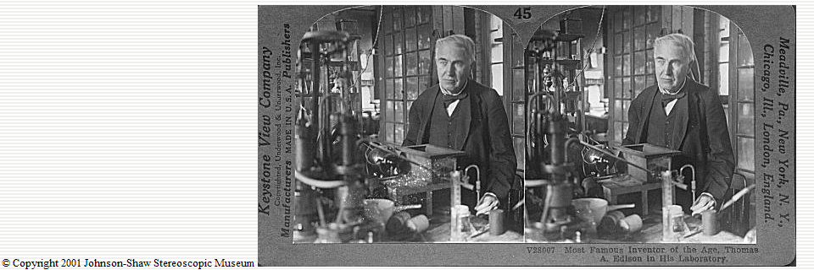
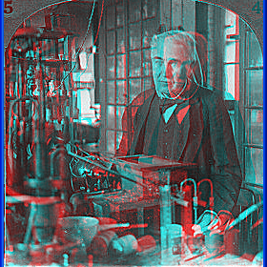
http://www.johnsonshawmuseum.org
Notes:
28

Slide 29
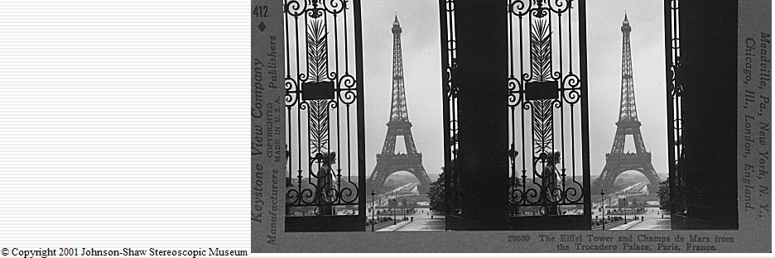
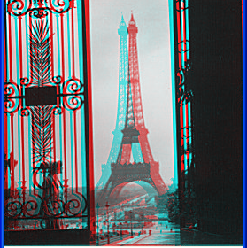
http://www.johnsonshawmuseum.org
Notes:
29

Slide 30
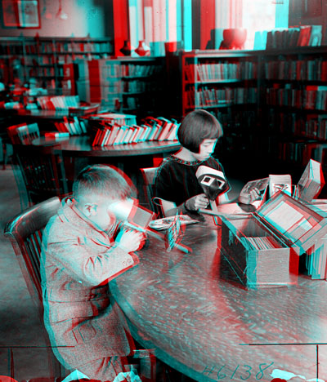

Public Library, Stereoscopic Looking Room, Chicago, by Phillips, 1923
Notes:
30

Slide 31
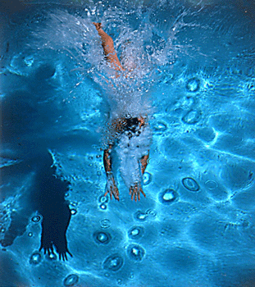
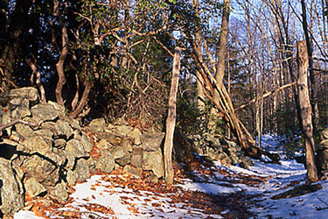
http://www.well.com/~jimg/stereo/stereo_list.html
Notes:
31

Slide 32
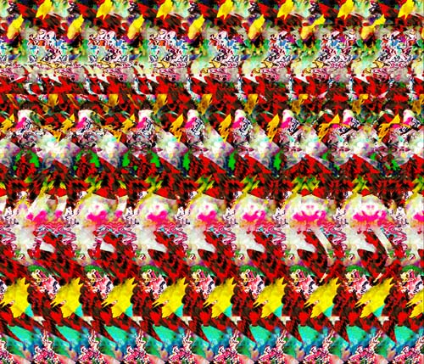
Autostereograms
Exploit disparity as depth cue using single image.
(Single image random dot stereogram, Single image stereogram)
Images from magiceye.com
Notes:
32

Slide 33
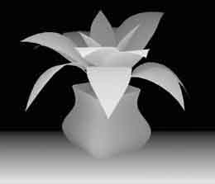
Autostereograms
Images from magiceye.com
Notes:
33

Slide 34
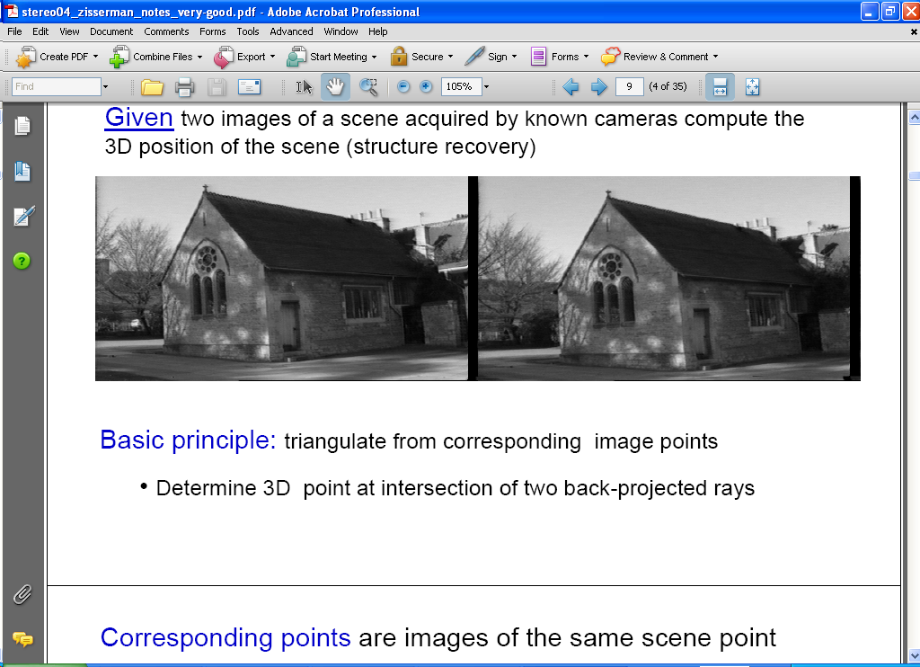
Estimating depth with stereo
Stereo: shape from “motion” between two views
We’ll need to consider:
Info on camera pose (“calibration”)
Image point correspondences
scene point
image plane
optical center
Notes:
34

Slide 35
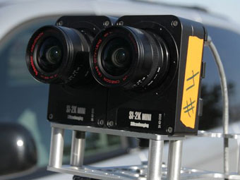
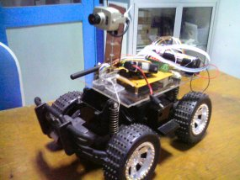
Stereo vision
Two cameras, simultaneous views
Single moving camera and static scene

Slide 36
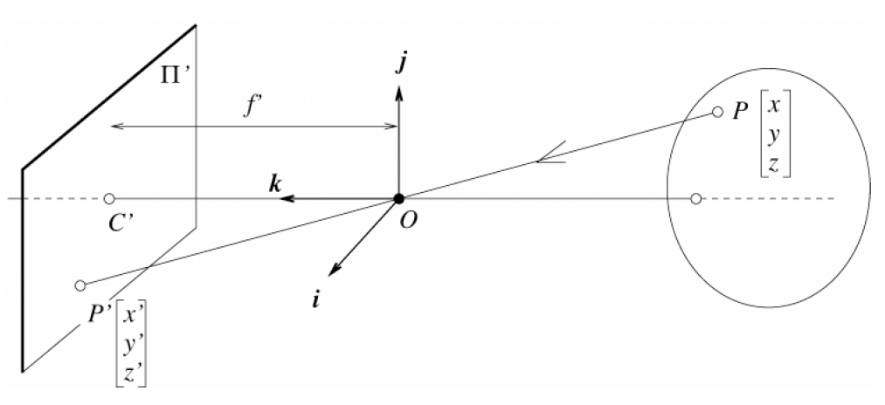
Camera parameters
Camera frame 2
Extrinsic parameters:
Camera frame 1 ←→ Camera frame 2
Intrinsic parameters:
Image coordinates relative to camera ←→ Pixel coordinates
Camera frame 1
Extrinsic params: rotation matrix and translation vector
Intrinsic params: focal length, pixel sizes (mm), image center point, radial distortion parameters
We’ll assume for now that these parameters are given and fixed.
Notes:
36

Slide 37
Outline
Human stereopsis
Stereograms
Epipolar geometry and the epipolar constraint
  Case example with parallel optical axes
  General case with calibrated cameras

Slide 38
Geometry for a simple stereo system
First, assuming parallel optical axes, known camera parameters (i.e., calibrated cameras):

Slide 39
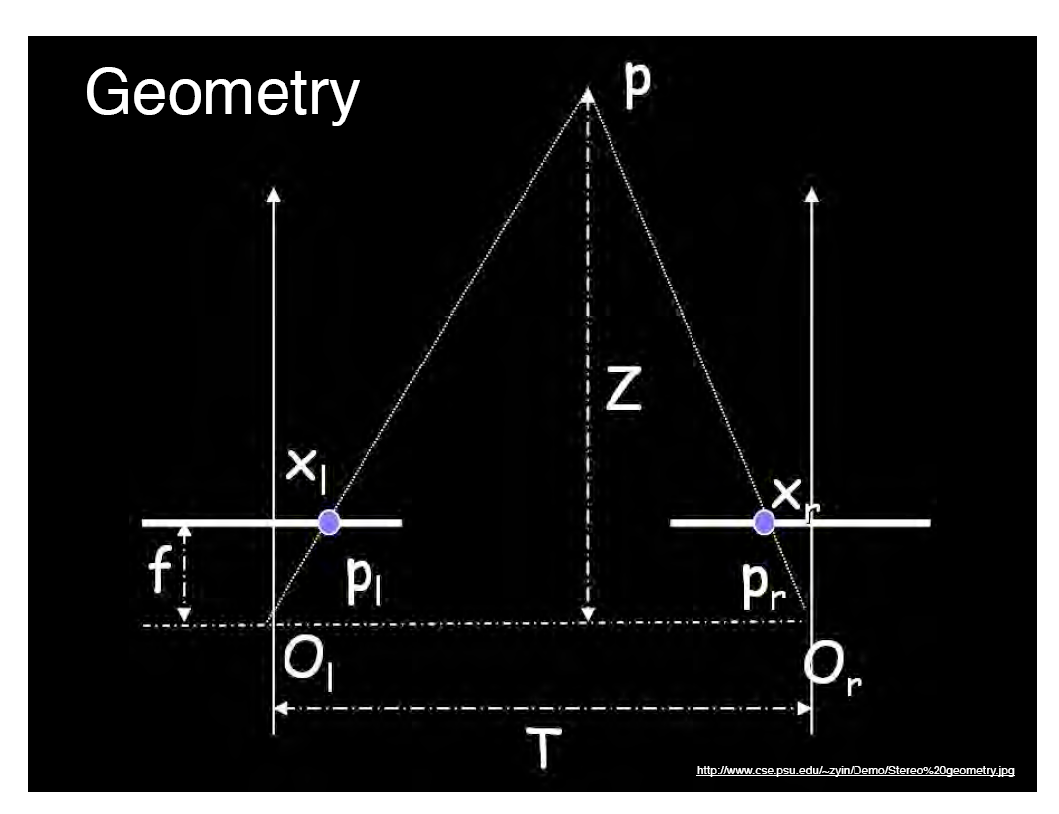
World point
Depth of p
image point (left)
image point (right)
Focal length
optical center (right)
optical center (left)
baseline
Notes:
39

Slide 40
Geometry for a simple stereo system
Assume parallel optical axes, known camera parameters (i.e., calibrated cameras). What is expression for Z?
Similar triangles (p_{l}, P, p_{r}) and (O_{l}, P, O_{r}):
disparity
Notes:
40

Slide 41
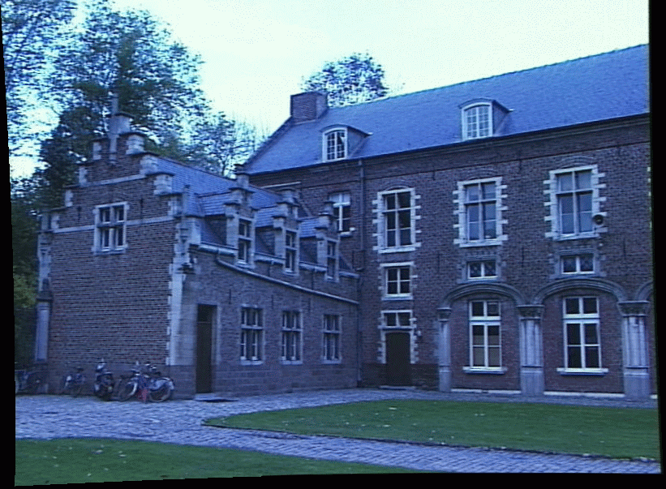
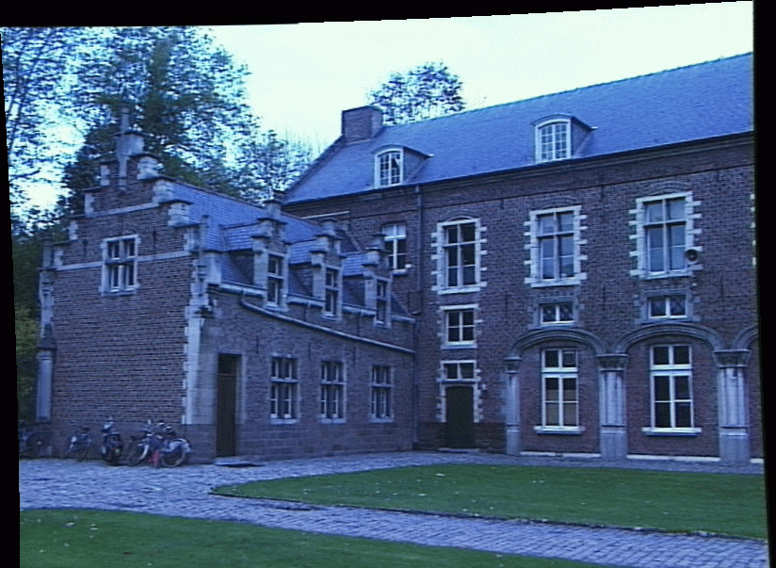
Depth from disparity
image I(x,y)
Disparity map D(x,y)
image I´(x´,y´)
(x´,y´)=(x+D(x,y), y)
So if we could find the corresponding points in two images, we could estimate relative depth…

Slide 42
Outline
Human stereopsis
Stereograms
Epipolar geometry and the epipolar constraint
  Case example with parallel optical axes
  General case with calibrated cameras

Slide 43
General case, with calibrated cameras
The two cameras need not have parallel optical axes.
Vs.

Slide 44
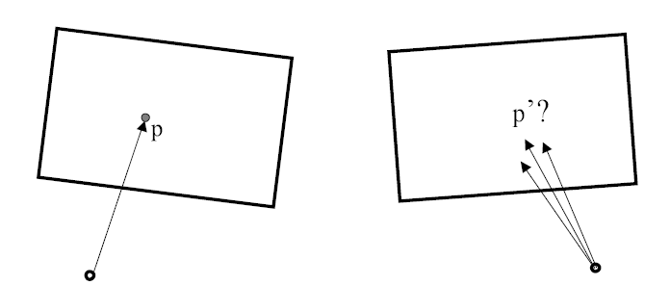
Stereo correspondence constraints
Given p in left image, where can corresponding point p’ be?

Slide 45
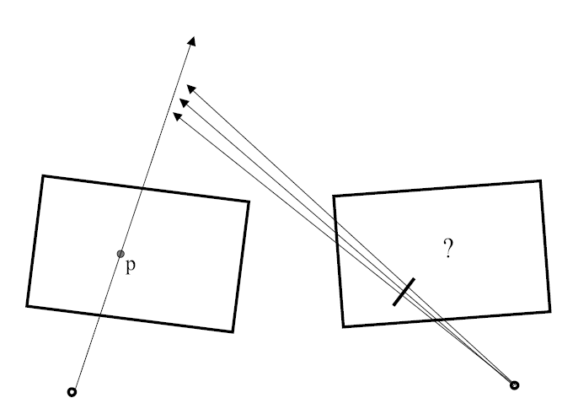
Stereo correspondence constraints

Slide 46
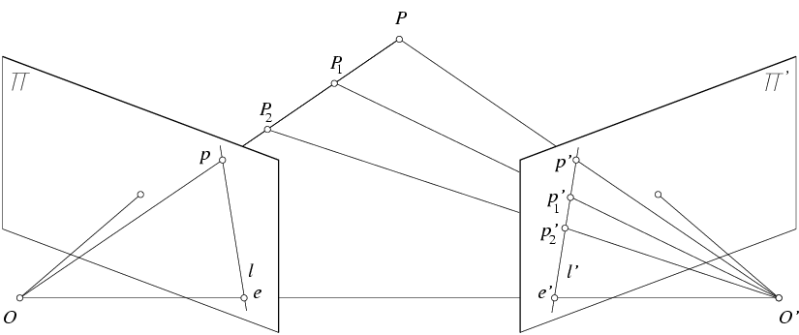
Epipolar constraint
Geometry of two views constrains where the corresponding pixel for some image point in the first view must occur in the second view.
  It must be on the line carved out by a plane connecting the world point and optical centers.
Notes:
46

Slide 47
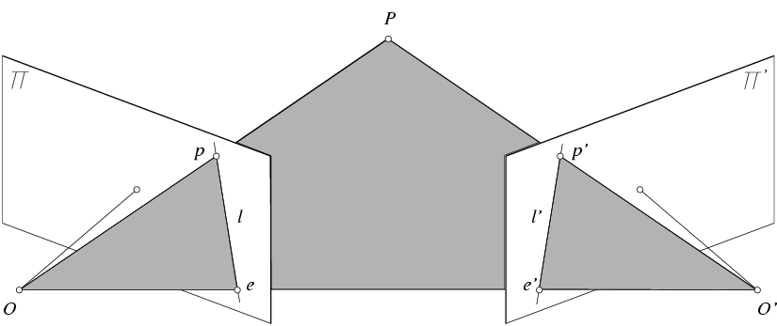
Epipolar geometry
Epipolar Line
Epipolar Plane
Epipole
Baseline
Epipole
http://www.ai.sri.com/~luong/research/Meta3DViewer/EpipolarGeo.html
Notes:
47

Slide 48
Epipolar geometry: terms
Baseline: line joining the camera centers
Epipole: point of intersection of baseline with image plane
Epipolar plane: plane containing baseline and world point
Epipolar line: intersection of epipolar plane with the image plane
All epipolar lines intersect at the epipole
An epipolar plane intersects the left and right image planes in epipolar lines
Why is the epipolar constraint useful?

Slide 49
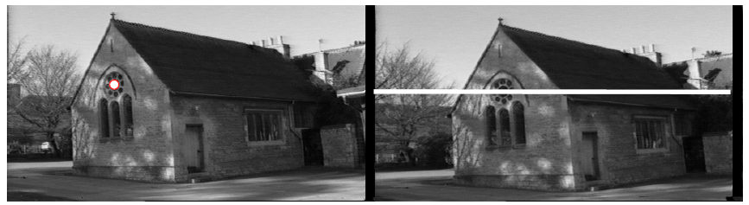
Epipolar constraint
This is useful because it reduces the correspondence problem to a 1D search along an epipolar line.
Image from Andrew Zisserman

Slide 50
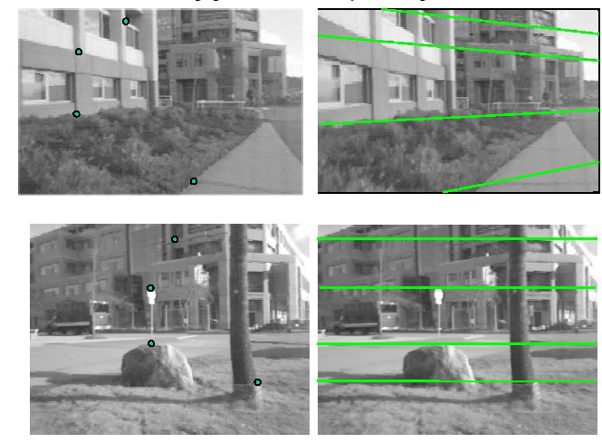
Example

Slide 51
What do the epipolar lines look like?
1.
O_{l}
O_{r}
2.
O_{l}
O_{r}

Slide 52
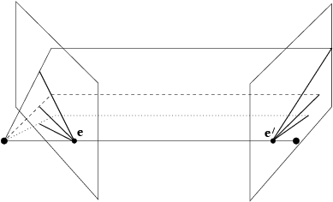
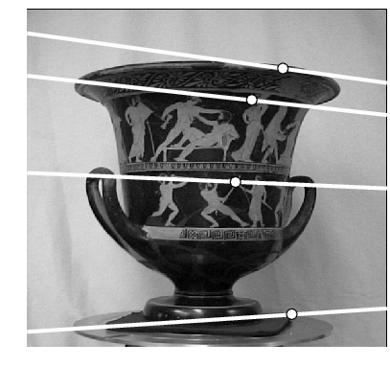
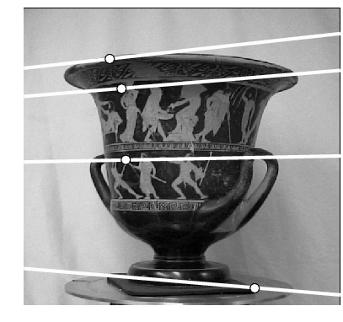
Example: converging cameras
Figure from Hartley & Zisserman
Notes:
52

Slide 53
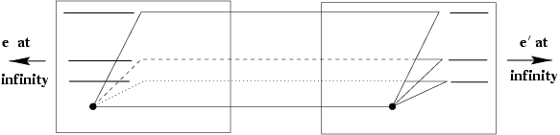

Example: parallel cameras
Where are the epipoles?
Figure from Hartley & Zisserman
Notes:
53

Slide 54
So far, we have the explanation in terms of geometry.
Now, how to express the epipolar constraints algebraically?

Slide 55

Stereo geometry, with calibrated cameras
Main idea
Notes:
55

Slide 56
Stereo geometry, with calibrated cameras
If the stereo rig is calibrated, we know :
  how to rotate and translate camera reference frame 1 to get to camera reference frame 2.
    Rotation: 3 x 3 matrix R; translation: 3 vector T.
Notes:
56

Slide 57
Stereo geometry, with calibrated cameras
If the stereo rig is calibrated, we know :
  how to rotate and translate camera reference frame 1 to get to camera reference frame 2.
Notes:
57

Slide 58

An aside: cross product
Vector cross product takes two vectors and returns a third vector that’s perpendicular to both inputs.
So here, c is perpendicular to both a and b, which means the dot product = 0.
Notes:
58

Slide 59
From geometry to algebra
Normal to the plane
Notes:
59

Slide 60
Another aside:
Matrix form of cross product
Can be expressed as a matrix multiplication.
Notes:
60

Slide 61
From geometry to algebra
Normal to the plane
Notes:
61

Slide 62

Essential matrix
Let
E is called the essential matrix, and it relates corresponding image points between both cameras, given the rotation and translation.
If we observe a point in one image, its position in other image is constrained to lie on line defined by above.
Note: these points are in camera coordinate systems.
Notes:
62

Slide 63


Essential matrix example: parallel cameras
0 0 0
0 0 d
0 –d 0
For the parallel cameras, image of any point must lie on same horizontal line in each image plane.
Notes:
63

Slide 64
image I(x,y)
Disparity map D(x,y)
image I´(x´,y´)
(x´,y´)=(x+D(x,y),y)
What about when cameras’ optical axes are not parallel?

Slide 65
Stereo image rectification
In practice, it is convenient if image scanlines (rows) are the epipolar lines.
reproject image planes onto a common
plane parallel to the line between optical centers
pixel motion is horizontal after this transformation
two homographies (3x3 transforms), one for each input image reprojection
Slide credit: Li Zhang
Notes:
65

Slide 66
Stereo image rectification: example
Source: Alyosha Efros

Slide 67


An audio camera & epipolar geometry
Adam O' Donovan, Ramani Duraiswami and Jan Neumann Microphone Arrays as Generalized Cameras for Integrated Audio Visual Processing, IEEE Conference on Computer Vision and Pattern Recognition (CVPR), Minneapolis, 2007
Spherical microphone array

Slide 68


An audio camera & epipolar geometry

Slide 69
Summary
Depth from stereo: main idea is to triangulate from corresponding image points.
Epipolar geometry defined by two cameras
  We’ve assumed known extrinsic parameters relating their poses
Epipolar constraint limits where points from one view will be imaged in the other
  Makes search for correspondences quicker
Terms: epipole, epipolar plane / lines, disparity, rectification, intrinsic/extrinsic parameters, essential matrix, baseline

Slide 70
Coming up
  Computing correspondences
  Non-geometric stereo constraints
  Weak calibration

