Slide 1
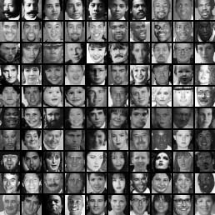
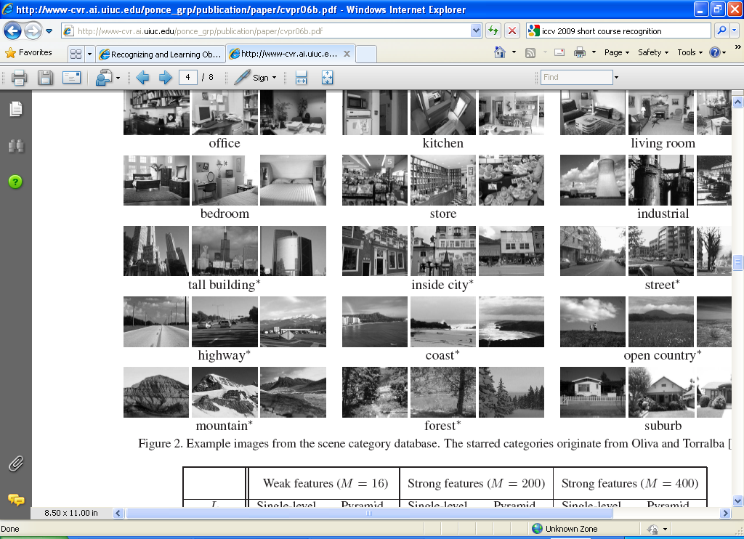
Generic object recognition
Wed, April 6
Kristen Grauman

Slide 2
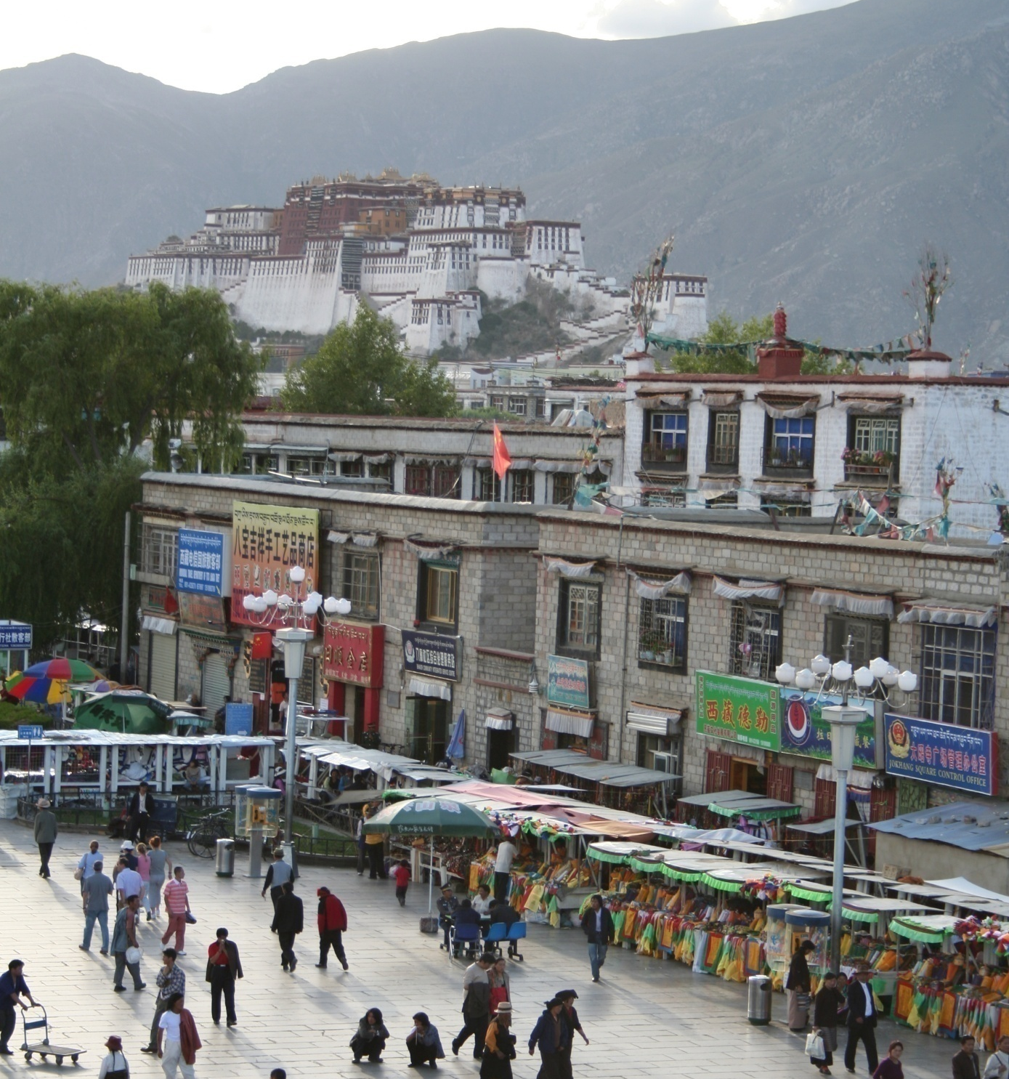
What does recognition involve?
Source: Fei-Fei Li, Rob Fergus, Antonio Torralba.

Slide 3
Verification: is that a lamp?
Source: Fei-Fei Li, Rob Fergus, Antonio Torralba.

Slide 4
Detection: are there people?
Source: Fei-Fei Li, Rob Fergus, Antonio Torralba.

Slide 5
Identification: is that Potala Palace?
Source: Fei-Fei Li, Rob Fergus, Antonio Torralba.

Slide 6
Object categorization
mountain
tree
building
banner
street lamp
vendor
people
Source: Fei-Fei Li, Rob Fergus, Antonio Torralba.

Slide 7
Scene and context categorization
outdoor
city
…
Source: Fei-Fei Li, Rob Fergus, Antonio Torralba.

Slide 8
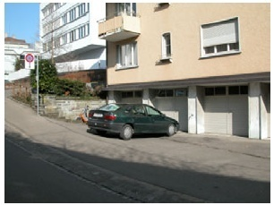
Instance-level recognition problem
John’s car

Slide 9
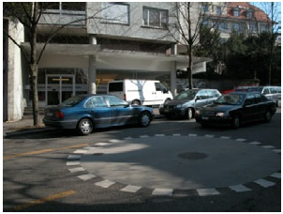
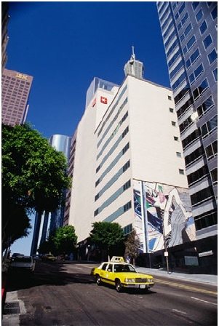
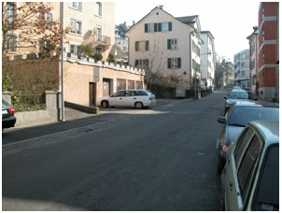
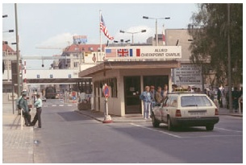
Generic categorization problem

Slide 10
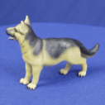
Object Categorization
“Fido”
German
shepherd
dog
animal
living
being
K. Grauman, B. Leibe
Task Description
  “Given a small number of training images of a category, recognize a-priori unknown instances of that category and assign the correct category label.”
Which categories are feasible visually?

Slide 11
Visual Object Categories
Basic Level Categories in human categorization
[Rosch 76, Lakoff 87]
  The highest level at which category members have similar perceived shape
  The highest level at which a single mental image reflects the entire category
  The level at which human subjects are usually fastest at identifying category members
  The first level named and understood by children
  The highest level at which a person uses similar motor actions for interaction with category members
K. Grauman, B. Leibe

Slide 12
Visual Object Categories
…
animal
Abstract
levels
…
…
quadruped
…
Basic level
dog
cat
cow
German
shepherd
Doberman
Individual
level
…
“Fido”
…
K. Grauman, B. Leibe
Basic-level categories in humans seem to be defined predominantly visually.
There is evidence that humans (usually)
start with basic-level categorization
before doing identification.
  ⇒ Basic-level categorization is easier
  and faster for humans than object
  identification!
  How does this transfer to automatic
  classification algorithms?

Slide 13
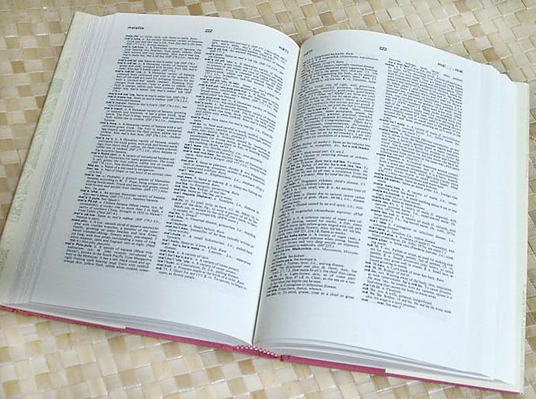

How many object categories are there?
~10,000 to 30,000
Biederman 1987
Source: Fei-Fei Li, Rob Fergus, Antonio Torralba.
Notes:
13

Slide 14
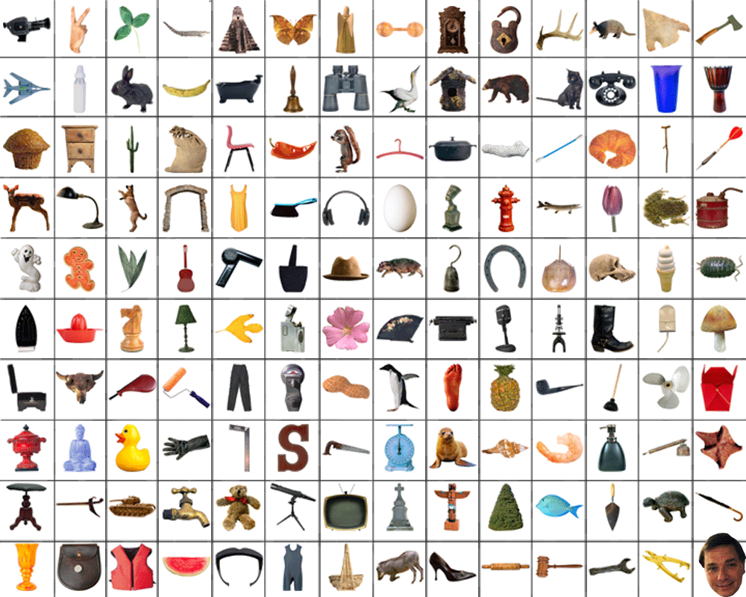
~10,000 to 30,000
Notes:
14

Slide 15
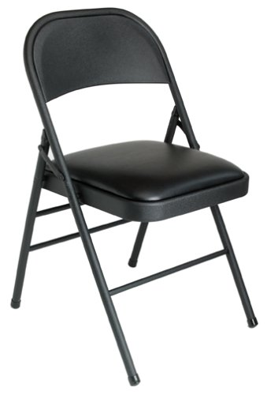
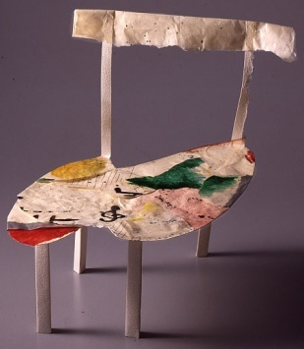
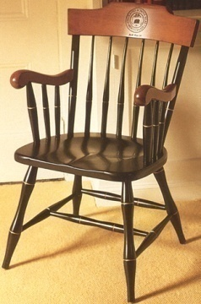
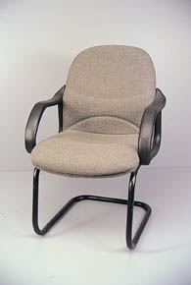
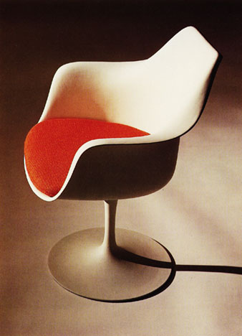
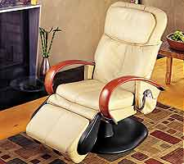
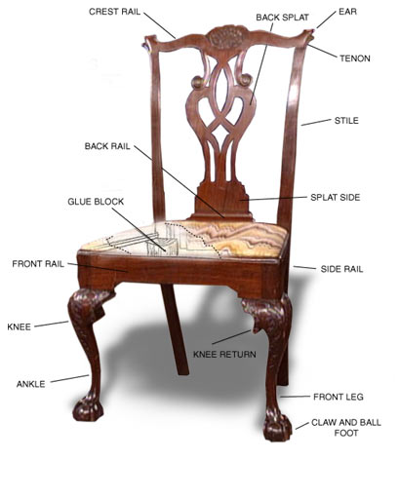
Other Types of Categories
K. Grauman, B. Leibe
Functional Categories
  e.g. chairs = “something you can sit on”

Slide 16

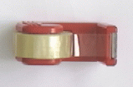


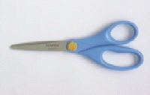
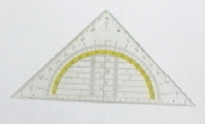
Other Types of Categories
K. Grauman, B. Leibe
Ad-hoc categories
  e.g. “something you can find in an office environment”

Slide 17
Why recognition?
  Recognition a fundamental part of perception
    e.g., robots, autonomous agents
  Organize and give access to visual content
    Connect to information
    Detect trends and themes
Notes:
17

Slide 18
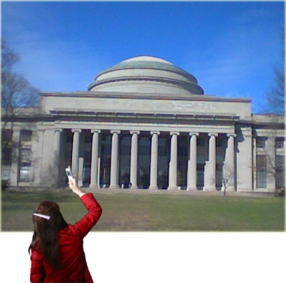
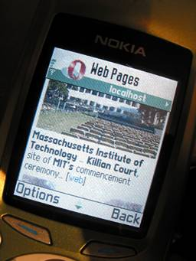
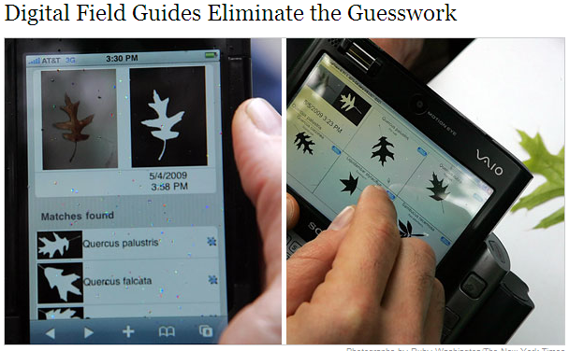
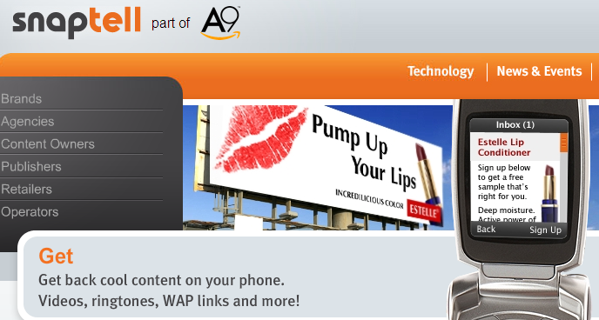

Posing visual queries
Yeh et al., MIT
Belhumeur et al.
Kooaba, Bay & Quack et al.

Slide 19
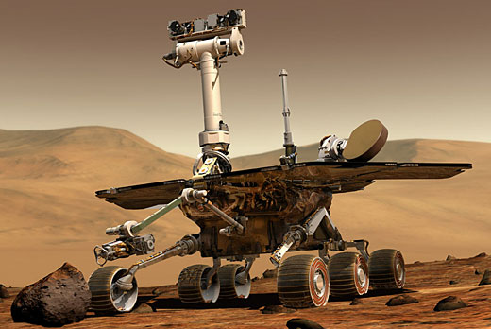
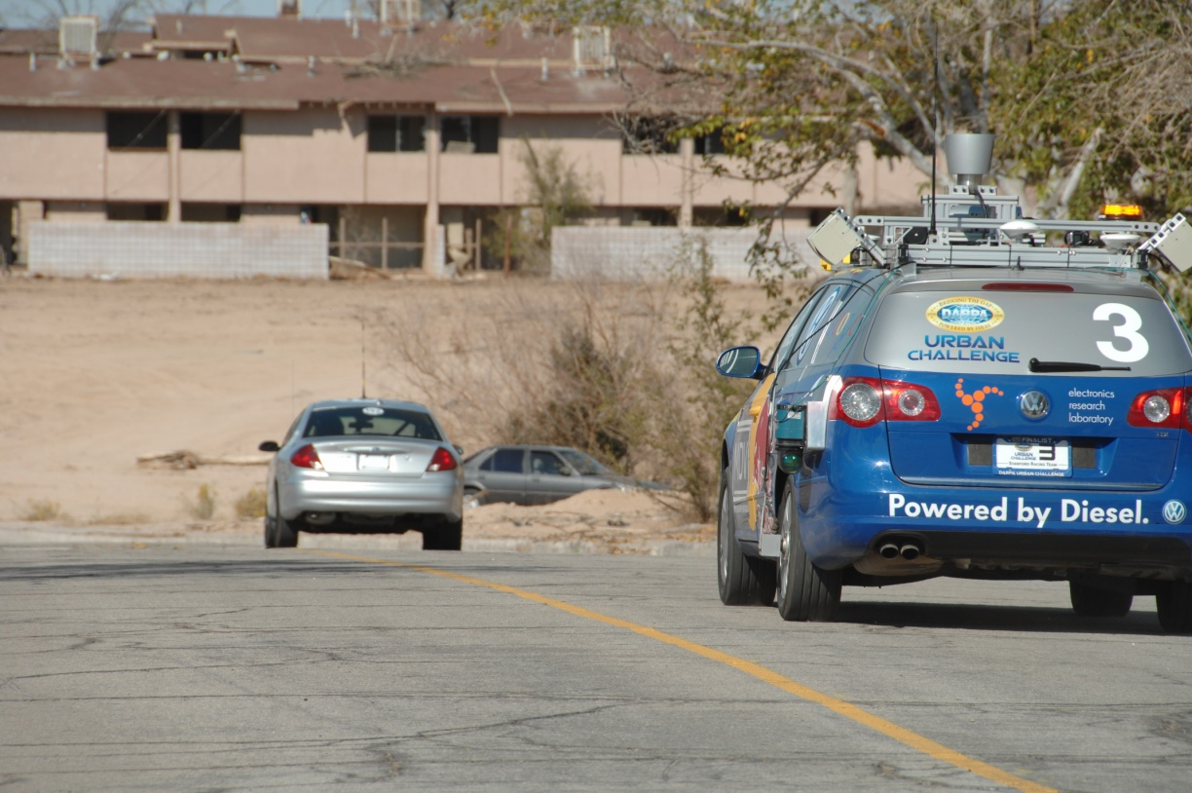
Autonomous agents able to detect objects
http://www.darpa.mil/grandchallenge/gallery.asp

Slide 20
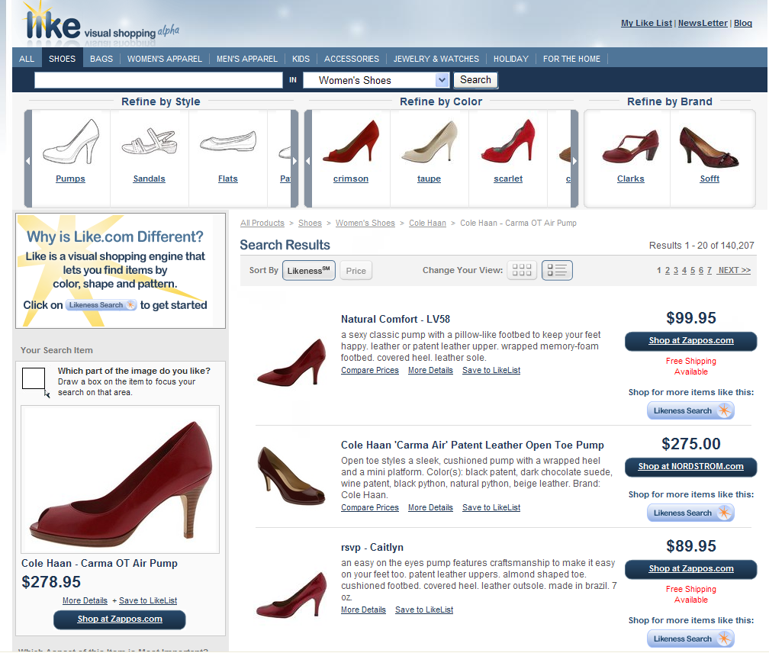
Finding visually similar objects
Notes:
20

Slide 21
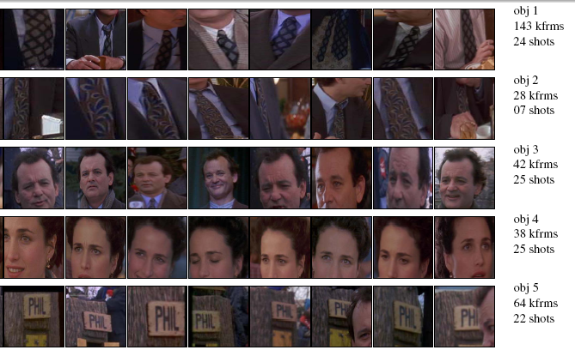
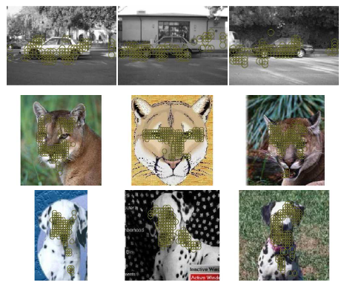
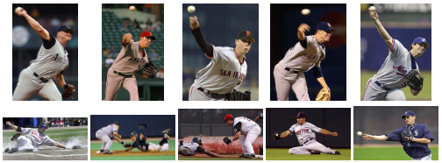
Discovering visual patterns
Objects
Sivic & Zisserman
Lee & Grauman
Categories
Actions
Wang et al.
Kristen Grauman

Slide 22
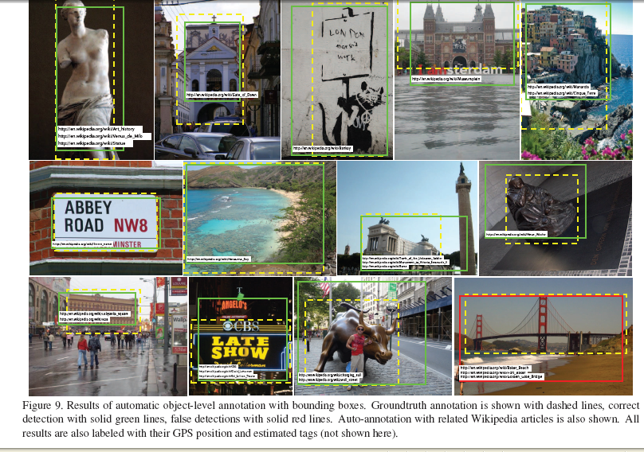
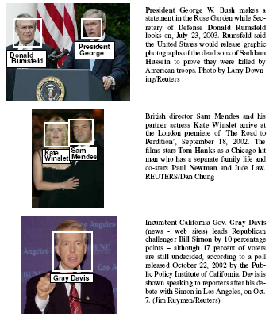
Auto-annotation
Gammeter et al.
T. Berg et al.
Kristen Grauman

Slide 23
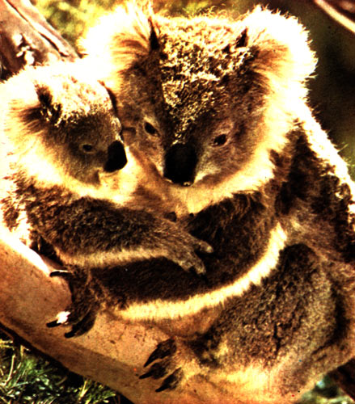
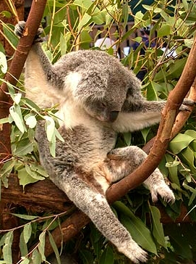
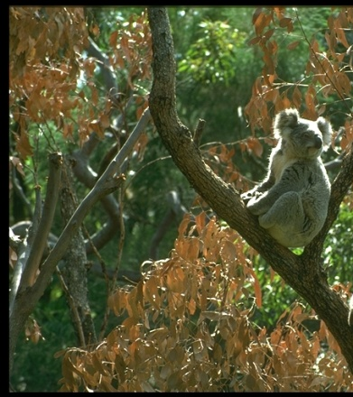
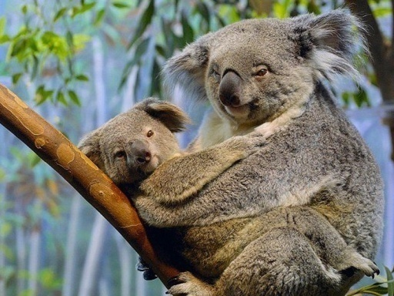
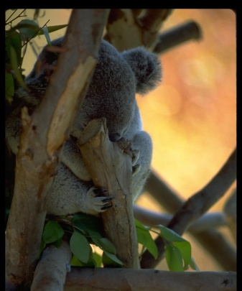
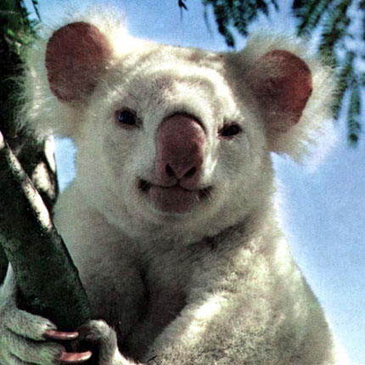
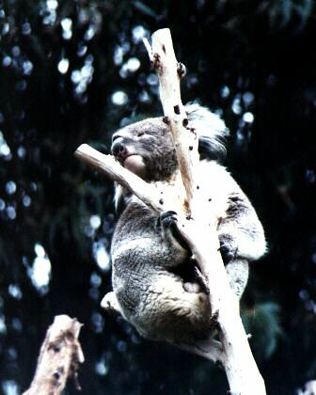
Challenges: robustness
Illumination
Object pose
Clutter
Occlusions
Intra-class appearance
Viewpoint
Kristen Grauman

Slide 24
Challenges: robustness
Realistic scenes are crowded, cluttered, have overlapping objects.

Slide 25


Challenges: importance of context
slide credit: Fei-Fei, Fergus & Torralba

Slide 26
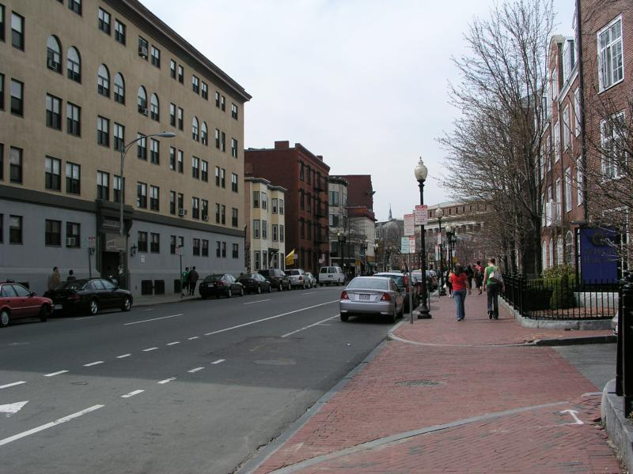
Challenges: importance of context

Slide 27
Challenges: complexity
Thousands to millions of pixels in an image
3,000-30,000 human recognizable object categories
30+ degrees of freedom in the pose of articulated objects (humans)
Billions of images indexed by Google Image Search
18 billion+ prints produced from digital camera images in 2004
295.5 million camera phones sold in 2005
About half of the cerebral cortex in primates is devoted to processing visual information [Felleman and van Essen 1991]
Kristen Grauman
Notes:
27

Slide 28
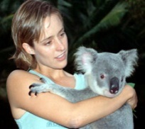
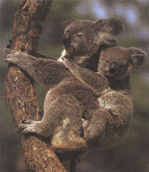
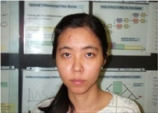









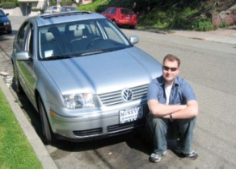



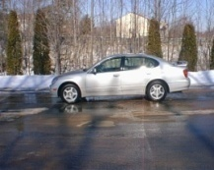



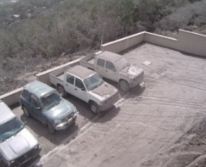

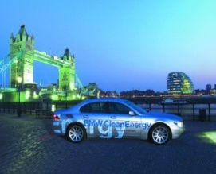
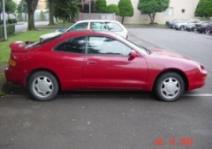


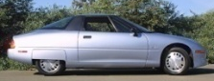

Challenges: learning with minimal supervision
Less
More
Unlabeled, multiple objects
Classes labeled, some clutter
Cropped to object, parts and classes labeled
Kristen Grauman

Slide 29

What works most reliably today
Reading license plates, zip codes, checks
Source: Lana Lazebnik
Notes:
29

Slide 30

What works most reliably today
Source: Lana Lazebnik
Reading license plates, zip codes, checks
Fingerprint recognition
Notes:
30

Slide 31


What works most reliably today
Source: Lana Lazebnik
Reading license plates, zip codes, checks
Fingerprint recognition
Face detection
Notes:
31

Slide 32
What works most reliably today
Source: Lana Lazebnik
Reading license plates, zip codes, checks
Fingerprint recognition
Face detection
Recognition of flat textured objects (CD covers, book covers, etc.)
Notes:
32

Slide 33
Generic category recognition: basic framework
Build/train object model
  Choose a representation
  Learn or fit parameters of model / classifier
Generate candidates in new image
Score the candidates
Kristen Grauman

Slide 34



Generic category recognition: representation choice
Window-based
Part-based
Kristen Grauman

Slide 35

Supervised classification
Given a collection of labeled examples, come up with a function that will predict the labels of new examples.
How good is some function we come up with to do the classification?
Depends on
  Mistakes made
  Cost associated with the mistakes
“four”
“nine”
?
Training examples
Novel input
Kristen Grauman

Slide 36
Supervised classification
Given a collection of labeled examples, come up with a function that will predict the labels of new examples.
Consider the two-class (binary) decision problem
  L(4→9): Loss of classifying a 4 as a 9
  L(9→4): Loss of classifying a 9 as a 4
Risk of a classifier s is expected loss:
We want to choose a classifier so as to minimize this total risk
Kristen Grauman

Slide 37
Supervised classification
Optimal classifier will minimize total risk.
At decision boundary, either choice of label yields same expected loss.
Feature value x
If we choose class “four” at boundary, expected loss is:
If we choose class “nine” at boundary, expected loss is:
Kristen Grauman

Slide 38
Supervised classification
Optimal classifier will minimize total risk.
At decision boundary, either choice of label yields same expected loss.
Feature value x
So, best decision boundary is at point x where
To classify a new point, choose class with lowest expected loss; i.e., choose “four” if
Kristen Grauman

Slide 39
Supervised classification
Optimal classifier will minimize total risk.
At decision boundary, either choice of label yields same expected loss.
P(4 | x)
P(9 | x)
Feature value x
So, best decision boundary is at point x where
To classify a new point, choose class with lowest expected loss; i.e., choose “four” if
How to evaluate these probabilities?
Kristen Grauman

Slide 40





Probability
Basic probability
  X is a random variable
  P(X) is the probability that X achieves a certain value
  or
  Conditional probability: P(X | Y)
    probability of X given that we already know Y
called a PDF
  probability distribution/density function
continuous X
discrete X
Source: Steve Seitz

Slide 41

Example: learning skin colors
We can represent a class-conditional density using a histogram (a “non-parametric” distribution)
Percentage of skin pixels in each bin
P(x|skin)
Feature x = Hue
P(x|not skin)
Feature x = Hue
Kristen Grauman

Slide 42

Example: learning skin colors
We can represent a class-conditional density using a histogram (a “non-parametric” distribution)
P(x|skin)
Feature x = Hue
Now we get a new image, and want to label each pixel as skin or non-skin.
What’s the probability we care about to do skin detection?
P(x|not skin)
Feature x = Hue
Kristen Grauman

Slide 43
Bayes rule
posterior
likelihood
prior
Where does the prior come from?
Why use a prior?

Slide 44


Example: classifying skin pixels
Now for every pixel in a new image, we can estimate probability that it is generated by skin.
Brighter pixels → higher probability of being skin
Classify pixels based on these probabilities
Kristen Grauman

Slide 45

Example: classifying skin pixels
Gary Bradski, 1998
Kristen Grauman

Slide 46


Example: classifying skin pixels
Using skin color-based face detection and pose estimation as a video-based interface
Gary Bradski, 1998
Kristen Grauman

Slide 47
Supervised classification
Want to minimize the expected misclassification
Two general strategies
  Use the training data to build representative probability model; separately model class-conditional densities and priors (generative)
  Directly construct a good decision boundary, model the posterior (discriminative)

Slide 48
Coming up
Pset 4 is posted, due in 2 weeks
Next week:
Face detection
Categorization with local features and part-based models

