Slide 1
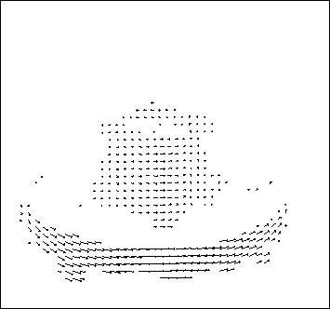
Motion
Wed, April 20
Kristen Grauman
UT-Austin
Many slides adapted from S. Seitz, R. Szeliski, M. Pollefeys, and S. Lazebnik

Slide 2
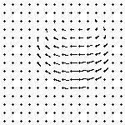
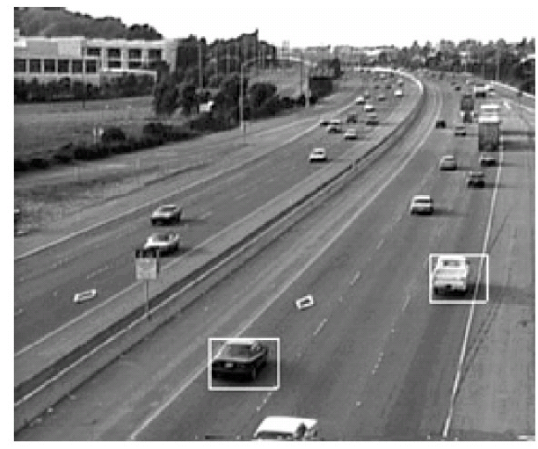
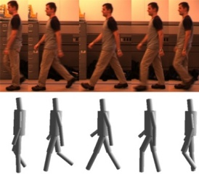
Finally: Motion and tracking
Tracking objects, video analysis, low level motion
Tomas Izo

Slide 3
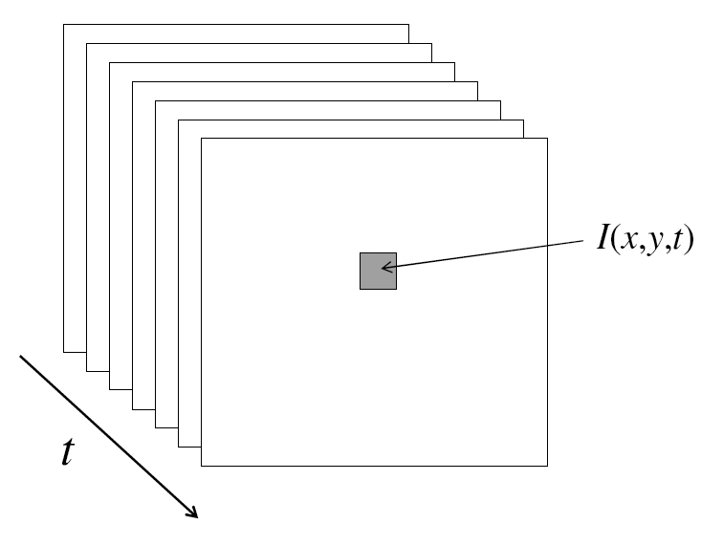
Video
A video is a sequence of frames captured over time
Now our image data is a function of space
(x, y) and time (t)

Slide 4
Uses of motion
Estimating 3D structure
Segmenting objects based on motion cues
Learning dynamical models
Recognizing events and activities
Improving video quality (motion stabilization)

Slide 5
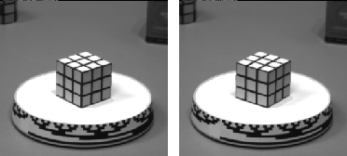
Motion field
The motion field is the projection of the 3D scene motion into the image

Slide 6
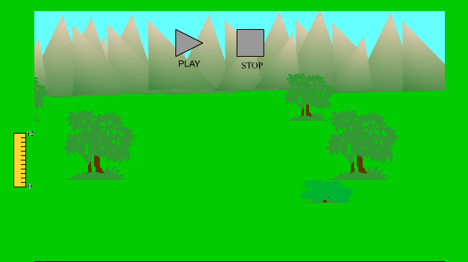
Motion parallax
http://psych.hanover.edu/KRANTZ/MotionParallax/MotionParallax.html

Slide 7
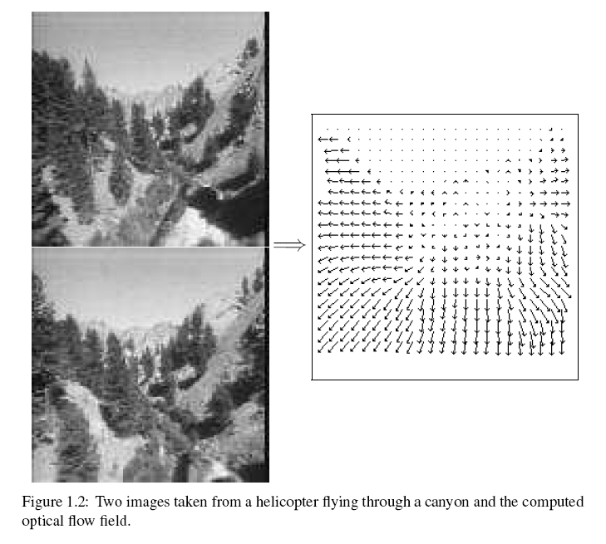
Motion field + camera motion
Length of flow vectors inversely proportional to depth Z of 3d point
points closer to the camera move more quickly across the image plane
Figure from Michael Black, Ph.D. Thesis

Slide 8
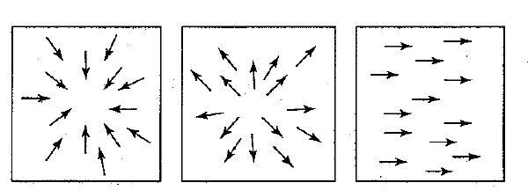
Motion field + camera motion
Zoom out
Zoom in
Pan right to left

Slide 9
Motion estimation techniques
Direct methods
  Directly recover image motion at each pixel from spatio-temporal image brightness variations
  Dense motion fields, but sensitive to appearance variations
  Suitable for video and when image motion is small
Feature-based methods
  Extract visual features (corners, textured areas) and track them over multiple frames
  Sparse motion fields, but more robust tracking
  Suitable when image motion is large (10s of pixels)

Slide 10
Optical flow
Definition: optical flow is the apparent motion of brightness patterns in the image
Ideally, optical flow would be the same as the motion field
Have to be careful: apparent motion can be caused by lighting changes without any actual motion

Slide 11
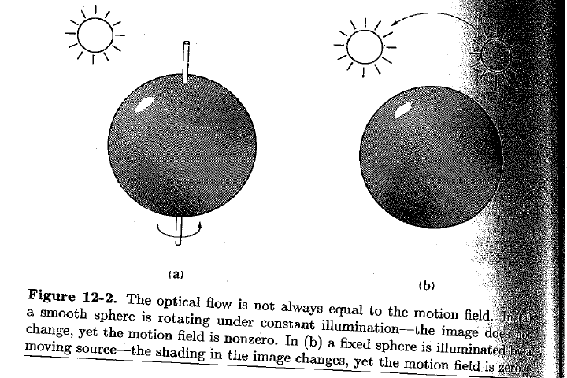
Apparent motion != motion field
Figure from Horn book

Slide 12


Problem definition: optical flow
How to estimate pixel motion from image H to image I?
  Solve pixel correspondence problem
    given a pixel in H, look for nearby pixels of the same color in I
Key assumptions
  color constancy: a point in H looks the same in I
    For grayscale images, this is brightness constancy
  small motion: points do not move very far
This is called the optical flow problem
Steve Seitz

Slide 13
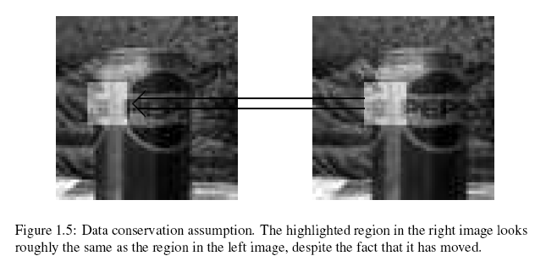
Brightness constancy
Figure by Michael Black

Slide 14


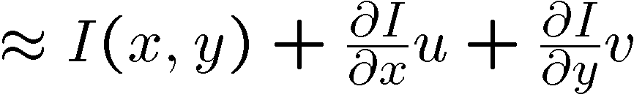
Optical flow constraints (grayscale images)
Let’s look at these constraints more closely
  brightness constancy: Q: what’s the equation?
  small motion:
Steve Seitz

Slide 15
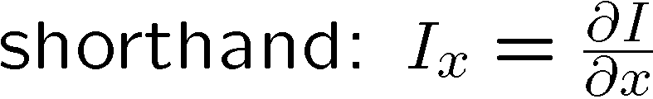


Optical flow equation
Combining these two equations
Steve Seitz

Slide 16

Optical flow equation
Q: how many unknowns and equations per pixel?
Intuitively, what does this ambiguity mean?

Slide 17
The aperture problem
Perceived motion
Notes:
The component of the flow perpendicular to the gradient (i.e., parallel to the edge) is unknown

Slide 18
The aperture problem
Actual motion

Slide 19

The barber pole illusion
http://en.wikipedia.org/wiki/Barberpole_illusion

Slide 20

The barber pole illusion
http://www.sandlotscience.com/Ambiguous/Barberpole_Illusion.htm

Slide 21
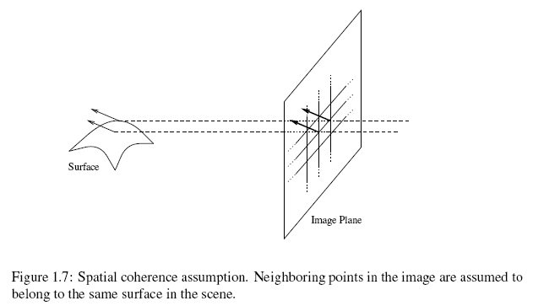
Solving the aperture problem (grayscale image)
How to get more equations for a pixel?
Spatial coherence constraint: pretend the pixel’s neighbors have the same (u,v)
Figure by Michael Black

Slide 22
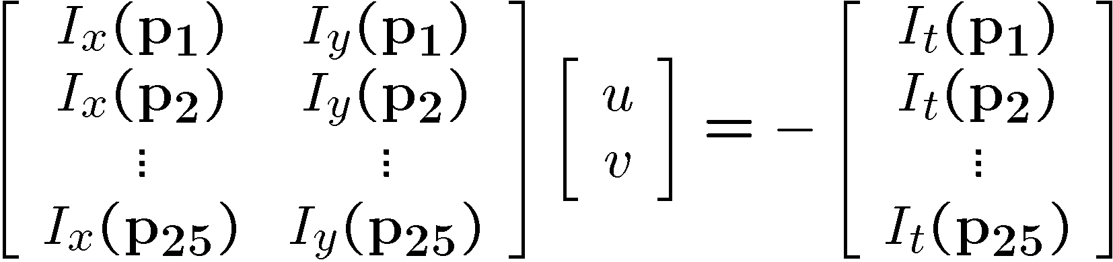




Solving the aperture problem (grayscale image)
How to get more equations for a pixel?
Spatial coherence constraint: pretend the pixel’s neighbors have the same (u,v)
  If we use a 5x5 window, that gives us 25 equations per pixel
Steve Seitz

Slide 23






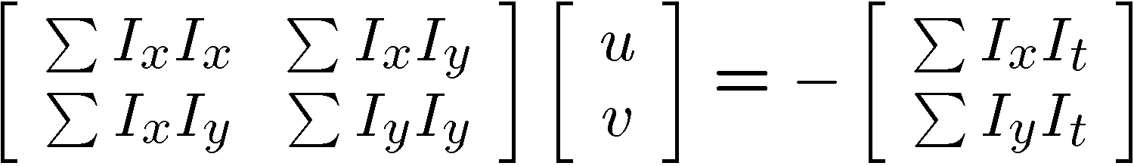


Solving the aperture problem
Prob: we have more equations than unknowns
Solution: solve least squares problem
  minimum least squares solution given by solution (in d) of:
  The summations are over all pixels in the K x K window
  This technique was first proposed by Lucas & Kanade (1981)

Slide 24
Conditions for solvability
When is this solvable?
  A^{T}A should be invertible
  A^{T}A should not be too small
    eigenvalues λ₁ and λ₂ of A^{T}A should not be too small
  A^{T}A should be well-conditioned
    λ₁/ λ₂ should not be too large (λ₁ = larger eigenvalue)
Slide by Steve Seitz, UW

Slide 25
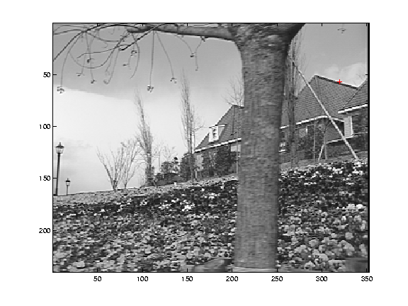
Edge
gradients very large or very small
large λ₁, small λ₂

Slide 26
Low-texture region
gradients have small magnitude
small λ₁, small λ₂

Slide 27
High-texture region
gradients are different, large magnitudes
large λ₁, large λ₂

Slide 28
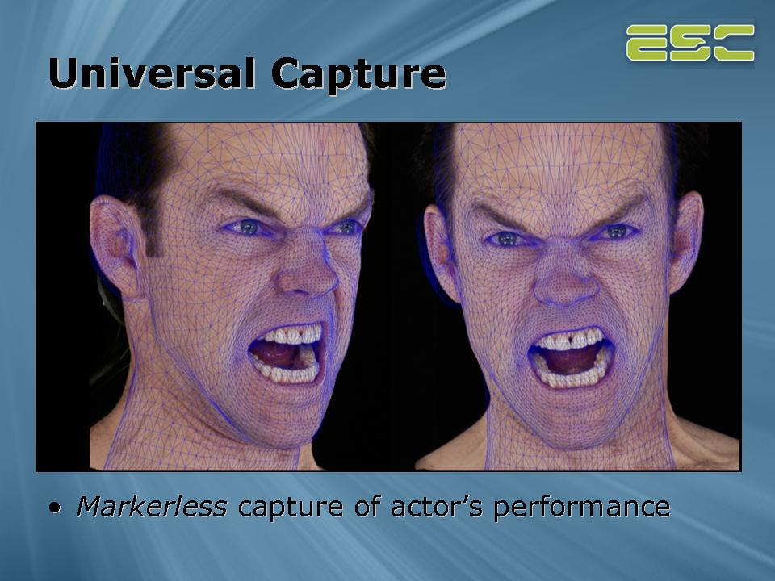
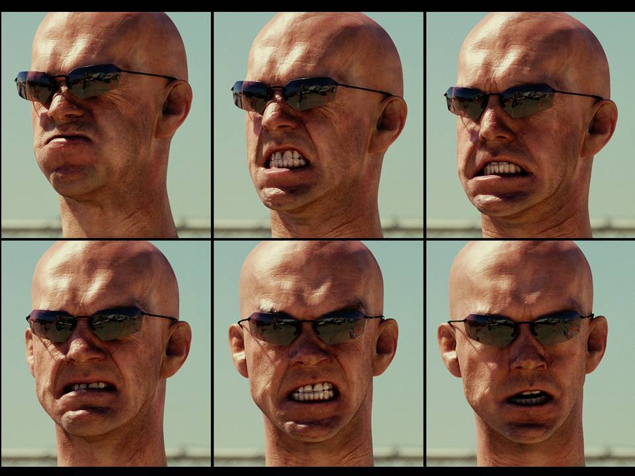
Example use of optical flow: facial animation
http://www.fxguide.com/article333.html

Slide 29
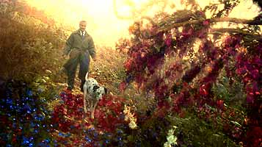
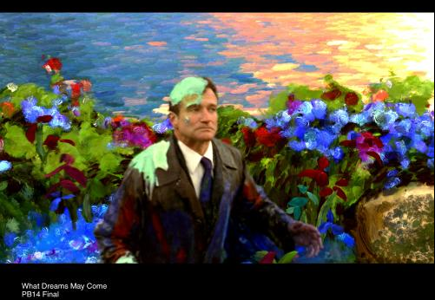
Example use of optical flow:
Motion Paint
Use optical flow to track brush strokes, in order to animate them to follow underlying scene motion.
http://www.fxguide.com/article333.html

Slide 30
Fun with flow
http://www.youtube.com/watch?v=TbJrc6QCeU0&feature=related
http://www.youtube.com/watch?v=pckFacsIWg4

Slide 31
Motion vs. Stereo: Similarities
Both involve solving
  Correspondence: disparities, motion vectors
  Reconstruction

Slide 32
Motion vs. Stereo: Differences
Motion:
  Uses velocity: consecutive frames must be close to get good approximate time derivative
  3d movement between camera and scene not necessarily single 3d rigid transformation
Whereas with stereo:
  Could have any disparity value
  View pair separated by a single 3d transformation

Slide 33
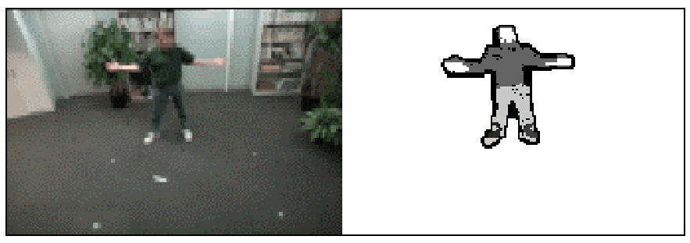
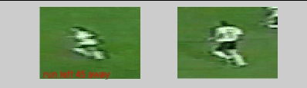
Coming up
Background subtraction, activity recognition, tracking

