Slide 1
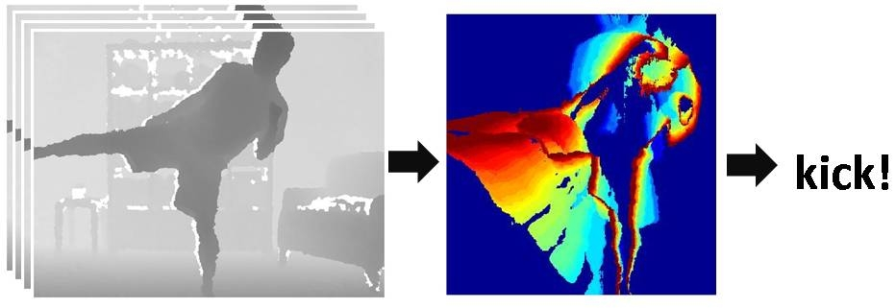
Actions in video
Monday, April 25
Kristen Grauman
UT-Austin

Slide 2
Today
Optical flow wrapup
Activity in video
Background subtraction
Recognition of actions based on motion patterns
Example applications

Slide 3
Using optical flow: recognizing facial expressions
Recognizing Human Facial Expression (1994)
by Yaser Yacoob, Larry S. Davis

Slide 4
Using optical flow: recognizing facial expressions

Slide 5
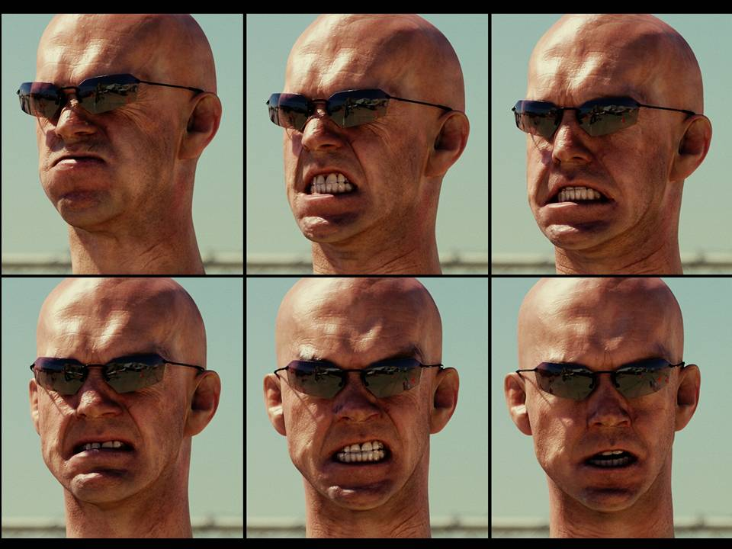
Example use of optical flow: facial animation
http://www.fxguide.com/article333.html

Slide 6
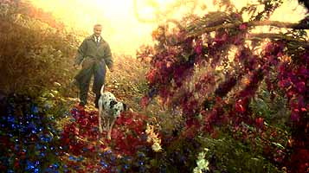
Example use of optical flow: Motion Paint
Use optical flow to track brush strokes, in order to animate them to follow underlying scene motion.
http://www.fxguide.com/article333.html

Slide 7
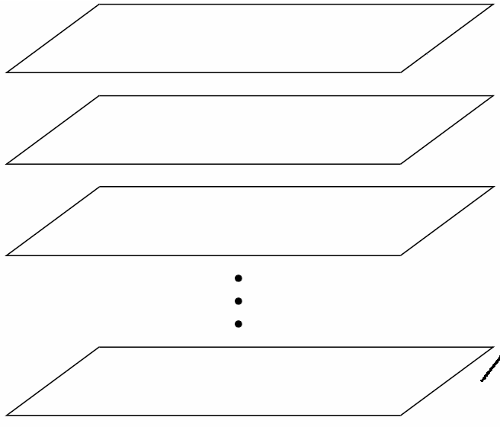
Video as an “Image Stack”
time
255
0
t
Can look at video data as a spatio-temporal volume
If camera is stationary, each line through time corresponds to a single ray in space
Alyosha Efros, CMU

Slide 8
Input Video
Alyosha Efros, CMU

Slide 9
Average Image
Alyosha Efros, CMU

Slide 10
Slide credit: Birgi Tamersoy

Slide 11
Background subtraction
Simple techniques can do ok with static camera
…But hard to do perfectly
Widely used:
Traffic monitoring (counting vehicles, detecting & tracking vehicles, pedestrians),
Human action recognition (run, walk, jump, squat),
Human-computer interaction
Object tracking

Slide 12
Slide credit: Birgi Tamersoy

Slide 13
Slide credit: Birgi Tamersoy

Slide 14
Slide credit: Birgi Tamersoy

Slide 15
Slide credit: Birgi Tamersoy

Slide 16
Frame differences vs. background subtraction
Toyama et al. 1999

Slide 17
Slide credit: Birgi Tamersoy

Slide 18
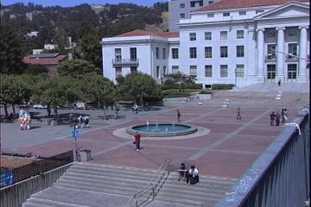
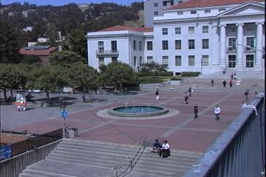
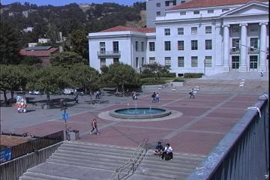
Average/Median Image
Alyosha Efros, CMU

Slide 19
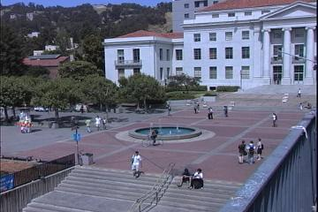
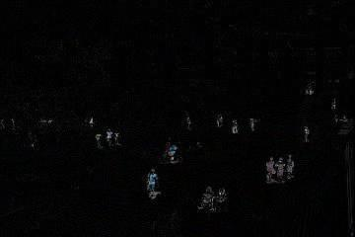
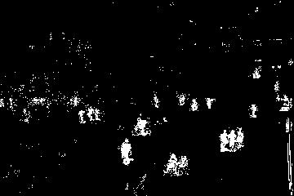
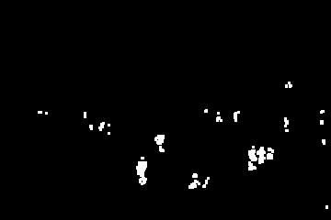
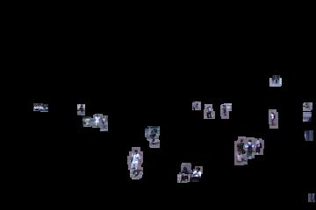
Background Subtraction
-
=
Alyosha Efros, CMU

Slide 20
Pros and cons
Advantages:
Extremely easy to implement and use!
All pretty fast.
Corresponding background models need not be constant, they change over time.
Disadvantages:
Accuracy of frame differencing depends on object speed and frame rate
Median background model: relatively high memory requirements.
Setting global threshold Th…
When will this basic approach fail?
Slide credit: Birgi Tamersoy

Slide 21
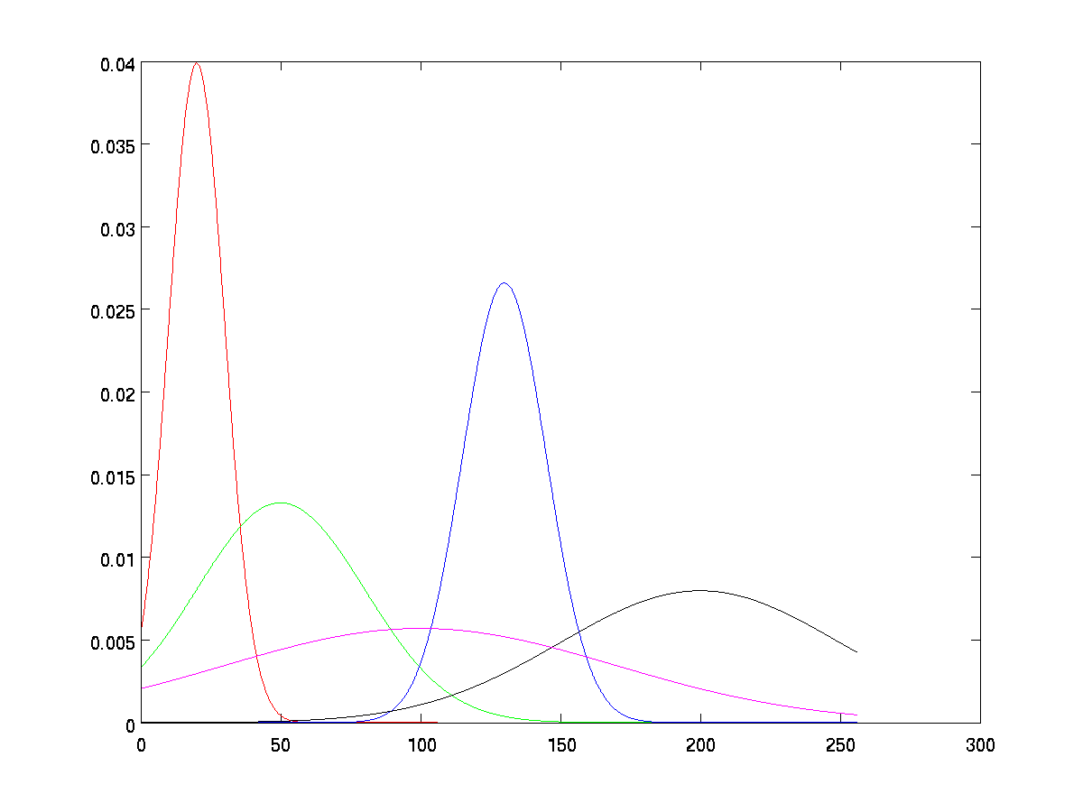
Background mixture models
Idea: model each background pixel with a mixture of Gaussians; update its parameters over time.
Adaptive Background Mixture Models for Real-Time Tracking, Chris Stauer & W.E.L. Grimson

Slide 22
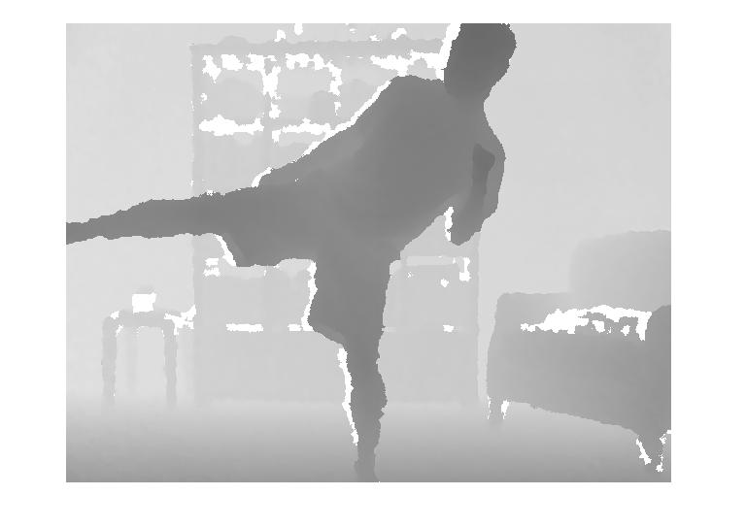
Background subtraction with depth
How can we select foreground pixels based on depth information?

Slide 23
Today
Optical flow wrapup
Activity in video
Background subtraction
Recognition of action based on motion patterns
Example applications

Slide 24
Human activity in video
No universal terminology, but approximately:
“Actions”: atomic motion patterns -- often gesture-like, single clear-cut trajectory, single nameable behavior (e.g., sit, wave arms)
“Activity”: series or composition of actions (e.g., interactions between people)
“Event”: combination of activities or actions (e.g., a football game, a traffic accident)
Adapted from Venu Govindaraju

Slide 25
Surveillance
http://users.isr.ist.utl.pt/~etienne/mypubs/Auvinetal06PETS.pdf

Slide 26
Interfaces
2011

Slide 27
Interfaces
2011
1995
W. T. Freeman and C. Weissman, Television control by hand gestures, International Workshop on Automatic Face- and Gesture- Recognition, IEEE Computer Society, Zurich, Switzerland, June, 1995, pp. 179--183. MERL-TR94-24
Notes:
www.botsquare.com

Slide 28
Human activity in video: basic approaches
Model-based action/activity recognition:
Use human body tracking and pose estimation techniques, relate to action descriptions (or learn)
Major challenge: accurate tracks in spite of occlusion, ambiguity, low resolution
Activity as motion, space-time appearance patterns
Describe overall patterns, but no explicit body tracking
Typically learn a classifier
We’ll look at some specific instances…

Slide 29
Motion and perceptual organization
Even “impoverished” motion data can evoke a strong percept

Slide 30
Motion and perceptual organization
Even “impoverished” motion data can evoke a strong percept

Slide 31
Motion and perceptual organization
Even “impoverished” motion data can evoke a strong percept
Video from Davis & Bobick

Slide 32
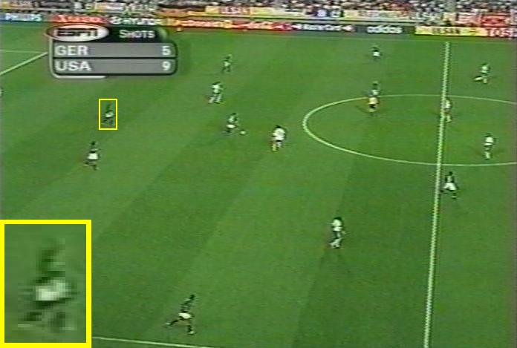
Using optical flow: action recognition at a distance
Features = optical flow within a region of interest
Classifier = nearest neighbors
Challenge: low-res data, not going to be able to track each limb.
The 30-Pixel Man
[Efros, Berg, Mori, & Malik 2003]
http://graphics.cs.cmu.edu/people/efros/research/action/

Slide 33
Using optical flow: action recognition at a distance
Correlation-based tracking
Extract person-centered frame window
[Efros, Berg, Mori, & Malik 2003]
http://graphics.cs.cmu.edu/people/efros/research/action/

Slide 34
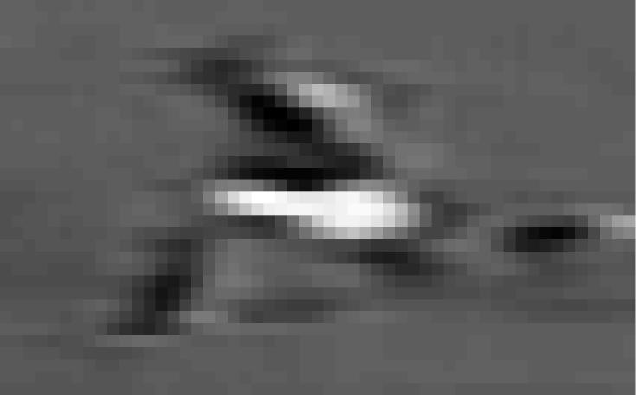
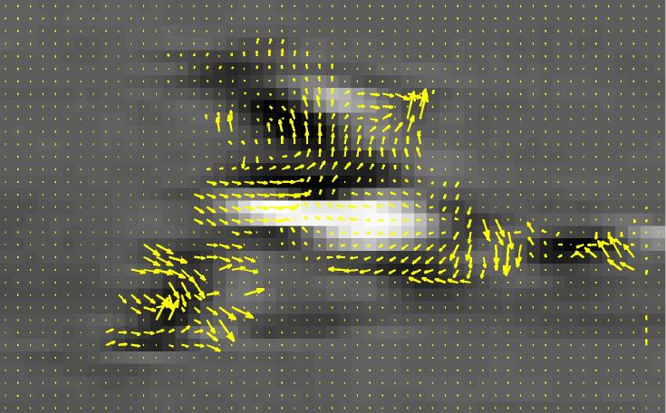
Using optical flow: action recognition at a distance
Extract optical flow to describe the region’s motion.
[Efros, Berg, Mori, & Malik 2003]
http://graphics.cs.cmu.edu/people/efros/research/action/

Slide 35
Using optical flow: action recognition at a distance
Input
Sequence
Matched
Frames
Use nearest neighbor classifier to name the actions occurring in new video frames.
[Efros, Berg, Mori, & Malik 2003]
http://graphics.cs.cmu.edu/people/efros/research/action/

Slide 36
Using optical flow: action recognition at a distance
Input
Sequence
Matched NN
Frame
Use nearest neighbor classifier to name the actions occurring in new video frames.
[Efros, Berg, Mori, & Malik 2003]
http://graphics.cs.cmu.edu/people/efros/research/action/

Slide 37
Do as I do: motion retargeting
[Efros, Berg, Mori, & Malik 2003]
http://graphics.cs.cmu.edu/people/efros/research/action/

Slide 38
Motivation
Even “impoverished” motion data can evoke a strong percept

Slide 39
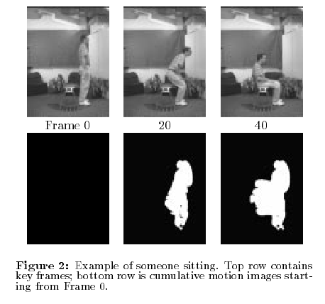
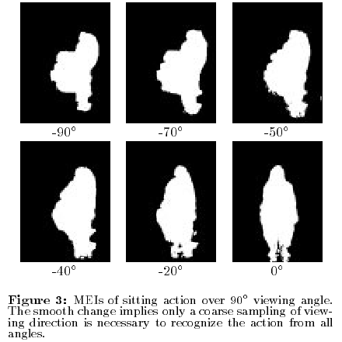
Motion Energy Images
D(x,y,t): Binary image sequence indicating motion locations
Davis & Bobick 1999: The Representation and Recognition of Action Using Temporal Templates

Slide 40
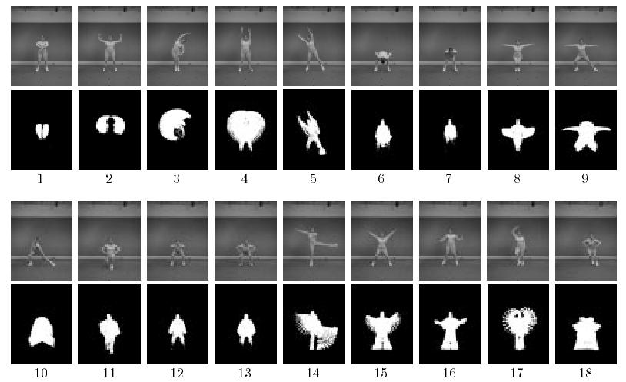
Motion Energy Images
Davis & Bobick 1999: The Representation and Recognition of Action Using Temporal Templates

Slide 41
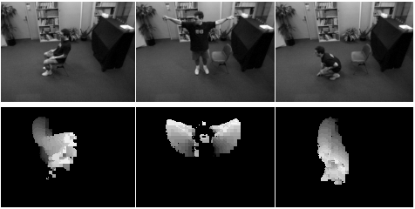
Motion History Images
Davis & Bobick 1999: The Representation and Recognition of Action Using Temporal Templates

Slide 42
Image moments
Use to summarize shape given image I(x,y)
Central moments are translation invariant:

Slide 43
Hu moments
Set of 7 moments
Apply to Motion History Image for global space-time “shape” descriptor
Translation and rotation invariant
See handout

Slide 44
Pset 5
Depth map sequence
Motion History Image
Nearest neighbor action classification with Motion History Images + Hu moments

Slide 45
Summary
Background subtraction:
Essential low-level processing tool to segment moving objects from static camera’s video
Action recognition:
Increasing attention to actions as motion and appearance patterns
For instrumented/constrained environments, relatively simple techniques allow effective gesture or action recognition

Slide 47
Hu moments

