Slide 1
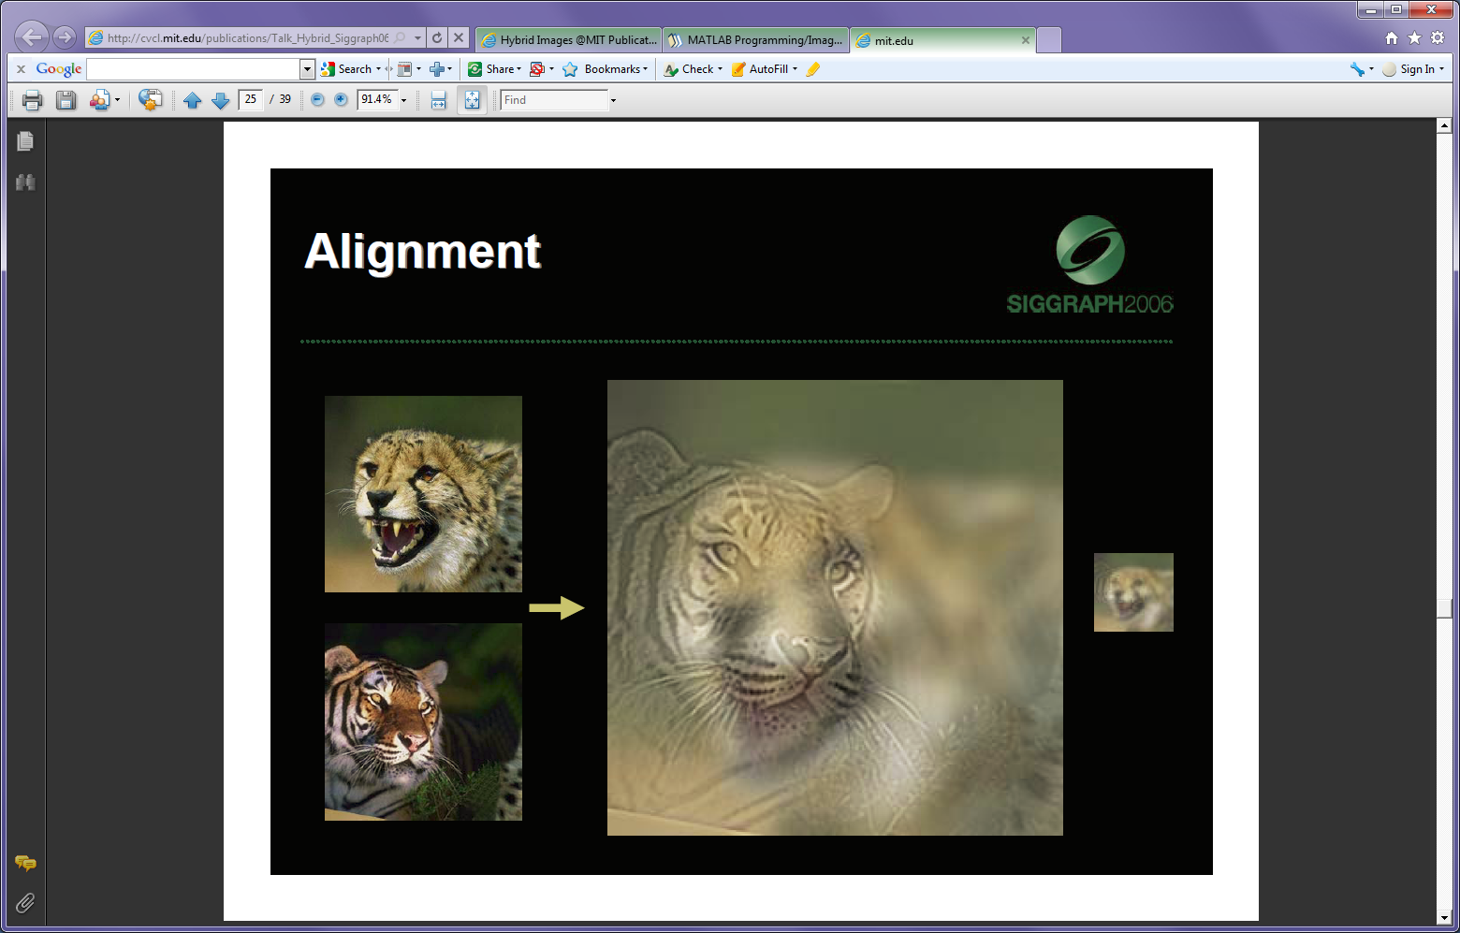
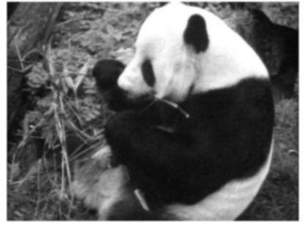
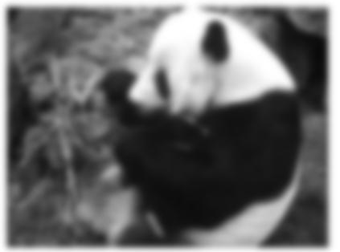
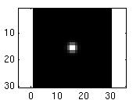
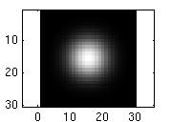
Linear Filters
Monday, Jan 24
Prof. Kristen Grauman
UT-Austin
…

Slide 2
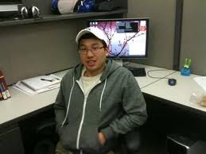
Announcements
Office hours Mon-Thurs 5-6 pm
  Mon: Yong Jae, PAI 5.33
  Tues/Thurs: Shalini, PAI 5.33
  Wed: Me, ACES 3.446
cv-spring2011@cs.utexas.edu for assignment questions outside of office hours
Pset 0 due Friday Jan 28. Drop box in PAI 5.38. Attach cover page with name and CS 376

Slide 3
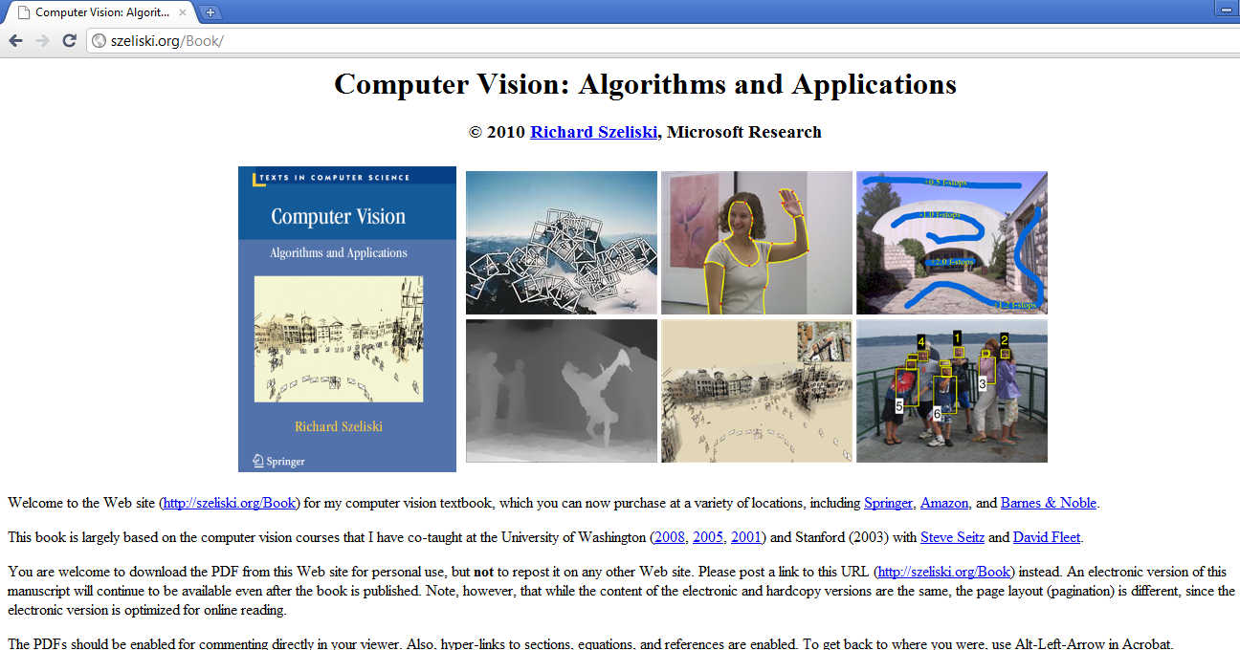

Slide 4
Plan for today
Image noise
Linear filters
  Examples: smoothing filters
Convolution / correlation

Slide 5
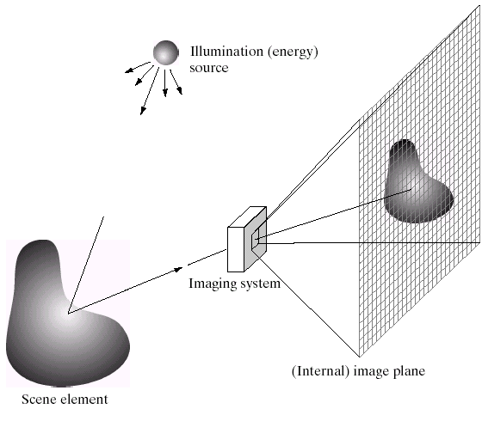
Image Formation
Slide credit: Derek Hoiem

Slide 6
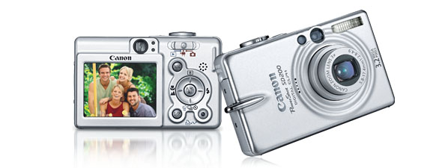
Digital camera
A digital camera replaces film with a sensor array
Each cell in the array is light-sensitive diode that converts photons to electrons
http://electronics.howstuffworks.com/digital-camera.htm
Slide by Steve Seitz

Slide 7
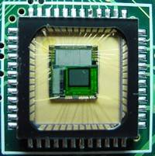
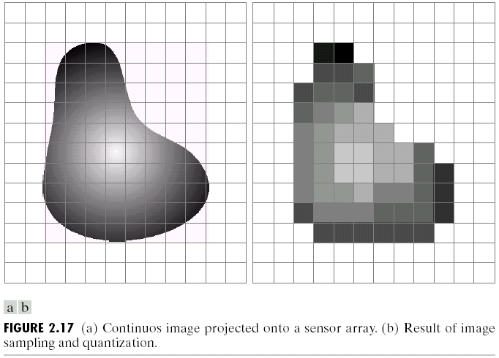
Digital images
Slide credit: Derek Hoiem

Slide 8

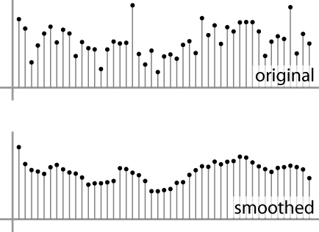
Digital images
Sample the 2D space on a regular grid
Quantize each sample (round to nearest integer)
Image thus represented as a matrix of integer values.
2D
1D
Adapted from S. Seitz

Slide 9
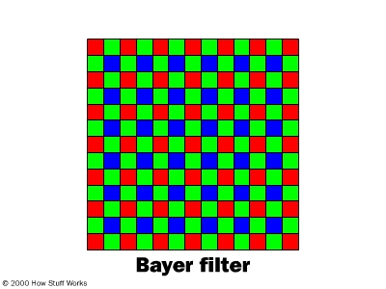
Digital color images

Slide 10
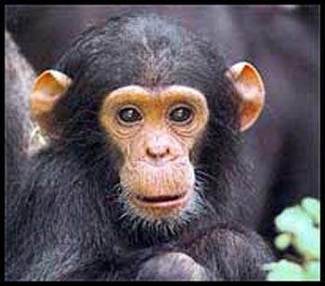
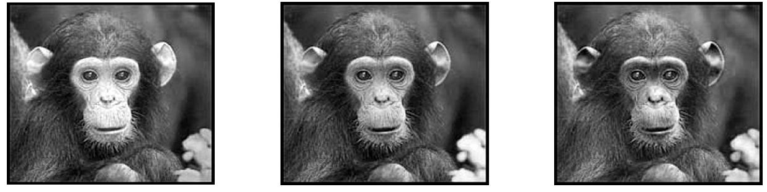
Digital color images
Color images, RGB color space
R
G
B

Slide 11
Images in Matlab
Images represented as a matrix
Suppose we have a NxM RGB image called “im”
  im(1,1,1) = top-left pixel value in R-channel
  im(y, x, b) = y pixels down, x pixels to right in the b^{th} channel
  im(N, M, 3) = bottom-right pixel in B-channel
imread(filename) returns a uint8 image (values 0 to 255)
  Convert to double format (values 0 to 1) with im2double
column
row
R
0.92 | 0.93 | 0.94 | 0.97 | 0.62 | 0.37 | 0.85 | 0.97 | 0.93 | 0.92 | 0.99
0.95 | 0.89 | 0.82 | 0.89 | 0.56 | 0.31 | 0.75 | 0.92 | 0.81 | 0.95 | 0.91
0.89 | 0.72 | 0.51 | 0.55 | 0.51 | 0.42 | 0.57 | 0.41 | 0.49 | 0.91 | 0.92
0.96 | 0.95 | 0.88 | 0.94 | 0.56 | 0.46 | 0.91 | 0.87 | 0.90 | 0.97 | 0.95
0.71 | 0.81 | 0.81 | 0.87 | 0.57 | 0.37 | 0.80 | 0.88 | 0.89 | 0.79 | 0.85
0.49 | 0.62 | 0.60 | 0.58 | 0.50 | 0.60 | 0.58 | 0.50 | 0.61 | 0.45 | 0.33
0.86 | 0.84 | 0.74 | 0.58 | 0.51 | 0.39 | 0.73 | 0.92 | 0.91 | 0.49 | 0.74
0.96 | 0.67 | 0.54 | 0.85 | 0.48 | 0.37 | 0.88 | 0.90 | 0.94 | 0.82 | 0.93
0.69 | 0.49 | 0.56 | 0.66 | 0.43 | 0.42 | 0.77 | 0.73 | 0.71 | 0.90 | 0.99
0.79 | 0.73 | 0.90 | 0.67 | 0.33 | 0.61 | 0.69 | 0.79 | 0.73 | 0.93 | 0.97
0.91 | 0.94 | 0.89 | 0.49 | 0.41 | 0.78 | 0.78 | 0.77 | 0.89 | 0.99 | 0.93
G
0.92 | 0.93 | 0.94 | 0.97 | 0.62 | 0.37 | 0.85 | 0.97 | 0.93 | 0.92 | 0.99
0.95 | 0.89 | 0.82 | 0.89 | 0.56 | 0.31 | 0.75 | 0.92 | 0.81 | 0.95 | 0.91
0.89 | 0.72 | 0.51 | 0.55 | 0.51 | 0.42 | 0.57 | 0.41 | 0.49 | 0.91 | 0.92
0.96 | 0.95 | 0.88 | 0.94 | 0.56 | 0.46 | 0.91 | 0.87 | 0.90 | 0.97 | 0.95
0.71 | 0.81 | 0.81 | 0.87 | 0.57 | 0.37 | 0.80 | 0.88 | 0.89 | 0.79 | 0.85
0.49 | 0.62 | 0.60 | 0.58 | 0.50 | 0.60 | 0.58 | 0.50 | 0.61 | 0.45 | 0.33
0.86 | 0.84 | 0.74 | 0.58 | 0.51 | 0.39 | 0.73 | 0.92 | 0.91 | 0.49 | 0.74
0.96 | 0.67 | 0.54 | 0.85 | 0.48 | 0.37 | 0.88 | 0.90 | 0.94 | 0.82 | 0.93
0.69 | 0.49 | 0.56 | 0.66 | 0.43 | 0.42 | 0.77 | 0.73 | 0.71 | 0.90 | 0.99
0.79 | 0.73 | 0.90 | 0.67 | 0.33 | 0.61 | 0.69 | 0.79 | 0.73 | 0.93 | 0.97
0.91 | 0.94 | 0.89 | 0.49 | 0.41 | 0.78 | 0.78 | 0.77 | 0.89 | 0.99 | 0.93
B
0.92 | 0.93 | 0.94 | 0.97 | 0.62 | 0.37 | 0.85 | 0.97 | 0.93 | 0.92 | 0.99
0.95 | 0.89 | 0.82 | 0.89 | 0.56 | 0.31 | 0.75 | 0.92 | 0.81 | 0.95 | 0.91
0.89 | 0.72 | 0.51 | 0.55 | 0.51 | 0.42 | 0.57 | 0.41 | 0.49 | 0.91 | 0.92
0.96 | 0.95 | 0.88 | 0.94 | 0.56 | 0.46 | 0.91 | 0.87 | 0.90 | 0.97 | 0.95
0.71 | 0.81 | 0.81 | 0.87 | 0.57 | 0.37 | 0.80 | 0.88 | 0.89 | 0.79 | 0.85
0.49 | 0.62 | 0.60 | 0.58 | 0.50 | 0.60 | 0.58 | 0.50 | 0.61 | 0.45 | 0.33
0.86 | 0.84 | 0.74 | 0.58 | 0.51 | 0.39 | 0.73 | 0.92 | 0.91 | 0.49 | 0.74
0.96 | 0.67 | 0.54 | 0.85 | 0.48 | 0.37 | 0.88 | 0.90 | 0.94 | 0.82 | 0.93
0.69 | 0.49 | 0.56 | 0.66 | 0.43 | 0.42 | 0.77 | 0.73 | 0.71 | 0.90 | 0.99
0.79 | 0.73 | 0.90 | 0.67 | 0.33 | 0.61 | 0.69 | 0.79 | 0.73 | 0.93 | 0.97
0.91 | 0.94 | 0.89 | 0.49 | 0.41 | 0.78 | 0.78 | 0.77 | 0.89 | 0.99 | 0.93
Slide credit: Derek Hoiem

Slide 12
Image filtering
Compute a function of the local neighborhood at each pixel in the image
  Function specified by a “filter” or mask saying how to combine values from neighbors.
Uses of filtering:
  Enhance an image (denoise, resize, etc)
  Extract information (texture, edges, etc)
  Detect patterns (template matching)
Adapted from Derek Hoiem

Slide 13
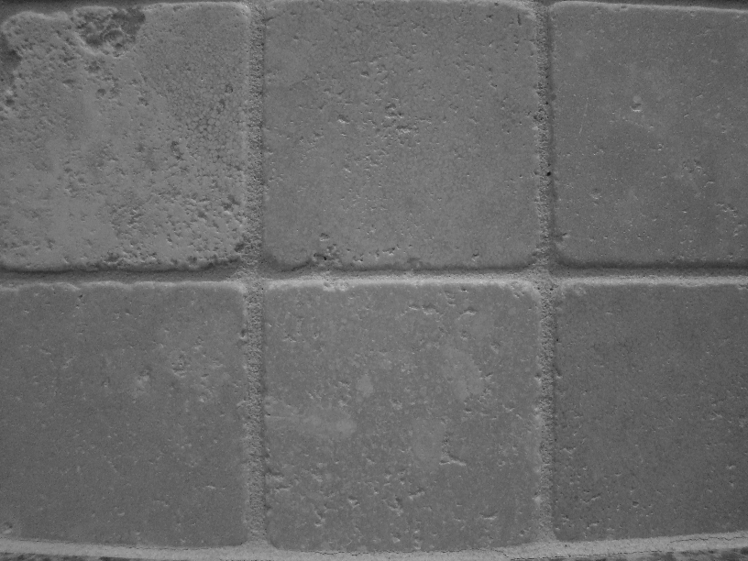
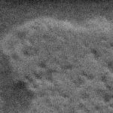
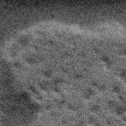

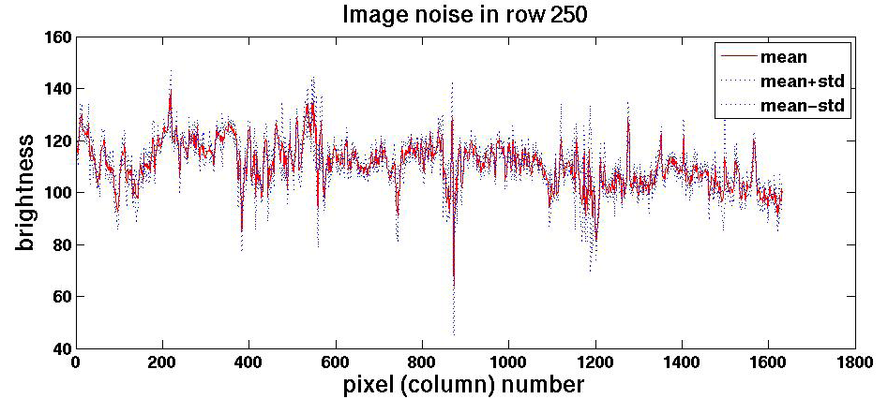
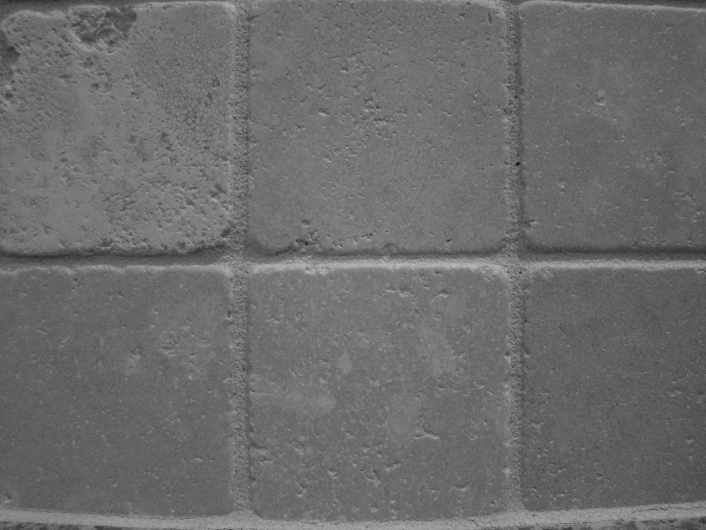
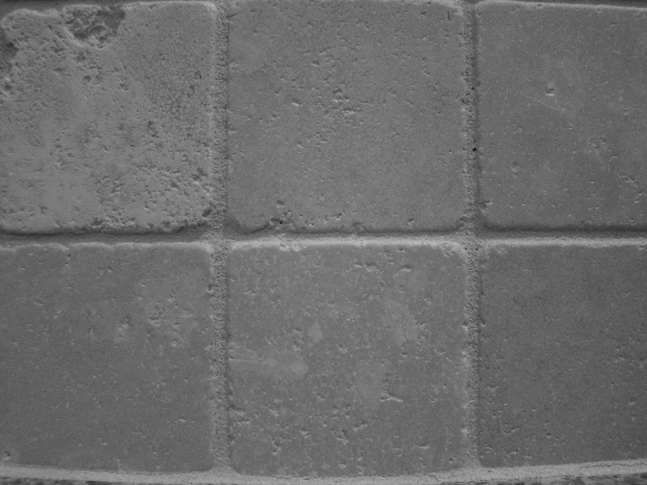


Motivation: noise reduction
Even multiple images of the same static scene will not be identical.

Slide 14
Common types of noise
  Salt and pepper noise: random occurrences of black and white pixels
  Impulse noise: random occurrences of white pixels
  Gaussian noise: variations in intensity drawn from a Gaussian normal distribution
Source: S. Seitz

Slide 15
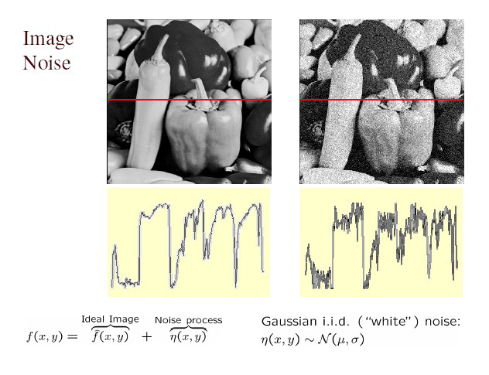
Gaussian noise
>> noise = randn(size(im)).*sigma;
>> output = im + noise;
What is impact of the sigma?
Fig: M. Hebert

Slide 16
Motivation: noise reduction
Even multiple images of the same static scene will not be identical.
How could we reduce the noise, i.e., give an estimate of the true intensities?
What if there’s only one image?

Slide 17
First attempt at a solution
Let’s replace each pixel with an average of all the values in its neighborhood
Assumptions:
  Expect pixels to be like their neighbors
  Expect noise processes to be independent from pixel to pixel

Slide 18
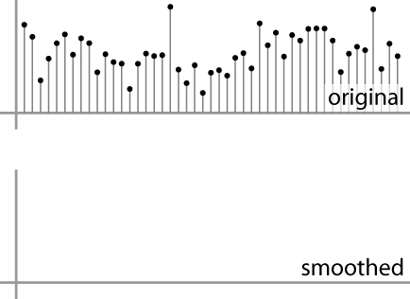
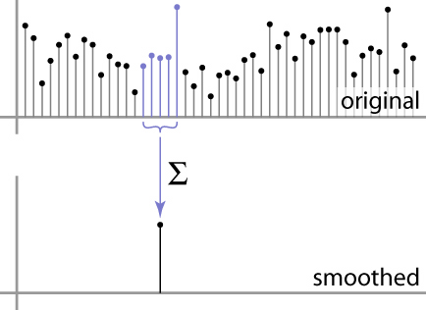
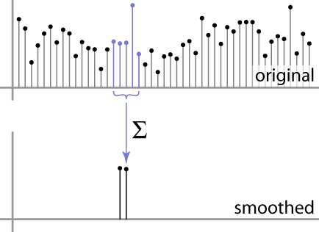
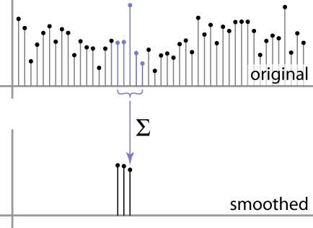
First attempt at a solution
Let’s replace each pixel with an average of all the values in its neighborhood
Moving average in 1D:
Source: S. Marschner

Slide 19
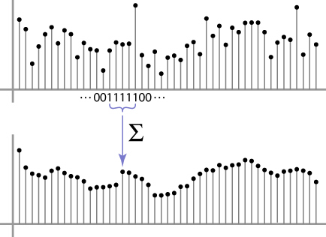
Weighted Moving Average
Can add weights to our moving average
Weights [1, 1, 1, 1, 1] / 5
Source: S. Marschner

Slide 20

Weighted Moving Average
Non-uniform weights [1, 4, 6, 4, 1] / 16
Source: S. Marschner

Slide 21


Moving Average In 2D
0 | 0 | 0 | 0 | 0 | 0 | 0 | 0 | 0 | 0
0 | 0 | 0 | 0 | 0 | 0 | 0 | 0 | 0 | 0
0 | 0 | 0 | 90 | 90 | 90 | 90 | 90 | 0 | 0
0 | 0 | 0 | 90 | 90 | 90 | 90 | 90 | 0 | 0
0 | 0 | 0 | 90 | 90 | 90 | 90 | 90 | 0 | 0
0 | 0 | 0 | 90 | 0 | 90 | 90 | 90 | 0 | 0
0 | 0 | 0 | 90 | 90 | 90 | 90 | 90 | 0 | 0
0 | 0 | 0 | 0 | 0 | 0 | 0 | 0 | 0 | 0
0 | 0 | 90 | 0 | 0 | 0 | 0 | 0 | 0 | 0
0 | 0 | 0 | 0 | 0 | 0 | 0 | 0 | 0 | 0
 | 0
0 | 0 | 0 | 0 | 0 | 0 | 0 | 0 | 0 | 0
0 | 0 | 0 | 0 | 0 | 0 | 0 | 0 | 0 | 0
0 | 0 | 0 | 90 | 90 | 90 | 90 | 90 | 0 | 0
0 | 0 | 0 | 90 | 90 | 90 | 90 | 90 | 0 | 0
0 | 0 | 0 | 90 | 90 | 90 | 90 | 90 | 0 | 0
0 | 0 | 0 | 90 | 0 | 90 | 90 | 90 | 0 | 0
0 | 0 | 0 | 90 | 90 | 90 | 90 | 90 | 0 | 0
0 | 0 | 0 | 0 | 0 | 0 | 0 | 0 | 0 | 0
0 | 0 | 90 | 0 | 0 | 0 | 0 | 0 | 0 | 0
0 | 0 | 0 | 0 | 0 | 0 | 0 | 0 | 0 | 0
Source: S. Seitz

Slide 22
Moving Average In 2D
0 | 0 | 0 | 0 | 0 | 0 | 0 | 0 | 0 | 0
0 | 0 | 0 | 0 | 0 | 0 | 0 | 0 | 0 | 0
0 | 0 | 0 | 90 | 90 | 90 | 90 | 90 | 0 | 0
0 | 0 | 0 | 90 | 90 | 90 | 90 | 90 | 0 | 0
0 | 0 | 0 | 90 | 90 | 90 | 90 | 90 | 0 | 0
0 | 0 | 0 | 90 | 0 | 90 | 90 | 90 | 0 | 0
0 | 0 | 0 | 90 | 90 | 90 | 90 | 90 | 0 | 0
0 | 0 | 0 | 0 | 0 | 0 | 0 | 0 | 0 | 0
0 | 0 | 90 | 0 | 0 | 0 | 0 | 0 | 0 | 0
0 | 0 | 0 | 0 | 0 | 0 | 0 | 0 | 0 | 0
 | 0 | 10
0 | 0 | 0 | 0 | 0 | 0 | 0 | 0 | 0 | 0
0 | 0 | 0 | 0 | 0 | 0 | 0 | 0 | 0 | 0
0 | 0 | 0 | 90 | 90 | 90 | 90 | 90 | 0 | 0
0 | 0 | 0 | 90 | 90 | 90 | 90 | 90 | 0 | 0
0 | 0 | 0 | 90 | 90 | 90 | 90 | 90 | 0 | 0
0 | 0 | 0 | 90 | 0 | 90 | 90 | 90 | 0 | 0
0 | 0 | 0 | 90 | 90 | 90 | 90 | 90 | 0 | 0
0 | 0 | 0 | 0 | 0 | 0 | 0 | 0 | 0 | 0
0 | 0 | 90 | 0 | 0 | 0 | 0 | 0 | 0 | 0
0 | 0 | 0 | 0 | 0 | 0 | 0 | 0 | 0 | 0
Source: S. Seitz

Slide 23
Moving Average In 2D
0 | 0 | 0 | 0 | 0 | 0 | 0 | 0 | 0 | 0
0 | 0 | 0 | 0 | 0 | 0 | 0 | 0 | 0 | 0
0 | 0 | 0 | 90 | 90 | 90 | 90 | 90 | 0 | 0
0 | 0 | 0 | 90 | 90 | 90 | 90 | 90 | 0 | 0
0 | 0 | 0 | 90 | 90 | 90 | 90 | 90 | 0 | 0
0 | 0 | 0 | 90 | 0 | 90 | 90 | 90 | 0 | 0
0 | 0 | 0 | 90 | 90 | 90 | 90 | 90 | 0 | 0
0 | 0 | 0 | 0 | 0 | 0 | 0 | 0 | 0 | 0
0 | 0 | 90 | 0 | 0 | 0 | 0 | 0 | 0 | 0
0 | 0 | 0 | 0 | 0 | 0 | 0 | 0 | 0 | 0
 | 0 | 10 | 20
0 | 0 | 0 | 0 | 0 | 0 | 0 | 0 | 0 | 0
0 | 0 | 0 | 0 | 0 | 0 | 0 | 0 | 0 | 0
0 | 0 | 0 | 90 | 90 | 90 | 90 | 90 | 0 | 0
0 | 0 | 0 | 90 | 90 | 90 | 90 | 90 | 0 | 0
0 | 0 | 0 | 90 | 90 | 90 | 90 | 90 | 0 | 0
0 | 0 | 0 | 90 | 0 | 90 | 90 | 90 | 0 | 0
0 | 0 | 0 | 90 | 90 | 90 | 90 | 90 | 0 | 0
0 | 0 | 0 | 0 | 0 | 0 | 0 | 0 | 0 | 0
0 | 0 | 90 | 0 | 0 | 0 | 0 | 0 | 0 | 0
0 | 0 | 0 | 0 | 0 | 0 | 0 | 0 | 0 | 0
Source: S. Seitz

Slide 24
Moving Average In 2D
0 | 0 | 0 | 0 | 0 | 0 | 0 | 0 | 0 | 0
0 | 0 | 0 | 0 | 0 | 0 | 0 | 0 | 0 | 0
0 | 0 | 0 | 90 | 90 | 90 | 90 | 90 | 0 | 0
0 | 0 | 0 | 90 | 90 | 90 | 90 | 90 | 0 | 0
0 | 0 | 0 | 90 | 90 | 90 | 90 | 90 | 0 | 0
0 | 0 | 0 | 90 | 0 | 90 | 90 | 90 | 0 | 0
0 | 0 | 0 | 90 | 90 | 90 | 90 | 90 | 0 | 0
0 | 0 | 0 | 0 | 0 | 0 | 0 | 0 | 0 | 0
0 | 0 | 90 | 0 | 0 | 0 | 0 | 0 | 0 | 0
0 | 0 | 0 | 0 | 0 | 0 | 0 | 0 | 0 | 0
 | 0 | 10 | 20 | 30
0 | 0 | 0 | 0 | 0 | 0 | 0 | 0 | 0 | 0
0 | 0 | 0 | 0 | 0 | 0 | 0 | 0 | 0 | 0
0 | 0 | 0 | 90 | 90 | 90 | 90 | 90 | 0 | 0
0 | 0 | 0 | 90 | 90 | 90 | 90 | 90 | 0 | 0
0 | 0 | 0 | 90 | 90 | 90 | 90 | 90 | 0 | 0
0 | 0 | 0 | 90 | 0 | 90 | 90 | 90 | 0 | 0
0 | 0 | 0 | 90 | 90 | 90 | 90 | 90 | 0 | 0
0 | 0 | 0 | 0 | 0 | 0 | 0 | 0 | 0 | 0
0 | 0 | 90 | 0 | 0 | 0 | 0 | 0 | 0 | 0
0 | 0 | 0 | 0 | 0 | 0 | 0 | 0 | 0 | 0
Source: S. Seitz

Slide 25
Moving Average In 2D
0 | 0 | 0 | 0 | 0 | 0 | 0 | 0 | 0 | 0
0 | 0 | 0 | 0 | 0 | 0 | 0 | 0 | 0 | 0
0 | 0 | 0 | 90 | 90 | 90 | 90 | 90 | 0 | 0
0 | 0 | 0 | 90 | 90 | 90 | 90 | 90 | 0 | 0
0 | 0 | 0 | 90 | 90 | 90 | 90 | 90 | 0 | 0
0 | 0 | 0 | 90 | 0 | 90 | 90 | 90 | 0 | 0
0 | 0 | 0 | 90 | 90 | 90 | 90 | 90 | 0 | 0
0 | 0 | 0 | 0 | 0 | 0 | 0 | 0 | 0 | 0
0 | 0 | 90 | 0 | 0 | 0 | 0 | 0 | 0 | 0
0 | 0 | 0 | 0 | 0 | 0 | 0 | 0 | 0 | 0
 | 0 | 10 | 20 | 30 | 30
Source: S. Seitz

Slide 26
Moving Average In 2D
0 | 0 | 0 | 0 | 0 | 0 | 0 | 0 | 0 | 0
0 | 0 | 0 | 0 | 0 | 0 | 0 | 0 | 0 | 0
0 | 0 | 0 | 90 | 90 | 90 | 90 | 90 | 0 | 0
0 | 0 | 0 | 90 | 90 | 90 | 90 | 90 | 0 | 0
0 | 0 | 0 | 90 | 90 | 90 | 90 | 90 | 0 | 0
0 | 0 | 0 | 90 | 0 | 90 | 90 | 90 | 0 | 0
0 | 0 | 0 | 90 | 90 | 90 | 90 | 90 | 0 | 0
0 | 0 | 0 | 0 | 0 | 0 | 0 | 0 | 0 | 0
0 | 0 | 90 | 0 | 0 | 0 | 0 | 0 | 0 | 0
0 | 0 | 0 | 0 | 0 | 0 | 0 | 0 | 0 | 0
 | 0 | 10 | 20 | 30 | 30 | 30 | 20 | 10
 | 0 | 20 | 40 | 60 | 60 | 60 | 40 | 20
 | 0 | 30 | 60 | 90 | 90 | 90 | 60 | 30
 | 0 | 30 | 50 | 80 | 80 | 90 | 60 | 30
 | 0 | 30 | 50 | 80 | 80 | 90 | 60 | 30
 | 0 | 20 | 30 | 50 | 50 | 60 | 40 | 20
 | 10 | 20 | 30 | 30 | 30 | 30 | 20 | 10
 | 10 | 10 | 10 | 0 | 0 | 0 | 0 | 0
Source: S. Seitz
Notes:
ones, divide by 9

Slide 27
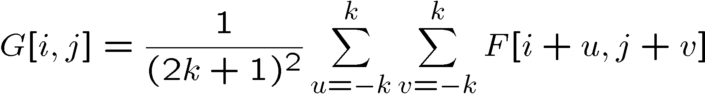
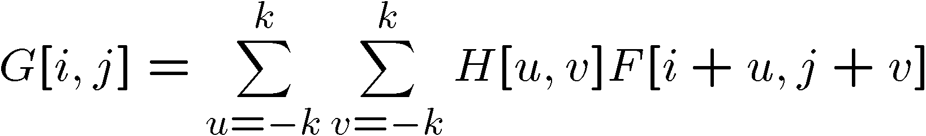
Correlation filtering
Say the averaging window size is 2k+1 x 2k+1:
Attribute uniform weight to each pixel
Loop over all pixels in neighborhood around image pixel F[i,j]
Now generalize to allow different weights depending on neighboring pixel’s relative position:
Non-uniform weights

Slide 28

Correlation filtering
This is called cross-correlation, denoted
Filtering an image: replace each pixel with a linear combination of its neighbors.
The filter “kernel” or “mask” H[u,v] is the prescription for the weights in the linear combination.

Slide 29


Averaging filter
What values belong in the kernel H for the moving average example?
0 | 0 | 0 | 0 | 0 | 0 | 0 | 0 | 0 | 0
0 | 0 | 0 | 0 | 0 | 0 | 0 | 0 | 0 | 0
0 | 0 | 0 | 90 | 90 | 90 | 90 | 90 | 0 | 0
0 | 0 | 0 | 90 | 90 | 90 | 90 | 90 | 0 | 0
0 | 0 | 0 | 90 | 90 | 90 | 90 | 90 | 0 | 0
0 | 0 | 0 | 90 | 0 | 90 | 90 | 90 | 0 | 0
0 | 0 | 0 | 90 | 90 | 90 | 90 | 90 | 0 | 0
0 | 0 | 0 | 0 | 0 | 0 | 0 | 0 | 0 | 0
0 | 0 | 90 | 0 | 0 | 0 | 0 | 0 | 0 | 0
0 | 0 | 0 | 0 | 0 | 0 | 0 | 0 | 0 | 0
 | 0 | 10 | 20 | 30 | 30
1
1
1
1
?
1
1
1
1
1
“box filter”

Slide 30
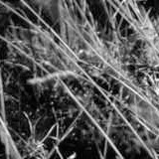
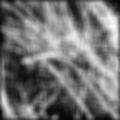
Smoothing by averaging
depicts box filter:
white = high value, black = low value
original
filtered
What if the filter size was 5 x 5 instead of 3 x 3?

Slide 31
Boundary issues
What is the size of the output?
MATLAB: output size / “shape” options
  shape = ‘full’: output size is sum of sizes of f and g
  shape = ‘same’: output size is same as f
  shape = ‘valid’: output size is difference of sizes of f and g
full
same
valid
g
g
g
g
f
f
f
g
g
g
g
g
g
g
g
Source: S. Lazebnik

Slide 32
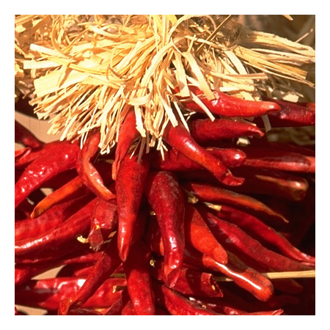
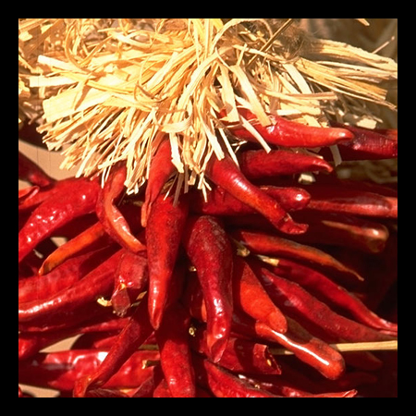

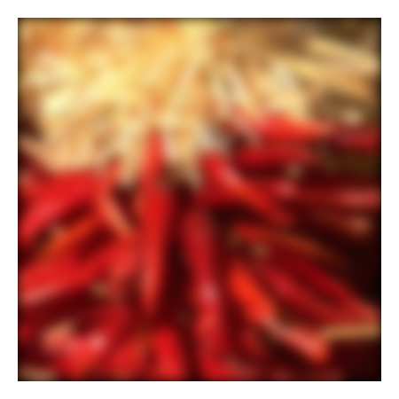
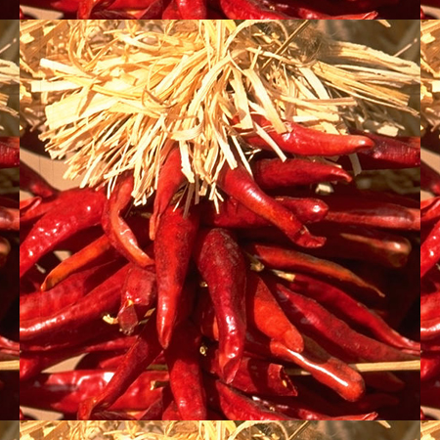

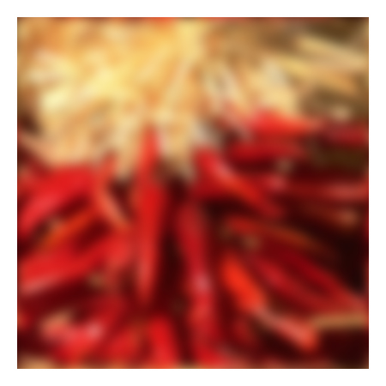
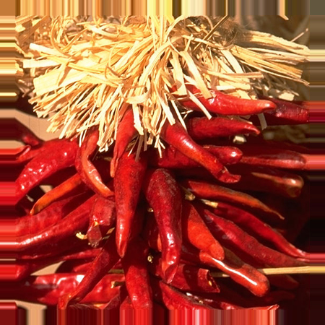


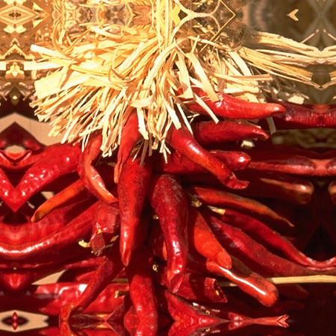


Boundary issues
What about near the edge?
  the filter window falls off the edge of the image
  need to extrapolate
  methods:
    clip filter (black)
    wrap around
    copy edge
    reflect across edge
Source: S. Marschner

Slide 33
Boundary issues
What about near the edge?
  the filter window falls off the edge of the image
  need to extrapolate
  methods (MATLAB):
    clip filter (black): imfilter(f, g, 0)
    wrap around: imfilter(f, g, ‘circular’)
    copy edge: imfilter(f, g, ‘replicate’)
    reflect across edge: imfilter(f, g, ‘symmetric’)
Source: S. Marschner

Slide 34
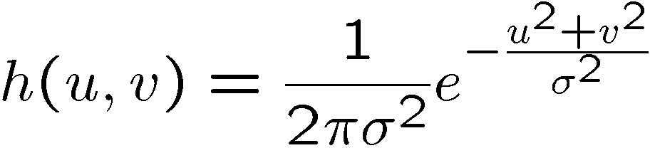
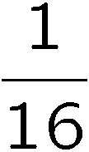
Gaussian filter
What if we want nearest neighboring pixels to have the most influence on the output?
Removes high-frequency components from the image (“low-pass filter”).
This kernel is an approximation of a 2d Gaussian function:
0 | 0 | 0 | 0 | 0 | 0 | 0 | 0 | 0 | 0
0 | 0 | 0 | 0 | 0 | 0 | 0 | 0 | 0 | 0
0 | 0 | 0 | 90 | 90 | 90 | 90 | 90 | 0 | 0
0 | 0 | 0 | 90 | 90 | 90 | 90 | 90 | 0 | 0
0 | 0 | 0 | 90 | 90 | 90 | 90 | 90 | 0 | 0
0 | 0 | 0 | 90 | 0 | 90 | 90 | 90 | 0 | 0
0 | 0 | 0 | 90 | 90 | 90 | 90 | 90 | 0 | 0
0 | 0 | 0 | 0 | 0 | 0 | 0 | 0 | 0 | 0
0 | 0 | 90 | 0 | 0 | 0 | 0 | 0 | 0 | 0
0 | 0 | 0 | 0 | 0 | 0 | 0 | 0 | 0 | 0
1 | 2 | 1
2 | 4 | 2
1 | 2 | 1
Source: S. Seitz

Slide 35

Smoothing with a Gaussian

Slide 36
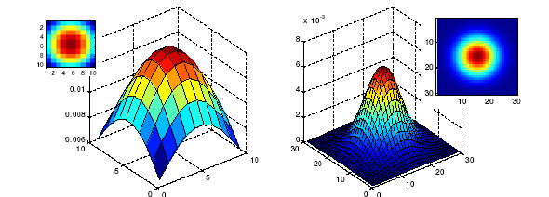
Gaussian filters
What parameters matter here?
Size of kernel or mask
  Note, Gaussian function has infinite support, but discrete filters use finite kernels
σ = 5 with 10 x 10 kernel
σ = 5 with 30 x 30 kernel

Slide 37
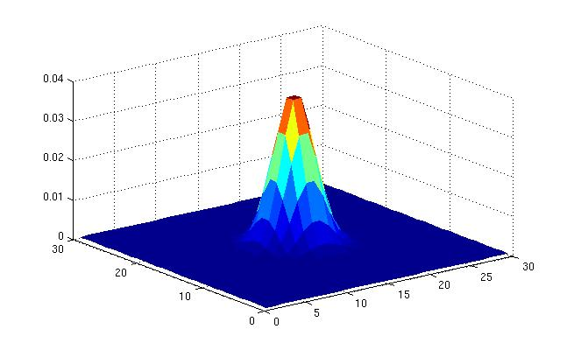
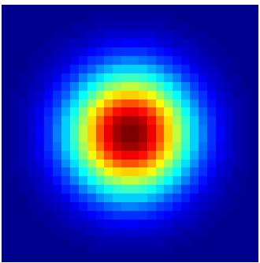
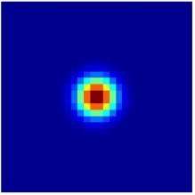
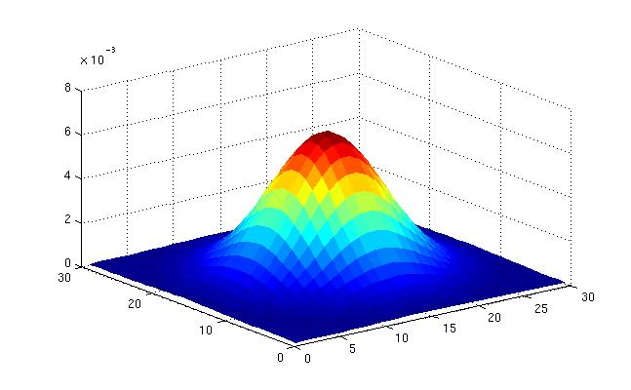
Gaussian filters
What parameters matter here?
Variance of Gaussian: determines extent of smoothing
σ = 2 with 30 x 30 kernel
σ = 5 with 30 x 30 kernel

Slide 38

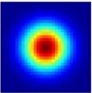
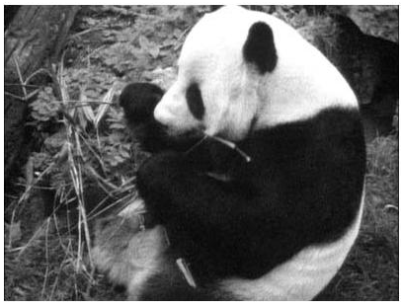
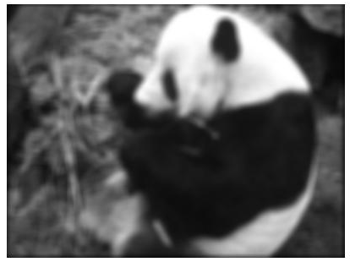
Matlab
>> hsize = 10;
>> sigma = 5;
>> h = fspecial(‘gaussian’ hsize, sigma);
>> mesh(h);
>> imagesc(h);
>> outim = imfilter(im, h); % correlation
>> imshow(outim);
outim
Notes:
In matlab, conv2 does convolution, filter2 does correlation. Imfilter does either if specified, correlation by default (‘conv’, ‘corr’ option)

Slide 39
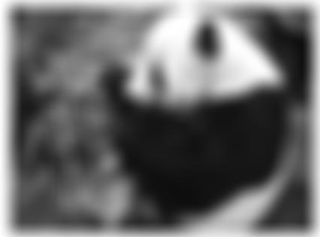
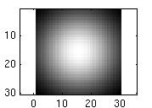
Smoothing with a Gaussian
Parameter σ is the “scale” / “width” / “spread” of the Gaussian kernel, and controls the amount of smoothing.
…
for sigma=1:3:10
h = fspecial('gaussian‘, fsize, sigma);
out = imfilter(im, h);
imshow(out);
pause;
end

Slide 40
Properties of smoothing filters
Smoothing
  Values positive
  Sum to 1 → constant regions same as input
  Amount of smoothing proportional to mask size
  Remove “high-frequency” components; “low-pass” filter

Slide 41

Filtering an impulse signal
What is the result of filtering the impulse signal (image) F with the arbitrary kernel H?
0 | 0 | 0 | 0 | 0 | 0 | 0
0 | 0 | 0 | 0 | 0 | 0 | 0
0 | 0 | 0 | 0 | 0 | 0 | 0
0 | 0 | 0 | 1 | 0 | 0 | 0
0 | 0 | 0 | 0 | 0 | 0 | 0
0 | 0 | 0 | 0 | 0 | 0 | 0
0 | 0 | 0 | 0 | 0 | 0 | 0
a | b | c
d | e | f
g | h | i
?

Slide 42



Convolution
Convolution:
  Flip the filter in both dimensions (bottom to top, right to left)
  Then apply cross-correlation
F
H
Notation for convolution operator

Slide 43
Convolution vs. correlation
Convolution
Cross-correlation
For a Gaussian or box filter, how will the outputs differ?
If the input is an impulse signal, how will the outputs differ?

Slide 44

Predict the outputs using correlation filtering
0
0
0
0
0
0
*
= ?
*
= ?
0
1
0
0
0
1
0
0
0
0
0
0
0
0
0
-
1
1
1
*
= ?
0
2
0
1
1
1
0
0
0
1
1
1

Slide 45
Practice with linear filters
0
0
0
?
0
1
0
0
0
0
Original
Source: D. Lowe

Slide 46
Practice with linear filters
0
0
0
0
1
0
0
0
0
Original
Filtered
(no change)
Source: D. Lowe

Slide 47
Practice with linear filters
0
0
0
?
0
0
1
0
0
0
Original
Source: D. Lowe

Slide 48
Practice with linear filters
0
0
0
0
0
1
0
0
0
Original
Shifted left
by 1 pixel with correlation
Source: D. Lowe

Slide 49
Practice with linear filters
1
1
1
?
1
1
1
1
1
1
Original
Source: D. Lowe

Slide 50

Practice with linear filters
1
1
1
1
1
1
1
1
1
Original
Blur (with a
box filter)
Source: D. Lowe

Slide 51
Practice with linear filters
0
0
0
-
1
1
1
?
0
2
0
1
1
1
0
0
0
1
1
1
Original
Source: D. Lowe

Slide 52


Practice with linear filters
0
0
0
-
1
1
1
0
2
0
1
1
1
0
0
0
1
1
1
Original
Sharpening filter:
  accentuates differences with local average
Source: D. Lowe

Slide 53

Filtering examples: sharpening

Slide 54
Properties of convolution
Shift invariant:
  Operator behaves the same everywhere, i.e. the value of the output depends on the pattern in the image neighborhood, not the position of the neighborhood.
Superposition:
  h * (f1 + f2) = (h * f1) + (h * f2)

Slide 55
Properties of convolution
Commutative:
  f * g = g * f
Associative
  (f * g) * h = f * (g * h)
Distributes over addition
f * (g + h) = (f * g) + (f * h)
Scalars factor out
kf * g = f * kg = k(f * g)
Identity:
  unit impulse e = […, 0, 0, 1, 0, 0, …]. f * e = f

Slide 56
Separability
In some cases, filter is separable, and we can factor into two steps:
  Convolve all rows
  Convolve all columns

Slide 57

Separability
In some cases, filter is separable, and we can factor into two steps: e.g.,
h
What is the computational complexity advantage for a separable filter of size k x k, in terms of number of operations per output pixel?
g
f
f * (g * h) = (f * g) * h

Slide 58
Effect of smoothing filters
Additive Gaussian noise
Salt and pepper noise

Slide 59

Median filter
No new pixel values introduced
Removes spikes: good for impulse, salt & pepper noise
Non-linear filter

Slide 60

Median filter
Salt and pepper noise
Median filtered
Plots of a row of the image
Matlab: output im = medfilt2(im, [h w]);
Source: M. Hebert

Slide 61

Median filter
Median filter is edge preserving

Slide 62

Filtering application: Hybrid Images
Aude Oliva & Antonio Torralba & Philippe G Schyns, SIGGRAPH 2006
Notes:
\

Slide 63



Application: Hybrid Images
A. Oliva, A. Torralba, P.G. Schyns,
“Hybrid Images,” SIGGRAPH 2006
Gaussian Filter
Laplacian Filter
unit impulse
Gaussian
Laplacian of Gaussian

Slide 64
Aude Oliva & Antonio Torralba & Philippe G Schyns, SIGGRAPH 2006

Slide 65

Aude Oliva & Antonio Torralba & Philippe G Schyns, SIGGRAPH 2006

Slide 66
Summary
Image “noise”
Linear filters and convolution useful for
  Enhancing images (smoothing, removing noise)
    Box filter
    Gaussian filter
    Impact of scale / width of smoothing filter
  Detecting features (next time)
Separable filters more efficient
Median filter: a non-linear filter, edge-preserving

Slide 67
Coming up
Wednesday:
  Filtering part 2: filtering for features
Friday:
  Pset 0 is due via turnin, 11:59 PM

