Slide 1
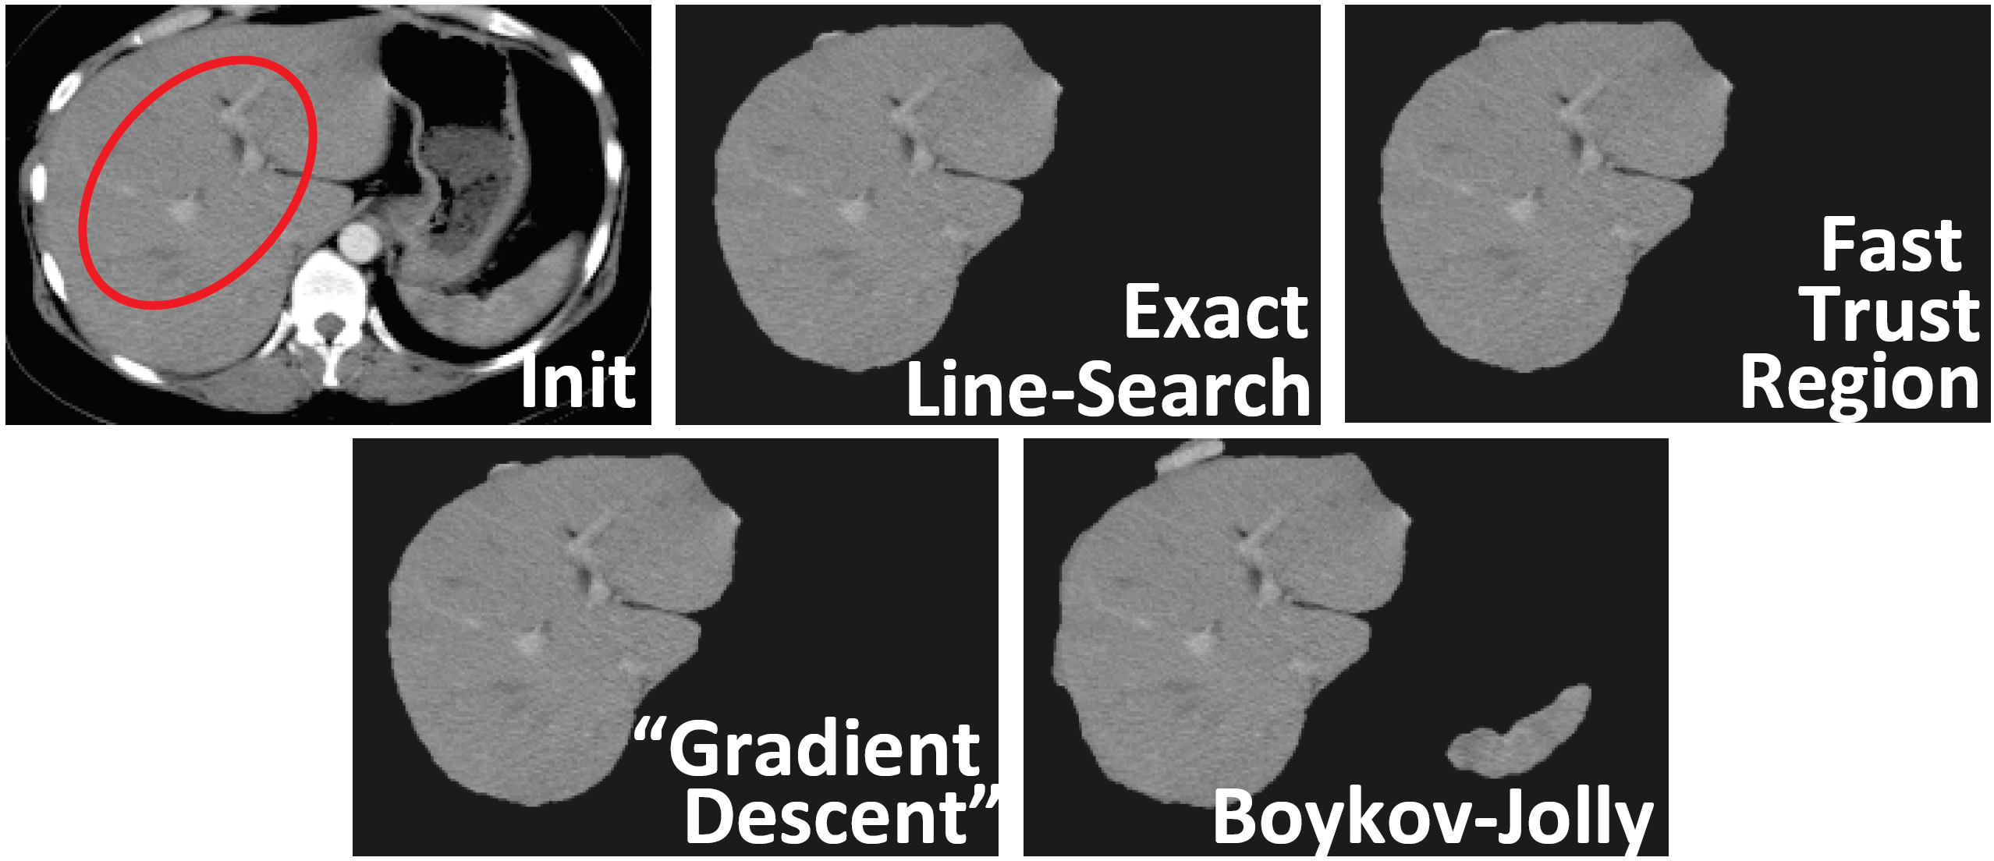
Applications of Trust Region Methods
Qixing Huang
Sep. 28th 2017

Slide 2
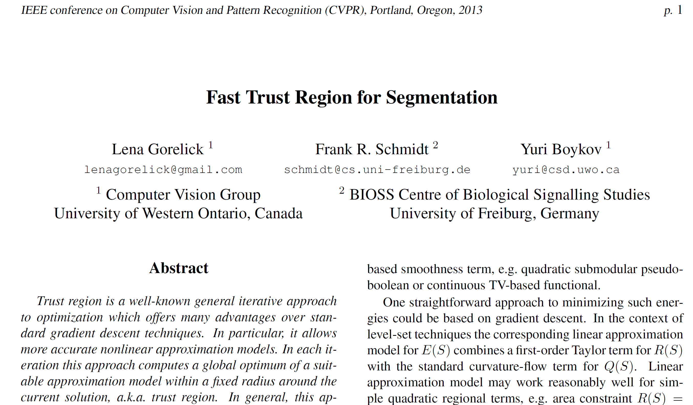

Slide 3
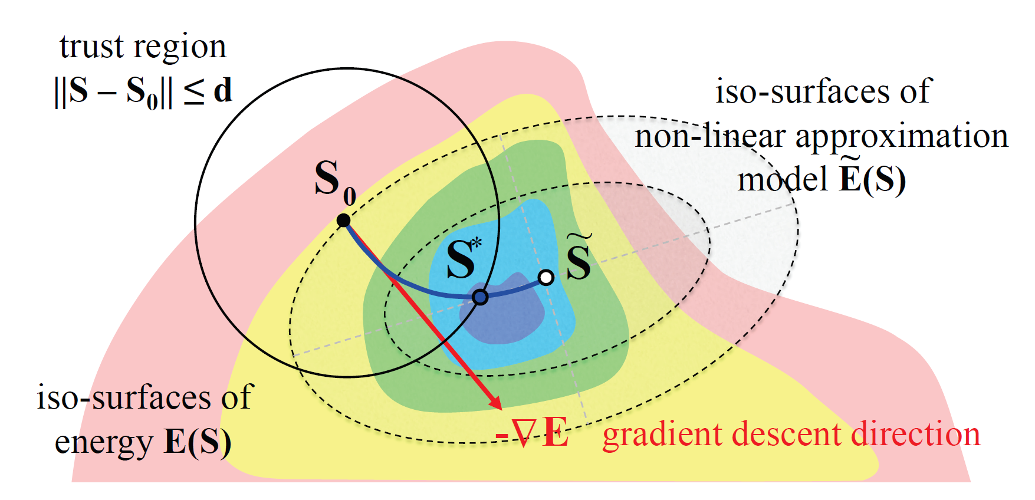
One Slide Summary

Slide 4
Trust Region Framework

Slide 5
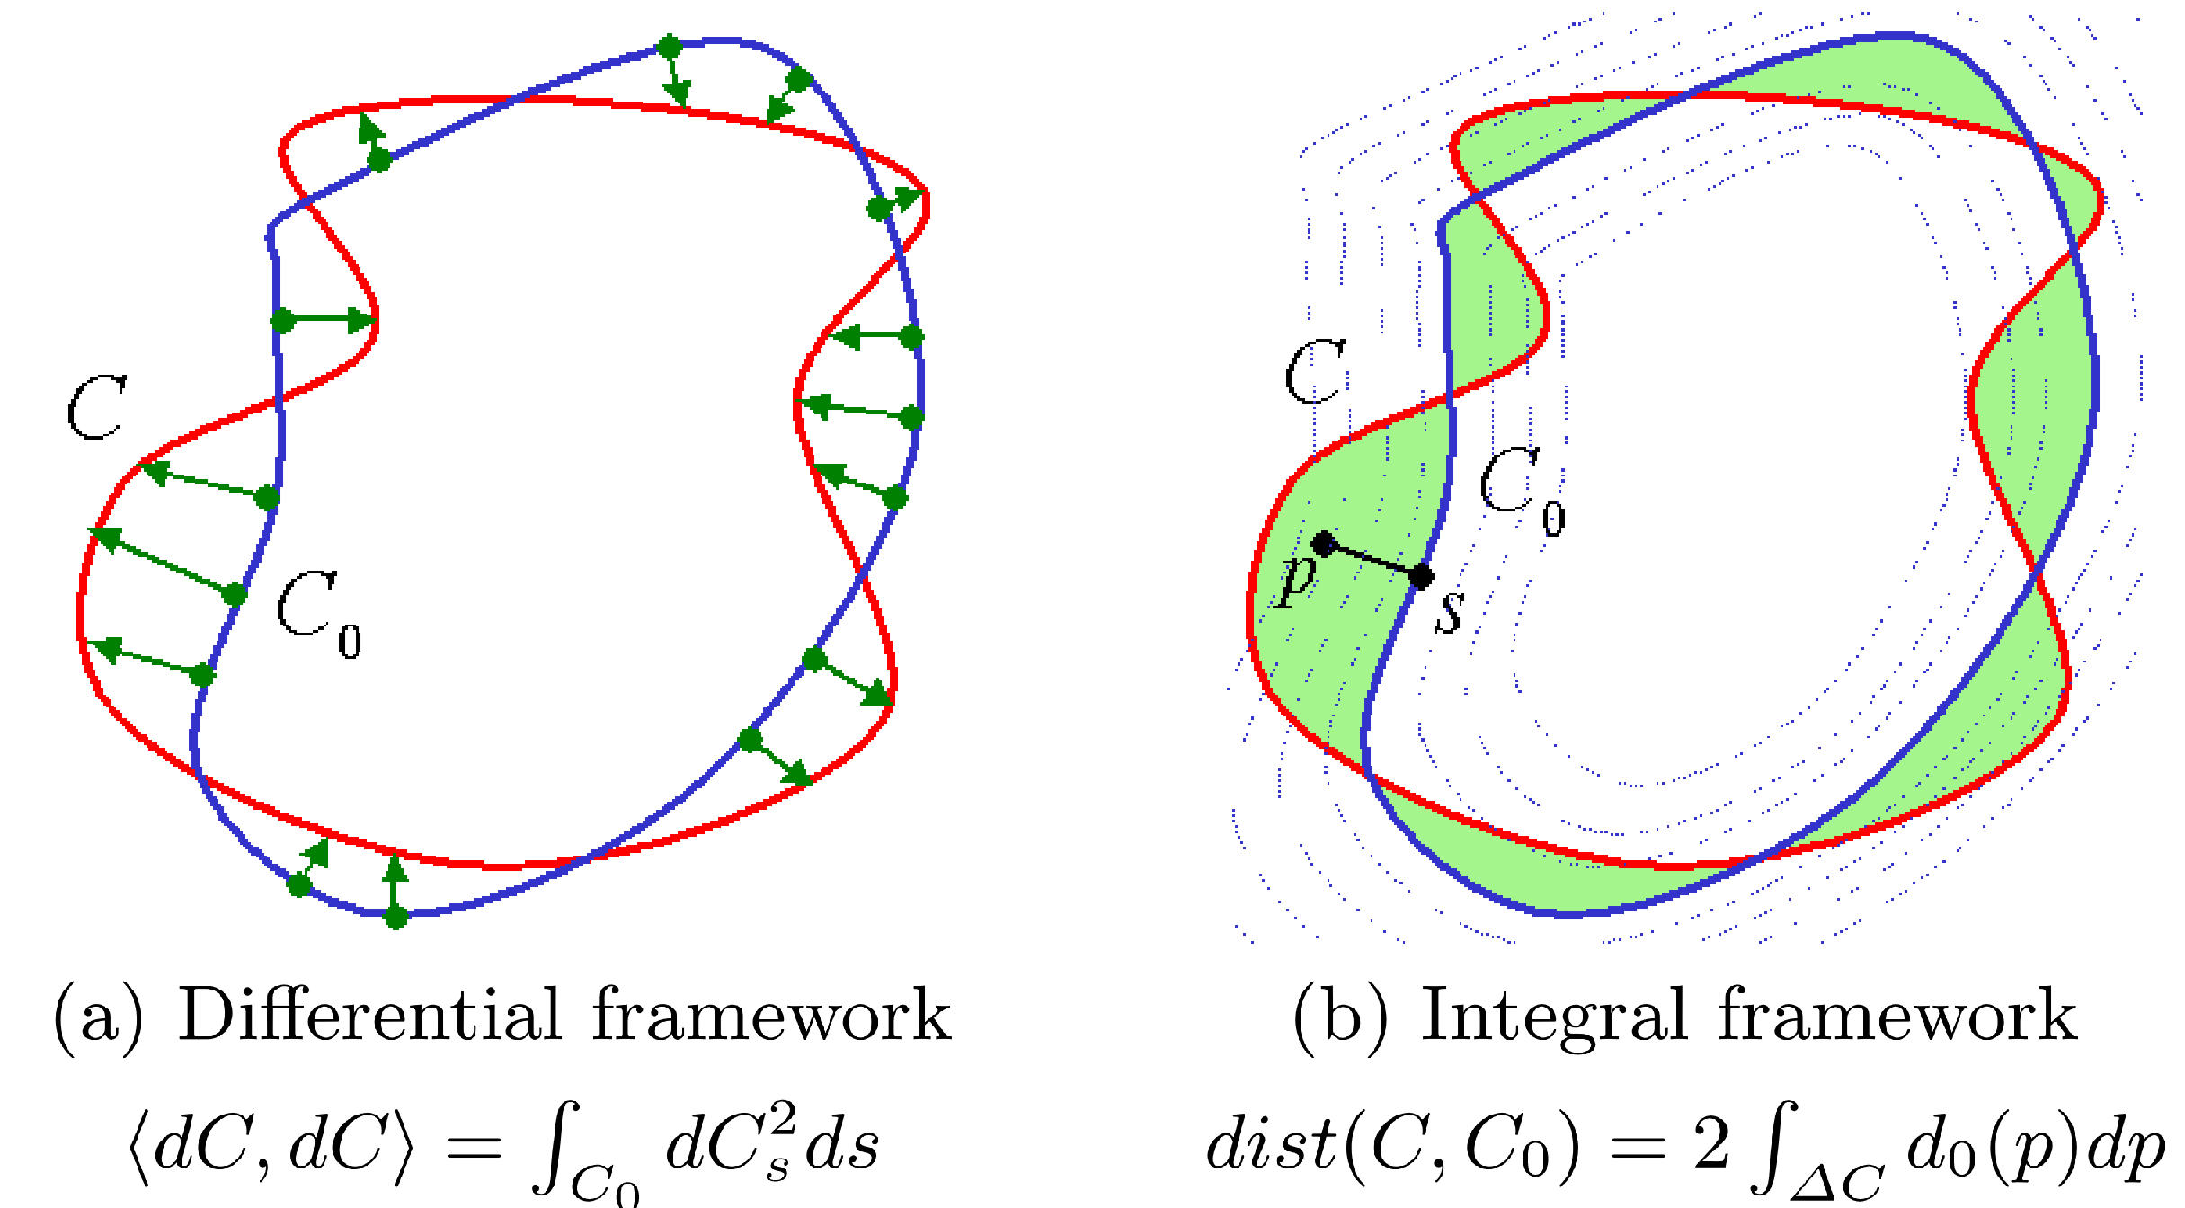
Main Technical Contribution

Slide 6
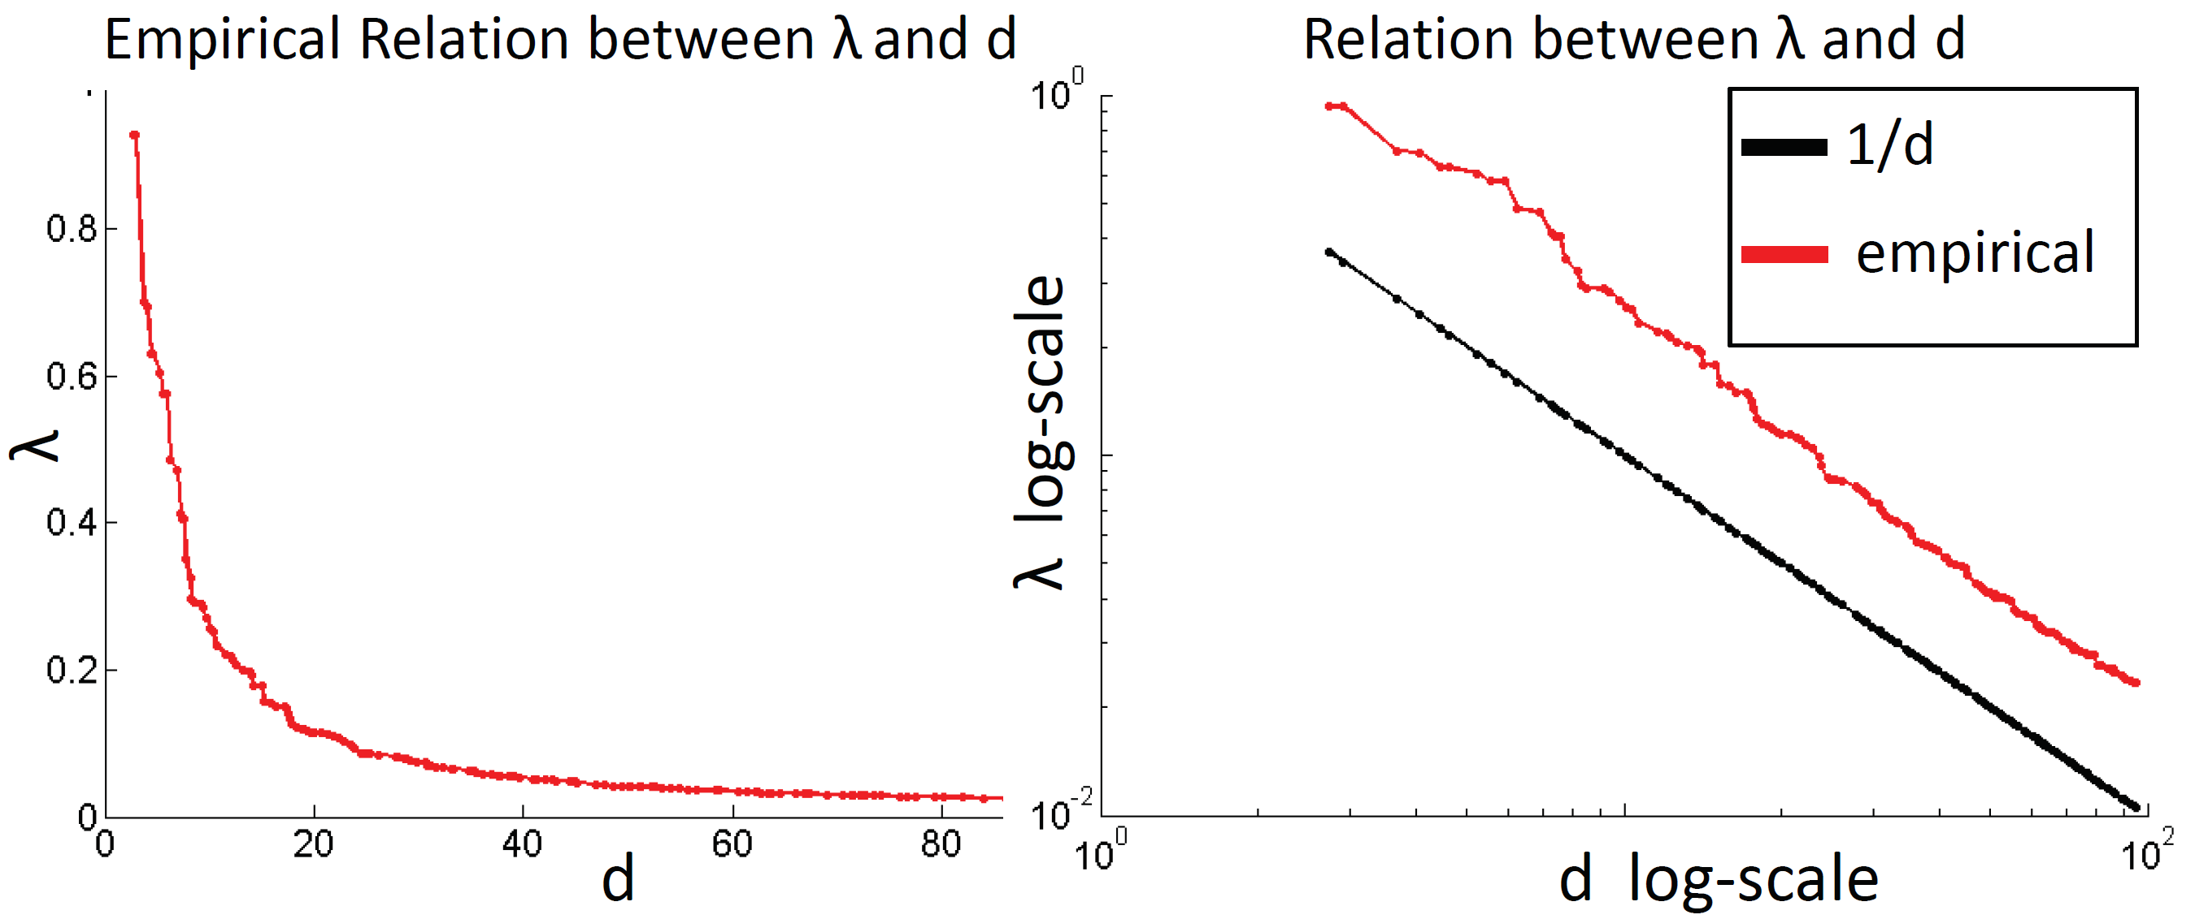
Relation Between lambda and d
Empirical dependence between lambda and d obtained in one typical iteration

Slide 7
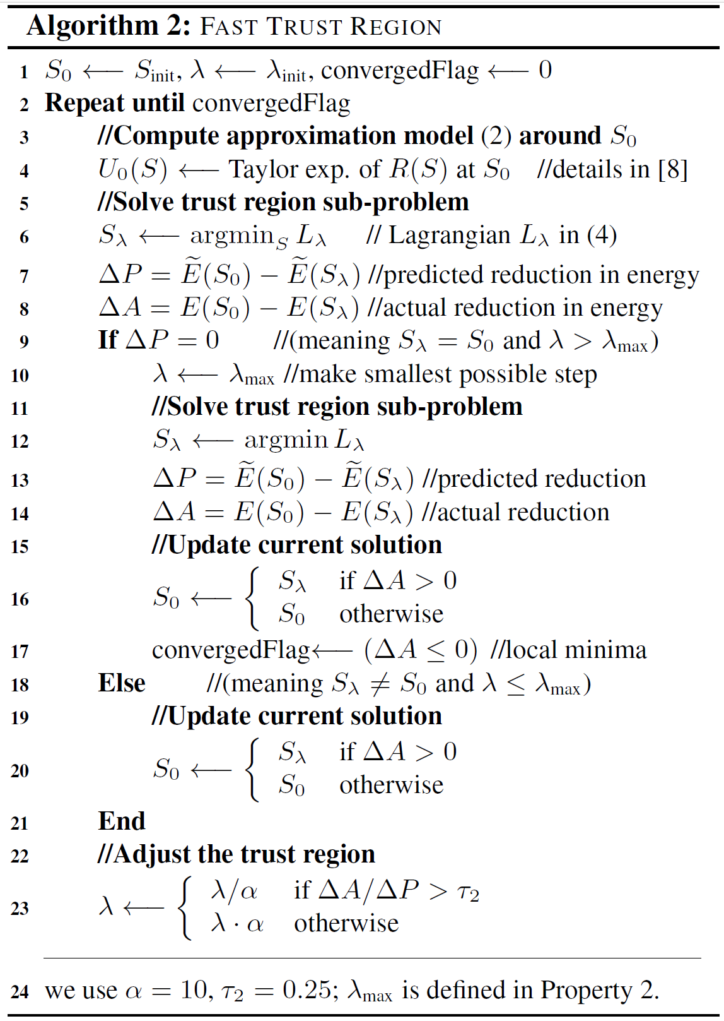
Fast Trust Region Framework

Slide 8
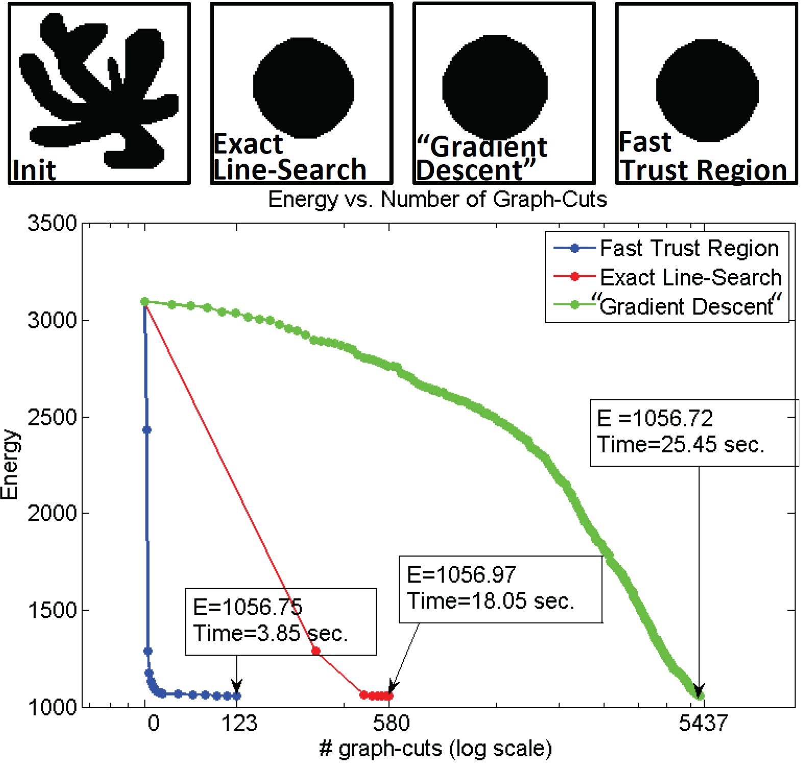
Synthetic Example

Slide 9
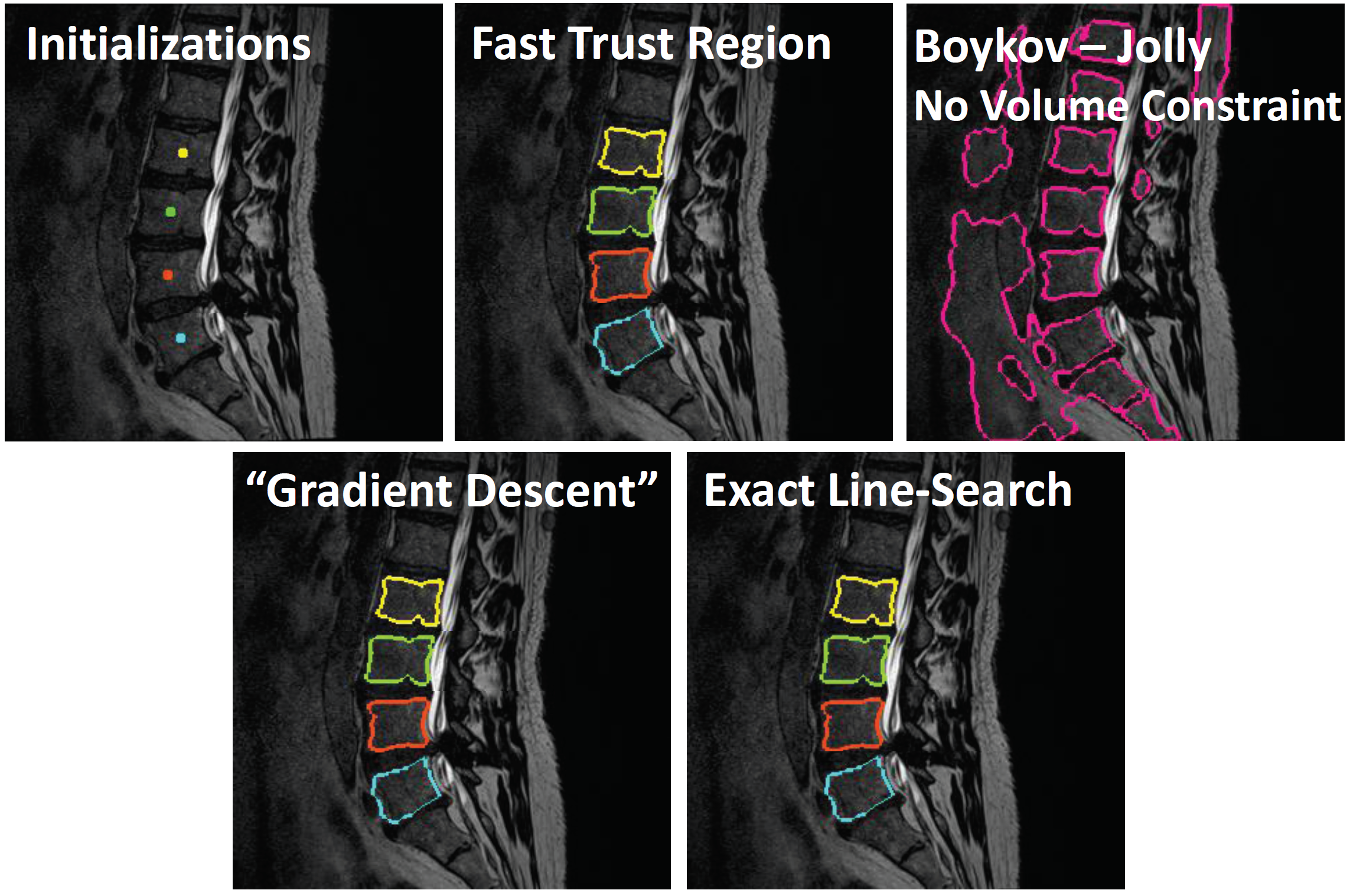
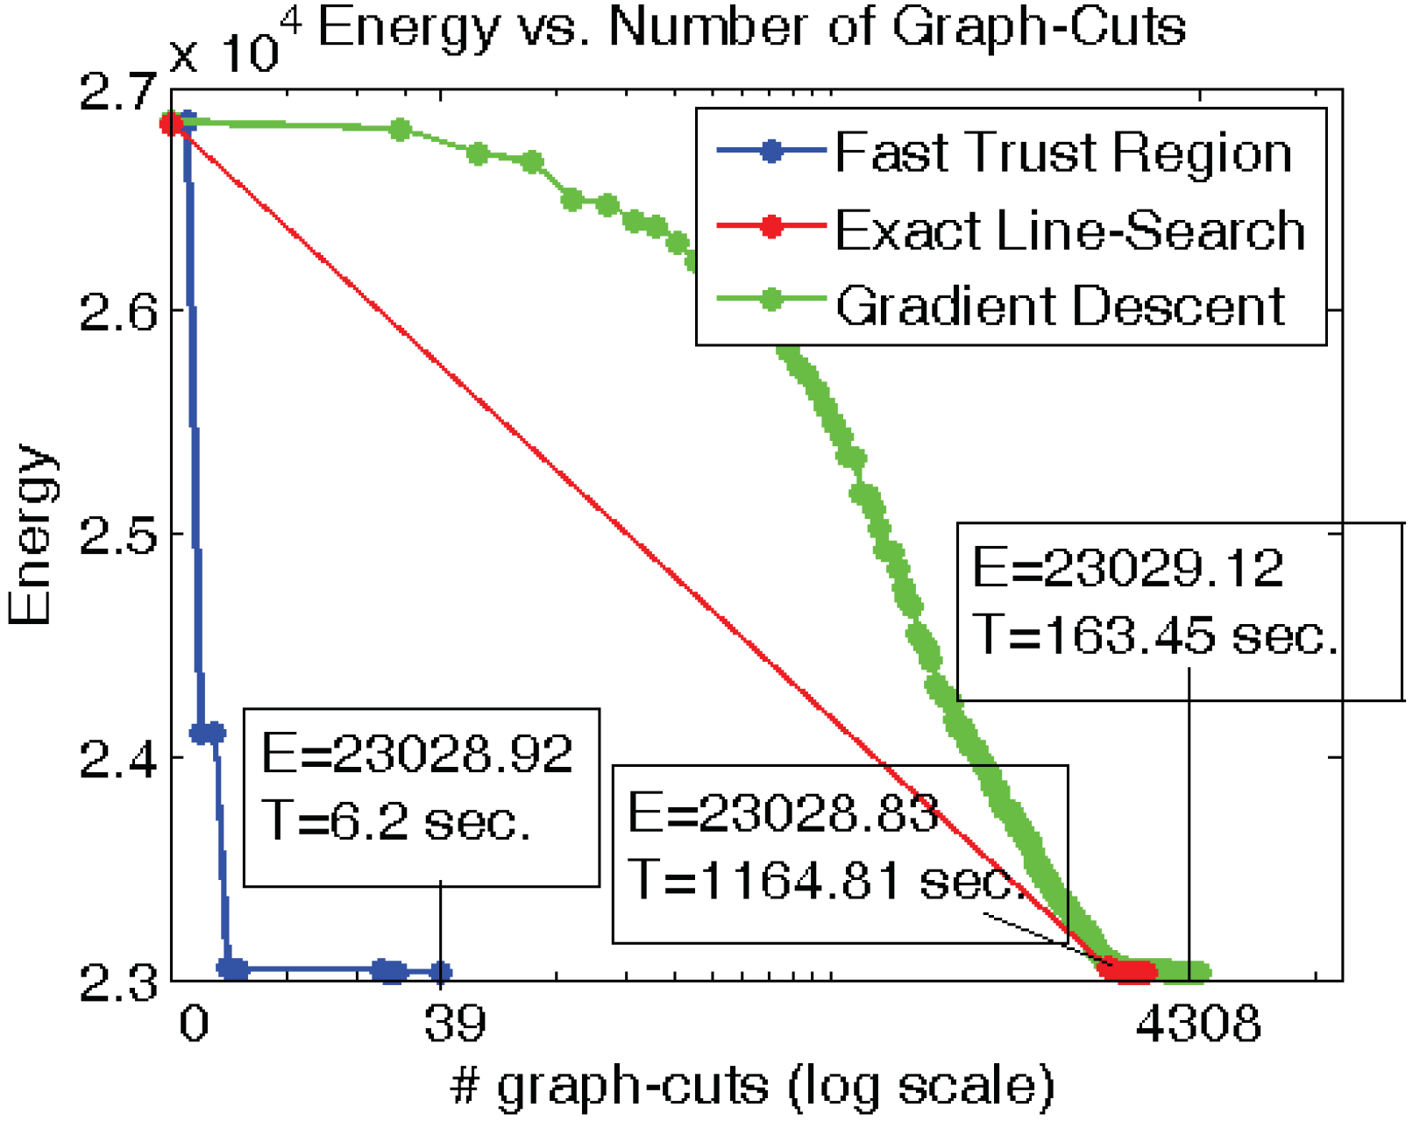
Vertebrae Segmentation with Range Volume Constraint
D(S) matches color histogram

Slide 10
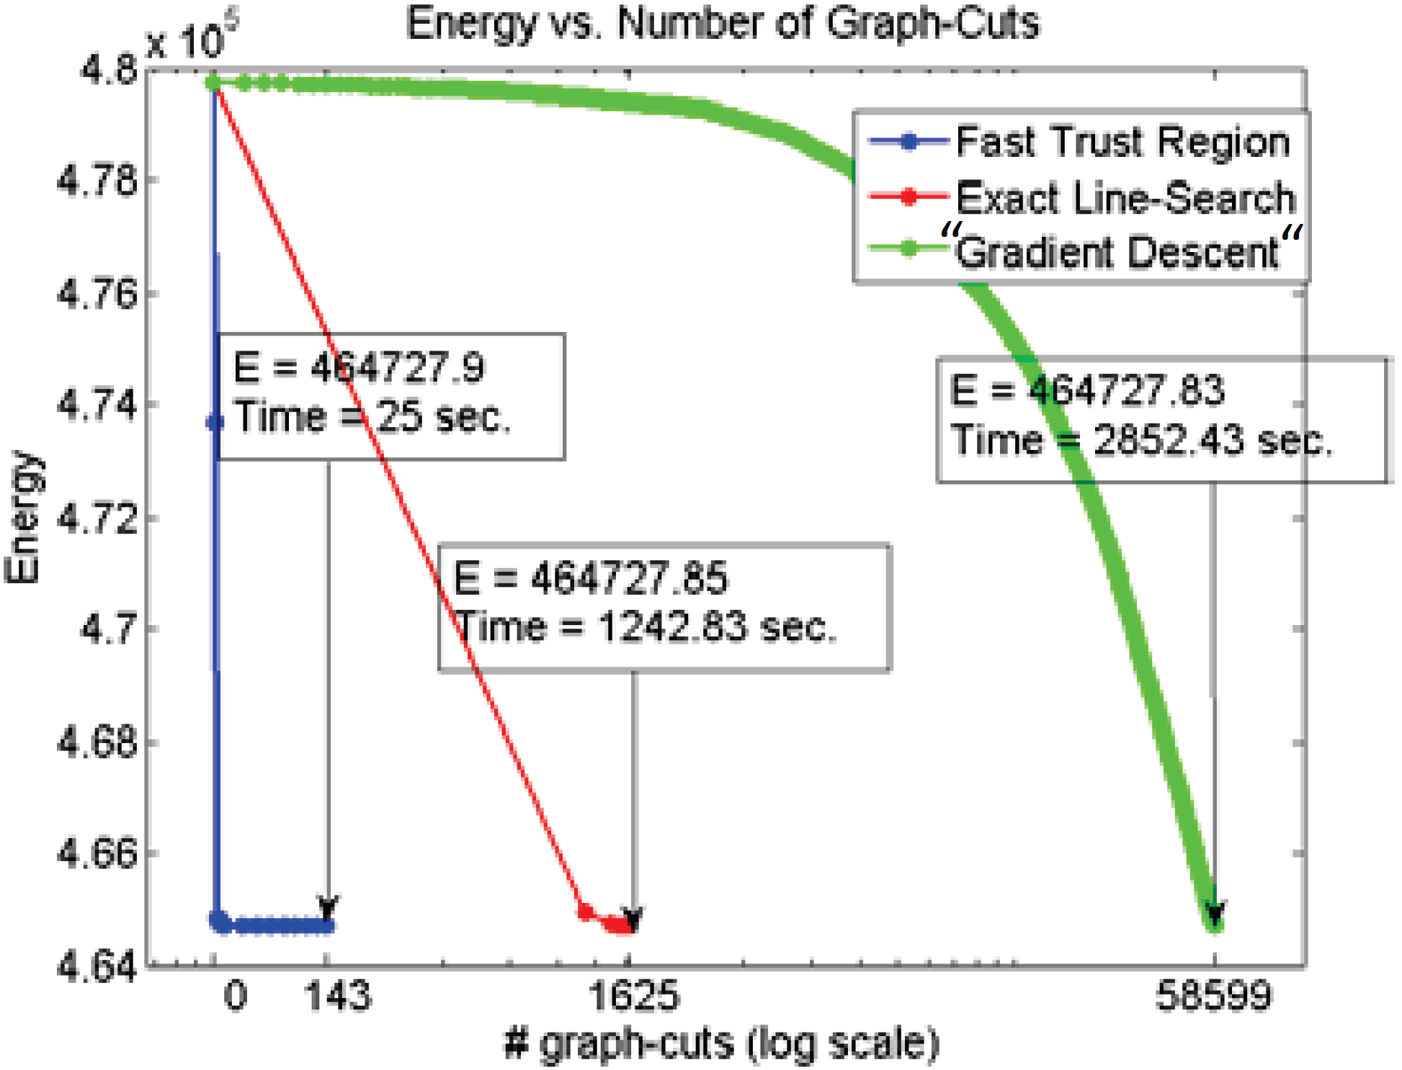
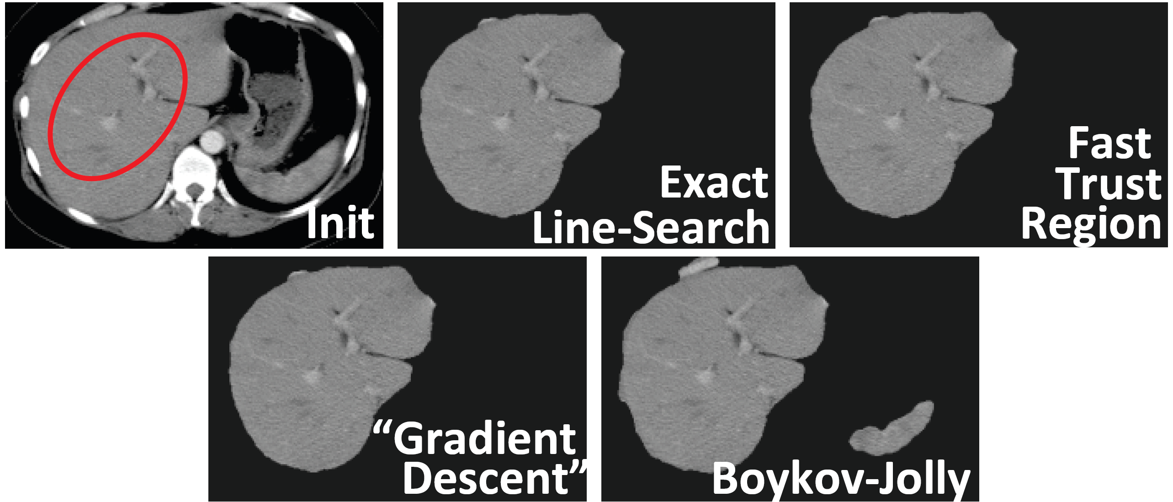
Liver Segmentation with the Shape Prior

Slide 11
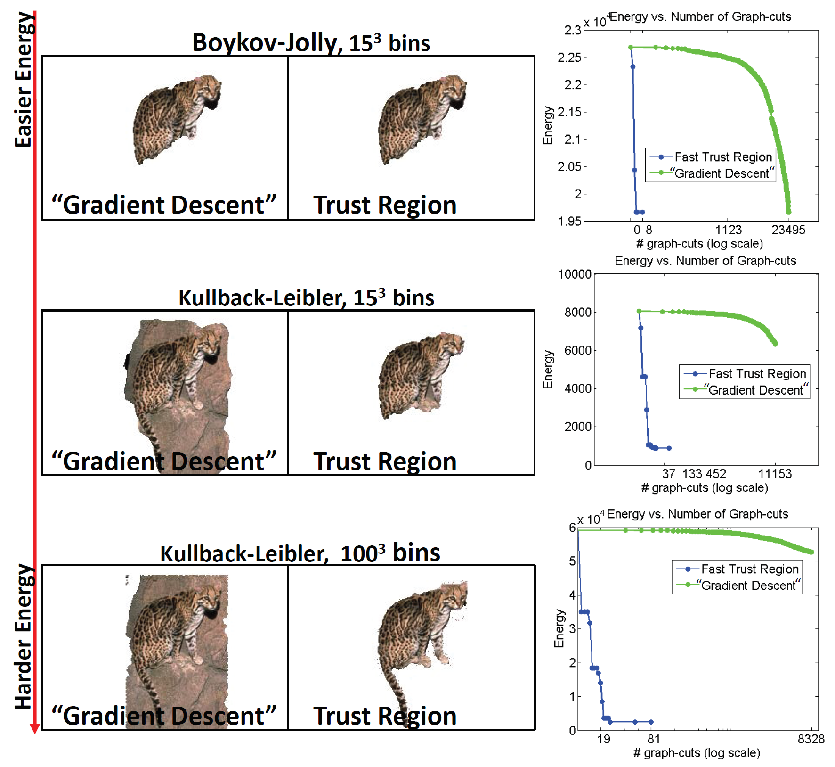
Matching Target Appearance Using Log-likelihood Term with 15 Bins

Slide 12
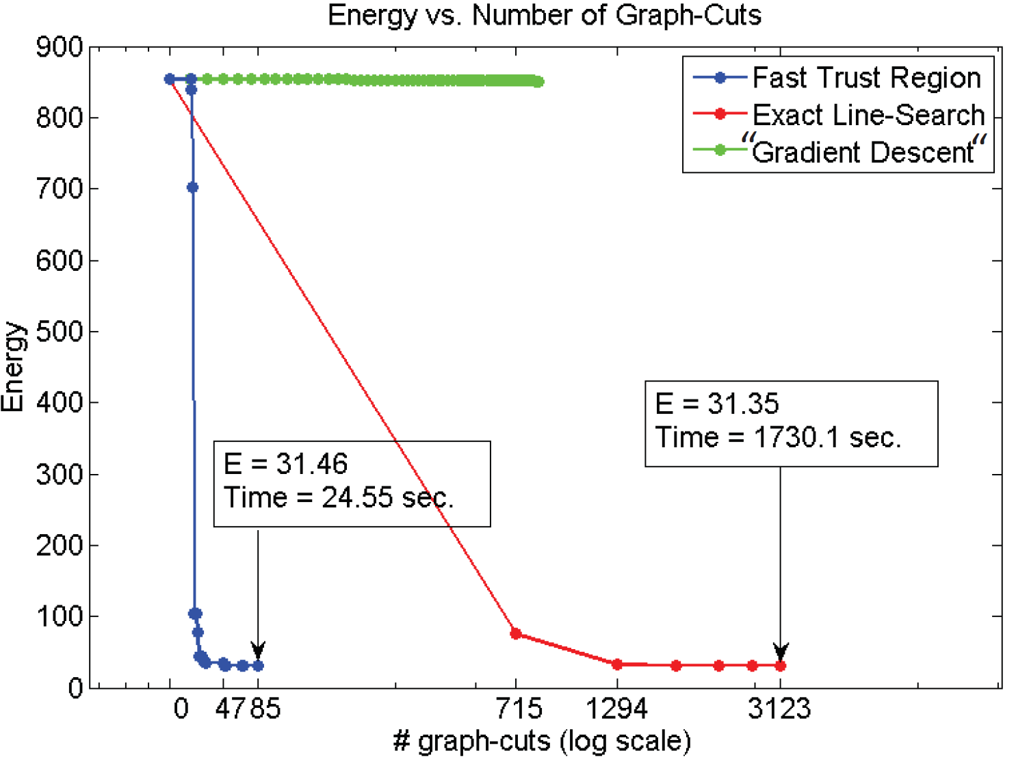
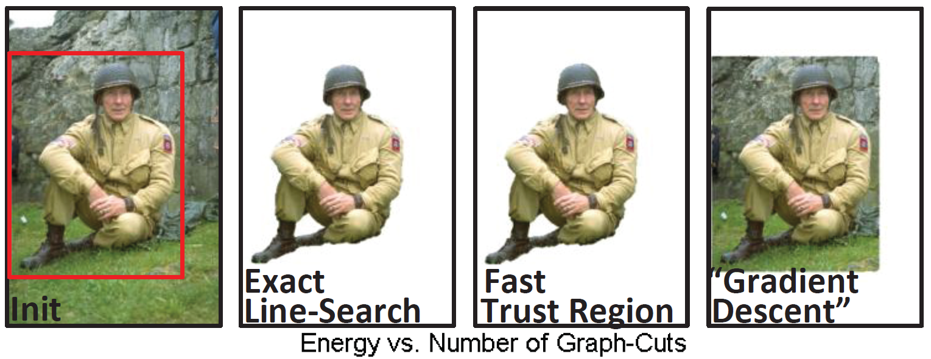
Matching Target Appearance with KL-Divergence and 100 Bins

Slide 13
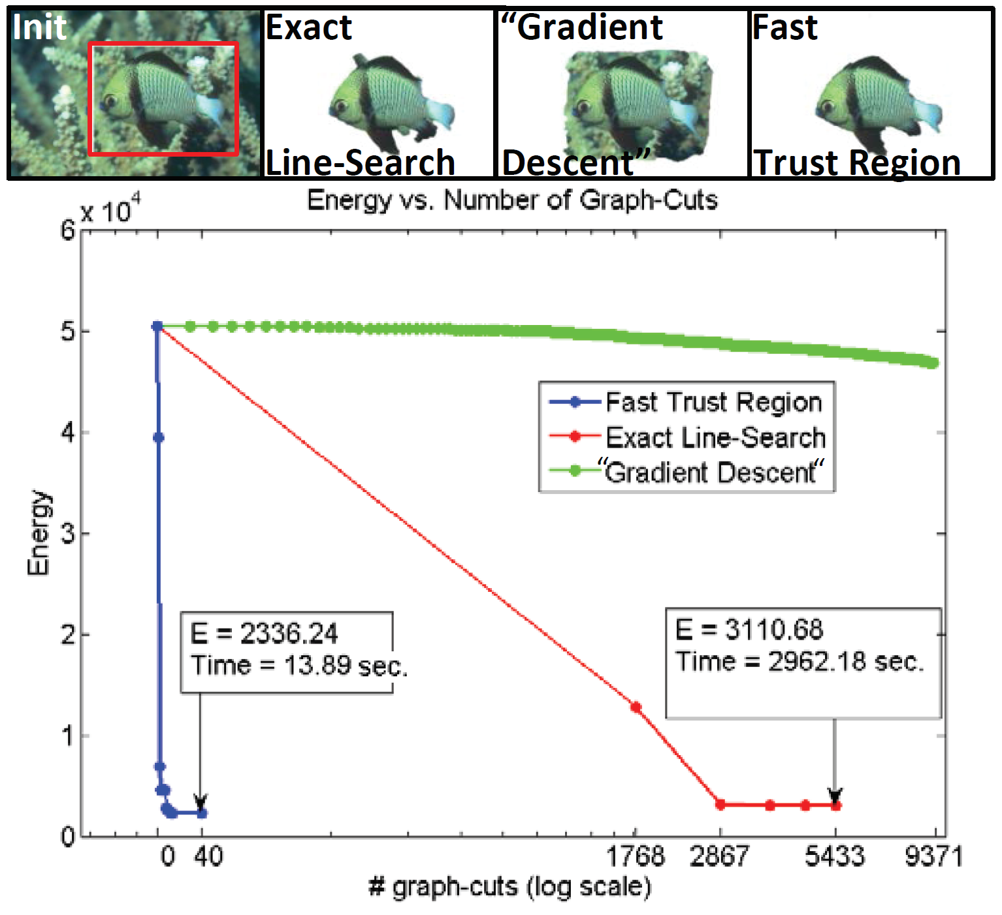
Matching Target Distribution Using Bhattacharyya Distance with 100 Bins

Slide 14
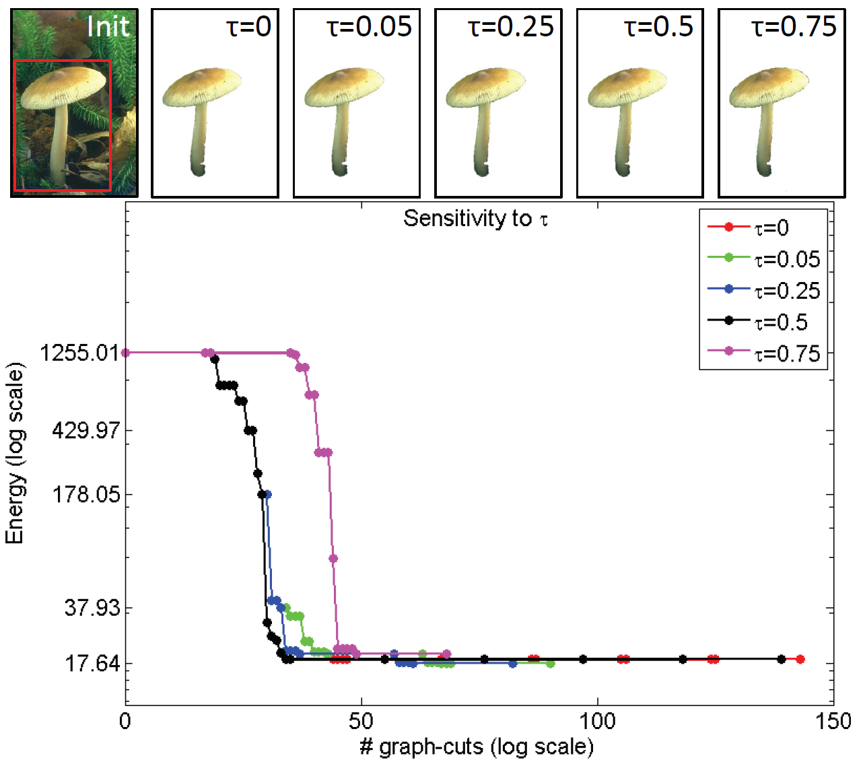
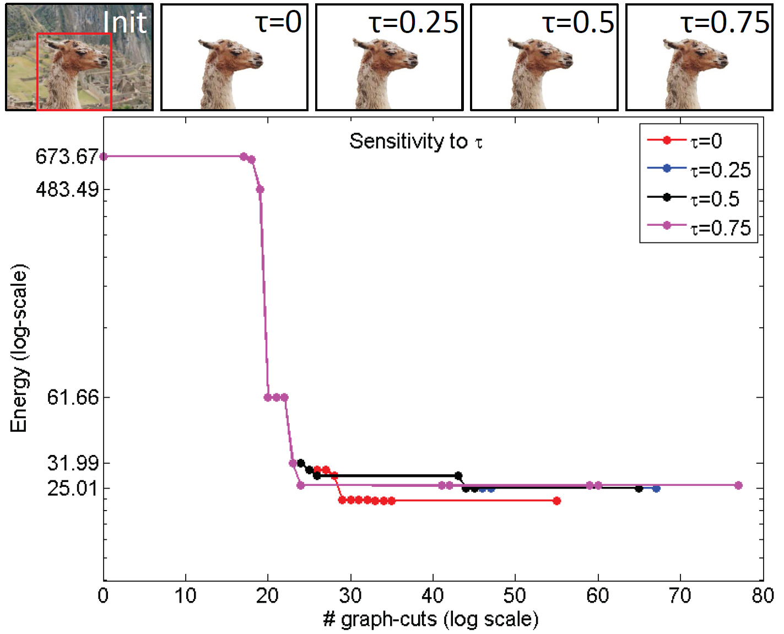
Robustness to Reduction Ratio tau₂ Using KL-Divergence

Slide 15
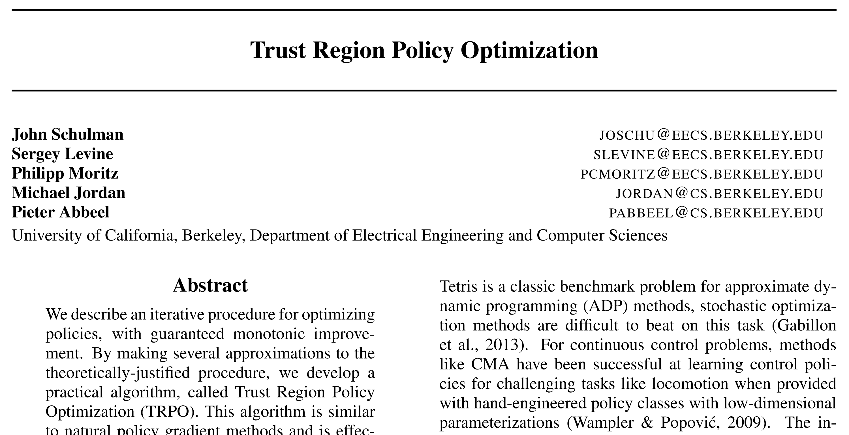

Slide 16
The optimization problem considered in this paper
Estimation of the expected reward using importance sampling
A measurement of the difference between the old and new policies

Slide 17
Algorithm
Use the sampling strategy (single path or vine procedures) to collect a set of
state-action pairs along with Monte Carlo estimates of their Q-values.
By averaging over samples, construct the estimated objective and constraint.
Approximately solve this constrained optimization problem to update the
policy’s parameter theta.

Slide 18
Approximate Solution
Compute a search direction, using a linear approximation to objective and quadratic approximation to the constraint
Perform a line search in that direction, ensuring that we improve the non-linear objective while satisfying the non-linear constraint
Backtrack for line-search

Slide 19
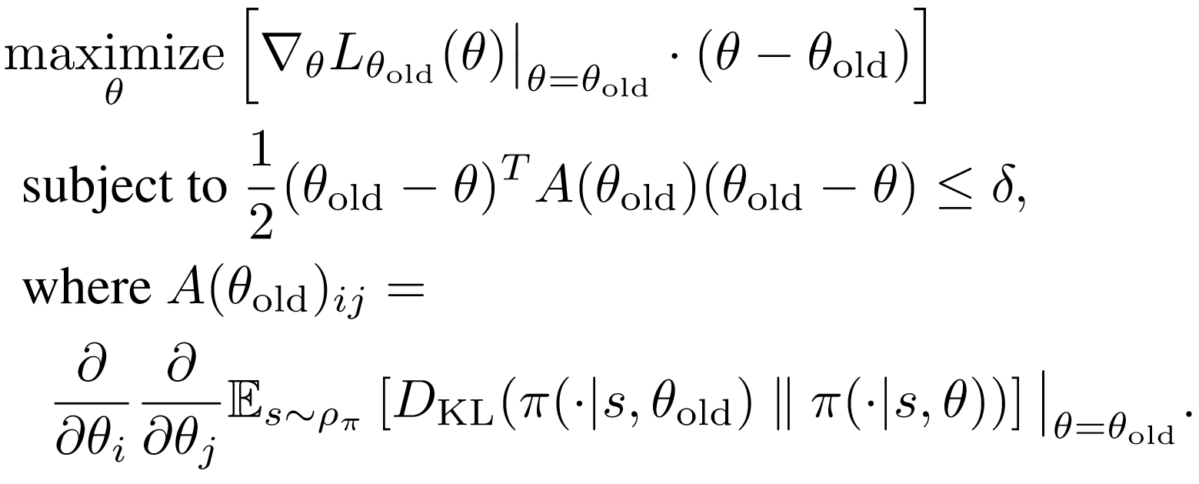
Connection to Natural Policy Gradient
Optimization in natural policy gradient:
Update:
NPG utilizes linear approximation to the objective function
and second-order approximation to the constraint
TRPO solves better approximations (generating the objective function
and the constraint take a lot of time)

Slide 20
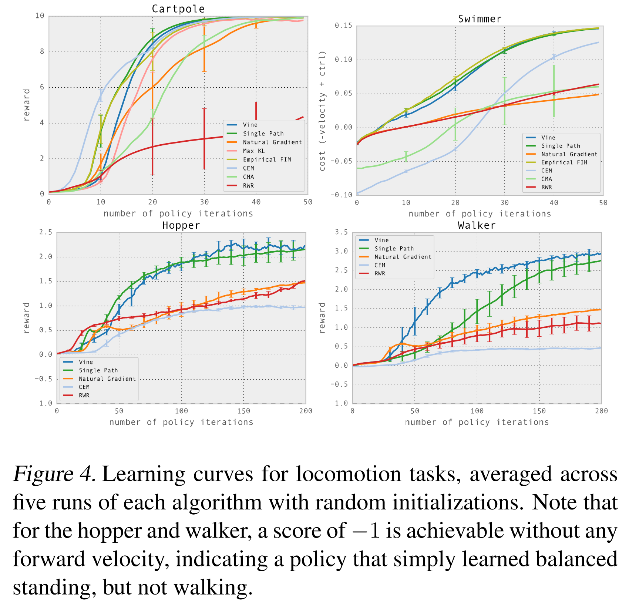
Experiments I

Slide 21
Practical Aspects of Trust Region Methods
How to compute the objective function and constraint
You have the flexibility to solve it in the constrained form or the Lagrangian form
Approximate solutions at each iteration for some problems

