Slide 1




Instructor: Matt Lease www.ischool.utexas.edu/~ml ml@ischool.utexas.edu
INF3854 / CS395T:
Concepts of Information Retrieval (& Web Search)

Slide 2
Dimensions of IR
Content | Applications | Tasks
Text | Web search | Ad hoc search
Images | Vertical search | Filtering
Video | Enterprise search | Classification
Scanned docs | Desktop search | Question answering
Audio | Forum search
Music | P2P search
 | Literature search
Some slides ©Addison Wesley, 2008

Slide 3


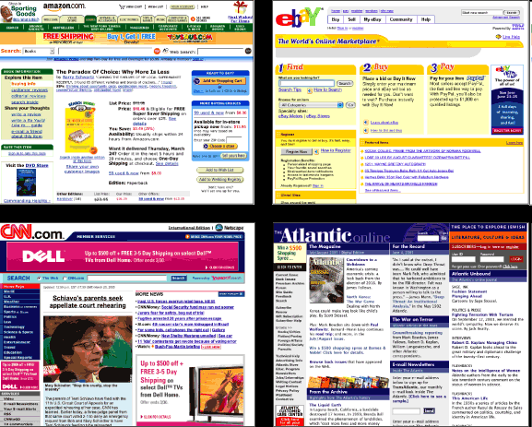
Search/Retrieval Landscape
Verticals/content: news, sports, classifieds, …
Format: text, images, audio, video
  text: html/xml, text, email, chat, transcribed, blog, …
Repository/archive/collection
  desktop/mobile, enterprise, Web
Query: descriptive (textual/spoken), by example
  Typically inexact (NOT ISBN, barcode, GUID, etc.)
Typically both content & query are unstructured or only semi-structured (e.g., not database)

Slide 4
Some IR Tasks
Ad-hoc search
  Find relevant documents for an arbitrary text query
Filtering
  Identify relevant user profiles for a new document
Classification
  Identify relevant labels for documents
Question answering
  Give a specific answer to a question

Slide 5
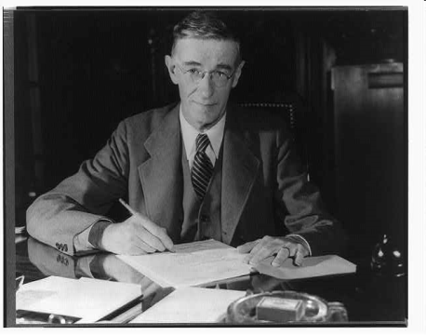
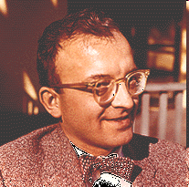
Beginnings
Vannevar Bush (1890 – 1974). 1945: “Consider a future device for individual use, which is a sort of mechanized private file and library. It needs a name, and, to coin one at random, "memex" will do. A memex is a device in which an individual stores all his books, records, and communications, and which is mechanized so that it may be consulted with exceeding speed and flexibility. … Books of all sorts, pictures, current periodicals, newspapers… Business correspondence… longhand notes, photographs, memoranda, all sorts of things… There is, of course, provision for consultation of the record by the usual scheme of indexing. If the user wishes to consult a certain book, he taps its code on the keyboard, and the title page of the book promptly appears…”
Calvin N. Mooers (1919–1994). 1951: IR “embraces the intellectual aspects of the description of information and its specification for search, and also whatever systems, technique, or machines that are employed to carry out the operation”

Slide 6
Relevance
What is it?
  Simplistic definition: A relevant document contains the information that a person was looking for when they submitted a query to the search engine
  Many factors influence a person’s decision about what is relevant: e.g., task, context, novelty, style
  Topical relevance vs. user relevance

Slide 7
Modeling Relevance
Retrieval models define a view of relevance
Ranking algorithms used in search engines are based on retrieval models
Ranking is typically statistical and more often (for text) based on its observable properties rather than latent linguistics
  i.e. counting simple text features such as words instead of inferring underlying linguistic syntax
  However, both kinds of features / evidence can be incorporated into a statistical model

Slide 8
Evaluation
Experimental procedures and measures for comparing system output to user expectations
  Originated in Cranfield experiments in the 60s
Experiments often use one or more pre-defined test collections of documents, queries, and relevance judgments
Recall and precision are two examples of effectiveness measures

Slide 9
Users and Information Needs
Search evaluation is user-centered
Keyword queries are often poor descriptions of actual information needs
Interaction and context are important for inferring user intent
Query refinement techniques such as query expansion, query suggestion, relevance feedback improve ranking

Slide 10
IR and Search Engines
Information Retrieval
Search Engines
Performance
-Efficient search and indexing
Incorporating new data
-Coverage and freshness
Scalability
-Growing with data and users
Adaptability
-Tuning for applications
Specific problems
-e.g. Spam
Relevance
-Effective ranking
Evaluation
-Testing and measuring
Information needs
-User interaction

Slide 11
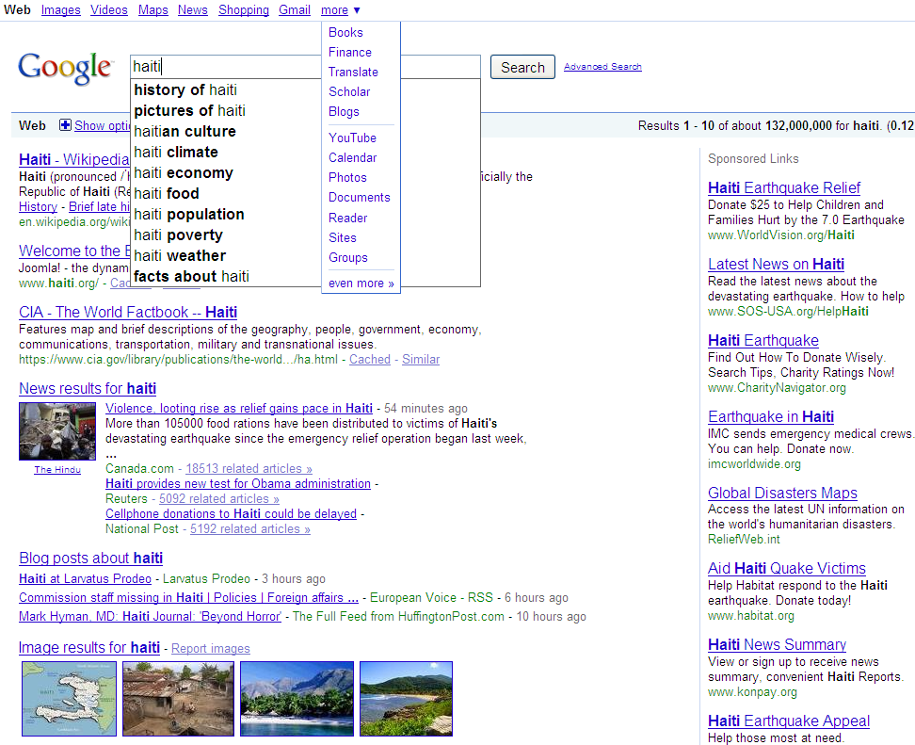
Web Search: Google
Search suggestions
Query-biased summarization / snippet generation
Sponsored search
Search shortcuts
Vertical search (news, blog, image)

Slide 12

Web Search: Google II
Vertical search (local)
Spelling correction
Personalized search / social ranking

Slide 13
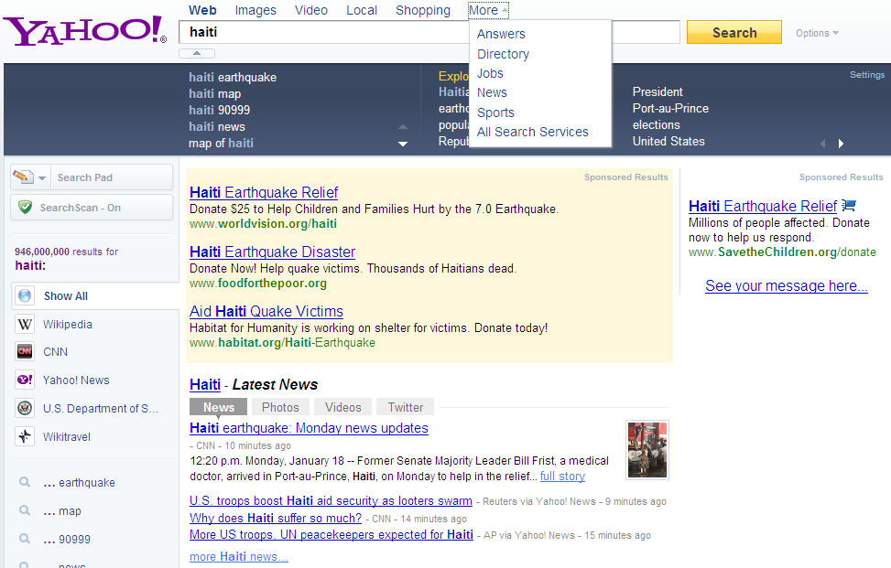
Web Search: Yahoo

Slide 14
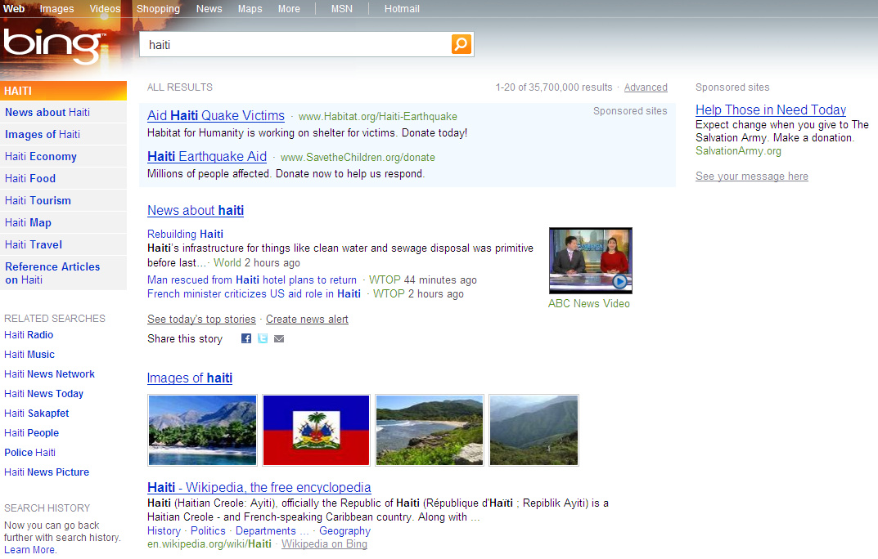
Web Search: Bing

Slide 15
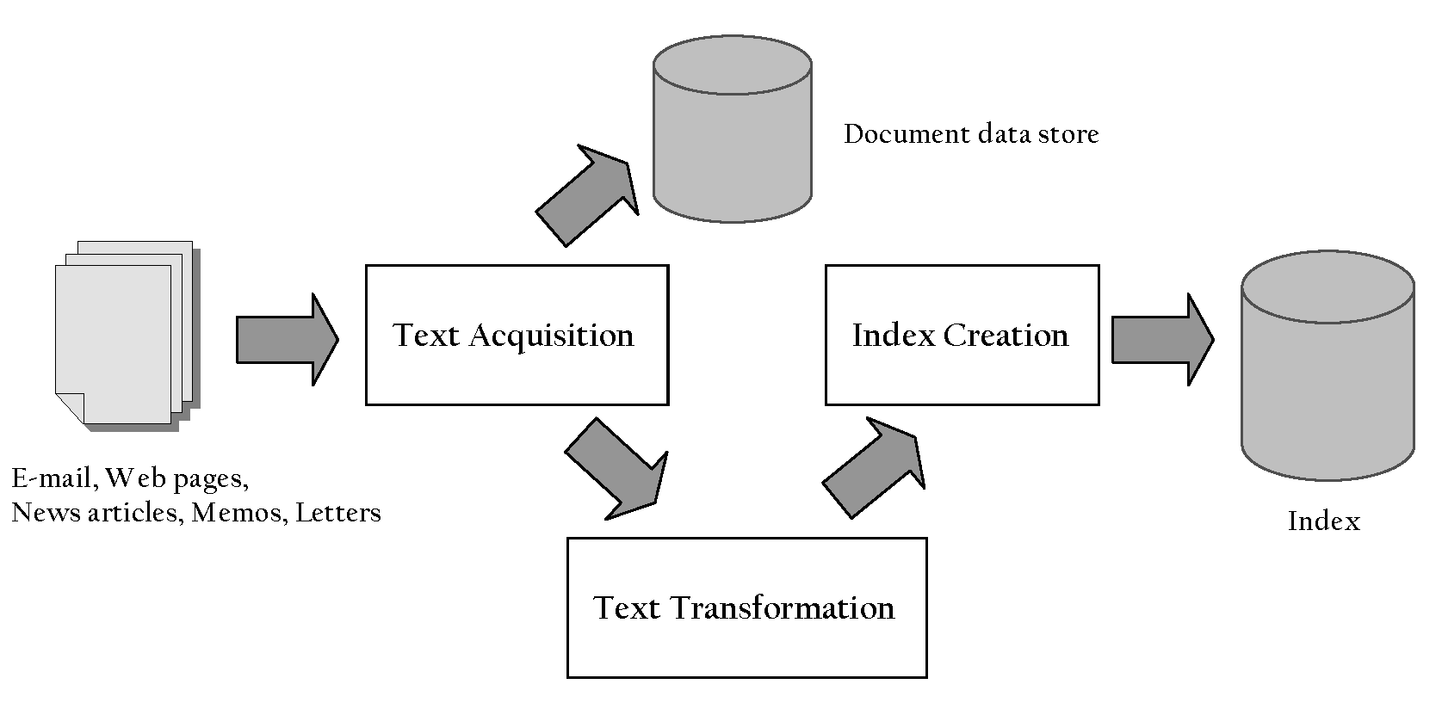
Indexing Process

Slide 16
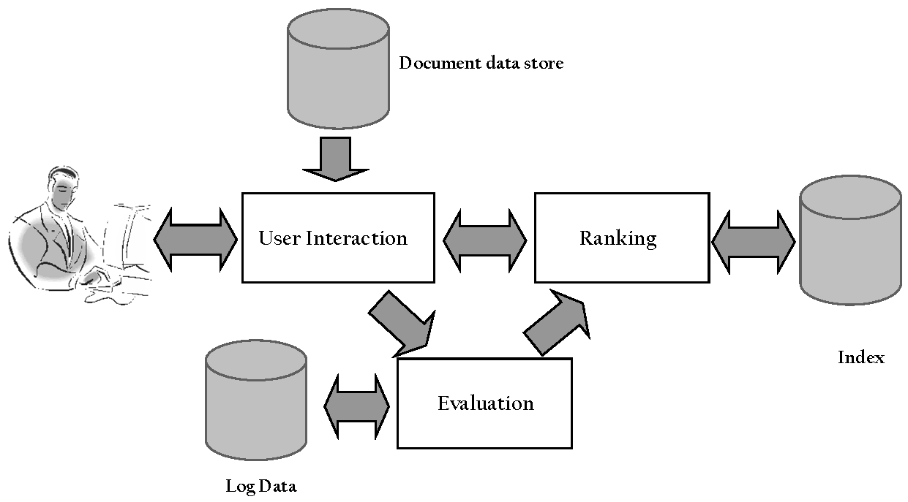
Query Process

Slide 17
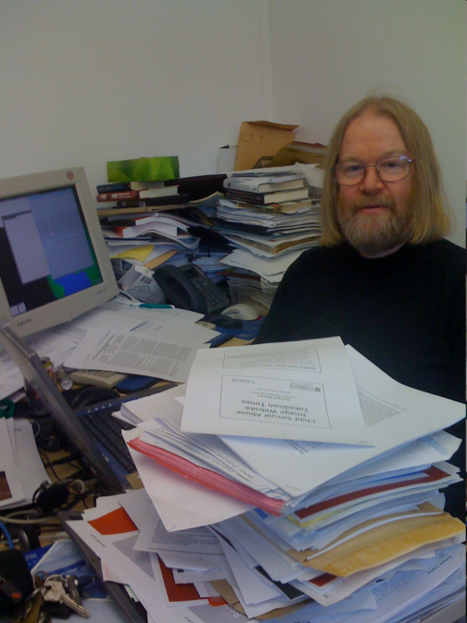




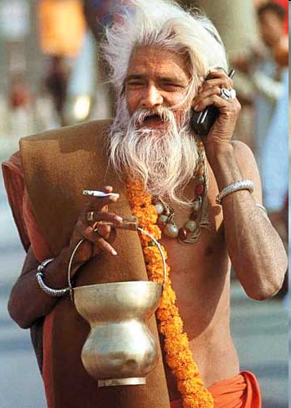
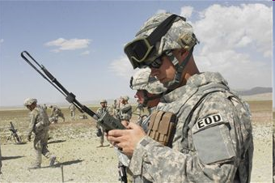
Who and Where?

Slide 18
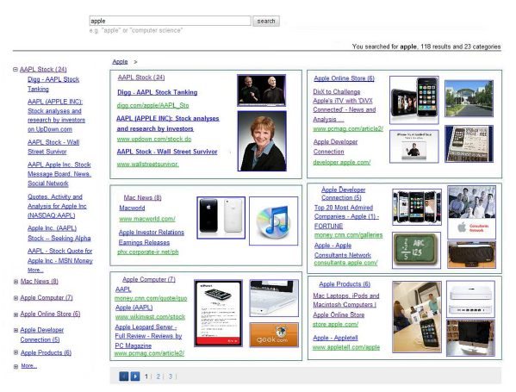
Query Disambiguation
Given (typically terse like “apple”) query, infer possible underlying intents / needs / tasks
With longer queries, detect key concepts and/or segment (e.g. “new york times square”)

Slide 19

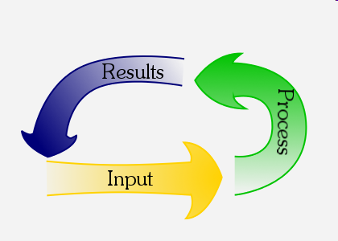

User <-> Search Engine Feedback Cycle
Query formulation reflects an ongoing dialog between users and search engines
Users formulate queries for the search engine, based on a mental model of what it “understands”
Search engines optimize their “understanding” for the (most frequent) submitted queries
Individual session and long term, personal and aggregate
Result: query “language” is continually evolving
“Handwriting recognition”

Slide 20
Verbosity and Complexity
Complex information requires complex description
  Information theory [Shannon’51]
  Human discourse implicitly respects this [Grice’67]
Simple searches easily expressed in keywords
  navigation: “alaska airlines”
  information: “american revolution”
Verbosity naturally increases with complexity
  More specific information needs [Phan et al.’07]
  Iterative reformulation [Lau and Horvitz’99]

Slide 21

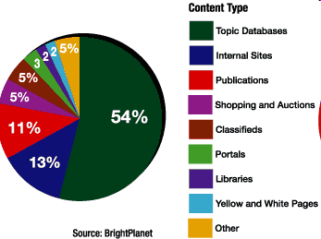







Vertical Search
Aka/related: federated / distributed / specialty
Searching the “Deep” web
One-size-fits-all vs. niche search
  Query formulation, content, usability/presentation

Slide 22
Cross-Lingual IR
2/3 of the Web is in English
About 50% of Web users do not use English as their primary language
Many (maybe most) search applications have to deal with multiple languages
  monolingual search: search in one language, but with many possible languages
  cross-language search: search in multiple languages at the same time

Slide 23
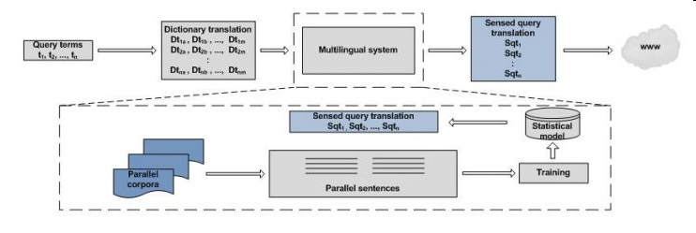
Cross-Lingual IR
Ideal
Let user express query in native language
Search information in multiple languages
Translate results into user’s native language

Slide 24
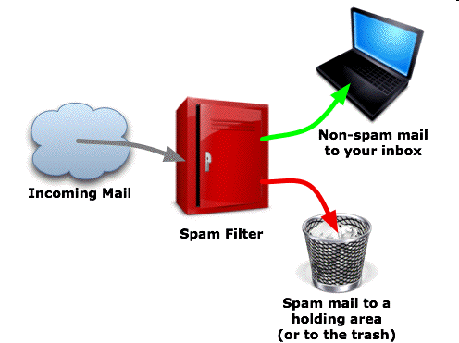
Routing / Filtering
Given standing query, analyze new information as it arrives
  Input: all email, RSS feed or listserv, …
  Typically classification rather than ranking
  Simple example: Ham vs. spam
  Anomaly detection

Slide 25



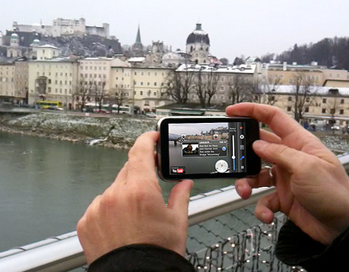

Location-based Search

Slide 26
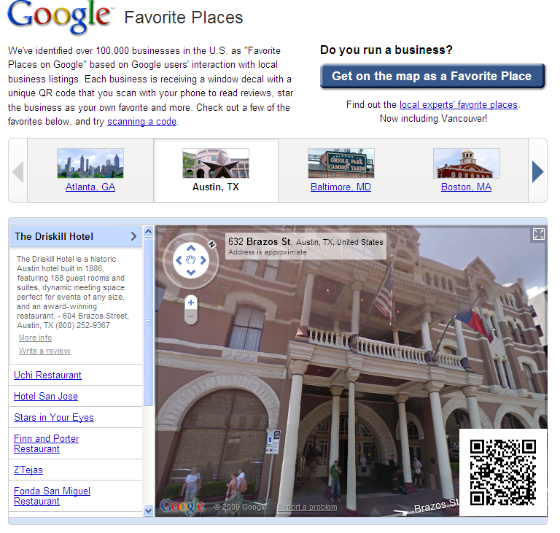

Slide 27





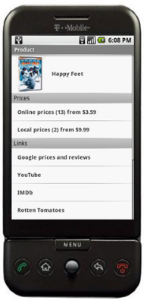



Slide 28

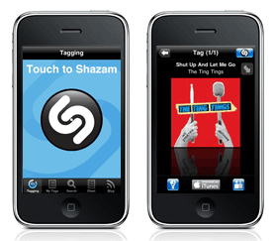


Content-based music search

Slide 29

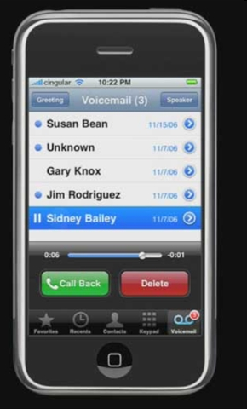

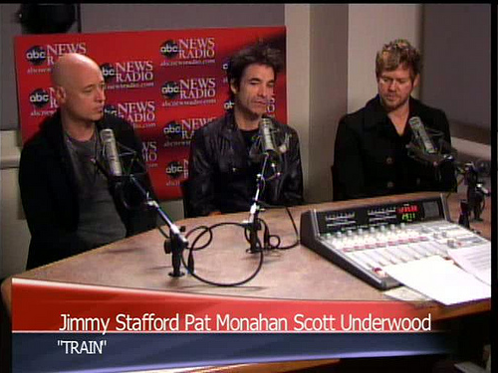


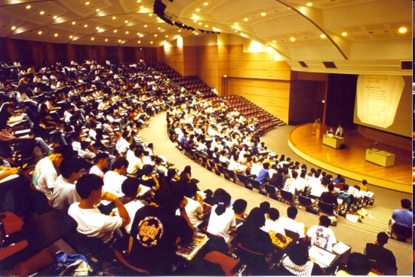

Spoken “Document” Retrieval

Slide 30
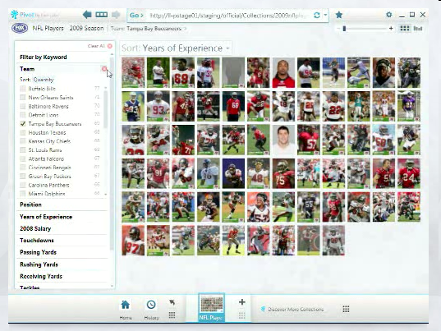
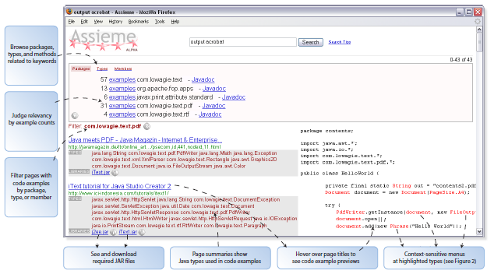

Other Visual Interfaces

Slide 31
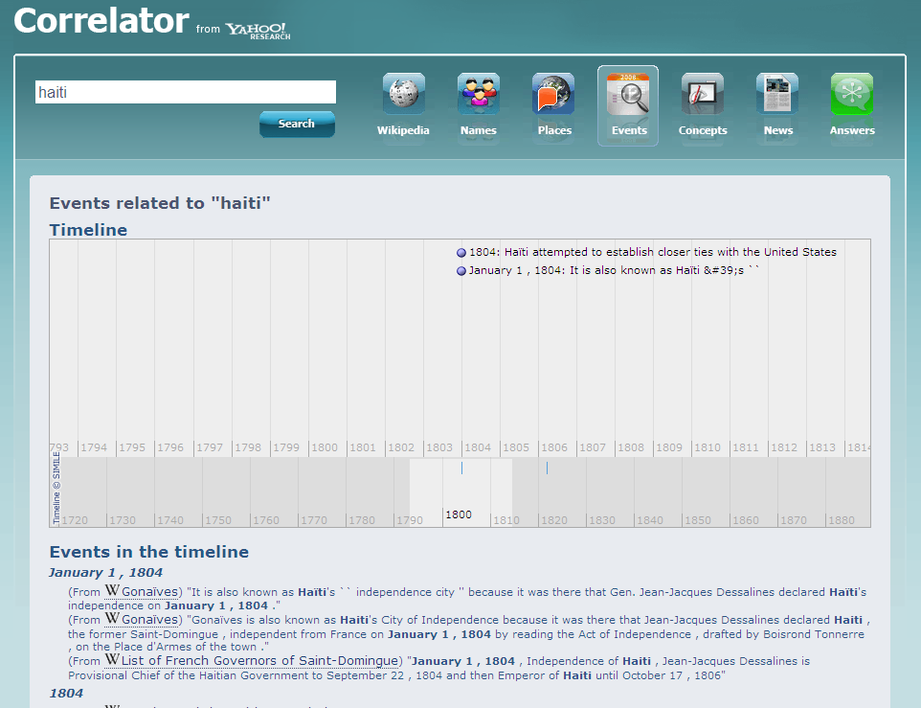
Retrieving Information, not Documents

Slide 32
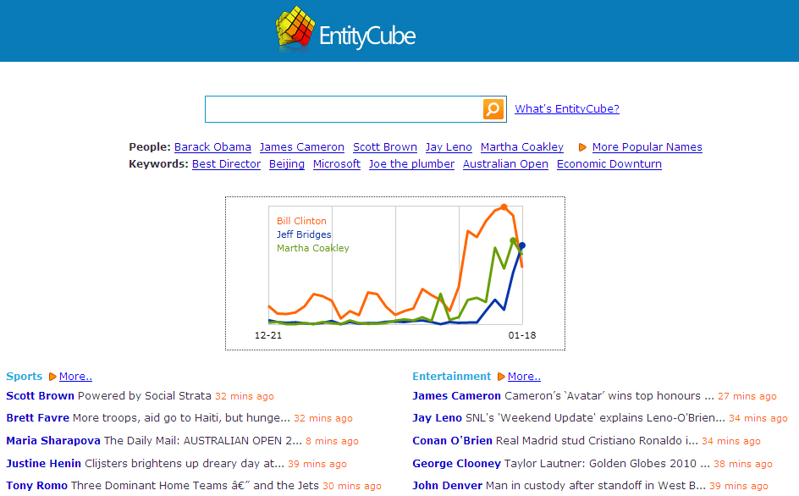
Entity Search

Slide 33
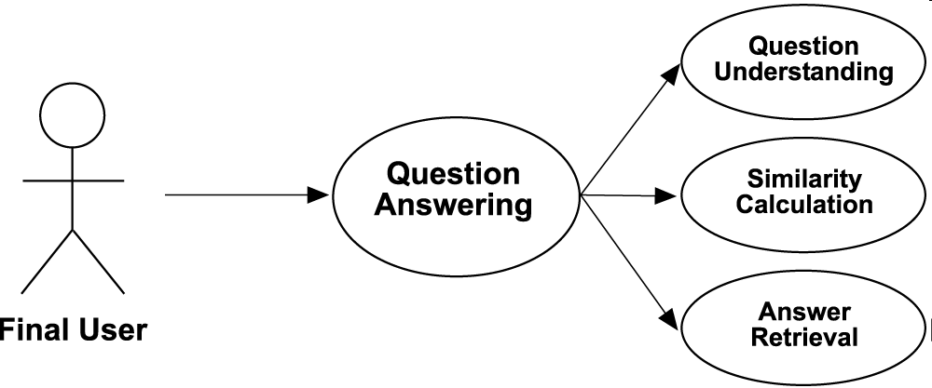
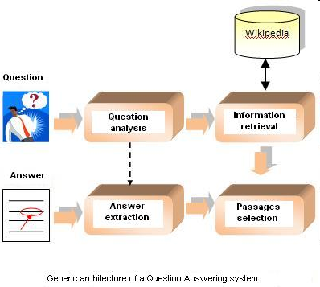
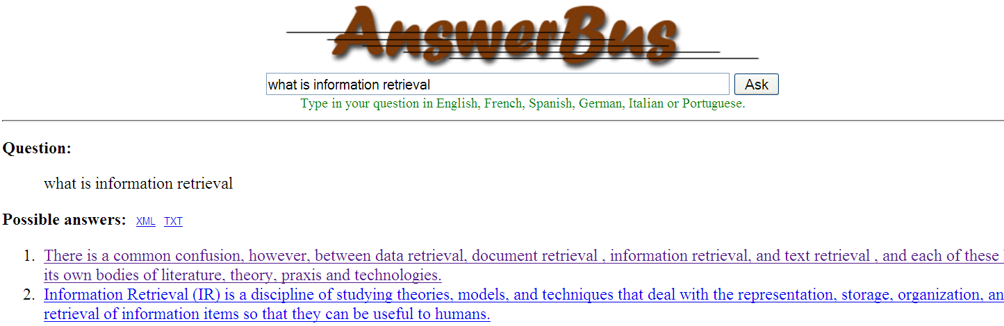
Question Answering & Focused Retrieval

Slide 34
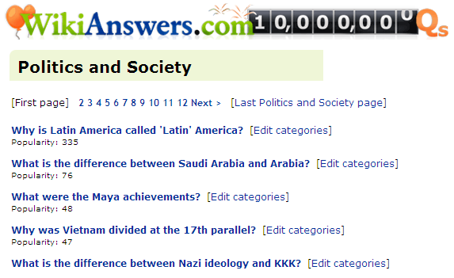

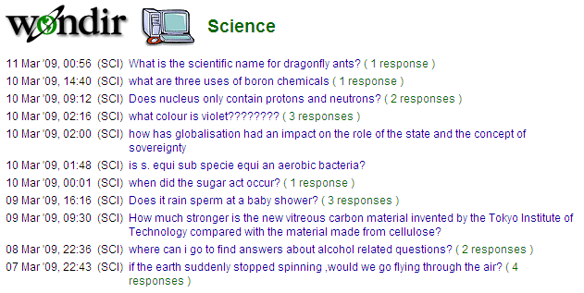
Community QA

Slide 35
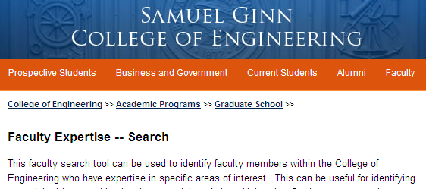
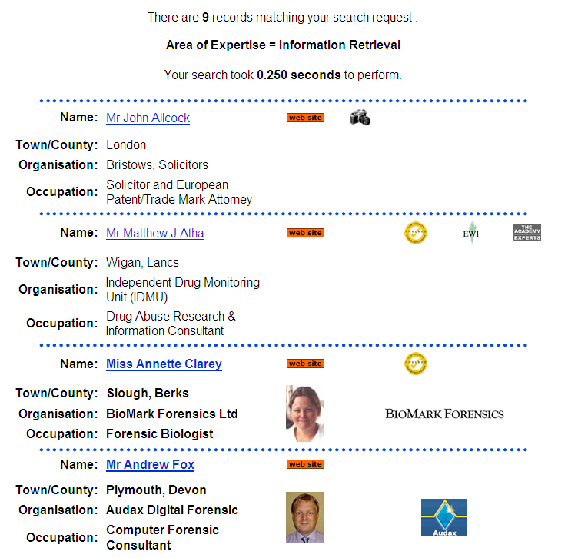

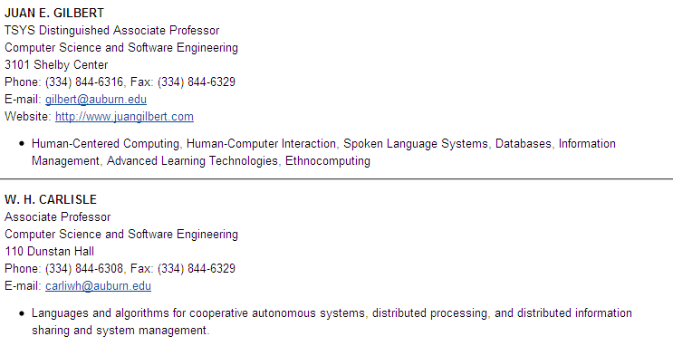
Expertise Search

Slide 36
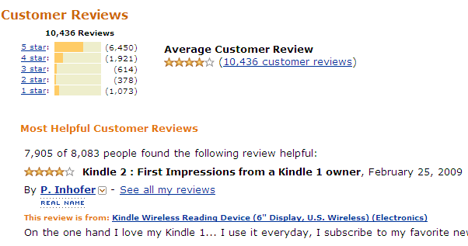

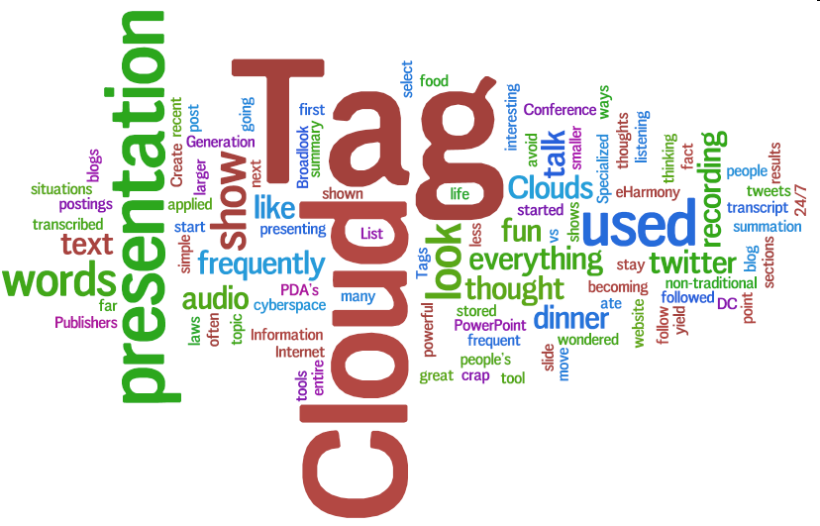
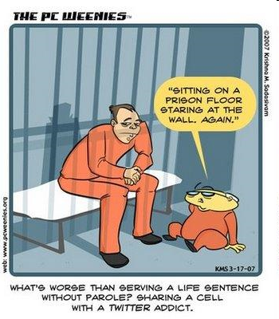

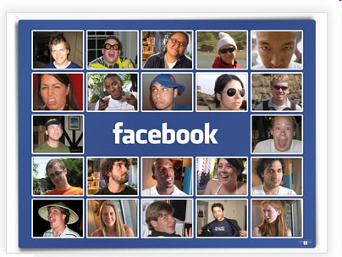
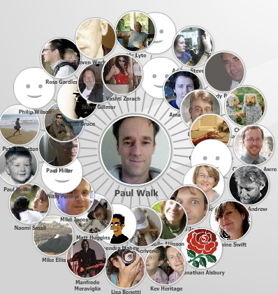
Social Media

Slide 37

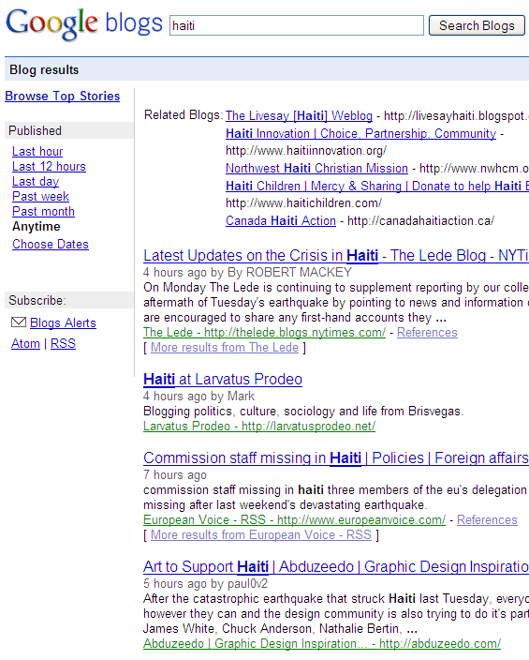
Blog Search

Slide 38

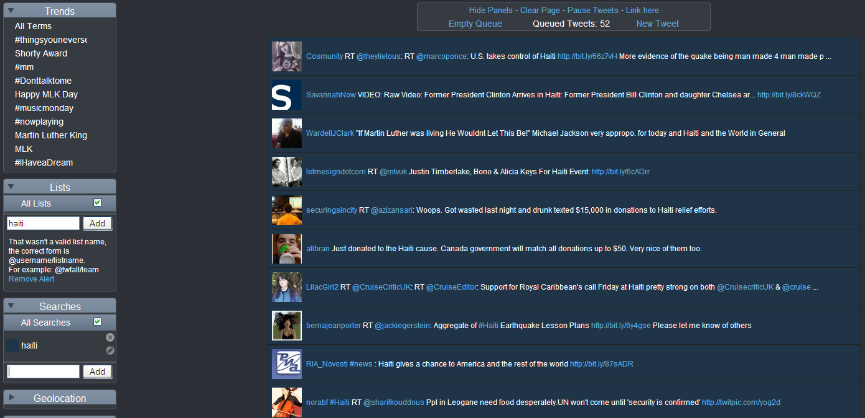
μ-Blog Search (e.g. Twitter)

Slide 39
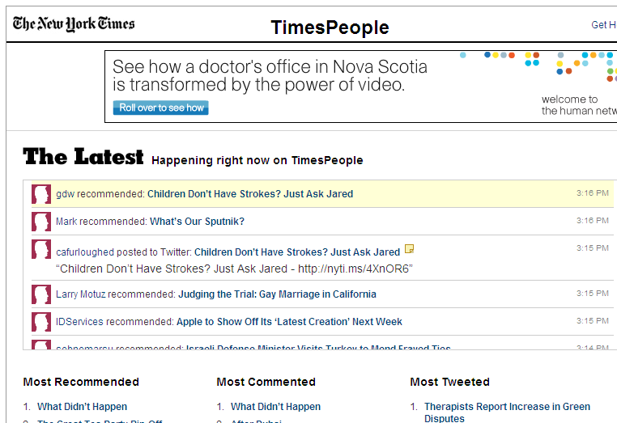
What’s Happening / Trending?

Slide 40
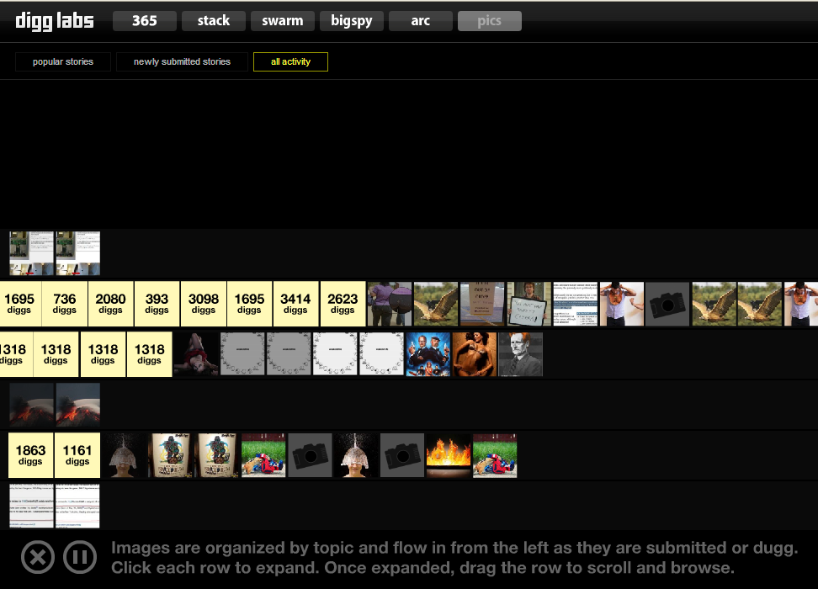
Social Bookmarking/Tagging

Slide 41

News Tracking (Living Stories)

Slide 42
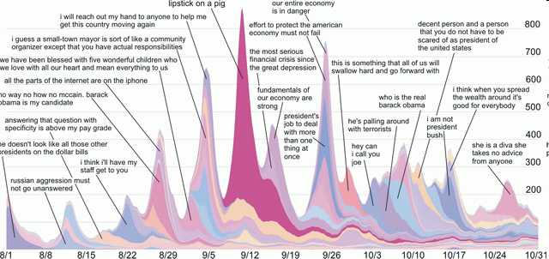
Memetracker

Slide 43

“Hyper-local” Search

Slide 44


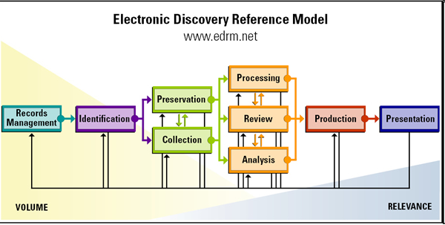

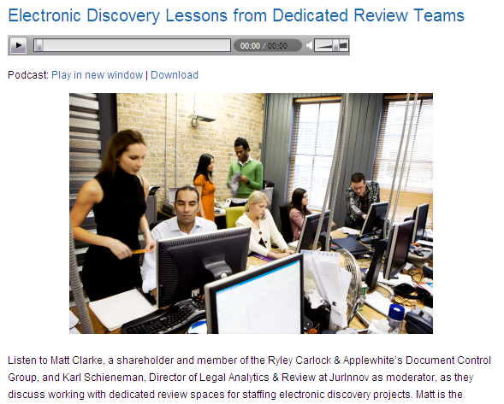
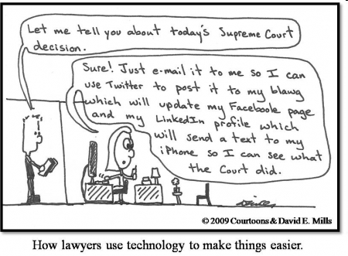
e-Discovery

Slide 45

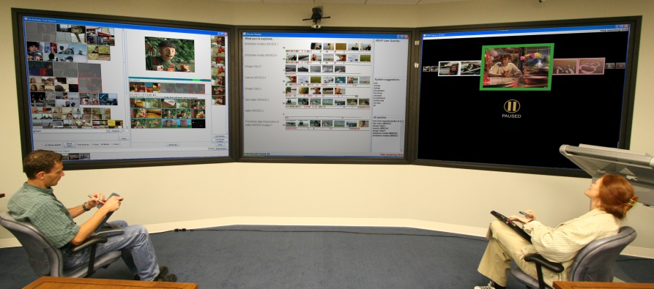
Collaborative Search

Slide 46
Book Search
Find books or more focused results
Detect / generate / link table of contents
Classification: detect genre (e.g. for browsing)
Detect related books, revised editions
Challenges
  Variable scan quality, OCR accuracy
  Copyright
  Monetary model

Slide 47
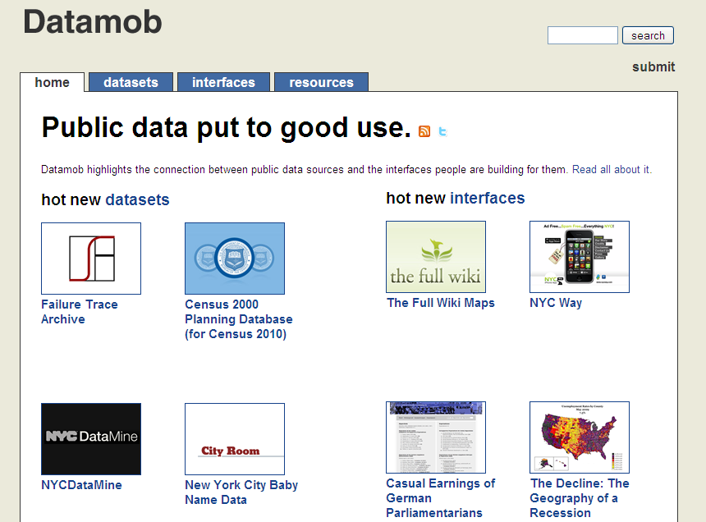
The Information’s Out There

Slide 48




Crowdsourcing

Slide 49


Mechanical Turk

Slide 50


Big Tent Challenges and Opportunities
Your guide

Slide 51



Usability Lab and Faculty

Slide 52





Human-Computer Interaction (HCI)
3 Multi-touch kiosks

Slide 53



HCI
Focus: designing software interfaces to support students and scholars in their tasks.

Slide 54

Cognitive & Health IR
Yan Zhang
Assistant professor
School of Information
Guest Lecture: March 26, 2010
Research interests in main two areas:
Psychological processes involved in people’s interaction with information systems, particularly web-based IR
Consumer health information needs and information seeking, as well as the design of consumer health information systems.

Slide 55

Natural Language Processing
Raymond J. Mooney
Professor of Computer Science The University of Texas at Austin
Syntactic and Semantic Analysis
Named-Entity Recognition
Also Machine Learning

Slide 56




Content-based Image Retrieval
Kristen Grauman
Assistant Professor
Department of Computer Sciences

