Slide 1
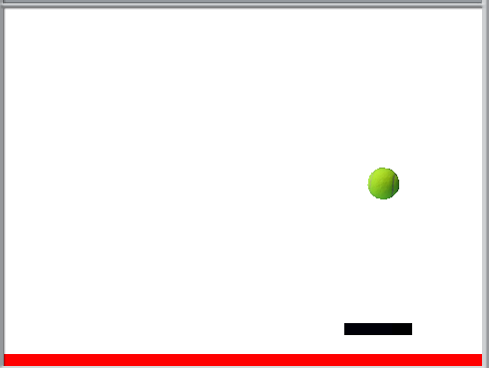
Pong with Scratch
Scratch is a Visual Programming Language
http://scratch.mit.edu/

Slide 2
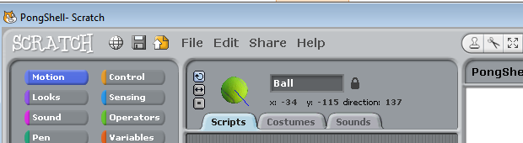
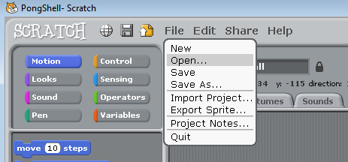
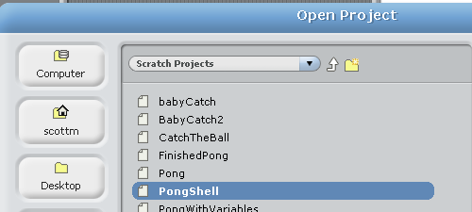
Open the PongShell

Slide 3
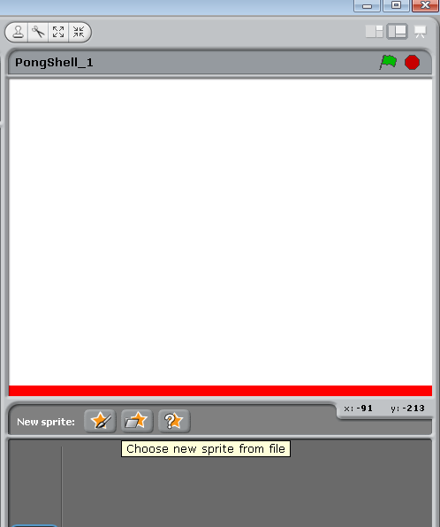
Add Sprites
Scratch program use Sprites
Images we can move!
Add a ball

Slide 4
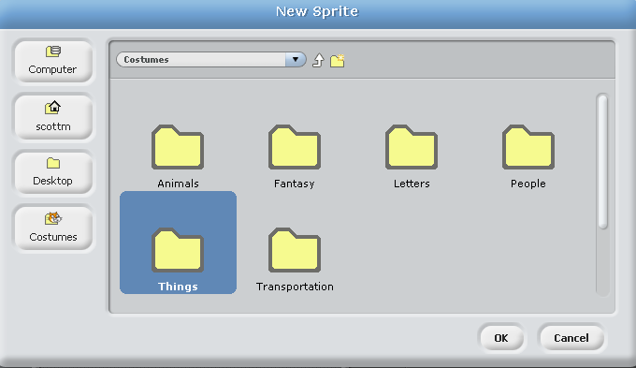
Choose Things
Select Object for Ball and click OK

Slide 5
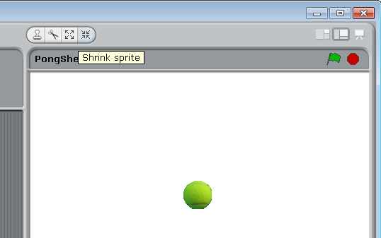
Shrink Ball
Click Shrink Sprite Button and click on sprite many times to make it smaller

Slide 6
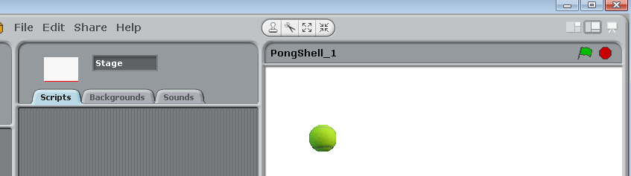
Make Ball Move
Get Ball to move by telling it to
Computer programs have commands
In Scratch these all called scripts
Click on ball and make sure scripts tab is selected

Slide 7
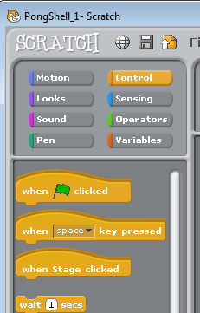
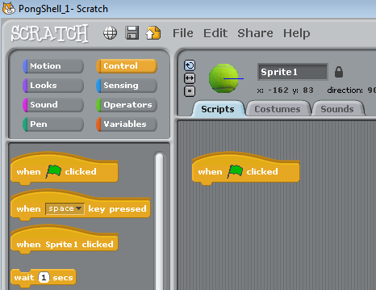
Add A Script
Select the Control Script
Drag a when green flag clicker control to script area

Slide 8
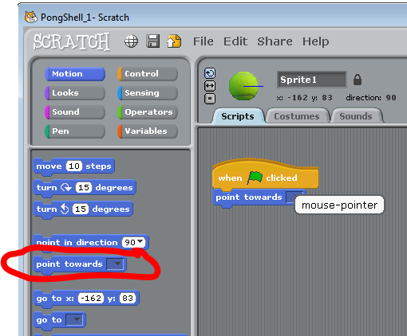
Add Commands to Script
Drag and connect a point
towards motion action.
Pick mouse-pointer

Slide 9
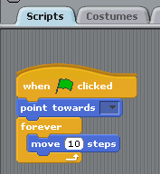
Make Ball Move
Add forever command from Control
Add move forward
10 steps from
motion
Click green flag in upper
right corner to start!
What happens?

Slide 10
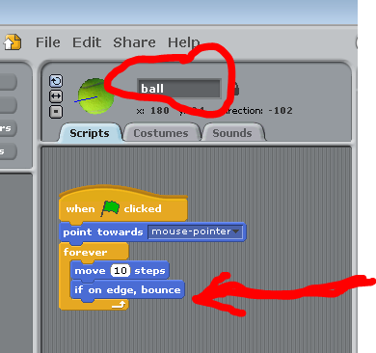
Make Ball Bounce
From motion add
if on edge, bounce
Stop program
with stop sign
Rename sprite ball in

Slide 11
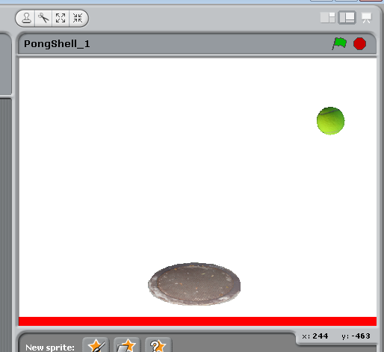
Add a Paddle
Add or draw another sprite for the paddle
I picked a manhole cover
Resize and rename sprite to paddle
Move paddle to bottom of stage

Slide 12
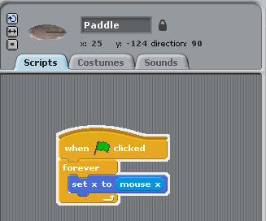
Make Paddle Move
Click Paddle
Go to Scripts
Add when Green Flag Clicked
Add Forever
Add set x to (motion)
Replace 0 with mouse x from Sensing
Click the Green Flag to Test
What happens?

Slide 13
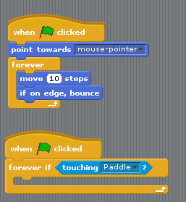
Bounce Off Paddle
Click the Ball Spring and add
a script
When Green Flag Clicked
forever if (control)
fill in condition with
touching (sensing)
pick touching paddle

Slide 14
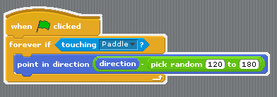
Bounce Off Paddle
fill in forever if with
point in direction (motion)
replace 90 with
0 - 0 (operators)
replace first blank with
direction (motion) of ball
replace second blank with pick a random number (operators)
type in 120 and 180

Slide 15
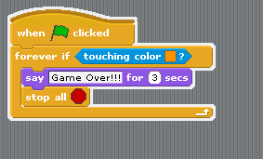
Game Over
Click Ball sprite
Build another script
When Green Flag Clicked
forever if
touching color (sensing)
click color for eye dropper and click orange
add say "Game Over" for 2 seconds (looks)
stop all (control)

Slide 16
More!
Try Changing Speed
Other things to hit
Multiple balls
Multiple lives

