Slide 1
Academic Integrity
Mike Scott
Lecturer, CS Dept.
scottm@cs.utexas.edu

Slide 2
Expectations
I'll ask questions.
Try to answer my questions and ask your own questions.
Be the first Penguin.

Slide 3
Question 1
What do UTCS students do after they graduate?

Slide 4
Question 1
They go to graduate school.
They go to work, usually as software developers.
Some start their own companies, become teachers, attend professional schools, and more.

Slide 5
Question 2
Where do our students go to graduate school?

Slide 6
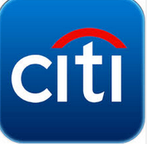
Question 3
Where do our students go to work?

Slide 7
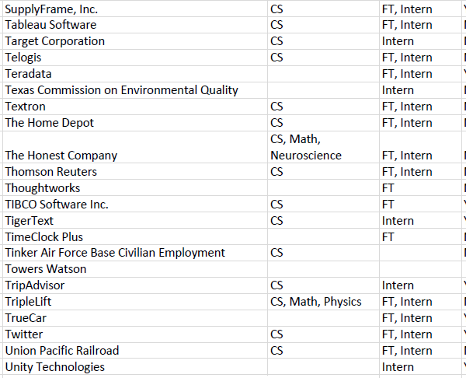
Spring 2016 CNS Career Fair
Fall 2016 Career CNS Career Fair
Tuesday, September 20th
1 - 6 pm
GO!!!!!
but don't skip class

Slide 8
Question 4
Why is that? How?
Our faculty, students, and staff are extraordinarily talented.
Past students succeeded in graduate school and at companies.
Our program is rigorous.
The reputation afforded a UTCS degree is quite high.

Slide 9
Question 5
How do we maintain the reputation of the UTCS undergraduate degree?
Among other things, we have high standards of academic integrity.

Slide 10
UT Honor Code
As a student of The University of Texas at Austin, I shall abide by the core values of the University and uphold academic integrity.

Slide 11
Academic Integrity
At a minimum, you should complete any assignments, exams, and other scholastic endeavors with the utmost honesty, which requires you to:
acknowledge the contributions of other sources to your scholastic efforts;
complete your assignments independently unless expressly authorized to seek or obtain assistance in preparing them;
follow instructions for assignments and exams, and observe the standards of your academic discipline; and
avoid engaging in any form of academic dishonesty on behalf of yourself or another student.

Slide 12
UTCS Rules to Live By
Every piece of work that you turn in with your name on it must be yours and yours alone unless explicitly allowed by an instructor in a particular class. Specifically, unless otherwise authorized by an instructor:
Students may not discuss their work with anyone except the instructor and other members of the instructional staff (TA, Section Leader or Lab Proctor).
Students may not acquire from any source (e.g., another student or an internet site) a partial or complete solution to a problem or project that has been assigned.

Slide 13
UTCS Rules to Live By
You are responsible for complying with this policy in two ways:
You must not turn in work that is not yours, except as expressly permitted by the instructor of each course.
You must take all reasonable precautions to prevent your work from being stolen.

Slide 14
Each Class is Different
Check course syllabus.
What if syllabus doesn't cover this or you are unclear about expectations?
Many instructors use plagiarism detection software to check your submissions against others in the class and past classes.
We know how to search the web too.
GitHub, Stackoverflow, Pastebin

Slide 15
Academic Dishonesty Cases
Initiated by Instructors
Student Judicial Services
division of Office of the Dean of Students
Faculty Disposition
admit to violation and accept Faculty's penalty
on record with SJS
Referral to SJS
evidence sent to SJS and they handle investigation, determination, and penalty

