Slide 1
The End of Anonymity
Vitaly Shmatikov

Slide 2





Tastes and Purchases

Slide 3












Social Networks

Slide 4






Health Care and Genetics

Slide 5



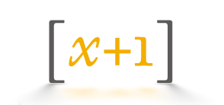






Web Tracking

Slide 6





Solution: Anonymity!
“… breakthrough technology that uses social graph data to dramatically improve online marketing …
"Social Engagement Data" consists of anonymous information regarding the relationships between people”
“The critical distinction … between the use of personal information for advertisements in personally-identifiable form, and the use, dissemination, or sharing of information with advertisers in non-personally-identifiable form.”

Slide 7
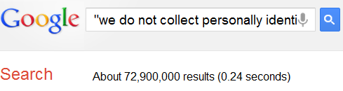
Phew…

Slide 8



“Privacy-Preserving” Data Release
x₁
x₂
x₃

x_{n-1}
Privacy!
“anonymization”
“de-identification”
“sanitization”
x_{n}
Data

Slide 9
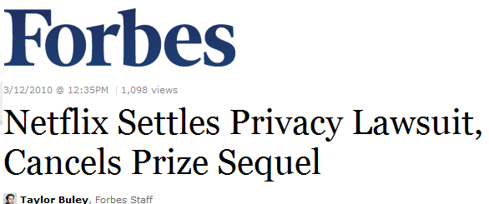

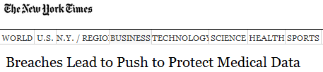
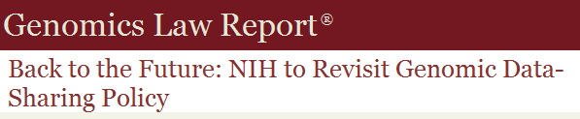


Some Privacy Disasters
What went wrong?

Slide 10
The Myth of the PII
Data are “anonymized” by removing personally identifying information (PII)
  Name, Social Security number, phone number, email, address… what else?
Problem: PII has no technical meaning
  Defined in disclosure notification laws (if certain information is lost, consumer must be notified)
  In privacy breaches, any information can be personally identifying

Slide 11


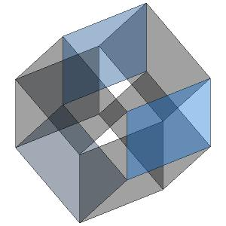
The Curse of Dimensionality
Item 1
Item 2
Item M
Row = user record
Column = dimension
Thousands or millions of dimensions
  Netflix movie ratings: 35,000
  Amazon purchases: 10⁷
User 1
User 2
User N

Slide 12
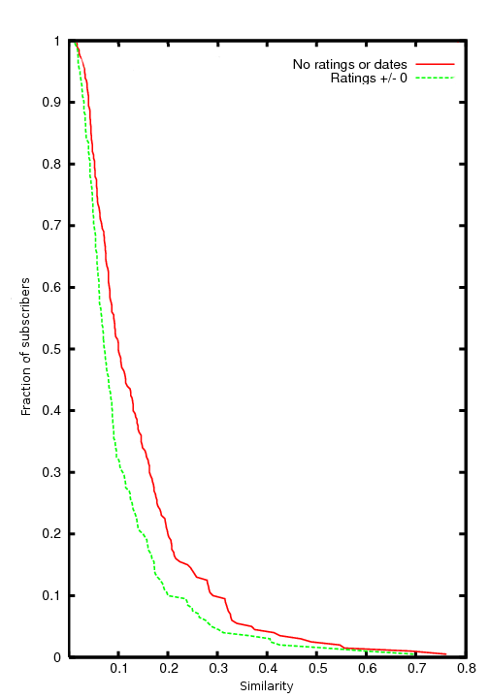
Sparsity and “Long Tail”
Average record has no “similar” records
Fraction of subscribers
Netflix Prize dataset:
Considering just movie names, for 90% of records there isn’t a single other record which is more than 30% similar
Similarity

Slide 13
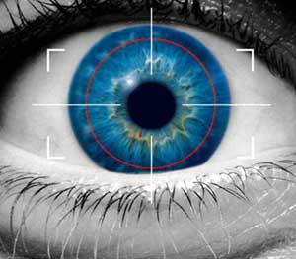
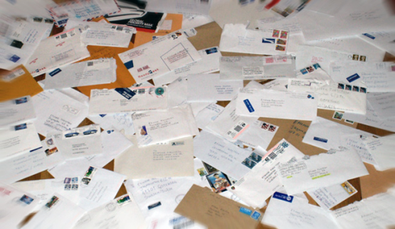


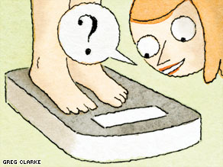
Privacy Threats
Spammers
Abusive advertisers and marketers
Global surveillance
Phishing
Employers, insurers,
stalkers, nosy friends

Slide 14
It’s All About the Aux
Item 1
Item 2
Item M
User 1
What can the adversary learn by combining this with auxiliary information?
User 2
Information available to
adversary outside of
normal data release process
User N
No explicit identifiers

Slide 15



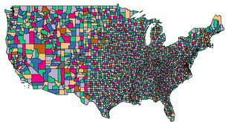


De-anonymizing Sparse Datasets
Auxiliary
information

Slide 16
De-anonymization Objectives
Fix some target record r in the original dataset
Goal: learn as much about r as possible
Subtler than “identify r in the released dataset”
  Don’t fall for the k-anonymity fallacy!
    Silly example: released dataset contains k copies of each original record – this is k-anonymous!
  Can’t identify the “right” record, yet the released dataset completely leaks everything about r
Notes:
16

Slide 17



Aux as Noisy Projection

Slide 18
How Much Aux Is Needed?
How much does the adversary need to know about a record to find a very similar record in the released dataset?
  Under very mild sparsity assumption, O(log N), where N is the number of records
What if not enough Aux is available?
  Identifying a small number of candidate records similar to the target still reveals a lot of information

Slide 19
De-Anonymization in Practice
Sweeney (1998):
Massachusetts hospital discharge dataset + voter database
Narayanan and Shmatikov (2006):
Netflix Prize dataset + IMDb
Narayanan and Shmatikov (2009):
social networks

Slide 20
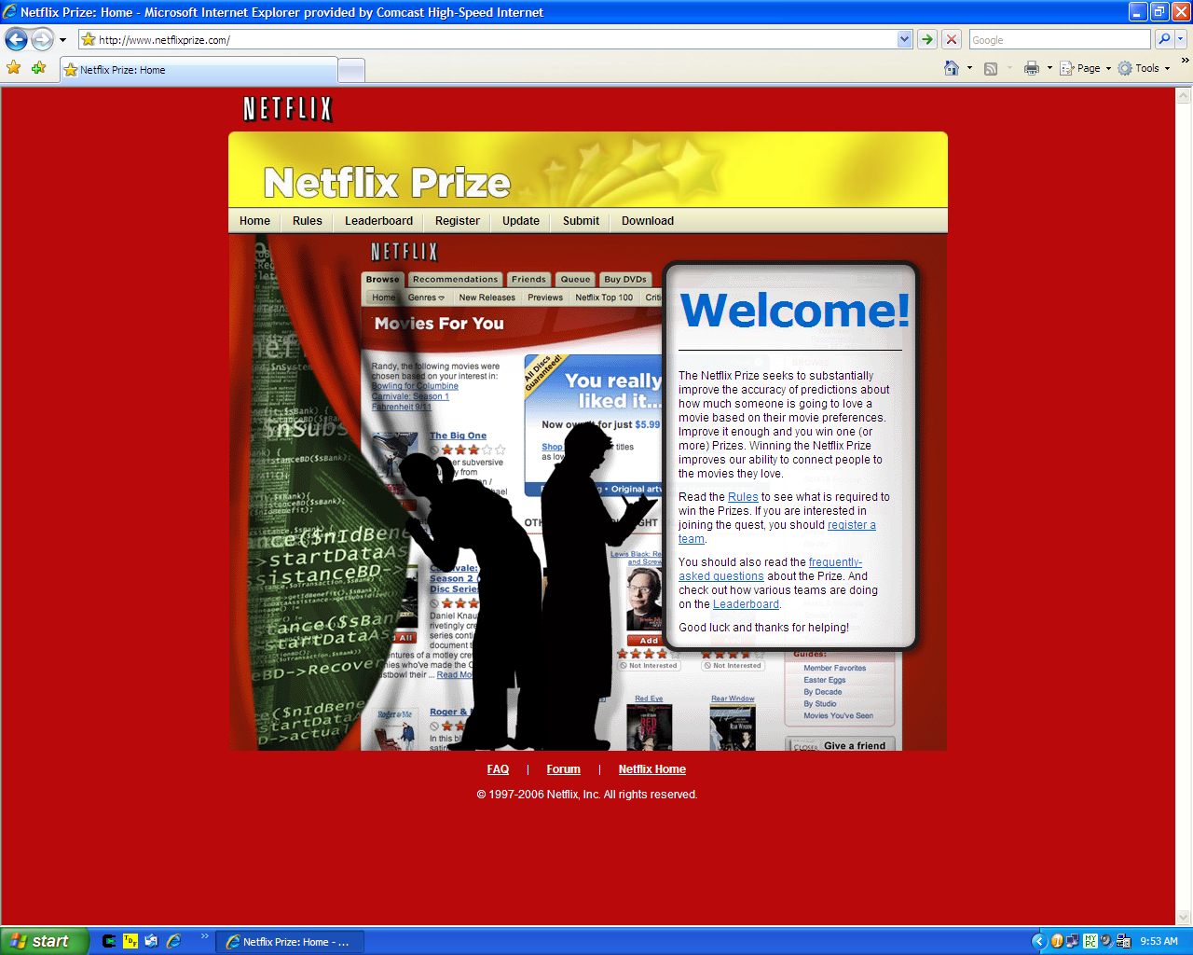

Slide 21
De-anonymizing the Netflix Dataset
500K users, 18,000 movies
213 dated ratings per user, on average
Two is enough to reduce to 8 candidate records
Four is enough to identify uniquely (on average)
Works even better with relatively rare ratings
    “The Astro-Zombies” rather than “Star Wars”
Long Tail effect:
most people watch obscure crap

Slide 22
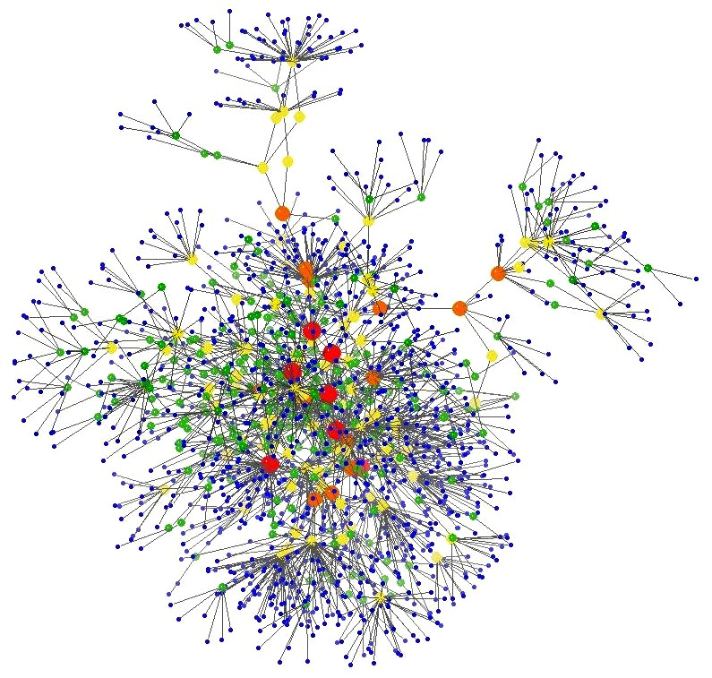
Exploiting Data Structure

Slide 23
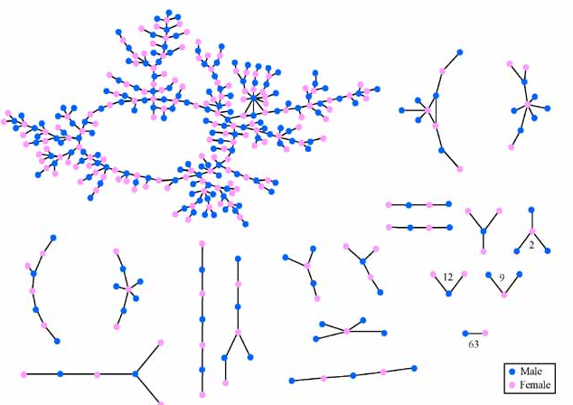
“Jefferson High”:
Romantic and Sexual Network
Real data!

Slide 24
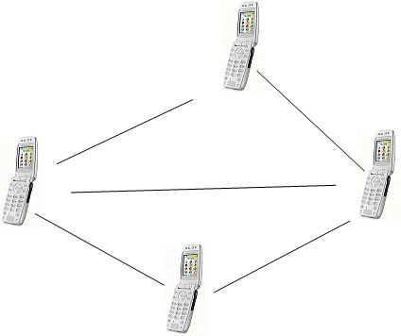

Phone Call Graphs
2 trillion edges
Examples of outsourced call graphs
Hungary | 2.5M nodes
France | 7M nodes
India | 3M nodes
3,000 companies providing
wireless services in the U.S

Slide 25
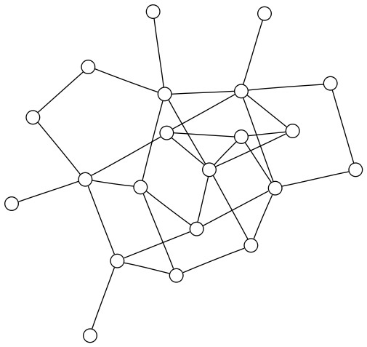
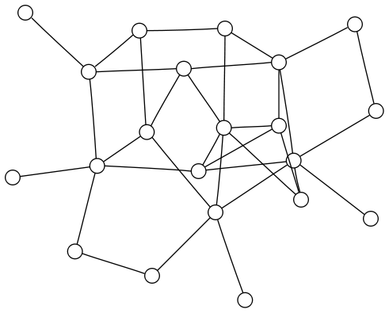
Structural De-anonymization
Goal: structural mapping between two graphs
For example, Facebook vs. anonymized phone call graph

Slide 26




Winning the IJCNN/Kaggle
Social Network Challenge
[Narayanan, Shi, Rubinstein]
“Anonymized” graph of Flickr used as challenge for a link prediction contest
De-anonymization = “oracle” for true answers
  57% coverage
  98% accuracy
?

Slide 27
More De-Anonymization
Social networks – again and again
Stylometry (writing style)
Location data
  De Montjoye et al. (2013): mobility traces from a cell phone carrier - 4 points is enough
Credit card transaction meta-data
  De Montjoye et al. (2015) – 4 purchases is enough

Slide 28
Lesson #1:
De-anonymization Is Robust
33 bits of entropy
  6-8 movies, 4-7 friends, etc.
Perturbing data to foil de-anonymization often destroys utility
We can estimate confidence even without ground truth
Accretive and iterative:
more de-anonymization →
better de-anonymization

Slide 29


Lesson #2:
“PII” Is Technically Meaningless
PII is info “with respect to which there is a reasonable basis to believe the information can be used to identify the individual.”
Any piece of data can be used
for re-identification!
Narayanan, Shmatikov
CACM column, 2010
“blurring of the distinction between personally identifiable information and supposedly anonymous or de-identified information”

