Slide 1


Computer Vision for Fashion:
From Individual Recommendations to World-wide Trends
Kristen Grauman
University of Texas at Austin
Facebook AI Research

Slide 2

Fashion: what people wear
Kristen Grauman, UT Austin and FAIR

Slide 3
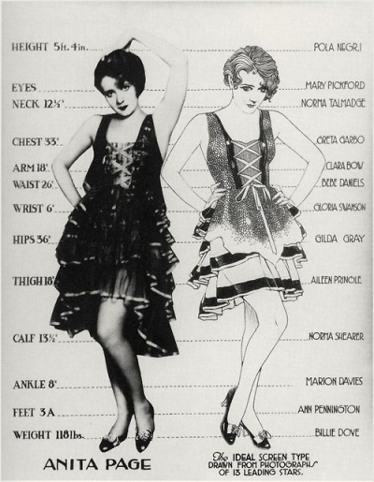
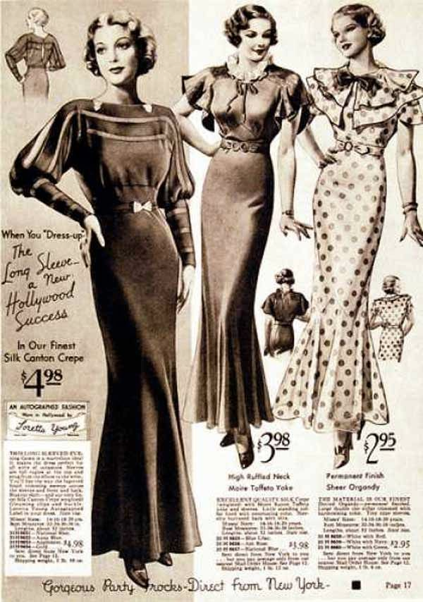
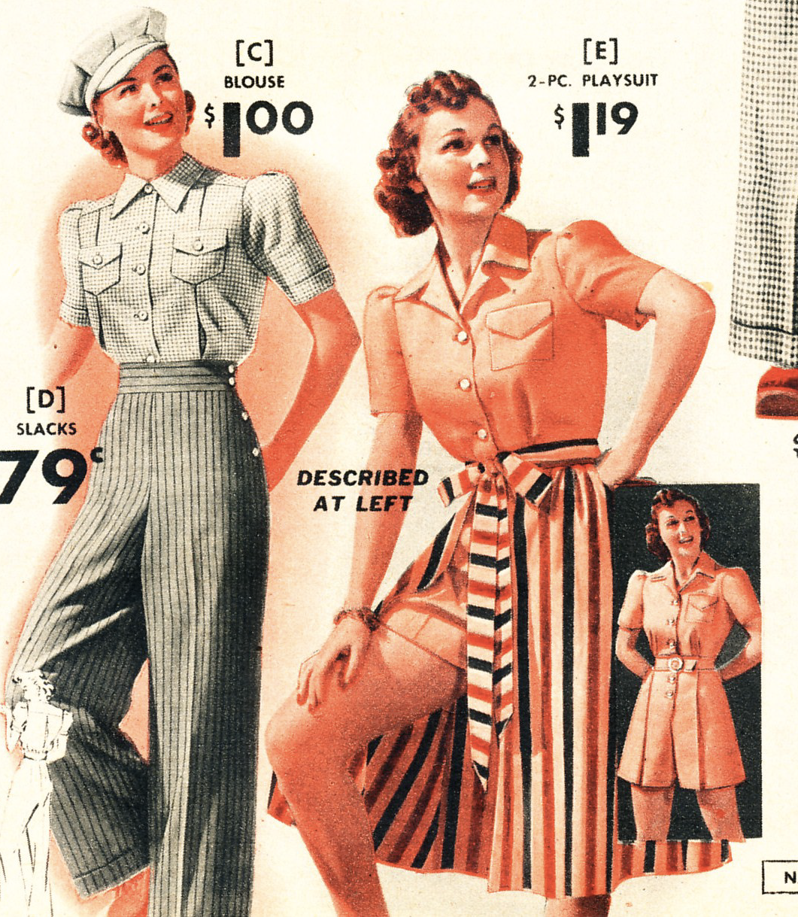
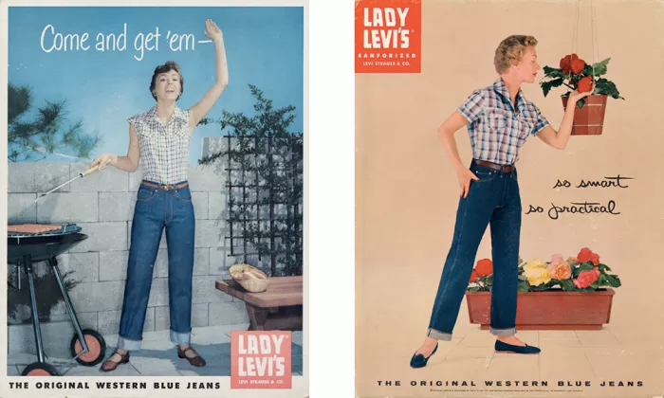
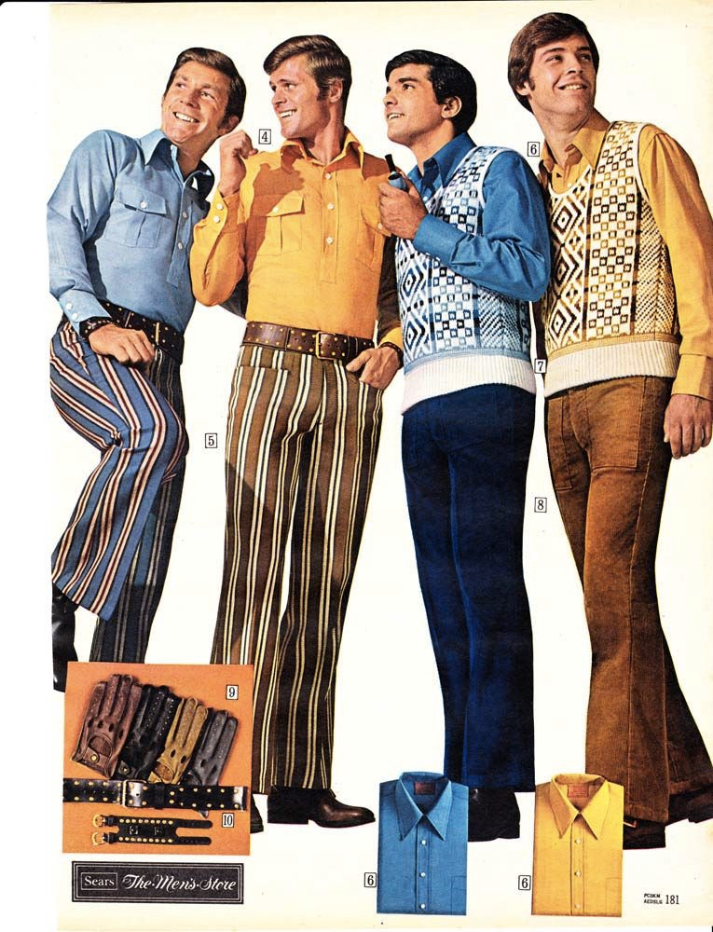
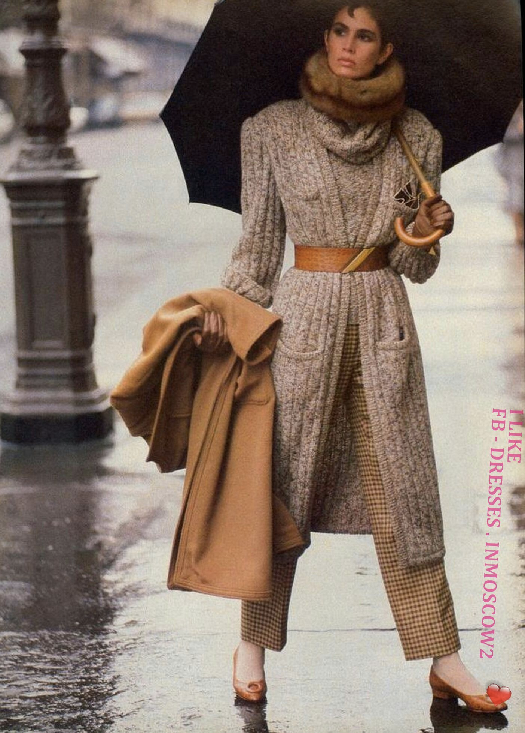
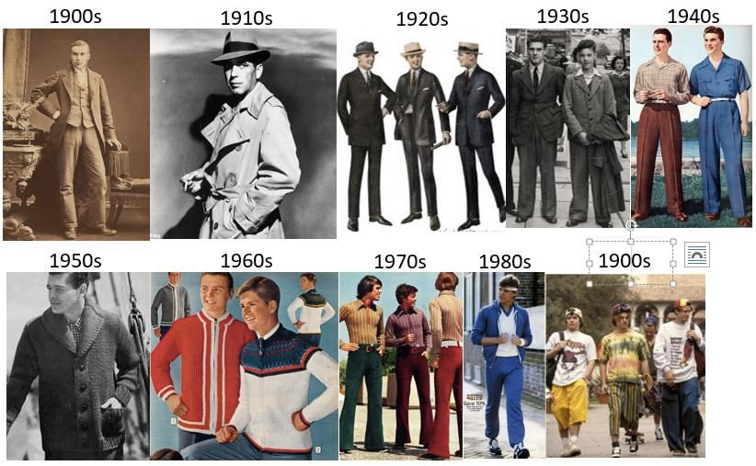
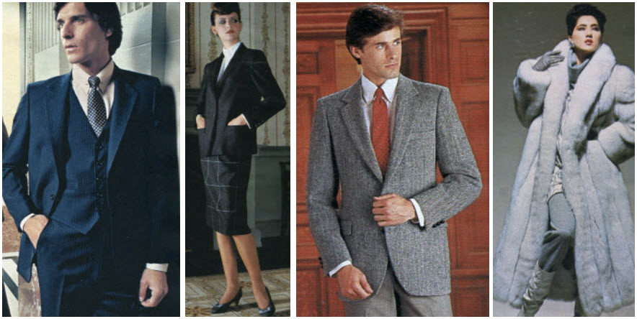
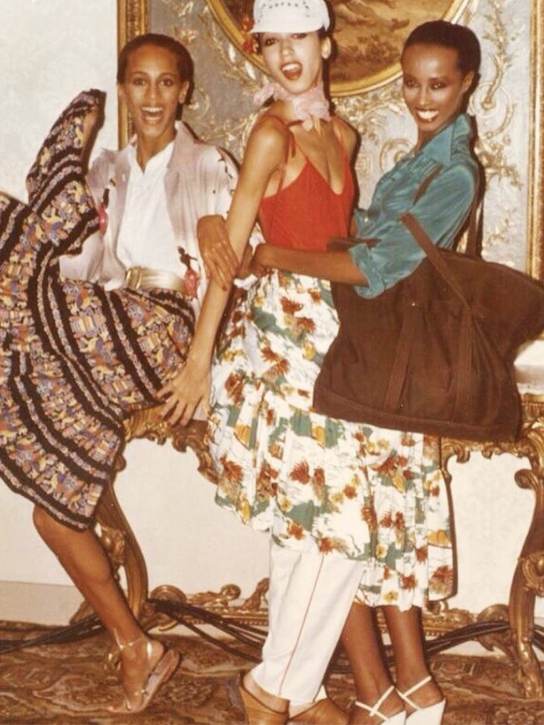
Fashion and culture
Postwar simplicity
Manufacturing fabrics
WWII austerity
Feminism
Anti-war
Women in the workplace
1920
1930
1940
1950
1970
1980
Kristen Grauman, UT Austin and FAIR

Slide 4


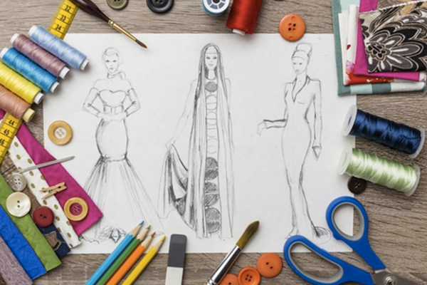




Vision → fashion
Business
How we shop
Design & creativity
Kristen Grauman, UT Austin and FAIR

Slide 5
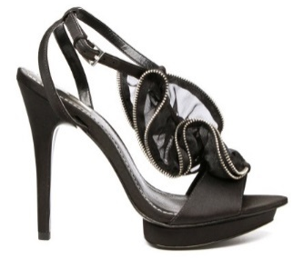
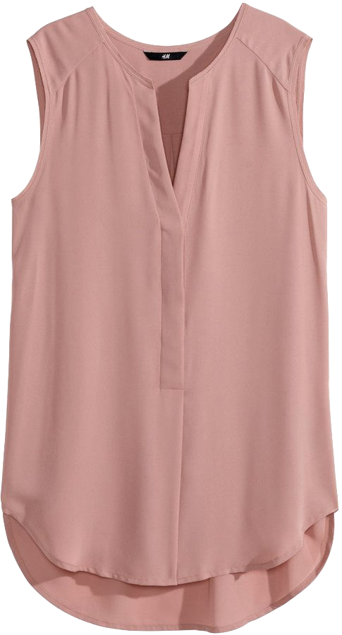

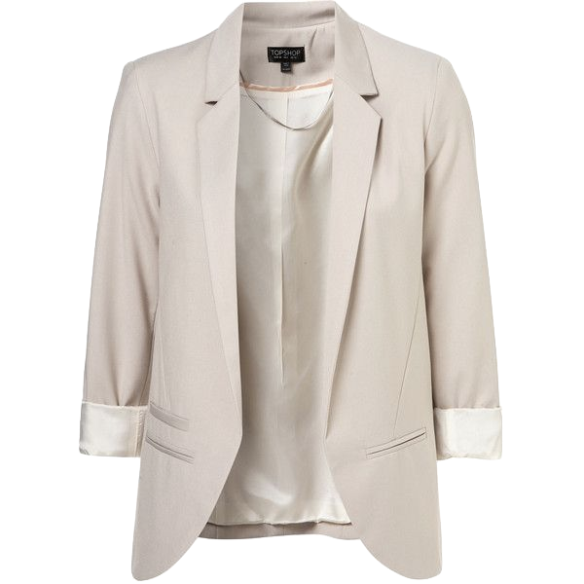
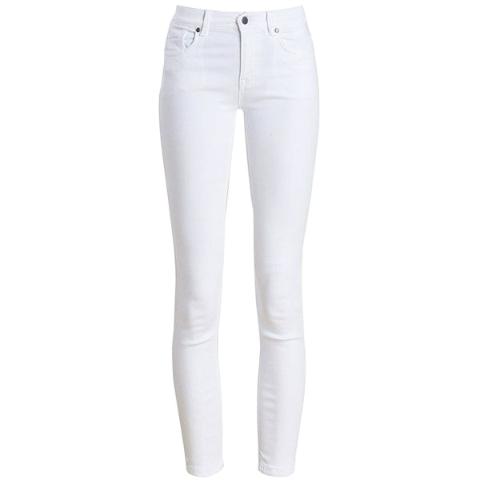
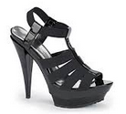
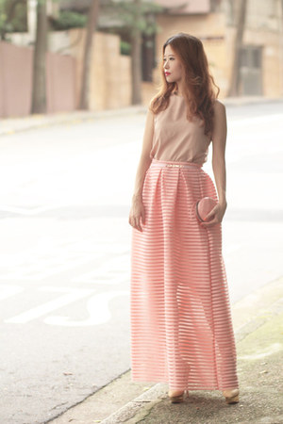
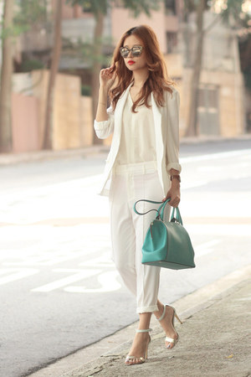
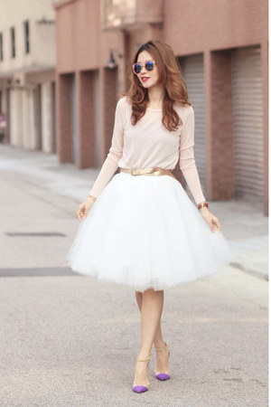
Fashion → vision
Fashion introduces new challenges for high-level vision:
Subtle distinctions
Composition and compatibility
Personalization and taste
Require computational model for visual style
Kristen Grauman, UT Austin and FAIR

Slide 6
This talk
Learning about fashion from Web photos
Discovering latent styles
Assembling outfits
Forecasting future trends
Kristen Grauman, UT Austin and FAIR

Slide 7
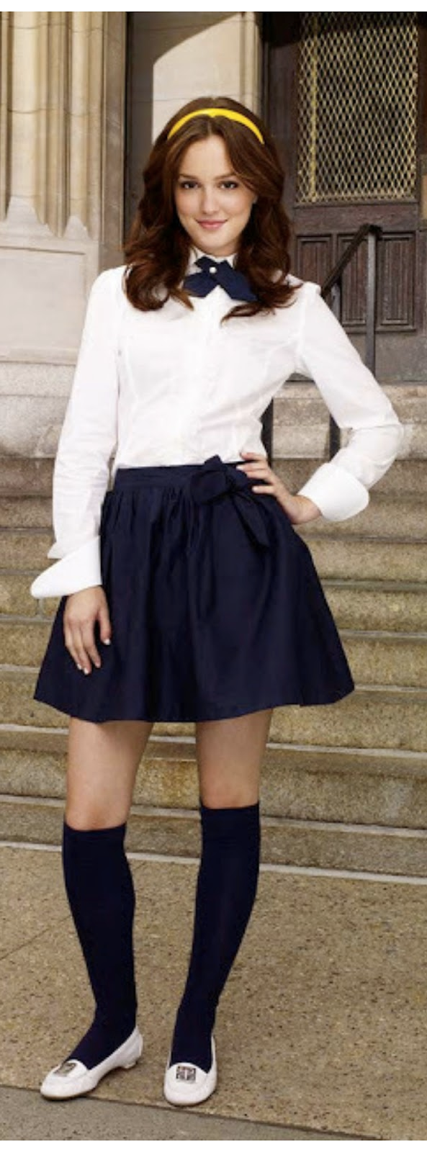
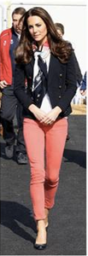
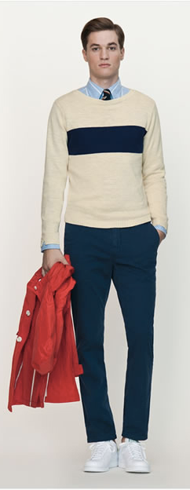
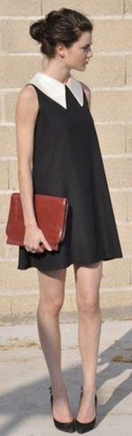
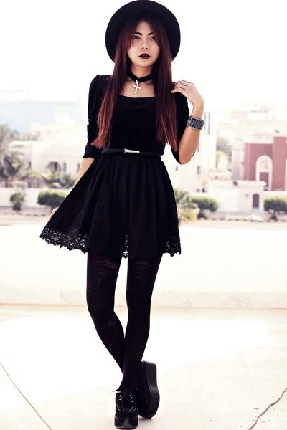
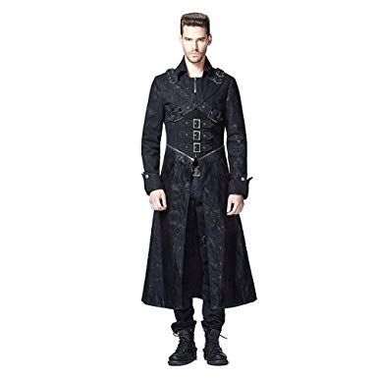
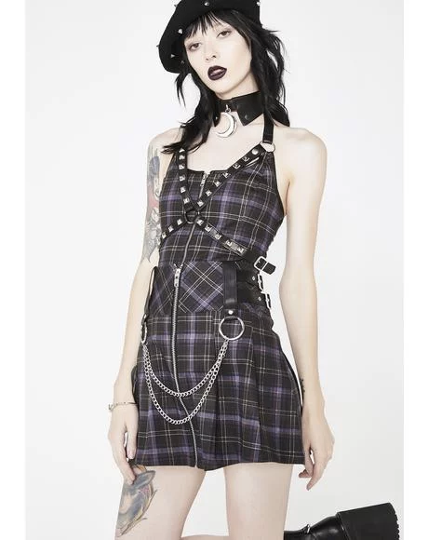
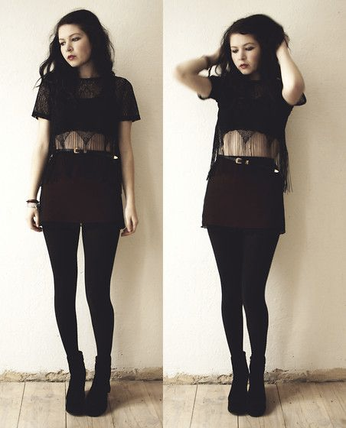
What defines a style?
Kristen Grauman, UT Austin and FAIR

Slide 8
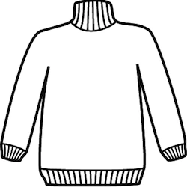

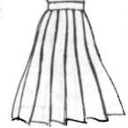



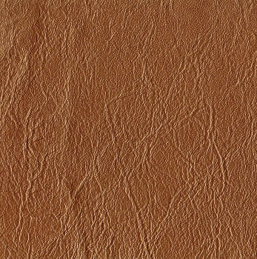
Attributes as style elements
Style: underlying composition of visual elements.
Kristen Grauman, UT Austin and FAIR

Slide 9
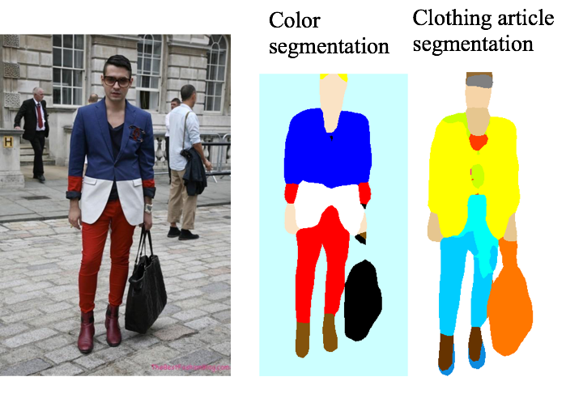
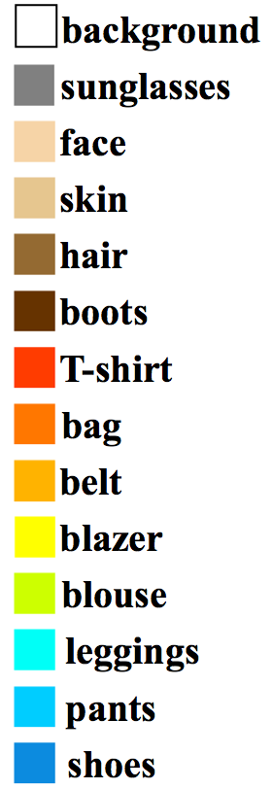
Attributes as style elements
blazer-color-blue
pants-color-red
Material, cut, pattern
  Fine-tune classification on ResNet50
Color, clothing article:
  Segmentation on DeepLab-DenseCRF
Kristen Grauman, UT Austin and FAIR

Slide 10
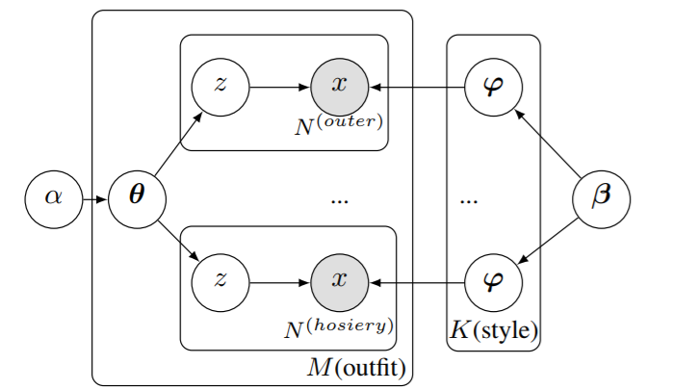
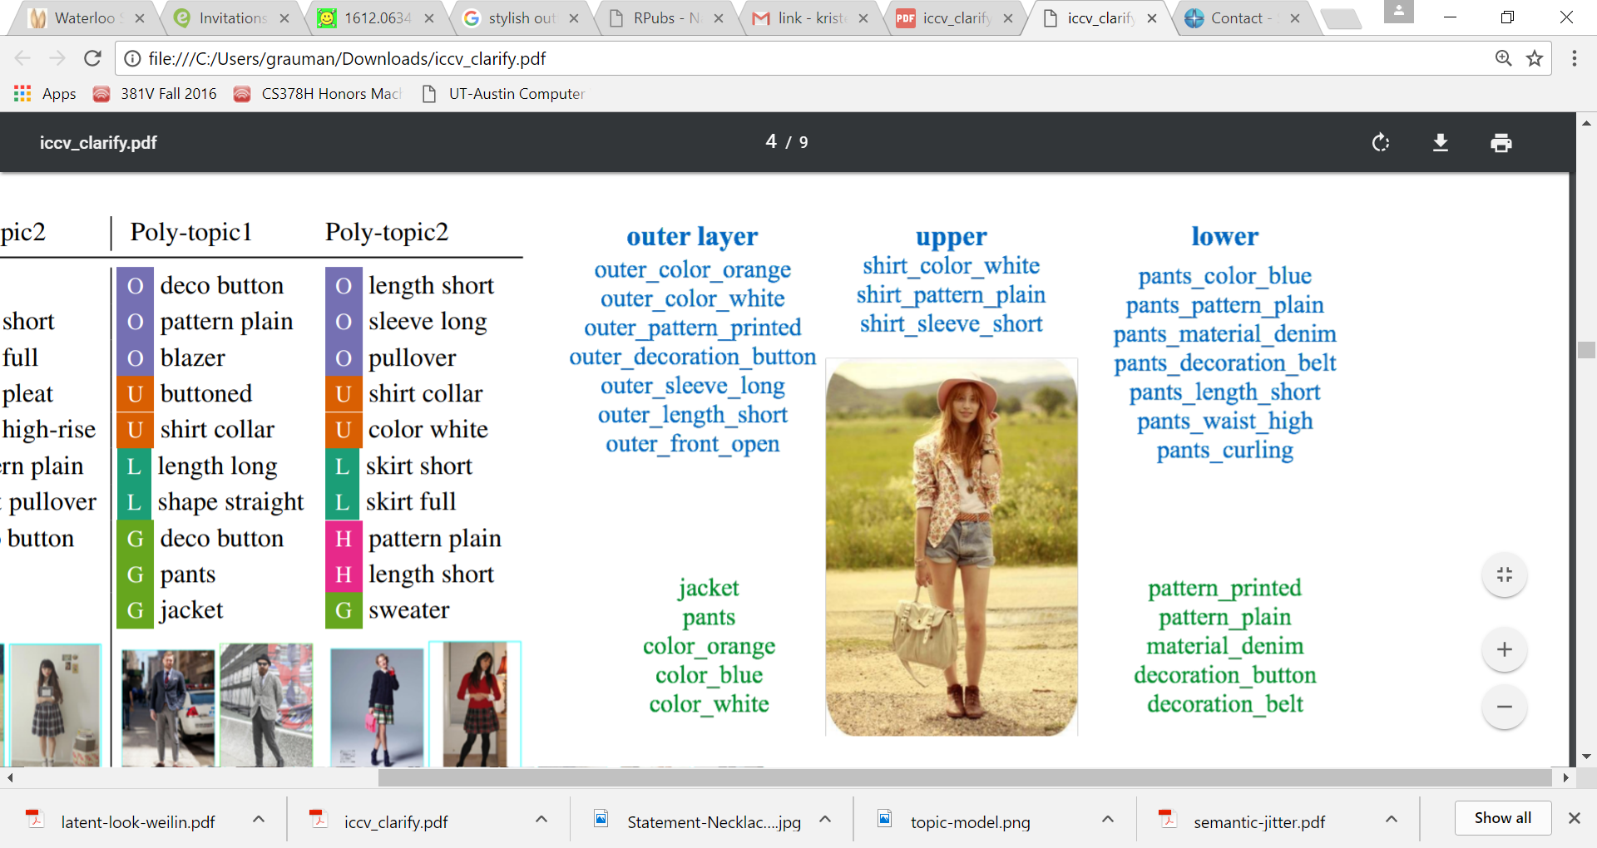
Learning styles from web photos
Unsupervised learning of “visual style topics” with a topic model
...
An outfit is a mixture of (latent) styles.
A style is a distribution over attributes.
Mimno et al. "Polylingual topic models." EMNLP 2009.
Kristen Grauman, UT Austin and FAIR
Hsiao & Grauman, ICCV 2017

Slide 11
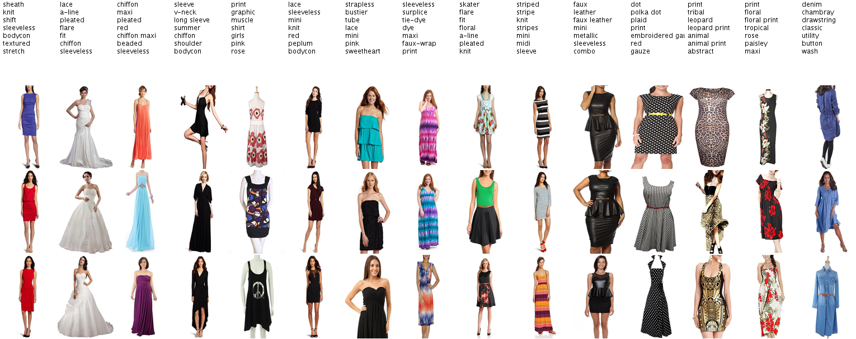
Styles we automatically discover in the Amazon dataset [McAuley et al. 2015]
Example discovered styles (dresses)
Kristen Grauman, UT Austin and FAIR

Slide 12
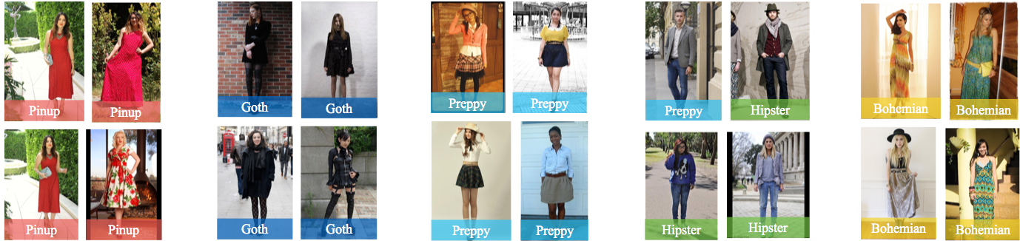
Styles we automatically discover in the HipsterWars dataset [Kiapour et al]
Example discovered styles (full outfit)
Kristen Grauman, UT Austin and FAIR

Slide 13
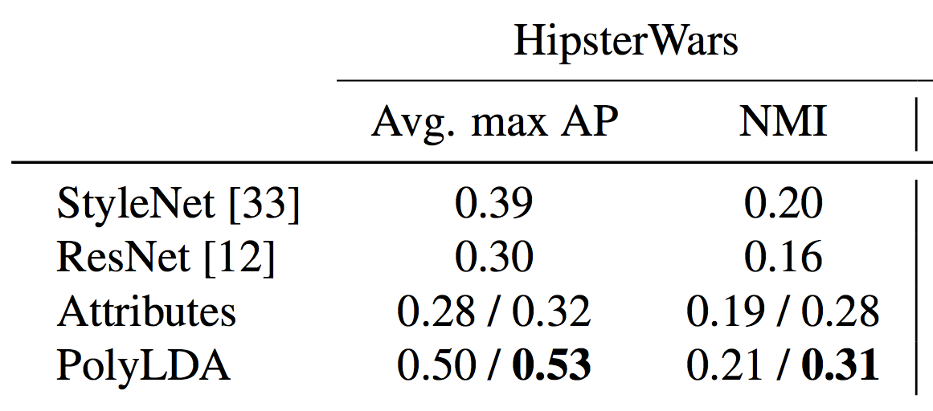
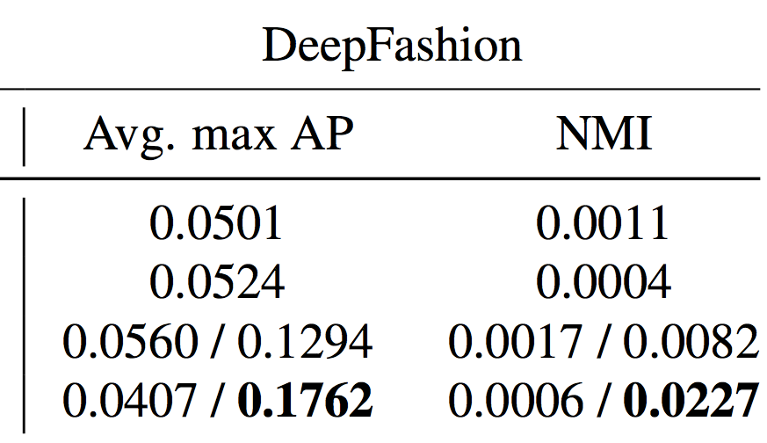
Style discovery accuracy
How well do our discovered styles align with human-perceived styles?
Attributes and PolyLDA show result if using either predicted attributes (first) or ground truth attributes (second).
Kristen Grauman, UT Austin and FAIR

Slide 14
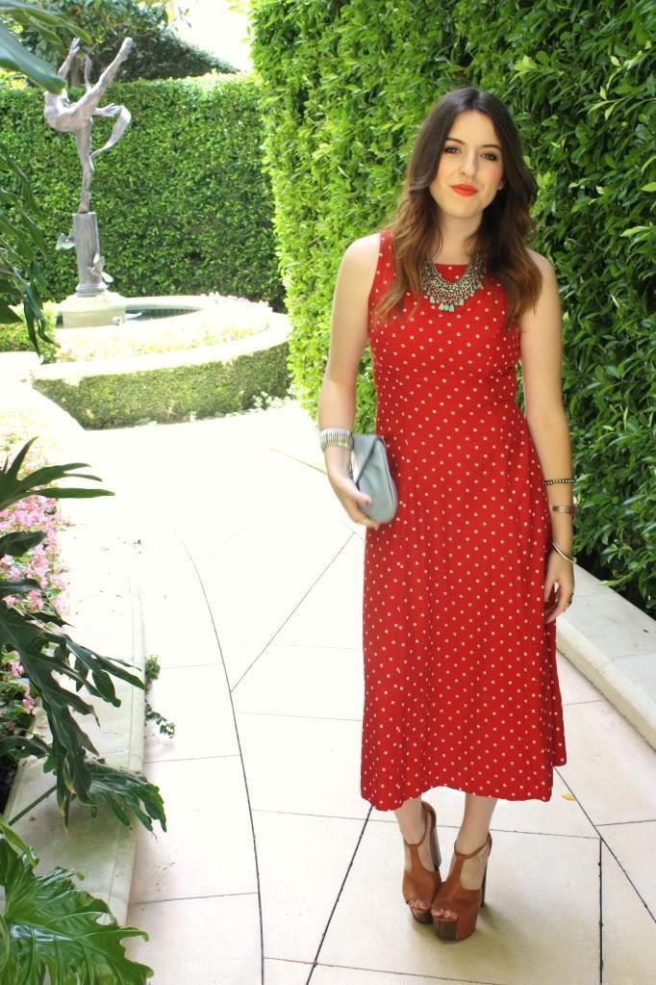
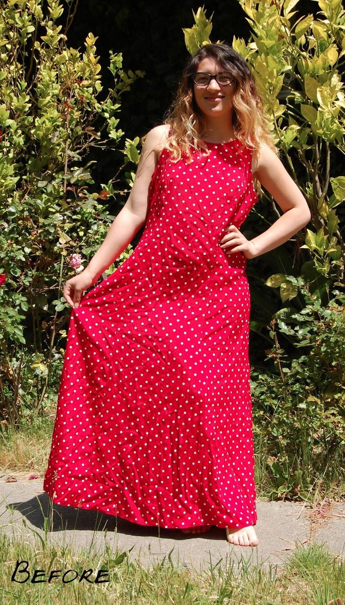
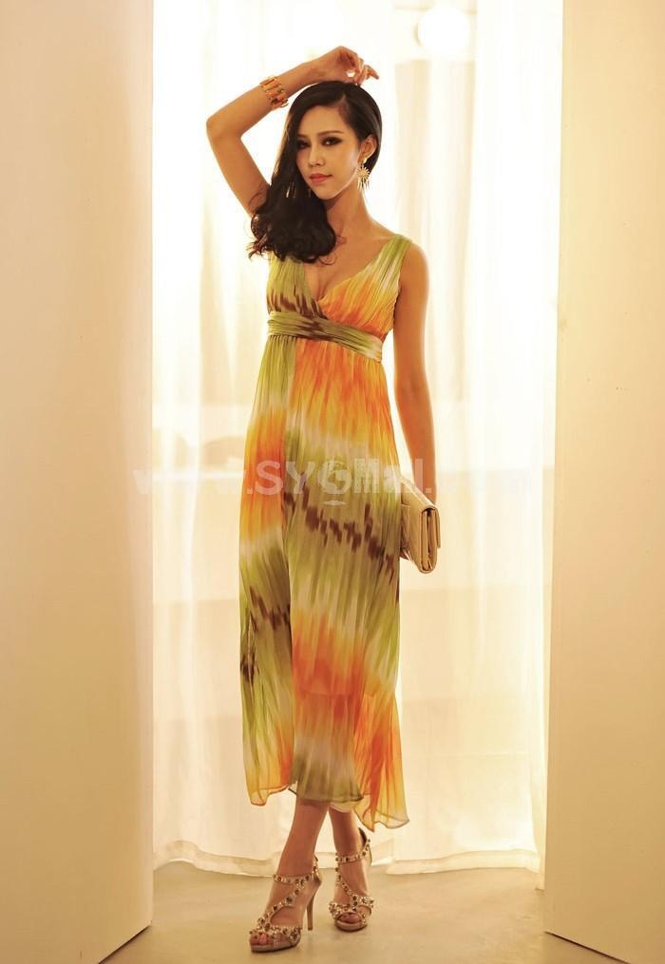
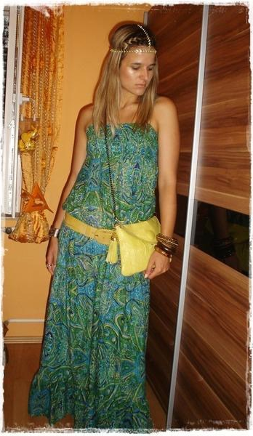
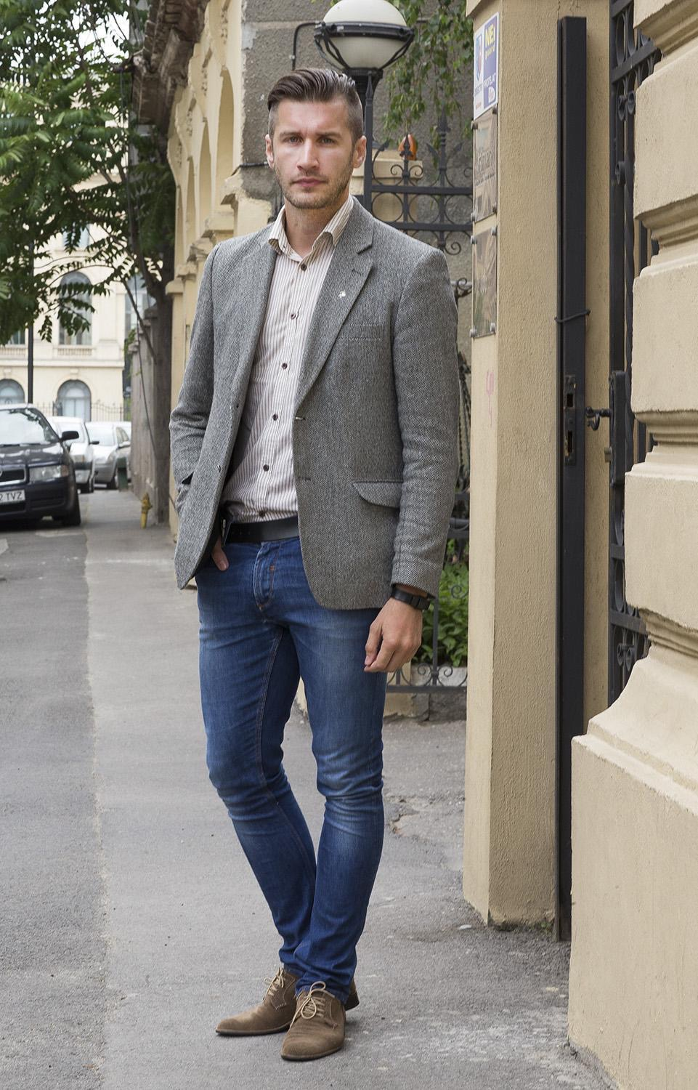
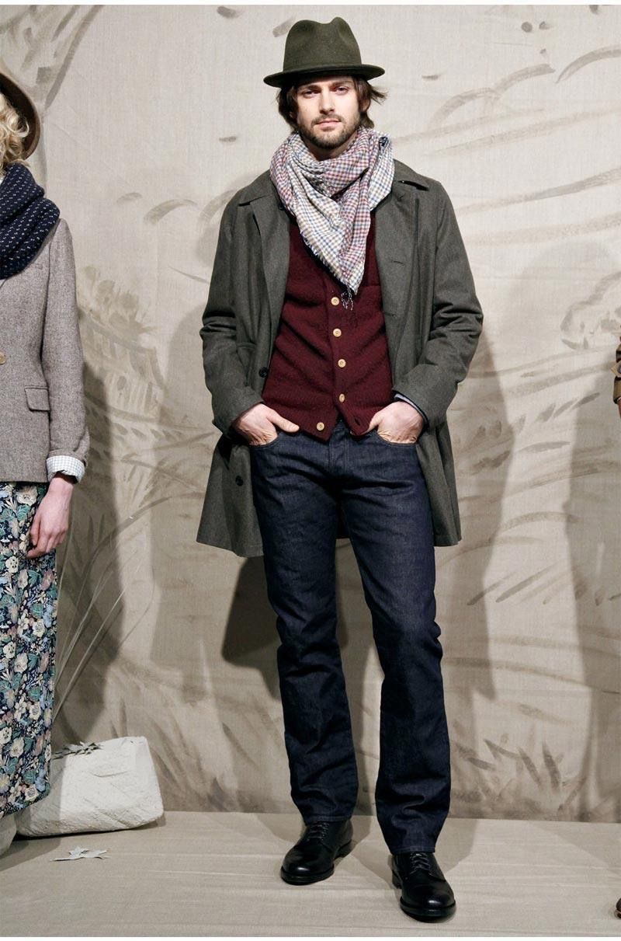
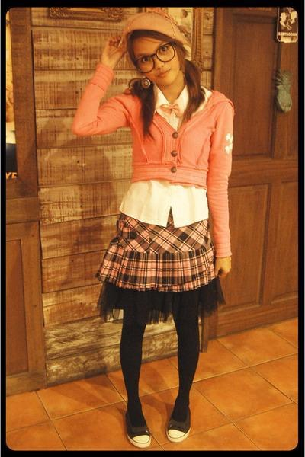
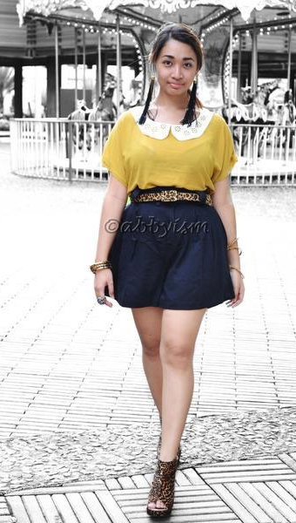
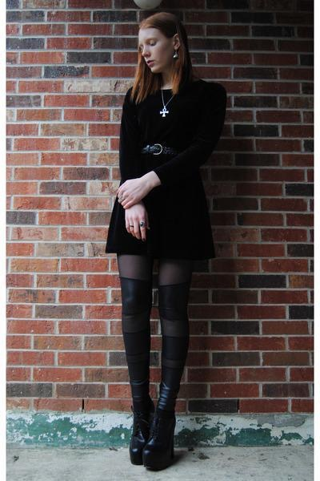
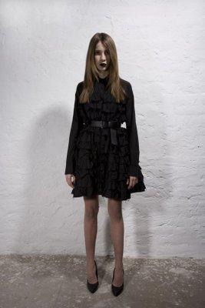
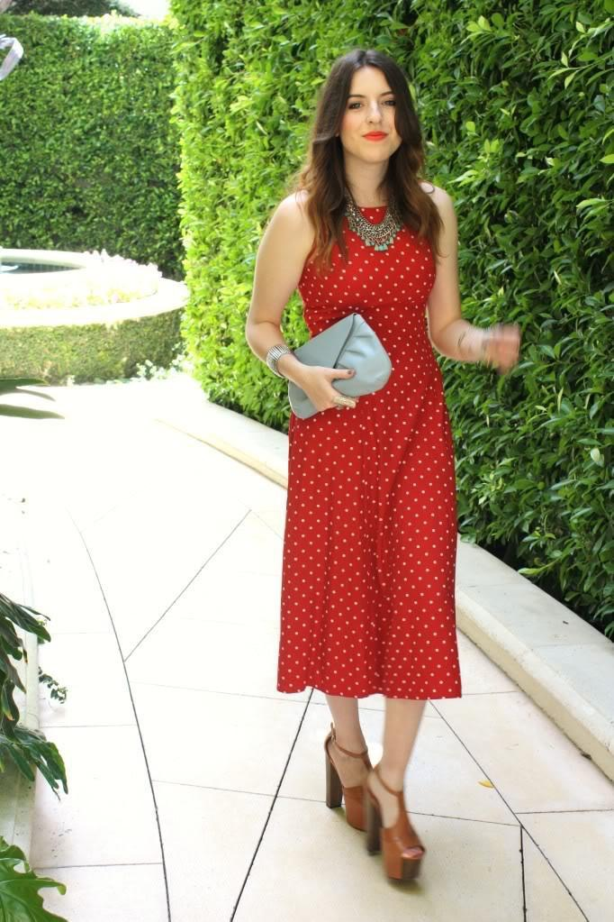
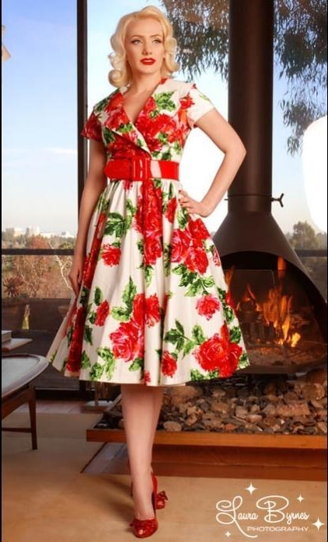
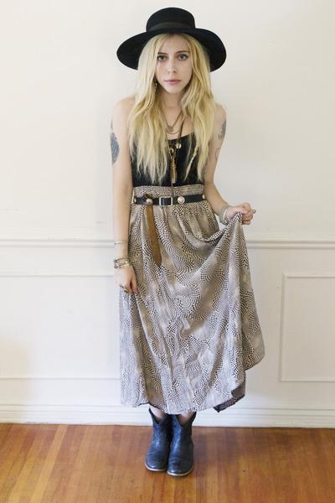













Style-coherent embedding
Discovered latent styles (topics)
Image embedding
Kristen Grauman, UT Austin and FAIR

Slide 15




Style browsing
vs.
HipsterWars dataset
[Kiapour ECCV 2014]
DeepFashion dataset
[Liu CVPR 2016]
query
Similar in CNN space
Similar in style space (ours)
Maintain style coherence while also permitting diversity
Kristen Grauman, UT Austin and FAIR

Slide 16


















Style summarization
Given a gallery of photos
Summarize by dominant styles
Hsiao & Grauman, ICCV 2017
Kristen Grauman, UT Austin and FAIR

Slide 17
This talk
Learning about fashion from Web photos
Discovering latent styles
Assembling outfits
Forecasting future trends
Kristen Grauman, UT Austin and FAIR

Slide 18






Creating a “capsule” wardrobe
Goal: Select minimal set of pieces that mix and match well to create many viable outfits
Capsule pieces
Outfit #1
Outfit #2
Outfit #3
Outfit #4
Outfit #5
Kristen Grauman, UT Austin and FAIR

Slide 19

Q1: How to learn visual compatibility?
Co-purchase data
[McAuley 2015, Veit 2015, He 2016]
Manual curation
[Li 2017, Song 2017, Han 2017]
Our goal:
Unlabeled in the wild photos
Supervised
Kristen Grauman, UT Austin and FAIR

Slide 20







Style model → Visual compatibility
Gauge compatibility of garments via likelihood under topic model
Recall: an outfit is a mixture of (latent) styles.
A style is a distribution over attributes.
Kristen Grauman, UT Austin and FAIR
Hsiao & Grauman, CVPR 2018

Slide 21




























Visual compatibility results
Most compatible
Kristen Grauman, UT Austin and FAIR

Slide 22






























Visual compatibility results
Least compatible
Kristen Grauman, UT Austin and FAIR

Slide 23

Visual compatibility results
Evaluated on Polyvore images
BiLSTM ^{[Han et al. 17]}: unsupervised sequential model trained on Polyvore sets.
Monomer ^{[He et al. 16]}: supervised embedding trained on Amazon products co-purchase info.
Encouraging results for learning compatibility from unlabeled, full-body Web images
Kristen Grauman, UT Austin and FAIR
Hsiao & Grauman, CVPR 2018

Slide 24
Q2: How to optimize a capsule?
Pose as subset selection problem
set of garments = argmax compatibility + versatility
Capsule pieces
Outfit #1
Outfit #2
Outfit #3
Outfit #4
Outfit #5
Kristen Grauman, UT Austin and FAIR
Hsiao & Grauman, CVPR 2018

Slide 25








Capsule via subset selection
optimal set of composed outfits
Pose as subset selection problem
set of garments = argmax compatibility + versatility
Capsule pieces
A0T
Outfit #1
Outfit #2
A1T
…..
y
Outfit #3
Outfit #4
A2T
Kristen Grauman, UT Austin and FAIR
Hsiao & Grauman, CVPR 2018

Slide 26

Capsule via subset selection
Capsule pieces
A0T
Outfit #1
Outfit #2
Compatibility scored by topic model likelihood
c(o1)
c(o2)
A1T
…..
y
Outfit #3
Outfit #4
modular
A2T
c(o3)
c(o4)
Kristen Grauman, UT Austin and FAIR
Hsiao & Grauman, CVPR 2018

Slide 27













Capsule via subset selection
Capsule pieces
work
evening
shopping
A0T
Versatility scored by style coverage
…
A1T
y
z1
z2
z3
A2T
style
outfit
Kristen Grauman, UT Austin and FAIR
Hsiao & Grauman, CVPR 2018

Slide 28
Capsule via subset selection
work
z1
eve
z2
shop
z3
Capsule pieces
A0T
…
Versatility scored by style coverage
A1T
submodular
A2T
covers
z2
covers
z3
covers
z1
covers
z3
: coverage of each style
Kristen Grauman, UT Austin and FAIR
Hsiao & Grauman, CVPR 2018

Slide 29
Capsule via subset selection
optimal set of outfits
Capsule pieces
Compatibility scored by topic model likelihood
A0T
We devise EM-like solution for which we can show (sub)modularity holds.
A1T
modular
y
Versatility scored by style coverage
A2T
But each addition is a garment!
submodular
Kristen Grauman, UT Austin and FAIR
Hsiao & Grauman, CVPR 2018

Slide 30













Personalized capsule
Discover user’s style preferences from album
Personalized capsule
Kristen Grauman, UT Austin and FAIR
Hsiao & Grauman, CVPR 2018

Slide 31























Personalized capsule
Discover user’s style preferences from album
Personalized capsule
Kristen Grauman, UT Austin and FAIR
Hsiao & Grauman, CVPR 2018

Slide 32

Quantifying capsule error
Distance from “ground truth” manually curated capsules from Polyvore.com
Kristen Grauman, UT Austin and FAIR
Hsiao & Grauman, CVPR 2018

Slide 33

Editing an existing outfit
“Before you leave the house, look in the mirror and take one thing off.”
---Coco Chanel
Kristen Grauman, UT Austin and FAIR

Slide 34








Idea: Minimal edits for outfit improvement
[Hsiao et al. ICCV 2019]
Kristen Grauman, UT Austin and FAIR

Slide 35



Fashion++
[Hsiao et al. ICCV 2019]
Kristen Grauman, UT Austin and FAIR

Slide 36


Fashion++
Try this top!
[Hsiao et al. ICCV 2019]
Kristen Grauman, UT Austin and FAIR

Slide 37





Our approach: Fashion++
Image generation pipeline factorizes shape and texture
u⁺⁺
x^{(q)}
Region-wise propagate
t^{(q)}
t⁺⁺
Et
x⁺⁺
Gt
F⁺⁺
m⁺⁺
m^{(q)}
s^{(q)}
s⁺⁺
Es
Gs
Learn fashionability gradient from bootstrapped (un)fashionable Web photos
[Hsiao et al. ICCV 2019]

Slide 38

Learning discriminative fashionability model
positive
…
Represent an outfit as concatenation of its latent codes
[Hsiao et al. ICCV 2019]

Slide 39

Learning discriminative fashionability model
positive
negative
…
…
Bootstrap web photos for “negatives” to learn fashionability
[Hsiao et al. ICCV 2019]

Slide 40
Computing an outfit edit
c
F⁺⁺
z
P(y|z)
y
Fashionable
…
fc1
fc2
fc3
Unfashionable
[Hsiao et al. ICCV 2019]

Slide 41
Computing an outfit edit
c
F⁺⁺
z
P(y|z)
y
Fashionable
…
fc1
fc2
fc3
Unfashionable
  Propagate gradients to iteratively update the target feature (e.g., shape)
[Hsiao et al. ICCV 2019]

Slide 42










Fashion++ minimal edits
Visualization of changed garment in new presentation.
Swap to garment from inventory.
[Hsiao et al. ICCV 2019]
Kristen Grauman, UT Austin and FAIR

Slide 43




































Fashion++ minimal edits
[Hsiao et al. ICCV 2019]
Kristen Grauman, UT Austin and FAIR

Slide 44









Fashion++ minimal edits
Recommended shape changes
Blouse shirt out
Blouse shirt out
Change pants fit
Tuck shirt in
Blouse shirt out
Change pants fit
Change pants fit
Change pants length
Tuck shirt in
Change pants length
Tuck shirt in
Change pants length
[Hsiao et al. ICCV 2019]
Kristen Grauman, UT Austin and FAIR

Slide 45

Fashion++ minimal edits
Automatic evaluation
Human subject study
  Fashion++ balances best by improving fashionability while not changing too much.
[Hsiao et al. ICCV 2019]
Kristen Grauman, UT Austin and FAIR

Slide 46

Dressing diverse body shapes
Goal: recommend clothing sensitive to body shape
Kristen Grauman, UT Austin and FAIR

Slide 47







Dressing diverse body shapes
Which dress flatters my body?
Kristen Grauman, UT Austin and FAIR

Slide 48


















Danger of body bias in existing data
Ours
Curvy
Lean
Curvy
Lean
Population average
DeepFashion
DeepFashion: Powering robust clothes recognition and retrieval with rich annotations, CVPR 2016
[Hsiao & Grauman, arXiv 2019]
Kristen Grauman, UT Austin and FAIR

Slide 49




Web data for diverse body shapes
https://birdsnest.com.au
Model image
Attributes
Catalog image
Multiple models
Body measurement
[Hsiao & Grauman, arXiv 2019]

Slide 50


















Implicit body-clothing supervision
Convert catalog entries into body-aware supervision
Positive pairs
Negative pairs
[Hsiao & Grauman, arXiv 2019]
Kristen Grauman, UT Austin and FAIR

Slide 51



VIsual Body-aware Embedding (VIBE)
Learn a joint embedding for clothes and bodies
Joint embedding
Floral print
Round neckline
Extended cap sleeves
…
clothing
objective 1: bodies close to flattering clothing
objective 2: bodies close to similar bodies
body
[Hsiao & Grauman, arXiv 2019]
Kristen Grauman, UT Austin and FAIR

Slide 52







VIsual Body-aware Embedding (VIBE)
Floral print
Round neckline
Extended cap sleeves
Slight pleat gathering at side waist
Small elasticated band at back waist
Subtle handkerchief skirt cut
Knee length
Semi fitted
Lightweight soft fabric
Clothing
Body
Fit a SMPL mesh to photo
[Bogo et al. ECCV16]
Height: 176 cm
Bust: 86.5 cm
Waist: 70.0 cm
Hips: 91.5 cm
[Hsiao & Grauman, arXiv 2019]
Kristen Grauman, UT Austin and FAIR

Slide 53


Body-aware clothing recommendations
A
B
or
?
User study
 | Agnostic-CF | Aware-CF | Agnostic-embed | ViBE
AUC | 0.51 | 0.52 | 0.55 | 0.58
# subjects: 329
# clothing-body triplets: 306
Kristen Grauman, UT Austin and FAIR
[Hsiao & Grauman, arXiv 2019]

Slide 54










Body-aware recommendations
Subject
(curvy)
Kristen Grauman, UT Austin and FAIR
[Hsiao & Grauman, arXiv 2019]

Slide 55

Body-aware recommendations
Subject
(curvy)
Suitable silhouette
Wrap
Bell sleeve, 3/4 sleeve, extended sleeve
Side Split
Overlay
v-neckline
Relaxed fit
Elastic waist, waistband
A-line
Short sleeve
No stretch
Embroider, floral
Tier
Kristen Grauman, UT Austin and FAIR
[Hsiao & Grauman, arXiv 2019]

Slide 56









Body-aware recommendations
Subject
(petite)
Kristen Grauman, UT Austin and FAIR
[Hsiao & Grauman, arXiv 2019]

Slide 57

Body-aware recommendations
Subject
(petite)
Suitable silhouette
Embroider
Elastic waist, waistband
A-line
Short, cuff sleeves
Ruffle, high-low hem
Empire
Fit
Side split
Shift
Square, v neckline
Belt
3/4 sleeve
Wrap
Crepe, linen, jersey fabric
Kristen Grauman, UT Austin and FAIR
[Hsiao & Grauman, arXiv 2019]

Slide 58
This talk
Learning about fashion from Web photos
Discovering latent styles
Assembling outfits
Forecasting future trends
Kristen Grauman, UT Austin and FAIR

Slide 59

Style forecasting
Can we predict the future popularity of styles?
Kristen Grauman, UT Austin and FAIR
Al-Halah et al., ICCV 2017

Slide 60

Visual trend forecasting
We predict the future popularity of each style
Amazon dataset – 6 years of transactions for 80K items
[McAuley et al. SIGIR 2015]
Kristen Grauman, UT Austin and FAIR
Al-Halah et al., ICCV 2017

Slide 61

Lifecycle of a visual style
Out of fashion
Classic
In fashion
Trending
Unpopular
Re-emerging
Amazon dataset – 6 years of transactions for 80K items
[McAuley et al. SIGIR 2015]
Kristen Grauman, UT Austin and FAIR
Al-Halah et al., ICCV 2017

Slide 62

Interpretable forecasts via attributes
What kind of fabric, texture, color will be popular next year?
Kristen Grauman, UT Austin and FAIR

Slide 63


GeoStyle dataset
[Mall et al. ICCV 2019]
Example styles discovered with attributes
7.7M Instagram photos from 44 cities
Kristen Grauman, UT Austin and FAIR

Slide 64

Influence-based fashion forecasting
Kristen Grauman, UT Austin and FAIR
Al-Halah & Grauman, 2019

Slide 65
City → city influences
European cities
Asian cities
Al-Halah & Grauman, 2019

Slide 66
City → city influences
Paris:
Multi-city influencer
Beijing:
Influence receiver
Al-Halah & Grauman, 2019

Slide 67

City → city net influence
Kristen Grauman, UT Austin and FAIR
Al-Halah & Grauman, 2019

Slide 68

Net influence per country
* Caveat: subject to data sampling bias of Instagram photos
Kristen Grauman, UT Austin and FAIR
Al-Halah & Grauman, 2019

Slide 69



Summary
Kristen Grauman
grauman@cs.utexas.edu
Visual style introduces new problems for computer vision
  Discovering styles from unlabeled photos
  Capsule wardrobe creation
  Minimal edits to improve outfit fashionability
  Body-aware recommendations
  Style forecasting with global influence
Kimberly Hsiao
Ziad Al-Halah

Slide 70
Papers
Fashion++: Minimal Edits for Outfit Improvement. W-L. Hsiao, I. Katsman, C-Y. Wu, D. Parikh, K. Grauman. In Proceedings of the International Conference on Computer Vision (ICCV), Seoul, Korea, Nov 2019.
Creating Capsule Wardrobes from Fashion Images. W-L. Hsiao and K. Grauman. In Proceedings of IEEE Conference on Computer Vision and Pattern Recognition (CVPR), Salt Lake City, June 2018.
Learning the Latent "Look": Unsupervised Discovery of a Style-Coherent Embedding from Fashion Images. W-L. Hsiao and K. Grauman. In Proceedings of the International Conference on Computer Vision (ICCV), Venice, Italy, Oct 2017.
Fashion Forward: Forecasting Visual Style in Fashion. Z. Al-Halah, R. Stiefelhagen, and K. Grauman. In Proceedings of the International Conference on Computer Vision (ICCV), Venice, Italy, Oct 2017.
Discovering Style Influences Around the World. . Z. Al-Halah and K. Grauman. Nov 2019.

