Slide 1
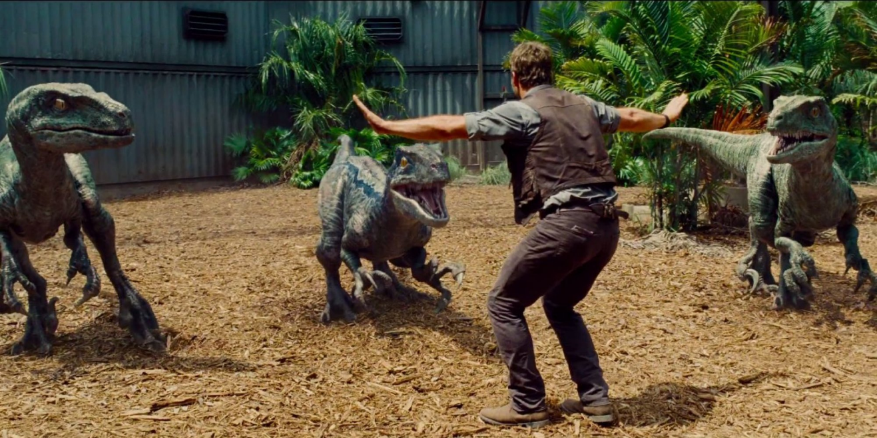
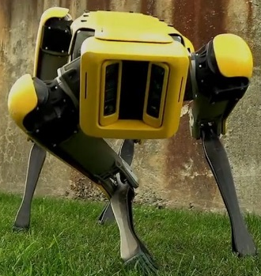

Deep TAMER: Interactive Agent Shaping in High-Dimensional State Spaces
Garrett Warnell, Nicholas Waytowich, Vernon Lawhern, Peter Stone
US Army Research Laboratory, The University of Texas at Austin
30 November 2017
30 November 2017
G. Warnell | US Army Research Laboratory | UNCLASSIFIED
1
Notes:
<number>

Slide 2
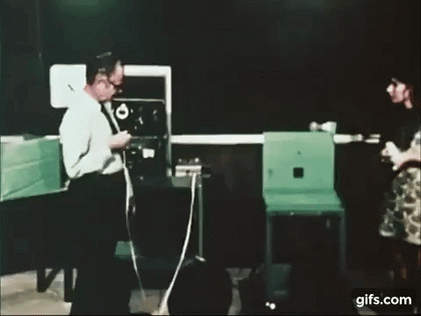
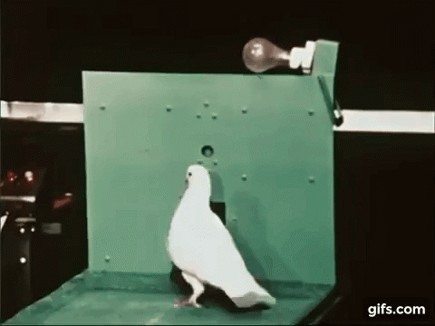
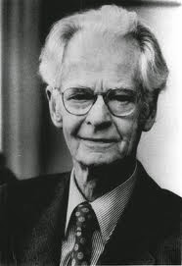
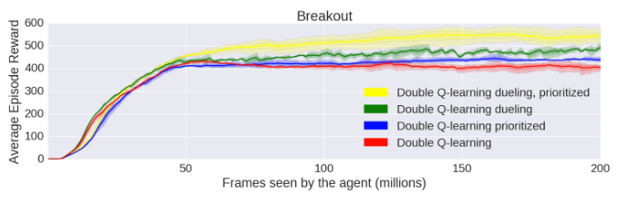
Interactive Agent Shaping
motivation: many autonomous agents currently learn very slowly
inspiration:
50M frames, or
~4 days @ 30fps!
30 November 2017
G. Warnell | US Army Research Laboratory | UNCLASSIFIED
1

Slide 3

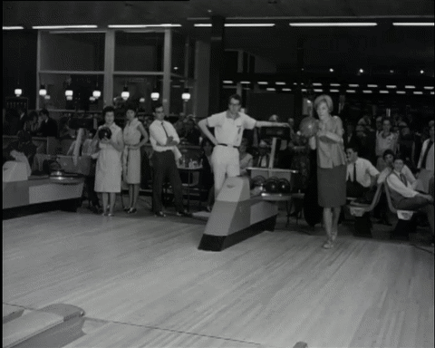
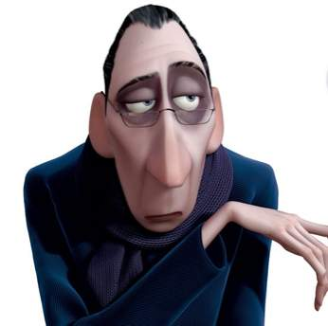
Interactive Agent Shaping
goal: agents that quickly learn effective policies using real-time, interactive, human
30 November 2017
G. Warnell | US Army Research Laboratory | UNCLASSIFIED
1

Slide 4
Related Work
learning from demonstration (e.g., Argall et al., 2009)
requires a demonstrator
manual reward shaping (e.g., Ng et al., 1999)
influence achieved through expert knowledge only, communication to agent is cumbersome
TAMER (e.g., Knox and Stone, 2009)
didn’t consider high-dimensional state spaces
30 November 2017
G. Warnell | US Army Research Laboratory | UNCLASSIFIED
1

Slide 5
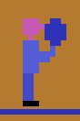
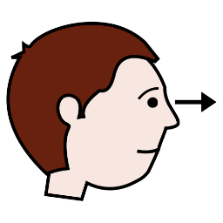

Central Question
how can autonomous agents use interactive human feedback to train quickly in complex environments?
can deep learning help?
TAMER
agent
feature extraction
predictive model of human
policy
human
30 November 2017
G. Warnell | US Army Research Laboratory | UNCLASSIFIED
1

Slide 6



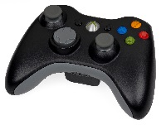
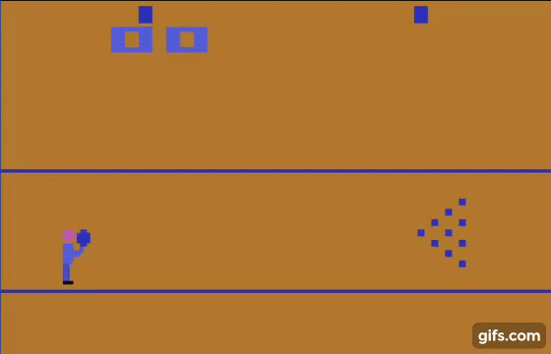














Setting
agent state space, :
agent action space, :
agent trajectories, :
human feedback, :
interaction timeline:
30 November 2017
G. Warnell | US Army Research Laboratory | UNCLASSIFIED
1

Slide 7


Human
provides feedback according to hidden reward function,
30 November 2017
G. Warnell | US Army Research Laboratory | UNCLASSIFIED
1

Slide 8


Agent
maintains estimate of human reward function
… then acts by trying to maximize predicted human reward
30 November 2017
G. Warnell | US Army Research Laboratory | UNCLASSIFIED
1

Slide 9


Problem Formulation
agent must estimate from interaction
…which can be viewed as a supervised learning problem:
30 November 2017
G. Warnell | US Army Research Laboratory | UNCLASSIFIED
1

Slide 10








Supervised Learning
input:
30 November 2017
G. Warnell | US Army Research Laboratory | UNCLASSIFIED
1

Slide 11


Supervised Learning
loss:
solution:
time-dependent weight
human-model agreement
30 November 2017
G. Warnell | US Army Research Laboratory | UNCLASSIFIED
1

Slide 12


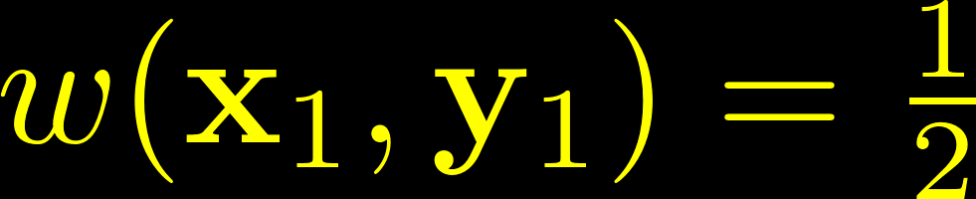
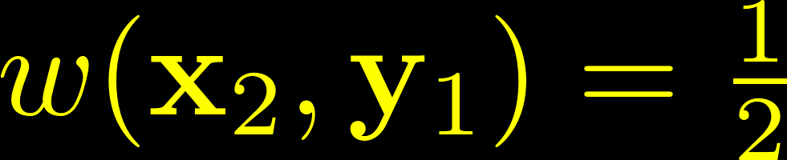

Weighting Function
…aka credit assignment
assume human meant feedback for a single state-action pair
when things happen fast, need a way to disambiguate
if distribution is assumed to be
30 November 2017
G. Warnell | US Army Research Laboratory | UNCLASSIFIED
1

Slide 13
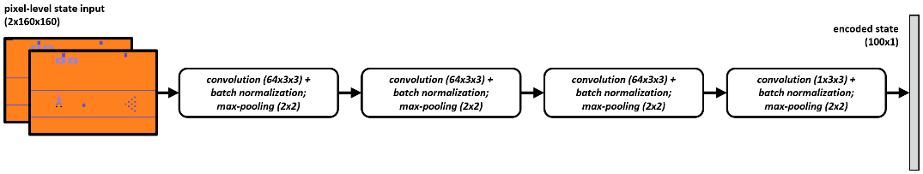
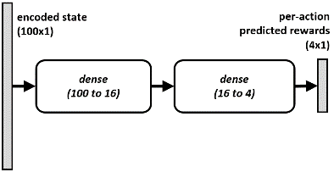
Deep TAMER
augments TAMER such that it can be applied to higher-dimensional state spaces via:
a deep neural network reward model
+
feedback replay
buffer
high-rate
SGD
30 November 2017
G. Warnell | US Army Research Laboratory | UNCLASSIFIED
<number>

Slide 14
Deep TAMER: Reward Model
deep convolutional encoder:
pre-trained offline via auto-encoder that uses a random policy
reward predictor
30 November 2017
G. Warnell | US Army Research Laboratory | UNCLASSIFIED
1

Slide 15
Deep TAMER: Training
continuous learning from old feedback:
sparse feedback
feedback replay
buffer
dense sampling
SGD
30 November 2017
G. Warnell | US Army Research Laboratory | UNCLASSIFIED
1

Slide 16
Experiments
environment: Atari Bowling
states: 2 consecutive frames (dimension 160x160x2 = ~50k)
actions: {do nothing, move up, move down, throw ball}
methods analyzed:
critique: TAMER (linear model), Deep TAMER
demonstration: DQfD (Hester et al., 2017)
reinforcement learning: Double-DQN, A3C
TAMER training:
9 humans
play + 10-minute practice training
15-minute training
30 November 2017
G. Warnell | US Army Research Laboratory | UNCLASSIFIED
<number>

Slide 17
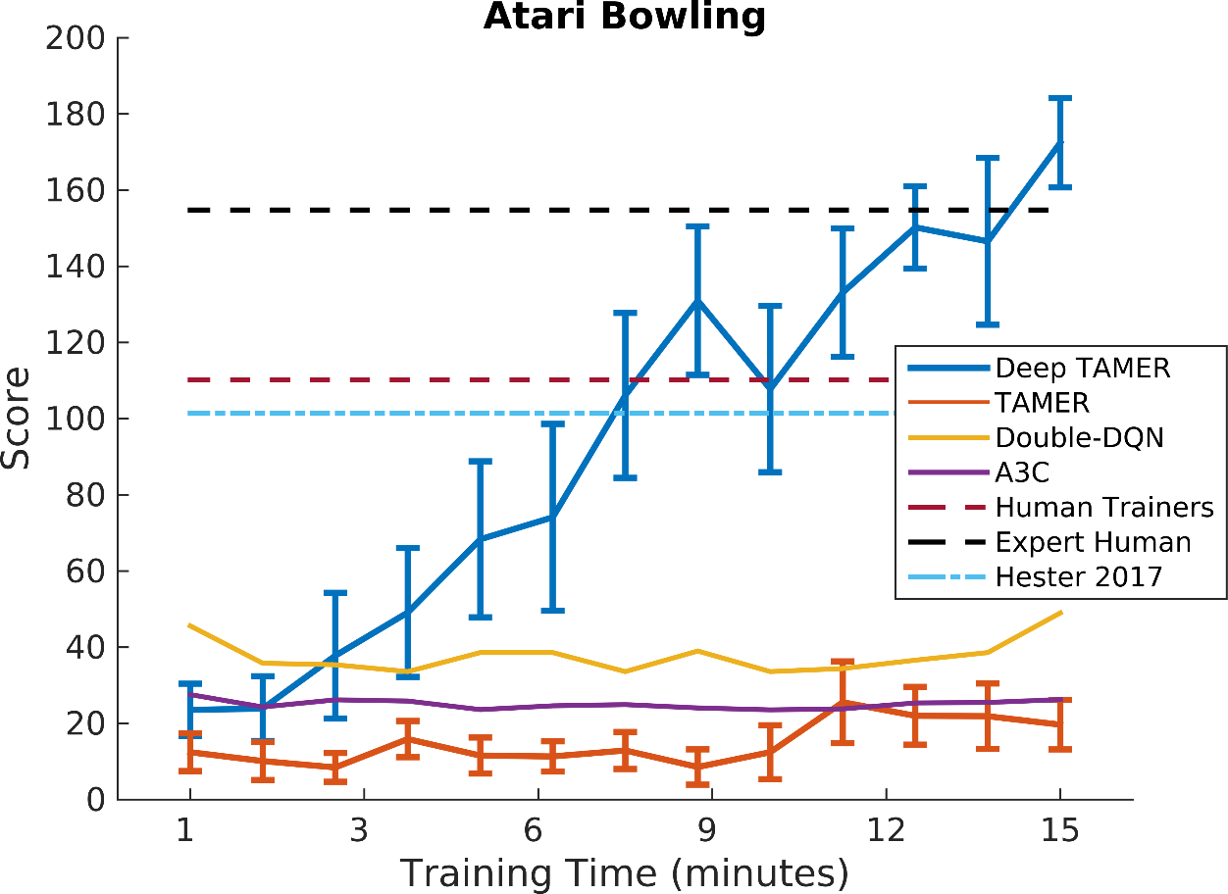
Results
Deep TAMER agents learn to bowl
30 November 2017
G. Warnell | US Army Research Laboratory | UNCLASSIFIED
<number>

Slide 18
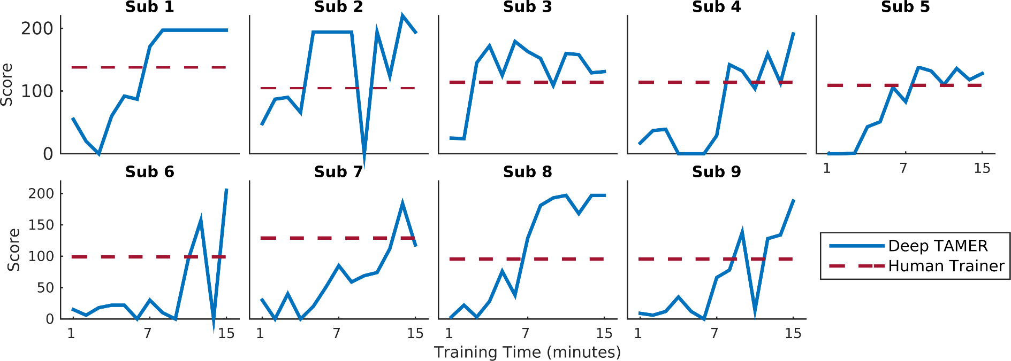
Results
Deep TAMER agents bowl at a super-human
30 November 2017
G. Warnell | US Army Research Laboratory | UNCLASSIFIED
<number>

Slide 19

Summary
how can autonomous agents use interactive human feedback to train quickly in complex environments?
can deep learning help?
TAMER
feedback replay
buffer
agent
feature extraction
predictive model of human
+
policy
human
30 November 2017
G. Warnell | US Army Research Laboratory | UNCLASSIFIED
<number>

Slide 20
Garrett Warnell
US Army Research Laboratory
garrett.a.warnell.civ@mail.mil
thanks!
30 November 2017
G. Warnell | US Army Research Laboratory | UNCLASSIFIED
<number>
Notes:
<number>

Slide 21
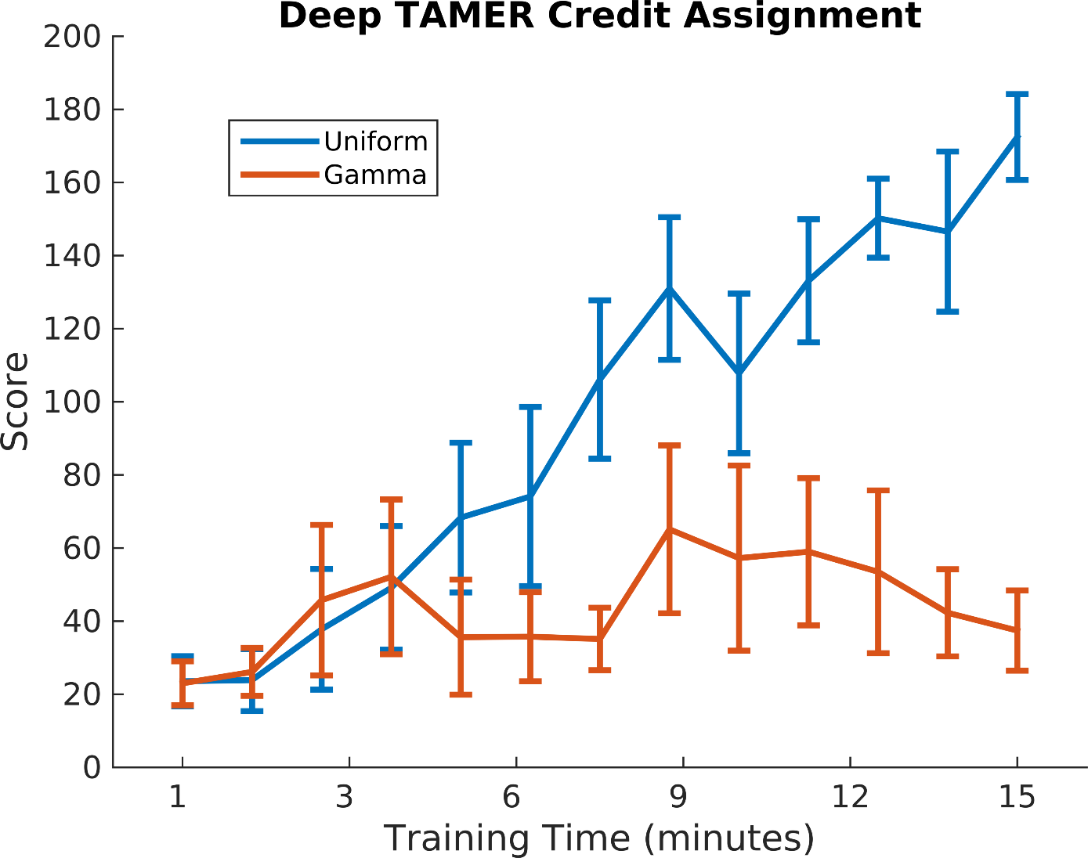
backup: credit assignment
30 November 2017
G. Warnell | US Army Research Laboratory | UNCLASSIFIED
<number>

Slide 22
backup
deep reinforcement learning from human preferences (Christiano, 2017)
similar: learning in high-dimensional environments from human feedback
different: not truly interactive; requires reinforcement learning in background simulator
30 November 2017
G. Warnell | US Army Research Laboratory | UNCLASSIFIED
<number>

