Slide 1
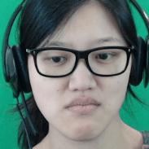





The EMPATHIC Framework for
Task Learning from
Implicit Human Feedback
Brad Knox and Alessandro Allievi (Bosch / UT Austin)
Joint research with Yuchen Cui, Qiping Zhang, Scott Niekum, and Peter Stone (UT Austin)

Slide 2
Learning Tasks from Implicit Human Feedback
Human reactions provide rich, natural, low-cost feedback.
We want to harness this information to train AI agents to act according to human preference / desires.
Target AD application:
Learn to adapt driving behavior from human reactions
  Deliverable: research towards an algorithm for improving the “quality” of an agent’s behavior through the observation of spontaneous human reactions

Slide 3

Photo by www.amtec.us.com (CC license)

Slide 4
Task Learning from
Implicit Human Feedback
Photo by www.amtec.us.com (CC license)

Slide 5
(CC0 license, source)
Notes:
scowled at robot vacuums, raised eyebrows at cruise 24 control, and shared choice words with automatic doors

Slide 6
(CC license, source)
Notes:
scowled at robot vacuums, raised eyebrows at cruise 24 control, and shared choice words with automatic doors

Slide 7
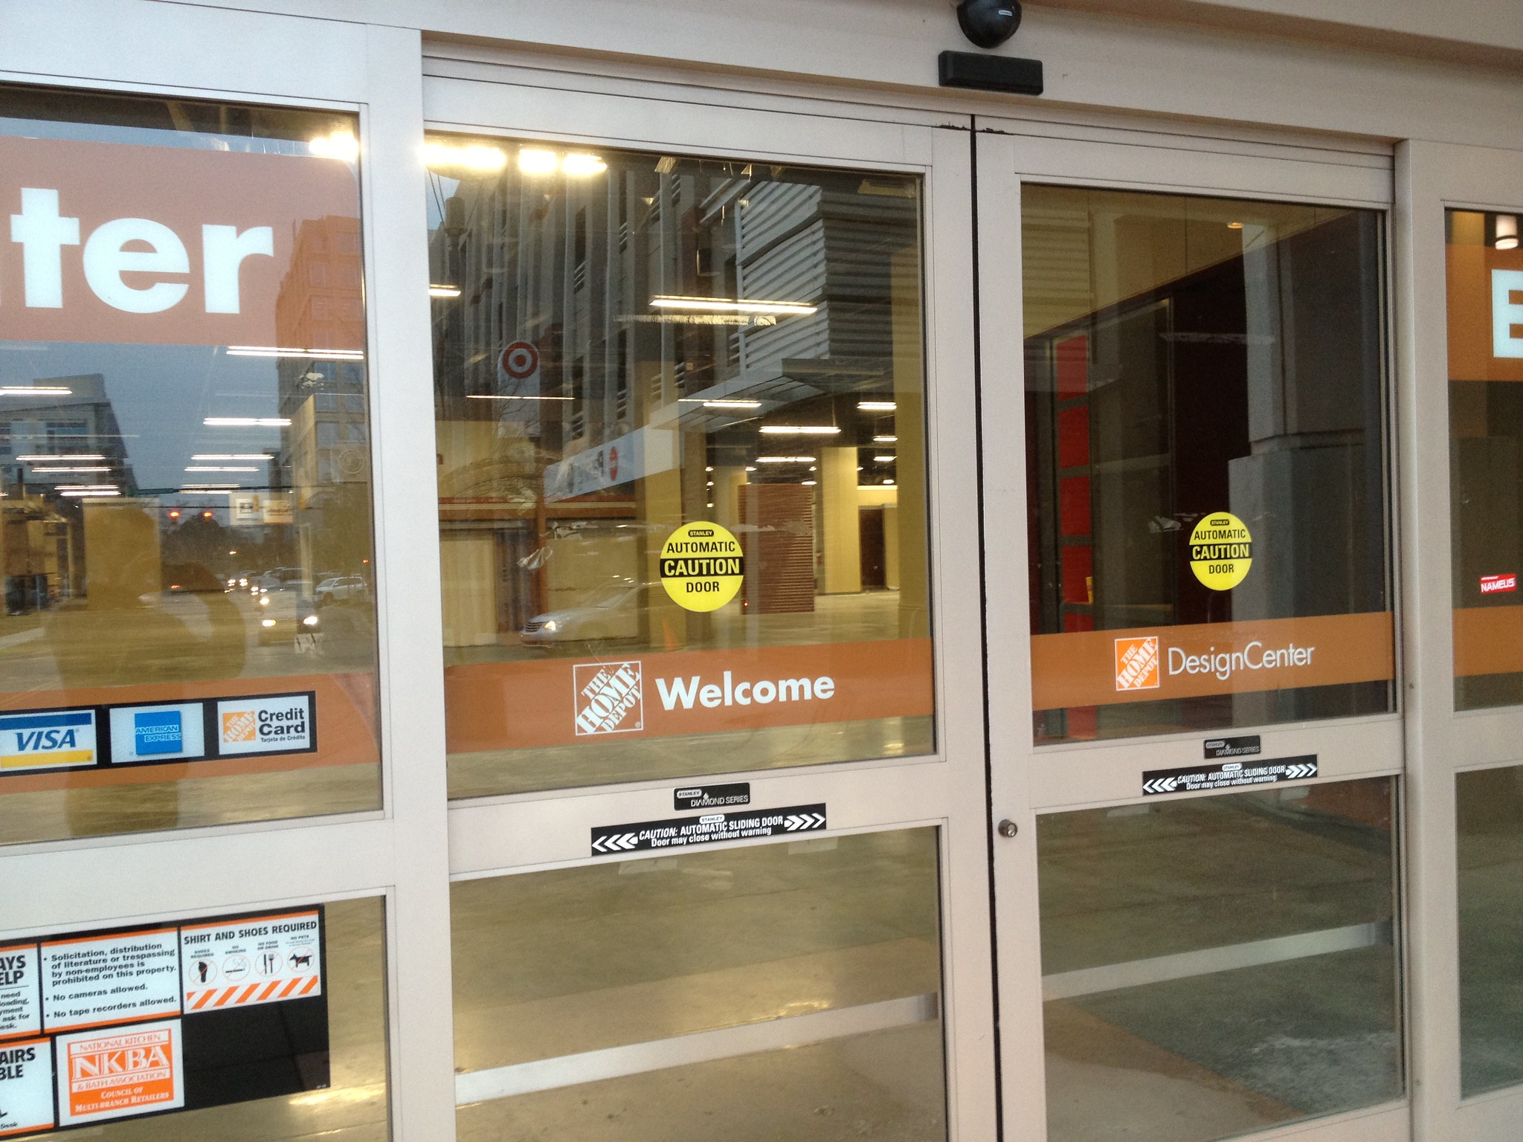
Photo by Mike Kalasnik (CC license, source)
Notes:
scowled at robot vacuums, raised eyebrows at cruise 24 control, and shared choice words with automatic doors

Slide 8
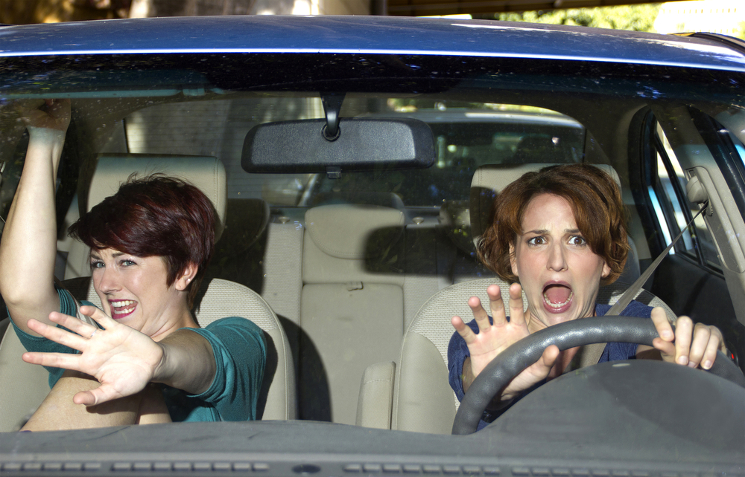
Licensed via depositphotos.com (source)
Notes:
License purchased from depositphotos.com.

Slide 9
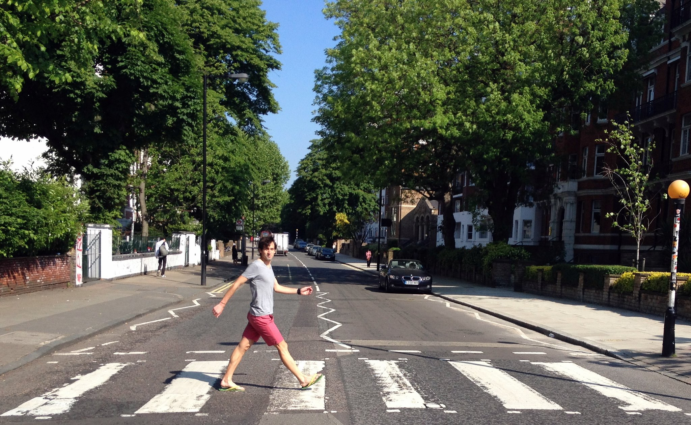
Example autonomous driving application:
Learning a deceleration profile from implicit human feedback
Photo by Martin Alvarez Espinar (source, CC license)

Slide 10
Related work
Mapping from facial reactions
Veeriah (2017) – Learn mapping:
facial reactions + action -> time-discounted sum of future manual negative feedback
  with no state in their learned mapping, face directly controls the agent
Arakawa et al. (2018) – Hand code mapping:
face-based emotion classification -> positive or negative TAMER feedback
Li et al. (2020) – Learn mapping:
facial reactions -> TAMER feedback
  then use predictions to augment actual feedback
All cases involve explicit teaching at training and/or testing, which creates data in a different context than a deployment scenario of passively learning from a human.
Only Li et al. learn a mapping to information that can be used for task learning.
Brain-computer interaction work by various researchers
Notes:
Do these approaches require personalization (i.e., training data from the specific user)?

Slide 11
Related work
Mapping from facial reactions
  Veeriah (2017) – Learn mapping: facial reactions + action -> sum of future manual negative feedback
    with no state input to their learned mapping, face directly controls the agent
  Arakawa et al. (2018) – Hand code mapping: face-based emotion classification -> positive or negative TAMER feedback
  Li et al. (2020) – Learn mapping: facial reactions -> TAMER feedback
    then use predictions to augment actual feedback
  All cases involve explicit teaching at training and/or testing, which creates data in a different context than a deployment scenario of passively learning from a human.
  Only Li et al. learn a mapping to information that can be used for task learning.
Brain-computer interaction work by various researchers

Slide 12
Do not require explicit teaching or manual labeling by users, use only human reactions as input to the reaction mapping, and let the data decide what task statistics to map human reactions to.
Our approach

Slide 13
The LIHF Problem
Learning from Implicit Human Feedback

Slide 14
The LIHF Problem
How can an agent maximize return under a human’s (hidden) reward function, using information derived from the human’s reactions to its behavior?
Human’s hidden reward function
Set of possible single-step observations of the human
Function for the conditional probability over human observations, given a trajectory of states
and actions and the human’s hidden reward function R^{H.}
Notes:
Ξ is xi (pronounced “psi”/“sai”).

Slide 15
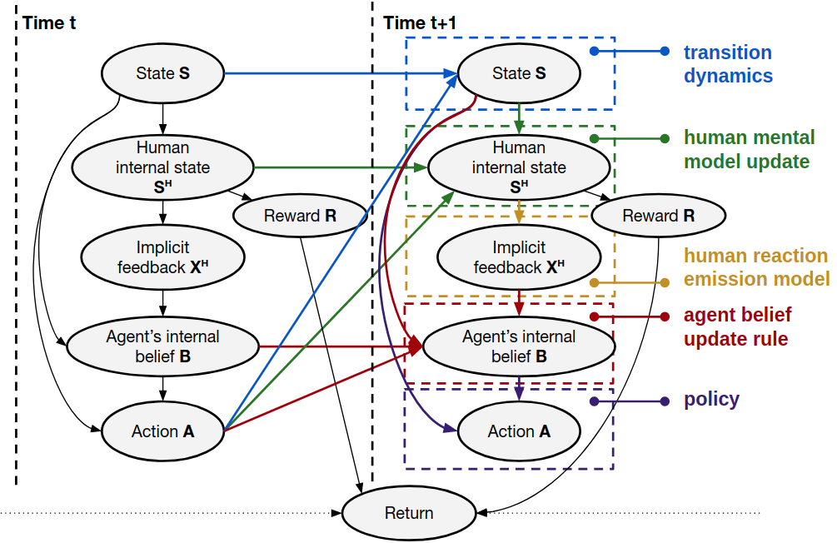

Slide 16
The EMPATHIC Framework

Slide 17







1. Learning a mapping from implicit human feedback to task statistics
Reactions
(implicit feedback)
Multi-modal
Reaction Feature Extraction
Human
Observer
Incentivize
Display
Task Specification
Reaction feature vector
Mapping of reaction features to task statistic(s)
Environment
Reward
Model
Training
State
Dataset Store
Action
State,
Action
Task statistics
Agent
Task statistic tables

Slide 18

1. Learning a mapping from implicit human feedback to task statistics
2. Learning a new task from implicit human feedback
Reactions
(implicit feedback)
Reactions
(implicit feedback)
Multi-modal
Reaction Feature Extraction
Human
Observer
Human
Observer
Incentivize
Reaction feature vector
Display
Display
Task Specification
State, Action
Mapping of reaction features to task statistic(s)
Environment
Reward
Model
Training
Environment
State
Dataset Store
State
Action
Assembler of Task/Behavior
Action
Task statistic(s)
State,
Action
Task statistics
Agent
Agent
Task statistic tables
Task/Policy Description

Slide 19
1. Learning a mapping from implicit human feedback to task statistics
2. Learning a new task from implicit human feedback
Reactions
(implicit feedback)
Reactions
(implicit feedback)
Multi-modal
Reaction Feature Extraction
Human
Observer
Human
Observer
Incentivize
Reaction feature vector
Display
Display
Task Specification
State, Action
Mapping of reaction features to task statistic(s)
Environment
Reward
Model
Training
Environment
State
Dataset Store
State
Action
Assembler of Task/Behavior
Action
Task statistic(s)
State,
Action
Task statistics
Agent
Agent
Task statistic tables
Task/Policy Description
A novel framework for Learning from Implicit Human Feedback (LIHF):
EMPATHIC
(Evaluative MaPping for Affective Task-learning via Human Implicit Cues)

Slide 20
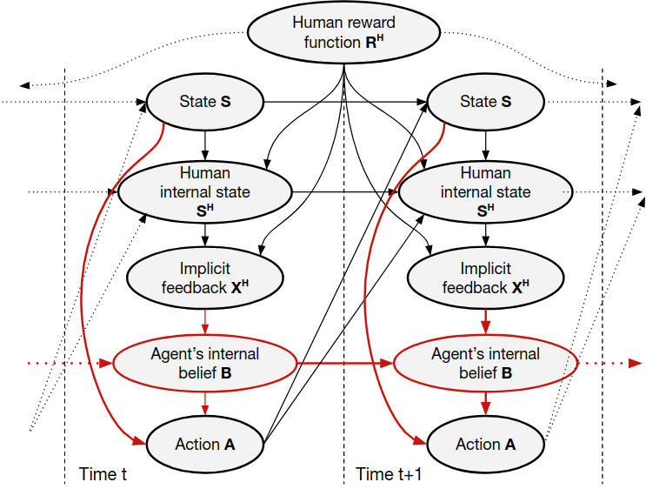

Slide 21
Instantiating EMPATHIC

Slide 22
Instantiating EMPATHIC
Crafting a session to gather rich, authentic data

Slide 23
1. Learning a mapping from implicit human feedback to task statistics
Reactions
(implicit feedback)
Multi-modal
Reaction Feature Extraction
Human
Observer
Incentivize
Display
Task Specification
Reaction feature vector
Mapping of reaction features to task statistic(s)
Environment
Reward
Model
Training
State
Dataset Store
Action
State,
Action
Task statistics
Agent
Task statistic tables

Slide 24
1. Learning a mapping from implicit human feedback to task statistics
Reactions
(implicit feedback)
Multi-modal
Reaction Feature Extraction
Human
Observer
Incentivize
Designing the training task and experimental set-up
Display
Task Specification
Reaction feature vector
Mapping of reaction features to task statistic(s)
Environment
Reward
Model
Training
State
Dataset Store
Action
State,
Action
Task statistics
Agent
Task statistic tables

Slide 25
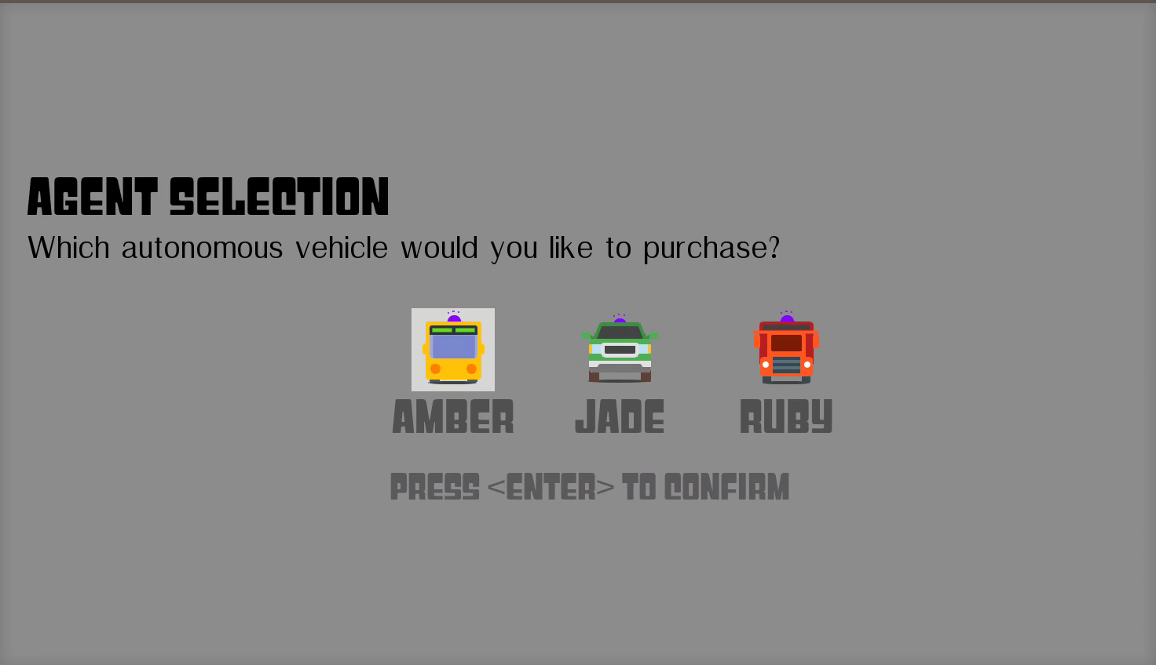

Slide 26








Sample Reactions

Slide 27
Instantiating EMPATHIC
Human exploration of the data

Slide 28
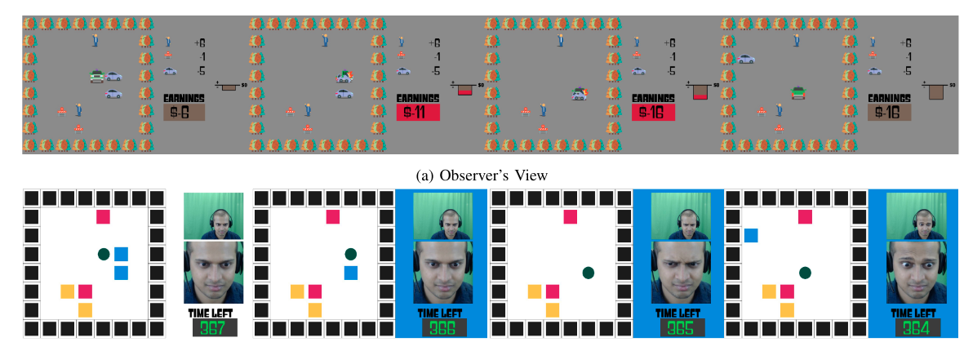
Human Proxy Experiment

Slide 29
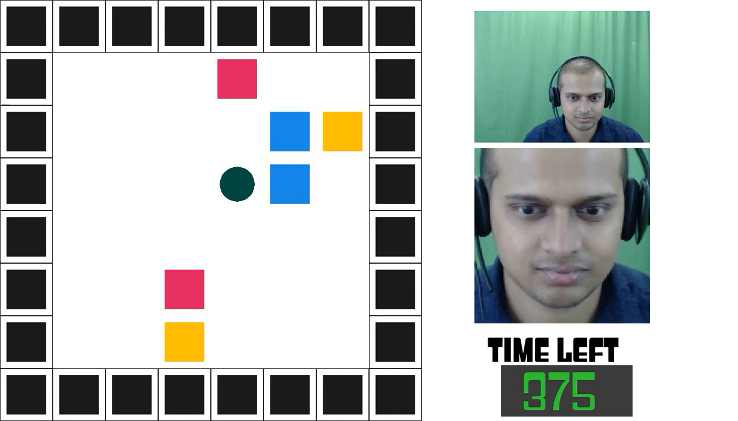
Notes:
From unconditioned group
Correct mapping – Red = very good; blue = very bad; yellow = bad

Slide 30
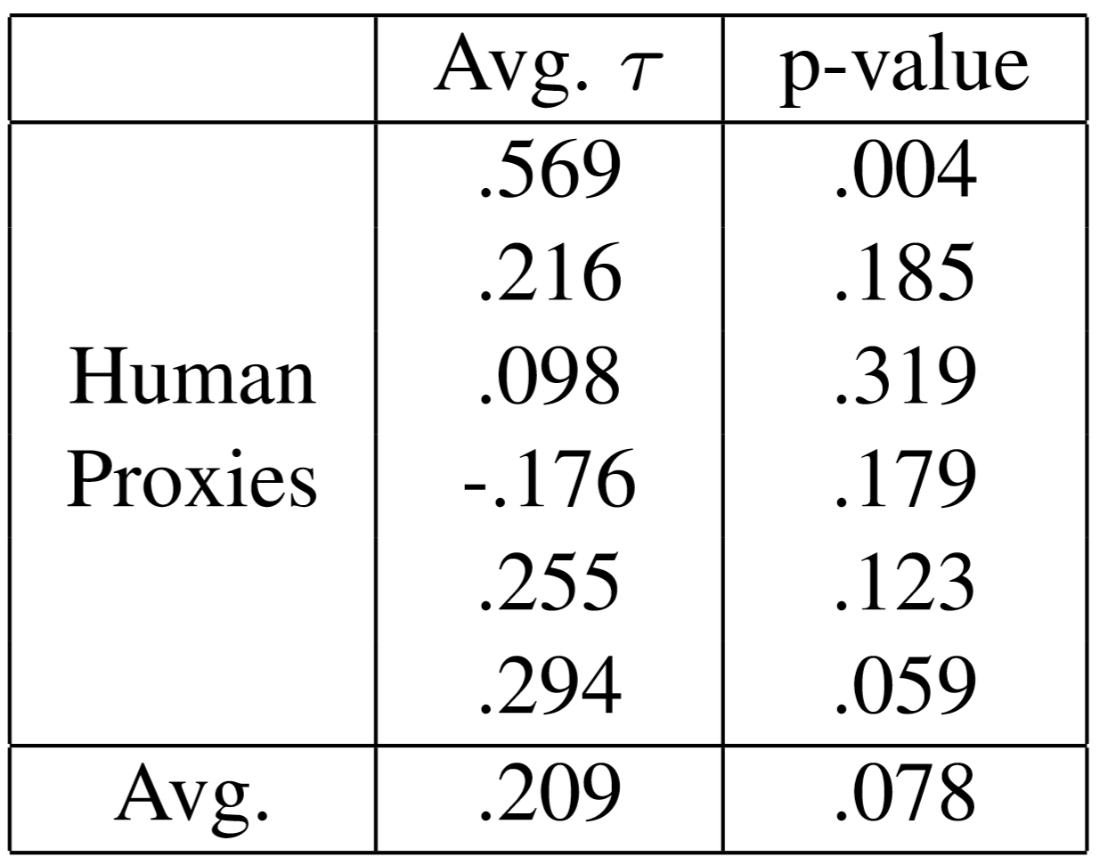
Results of the Human Proxy Experiment
Average Kendall’s τ scores across subjects; a baseline that randomly picks rankings has an expected τ of 0.

Slide 31
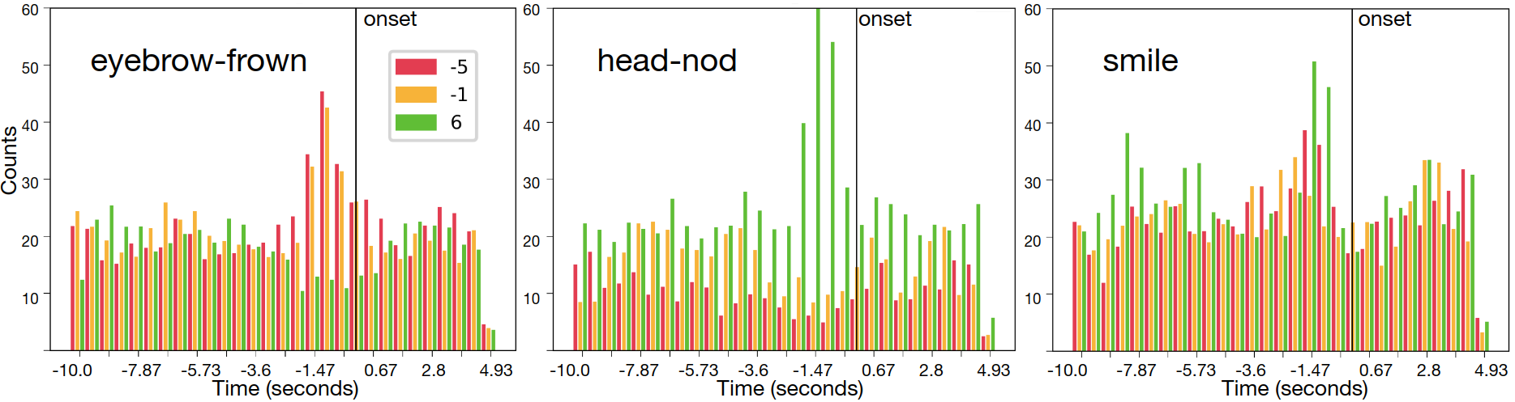
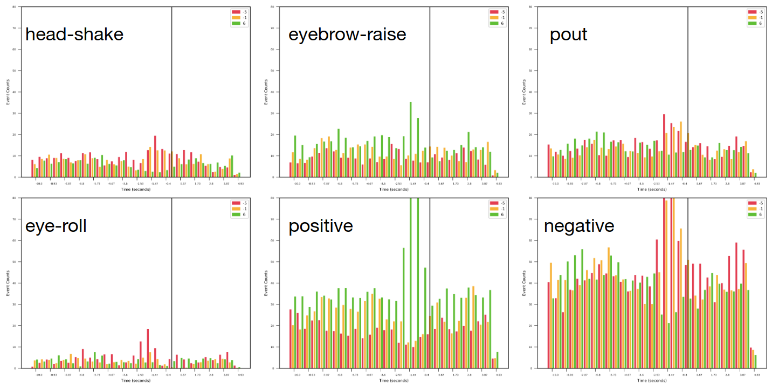
Human Exploration of Data
Aggregated reward events around annotated reactions

Slide 32
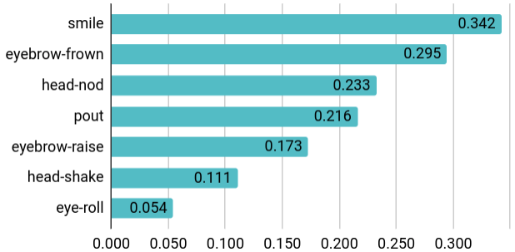
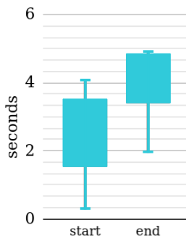
Annotated social cues (proportion)
Human Exploration of Data
Reaction Window

Slide 33
Instantiating EMPATHIC
Overview of creating and using the reaction mapping

Slide 34
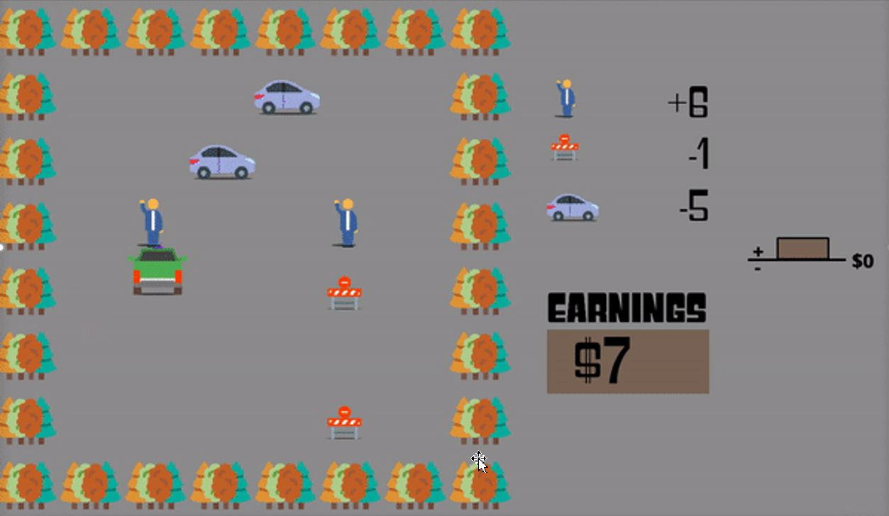
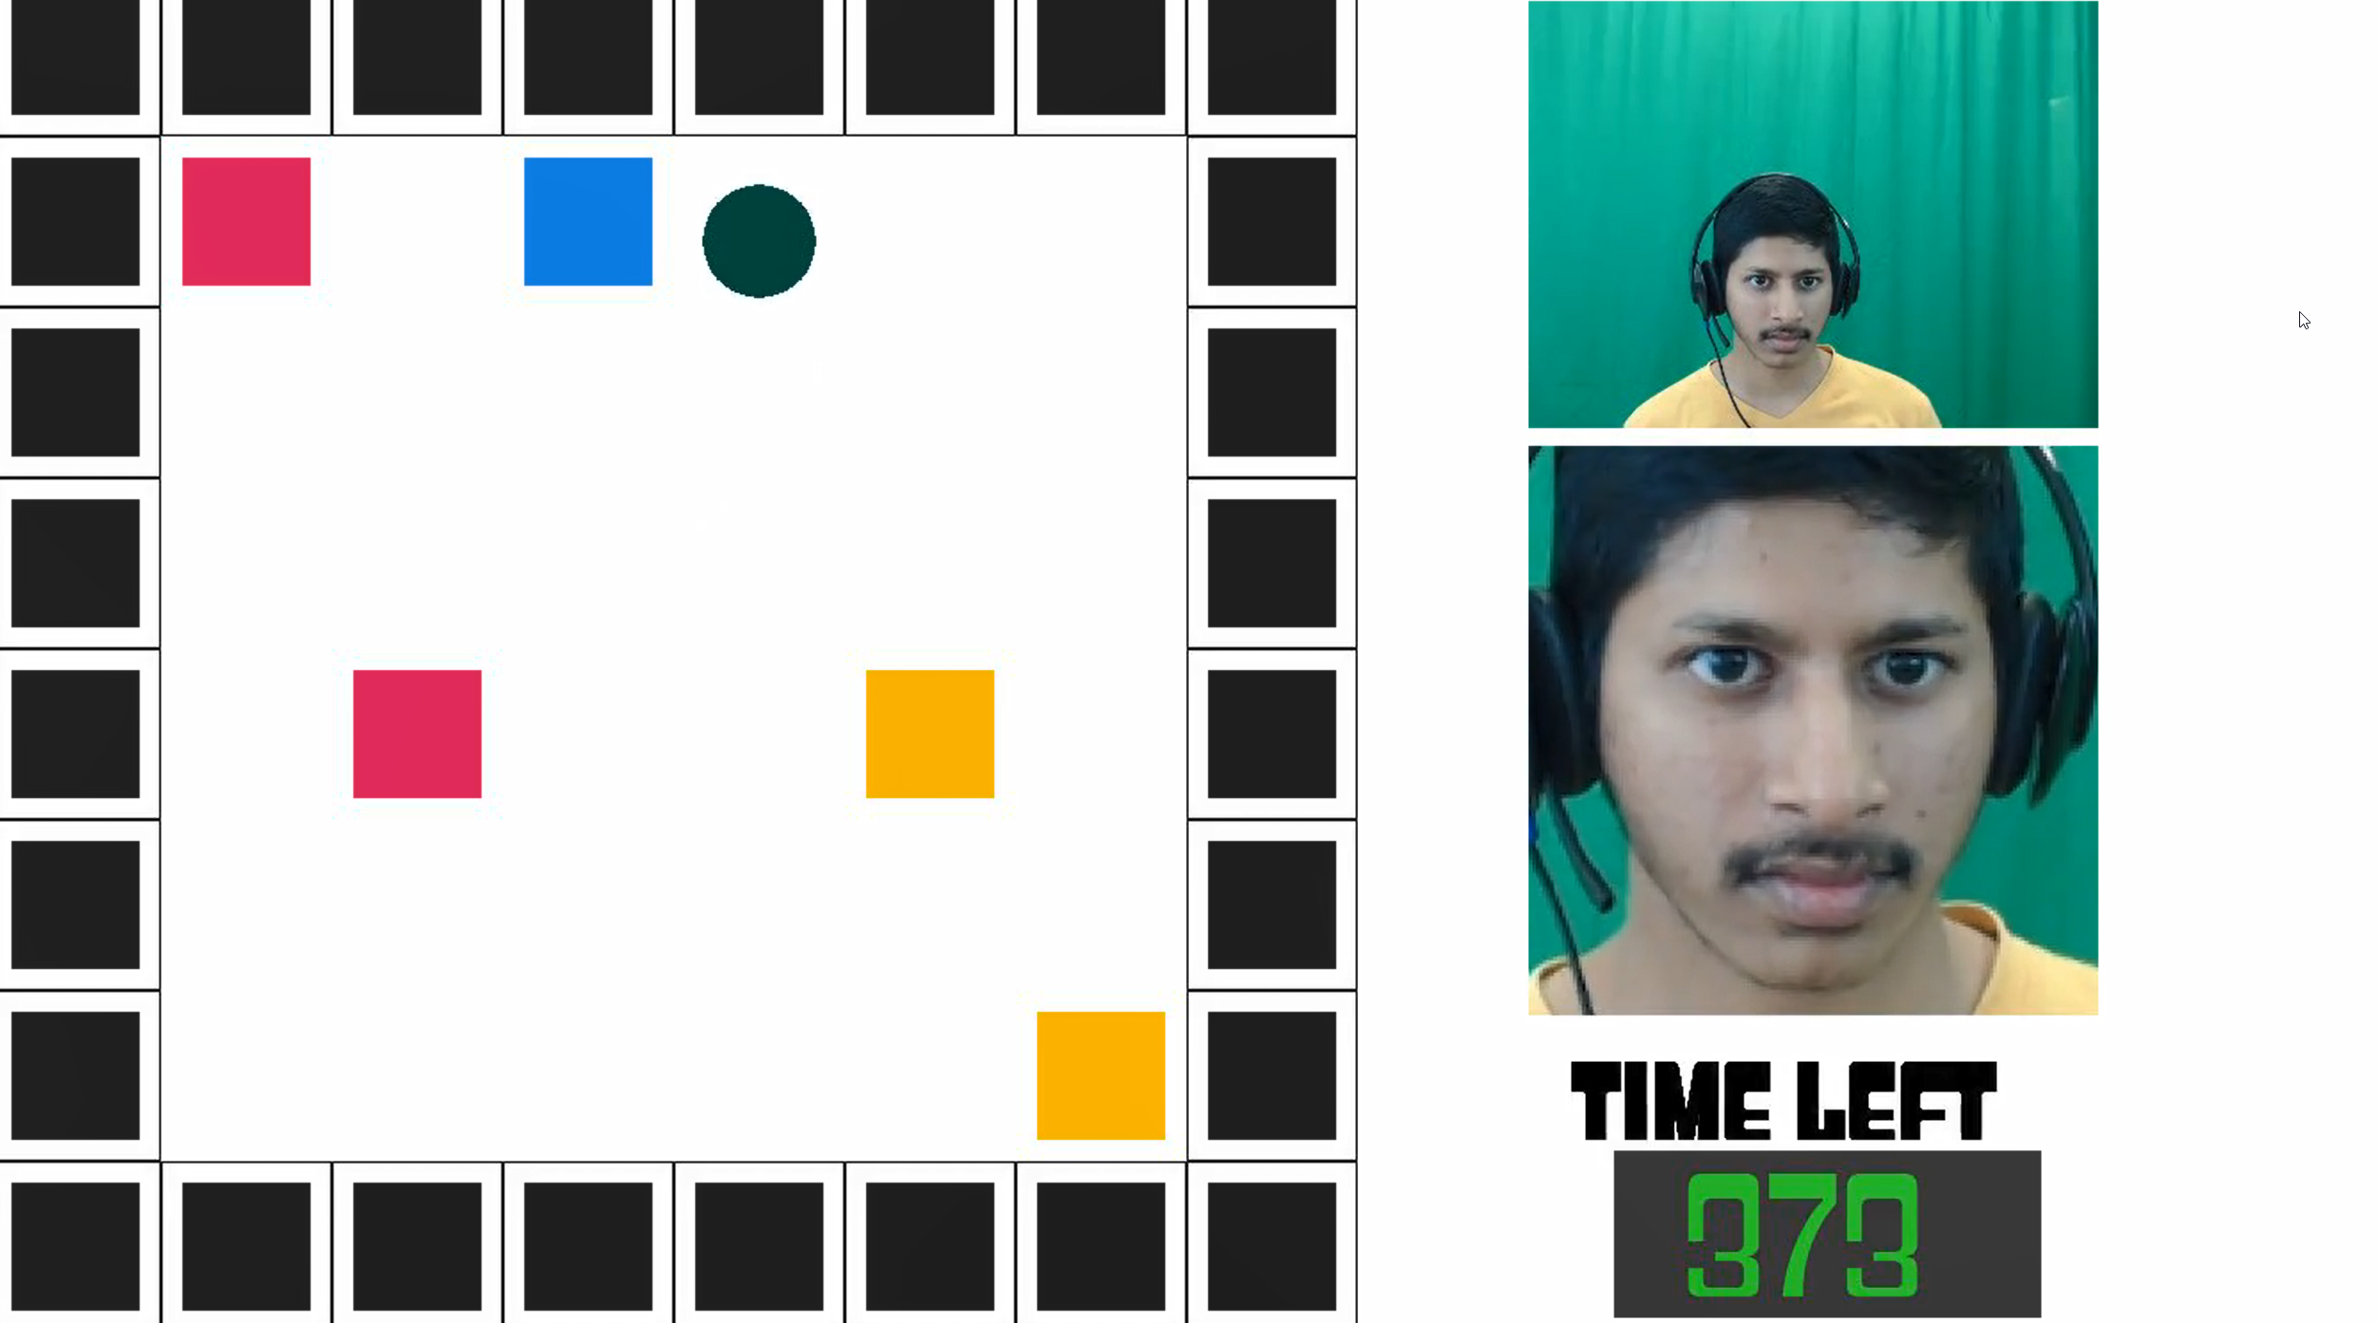
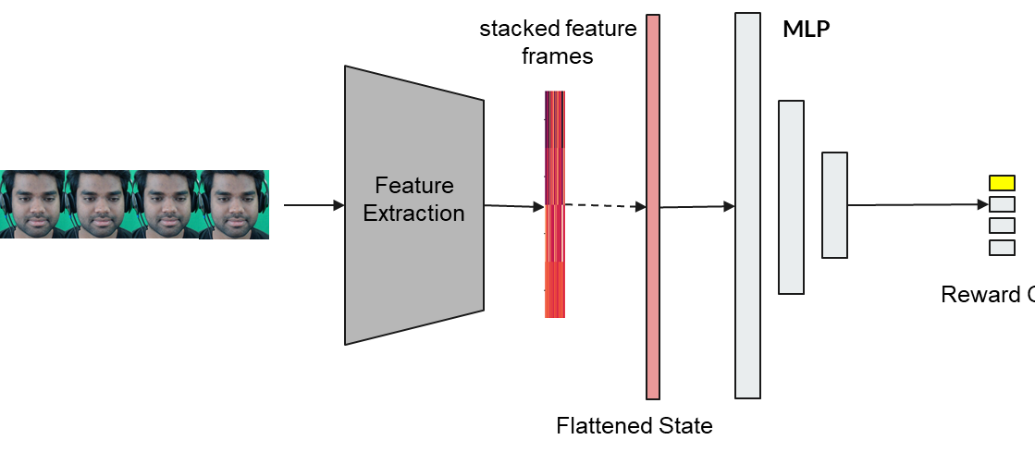

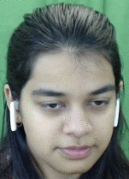

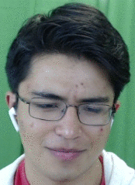
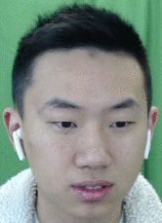
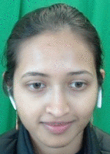



Stage 1
Stage 2
Task visualization & task stats
RL-stat (e.g. reward) classifier
Reactions
DNN
Reward Class
Trained Reaction Mapping
Subject reactions
Reward likelihoods
…

Slide 35
Instantiating EMPATHIC
Stage 1: Learning a reaction mapping from facial reaction data to reward

Slide 36
1. Learning a mapping from implicit human feedback to task statistics
Reactions
(implicit feedback)
Multi-modal
Reaction Feature Extraction
Human
Observer
Incentivize
Display
Task Specification
Reaction feature vector
Mapping of reaction features to task statistic(s)
Environment
Reward
Model
Training
State
Dataset Store
Action
State,
Action
Task statistics
Agent
Task statistic tables

Slide 37
1. Learning a mapping from implicit human feedback to task statistics
Reactions
(implicit feedback)
Multi-modal
Reaction Feature Extraction
Human
Observer
Incentivize
Extracting samples for supervised learning
Display
Task Specification
Reaction feature vector
Mapping of reaction features to task statistic(s)
Environment
Reward
Model
Training
State
Dataset Store
Action
State,
Action
Task statistics
Agent
Task statistic tables

Slide 38
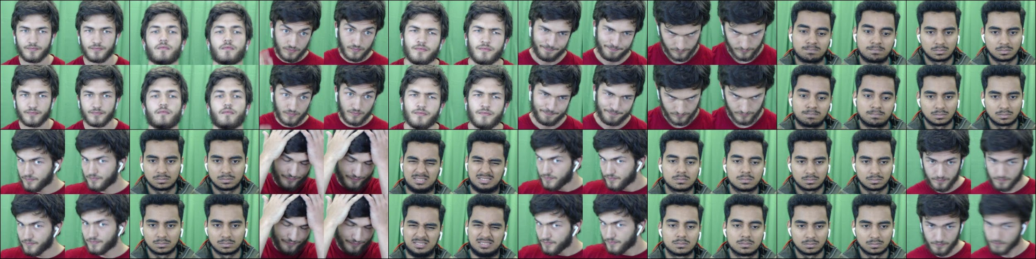
Time
t₀
(Label: reward class y)
t⁻
t
t⁺
Game Frames
(1.2 FPS)
Image Frames
(30 FPS)
Feature Extraction (𝚽)
Aggregated Frames
(6 FPS)
T-k
...
T-1
T
T+1
T+2
...
...
...
...
...
...
...
T+l
k
l
Image Frames
X_{t0} ... X_{t+}
Feature Extraction (𝚽)
Window of Aggregated Frames
Facial Action Units {𝜑_{FAU}}
concat
OpenFace 2.0
Toolkit
Facial Action Units
flatten
max pool
Head-motion Features {𝜑_{head}}
encode
Fourier Transform
Head Pose
flatten

Slide 39
1. Learning a mapping from implicit human feedback to task statistics
Reactions
(implicit feedback)
Multi-modal
Reaction Feature Extraction
Human
Observer
Incentivize
Extracting samples for supervised learning
Display
Task Specification
Reaction feature vector
Mapping of reaction features to task statistic(s)
Environment
Reward
Model
Training
State
Dataset Store
Action
State,
Action
Task statistics
Agent
Task statistic tables

Slide 40
Time
t₀
(Label: reward class y)
t⁻
t
t⁺
Game Frames
(1.2 FPS)
Image Frames
(30 FPS)
Feature Extraction (𝚽)
Aggregated Frames
(6 FPS)
T-k
...
T-1
T
T+1
T+2
...
...
...
...
...
...
...
T+l
k
l
Image Frames
X_{t0} ... X_{t+}
Window of Aggregated Frames
flatten
a
Feature Extraction (𝚽)
Annotations
AT-k .. AT+l
Facial Action Units {𝜑_{FAU}}
concat
OpenFace 2.0
Toolkit
Facial Action Units
flatten
Auxiliary Task
o
Mean Square Error
max pool
Head-motion Features {𝜑_{head}}
encode
Reward
Classification
Fourier Transform
z
Ground Truth
RL Statistic
Head Pose
flatten
MLP hidden layers
Cross Entropy Loss
(binary + ternary)

Slide 41
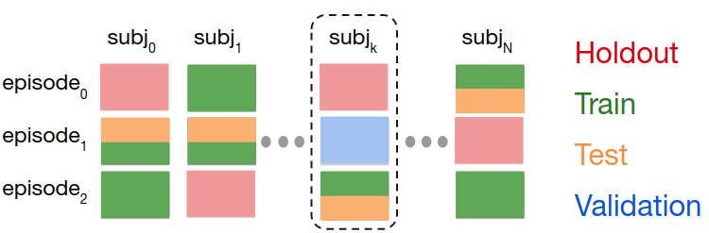

Slide 42
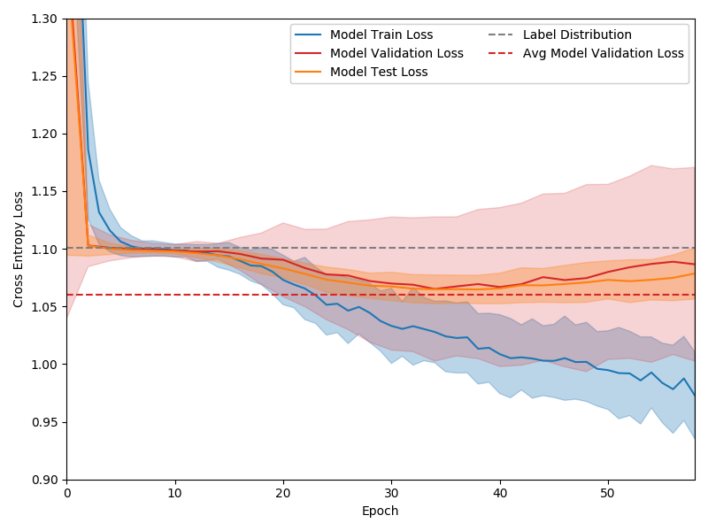
Results
Predicting the reward values of Robotaxi events through applying the reaction mapping to facial reactions
Best model
Notes:
Model: Transformer Model 3 fc layer + dropout (0.5) + 8 heads (2 tfmr layers)
Modular net for processing inputs
Learning rate: 0.0001
Optimization: Adam
Activation: Leaky ReLu (all hidden layers)
Input: 14 * 698 = 14 sequential detection-frame features (VGG+landmark+facs+pose+pmd)
Two Stage Class Balancing
Output: 4 classes
Label: Reward

Slide 43
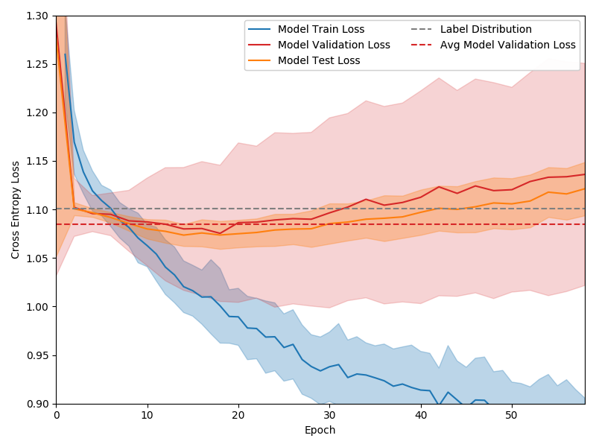
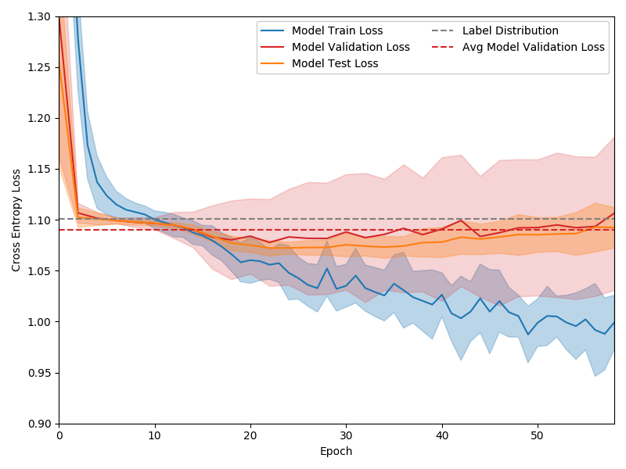
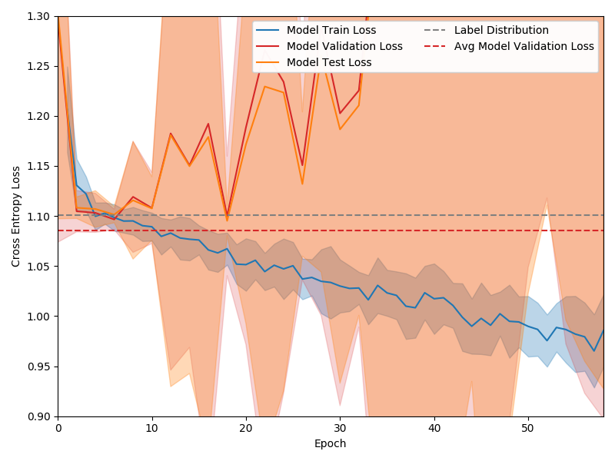
Results
Robotaxi reaction mapping
Best model
No auxiliary task
Only Facial Action Units as input
Only head-pose as input
Notes:
Model: Transformer Model 3 fc layer + dropout (0.5) + 8 heads (2 tfmr layers)
Modular net for processing inputs
Learning rate: 0.0001
Optimization: Adam
Activation: Leaky ReLu (all hidden layers)
Input: 14 * 698 = 14 sequential detection-frame features (VGG+landmark+facs+pose+pmd)
Two Stage Class Balancing
Output: 4 classes
Label: Reward

Slide 44
Instantiating EMPATHIC
Stage 2 (v. 1):
Deploying offline in the Robotaxi training task

Slide 45
1. Learning a mapping from implicit human feedback to task statistics
Reactions
(implicit feedback)
Multi-modal
Reaction Feature Extraction
Human
Observer
Incentivize
Display
Task Specification
Reaction feature vector
Mapping of reaction features to task statistic(s)
Environment
Reward
Model
Training
State
Dataset Store
Action
State,
Action
Task statistics
Agent
Task statistic tables

Slide 46
1. Learning a mapping from implicit human feedback to task statistics
2. Learning a new task from implicit human feedback
Reactions
(implicit feedback)
Reactions
(implicit feedback)
Multi-modal
Reaction Feature Extraction
Human
Observer
Human
Observer
Incentivize
Reaction feature vector
Display
Display
Task Specification
State, Action
Mapping of reaction features to task statistic(s)
Environment
Reward
Model
Training
Environment
State
Dataset Store
State
Action
Assembler of Task/Behavior
Action
Task statistic(s)
State,
Action
Task statistics
Agent
Agent
Task statistic tables
Task/Policy Description

Slide 47
1. Learning a mapping from implicit human feedback to task statistics
2. Learning a new task from implicit human feedback
Reactions
(implicit feedback)
Reactions
(implicit feedback)
Multi-modal
Reaction Feature Extraction
Human
Observer
Human
Observer
Incentivize
Reaction feature vector
Display
Display
Task Specification
State, Action
Mapping of reaction features to task statistic(s)
Environment
Reward
Model
Training
Environment
State
Dataset Store
State
Action
Assembler of Task/Behavior
Action
Task statistic(s)
State,
Action
Task statistics
Agent
Agent
Task statistic tables
Task/Policy Description

Slide 49
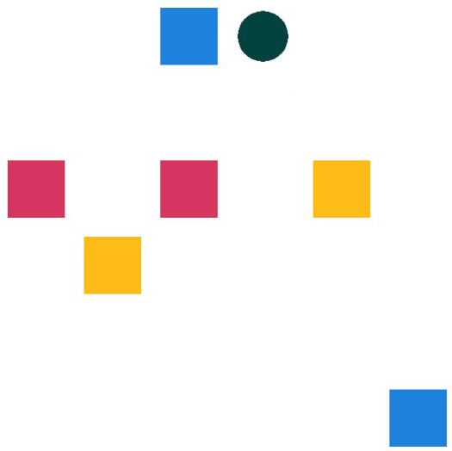



Time
Event
Reaction mapping
Reaction mapping
Reaction mapping

Slide 50
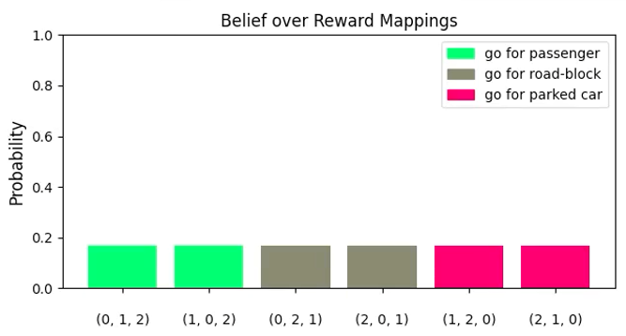
Reward mappings
Likelihood of each reward mapping
Event
Event
Normalized product of mapping likelihoods over many events
Likelihood
Reaction mapping
Reward mappings

Slide 51
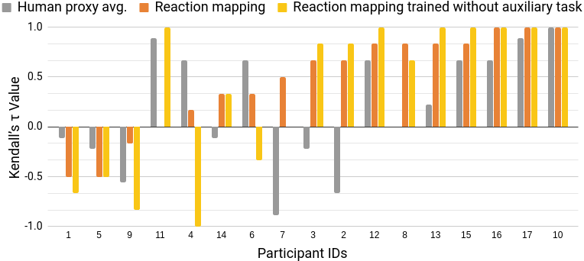
Results
Robotaxi reward-ranking on holdout set
Wilcoxon Signed-Rank test: the model's performance is significantly better than uniformly random guessing; p=0.0024 with the annotation-reliant auxiliary task and p=0.0207 without it.

Slide 52
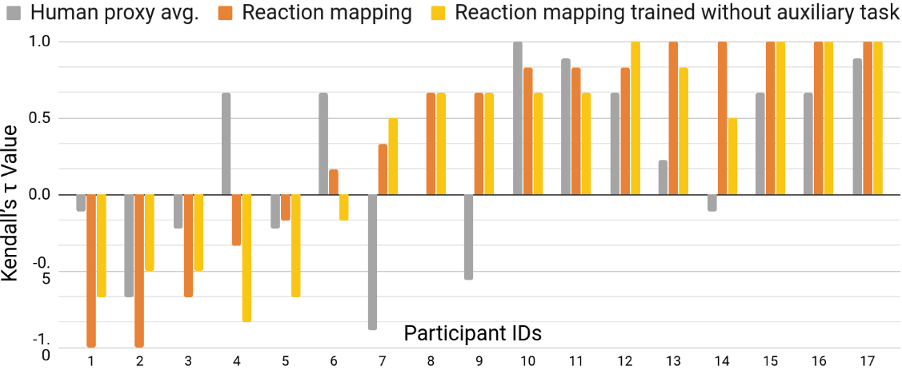
Results
Robotaxi reward-ranking on a validation set that matches episodes evaluated in the human proxy task
Wilcoxon Signed-Rank test: the model's performance is significantly better than uniformly random guessing; p=0.0021 with the annotation-reliant auxiliary task and p=0.0012 without it.
Notes:
Danger of overfitting (b/c not holdout set), but the plot allows a weak comparison of human performance. Don’t put much weight on this analysis though, because outperforming humans is not the goal and we therefore did not design the study to allow rigorous comparison to human performance (authors aren’t representative, etc.).

Slide 53
Instantiating EMPATHIC
Stage 2 (v. 2):
Deploying online in the Robotaxi training task

Slide 54
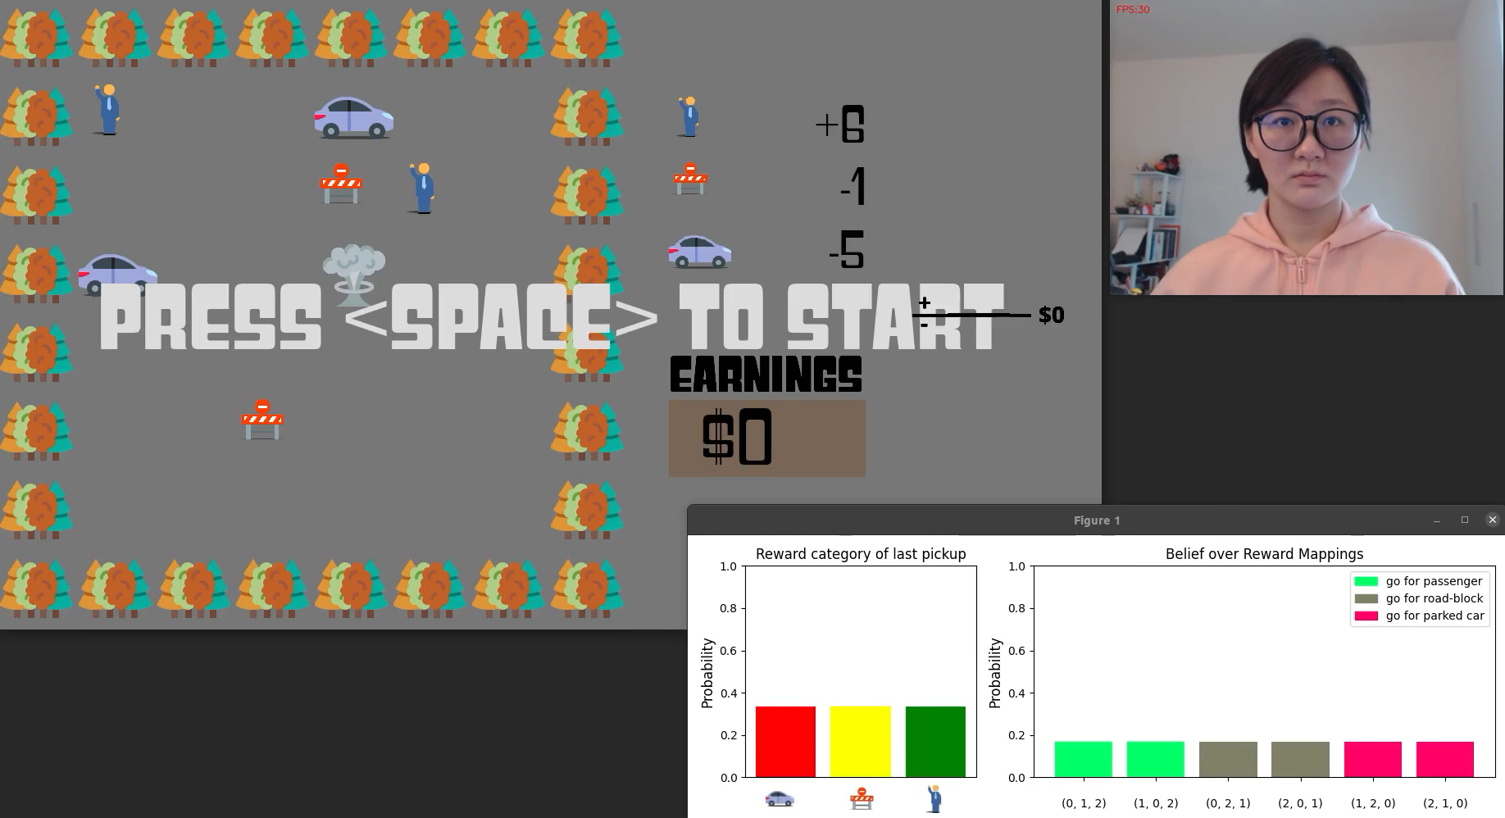

Slide 55
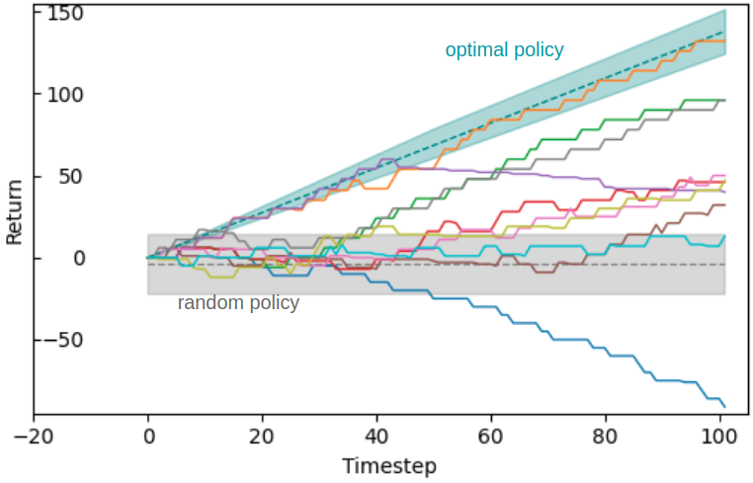
Results
Robotaxi online learning from implicit human feedback
For 9 of 10 subjects, return is higher than the the mean return for a random policy.
For 7 of 10 subjects, the session ended with a max-likelihood reward mapping that correctly considers the passenger pickup to be the best.
Notes:
Reasons these results are pessimistic: no reward alignment, non-controlled experimental setting, greedy policy may have reduced helpful samples

Slide 56
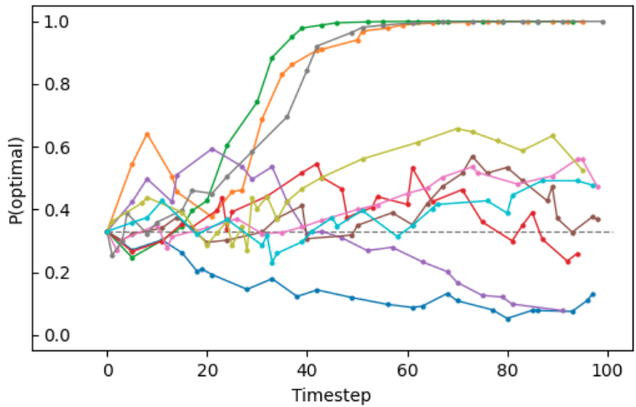
Results
Robotaxi online learning from Implicit Human Feedback
For 9 of 10 subjects, return is higher than the the mean return for a random policy.
For 7 of 10 subjects, the session ended with a max-likelihood reward mapping that correctly considers the passenger pickup to be the best.
For 3 of those 7 subjects, the distribution over reward mappings had low entropy.
Notes:
Reasons these results are pessimistic: no reward alignment, non-controlled experimental setting, greedy policy may have reduced helpful samples

Slide 57
Instantiating EMPATHIC
Stage 2 (v. 3):
Deploying offline in a new task, robotic sorting

Slide 58
1. Learning a mapping from implicit human feedback to task statistics
2. Learning a new task from implicit human feedback
Reactions
(implicit feedback)
Reactions
(implicit feedback)
Multi-modal
Reaction Feature Extraction
Human
Observer
Human
Observer
Incentivize
Reaction feature vector
Display
Display
Task Specification
State, Action
Mapping of reaction features to task statistic(s)
Environment
Reward
Model
Training
Environment
State
Dataset Store
State
Action
Assembler of Task/Behavior
Action
Task statistic(s)
State,
Action
Task statistics
Agent
Agent
Task statistic tables
Task/Policy Description

Slide 59
1. Learning a mapping from implicit human feedback to task statistics
2. Learning a new task from implicit human feedback
Reactions
(implicit feedback)
Reactions
(implicit feedback)
Multi-modal
Reaction Feature Extraction
Human
Observer
Human
Observer
Incentivize
Reaction feature vector
Display
Display
Task Specification
State, Action
Mapping of reaction features to task statistic(s)
Environment
Reward
Model
Training
Environment
State
Dataset Store
State
Action
Assembler of Task/Behavior
Action
Task statistic(s)
State,
Action
Task statistics
Agent
Agent
Task statistic tables
Task/Policy Description
New Task Domain

Slide 60
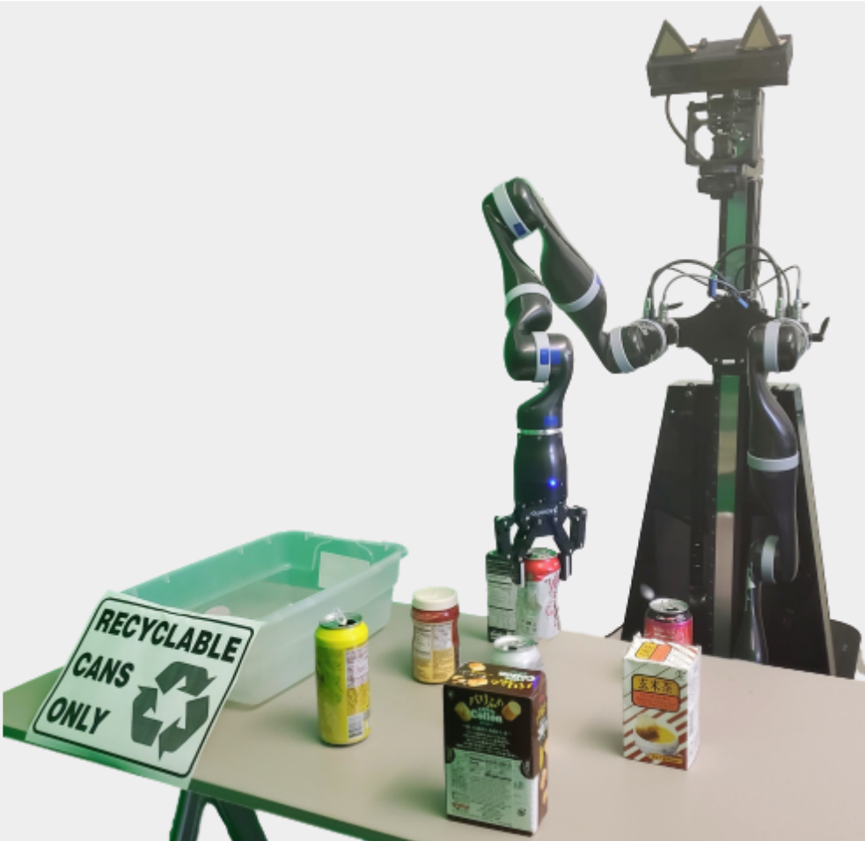
Learning offline from implicit human feedback in a new task
The robot sorting task
Rewards:
+2 upon recycling a can
-1 upon recycling any other object
0 at all other times
Episodes are short (<20 seconds), containing pre-determined trajectories with at most a single non-zero reward event.

Slide 61
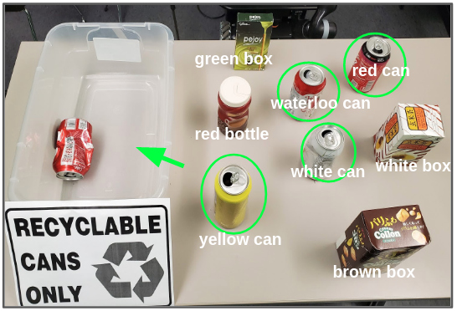
Learning offline from implicit human feedback in a new task
The robot sorting task
Rewards:
+2 upon recycling a can
-1 upon recycling any other object
0 at all other times
Episodes are short (<20 seconds), containing pre-determined trajectories with at most a single non-zero reward event.

Slide 62
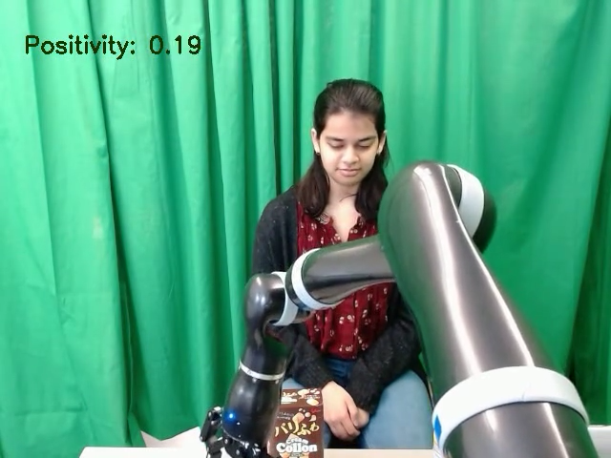
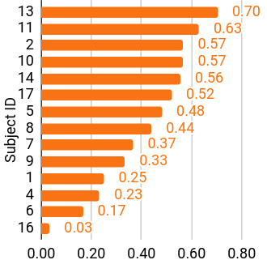
Steps
Subject observes pre-computed trajectories
Reaction mapping’s output probability of +6 reward class → “positivity score” for aggregated frames
Trajectories are ranked by their mean positivity scores and compared to the ground-truth ranking by their return.
Learning offline from implicit human feedback in a new task

Slide 63
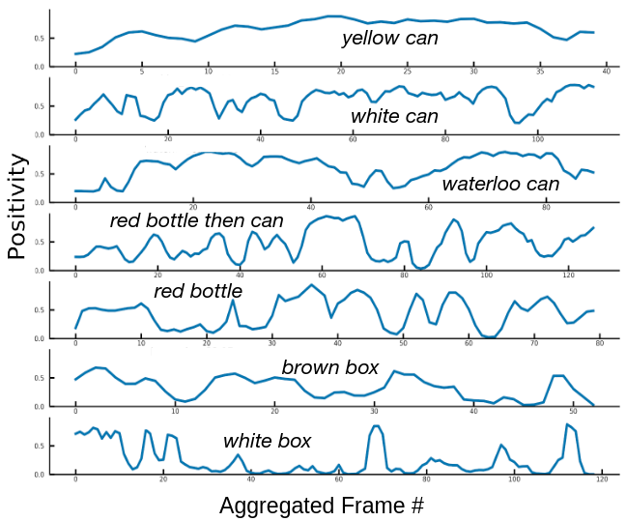
Learning offline from implicit human feedback in a new task

Slide 64
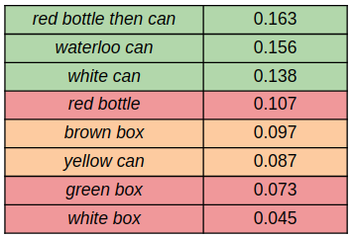
Mean positivity score
Trajectory
Learning offline from implicit human feedback in a new task
Trajectories are colored by their return: +2, 0, or -1.
Using Kendall’s τ independence test, our reaction model significantly outperforms random ranking (τ = 0.70; p = 0.034).

Slide 65
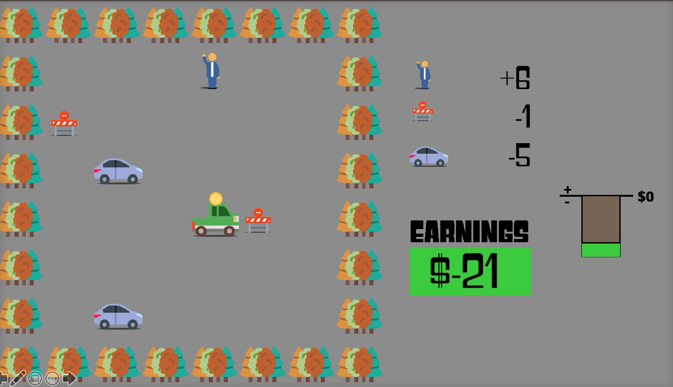
Stage 2 instantiations with positive results
1) Same task, offline learning
2) Same task, online learning (and improving policy)
3) Different task, offline learning

Slide 66
How we are simplifying the problem (for now)
A private experimental setting reduces distraction ← less need to determine whether the subject is reacting to the agent or something else
Avoiding the question of how people’s behavior will change if they know they are influencing the system
Friendly tasks were chosen: (1) Reaction mapping has predetermined discrete reward classes. (2) Tasks are pseudo-bandit (where state has little impact on return beyond near-term reward).

Slide 67
Towards real-world applicability
More data – scale-up data collection via the MTurk online worker platform
Try predicting more types of task statistics
(e.g., ones that incorporate human anticipation)
Explore more reaction modalities
(e.g., gaze, vocalizations, and gestures)
Adapt method to a wider range of tasks
(e.g., with varying temporal characteristics)
Extend to scenarios in which humans are primarily attending to a different task
Notes:
Try other labels

