Slide 1

Traffic Optimization For a Mixture of Self-interested and Compliant Agents
Guni Sharon, Michael Albert, Tarun Rambha, Stephen Boyles and Peter Stone

Slide 2
Overview
Route a flow of agents across a network
S
T

Slide 3
Overview
Route a flow of agents across a network
Self interested routing → user equilibrium
S
T

Slide 4
Overview
Route a flow of agents across a network
Self interested routing → user equilibrium
System optimum routing → optimal flow
Least marginal cost path
S
T

Slide 5
Overview
Route a flow of agents across a network
Self interested routing → user equilibrium
System optimum routing → optimal flow
Mixed, SO-UE scenario → ?
?
S
T

Slide 6
Mixed UE-SO equilibrium
Mixed scenario is a Stackelberg game
SO agents are the leaders
UE agents are the followers
S
T
UE
SO

Slide 7
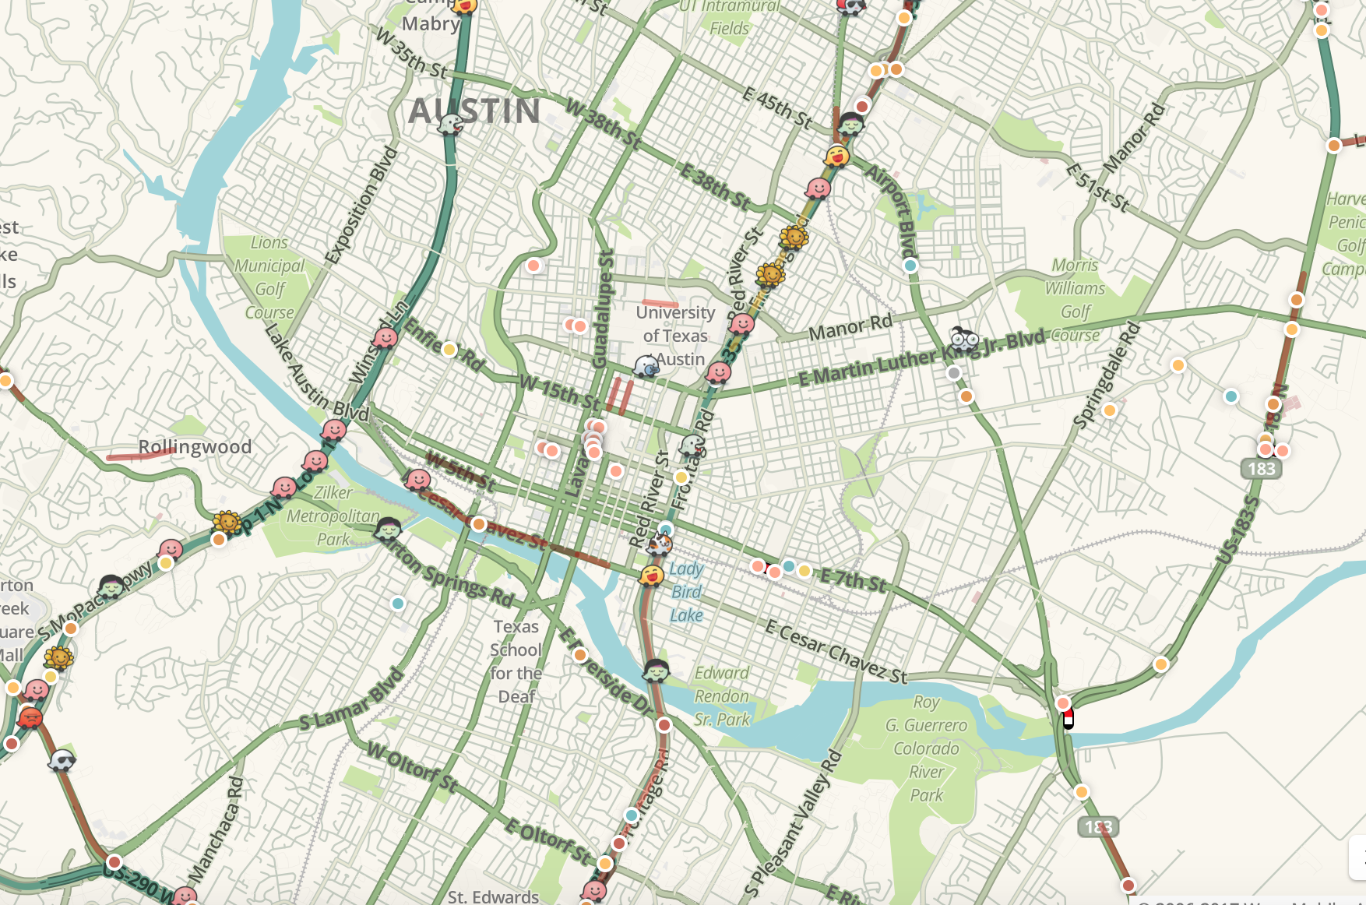
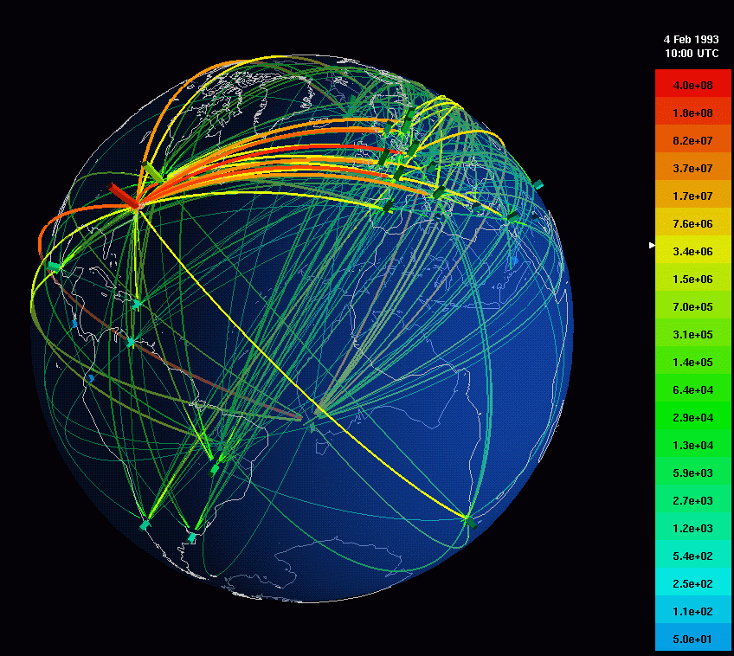
Motivation
Influencing self interested agents is expensive
A system manager usually has limited resources

Slide 8
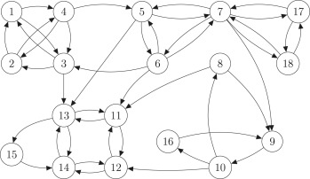
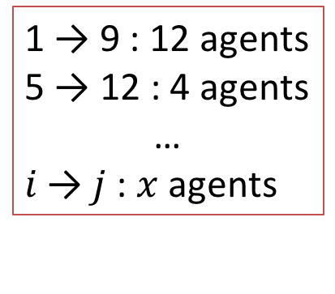
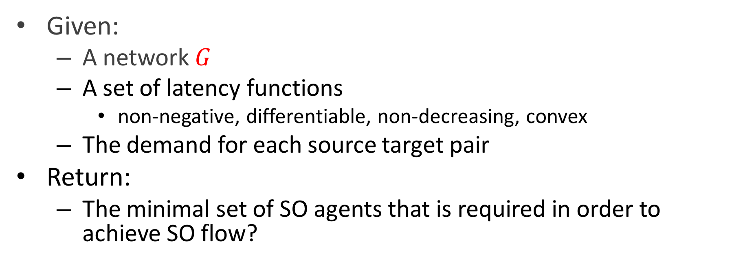
Problem definition
Given:
  A network $G$
  A set of latency functions
    non-negative, differentiable, non-decreasing, convex
  The demand for each source target pair
Return:
  The minimal set of SO agents that is required in order to achieve SO flow?
1 → 9 : 12 agents
5 → 12 : 4 agents
…
$i \text{→}$ $j$ : $x$ agents

Slide 9
Related work
Equilibrium for a mixed UE, Cournot-Nash (CN) scenario
  Unique, can be computed using a convex program
    (Haurie and Marcotte 1985; Yang and Zhang 2008)
  Equilibrium for a mixed UE, SO scenario with common source and a common target and any number of parallel links
  Korilis et. al. (1997)
  NP-hard in the general case (Roughgarden 2004)
S
T

Slide 10
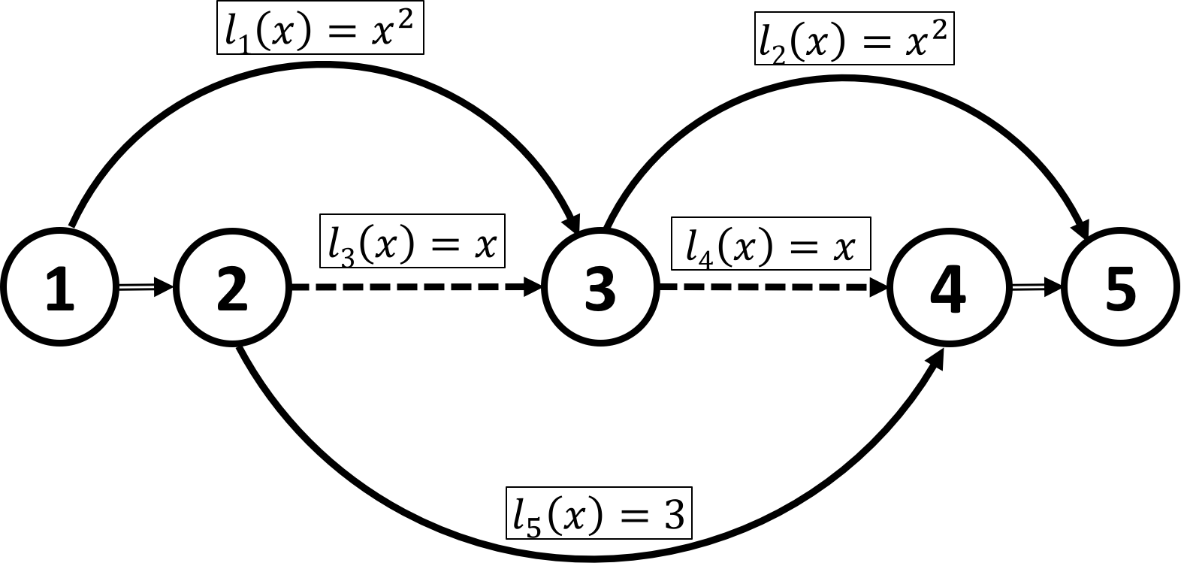
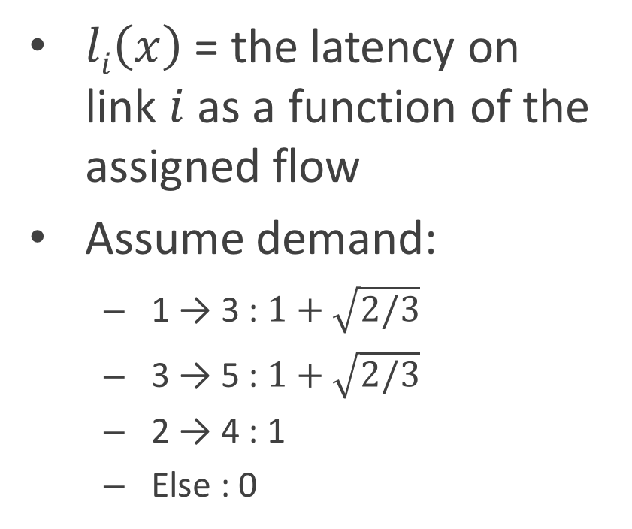
Example problem
$li\left(x\right)$ = the latency on link $i$ as a function of the assigned flow
Assume demand:
  1 → 3 : $1+\sqrt{2/3}$
  3 → 5 : $1+\sqrt{2/3}$
  2 → 4 : 1
  Else : 0

Slide 11
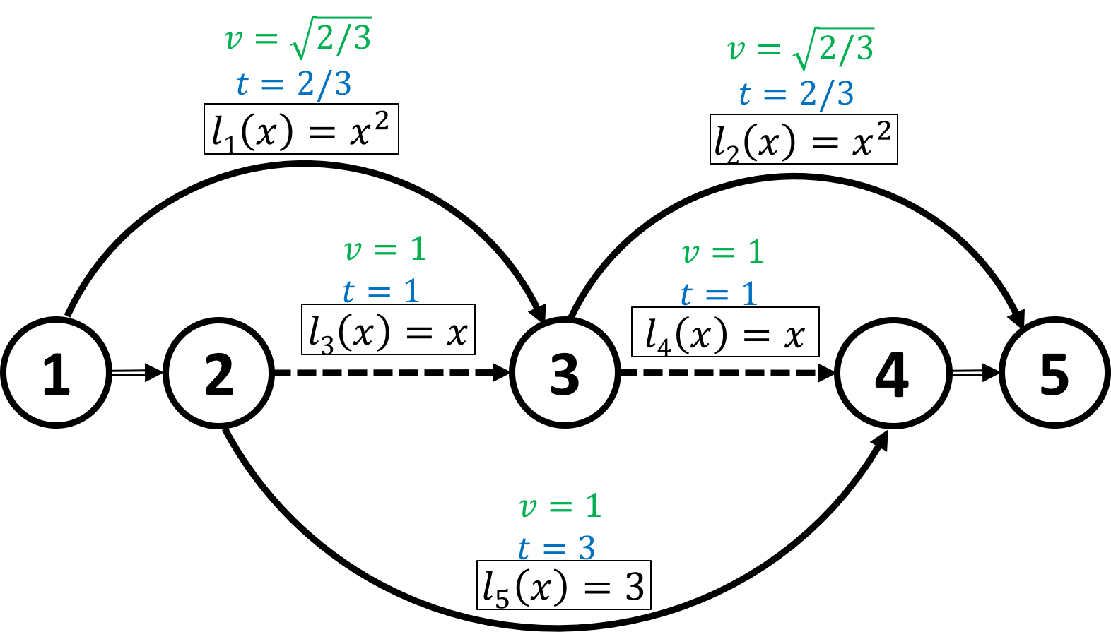
System optimum
What routes would a self interested agent consider?

Slide 12
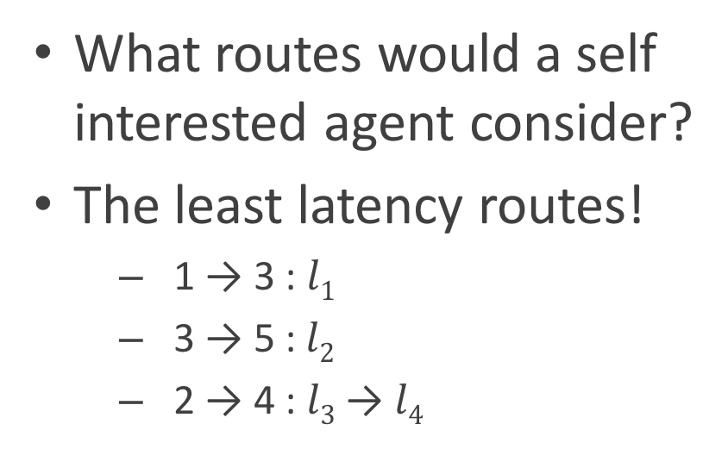
System optimum
What routes would a self interested agent consider?
The least latency routes!
  1 → 3 : $l1$
  3 → 5 :$l2$
  2 → 4 : $l3$ → $l4$

Slide 13
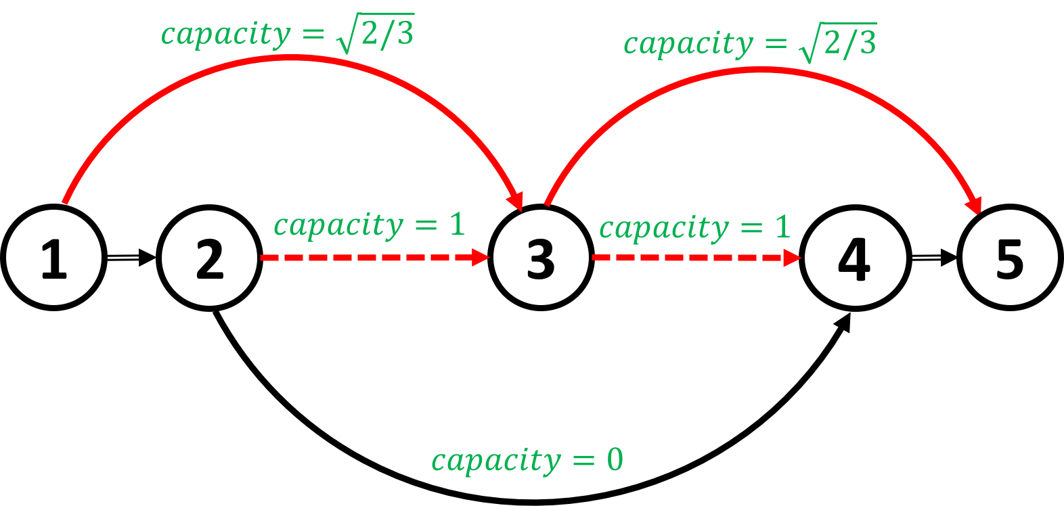
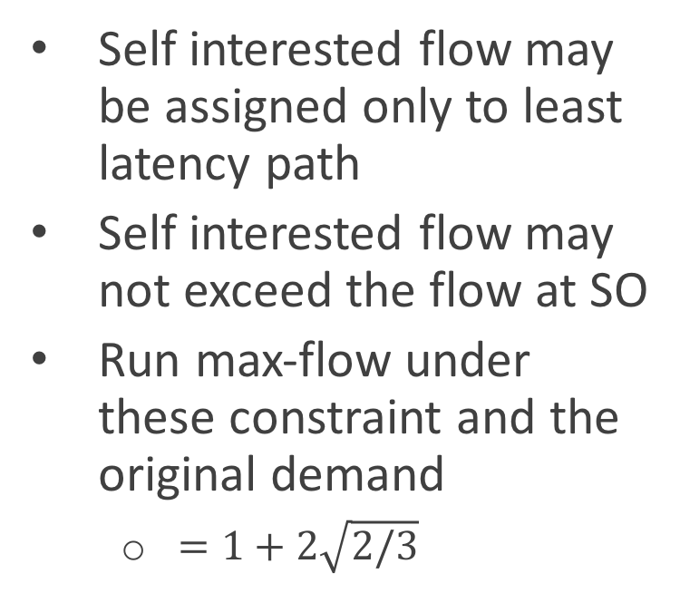
Self interested sub-flow
Self interested flow may be assigned only to least latency path
Self interested flow may not exceed the flow at SO
Run max-flow under these constraint and the original demand
  $=1+2\sqrt{2/3}$

Slide 14

Self interested sub-flow
Self interested flow may be assigned only to lease latency path
Self interested flow may not exceed the flow at SO
Run max-flow under these constraint and the original demand
  $=1+2\sqrt{2/3}$
Wrong!
We are missing a constraint

Slide 15
Missing a constraint
The previous solution assigns a flow of 1 to the dashed link
At SO no flow originating from 1 or 3 may travel the dotted line
At SO no flow originating from 2 may travel the dotted line

Slide 16
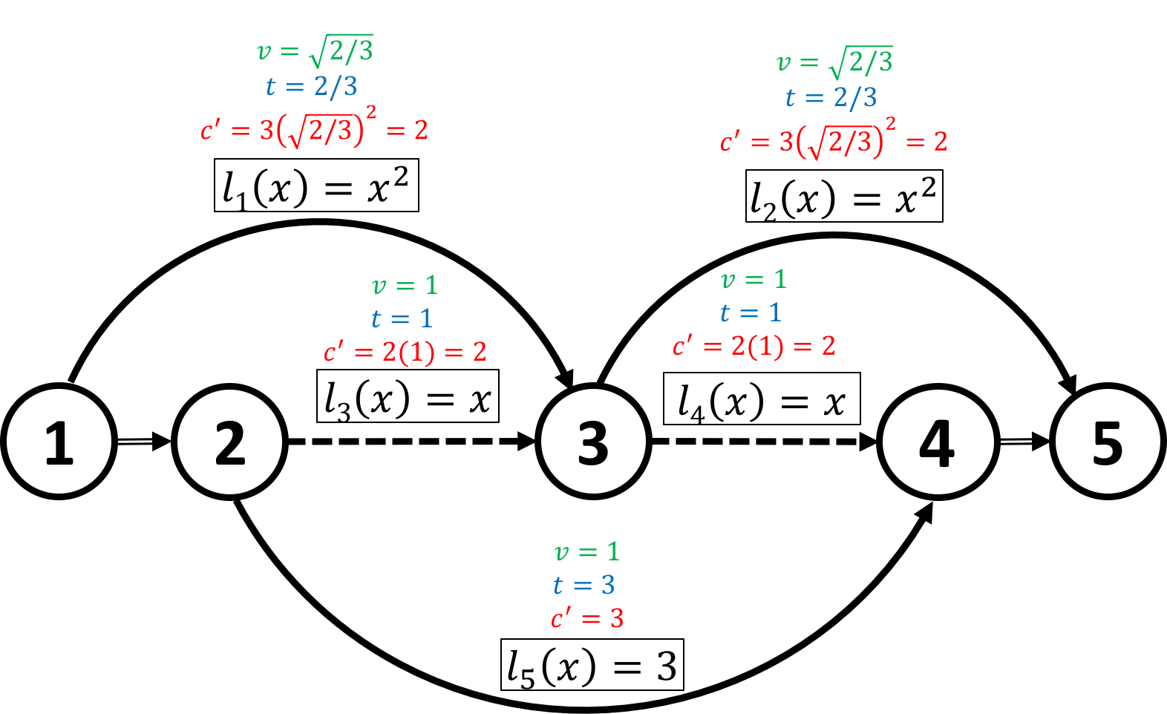
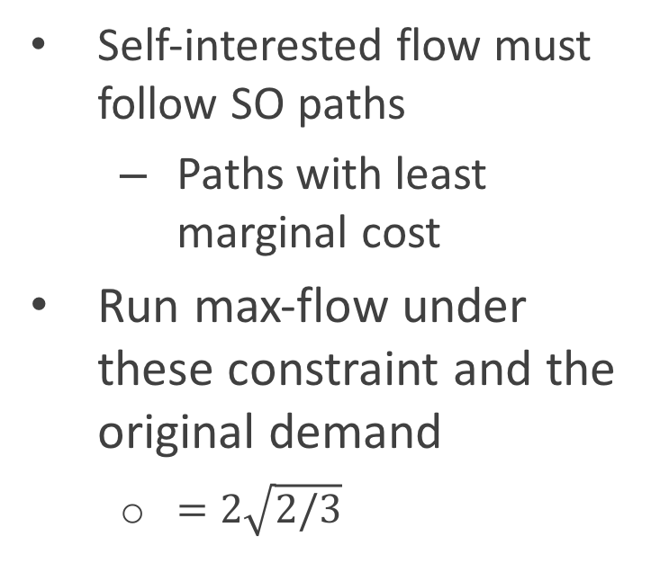
Another necessary constraint
Self-interested flow must follow SO paths
  Paths with least marginal cost
Run max-flow under these constraint and the original demand
  $=2\sqrt{2/3}$

Slide 17
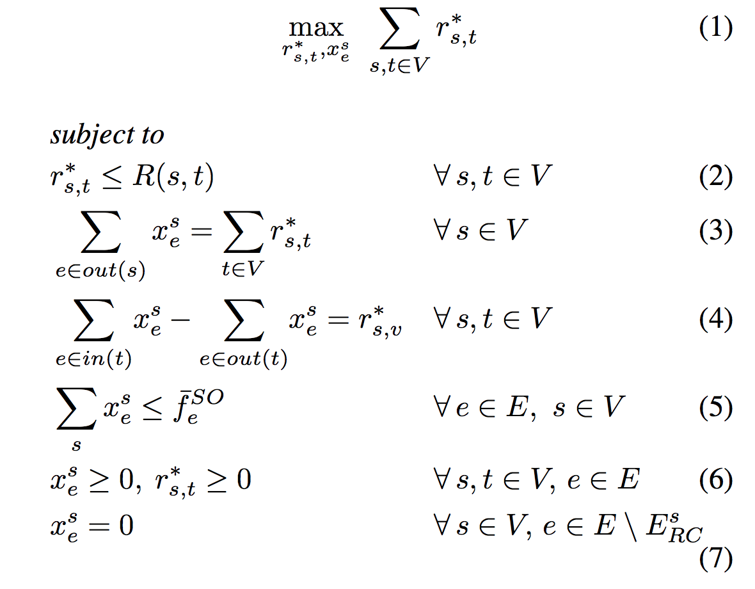
LP formalization
Maximize the self-interested flow over all source-target pairs
Self interested flow may not exceed original demand
Flow originate at source
Flow preservation constraint
Self-interested flow may not exceed flow at SO solution
No negative flow or demand
Positive flow is assigned only to paths with minimal latency and minimal marginal cost

Slide 18

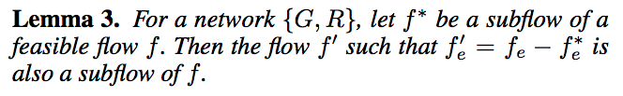

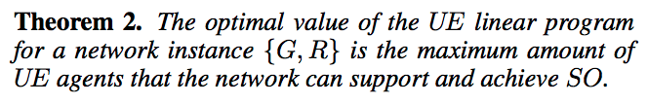

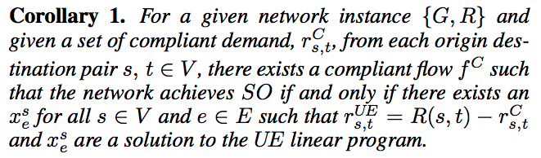
Proof of correctness

Slide 19
Experimental results
Six benchmark traffic scenarios, available at: https://github.com/bstabler/
Smaller networks can tolerate more self-interested agents at SO
  Larger networks -> less zero reduced paths -> less self-interested agents
Scenario | Vertices | Links | Total demand | UE TTT | SO TTT | % improvement | % self-interested
Sioux Falls | 24 | 76 | 360,600 | 7,480,225 | 7,194,256 | 3.82 | 86.96
Eastern MA | 74 | 258 | 65,576 | 28,181 | 27,323 | 3.04 | 80.27
Anaheim | 416 | 914 | 104,694 | 1,419,913 | 1,395,015 | 1.75 | 80.24
Chicago | 933 | 2,950 | 1,260,907 | 18,377,329 | 17,953,267 | 2.31 | 72.71
Philadelphia | 13,389 | 40,003 | 18,503,872 | 335,647,106 | 324,268,465 | 3.39 | 50.41
Chicago regional | 12,982 | 39,018 | 1,360,427 | 33,656,964 | 31,942,956 | 5.09 | 46.66

Slide 20
Take home
Achieving optimal traffic flow might not require controlling all agents
The paper presents a tractable LP for computing the maximal volume of self-interested agents that a system can tolerate at SO
The LP solution identifies the set of required SO agents
The paper also provides answers to the following:
  What routes should be assigned to the SO agents?
  Is a given set of SO agents sufficient for achieving SO flow?

