Slide 1
Optimizing Interdependent Skills for Simulated 3D Humanoid Robot Soccer
Daniel Urieli, Patrick MacAlpine, Shivaram Kalyanakrishnan, Yinon Bentor, Peter Stone
UT Austin Villa
The University of Texas at Austin

Slide 2
Goal
Creating and integrating a set of motion skills for a 3D simulated robot soccer player

Slide 3
Background
Simspark simulation
Based on ODE engine
Robot model: Aldebaran’s Nao
22 degrees of freedom
Message-based interaction with simulator
Communication between agents – 20 bytes messages
A robot is operated by joint torques
We wrapped it with a PID controller
Notes:
may be able to skip if other people talked about it in the workshop

Slide 4
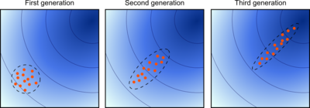
Contributions
  A skill learning architecture for a humanoid robot soccer agent
    Fully deployed in Robocup 2010
    Learning rather than hand-coding more than 100 parameters
    A significant building block in our agent, which is competitive with top-8 agents of Robocup 2010
  Sheds light on designing fitness functions for constraining an evolutionary learning process
  A new successful application of the CMA-ES algorithm

Slide 5
The Need for A Learning Architecture
Skills needed by a soccer playing robot:
  Walk-front
  Walk-back
  Walk-diagonally
  Walk-sideways
  Turn
  Kick
  Goalie-dive
  More…
Coding each skill by hand might be tedious and sub-optimal
On top of it, a skill design need to account for cooperation with other skills
  A robot running full speed forwards need to be able to stop and turn without falling….
Calls for a skill learning architecture

Slide 6
A Framework for Skills Learning and Optimization
Open loop joints control
Repeatedly execute 4 control frames
SKILL WALK_FRONT
KEYFRAME 1
reset ARM_LEFT ARM_RIGHT …
setTarget JOINT1 $jointvalue1 JOINT2 $jointvalue2
setTarget JOINT3 4.3 JOINT4 52.5
...
wait 0.08
KEYFRAME 2
...
Each frame specifies direct joint angles
Skills Description Language
Notes:
Framework – for walk and similar skills

Slide 7
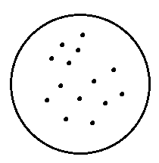
Parallel Job Evaluation through Condor
Our framework implements several evolutionary algorithms for parameters learning
Evaluations are done in parallel using Condor (www.cs.wisc.edu/condor) - an open source software framework for distributed computing
Repeatedly:
A skill learning experiment contains 15,000-50,000 evaluation runs
  For instance, 100 generations x 100 population x 5 averaging runs
  Using condor, we run 100 simulations in parallel, 25 seconds per simulation
  Wall clock time is 5-7 hours, for a total CPU time of ~350 hours
Parameters-sets
population
Send to condor for real-time fitness evaluation of parameters
condor
Based on the fitness values, create population of the next generation

Slide 8
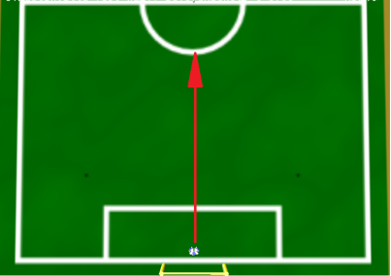
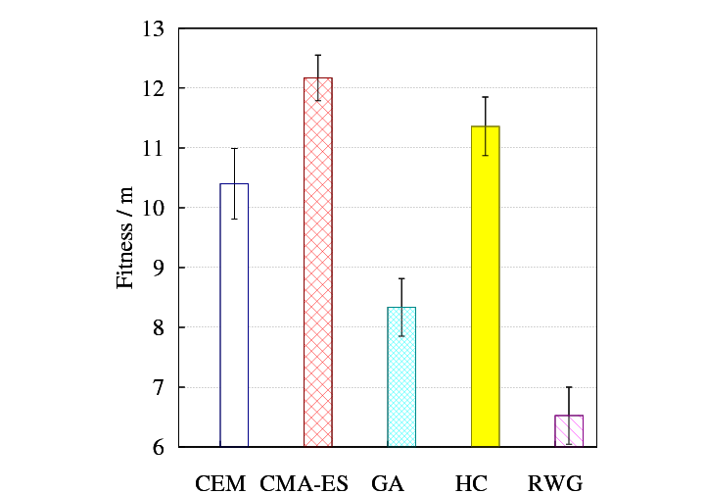
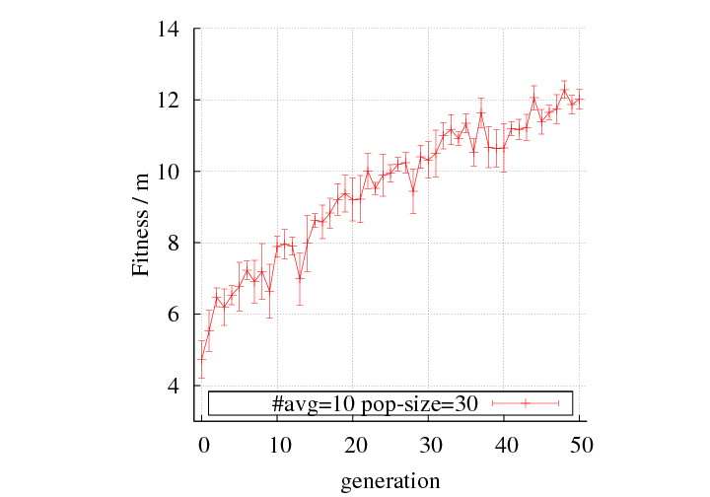
Optimizing individual skills
Goal: optimize the set of joint angles for maximum speed
A fitness of a set of joint angles:
The agent’s displacement in the desired direction
    Inherently accounts for falls and non-straight walks
    Measured over 15 seconds
Extensively compared several learning algorithms:
  Hill-Climbing, Cross-Entropy Method, Genetic Algorithm and CMA-ES
CMA-ES learning curve

Slide 9
CMA-ES
A stochastic, derivative-free, evolutionary numerical optimization method for non-linear or non-convex problems
In each generation, candidates are sampled from a multidimensional
Gaussian and evaluated for their fitness
Two main principles for parameter adaptation:
  Mean maximizes the likelihood of previously successful candidates, Covariance maximizes the likelihood of previously successful search steps (Natural Gradient Decent)
  Evolution paths are recorded and used as an information source
Found to be extremely effective in our domain
Notes:
Mention example is in 2D space

Slide 10
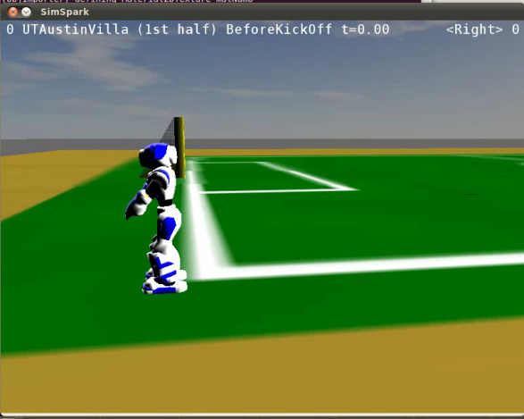
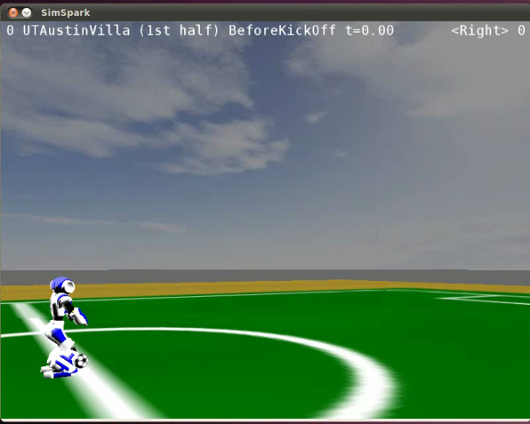
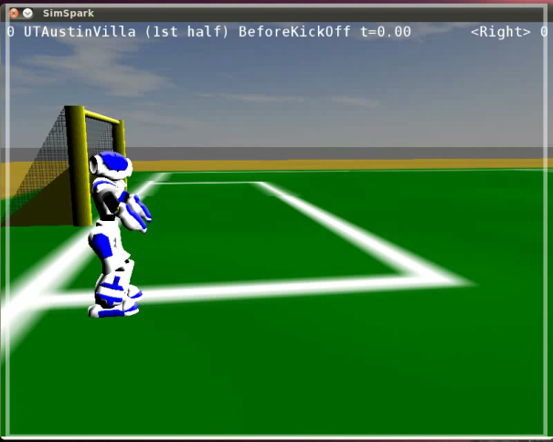
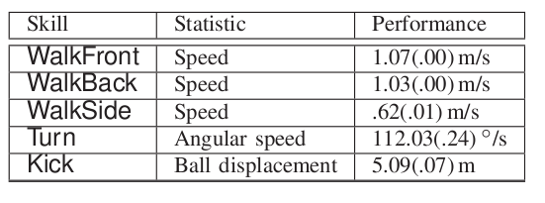
Results – Individual Skills

Slide 11
Front Walk

Slide 12
Back Walk

Slide 13
Kick

Slide 14
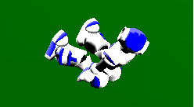

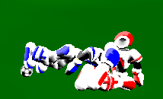
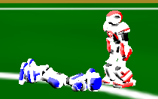
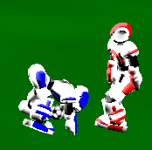
Optimizing Sequences of Skills
Problem: fast locomotion skills, when integrated directly into the robot, result in frequent falls.

Slide 15

Optimizing Sequences of Skills
Problem: fast locomotion skills, when integrated directly into the robot result in frequent falls.
An example skill execution log (32ms decision cycle):
Skills are interdependent: Learn them together
Skills dependencies graph:

Slide 16
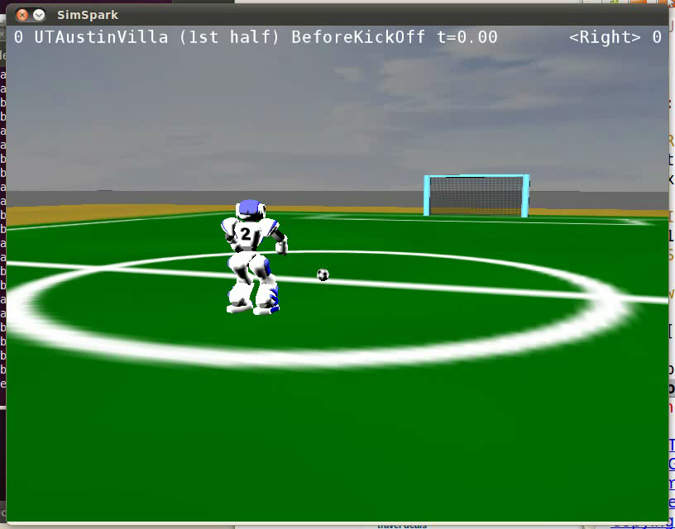
Idea 1: Optimize skills in conjunction
Want both speed and stability under these transitions:
Change the fitness evaluation method:
  Evaluation method should include all skill transitions
  But still reflect how good the currently-learned skill is
An ideal fitness evaluation: Full Game results
  But too noisy
An effective alternative:
  The time-to-score on an empty field
  No noise caused by other players
  Robot moves in a realistic scenario of skill
  transitions
  Evaluated based on its ultimate objective

Slide 17
A Problem
So far, optimized under these constraints
The need to transition smoothly from every skill to every skill limits our max-speed
Can we relax some constraints, thus achieving faster speeds?

Slide 18
Idea 2: Skill Decoupling
It turns out we can further optimize speed, by adding additional, less-constrained skills.
Add new skills, constrained by only one skill

Slide 19
Putting it all together
Agent A0 – initial seed
Agent A1 – WalkFront_S optimized
Agent A2 – WalkFront_F optimized
Agent A5 – Decision thresholds tuned
Agent A4 – WalkBack_F optimized
Agent A3 – WalkBack_S optimized
Notes:
what about the time to transition between slow and fast walk?
need for tuning?

Slide 20
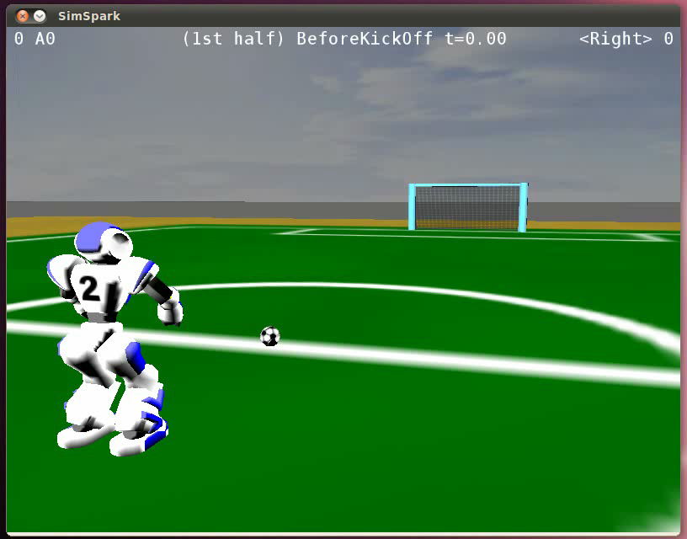
A0 vs. A5
A0
A5

Slide 21
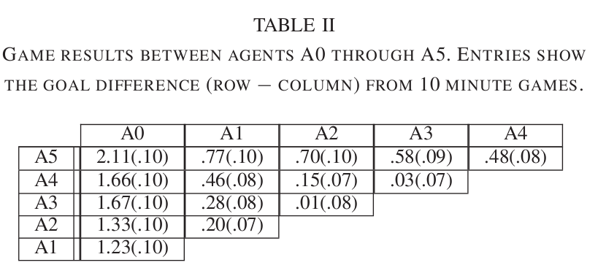
Results – Agents Improvements
Full 6x6 game results

Slide 22
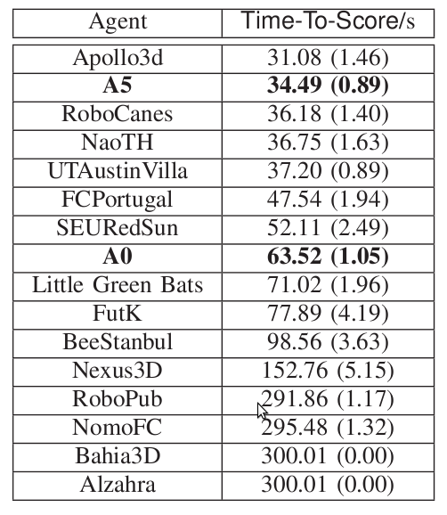
Results – Time-To-Score Measure

Slide 23
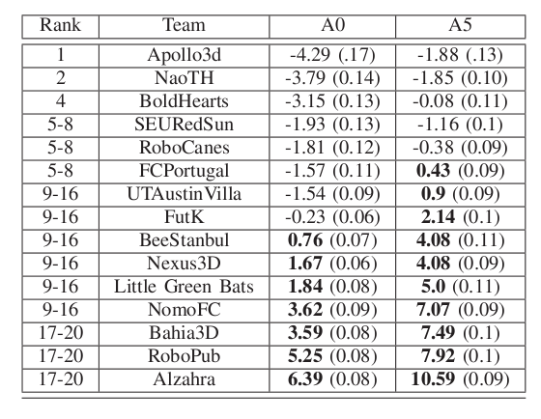
Results – Full Games
Goal Differential (stderr)
Notes:
Indicate “goal diff”

Slide 24
Future Work
Extend the scope of learning within our agent:
  Waiting times between frames
  Replace hand-coded skills: fine positioning, getting up
  Decision thresholds
Alternative parameterizations: closed-loop, inverse kinematics
Extend to real robots?

Slide 25
Related Work
N. Hansen. The CMA Evolution Strategy: A Tutorial, January 2009.
N. Shafii, L. P. Reis, and N. Lao. Biped walking using coronal and sagittal movements based on truncated Fourier series, January 2010.
J. E. Pratt. Exploiting Inherent Robustness and Natural Dynamics in the Control of Bipedal Walking Robots. PhD thesis, Massachusetts Institute of Technology, Cambridge, MA, USA, June 2000.
N. Kohl and P. Stone. Machine learning for fast quadrupedal locomotion, 2004.

Slide 26
Summary
We presented a learning architecture for a simulated humanoid robot soccer player
Optimized over 100 parameters
Used 2 ideas for improving speed while maintaining stability:
  Optimizing under constraints
  Skills decoupling
A main building block in our agent, which is competitive with Robocup 2010 top-8 teams
Found a new, successful application for the relatively new, CMA-ES algorithm

