Slide 1




Marginal Cost Pricing with a Fixed Error Factor in Traffic Networks
Guni Sharon, Stephen Boyles, Shani Alkoby, Peter Stone

Slide 2





Our objective
1 Hr
59 Min
Assign routes to drivers such that the total travel time is reduced

Slide 3
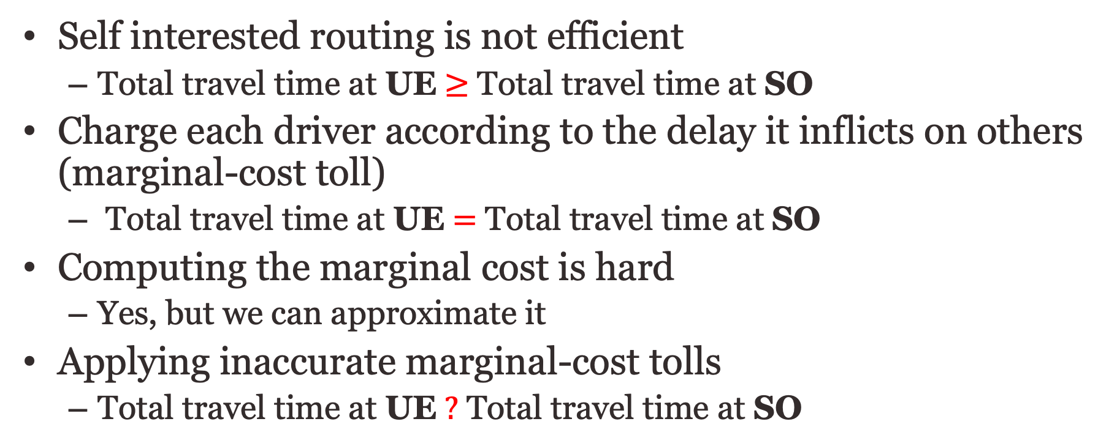
Overview
Self interested routing is not efficient
  Total travel time at UE $≥$ Total travel time at SO
Charge each driver according to the delay it inflicts on others (marginal-cost toll)
  Total travel time at UE $=$ Total travel time at SO
Computing the marginal cost is hard
  Yes, but we can approximate it
Applying inaccurate marginal-cost tolls
  Total travel time at UE $?$ Total travel time at SO

Slide 4
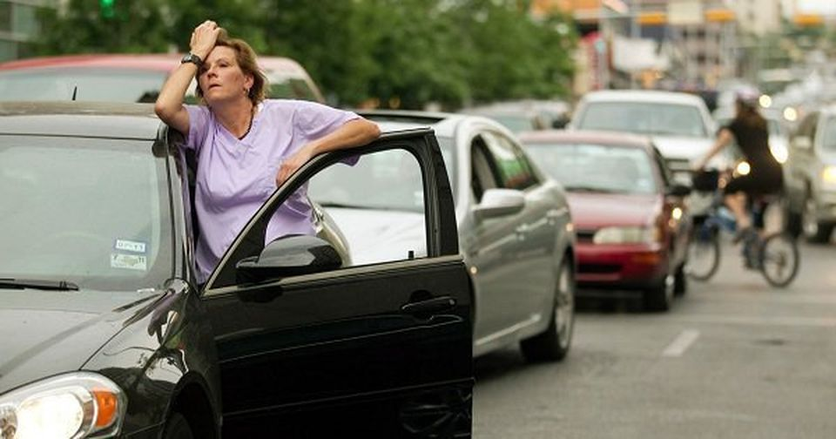
Background
Previous work showed significant reductions in travel time (up to 46%) when utilizing road pricing
  [Mirzaei et al., ITSC-2018; Hanna et al., AAAI-2019; Chen et al., AAAI-2018; Sharon et al., AAMAS-2017]
Why should we care?
  In the U.S. alone, congestion cost $305 billion per year (INRIX)
  1% reduction in traffic congestion = saving $billions

Slide 5
Marginal-cost tolls
Each driver pays his “social cost” (how much his existence hurts others)
When applying Marginal-Cost Toll
  UE and SO align [Pigou 1920; Beckmann et al. 1956; Braess 1969]
1$ delay
$1 delay
To: turtle
$2 toll

Slide 6
Computing MCT
MCT = the marginal delay that each agent will impose on all others
Requires exact knowledge of
  Future demand
  Roadway capacity conditions
  Counterfactual knowledge about traffic conditions without each vehicle
Exact solution is infeasible in real-life

Slide 7

Approximating MCT
A recent line of work proposed feasible MCT approximations
  [Sharon et al., 2017, Mirzaei et al., 2018, Hanna et al., 2019]
Known: MCT leads to optimal flow
What guarantees can we give for ~MCT ?
Promise me that traffic congestion will never worsen

Slide 8
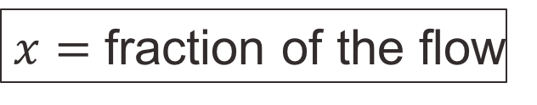
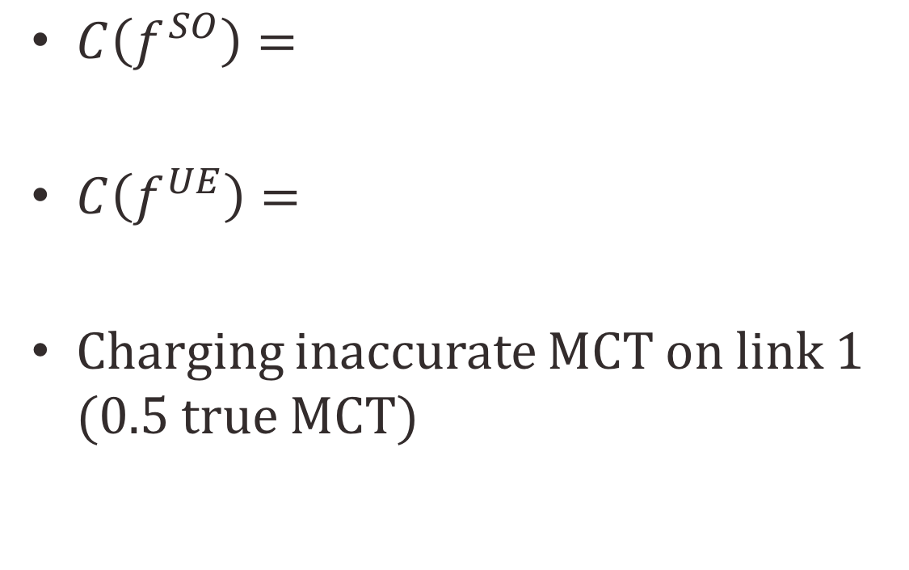


What can go wrong?
$C\left(f^{SO}\right)=$
$C\left(f^{UE}\right)=$
Charging inaccurate MCT on link 1 (0.5 true MCT)
$$l\left(x\right)=x$$
S
T
$$l\left(x\right)=x$$
$x=$ fraction of the flow

Slide 9
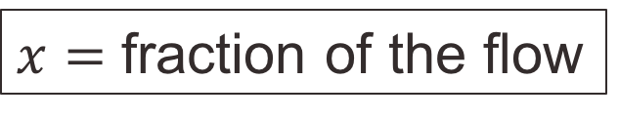

What can go wrong?
$C\left(f^{SO}\right)=0.5$
  ${l_{1}(f}_{1})+l_{1}^{′}\left(f_{1}\right)f_{1}={l_{2}(f}_{2})+l_{2}^{′}\left(f_{2}\right)f_{2}$
  $f_{1}=f_{2}=0.5$
$C\left(f^{UE}\right)=0.5$
  ${l_{1}(f}_{1})={l_{2}(f}_{2})$
  $f_{1}=f_{2}=0.5$
Charging inaccurate MCT on link 1
  ${l_{1}(f}_{1})+0.5l_{1}^{′}\left(f_{1}\right)f_{1}={l_{2}(f}_{2})+l_{2}^{′}\left(f_{2}\right)f_{2}$
  ${1.5f}_{1}={2f}_{2}→\frac{f_{1}}{f_{2}}=\frac{3}{4}$
  $C\left(f^{error}\right)={\left(\frac{3}{7}\right)}^{2}+{\left(\frac{4}{7}\right)}^{2}=\text{0.}\text{51 >} C\left(f^{UE}\right)$
$$l\left(x\right)=x$$
S
T
$$l\left(x\right)=x$$
$x=$ fraction of the flow

Slide 10
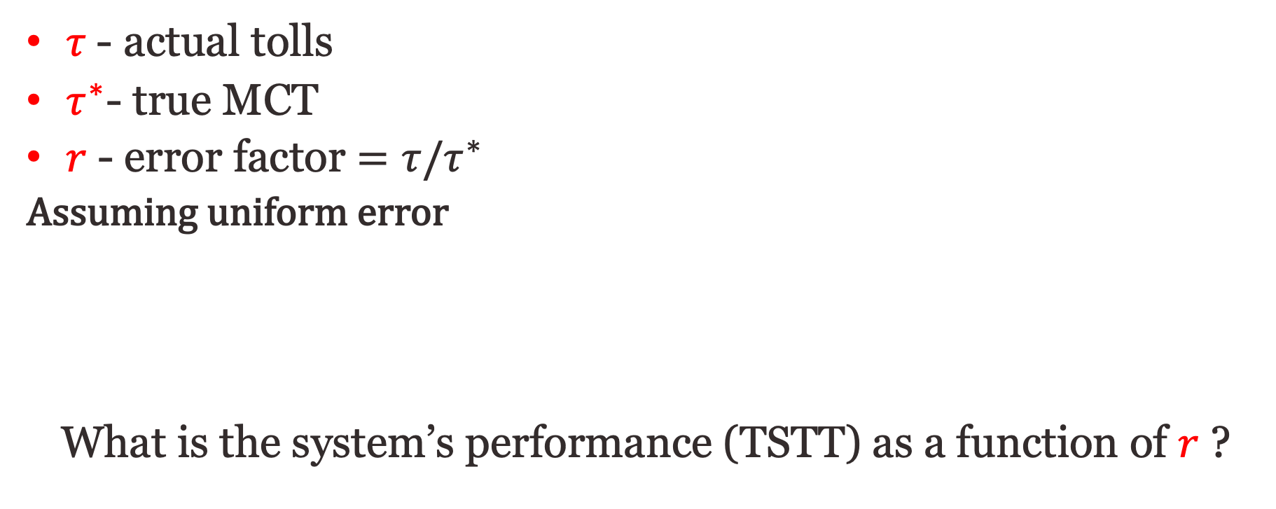
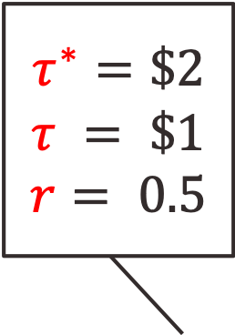
~MCT
$τ$- actual tolls
$τ^{∗}$- true MCT
$r$- error factor $=τ/τ^{∗}$
Assuming uniform error
What is the system’s performance (TSTT) as a function of $r$ ?
$$τ^{∗}=\$2$$
$$τ = \$1$$
$$r= 0.5$$
1$ delay
$1 delay

Slide 11
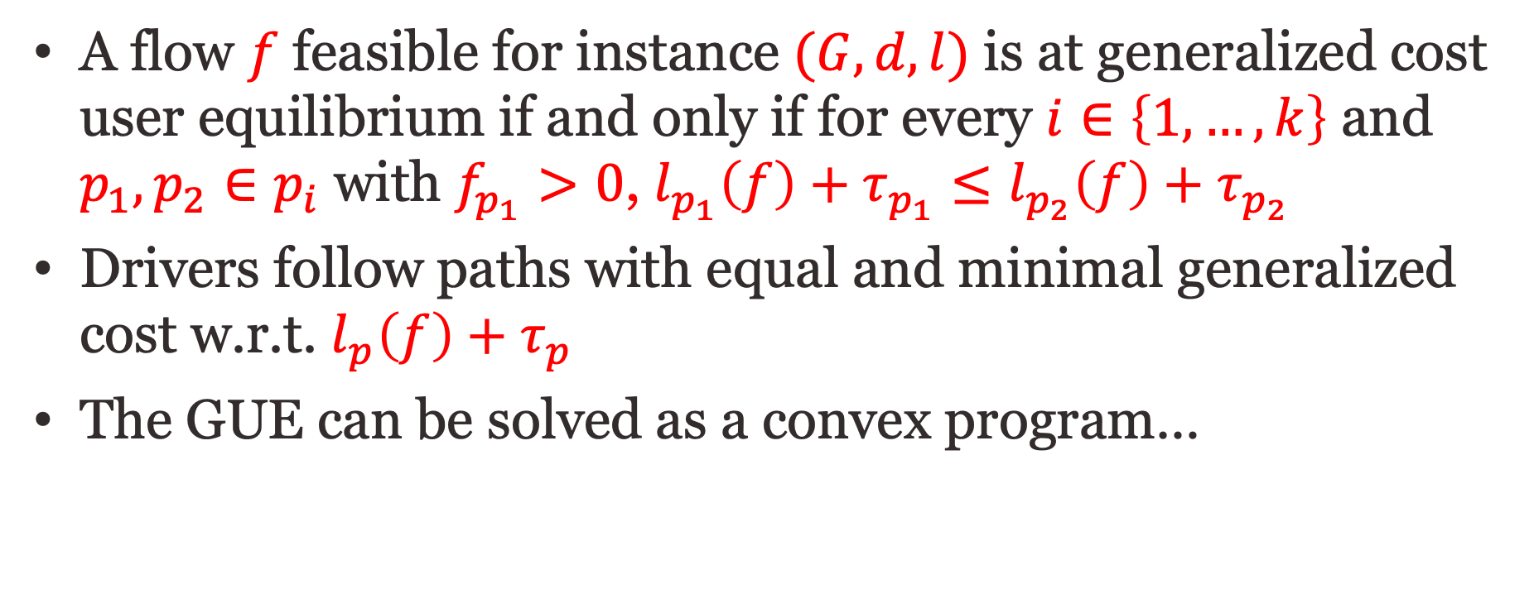
Generalized cost UE (GUE)
A flow $f$ feasible for instance $(G,d,l)$ is at generalized cost user equilibrium if and only if for every $i∈\left\{1,…,k\right\}$ and $p_{1},p_{2}∈p_{i}$ with $f_{p_{1}}>0$, $l_{p_{1}}\left(f\right)+τ_{p_{1}}≤l_{p_{2}}\left(f\right)+τ_{p_{2}}$
Drivers follow paths with equal and minimal generalized cost w.r.t. $l_{p}\left(f\right)+τ_{p}$
The GUE can be solved as a convex program…

Slide 12
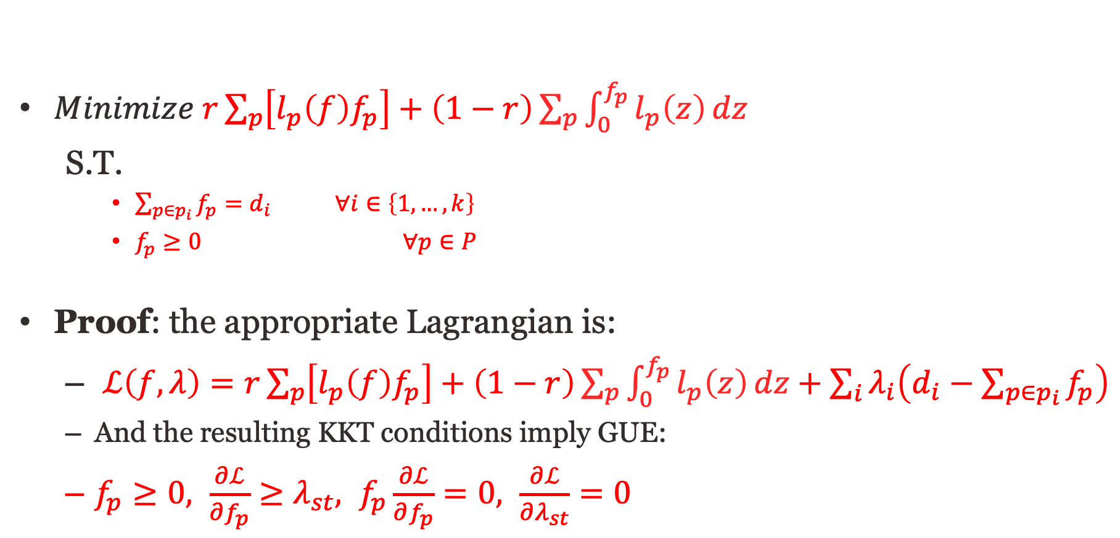
GUE as a convex program
$Minimize r\sum_{p}{\left[l_{p}\left(f\right)f_{p}\right]}+\left(1−r\right)\sum_{p}{\int_{0}^{f_{p}}{l_{p}\left(z\right)}dz}$
S.T.
    $\sum_{p∈p_{i}}{f_{p}}=d_{i} ∀i∈\left\{1,…,k\right\}$
    $f_{p}≥0 ∀p∈P$
Proof: the appropriate Lagrangian is:
  $ℒ\left(f,λ\right)=r\sum_{p}{\left[l_{p}\left(f\right)f_{p}\right]+\left(1−r\right)\sum_{p}{\int_{0}^{f_{p}}{l_{p}\left(z\right)}dz}+\sum_{i}{λ_{i}\left(d_{i}−\sum_{p∈p_{i}}{f_{p}}\right)}}$
  And the resulting KKT conditions imply GUE:
  $f_{p}≥0, \frac{∂ℒ}{∂f_{p}}≥λ_{st}, f_{p}\frac{∂ℒ}{∂f_{p}}=0, \frac{∂ℒ}{∂λ_{st}}=0$
GUE is a linear combination between the SO objective and UE objective (Beckman’s formulation)

Slide 13
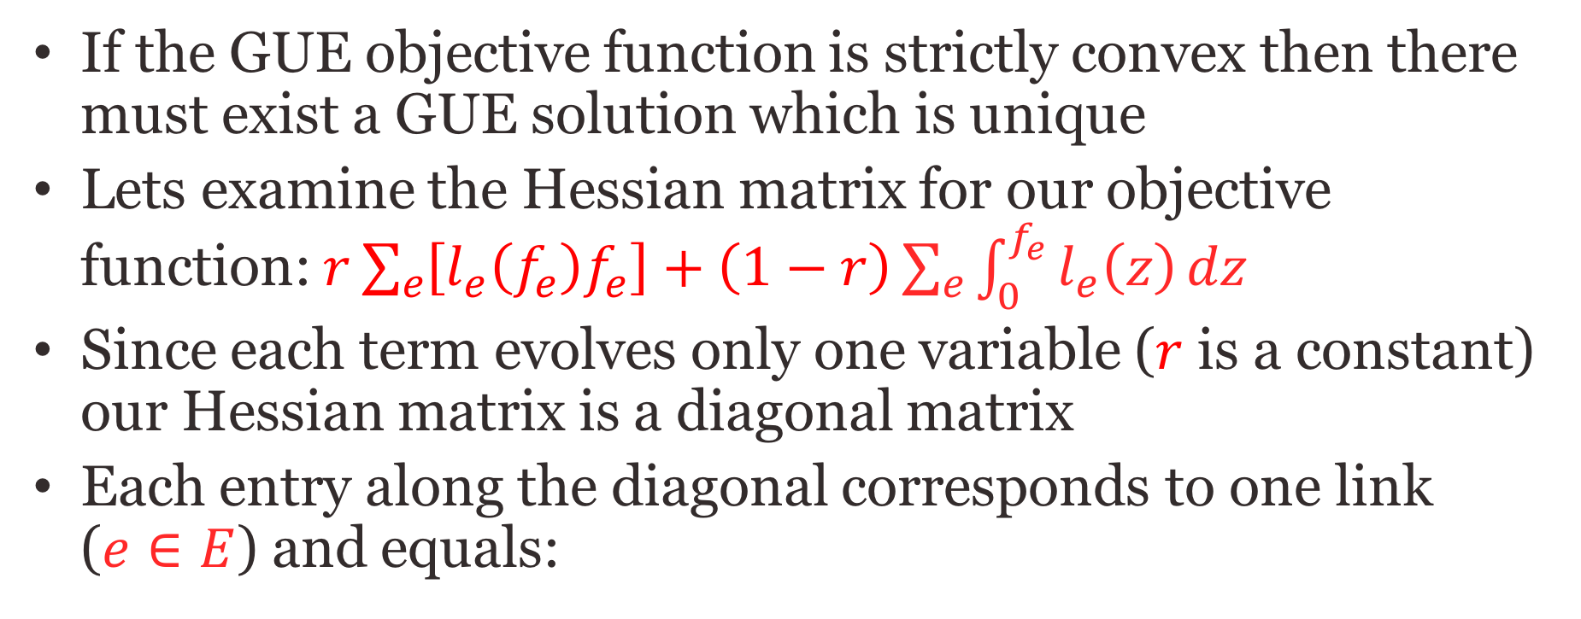
Existence of GUE flow
If the GUE objective function is strictly convex then there must exist a GUE solution which is unique
Lets examine the Hessian matrix for our objective function: $r\sum_{e}{\left[l_{e}\left(f_{e}\right)f_{e}\right]}+\left(1−r\right)\sum_{e}{\int_{0}^{f_{e}}{l_{e}\left(z\right)}dz}$
Since each term evolves only one variable ($r$ is a constant) our Hessian matrix is a diagonal matrix
Each entry along the diagonal corresponds to one link ($e∈E$) and equals:

Slide 14
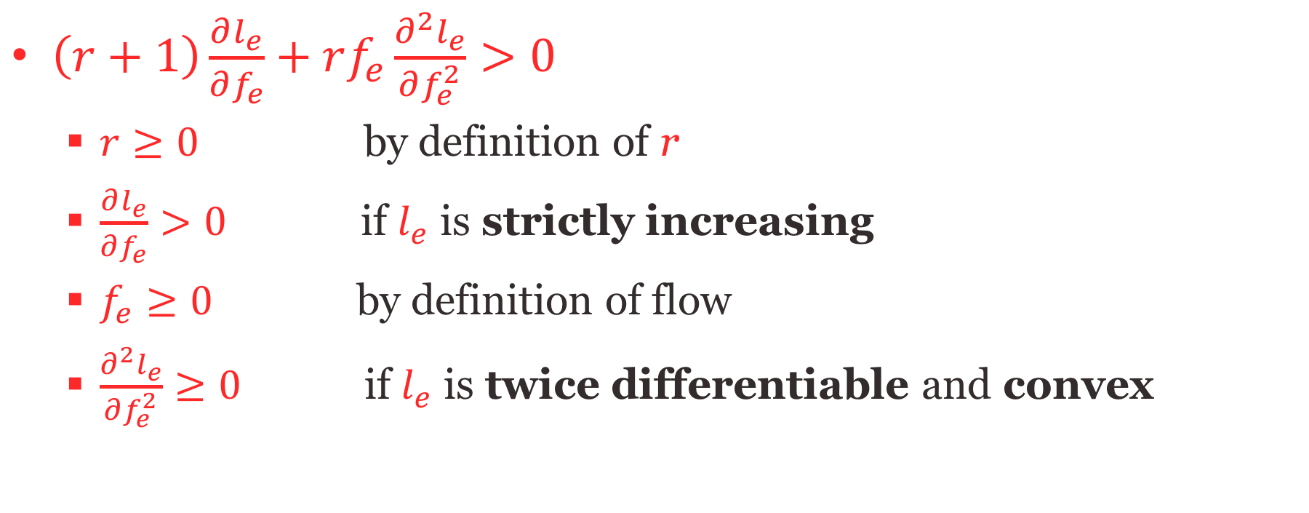
Existence of GUE flow
$\left(r+1\right)\frac{∂l_{e}}{∂f_{e}}+rf_{e}\frac{∂^{2}l_{e}}{∂f_{e}^{2}}>0$
  $r≥0$ by definition of r
  $\frac{∂l_{e}}{∂f_{e}}>0$ if $l_{e}$ is strictly increasing
  $f_{e}≥0$ by definition of flow
  $\frac{∂^{2}l_{e}}{∂f_{e}^{2}}≥0$ if $l_{e}$ is twice differentiable and convex

Slide 15
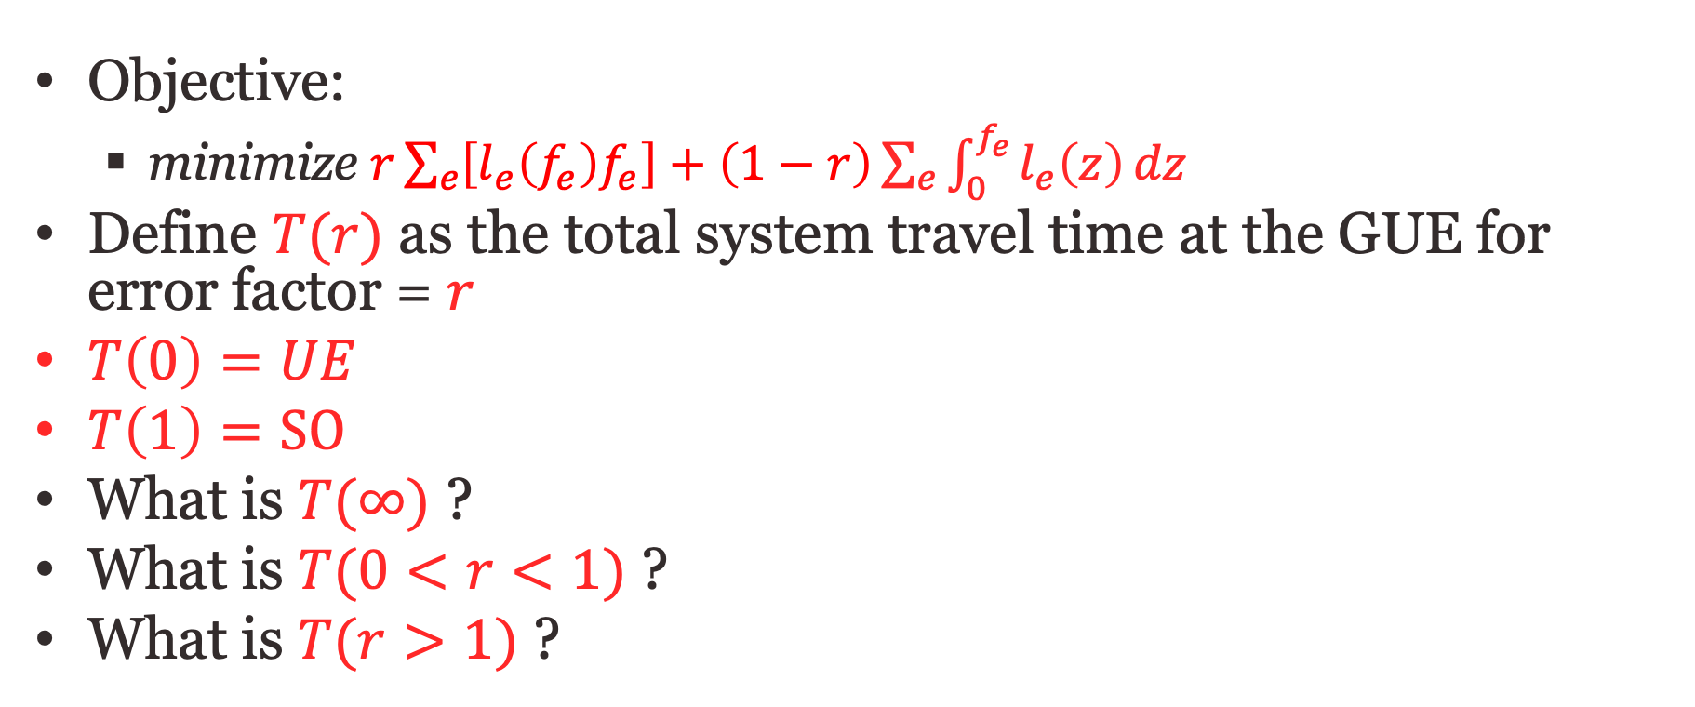
Attributes of a GUE
Objective:
  minimize $r\sum_{e}{\left[l_{e}\left(f_{e}\right)f_{e}\right]}+\left(1−r\right)\sum_{e}{\int_{0}^{f_{e}}{l_{e}\left(z\right)}dz}$
Define $T(r)$ as the total system travel time at the GUE for error factor = $r$
$T\left(0\right)=UE$
$T\left(1\right)=SO$
What is $T(∞)$ ?
What is $T(0<r<1)$ ?
What is $T(r>1)$ ?

Slide 16


Error in MCT
$$r→∞$$
UE
$$×$$
$$×$$
$$×$$
SO

Slide 17
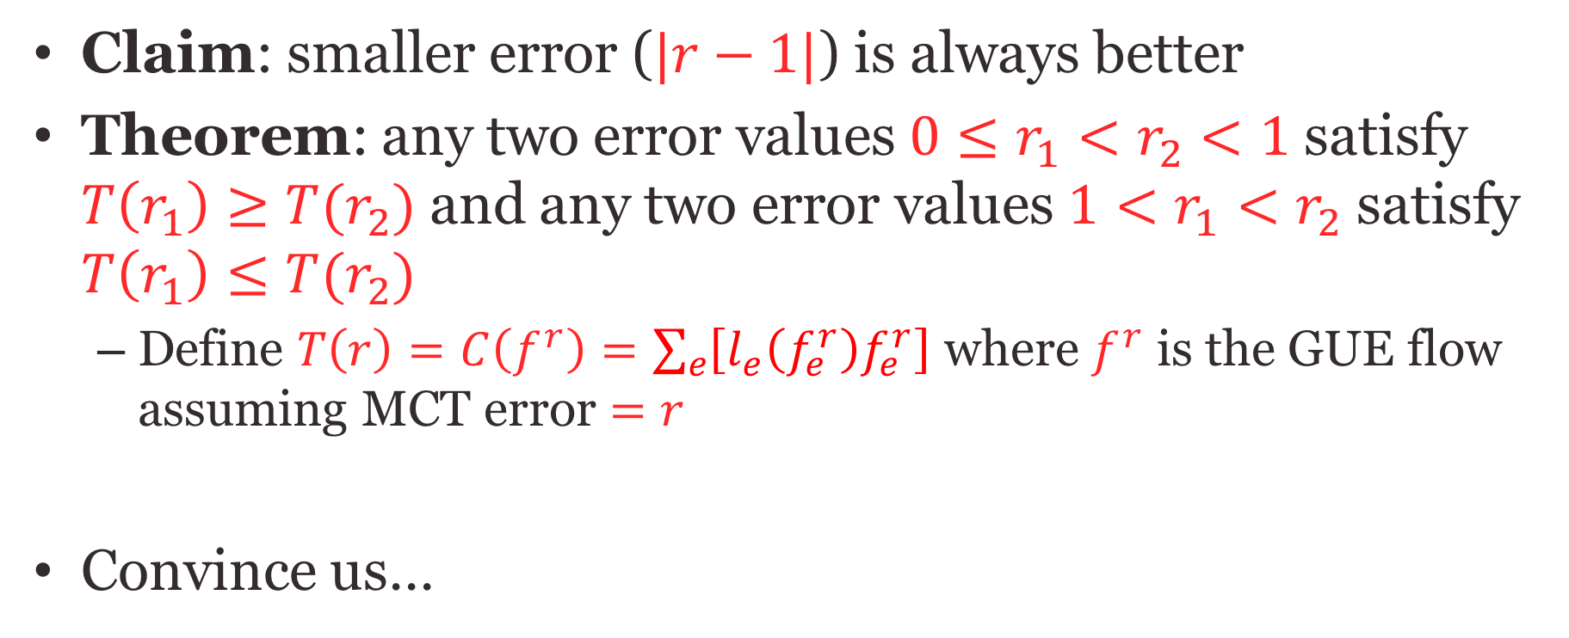
Error in MCT
Claim: smaller error ($|r−1|$) is always better
Theorem: any two error values $0≤r_{1}<r_{2}<1$satisfy $T\left(r_{1}\right)≥T(r_{2})$ and any two error values $1<r_{1}<r_{2}$ satisfy $T\left(r_{1}\right)≤T(r_{2})$
  Define $T\left(r\right)=C\left(f^{r}\right)=\sum_{e}{\left[l_{e}\left(f_{e}^{r}\right)f_{e}^{r}\right]}$ where $f^{r}$ is the GUE flow assuming MCT error $=r$
Convince us…

Slide 18
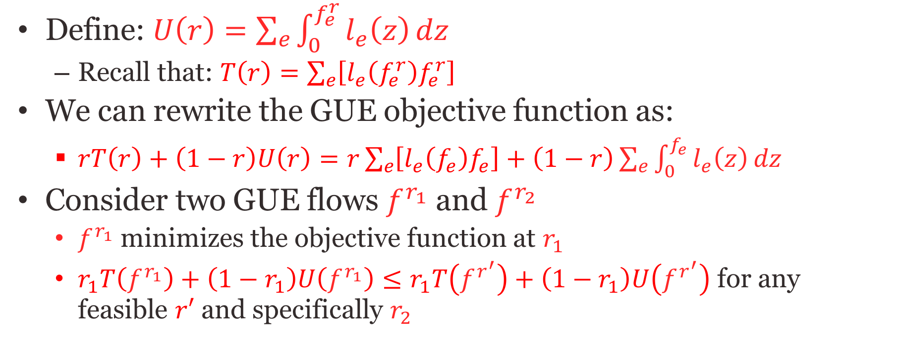
I’ll convince you
Define: $U\left(r\right)=\sum_{e}{\int_{0}^{f_{e}^{r}}{l_{e}\left(z\right)}dz}$
  Recall that: $T\left(r\right)=\sum_{e}{\left[l_{e}\left(f_{e}^{r}\right)f_{e}^{r}\right]}$
We can rewrite the GUE objective function as:
  $rT\left(r\right)+\left(1−r\right)U\left(r\right)=r\sum_{e}{\left[l_{e}\left(f_{e}\right)f_{e}\right]}+\left(1−r\right)\sum_{e}{\int_{0}^{f_{e}}{l_{e}\left(z\right)}dz}$
Consider two GUE flows $f^{r_{1}}$ and $f^{r_{2}}$
  $f^{r_{1}}$ minimizes the objective function at $r_{1}$
  $r_{1}T\left(f^{r_{1}}\right)+\left(1−r_{1}\right)U\left(f^{r_{1}}\right)≤r_{1}T\left(f^{r^{′}}\right)+\left(1−r_{1}\right)U\left(f^{r^{′}}\right)$ for any feasible $r′$ and specifically $r_{2}$

Slide 19
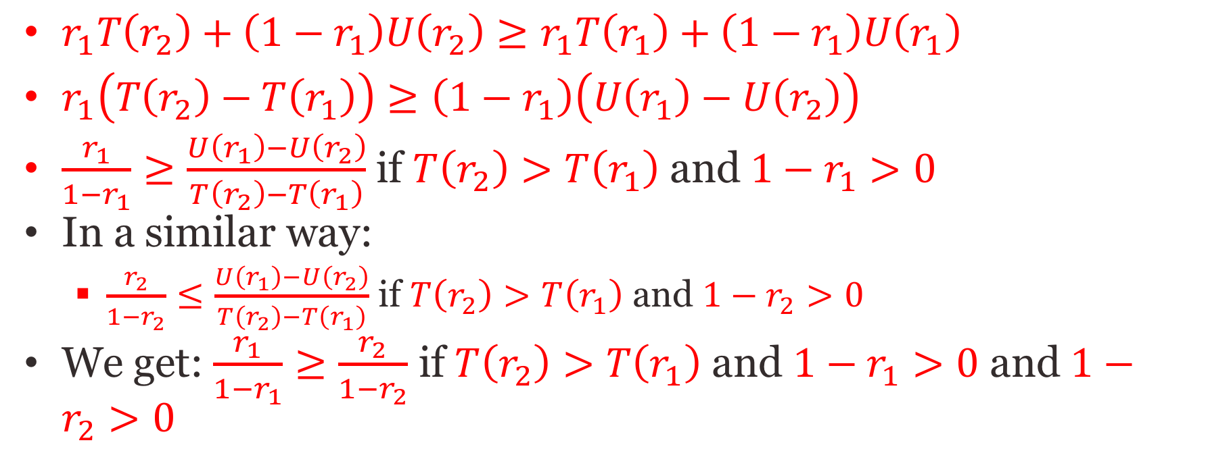
Smaller error is better
$r_{1}T\left(r_{2}\right)+\left(1−r_{1}\right)U\left(r_{2}\right)≥r_{1}T\left(r_{1}\right)+\left(1−r_{1}\right)U\left(r_{1}\right)$
$r_{1}\left(T\left(r_{2}\right)−T\left(r_{1}\right)\right)≥\left(1−r_{1}\right)\left(U\left(r_{1}\right)−U\left(r_{2}\right)\right)$
$\frac{r_{1}}{1−r_{1}}≥\frac{U\left(r_{1}\right)−U\left(r_{2}\right)}{T\left(r_{2}\right)−T\left(r_{1}\right)}$ if $T\left(r_{2}\right)>T\left(r_{1}\right)$ and $1−r_{1}>0$
In a similar way:
  $\frac{r_{2}}{1−r_{2}}≤\frac{U\left(r_{1}\right)−U\left(r_{2}\right)}{T\left(r_{2}\right)−T\left(r_{1}\right)}$ if $T\left(r_{2}\right)>T\left(r_{1}\right)$ and $1−r_{2}>0$
We get: $\frac{r_{1}}{1−r_{1}}≥\frac{r_{2}}{1−r_{2}}$ if $T\left(r_{2}\right)>T\left(r_{1}\right)$ and $1−r_{1}>0$ and $1−r_{2}>0$

Slide 20
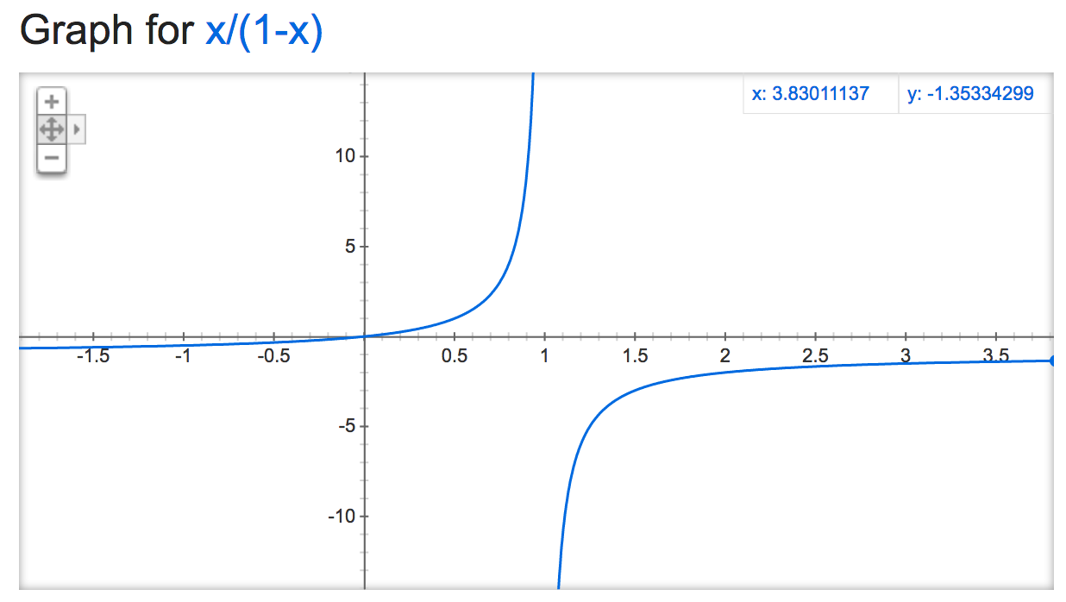
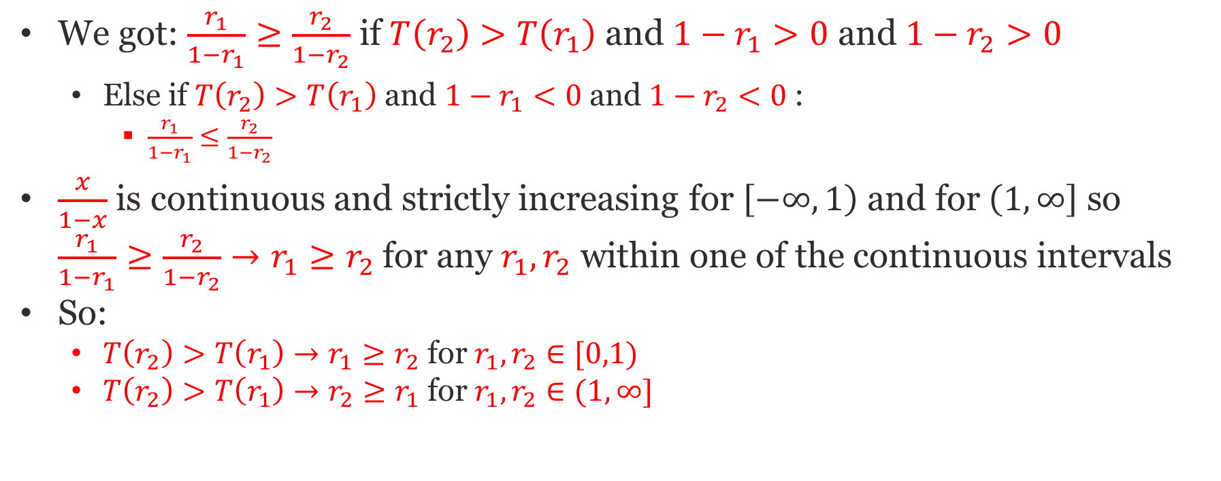
Smaller error is better
We got: $\frac{r_{1}}{1−r_{1}}≥\frac{r_{2}}{1−r_{2}}$ if $T\left(r_{2}\right)>T\left(r_{1}\right)$ and $1−r_{1}>0$ and $1−r_{2}>0$
  Else if $T\left(r_{2}\right)>T\left(r_{1}\right)$ and $1−r_{1}<0$ and $1−r_{2}<0$ :
    $\frac{r_{1}}{1−r_{1}}≤\frac{r_{2}}{1−r_{2}}$
$\frac{x}{1−x}$ is continuous and strictly increasing for $\left[−∞,1\right)$ and for $\left(1,∞\right]$ so $\frac{r_{1}}{1−r_{1}}≥\frac{r_{2}}{1−r_{2}}→r_{1}≥r_{2}$ for any $r_{1},r_{2}$ within one of the continuous intervals
So:
  $T\left(r_{2}\right)>T\left(r_{1}\right)→r_{1}≥r_{2}$ for $r_{1},r_{2}∈[0,1)$
  $T\left(r_{2}\right)>T\left(r_{1}\right)→r_{2}≥r_{1}$ for $r_{1},r_{2}∈(1,∞]$

Slide 21
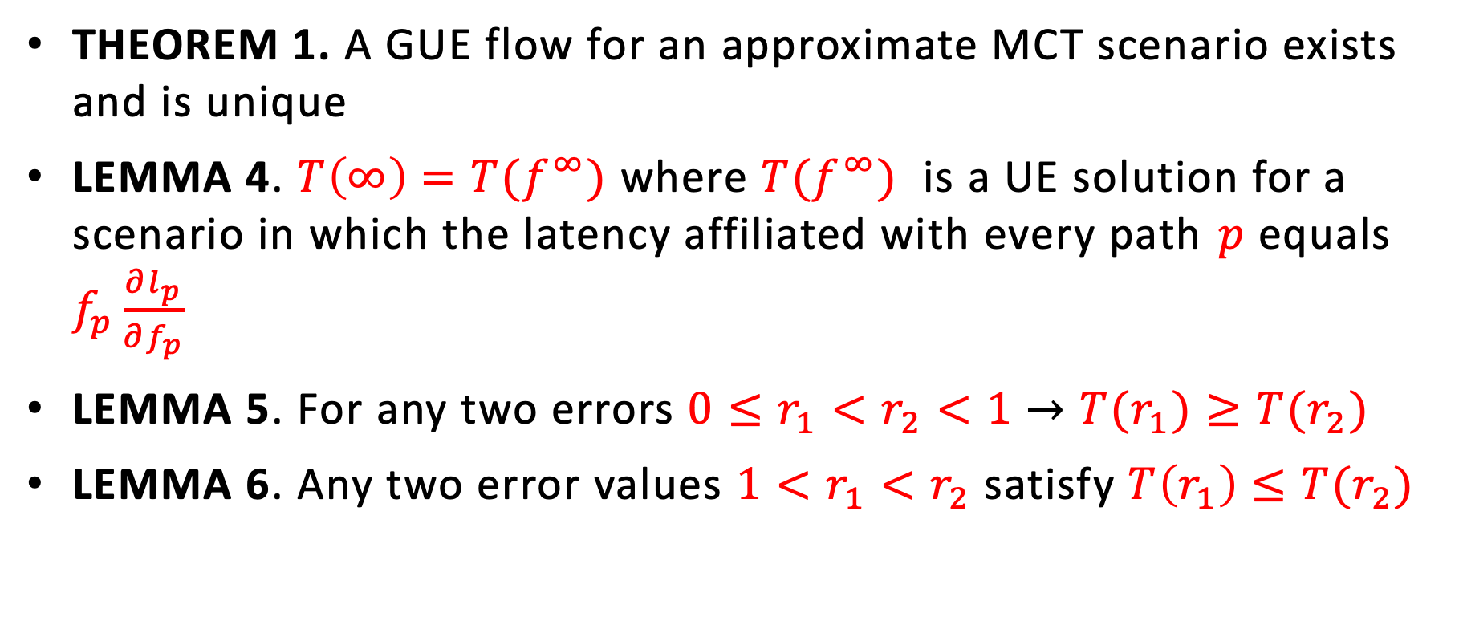
The paper proves:
THEOREM 1. A GUE flow for an approximate MCT scenario exists and is unique
LEMMA 4. $T\left(∞\right)=T(f^{∞})$where $T(f^{∞})$ is a UE solution for a scenario in which the latency affiliated with every path $p$ equals $f_{p}\frac{∂l_{p}}{∂f_{p}}$
LEMMA 5. For any two errors $0≤r_{1}<r_{2}<1$ $→$ $T(r_{1})≥T(r_{2})$
LEMMA 6. Any two error values $1<r_{1}<r_{2}$satisfy $T\left(r_{1}\right)≤T(r_{2})$

Slide 22




As a result:
$$r→∞$$
UE
$$×$$
$$×$$
$$×$$
SO

Slide 23
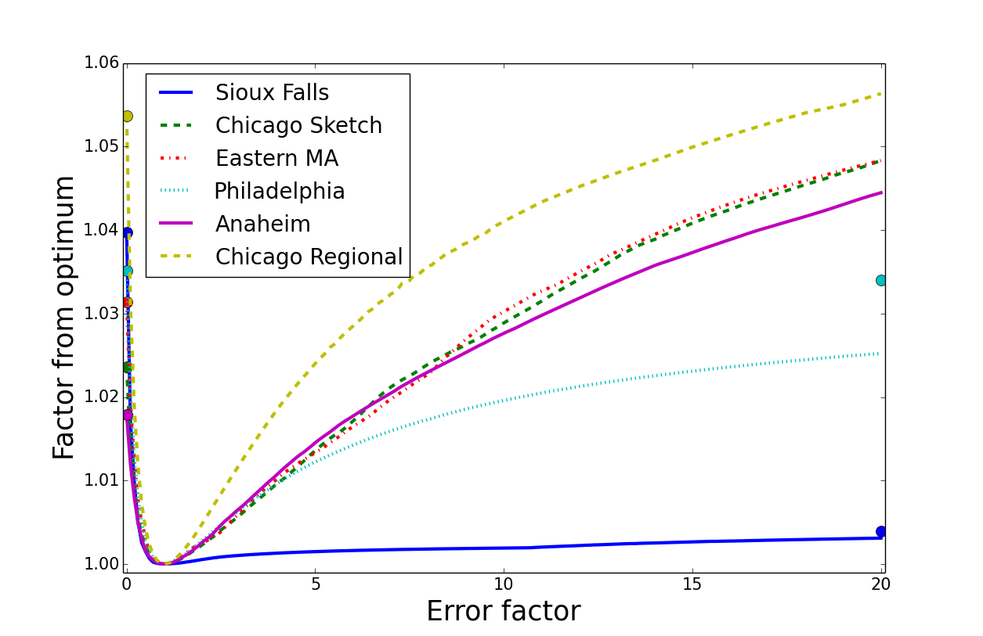
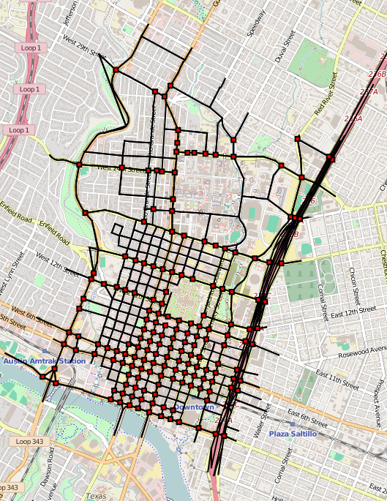
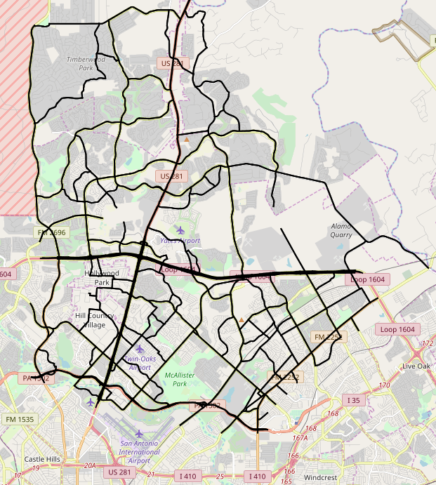
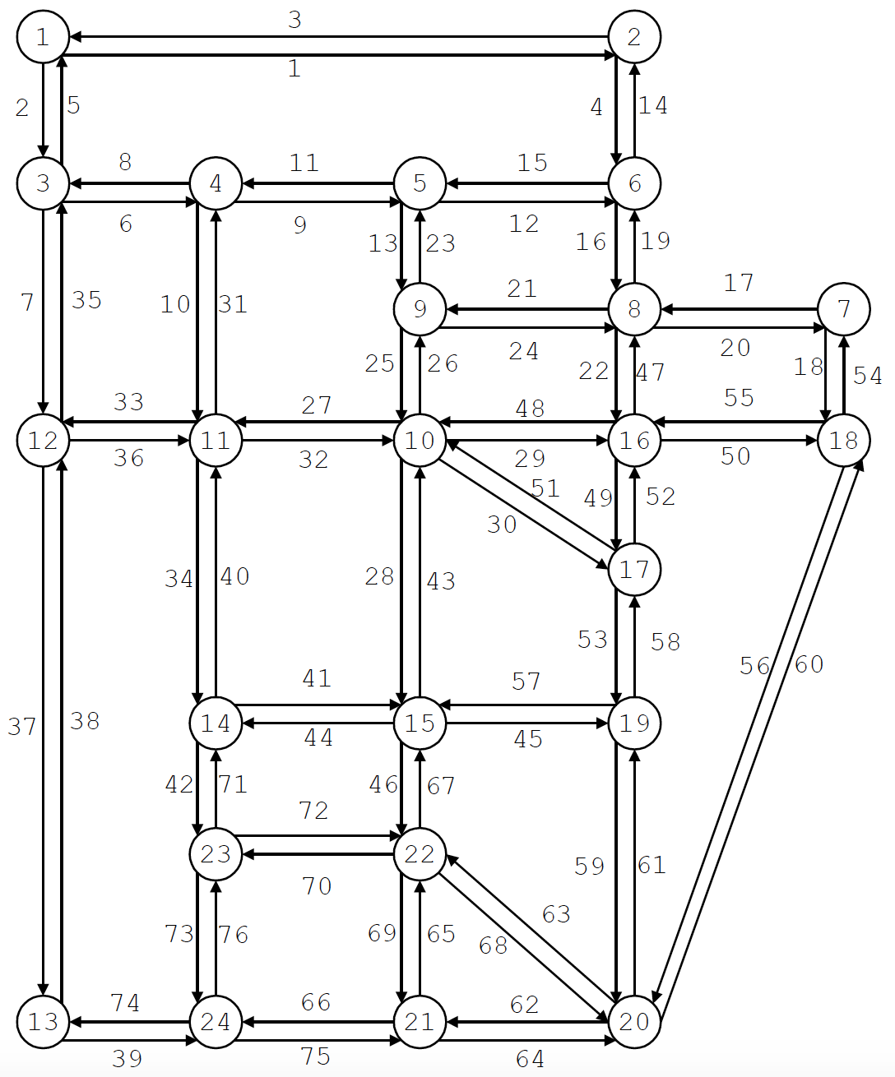
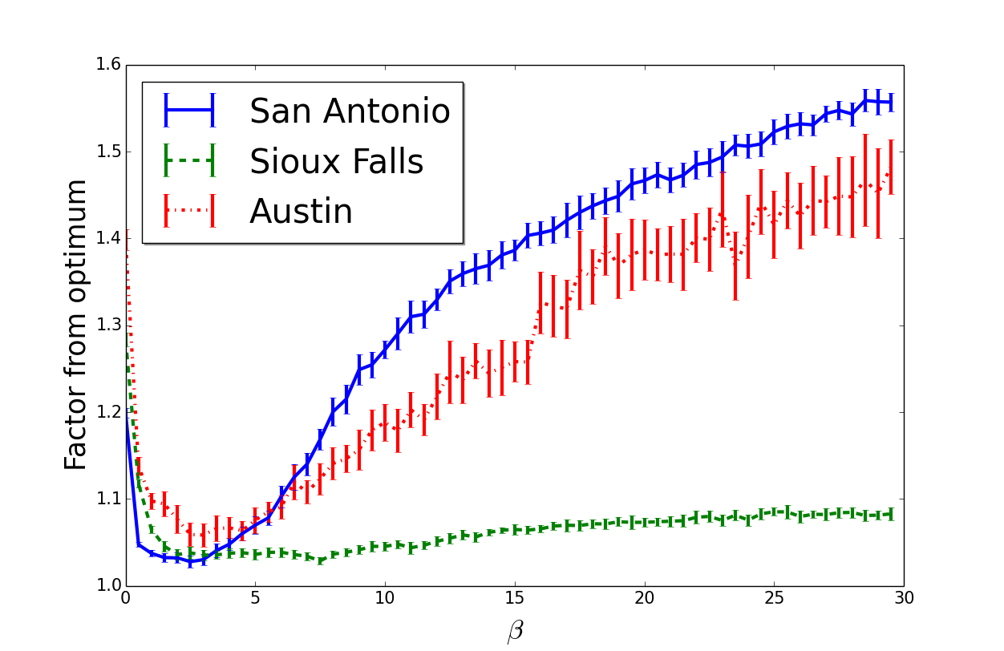
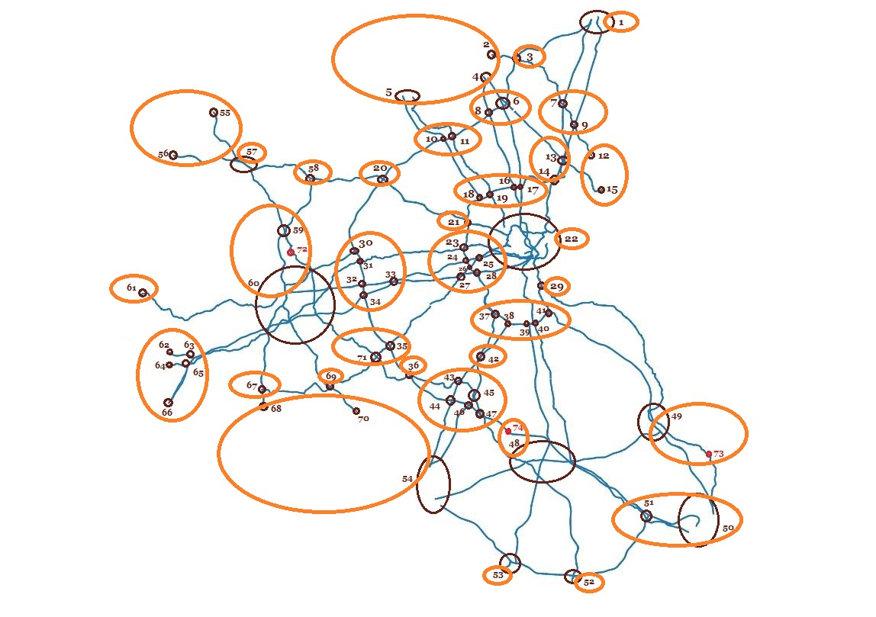
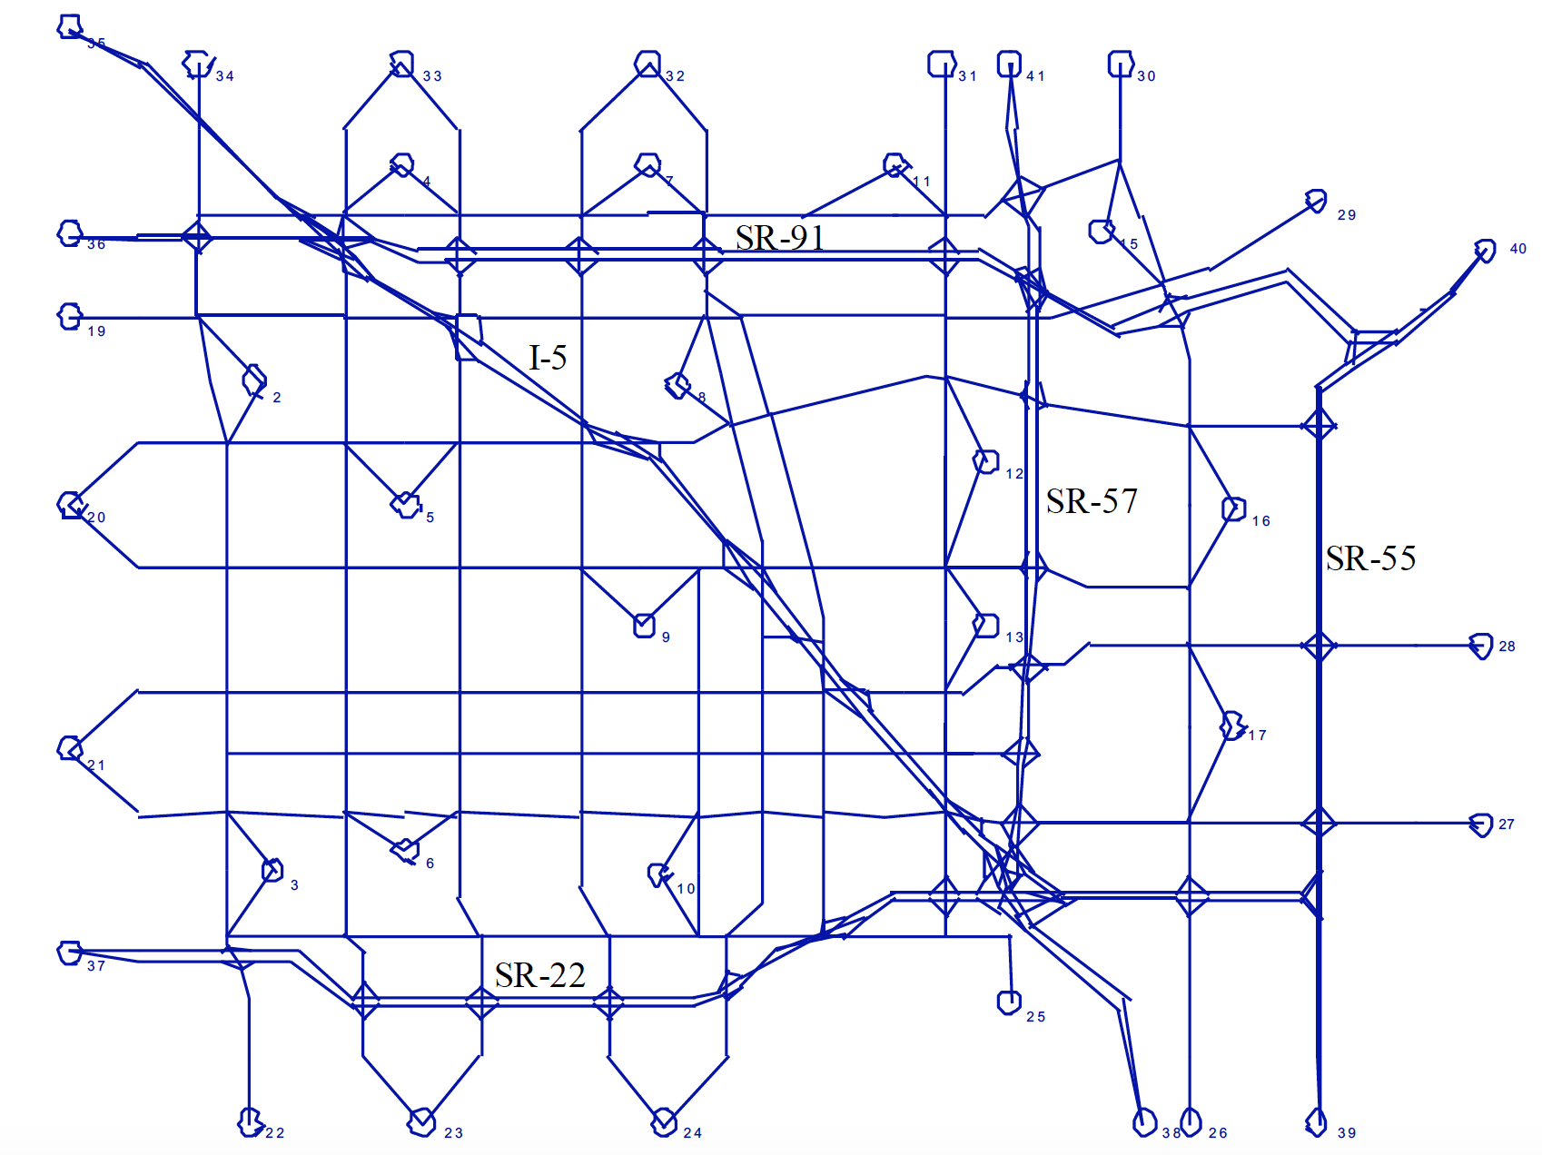
Our theory is backed empirically
DTA

Slide 24
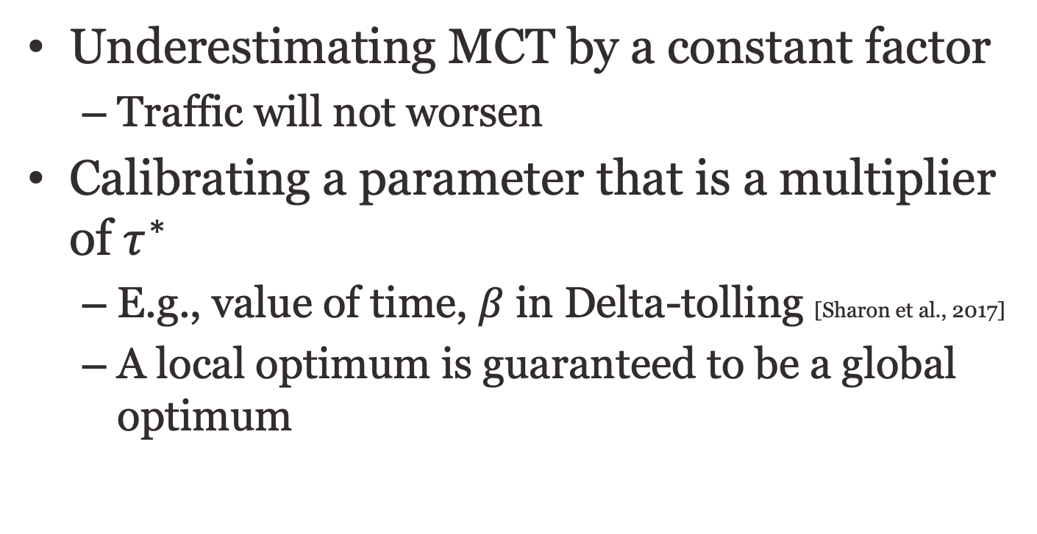
Conclusions:
I’m convinced
Underestimating MCT by a constant factor
  Traffic will not worsen
Calibrating a parameter that is a multiplier of $τ^{∗}$
  E.g., value of time, $β$ in Delta-tolling [Sharon et al., 2017]
  A local optimum is guaranteed to be a global optimum

Slide 25
Appendix

Slide 26
Non-uniform error?
$C\left(f^{SO}\right)=$
$C\left(f^{UE}\right)=$
Charging inaccurate MCT on link 1 (0.5 true MCT)
$$l\left(x\right)=x$$
S
T
$$l\left(x\right)=x$$
$x=$ fraction of the flow

Slide 27
What can go wrong?
$C\left(f^{SO}\right)=0.5$
  ${l_{1}(f}_{1})+l_{1}^{′}\left(f_{1}\right)f_{1}={l_{2}(f}_{2})+l_{2}^{′}\left(f_{2}\right)f_{2}$
  $f_{1}=f_{2}=0.5$
$C\left(f^{UE}\right)=0.5$
  ${l_{1}(f}_{1})={l_{2}(f}_{2})$
  $f_{1}=f_{2}=0.5$
Charging inaccurate MCT on link 1
  ${l_{1}(f}_{1})+0.5l_{1}^{′}\left(f_{1}\right)f_{1}={l_{2}(f}_{2})+l_{2}^{′}\left(f_{2}\right)f_{2}$
  ${1.5f}_{1}={2f}_{2}→\frac{f_{1}}{f_{2}}=\frac{3}{4}$
  $C\left(f^{error}\right)={\left(\frac{3}{7}\right)}^{2}+{\left(\frac{4}{7}\right)}^{2}=\text{0.}\text{51 >} C\left(f^{UE}\right)$
$$l\left(x\right)=x$$
S
T
$$l\left(x\right)=x$$
$x=$ fraction of the flow

Slide 28
Existence of GUE flow
If the GUE objective function is strictly convex then there must exist a GUE solution which is unique
Lets examine the Hessian matrix for our objective function: $r\sum_{e}{\left[l_{e}\left(f_{e}\right)f_{e}\right]}+\left(1−r\right)\sum_{e}{\int_{0}^{f_{e}}{l_{e}\left(z\right)}dz}$
Since each term evolves only one variable ($r$ is a constant) our Hessian matrix is a diagonal matrix
Each entry along the diagonal corresponds to one link ($e∈E$) and equals:

Slide 29
Existence of GUE flow
$\left(r+1\right)\frac{∂l_{e}}{∂f_{e}}+rf_{e}\frac{∂^{2}l_{e}}{∂f_{e}^{2}}>0$
  $r≥0$ by definition of r
  $\frac{∂l_{e}}{∂f_{e}}>0$ if $l_{e}$ is strictly increasing
  $f_{e}≥0$ by definition of flow
  $\frac{∂^{2}l_{e}}{∂f_{e}^{2}}≥0$ if $l_{e}$ is twice differentiable and convex

Slide 30
Error in MCT
Claim: smaller error ($|r−1|$) is always better
Theorem: any two error values $0≤r_{1}<r_{2}<1$satisfy $T\left(r_{1}\right)≥T(r_{2})$ and any two error values $1<r_{1}<r_{2}$ satisfy $T\left(r_{1}\right)≤T(r_{2})$
  Define $T\left(r\right)=C\left(f^{r}\right)=\sum_{e}{\left[l_{e}\left(f_{e}^{r}\right)f_{e}^{r}\right]}$ where $f^{r}$ is the GUE flow assuming MCT error $=r$
Convince us…

Slide 31
I’ll convince you
Define: $U\left(r\right)=\sum_{e}{\int_{0}^{f_{e}^{r}}{l_{e}\left(z\right)}dz}$
  Recall that: $T\left(r\right)=\sum_{e}{\left[l_{e}\left(f_{e}^{r}\right)f_{e}^{r}\right]}$
We can rewrite the GUE objective function as:
  $rT\left(r\right)+\left(1−r\right)U\left(r\right)=r\sum_{e}{\left[l_{e}\left(f_{e}\right)f_{e}\right]}+\left(1−r\right)\sum_{e}{\int_{0}^{f_{e}}{l_{e}\left(z\right)}dz}$
Consider two GUE flows $f^{r_{1}}$ and $f^{r_{2}}$
  $f^{r_{1}}$ minimizes the objective function at $r_{1}$
  $r_{1}T\left(f^{r_{1}}\right)+\left(1−r_{1}\right)U\left(f^{r_{1}}\right)≤r_{1}T\left(f^{r^{′}}\right)+\left(1−r_{1}\right)U\left(f^{r^{′}}\right)$ for any feasible $r′$ and specifically $r_{2}$

Slide 32
Smaller error is better
$r_{1}T\left(r_{2}\right)+\left(1−r_{1}\right)U\left(r_{2}\right)≥r_{1}T\left(r_{1}\right)+\left(1−r_{1}\right)U\left(r_{1}\right)$
$r_{1}\left(T\left(r_{2}\right)−T\left(r_{1}\right)\right)≥\left(1−r_{1}\right)\left(U\left(r_{1}\right)−U\left(r_{2}\right)\right)$
$\frac{r_{1}}{1−r_{1}}≥\frac{U\left(r_{1}\right)−U\left(r_{2}\right)}{T\left(r_{2}\right)−T\left(r_{1}\right)}$ if $T\left(r_{2}\right)>T\left(r_{1}\right)$ and $1−r_{1}>0$
In a similar way:
  $\frac{r_{2}}{1−r_{2}}≤\frac{U\left(r_{1}\right)−U\left(r_{2}\right)}{T\left(r_{2}\right)−T\left(r_{1}\right)}$ if $T\left(r_{2}\right)>T\left(r_{1}\right)$ and $1−r_{2}>0$
We get: $\frac{r_{1}}{1−r_{1}}≥\frac{r_{2}}{1−r_{2}}$ if $T\left(r_{2}\right)>T\left(r_{1}\right)$ and $1−r_{1}>0$ and $1−r_{2}>0$

Slide 33
Smaller error is better
We got: $\frac{r_{1}}{1−r_{1}}≥\frac{r_{2}}{1−r_{2}}$ if $T\left(r_{2}\right)>T\left(r_{1}\right)$ and $1−r_{1}>0$ and $1−r_{2}>0$
  Else if $T\left(r_{2}\right)>T\left(r_{1}\right)$ and $1−r_{1}<0$ and $1−r_{2}<0$ :
    $\frac{r_{1}}{1−r_{1}}≤\frac{r_{2}}{1−r_{2}}$
$\frac{x}{1−x}$ is continuous and strictly increasing for $\left[−∞,1\right)$ and for $\left(1,∞\right]$ so $\frac{r_{1}}{1−r_{1}}≥\frac{r_{2}}{1−r_{2}}→r_{1}≥r_{2}$ for any $r_{1},r_{2}$ within one of the continuous intervals
So:
  $T\left(r_{2}\right)>T\left(r_{1}\right)→r_{1}≥r_{2}$ for $r_{1},r_{2}∈[0,1)$
  $T\left(r_{2}\right)>T\left(r_{1}\right)→r_{2}≥r_{1}$ for $r_{1},r_{2}∈(1,∞]$

