Slide 1



Scalable Multi-Agent Driving Policies For Reducing Traffic Congestion
Jiaxun Cui, William Macke, Harel Yedidsion, Daniel Urieli, Peter Stone
Learning Agent Research Group
The University of Texas at Austin
General Motors
Sony AI
Notes:
Hi and thank you for the introduction, before I present our work I would like to say that we are very excited about this collaboration, as Berkley’s Flow project has been the inspiration and the foundation for our research. And I would like to thank Daniel Urieli and GM for their support. This work on MULTI-AGENT DRIVING POLICY FOR CONGESTION REDUCTION IN A LARGE-SCALE SCENARIO has been partly presented in the NeurIPS workshop on ML4AD, and has been accepted for publication in AAMAS 2021.

Slide 2


Slide 3
E. Vinitsky, A. Kreidieh, L. Le Flem, N. Kheterpal, K. Jang, C. Wu, F. Wu, R. Liaw, E. Liang, and A. M. Bayen. Benchmarks for reinforcement learning in mixed-autonomy traffic. In Conference on Robot Learning, pages 399–409, 2018.

Slide 4
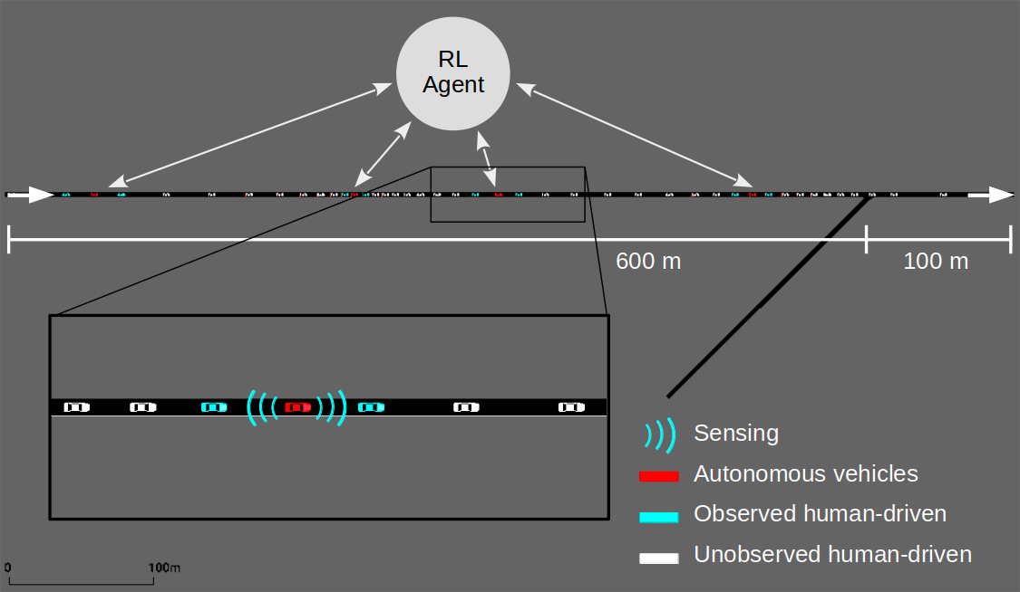
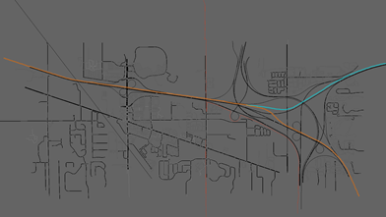
The goal is to scale to large networks
Simple Merge
I-696
Notes:
The goal of this project is to scale driving policies from simple merge to more complex realistic scenarios (specifically i696) In this talk I’ll present some of the challenges that we faced when scaing, and how we solved them , with the intention of raising pointers for later discussions with your team.
We have our sights on the a fully realistic scenario, but as a first step we start with a subset of the entire i696 network, which resembles a simple merge only enlarged by a roughly a factor of 10.

Slide 5
Problem Setting
Develop a multiagent driving policy for Autonomous Vehicles (AV) in a mixed autonomy setting, in large-scale, open road networks, to mitigate traffic congestion
Assumptions
Human driver behavior is homogeneous (IDM) with randomness
  IDM: Integrated Dynamic-Controller Module
Uniform Inflows
10% AVs and 90% Human-Driven vehicles
Uniform AV distribution
Notes:
We are still making some simplifying assumptions such as:
Homogenic human driving behavior according to the IDM controller
Uniform vehicle inflows
Fixed percentage of Avs 10%
Uniform AV distribution (1 – in 10)
We are currently working towards relaxing these assumptions.
But even with these simplifyning assumptions there are many challenges to overcome that arise from the length of the network

Slide 6
Challenges for Open and Large Network
Large number of vehicles in the network (~10X)
  Policy search space increases
  Credit assignment becomes harder. Any individual action has a much smaller effect on the entire system
More delayed and noisier reward
Larger variance in number of AVs in the network
  When monitoring a fixed number of AV, it becomes harder to determine the right number of AVs to monitor
Long Simulation time
Notes:
In large open networks there are more vehicles in the network which means that
the state and action space increase exponentially
Any individual action has a much smaller effect on the entire system
Much more delayed and noisy reward – which makes it much harder to assign credit
There is a large variance in the number Avs in the network – which makes it harder to determine theright number of Avs to monitor if we are monitoring a fixed number, and Noisy state representation since we have to zero pad missing inputs
And finally long training times and longer for the system to reach a steady state

Slide 7
Our Solutions
In this paper
Centralized Policy
Modular Policy
Decentralized Policy
Ongoing and future work
Centralized Training
Decentralized Execution
Hierarchical Learning

Slide 8
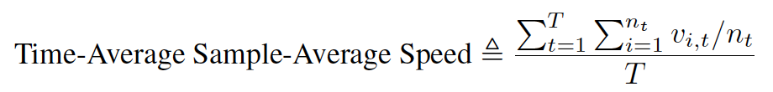
Metrics – Choosing the right objective function
In open networks, improving the Average Speed metric can be achieved by reducing the number of vehicles in the system
Average Speed -
Inflows - vehicles/hour entering the system
Outflows - vehicles/hour exiting the system
Time Delay - (not supported in SUMO)
Notes:
Another issue which is relevant to simulating any open network, regardless of its size, is choosing the right metric.
Since improving average speed can come at a cost of reduced inflows and outflows, as we can see in this video
We propose using the outflow metric for open network, and will be happy to discuss other alternatives such as time delay which is currently not supported in SUMO, but allows measuring equity.

Slide 9
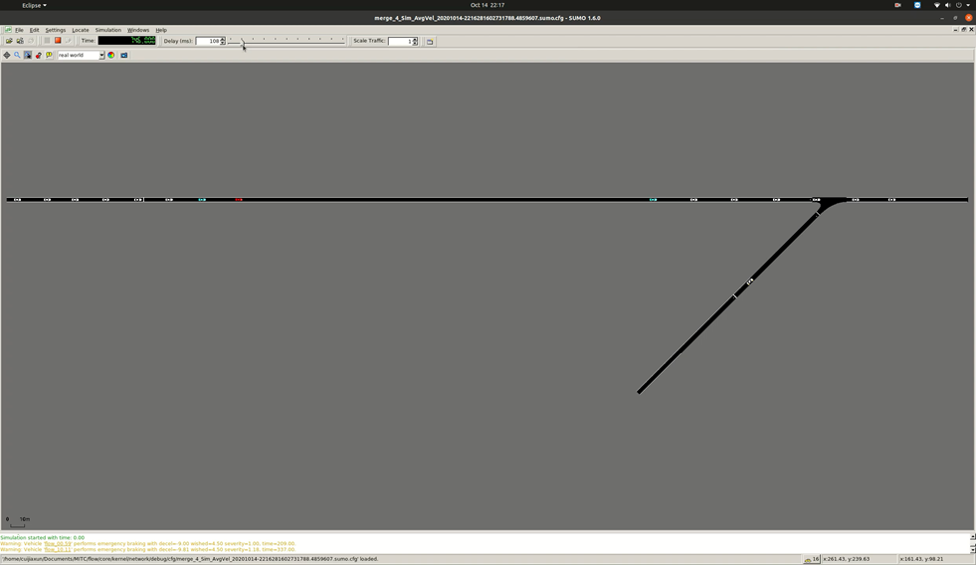
Metrics – Average Speed Manipulation
Notes:
The AV stops at the beginning of the road, blocking new vehicles from entering, and if we don’t take into account the speed of the vehicles that have not spawned as zero, then the average speed of the vehicles in the simulation can be increased.

Slide 11
Environment Setting
Main highway Inflow: 2000 vehs/hr, 10% Autonomous Vehicles, 90% Human Vehicles
Merging Inflow: 200 vehs/hr, 100% Human Vehicles
Episode Length: 1000 seconds, 2 steps/ second
Reinforcement Learning Algorithm: Proximal Policy Optimization (PPO)[2]
Main Highway Inflow: 2000 vehs/hr
Merging Inflow:
200 vehs/hr
[2] Schulman, J., Wolski, F., Dhariwal, P., Radford, A. and Klimov, O., 2017. Proximal policy optimization algorithms. arXiv preprint arXiv:1707.06347.

Slide 12
Centralized Policy

Slide 13
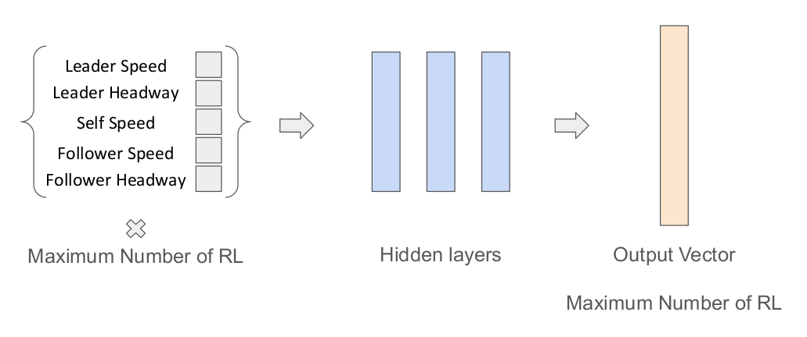
Centralized PPO Policy
AVs
[1] E. Vinitsky, A. Kreidieh, L. Le Flem, N. Kheterpal, K. Jang, C. Wu, F. Wu, R. Liaw, E. Liang, and A. M. Bayen. Benchmarks for reinforcement learning in mixed-autonomy traffic. In Conference on Robot Learning, pages 399–409, 2018.

Slide 14
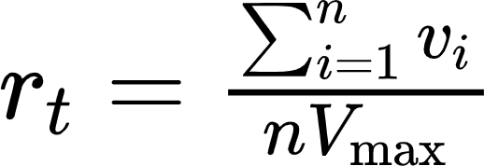

Reward Design
Flow Reward [1] (target speed Vd = 20 m/s)
Average Speed Reward
Outflow Reward
[1] E. Vinitsky, A. Kreidieh, L. Le Flem, N. Kheterpal, K. Jang, C. Wu, F. Wu, R. Liaw, E. Liang, and A. M. Bayen. Benchmarks for reinforcement learning in mixed-autonomy traffic. In Conference on Robot Learning, pages 399–409, 2018.

Slide 15
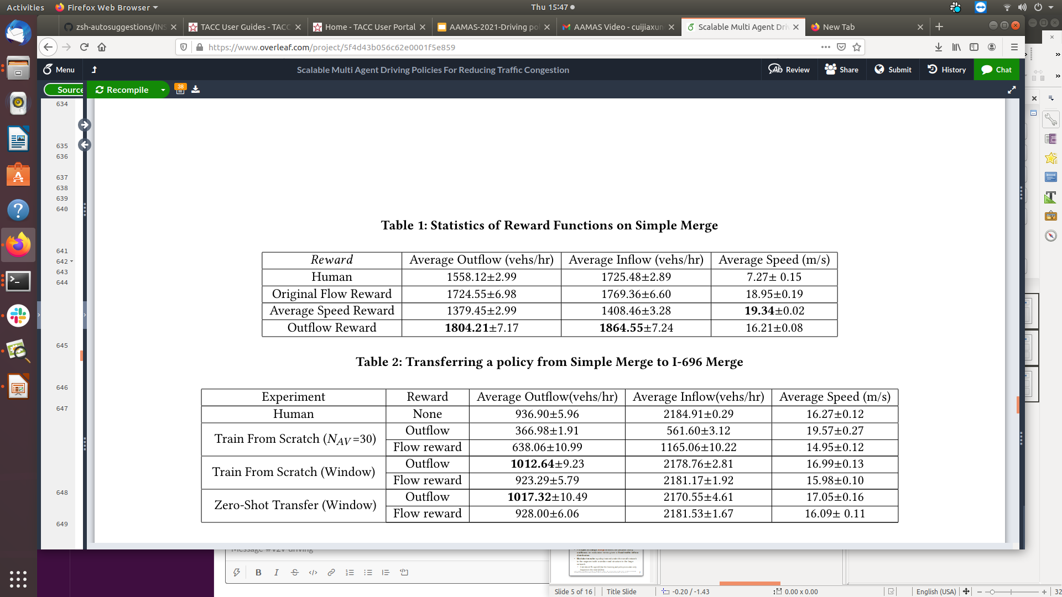
Experiment Result Simple Merge
Average Speed is Manipulable!
The results are obtained from 100 independent evaluations with controlled randomness. We report the mean values of metric readings accompanied with their 95% confidence interval bounds.

Slide 16
Simple Merge Human

Slide 17
Simple Merge Outflow

Slide 18
Simple Merge Average Velocity

Slide 19
Modular Policy

Slide 20
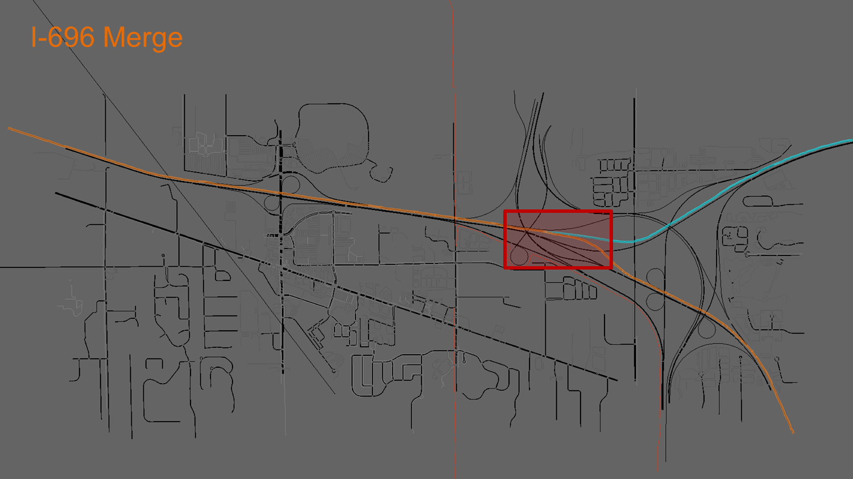

Slide 21
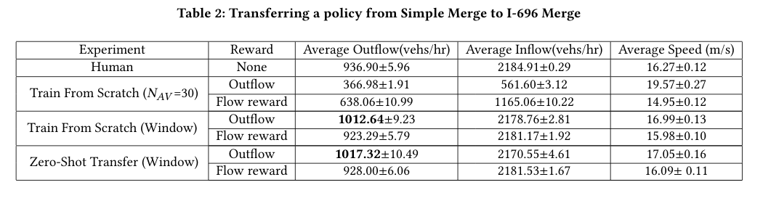
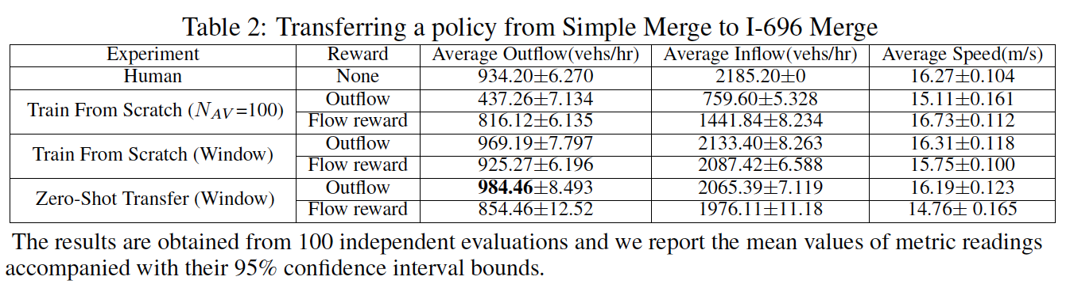
Experiment Result I-696 Merge
I-696 Merge is an Open and Large Merging Network
With a fixed inflow rate and number of controllable autonomous vehicles. Simply training RL agents from scratch can not yield better-than-human results

Slide 22
Experiment Result I-696 Merge
Training a policy a window near junction works much better than training for the entire road network from scratch

Slide 23
Experiment Result I-696 Merge
Transferring a policy trained in the small network can provide a warm start and potentially saves time, as the bottleneck of training large network is simulation time
Provides a direction for generalizing to new scenarios

Slide 24
Decentralized Policy

Slide 25
Issues with Centralized Controllers
Centralized Agent
Does not handle dynamic number of agents
Combinatorially enlarged search space
Unrealistic in real settings due to safety concern

Slide 26
Decentralized Problem Setting
Decentralized Agent
Each agent has its own policy based on local state information
We use parameter sharing to cut down on state space
RL
Agent
RL
Agent
RL
Agent
RL
Agent

Slide 27
New State Features
We augment the local state space with additional features
  Distance to merge point
  Congestion ahead of vehicle
  Distance and speed of merging vehicle
Junction

Slide 28
New State Features
We augment the local state space with additional features
  Distance to merge point
  Congestion ahead of vehicle before merging
  Distance and speed of merging vehicle
Average speed of vehicles between junction and ego vehicle
Junction

Slide 29
New State Features
We augment the local state space with additional features
  Distance to merge point
  Congestion ahead of vehicle before merging
  Distance and speed of merging vehicle
Junction
Speed and Distance of the first merging vehicle

Slide 30
New State Features
We augment the local state space with additional features
  Distance to merge point
  Congestion ahead of vehicle before merging
  Distance and speed of merging vehicle
Can be accessed through GPS and Vehicle-to-Vehicle Communication!
Junction
V2V communication
Speed and Distance of the first merging vehicle

Slide 31
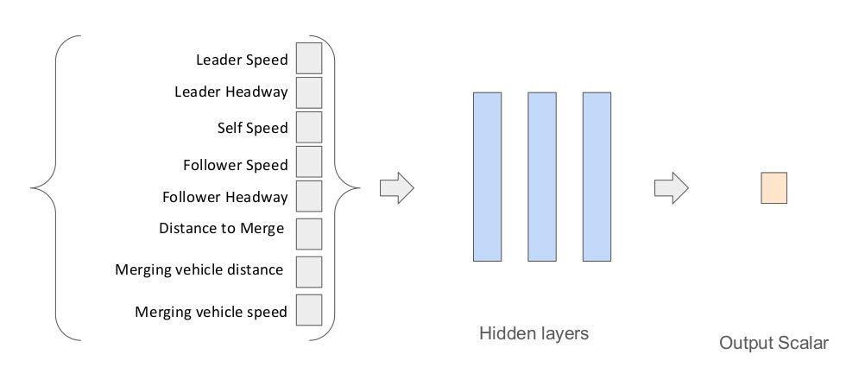
Decentralized Policy

Slide 32
Reward It’s a balance between to take or to give
For each individual autonomous vehicle
  Selfish: to go through the junction as quickly as possible
  Cooperative: to have as many vehicles passing through the junction as possible
Agents need to strike a balance between the two goals so that they can create a systematically smooth traffic flow, which benefits both themselves and others

Slide 33
Global vs Selfish Reward
Mixing selfish and team rewards has been shown to improve convergence
(1-α)*R₁ + α*R_{e}
AV₁
π
1-α
R₁
α
R_{e}
AV_{n}
α
π
1-α
R_{n}
Ishan Durugkar, Elad Liebman, and Peter Stone. Balancing Individual Preferences and Shared Objectives in Multiagent Reinforcement Learning. In Proceedings of the 29th International Joint Conference on Artificial Intelligence (IJCAI 2020), July 2020.

Slide 34
Reward Function
Cooperative Reward: Average Velocity
Selfish Reward: Time Penalty (-1 every time step) and positive bonus for successfully exiting the network
Final Reward:
η₁*Selfish_reward + η₂* Cooperative_reward + bonus
AVs are able to learn under this new function

Slide 35
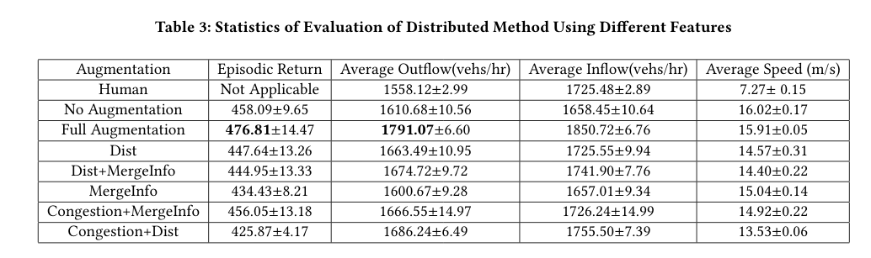
Ablation Study State Space
Fully decentralized policy with full augmentations can achieve similar episodic outflow as the best centralized policy with less training iterations
centralized

Slide 36
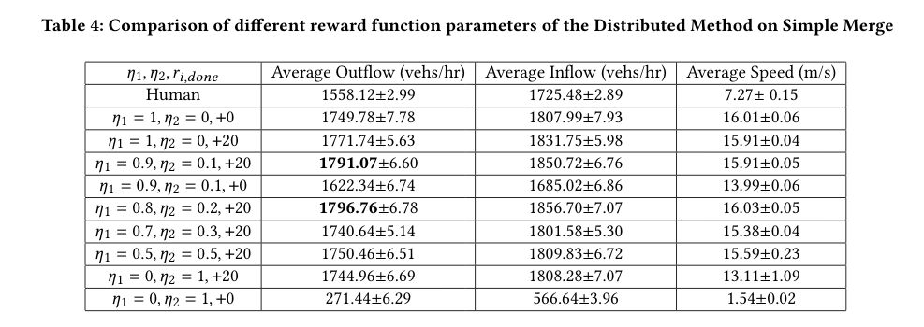
Ablation Study Reward Mixing
Cooperative reward alone does not encourage agents to exit the simulation network, they get stuck in the network to gain more rewards

Slide 37
Video: Collaborative reward does not encourage the vehicles to leave the network

Slide 38
Ablation Study Reward Mixing
It achieves best result outflow when trained with mostly selfish reward and a small portion of global reward

Slide 40
Ablation Study Reward Mixing
Selfish reward alone can work good enough in improving the traffic efficiency, though slightly worse than the mixed

Slide 41
Future Work
Expand to additional and more complicated road structures (i.e. multiple lanes, different merge points, multiple merge points)
Create general policies that can handle multiple road structures
Attempt to transfer learned policies to actual AVs

Slide 42
Summary
Open Networks provide additional challenges, such as exploiting inflows
RL can improve efficiency on larger road networks
We show a fully distributed policy that improves congestion

Slide 43
Scalable Multi-Agent Driving Policies For Reducing Traffic Congestion
Jiaxun Cui, William Macke, Harel Yedidsion, Daniel Urieli, Peter Stone
Learning Agent Research Group
The University of Texas at Austin
General Motors
Sony AI
Notes:
Hi and thank you for the introduction, before I present our work I would like to say that we are very excited about this collaboration, as Berkley’s Flow project has been the inspiration and the foundation for our research. And I would like to thank Daniel Urieli and GM for their support. This work on MULTI-AGENT DRIVING POLICY FOR CONGESTION REDUCTION IN A LARGE-SCALE SCENARIO has been partly presented in the NeurIPS workshop on ML4AD, and has been accepted for publication in AAMAS 2021.

