Slide 1


Model-based Meta Automatic
Curriculum Learning
Zifan Xu, Yulin Zhang, Shahaf S. Shperberg,
Reuth Mirsky, Yuqian Jiang, Bo Liu, Peter Stone
Second Conference on Lifelong Learning Agents (CoLLAs) 2023
Notes:
Hello, every! My name is Zifan Xu, a PhD student from University of Texas at Austin. In this video, I will present our work model-based meta automatic curriculum learning.

Slide 2
Curriculum Learning for RL
Learning a sequence of source tasks that can either
learn a target task more efficiently
learn a target task that cannot be learned directly
Notes:
A curriculum learning problem is to learn a sequence of source tasks that can either
Learn a target task more efficiently
Or learning a target task that cannot be learned directly.
For example here, to train an agent to play chess game, the learning can benefit from learning the chess board with simpler configuration then gradually extend to the full configuration.

Slide 3
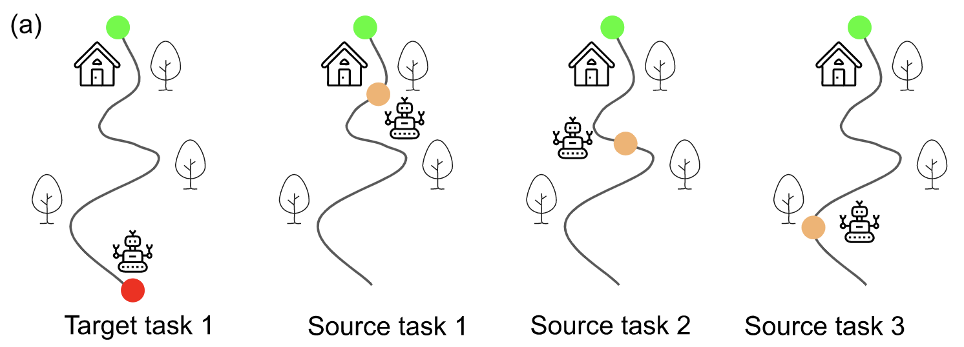
Curriculum Learning for RL
Learning a sequence of source tasks that can either
learn a target task more efficiently
learn a target task that cannot be learned directly
Notes:
A curriculum learning problem is to learn a sequence of source tasks that can either
Learn a target task more efficiently
Or learning a target task that cannot be learned directly.
For example here, to train an agent to play chess game, the learning can benefit from learning the chess board with simpler configuration then gradually extend to the full configuration.

Slide 4
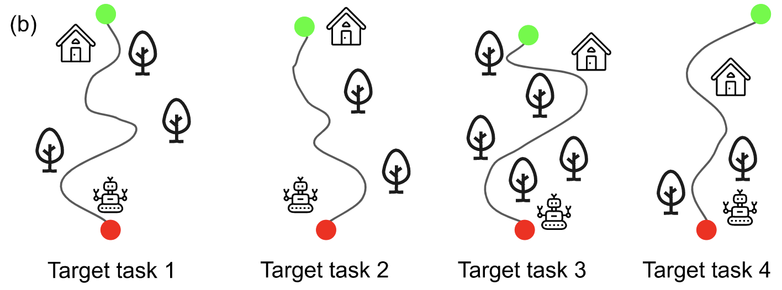
Meta Curriculum Learning
Different target tasks may benefit from similar curricula
Notes:
Sometimes, different students may benefit from similar curriculum. For example here, train bipedal walkers to pass through stumps with different height and spacings. Different embodiments can both benefit from training on small height and larger spacings first.
One nature questions is: Can the teacher be meta-learned to generate curriculum for novel students in the future?
We propose a meta curriculum learning method that meta learns a
Learning dynamics model to predicts the transferability from any given task A to task B

Slide 5
Meta Curriculum Learning
Different target tasks may benefit from similar curriculum
Can the teacher be meta-learned to generate curriculum for novel target tasks in the future?
(1) Do not rely on heuristic; (2) optimize the true objective of the curriculum learning problem
Notes:
Sometimes, different students may benefit from similar curriculum. For example here, train bipedal walkers to pass through stumps with different height and spacings. Different embodiments can both benefit from training on small height and larger spacings first.
One nature questions is: Can the teacher be meta-learned to generate curriculum for novel students in the future?
We propose a meta curriculum learning method that meta learns a
Learning dynamics model to predicts the transferability from any given task A to task B

Slide 6
Problem Definition
Under Specified Domain:

Slide 7
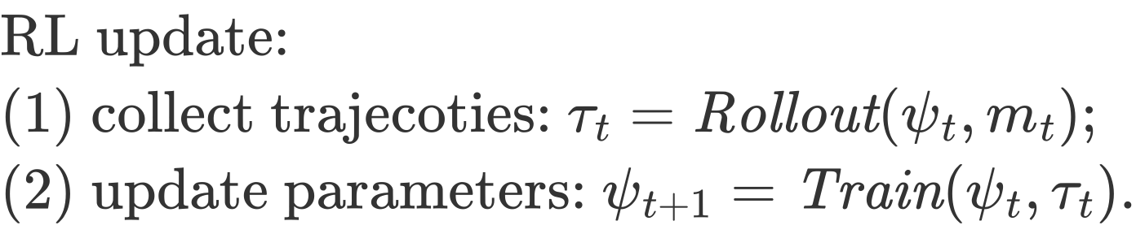
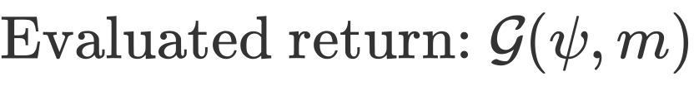
Problem Definition
Under Specified Domain:
RL student:

Slide 8
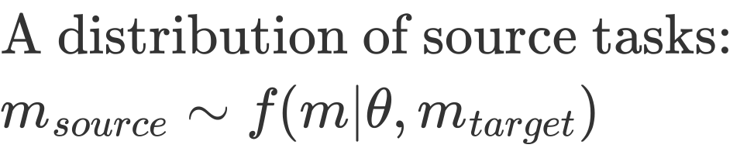
Problem Definition
Under Specified Domain:
RL student:
Teacher:

Slide 9
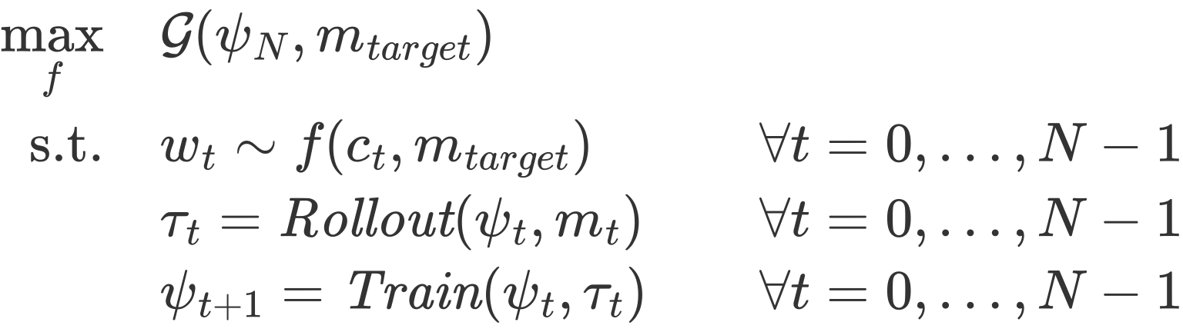
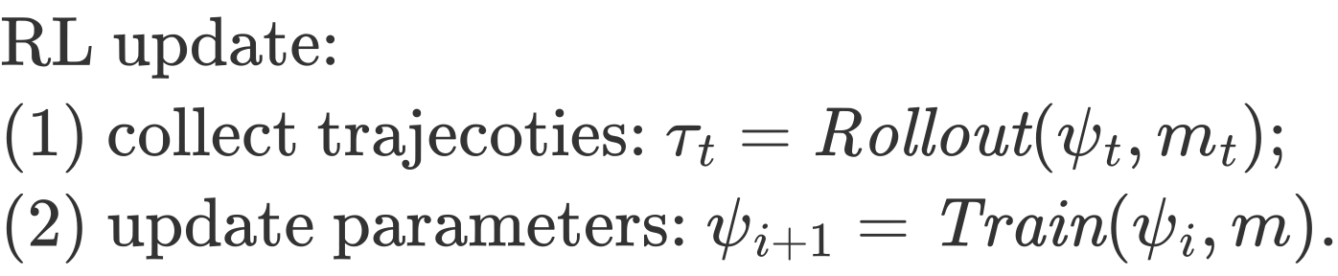
Problem Definition
Curriculum learning problem:
optimizing teacher w.r.t. a fixed target task
Under Specified Domain:
RL student:
Teacher:

Slide 10
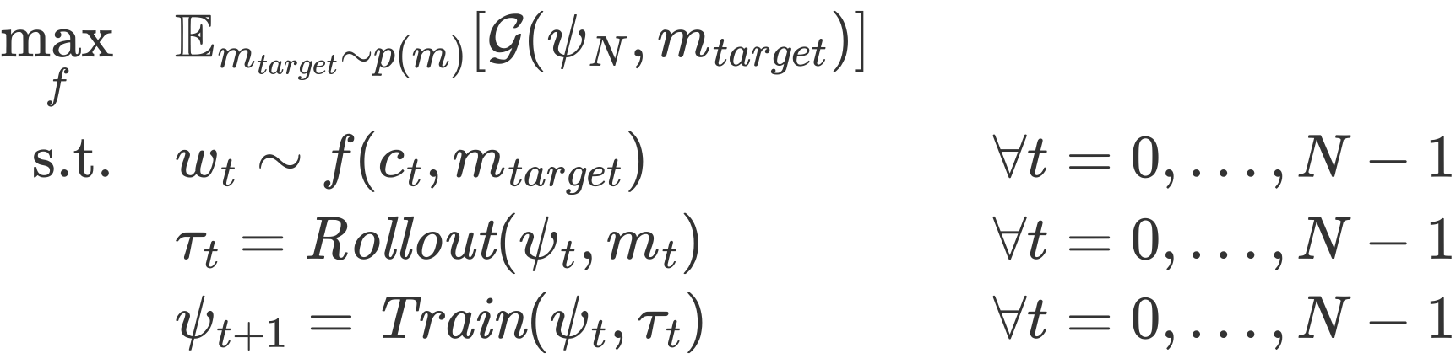
Problem Definition
Curriculum learning problem:
optimizing teacher w.r.t. a fixed target task
Under Specified Domain:
RL student:
Meta-curriculum learning problem:
optimizing teacher w.r.t. a distribution of target task
Teacher:

Slide 11
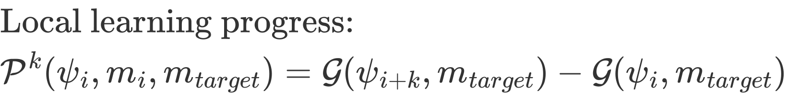
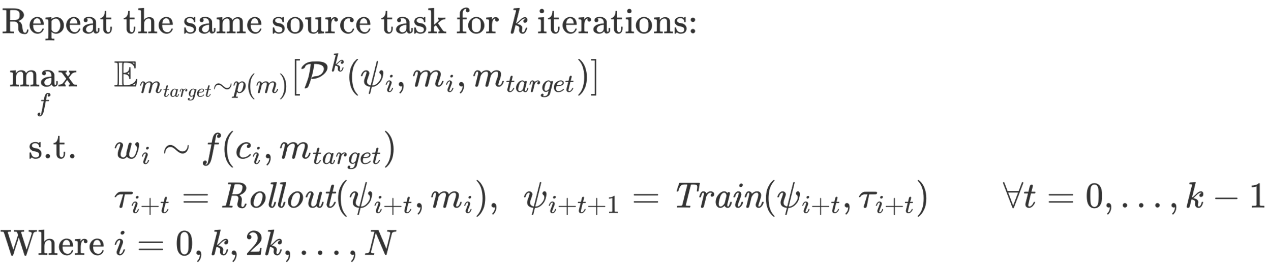
Assumptions
Myopic approximation:

Slide 12
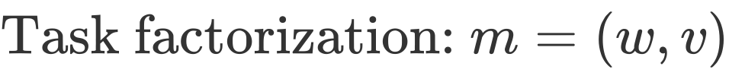
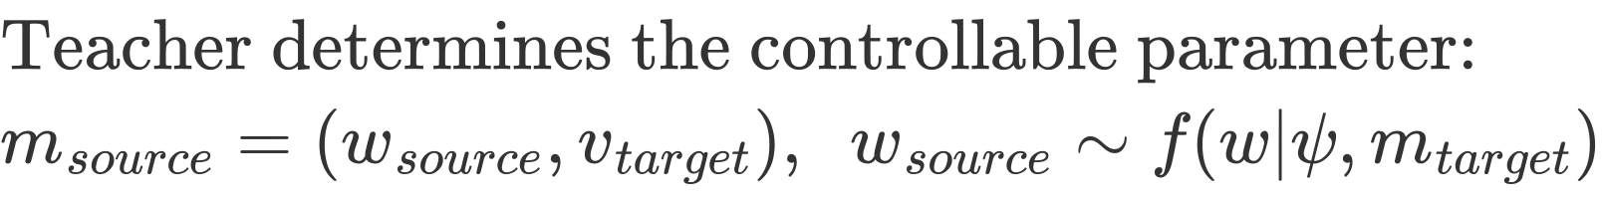
Assumptions
Factorize parameters into controllable and uncontrollable
Controllable parameters: starting position
Uncontrollable parameters: navigation environments

Slide 13
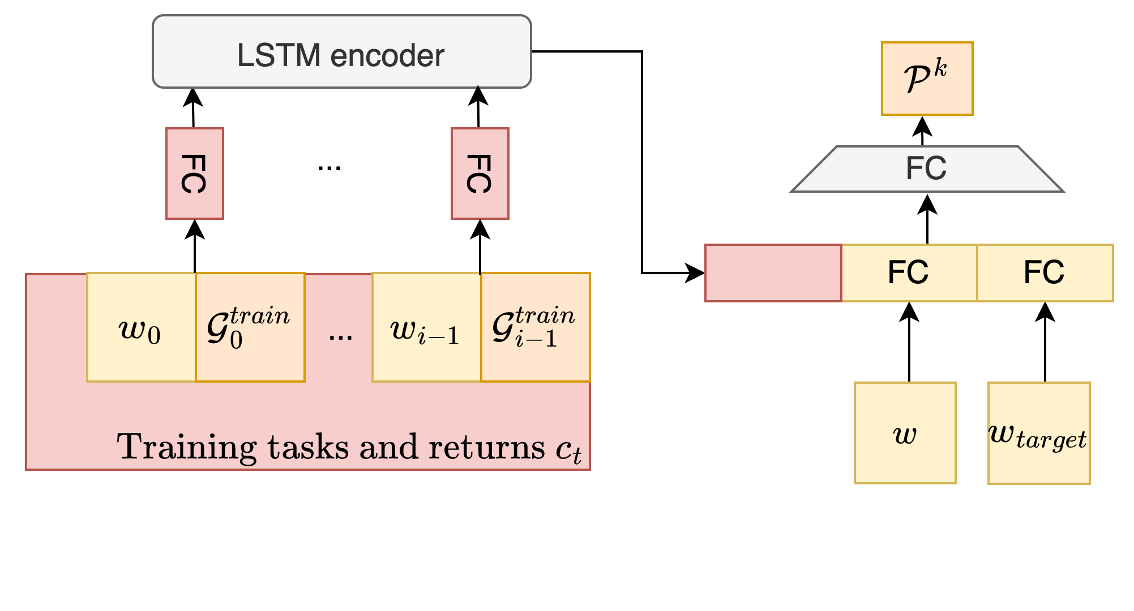
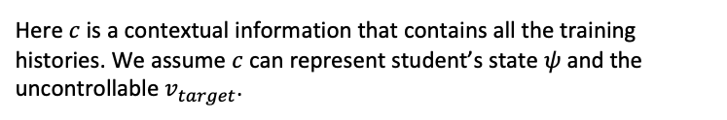
Learning Dynamics Model
Each sub-problem
Approximating local learning progress
Here $c$ is a contextual information that contains all the training histories. We assume $c$ can represent student’s state $ψ$ and the uncontrollable $v_{target}$.
Notes:
More specifically, a learning dynamics model takes inputs of
state (a state can be any useful information to predict the transferability, e.g. domain features and student’s knowledge)
Training task w
Validation task w prime
To predict the transferability or learning progress the agent makes on the validation task w prime by training on task w.
In practical, a full information of the state is not accessible, instead, we use a context of history training tasks and losses to estimate the learning progress.
A full diagram of learning dynamics model can be seen as below.

Slide 14
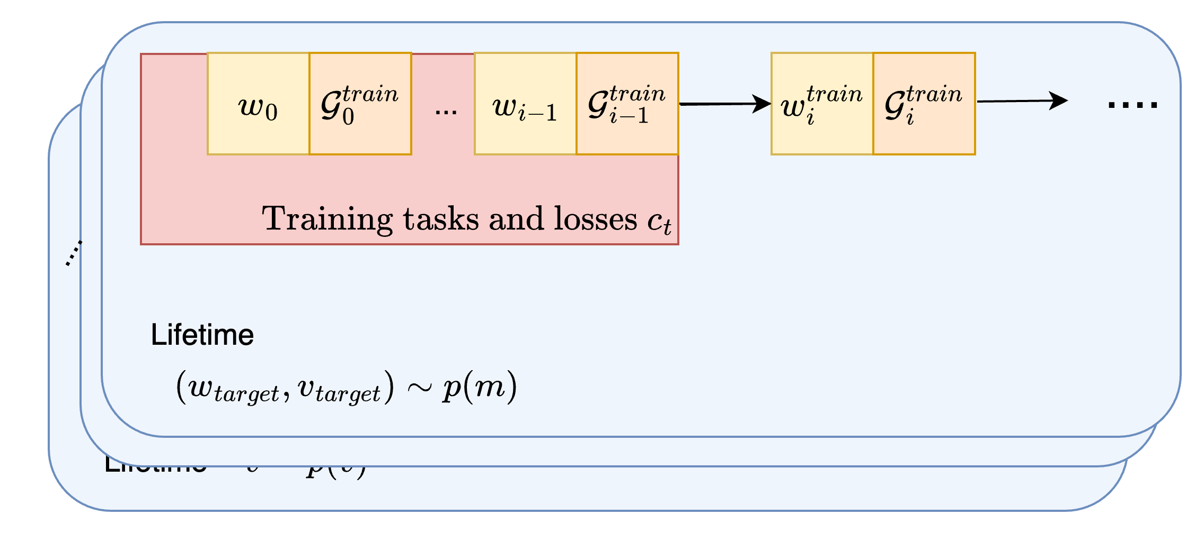
Model-based Meta Automatic Curriculum Learning (MM-ACL)
Meta-training phase: freely sample multiple lifetimes with different target tasks
Notes:
More specifically, a learning dynamics model takes inputs of
state (a state can be any useful information to predict the transferability, e.g. domain features and student’s knowledge)
Training task w
Validation task w prime
To predict the transferability or learning progress the agent makes on the validation task w prime by training on task w.
In practical, a full information of the state is not accessible, instead, we use a context of history training tasks and losses to estimate the learning progress.
A full diagram of learning dynamics model can be seen as below.

Slide 15
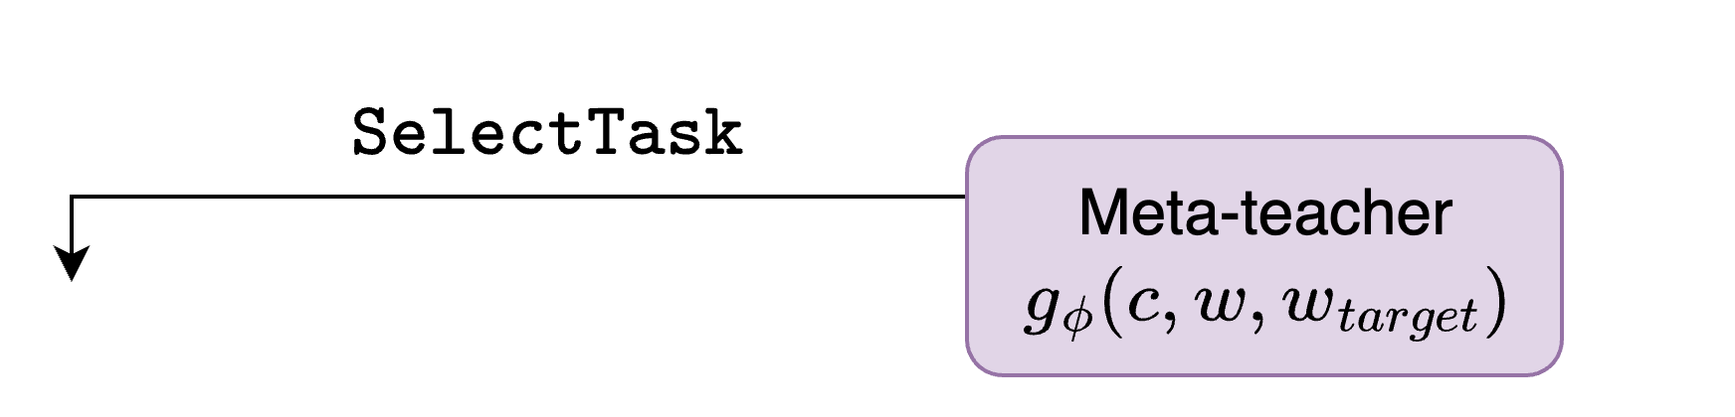
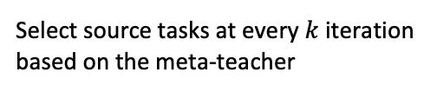
Model-based Meta Automatic Curriculum Learning (MM-ACL)
Meta-training phase
Select source tasks at every $k$ iteration based on the meta-teacher
Notes:
More specifically, a learning dynamics model takes inputs of
state (a state can be any useful information to predict the transferability, e.g. domain features and student’s knowledge)
Training task w
Validation task w prime
To predict the transferability or learning progress the agent makes on the validation task w prime by training on task w.
In practical, a full information of the state is not accessible, instead, we use a context of history training tasks and losses to estimate the learning progress.
A full diagram of learning dynamics model can be seen as below.

Slide 16
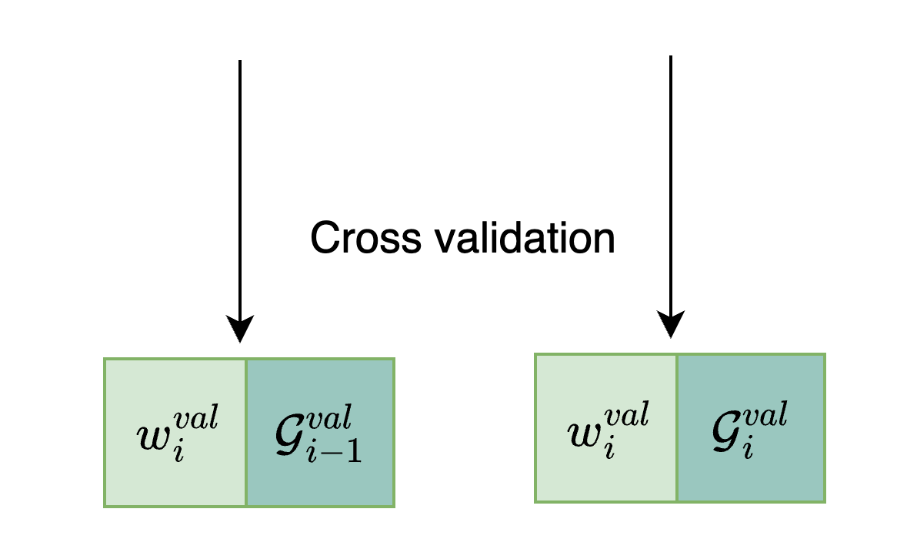
Model-based Meta Automatic Curriculum Learning (MM-ACL)
Meta-training phase
Perform cross validation to compute the local learning progress
Notes:
More specifically, a learning dynamics model takes inputs of
state (a state can be any useful information to predict the transferability, e.g. domain features and student’s knowledge)
Training task w
Validation task w prime
To predict the transferability or learning progress the agent makes on the validation task w prime by training on task w.
In practical, a full information of the state is not accessible, instead, we use a context of history training tasks and losses to estimate the learning progress.
A full diagram of learning dynamics model can be seen as below.

Slide 17
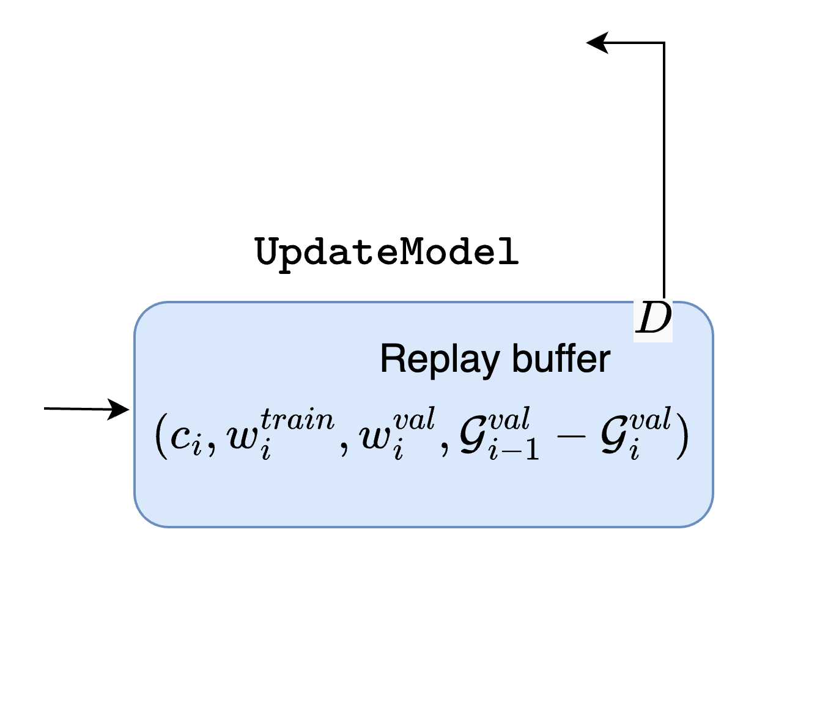
Model-based Meta Automatic Curriculum Learning (MM-ACL)
Meta-training phase
Add one data point to the replay buffer to update the meta-teacher
Notes:
More specifically, a learning dynamics model takes inputs of
state (a state can be any useful information to predict the transferability, e.g. domain features and student’s knowledge)
Training task w
Validation task w prime
To predict the transferability or learning progress the agent makes on the validation task w prime by training on task w.
In practical, a full information of the state is not accessible, instead, we use a context of history training tasks and losses to estimate the learning progress.
A full diagram of learning dynamics model can be seen as below.

Slide 18
Model-based Meta Automatic Curriculum Learning (MM-ACL)
Meta-training phase
Meta-testing phase: deploy the meta-teacher on unseen target tasks from the the same distribution without cross validation
Notes:
More specifically, a learning dynamics model takes inputs of
state (a state can be any useful information to predict the transferability, e.g. domain features and student’s knowledge)
Training task w
Validation task w prime
To predict the transferability or learning progress the agent makes on the validation task w prime by training on task w.
In practical, a full information of the state is not accessible, instead, we use a context of history training tasks and losses to estimate the learning progress.
A full diagram of learning dynamics model can be seen as below.

Slide 19
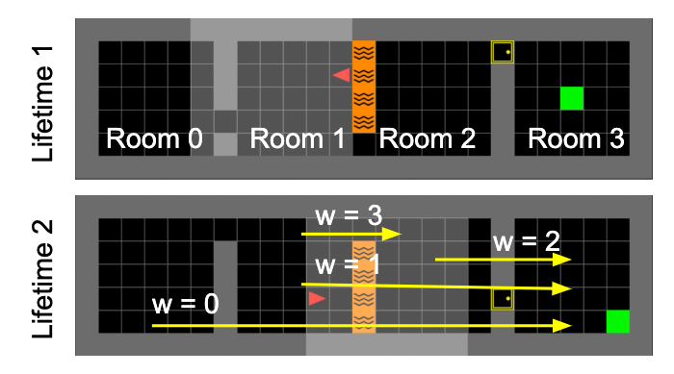
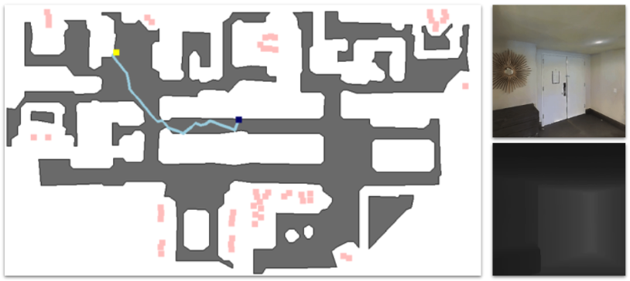
Experiments
FourRoom
Habitat

Slide 20
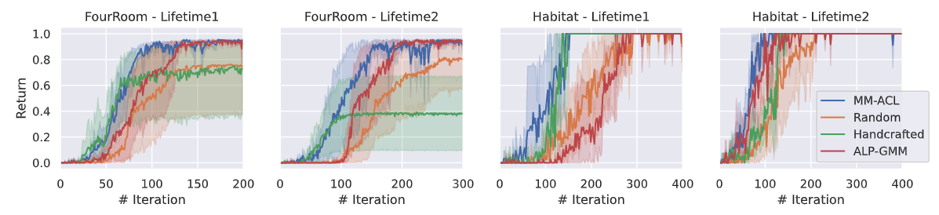
Results
FourRoom
Habitat

Slide 21
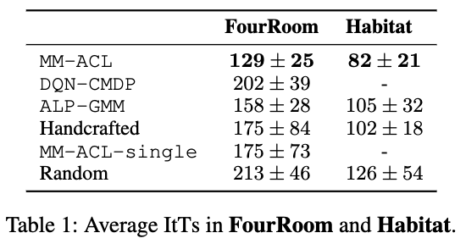
Results
FourRoom
Habitat
ItT: iteration to threshold

Slide 22







Model-based Meta Automatic Curriculum Learning
Zifan Xu, Yulin Zhang, Shahaf S. Shperberg, Reuth Mirsky, Yuqian Jiang, Bo Liu, Peter Stone

