Slide 1
Learning Perceptual Hallucination for Multi-Robot Navigation in Narrow Hallways
Jin-Soo Park¹, Xuesu Xiao^{2,5}, Garrett Warnell^{1,3}, Harel Yedidsion¹, Peter Stone^{1,4}
1
2
3
4
5
Notes:
Hi, my name is Jinsoo Park, Ph.D. student from the university of texas at austin.
Today, I will present about our paper, “learning perceptual hallucination for multi-robot navigation in narrow hallways”.

Slide 2
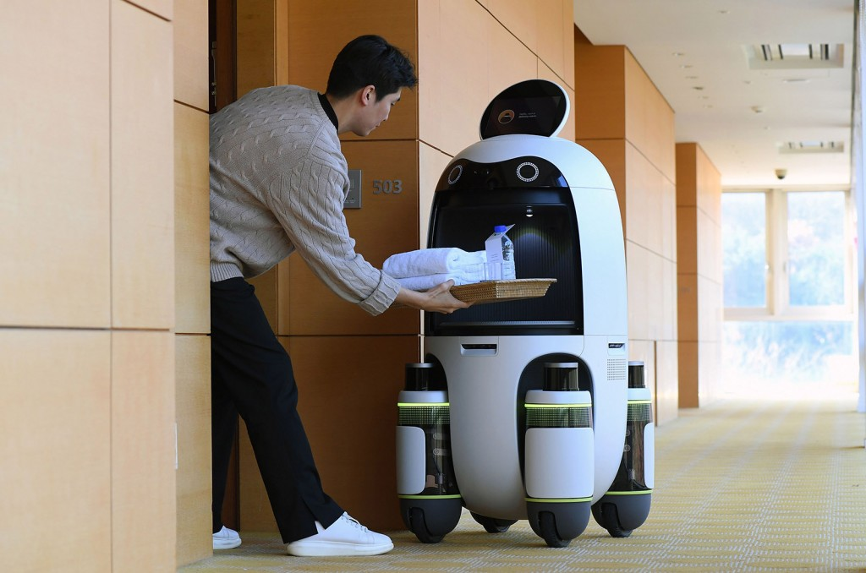
Motivation
Nowadays, many service robots are being developed and deployed.
The need for better indoor navigation when sharing the same space with other robots has become more important.
Hyundai (Room Service Robot)
Hyundai (Serving Robot)
Toyota (Human Support Robot)
Jinsoo Park, The University of Texas at Austin
Notes:
Nowadays, many service robots are developed and deployed in buildings.
Hyundai presents the 'room service robot' and the 'restaurant serving robot', while Toyota showcases the 'Human Support Robot’.
As the number of indoor robots increases, the need for a better navigation strategy is rapidly increasing.

Slide 3
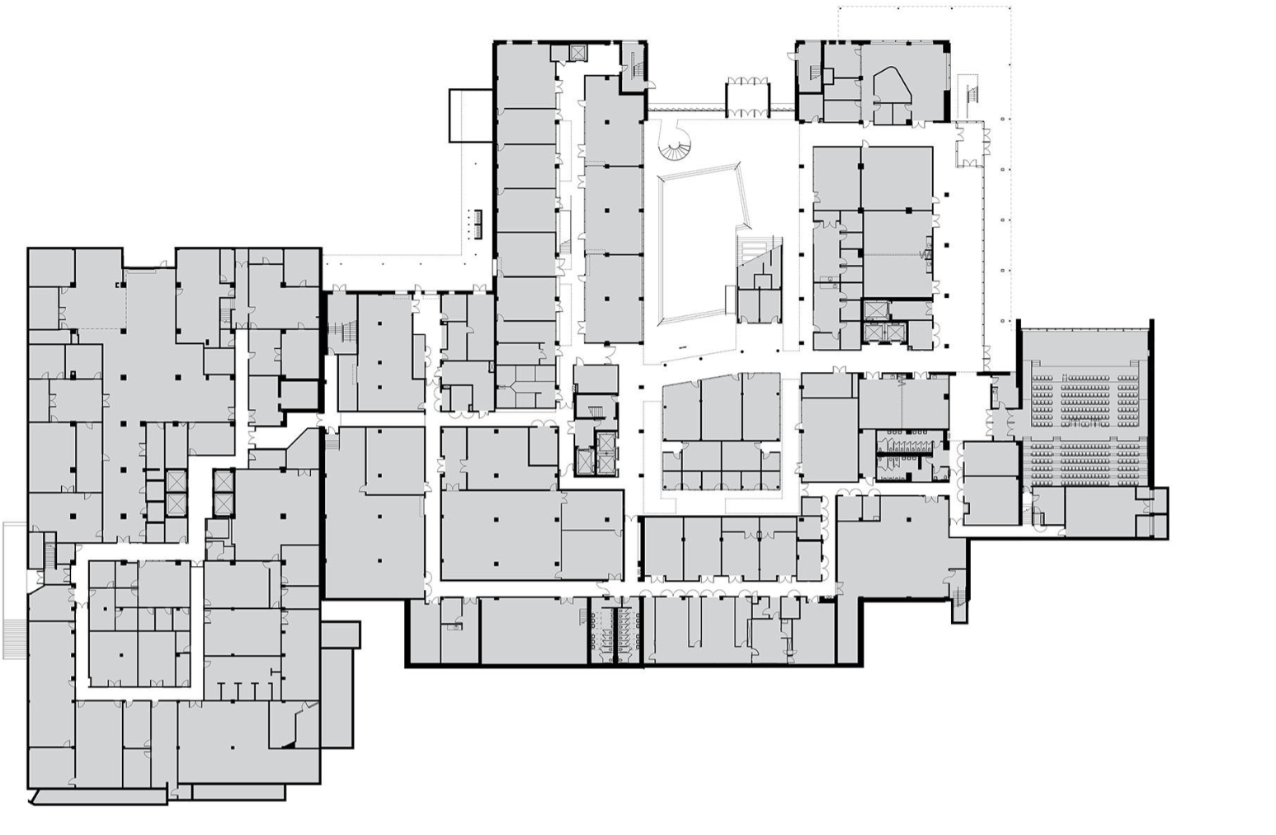
Motivation
Nowadays, many service robots are being developed and deployed.
The need for better indoor navigation when sharing the same space with other robots has become more important.
Most building structures can be categorized into:
narrow hallways
open spaces (atrium)
Jinsoo Park, The University of Texas at Austin
Jinsoo Park
Notes:
And when we look at the floorplan of buildings, indoor navigation can be categorized into two types.
One that happens at the narrow hallway, such as following or passing, and the other is navigating a large open space, such as an auditorium.

Slide 4
Motivation
Nowadays, many service robots are being developed and deployed.
The need for better indoor navigation when sharing the same space with other robots has become more important.
Most building structures can be categorized into:
narrow hallways
open spaces (atrium)
This presentation will focus on the hallway passing problem and present a novel solution using perceptual hallucination.
Jinsoo Park, The University of Texas at Austin
Jinsoo Park
Notes:
This presentation will focus on the hallway passing problem and present a novel solution using the perceptual hallucination.
1분 소요됨.

Slide 5
Related works
There are several prior works to solve decentralized multi-robot navigation problems in a confined space.
Velocity obstacle-based approaches
Reciprocal n-body collision avoidance (ORCA)
Optimal reciprocal collision avoidance for multiple non-holonomic robot (NH-ORCA)
End-to-end Reinforcement Learning-based approaches
Distributed multi-robot collision avoidance via deep reinforcement learning for navigation in complex scenario
Deepmnavigate: Deep reinforced multi-robot navigation unifying local & global collision avoidance
Note that velocity obstacles require perfect sensing or intensive communication, while RL-based approaches often result in unexplainable behavior, which may result in dangerous behavior.
Jinsoo Park, The University of Texas at Austin
Jinsoo Park
Notes:
e

Slide 6
Approach
Jinsoo Park, The University of Texas at Austin
Jinsoo Park
Notes:
Before we delve into the details of our paper, let me briefly introduce the motivation behind our research

Slide 7
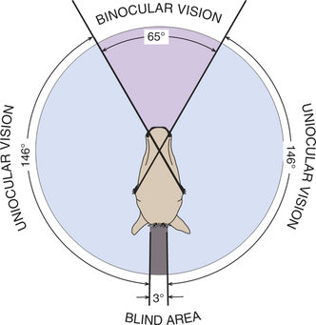
Inspiration (Horse race)
Horses can see 350 – 357 degrees and have a great fear of being chased.
Jinsoo Park, The University of Texas at Austin
Jinsoo Park
Notes:
.Have you ever seen a horse race?
Surprisingly, horses have almost 360-degree vision and are fearful of being chased by others.

Slide 8
Inspiration (Horse race)
Horses can see 350 – 357 degrees and have a great fear of being chased.
If we hold a horse race, a dangerous situation can occur if a horse becomes frightened by the other horses chasing from behind.
Jinsoo Park, The University of Texas at Austin
Jinsoo Park
Notes:
Therefore, if we were to use horses in a race, a dangerous situation could occur if a horse becomes frightened by the other horses chasing from behind.

Slide 9
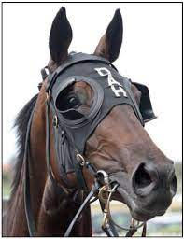
Inspiration (Horse race)
Horses can see 350 – 357 degrees and have a great fear of being chased.
If we hold a horse race, a dangerous situation can occur if a horse becomes frightened by the other horses chasing from behind.
Hence, blinkers are used in horse racing to prevent horses from being spooked by sudden movements from behind to increase the safety.
Jinsoo Park, The University of Texas at Austin
Jinsoo Park
Notes:
To ensure safety, people equip horses with eyemask that limits the field of view of the horses during the race to prevent them from being spooked by sudden movements from behind.

Slide 10
Inspiration (Horse race)
Hypothesis
Robots with classical single-robot navigation system may suffer similar problem in that observing other robots ends up with dangerous behaviors than not observing it.
Jinsoo Park, The University of Texas at Austin
Jinsoo Park
Notes:
A similar approach can be applied to robots for indoor navigation by blocking parts of the LiDAR scans.
We can use virtual obstacles to block unnecessary or even harmful observations of other robots to allow for more stable multi-robot navigation.
아마도 여기까지 2분~2분 30초!

Slide 11
Inspiration (Horse race)
Hypothesis
Robots with classical single-robot navigation system may suffer similar problem in that observing other robots ends up with dangerous behaviors than not observing it.
Hence, similar solution can be applied to robots for indoor navigation by blocking LiDAR scans.
Virtual obstacles can be used to block the unnecessary or even harmful observation of the other robots, allowing more stable multi-robot navigation.
Jinsoo Park, The University of Texas at Austin
Jinsoo Park
Notes:
A similar approach can be applied to robots for indoor navigation by blocking parts of the LiDAR scans.
We can use virtual obstacles to block unnecessary or even harmful observations of other robots to allow for more stable multi-robot navigation.
아마도 여기까지 2분~2분 30초!

Slide 12
Description
Jinsoo Park, The University of Texas at Austin
Jinsoo Park
Notes:
Now, let's delve into the proposed method of this paper, perceptual hallucination for hallway passing.

Slide 13
Perceptual Hallucination for Hallway Passing (PHHP)
1
2.4
Example scenario
Objective: Two robots have to pass each other in a narrow hallway.
Environment: The hallway is barely wide enough for two robots to pass each other simultaneously.
Robots: Robots are using a popular ROS navigation stack. (e.g., E-Band planner)
Jinsoo Park, The University of Texas at Austin
Jinsoo Park
Notes:
Imagine a scenario where two robots has to pass each other in the narrow hallway.
Assume that the hallway is barely wide enough for two robots to pass each other.
And robots are using a popular ROS navigation stack such as E-Band planner.

Slide 14
Perceptual Hallucination for Hallway Passing (PHHP)
Without PHHP
0.7
0.7
1
2.4
0.7
Without PHHP
Navigation systems designed for single robot navigation tend to leave a large margin on both sides.
Robots are highly likely to fail to reach their goal, as there may not be enough space for them to pass each other.
Jinsoo Park, The University of Texas at Austin
Jinsoo Park
Notes:
Here’s what will most likely to happened without our approach, PHHP.
navigation system designed for the single robot navigation tends to have as large margin as possible, or in other word, they love to maneuver through the center of the hallway.
Hence, if we directely deploy robots in this scenario, both robots will be most likely to failed to reach the goal since there is not enough room for robots to pass the opponents.

Slide 15
Perceptual Hallucination for Hallway Passing (PHHP)
With PHHP
Without PHHP
1.2
1
2.4
With PHHP
Virtual obstacle will block the Lidar scan, preventing the opponent robot from being observed.
The manipulated scan tricks the navigation stack into presuming that there is enough space to pass.
By the time when the robot passes the virtual obstacle, the other robot with PHHP also move to the side of the hallway, providing enough space for both robots to pass.
Jinsoo Park, The University of Texas at Austin
Jinsoo Park

Slide 16
Perceptual Hallucination for Hallway Passing (PHHP)
Single robot navigation, represented by the ROS navigation stack, often requires reducing speed (E-Band) or frequent replanning (DWA) to maneuver in narrow spaces for safety reasons.
Virtual obstacles effectively reduce the width of the hallway.
Hence, it is important to find the minimal virtual obstacle to achieve the fastest time-to-destination or best performance.
1
1.0m/s
2.4
2.4
1
0.5m/s
1.2
Jinsoo Park, The University of Texas at Austin
Jinsoo Park

Slide 17
Perceptual Hallucination for Hallway Passing (PHHP)
We optimized the size and placement of virtual obstacles for I-shaped (straight) hallways and L-shaped hallways using Covariance Matrix Adaptation Evolution Strategy (CMA-ES).
The optimal configurations for each environments are as follows:
Each variable is defined relative to the plan of the robot. Note that $k_{begin}$ and $k_{begin}$ are fraction.
Environment | Radius | 𝜟r | $$k_{begin}$$ | $$k_{end}$$
I-shaped | 0.7590 | 0.7888 | 0.4845 | 0.4910
L-shaped | 0.5122 | 0.5661 | 0.4842 | 0.5001
Radius
𝜟r
$$0$$
$$k_{begin}$$
$$k_{end}$$
$$1$$
Jinsoo Park, The University of Texas at Austin
Jinsoo Park
Notes:
This presentation will focus on the hallway passing problem and present a novel solution using the perceptual hallucination.
1분 소요됨.

Slide 18
Results
Jinsoo Park, The University of Texas at Austin
Jinsoo Park
Notes:
Finally, we tested our approach in a variety of environments.

Slide 19
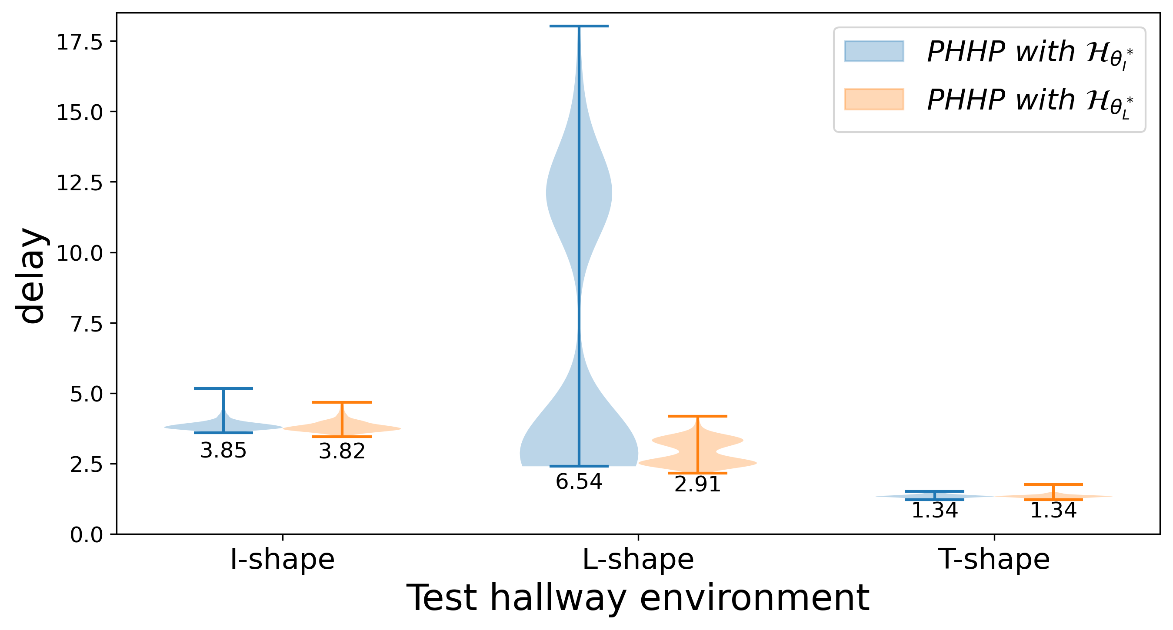
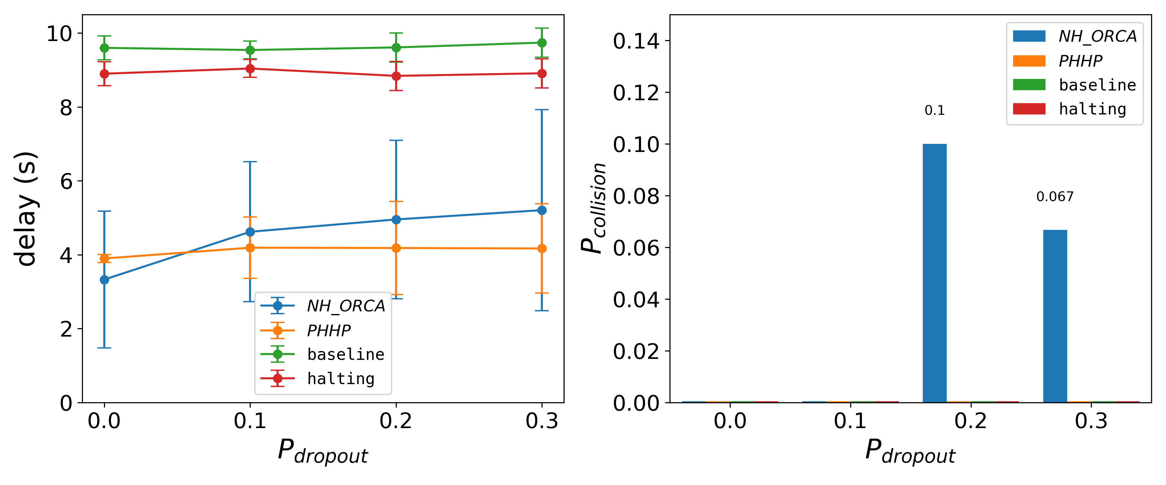
Simulation results
(Left) The performance of PHHP trained with L-shape hallway is better in all three test environments.
(Right) PHHP achieves better performance than all other alternative approaches, even with 5% of communication noise.
Jinsoo Park
Jinsoo Park, The University of Texas at Austin
Notes:
We tested 2 PHHP configurations in 3 different simulated hallways: I-, L-, and T-shaped.
The simulation results indicate that the one trained with L-shaped hallway performs better than the one with I-shaped hallway.
We also compared PHHP with nh_orca, right-lane-following baseline, and halting approach in an environment with communication noise.
The figure on the right shows that PHHP achieves better performance than all other alternative approaches, even with 5% of communication noise.

Slide 20
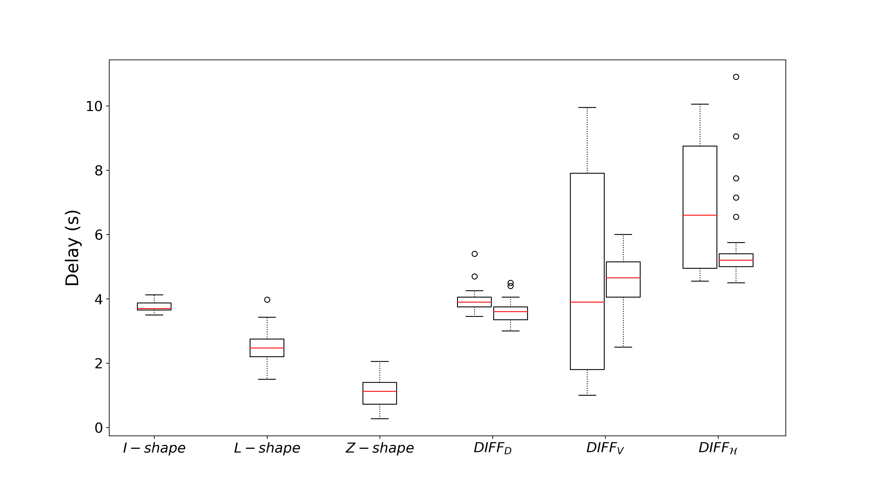
Real-world results
We also tested PHHP in various real-world environments.
Notably, no collisions or turnarounds were observed during the entire set of 192 experiments.
Jinsoo Park, The University of Texas at Austin
Jinsoo Park
Notes:
Finally, I'd like to conclude this presentation by showing how PHHP works in a real-world environment.
?????? This video only provides a brief explanation, so if you are interested in our paper, please refer to the paper.

Slide 21
Learning Perceptual Hallucination for Multi-Robot Navigation in Narrow Hallways
Jin-Soo Park, Xuesu Xiao, Garrett Warnell, Harel Yedidsion, Peter Stone
Scan to view paper
Notes:
Hi, my name is Jinsoo Park, Ph.D. student from the university of texas at austin.
Today, I will present about our paper, “learning perceptual hallucination for multi-robot navigation in narrow hallways”.

