Slide 1
When Security Games Go Green:
Designing Defender Strategies to Prevent Poaching and Illegal Fishing
Fei Fang¹, Peter Stone², Milind Tambe¹
University of Southern California¹
University of Texas at Austin²
Notes:
Good morning everyone, I am Fei Fang from University of Southern California. Today I would like to introduce our work on Green Security Games, where we design defender strategies against frequent adversarial actions such as poaching and illegal fishing. This is joint work with Peter Stone from UT Austin and my advisor Milind Tambe.
This talk would include more recent work so you may find the title is slightly different.

Slide 2
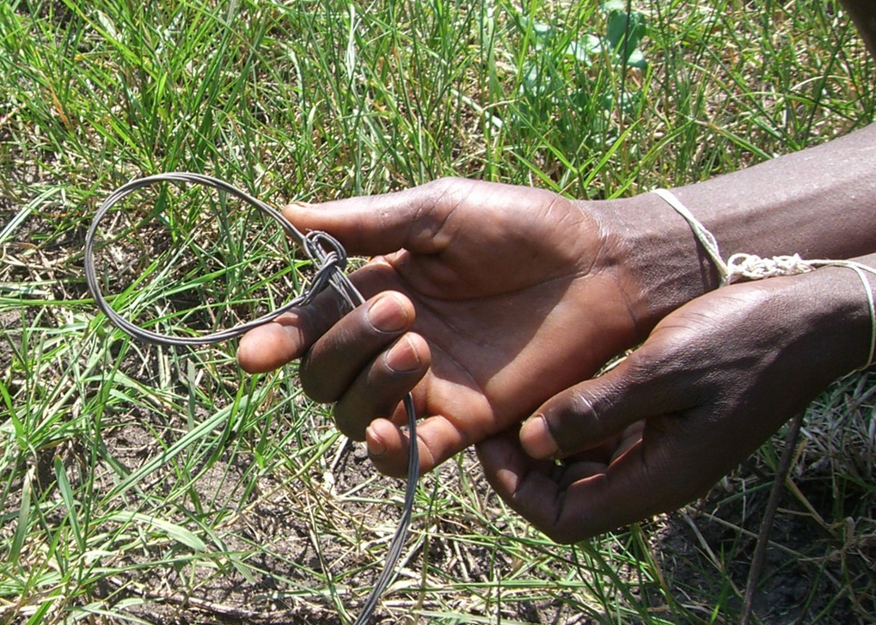
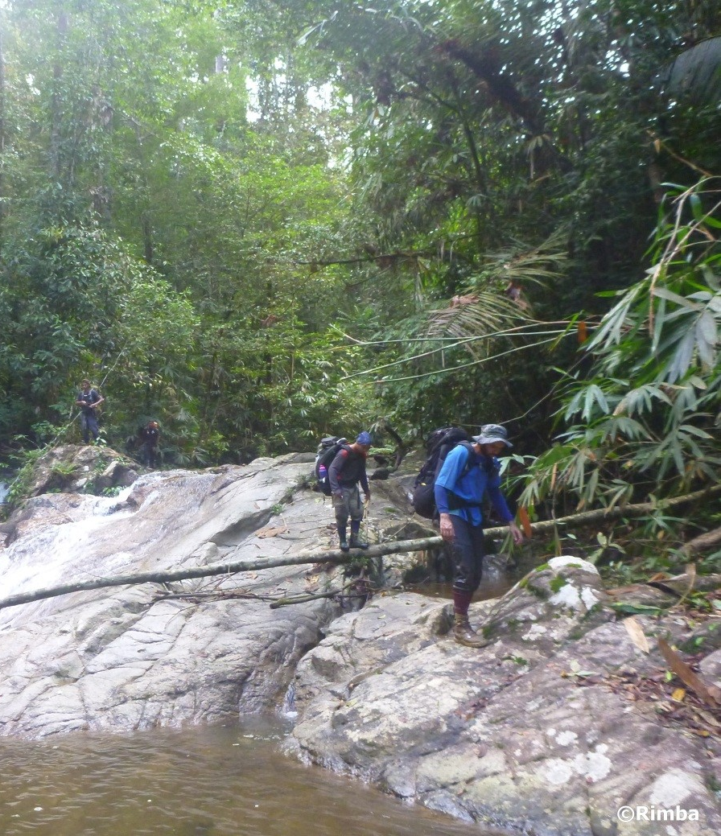

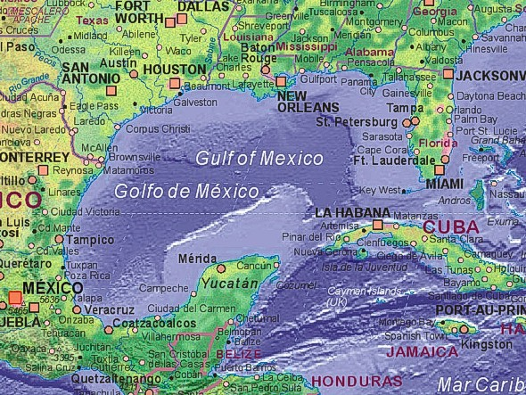


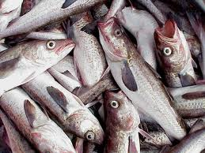
Green Security Domains:
Protecting Fish and Wildlife
Wildlife Protection
Fishery Protection
Notes:
The work is motivated by green security problems, including protecting wildlife from illegal poaching, and protecting fish stocks from illegal over-fishing.
Tigers and other wildlife species are in danger of extinction from poaching, due to the demands of illegal wildlife trade market. In the past century, the population of tigers has dropped over 95 percent. The poachers can place traps or wired snares on the ground to catch the animals, as shown in picture in the middle. To combat such illegal activities, government agencies and non-government has launched programs including implementing effective enforcement of protected areas through well-trained patrollers. Patrollers can save animals by confiscating the snares on the ground before they trap any animals. However it is impossible for them to always cover the whole protected area, and there is a need for strategic patrolling.
A similar challenge is faced by officers who try to protect fish stocks from illegal fishing.

Slide 3
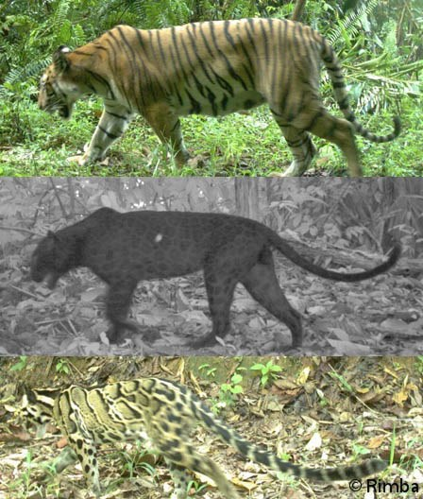
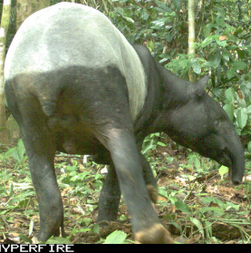
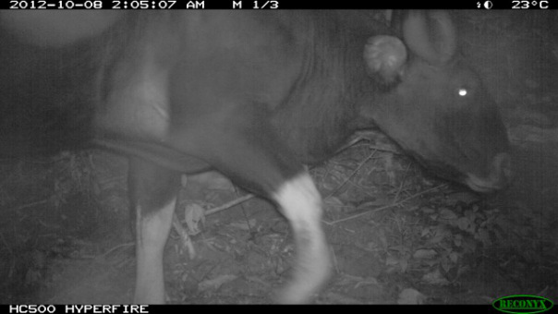
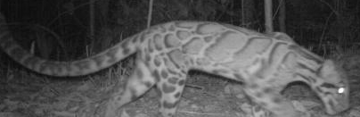
Green Security Domains:
Understand the Problem In the Field
  In collaboration with Panthera
  A tropical forest in southeast asia
  Main focus: Tiger, Leopard
  Other animals: Tapir, Serow, Gaur, etc
Notes:
Now let me summarize the presentation, first we proposed a novel …..
We introduce a LP based …… to solve the game.
We then discussed the concept of equilibrium refinement
And finally, we show the experimental results and the deployment of the work in the ferry protection domain.
Thank you all for your attention.

Slide 4
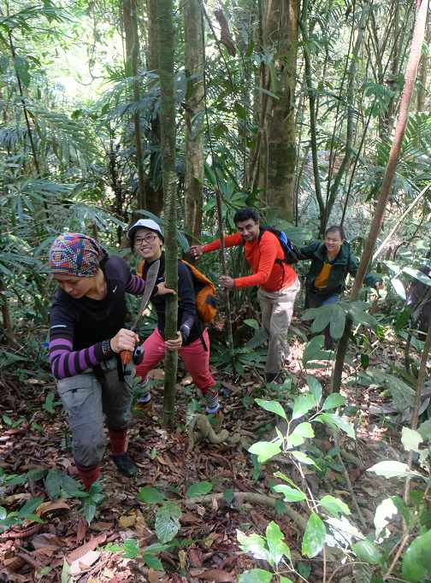
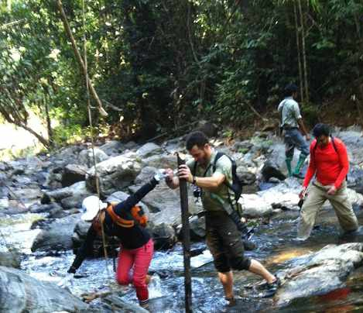
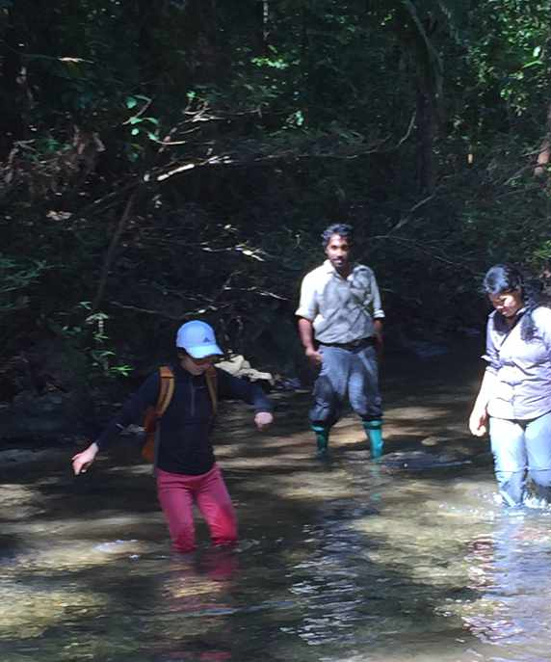
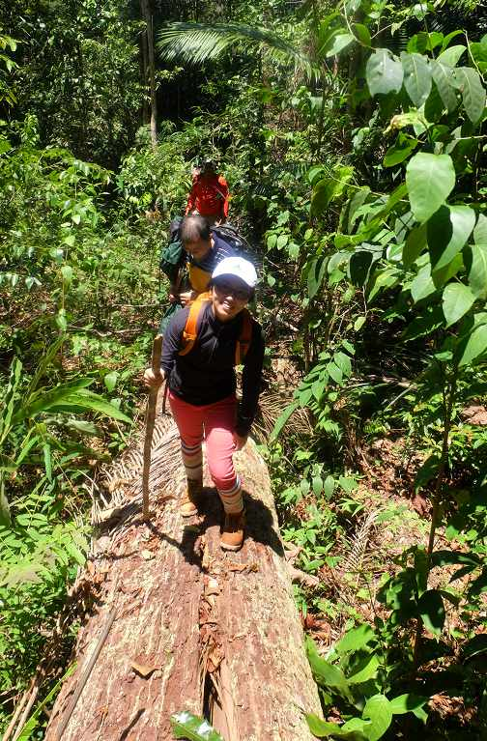
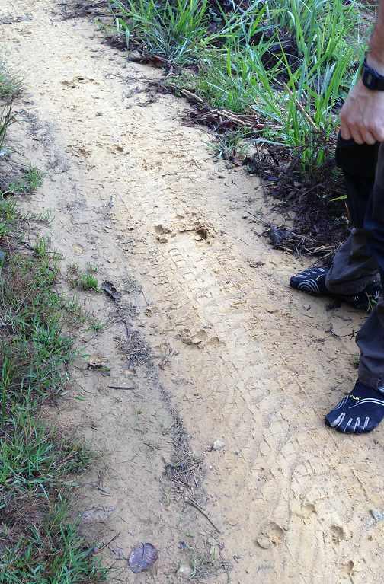
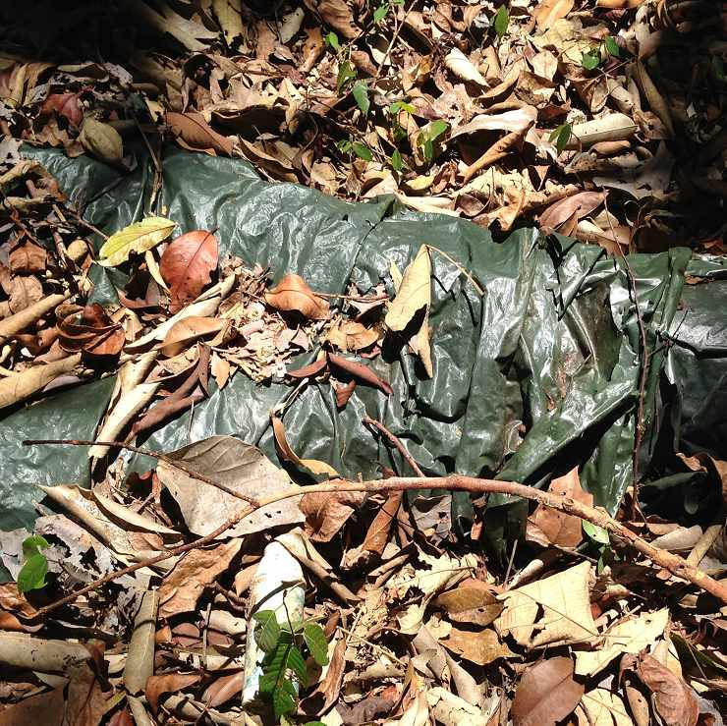
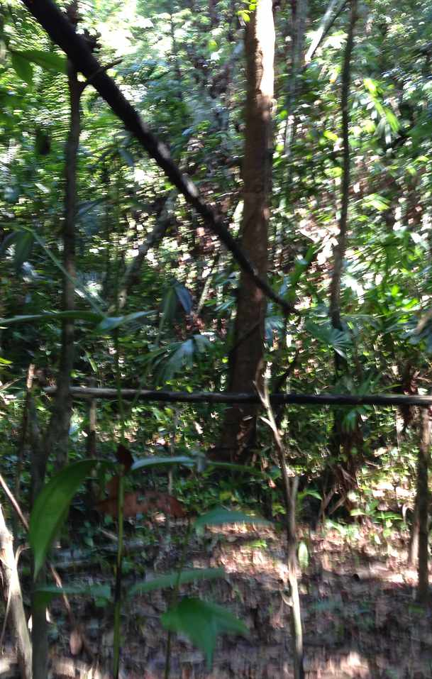
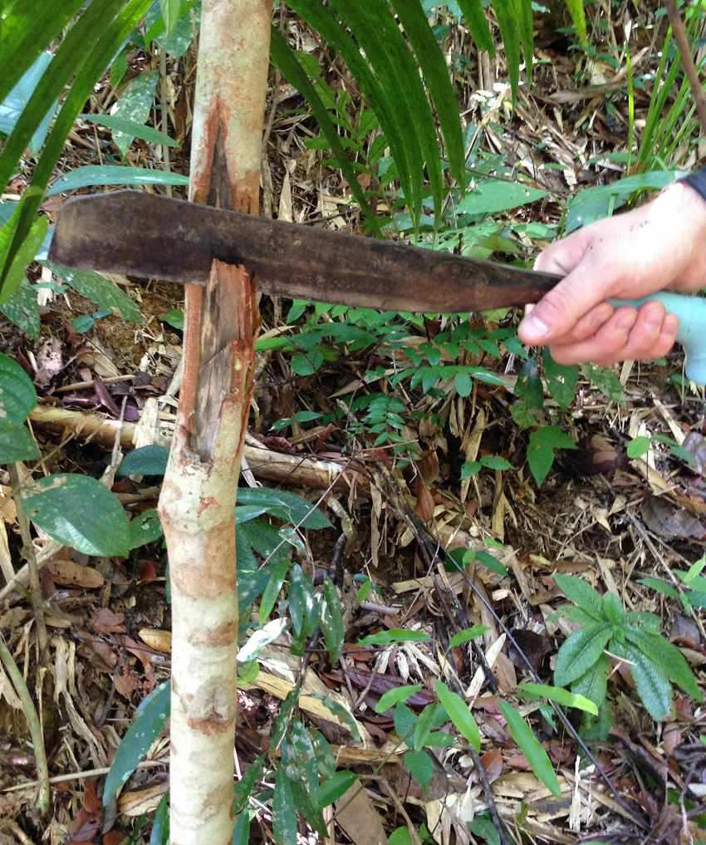
Green Security Domains:
Understand the Problem In the Field
8-hour patrol in April 2015
Notes:
Now let me summarize the presentation, first we proposed a novel …..
We introduce a LP based …… to solve the game.
We then discussed the concept of equilibrium refinement
And finally, we show the experimental results and the deployment of the work in the ferry protection domain.
Thank you all for your attention.

Slide 5


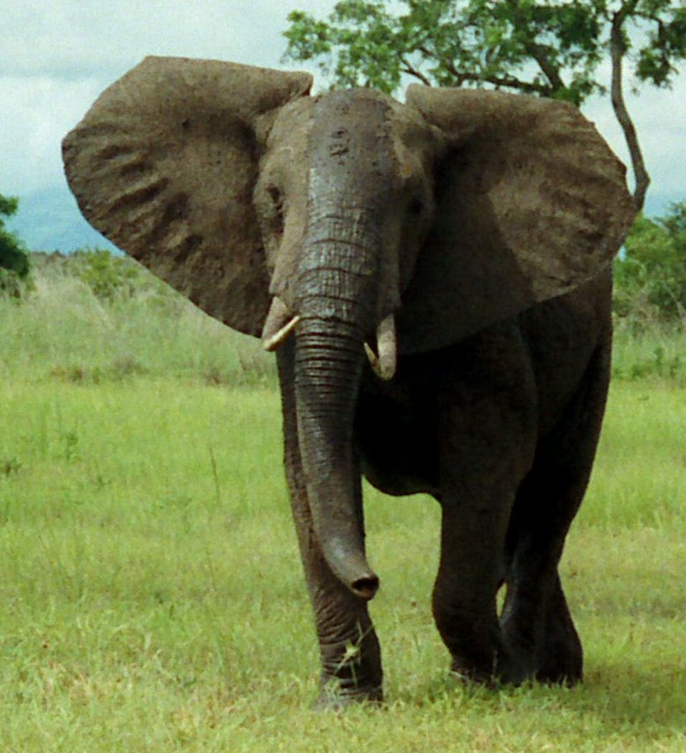
Security Games:
Infrastructure Security vs Green Security
Infrastructure security games
Protecting infrastructure
Single shot games
Very limited number of attacks
  Lack significant data
Highly strategic attackers
  Surveil/plan carefully
Green security games
Protecting wildlife, fish etc
Repeated games
  Repeated and frequent attacks
  Significant amounts data
Attacker bounded rationality
  Limited surveillance/planning
Notes:
In previous work, security games has been proposed to handle the strategic resource allocation problem for protecting infrastructure such as flights and ports, and many successfully applications have been deployed. However, the problem for protecting wildlife and fisheries is very different. The most important difference is that in such green security problem, there can be frequent and repeated adversary interaction. Unlike in infrastructure security problems where there are very limited number of attacks, poachers place snares and check the status of the snares frequently. So the one-shot game model for protecting infrastructure does not apply to green security domains. And because of the frequent attacks in green security domains, there are much more attack data available. Also, the attackers in green security domains are less strategic, as they have to make decisions frequently and they do not have enough time to make extensive surveillance before each of their attacks. So it is more important to consider the attackers’ bounded rationality and limited surveillance.

Slide 6
Contributions
Green Security Game
  A model for green security domains
  Generalize Stackelberg assumption
Planning algorithms
  Designs defender strategy sequence
Framework including planning and learning
  Learn parameters from attack data
Notes:
Due to all these differences, a new model is needed for green security problems. In this work, we introduce Green Security Games, a novel game model for green security domains with a generalized Stackelberg assumption. The Stackelberg assumption is the standard assumption used in infrastructure security games that the defender will commit to a strategy first, and then the attacker will conduct surveillance to fully observe the defender’s strategy before taking action. This assumption is also used in some prior work for green security domains. However, this assumption may not always hold as the poachers or the illegal fishmen take actions frequently and may not have time to fully observe the defender’s current strategy.
Actually, because they may not make long-time surveillance before taking actions, when the defender decides to change her strategy in one day, the poachers may not get a timely update about this change, and may still respond to what they believe the defender strategy is, which is already outdated. So the defender can benefit from the strategy change if planned carefully. This leads to our second contribution, which is to design a sequence of defender strategies, meaning the defender should exploit the attackers’ delayed observation and plan for strategy change.
The third contribution of the work is to incorporate planning and learning. Given the attack data collected by the patrollers, the defender can learn a better model about the poachers’ behavior, which can be used to improve the defender’s planning.

Slide 7
Outline
Background and Motivation
Contributions
Green Security Game Model
Planning
Planning and Learning
Experimental Results
Future Work and Conclusion
Notes:
For the rest of the presentation, I will go through our Green Security Game model, and provide the high level ideas of our planning and learning algorithm, followed by experimental results and future work,
7

Slide 8
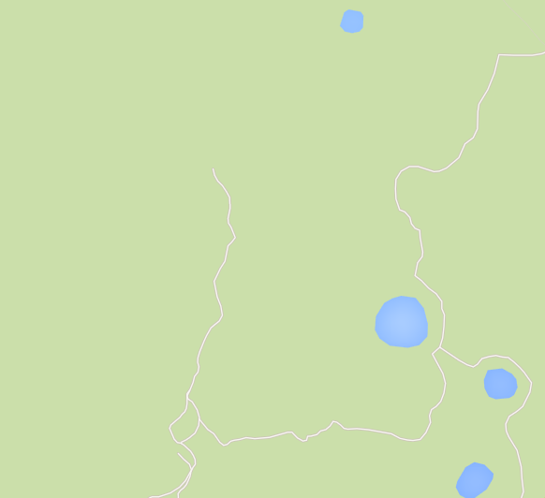

Green Security Game Model
$T$ round game, mixed defender strategy in each round
Jan | Feb | Mar | Apr | May
0.3 | 0.4 | 0.1 | 0.2 | 0.5 | 0 | 0.1 | 0.7
0.2 | 0.2 | 0.3 | 0.3 | 0.4 | 0.5 | 0.6 | 0.1
0.6 | 0.7 | 0.1 | 0.2 | 0.3 | 0.2 | 0 | 0.9
0.4 | 0.5 | 0.6 | 0.3 | 0.1 | 0.2 | 0.3 | 0
0.1 | 0.2 | 0.3 | 0.4 | 0.5 | 0.3 | 0.4 | 0.1
0.3 | 0.4 | 0.5 | 0.5 | 0.5 | 0.1 | 0.1 | 0.1
0.2 | 0.2 | 0.2 | 0.3 | 0.3 | 0.3 | 0.4 | 0.5
0.1 | 0.1 | 0.6 | 0.3 | 0.4 | 0.2 | 0.4 | 0.4
Notes:
To model the frequent and repeated interaction, we model the problem as a repeated game with T rounds, each round corresponds to a period of time, say a month for the players to take actions. The protected area is discretized into multiple subareas, each can be seen as a target. In each round, the defender chooses a mixed strategy, for example
There are K patrollers who will decide where to patrol every day. In this talk, we consider the special case where each patroller will choose a sub-area every day and do extensive patrols in that area. The defender is faced with a population of attackers, and each attacker will choose in which subarea to place snares every day.

Slide 9


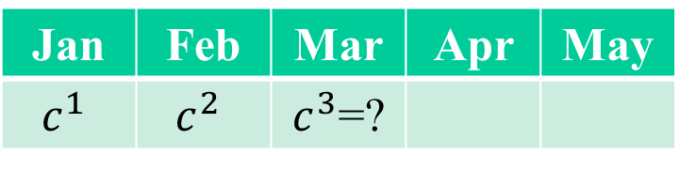
Green Security Game Model
  Attacker respond to convex combination of defender strategy in recent rounds
    Attackers’ observation maybe delayed (infer from signs)
    Information sharing among attackers
    A generalization of the Stackelberg assumption ($η^{t}=c^{t}$)
Jan | Feb | Mar | Apr | May
$$c^{1}$$ | $$c^{2}$$ | $c^{3}$=?
$$η^{3}=0.3c^{1}+0.7c^{2}$$
Notes:
We know that the attackers may not have up-to-date information about the defender strategy. For example, on one day in March, when the poacher needs to decide where to place snares, he does not know what is the defender strategy that is currently used in March. Naturally, he will take into account what he observed or learned from other poachers from the past. So we estimate the attackers’ belief about the defender strategy in current round, denoted by eta^t, as a convex combination of the defender strategies used in recent rounds. This is a generalization of the perfect Stackelberg assumption which says the attackers belief is always up-to-date. This generalized assumption provides more flexibility and better fits the situation in green security domains.

Slide 10
Green Security Game Model
  Attacker chooses target with bounded rationality
    Following the SUQR model
      Choose more promising targets with higher probability
      Evaluation on key properties
    Attackers have different characteristics (parameters)
Notes:
We also know that the attackers are boundedly rational in choosing targets, meaning they may not always go for the target with the highest expected utility. So we adopt the SUQR model, the best model for attackers’ bounded rationality when tested against human subjects. This models says that the attacker will choose more promising targets with higher probability. And the judgement on which target is more promising is based on the attacker’s evaluation on key properties of the targets
will choose a target i with probability q_i, which is a non-convex function of the reward, penalty and defender strategy. Note that omega 1, 2, 3 are parameters that describes how the attacker evaluate different targets and the parameters are different from attacker to attacker.

Slide 11

Outline
Background and Motivation
Contributions
Green Security Game Model
Planning
Planning and Learning
Experimental Results
Future Work and Conclusion
$$η^{t}=c^{t−1}$$
Notes:
Based on this model, when all the parameters are known, we propose planning algorithms that design defender strategies for each round of the game. In this talk, I will use a special case as an example, which is the attackers always respond to the defender strategy in the last round, meaning the attackers’ understanding about the defender strategy is always delayed by one round.
11

Slide 12

Planning
Exploit attackers’ delayed observation ($η^{t}=c^{t−1}$)
A simple example:
  Patrol Plan A: always uniformly random
  Patrol Plan B: change her strategy deliberately, detect more snares overall
N
 | Jan | Feb
N | 80% | 20%
S | 20% | 80%
S
Notes:
In this case, we need to plan for defender strategy change to exploit the attackers’ delayed observation.

Slide 13

Planning
x
  Solve directly
    Optimize over all rounds $→$ computationally expensive
Jan | Feb | Mar | Apr | May
? | ? | ? | ? | ? | ? | ? | ?
? | ? | ? | ? | ? | ? | ? | ?
? | ? | ? | ? | ? | ? | ? | ?
? | ? | ? | ? | ? | ? | ? | ?
? | ? | ? | ? | ? | ? | ? | ?
? | ? | ? | ? | ? | ? | ? | ?
? | ? | ? | ? | ? | ? | ? | ?
? | ? | ? | ? | ? | ? | ? | ?
Notes:
Build a large Mathematical Program (MP), optimize over all rounds simultaneously
Non-convex, large number of variables $→$ computationally expensive when $T$ is large

Slide 14
Planning
x
Solve greedily
  Consider current round utility only
  Ignore impact of current strategy in the future
Jan | Feb | Mar | Apr | May
$$c^{1}$$ | $c^{2}=$?
0 | 0 | 0 | 0 | 0 | 0 | 0 | 0
0 | 0 | 0 | 1 | 0 | 0 | 0 | 0
0 | 0 | 0 | 0 | 0 | 0 | 0 | 0
0 | 0 | 0 | 0 | 0 | 0 | 0 | 0
0 | 0 | 0 | 0 | 1 | 0 | 0 | 0
0 | 0 | 0 | 0 | 0 | 0 | 0 | 0
0 | 0 | 0 | 0 | 0 | 0 | 0 | 0
0 | 0 | 0 | 0 | 0 | 0 | 0 | 0
Notes:
Attacking probability for current round is known to defender
Consider current round utility only
Ignore impact of current strategy in the future $→$ high degradation when it is not the last round of the game

Slide 15
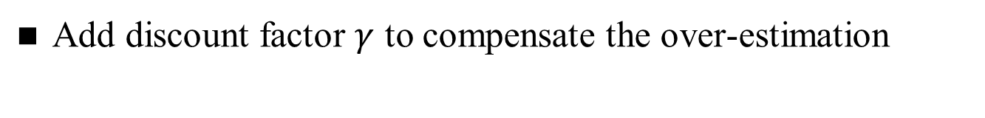




Planning
PlanAhead-M
PlanAhead-M
  Look ahead M steps: find an optimal strategy for current round as if it is the Mth last round of the game
  Sliding window of size M. Example with M=2
$$E^{1}+{\overline{E}}^{2}$$
$$E^{3}+{\overline{E}}^{4}$$
Jan | Feb | Mar | Apr | May
$$E^{2}+{\overline{E}}^{3}$$
$$E^{4}+E^{5}$$
Add discount factor $γ$ to compensate the over-estimation
Notes:
We use an example to illustrate the problem, three targets moves between terminals A and B. The schedule of a target F_q is a mapping from time to distance.
A patroller moves along AB, and provide protection to targets within protection radius. In this example, patroller P1 is protecting target F2.

Slide 16

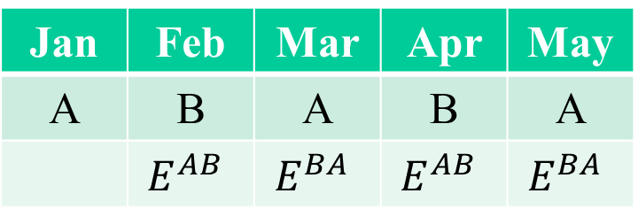
Planning
FixedSequence-M
Require the defender to execute the sequence of length M repeatedly
Example with M=2: find best strategy A and B
Theoretical guarantee: $\left(1−\frac{1}{M}\right)$ approximation of the optimal strategy profile
Jan | Feb | Mar | Apr | May
A | B | A | B | A
 | $$E^{AB}$$ | $$E^{BA}$$ | $$E^{AB}$$ | $$E^{BA}$$
Notes:
We use an example to illustrate the problem, three targets moves between terminals A and B. The schedule of a target F_q is a mapping from time to distance.
A patroller moves along AB, and provide protection to targets within protection radius. In this example, patroller P1 is protecting target F2.

Slide 17
Outline
Background and Motivation
Contributions
Green Security Game Model
Planning
Planning and Learning
Experimental Results
Future Work and Conclusion
Notes:
The planning algorithms assume that all parameters are known, however, it may not true and learning from attack data is necessary.
17

Slide 18
Planning and Learning
Learn parameters in attackers’ bounded rationality model from attack data
Previous work
  Apply Maximum Likelihood Estimation (MLE)
  May lead to highly biased results
Our learning algorithm
  Calculate posterior distribution for each data point
Notes:
Our work focus on learning the omega parameters that describe the attackers’ characteristic in choosing which target to attack. Previous work on learning these parameters in green security domains focus on maximum likelihood estimation, which may lead to highly biased results. as there may not be sufficient number of data, and in many cases, the data in green security domains could be anonymous. For example, the patrollers may only find the snares placed on the ground without knowing who placed it.
Our learning algorithms calculates a posterior distribution of each data point in every round, and use the average distribution to calculate the strategy for next round.

Slide 19
Outline
Background and Motivation
Contributions
Green Security Game Model
Planning
Planning and Learning
Experimental Results
Future Work and Conclusion
Notes:
For the rest of the presentation, I will go through the first two contributions in detail. For simplicity, we use single patroller as an example and multiple patrollers case can be found in the paper. We will then show the experimental results, discuss related work, followed by a conclusion. The discussion about equilibrium refinement is not covered in this presentation, please refer to the paper if you are interested.
19

Slide 20
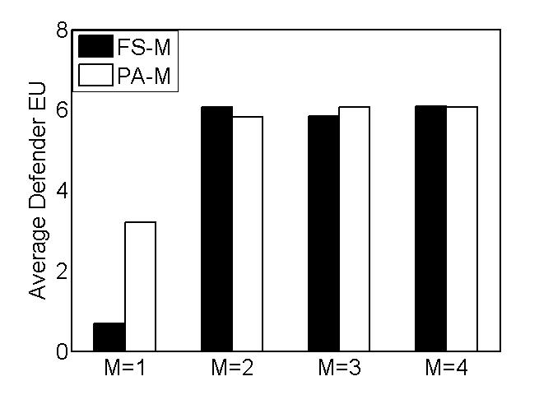
Experimental Results
Planning
Baseline: FS-1 (Stackelberg), PA-1 (Myopic)
Attacker respond to last round strategy, 10 Targets, 4 Patrollers
Baseline

Slide 21
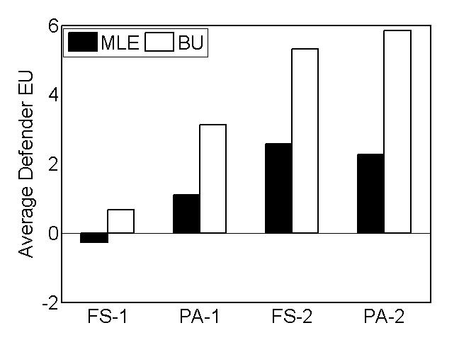
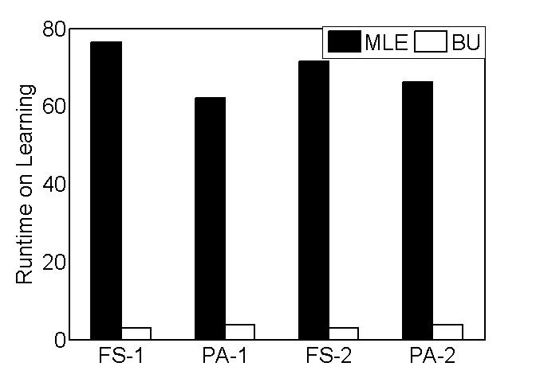
Experimental Results
Planning and Learning
Baseline: Maximum Likelihood Estimation (MLE)
Solution Quality
Runtime

Slide 22
Outline
Background and Motivation
Contributions
Green Security Game Model
Planning
Planning and Learning
Experimental Results
Future Work and Conclusion
$$η^{t}=c^{t−1}$$
Notes:
For the rest of the presentation, I will go through the first two contributions in detail. For simplicity, we use single patroller as an example and multiple patrollers case can be found in the paper. We will then show the experimental results, discuss related work, followed by a conclusion. The discussion about equilibrium refinement is not covered in this presentation, please refer to the paper if you are interested.
22

Slide 23
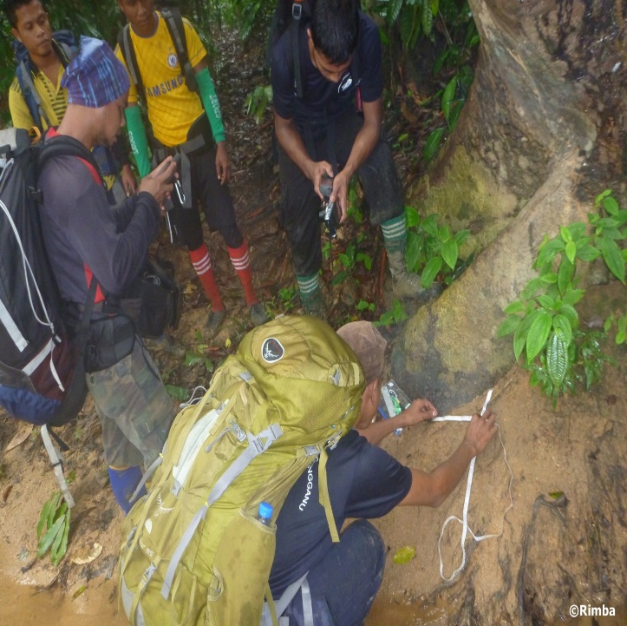
Future Work
  Learn the parameters in convex combination from attack data
  Consider missing data (silent victims)
  Uncertainty in the model and robust strategies
  Real-world deployment (on-going)
    Trial test: November 2014
    Extensive deployment: July 2015

Slide 24
Conclusion
Green Security Game
Planning is necessary with generalized Stackelberg assumption
Learn attackers’ behavior model from data
On-going real-world deployment
Thank you!
feifang@usc.edu
Notes:
Now let me summarize the presentation, first we proposed a novel …..
We introduce a LP based …… to solve the game.
We then discussed the concept of equilibrium refinement
And finally, we show the experimental results and the deployment of the work in the ferry protection domain.
Thank you all for your attention.

Slide 25
Backup Slides

Slide 26
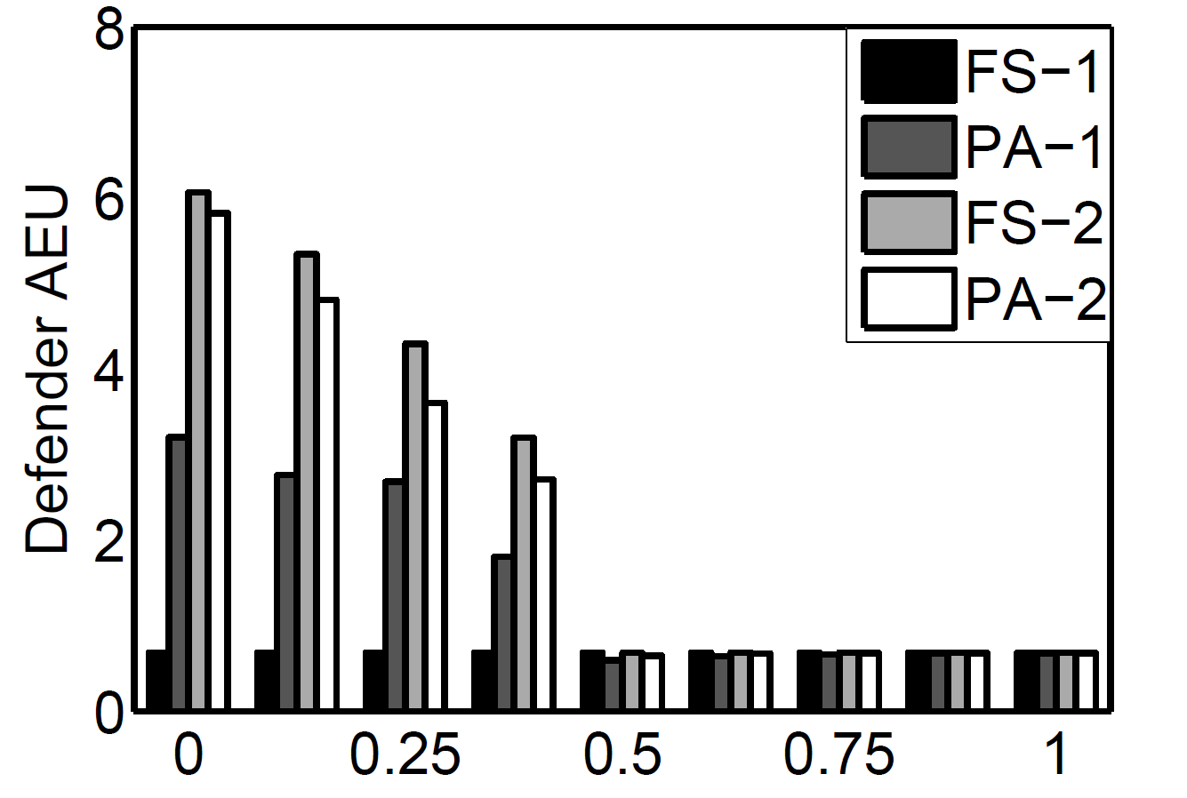
When Attackers’ Belief Getting Closer to Stackelberg Assumption

Slide 27
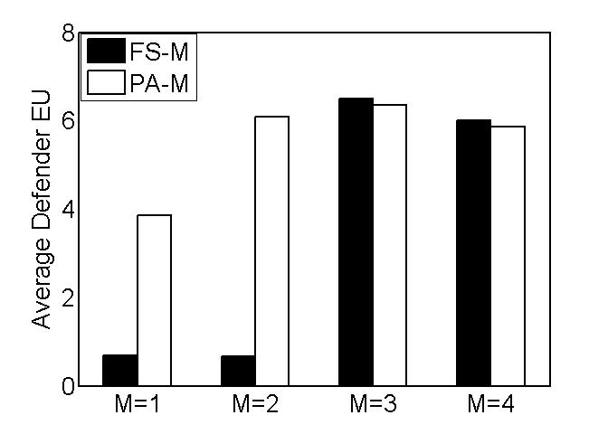
Attacker Memory = Two Rounds

Slide 28
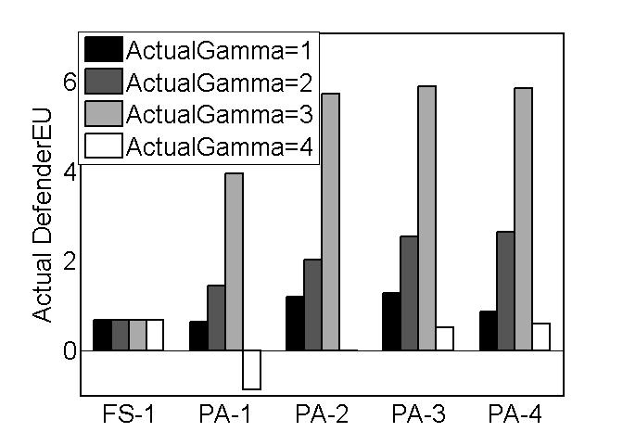

Robustness of PA-M
Robustness against uncertainty in attackers’ memory length $Γ$
Over-estimating attacker’s memory is a safer bet

Slide 29
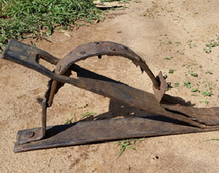
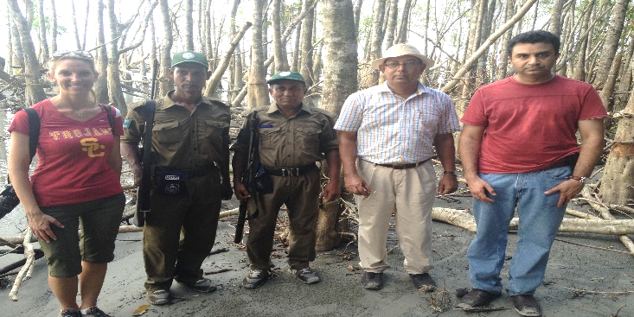
Green Security Domains:
Protecting Fish and Wildlife
How do rangers/poachers interact?
A population of poachers
Poachers lay snares, check/ relocate the snares frequently
Rarely caught on site
Rangers may find footprint/snares/ skulls of animals
All the findings are entered into data system every month
Notes:
You may hear about poachers who hunt the animals by guns, but many other poachers will place wired snares as shown here or other types of traps on the ground to catch the animals and this is the type of poaching that we will discuss in this talk.
Let us have a closer look into the problem of preventing poaching. We talk to domain expert Andrew Lemieux
Milind visited Sunderbans, a national region in Bangladesh
Rangers can free trapped animals, confiscate snares
Rangers have handheld GPS and their

Slide 30
General Framework of
Green Security Game
Defender plans her strategy
Start New Round
Learn from data: Improve model
Local guards executes patrols
Poachers attack targets
Notes:
So the framework of green security games is that the defender first plans her strategy, local guards then executes patrols, at the same time and the poachers will choose where to attack based on a maybe-delayed observation about the defender strategy. Then the defender can learn from the attack data collected, improve her model about the poachers’ behavior and re-plan her strategy for next round.

Slide 31
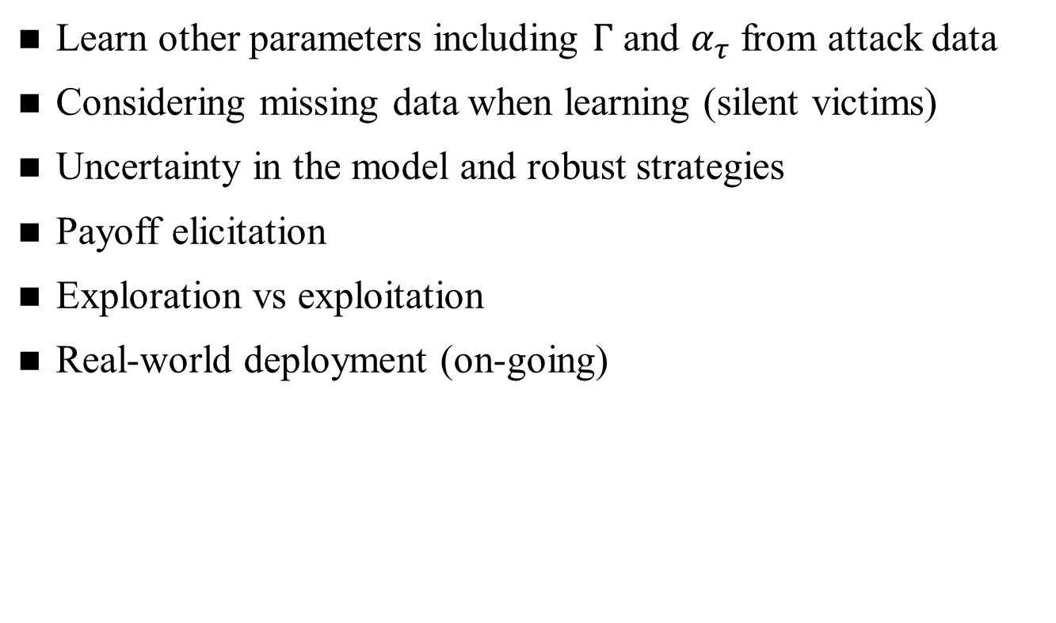
Future Work
  Learn other parameters including $Γ$ and $α_{τ}$ from attack data
  Considering missing data when learning (silent victims)
Uncertainty in the model and robust strategies
Payoff elicitation
Exploration vs exploitation
Real-world deployment (on-going)

