Slide 1
Imitation Learning from Video by Leveraging Proprioception
Faraz Torabi*, Garrett Warnell^, Peter Stone*
*University of Texas at Austin,
^Army Research Laboratory

Slide 2
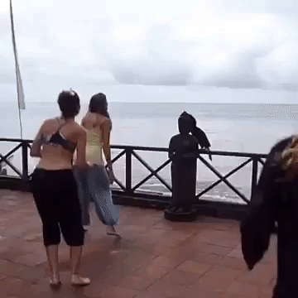
What is Imitation from Observation?

Slide 3
Related Work
Time Contrastive Networks [Sermanet et al. 2017]
Behavioral Cloning from Observation [Torabi et al. 2018]
Generative Adversarial Imitation from Observation [Torabi et al. 2018)]

Slide 4
Problem
In IfO problems, how to improve
performance
and, sample efficiency?

Slide 5
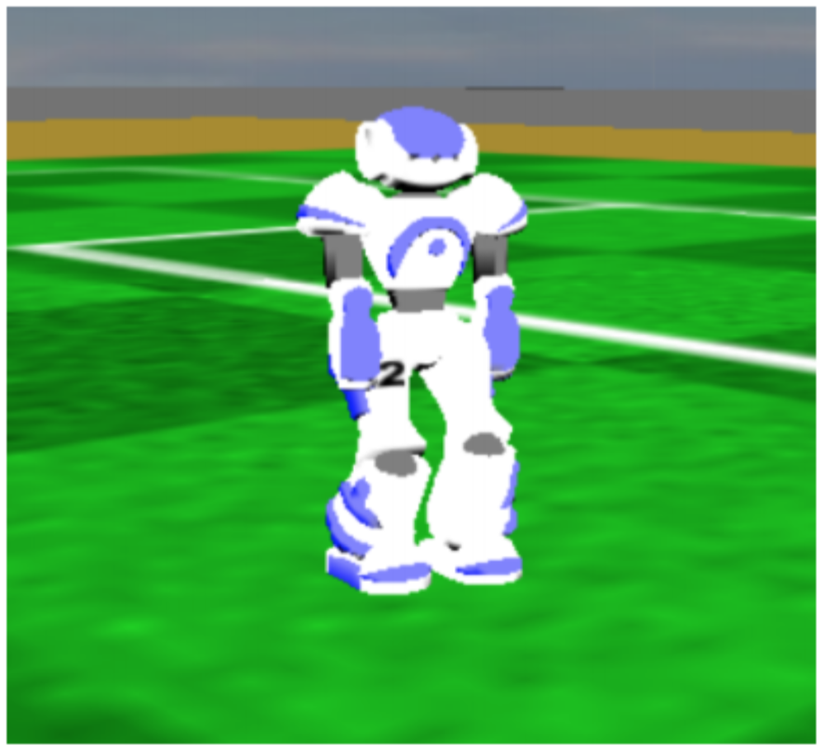
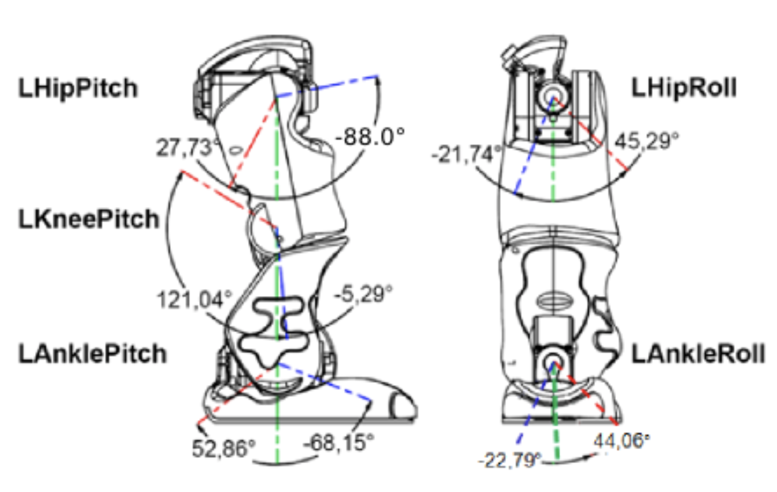
Visual Information
Proprioceptive Information
RGB, Grayscale, etc.
Low-level features such as Joint angles
http://doc.aldebaran.com/2-1/family/robots/joints_robot.html

Slide 6
Problem
In IfO problems, how to improve
performance
and, sample efficiency?
Hypothesis:
Leveraging proprioceptive information will help with both issues

Slide 7
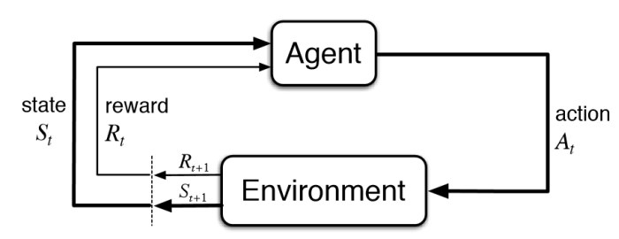
Reinforcement Learning (RL)

Slide 8
Markov Decision Process (MDP)
Formally, we model agent interaction as an MDP i.e.
Where,
S is the state space of the agent
A is the action space of the agent
T is transition probabilities i.e.
R is the scalar reward i.e.
is the discount factor
Goal:
where we want to find policy,
Drawback:
Requires extensive explorations
Designing reward functions are requires domain knowledge

Slide 9
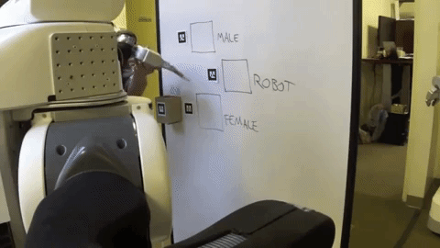
Imitation Learning
Goal:
Learn how to make decisions by trying to imitate another agent.
Observations of other agent (demonstrations) consist of state-action pairs.
Limitation:
Precludes using a large amount of demonstration data where action sequences are not given (e.g. YouTube videos).

Slide 10
Imitation from Observation
Goal:
Learn how to perform a task given state-only demonstrations.
Formulation:
Given:
Learn:

Slide 11
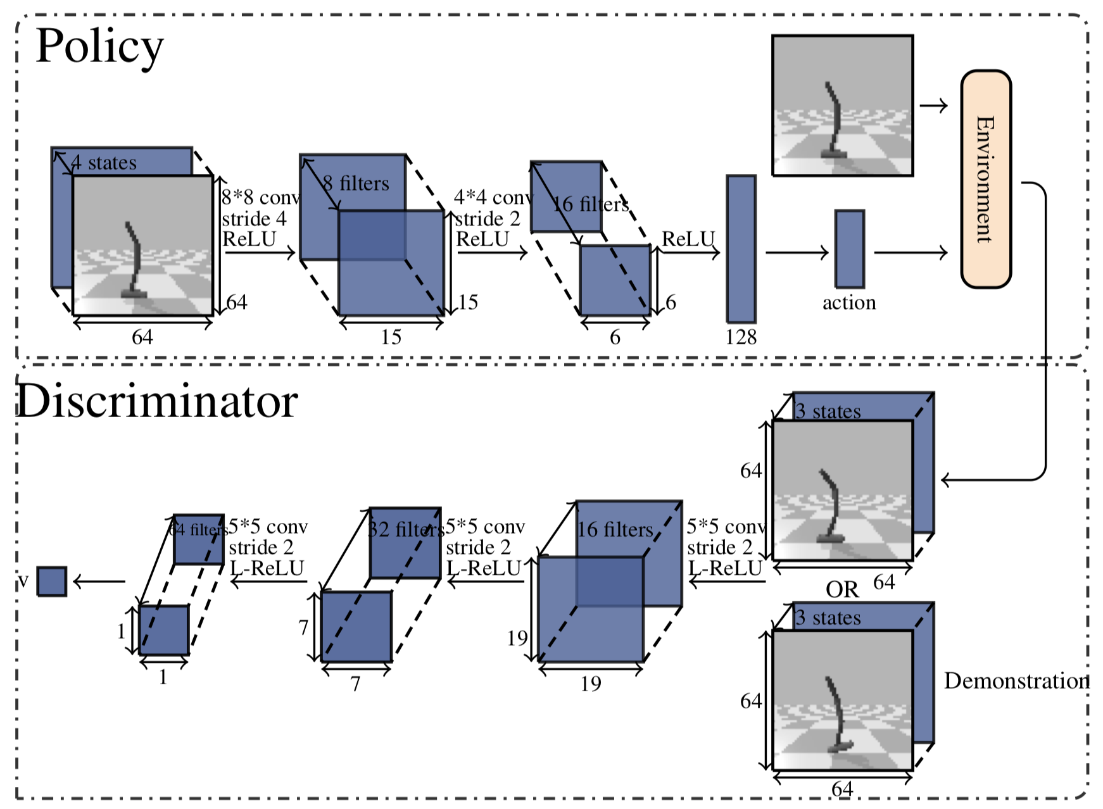
Generative Adversarial Imitation from Observation

Slide 12
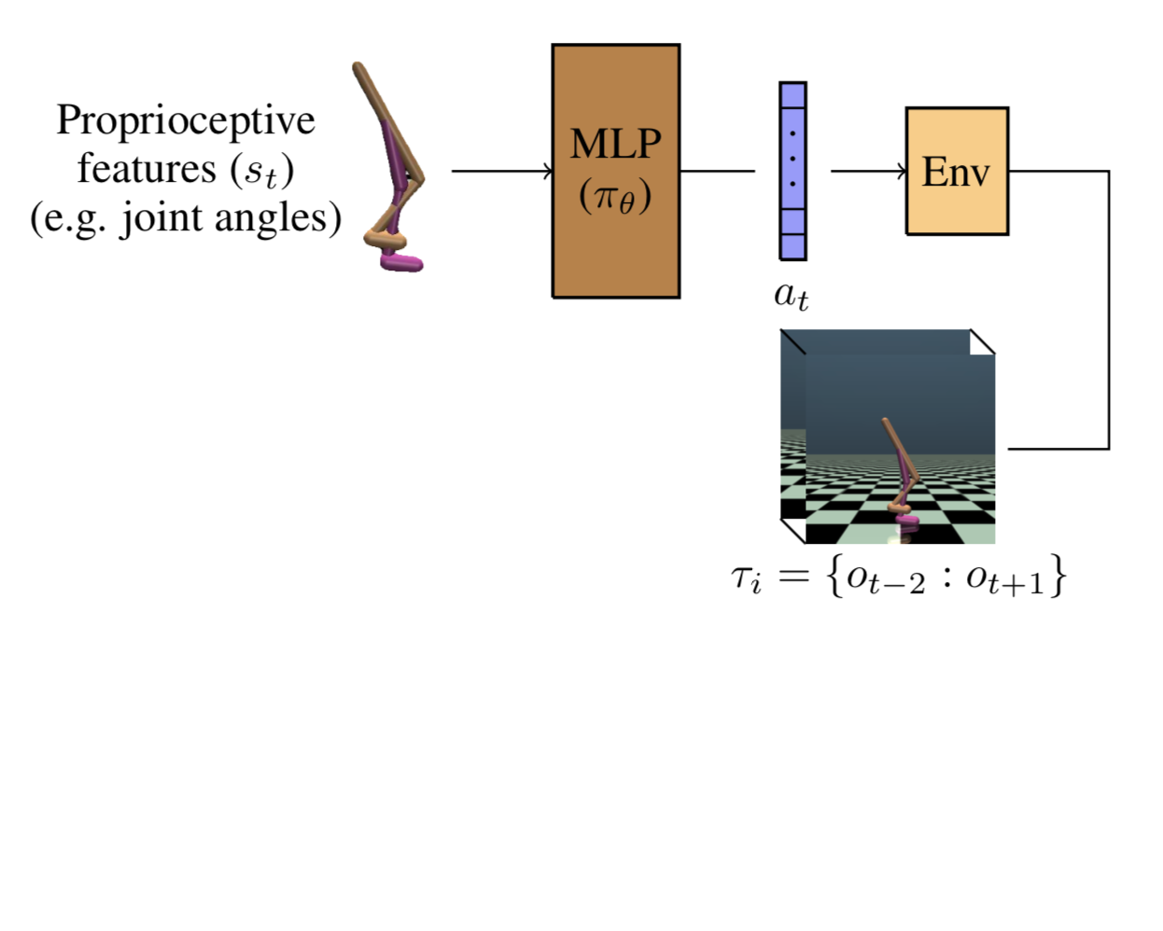
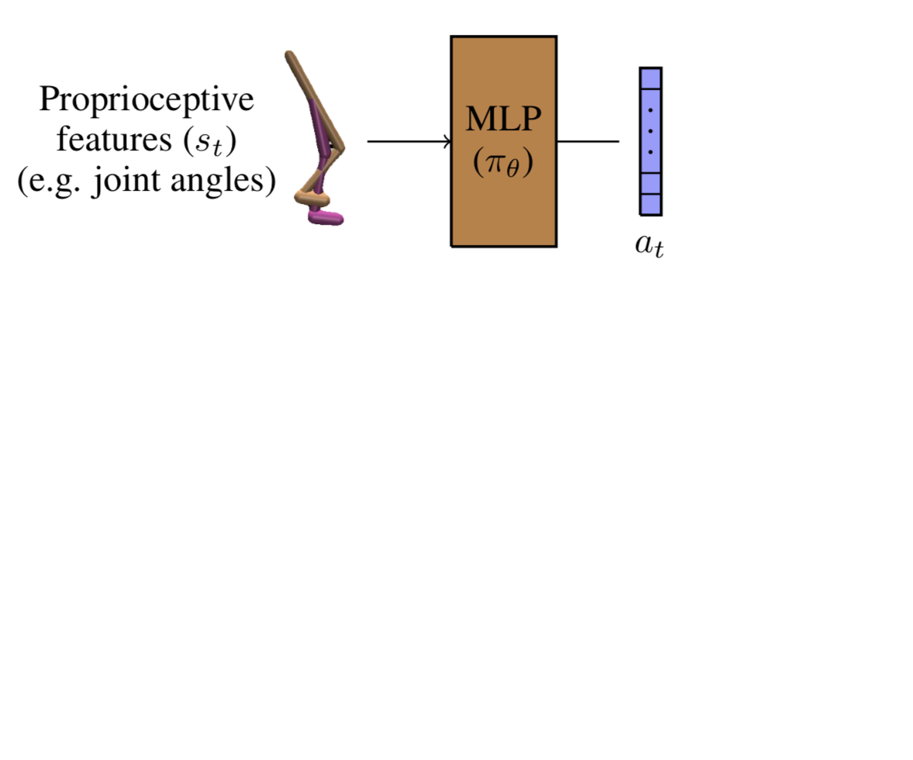
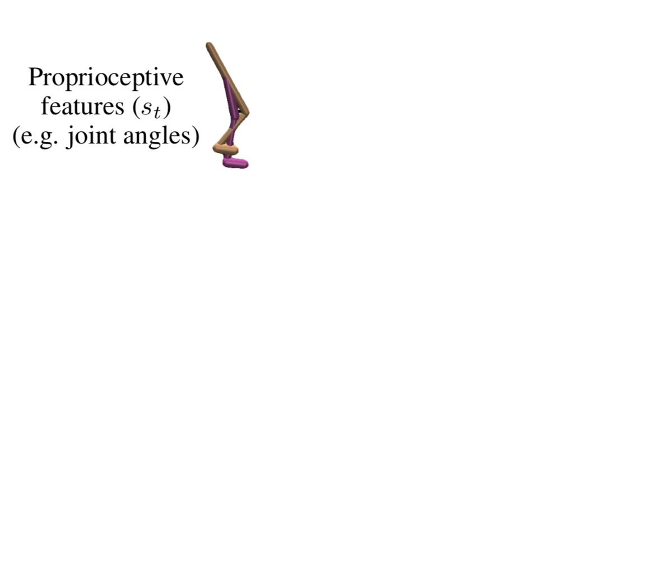
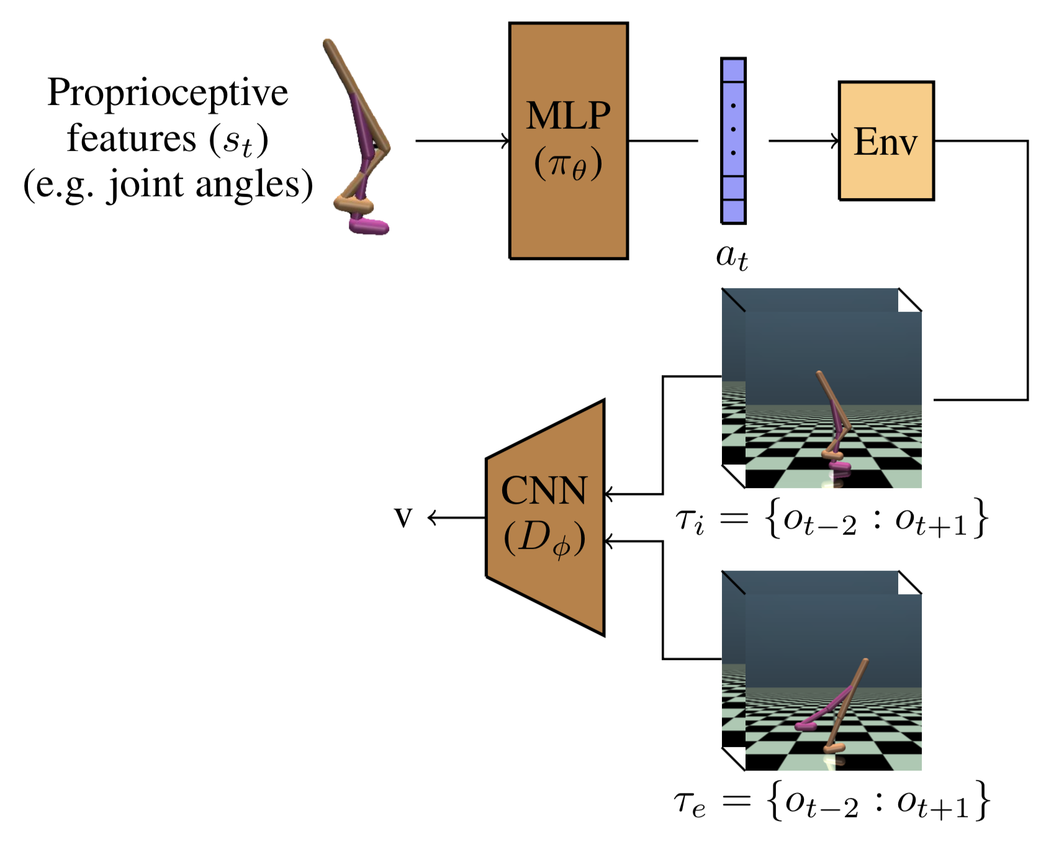
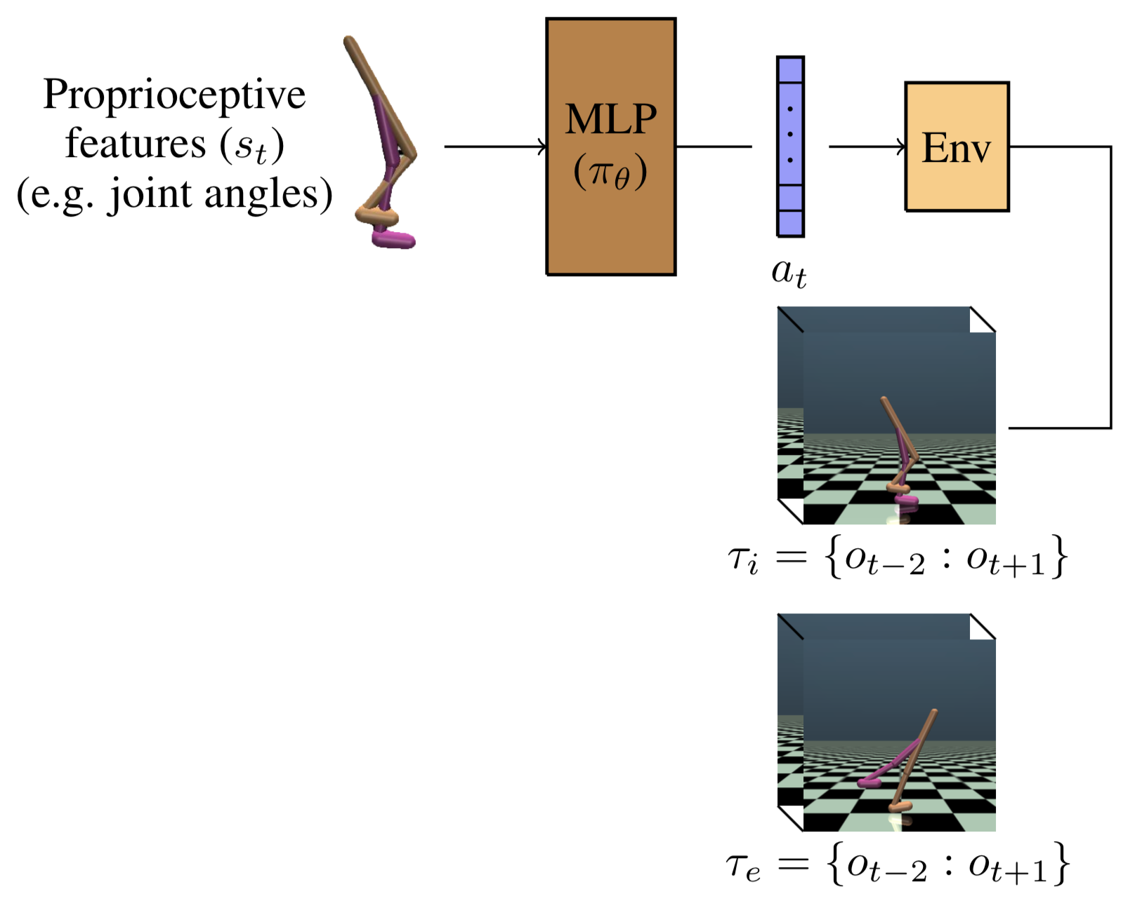
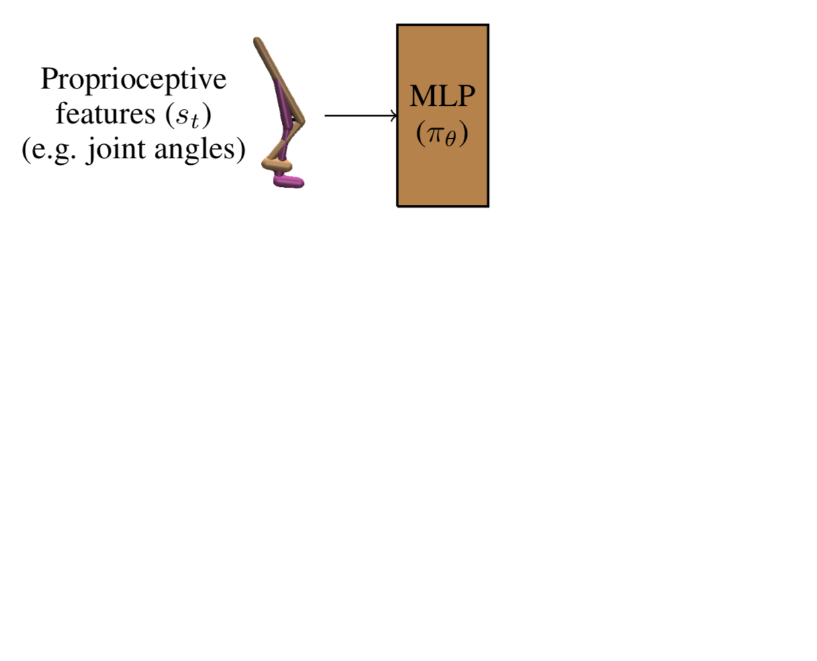
Proposed method
Propose an algorithm that uses both proprioceptive and visual information in order to:
Improver performance
Improve sample complexity

Slide 13
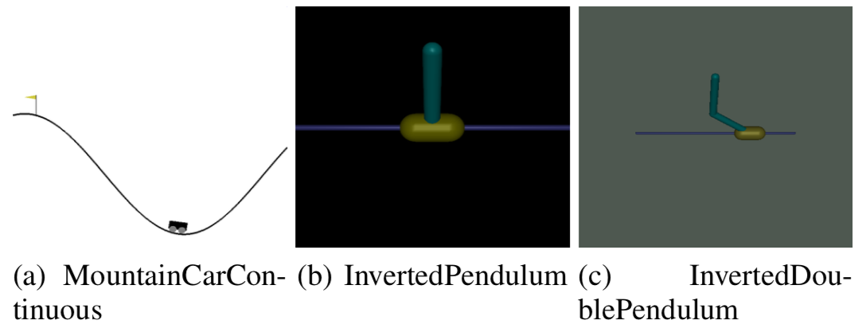
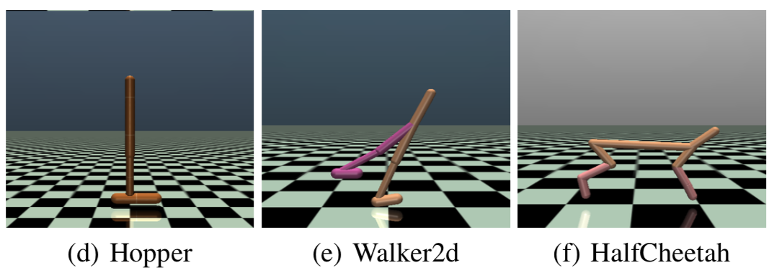
Experiments
Tasks:
OpenAI Gym Environments
Expert policies:
Learned by PPO
Visual demonstrations:
64*64 grayscale frames

Slide 14
Experiments
Baselines:
Generative Adversarial Imitation from Observation (GAIfO)¹
Behavioral Cloning from Observation (BCO)²
Time Contrastive Networks (TCN)³
¹Torabi, Faraz, Garrett Warnell, and Peter Stone. "Generative adversarial imitation from observation." arXiv preprint arXiv:1807.06158 (2018).64*64 grayscale frames
²Torabi, Faraz, Garrett Warnell, and Peter Stone. "Behavioral cloning from observation." Proceedings of the 27th International Joint Conference on Artificial Intelligence. AAAI Press, 2018.
³Sermanet, Pierre, et al. "Time-contrastive networks: Self-supervised learning from video." 2018 IEEE International Conference on Robotics and Automation (ICRA). IEEE, 2018.

Slide 15
Experiments
Demonstration:
Notes:
The agent focuses on optimizing for performance while using the expert’s state-transitions as a template for optimal behavior

Slide 16
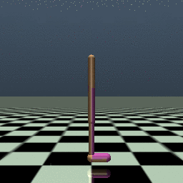
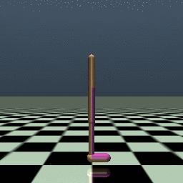
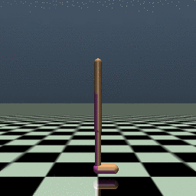
Experiments
Iteration 0:
Iteration 100:
Iteration 1942:

Slide 17
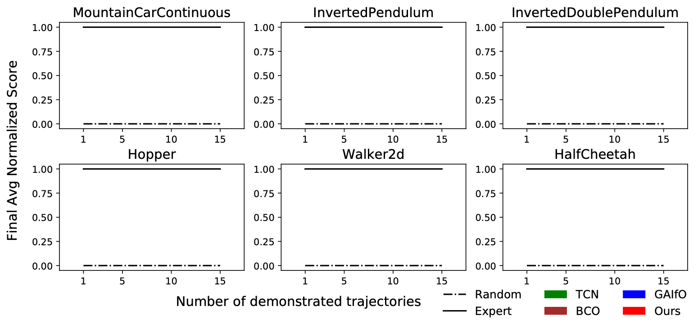
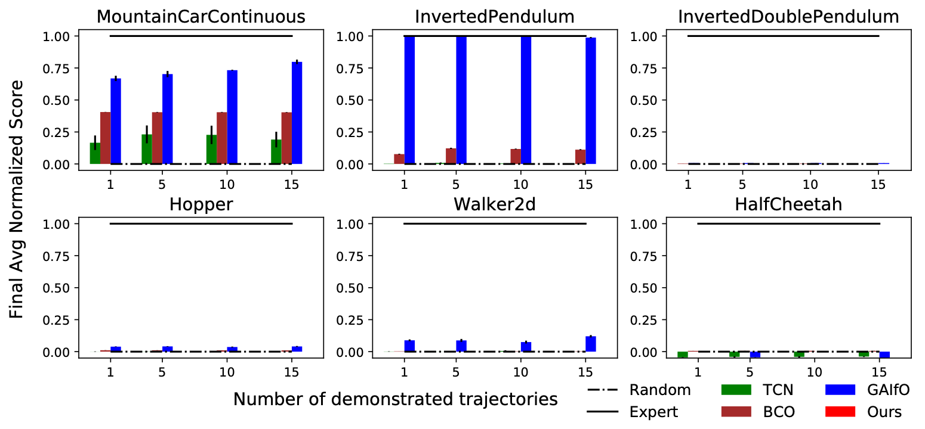
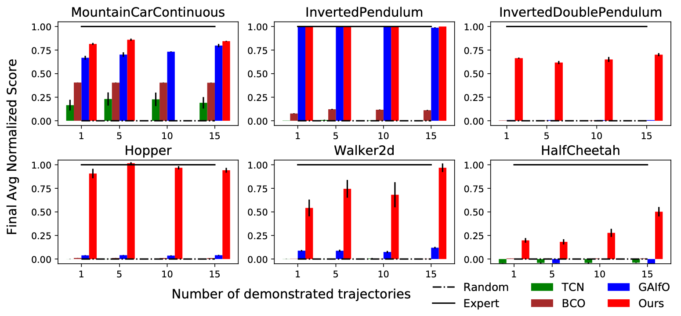
Experiments
Final Performance

Slide 18
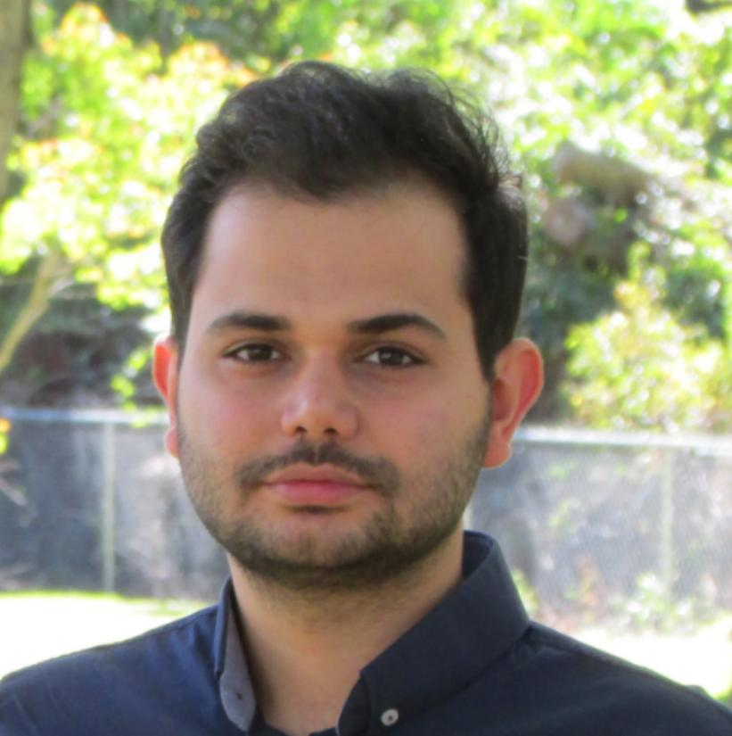
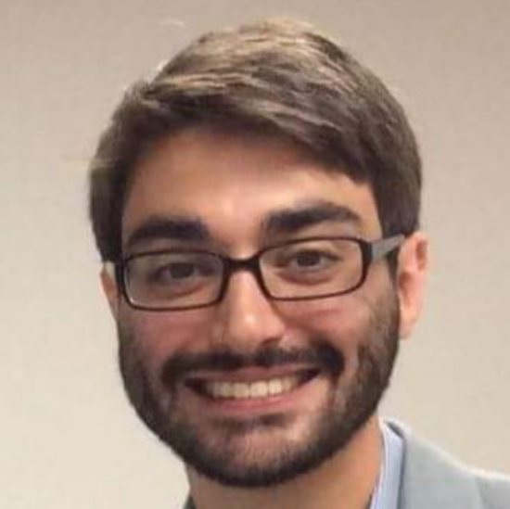
Summary
Hypothesis:
Leveraging proprioceptive information helps with learning speed and performance in IfO problems
Proposed an adversarial imitation learning from observation algorithm that:
Results in better final performance
Improves sample efficiency
Collaborators
Faraz Torabi
Garrett Warnell

