Slide 1










Dynamic Sparse Training for
Deep Reinforcement Learning
Ghada Sokar¹
Elena Mocanu²
Decebal Mocanu^{1,2}
Mykola Pechenizkiy¹
Peter Stone³
¹ Eindhoven University of Technology, The Netherlands
² University of Twente, The Netherlands
³ University of Texas at Austin, Sony AI
Email: g.a.z.n.sokar@tue.nl
The 31st International Joint Conference on Artificial Intelligence (IJCAI-22)

Slide 2
Dynamic Sparse Training
Dense neural network

Slide 3
Dynamic Sparse Training
A recent line of research in which sparse neural networks are trained from scratch. During training both the sparse topology and the weights are optimized.
Dense neural network
Dynamic Sparse Training (Drop , Grow )

Slide 4
Dynamic Sparse Training
A recent line of research in which sparse neural networks are trained from scratch. During training both the sparse topology and the weights are optimized.
Dense neural network
Dynamic Sparse Training (Drop , Grow )
Static Sparse neural network

Slide 5
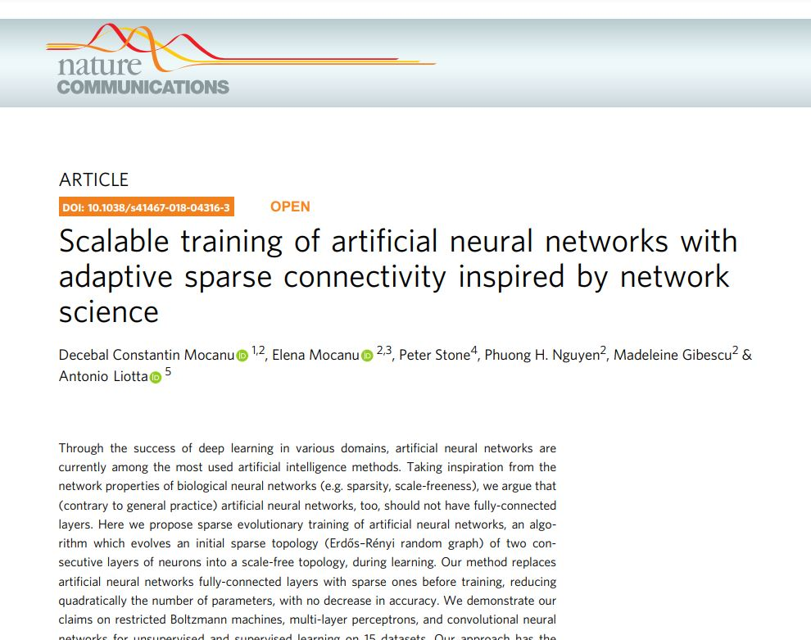
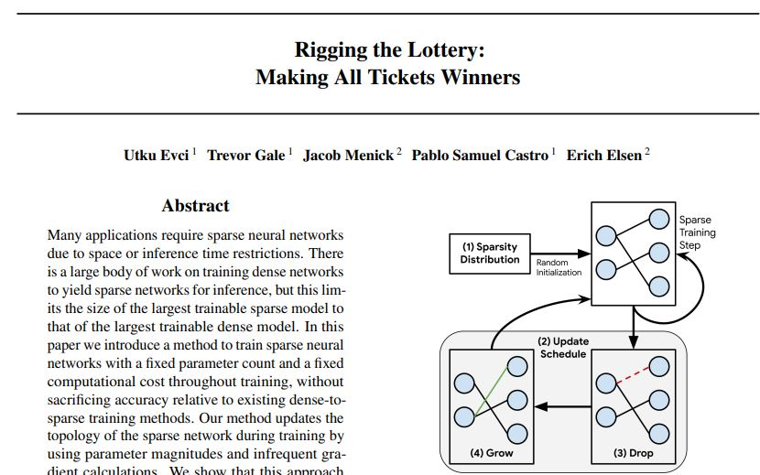
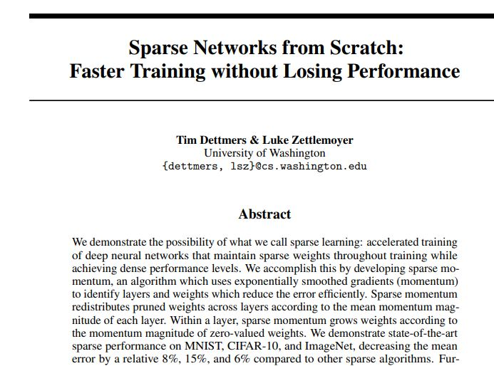
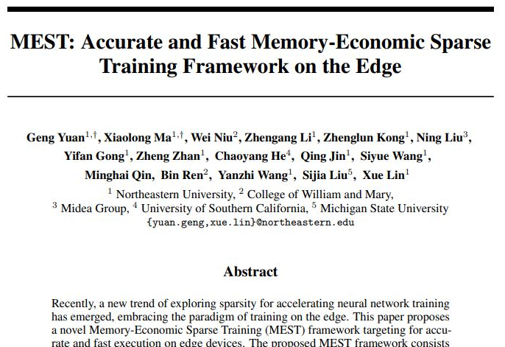
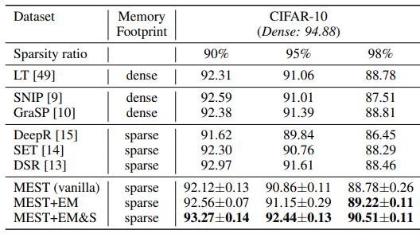
Dynamic Sparse Training for Supervised Learning

Slide 6
Deep Reinforcement Learning (DRL)
Challenges:
Distribution shift during training
Very long training time (many interactions with the environment , neural network size)

Slide 7
Dynamic Sparse Training for Deep Reinforcement Learning
Could we train deep reinforcement learning agents with sparse models from scratch?
What are the benefits that could be achieved?

Slide 8
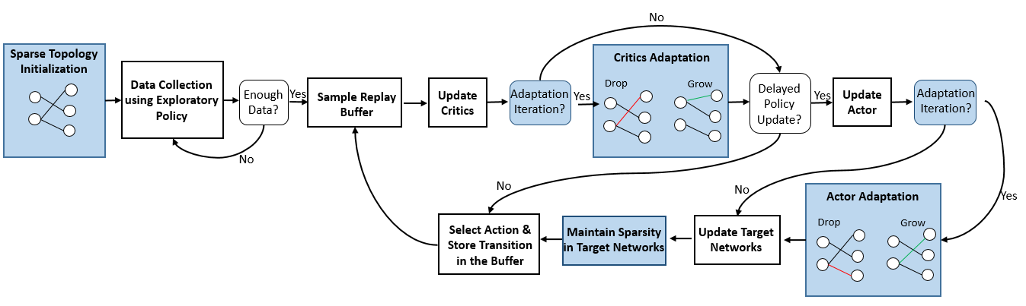
Dynamic Sparse Training for TD3 (DS-TD3)
Twin Delayed Deep Deterministic policy gradient (TD3)
- Actor-critic method (policy π_{φ}, value function Q_{Ө})

Slide 9
DS-TD3
I Sparse Topology Initialization
The actor and critics networks along with the corresponding target networks are initialized with sparse topologies.

Slide 10
DS-TD3
II Adaptation Schedule
Delay the adaptation process and perform it every e iterations. This would allow the newly added connections from the previous adaptation process to grow and learn in this online setting.

Slide 11
DS-TD3
III Adaptation Process
Every e steps, the topology of the critics and the actor are evolved using the SET algorithm [1].
[1] Decebal Constantin Mocanu, Elena Mocanu, Peter Stone, Phuong H. Nguyen, Madeleine Gibescu, and Antonio Liotta. "Scalable training of artificial neural networks with adaptive sparse connectivity inspired by network science." Nature communications 9.1 (2018): 1-12.

Slide 12
DS-TD3
IV Maintain Sparsity in Target Networks
Since the target networks (parametrized by φ’, Ө₁’, Ө’₂) are slowly updated by the current networks (φ, Ө₁, Ө₂) by proportion τ, the sparsity level could decrease.
φ’ = τ φ + (1 – τ) φ’ Ө₁’= τ Ө₁’ + (1 – τ) Ө₁ Ө₂’= τ Ө₂’ + (1 – τ) Ө₂
- We prune the extra weights based on their magnitude (i.e. the least absolute value).

Slide 13
Experiments & Results

Slide 14
Experimental Setup
  Environments:
  - We performed our experiments on MuJoCo continuous control tasks interfaced through OpenAI Gym
  - We tested on five environments (HalfCheetah-v3, Hopper-v3, Walker2d-v3, Ant-v3, and Humanoid-v3)
Baselines:
  TD3
  Static-TD3
  DS-TD3 (ours)

Slide 15
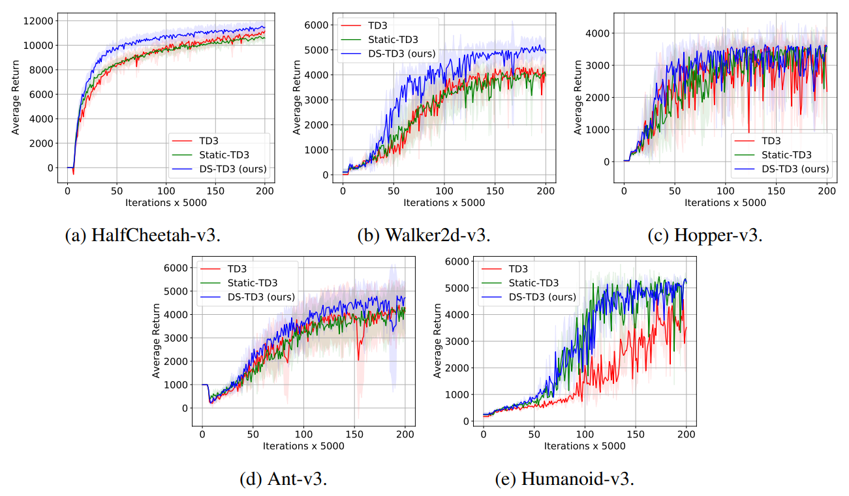
Results
1. Learning speed and the final performance
Learning curves of the studied algorithms on different continuous control tasks. The shaded region represents the standard deviation of the average evaluation over 5 runs.

Slide 16
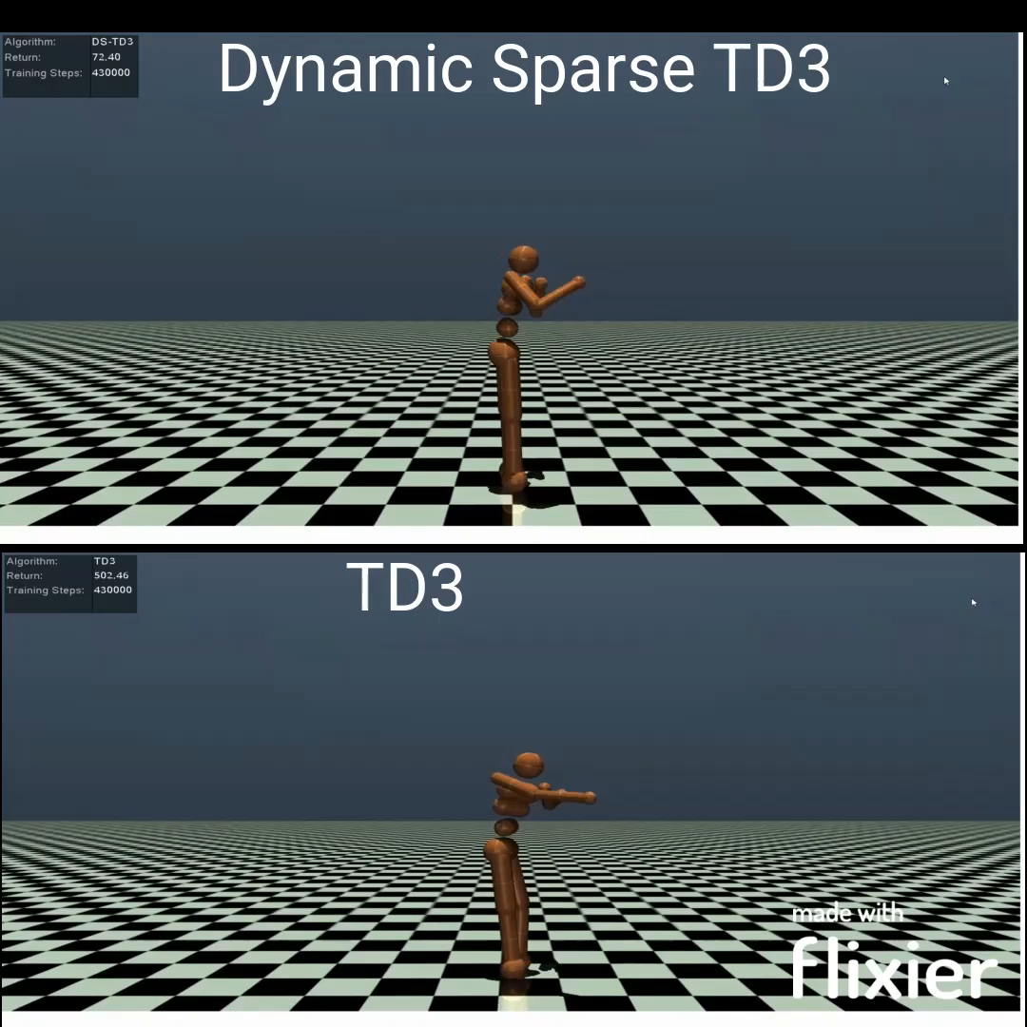
Results - Demo

Slide 17
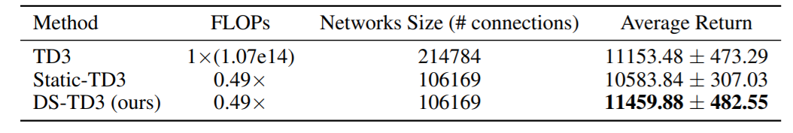
Results
2. Memory and computation costs
Performance and costs of training the actor and critics networks on HalfCheetah-v3 using different methods.
*
* Floating-point operations (FLOPs) are calculated using the method described in [1]
[1] Utku Evci, Trevor Gale, Jacob Menick, Pablo Samuel Castro, and Erich Elsen. "Rigging the lottery: Making all tickets winners." In International Conference on Machine Learning, pp. 2943-2952. PMLR, 2020.

Slide 18
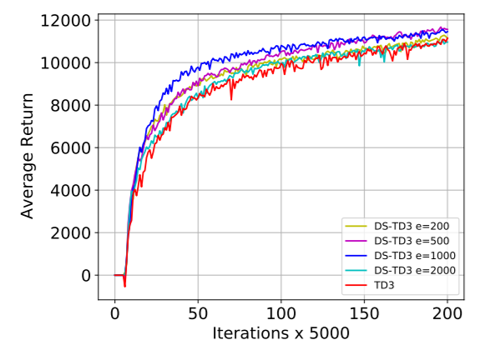
Results
3. The effect of adaptation schedule
The learning curves of our proposed DS-TD3 algorithm on HalfCheetah-v3 using different evolution schedules along with the learning curve of TD3 using dense networks.

Slide 19
Conclusion

Slide 20
Conclusion
Dynamic Sparse Training in DRL:
Obtains higher performance
Adapts faster to distribution shift
Reduces training steps and interactions with the environment
Reduces the memory and computational costs

Slide 21
Thank You!
Feel free to reach out!
g.a.z.n.sokar@tue.nl

