Slide 1




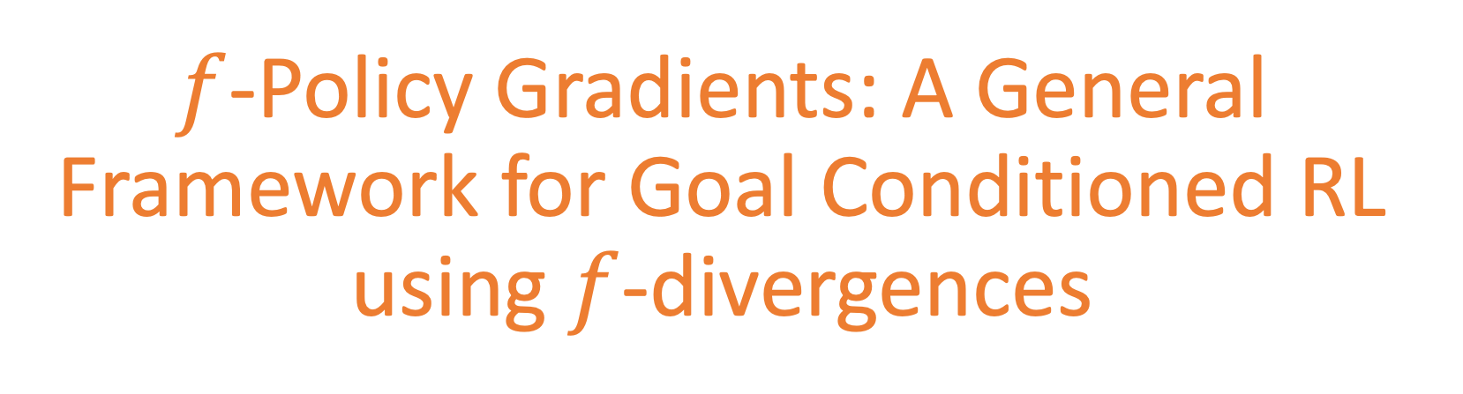
$f$-Policy Gradients: A General Framework for Goal Conditioned RL using $f$-divergences
Siddhant Agarwal¹, Ishan Durugkar², Peter Stone^{1,2}, Amy Zhang¹
¹UT Austin ²Sony AI
Notes:
Hello everyone, I am Siddhant. I will be presenting our work, f Policy Gradients: A General Framework for Goal Conditioned RL using f-divergences. This work was done in collaboration with Ishan Durugkar, Peter Stone and Amy Zhang at the University of Texas at Austin

Slide 2
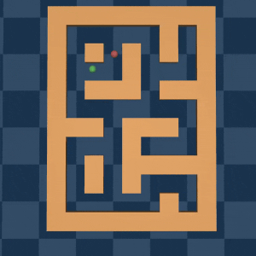

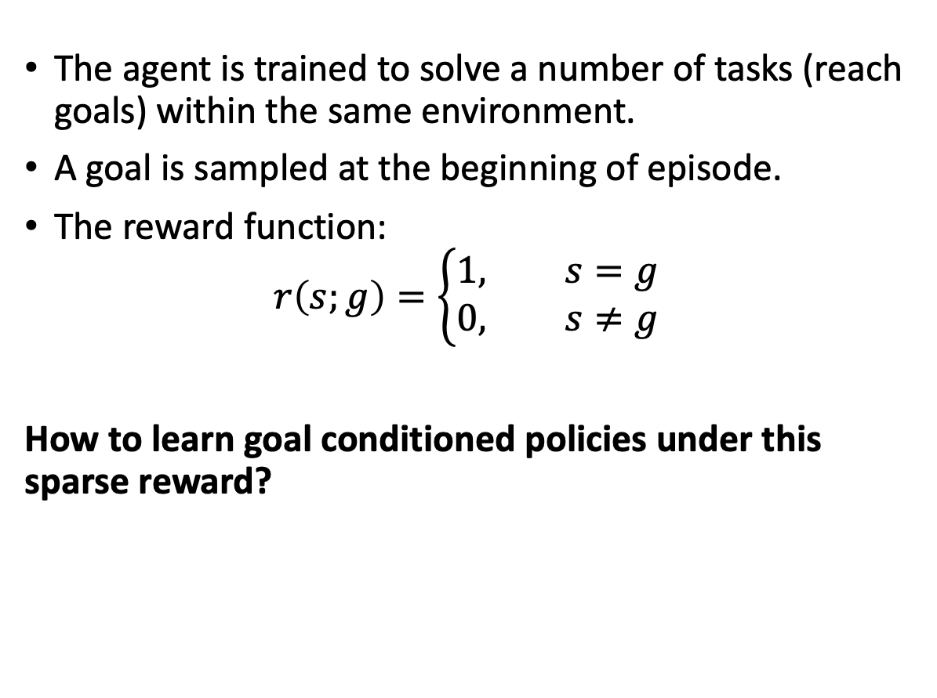

Goal Conditioned RL
The agent is trained to solve a number of tasks (reach goals) within the same environment.
A goal is sampled at the beginning of episode.
The reward function:
$$r\left(s;g\right)=\left\{\begin{aligned}1, s=g \\ 0, s≠g\end{aligned}\right.$$
How to learn goal conditioned policies under this sparse reward?
Siddhant Agarwal, $f$-Policy Gradients, UT Austin
Notes:
In our work, we deal with Goal Conditioned reinforcement learning which is a special case of RL where the policies are expected to solve a number of tasks i.e. reach different goal states within the same environment. The goal is conveyed at the beginning of the episode and remains fixed throughout.
The reward functions used for training these policies are generally sparse and given as shown. The reward is 1 at the goal states and zero everywhere else
The general question is how to learn goal conditioned policies under this sparse reward?

Slide 3
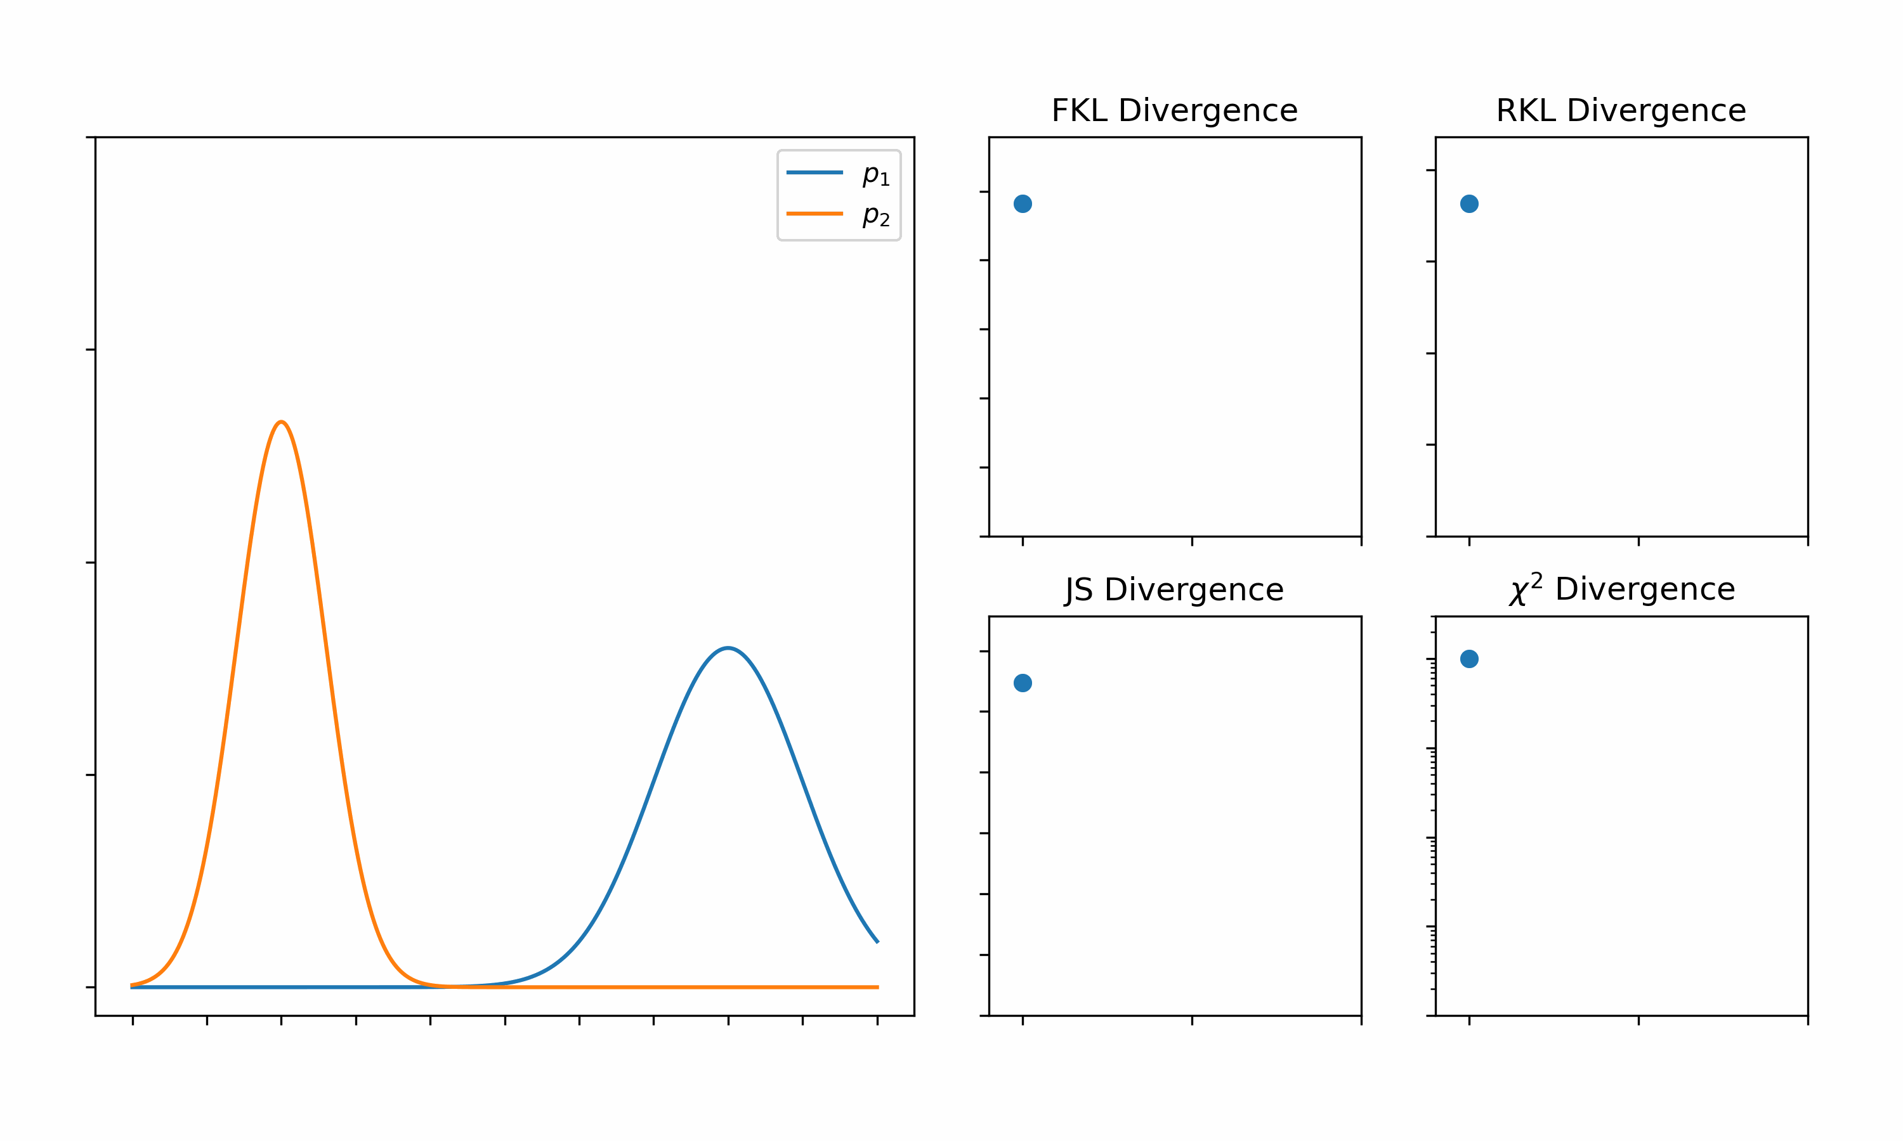
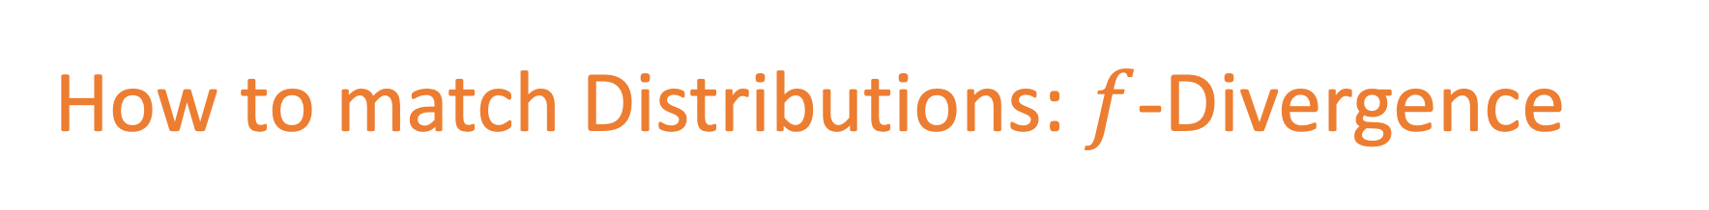
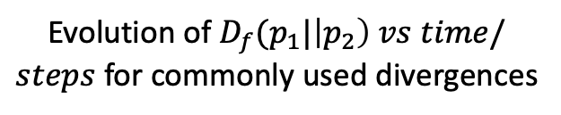
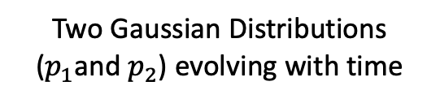
How to match Distributions: $f$-Divergence
Two Gaussian Distributions ($p_{1}$and $p_{2}$) evolving with time
Evolution of $D_{f}(p_{1}|\left|p_{2}\right) vs time/steps$ for commonly used divergences
Siddhant Agarwal, $f$-Policy Gradients, UT Austin
Notes:
Before diving into the method, we would like to introduce a general class of functions called f-divergences to compare two probability distributions. Some well known divergences are KL divergence and Jensen Shanon divergence are instances of f-divergence.
We present here a simple illustration to qualitatively depict f-divergences. On the left we have two gaussian distributions p1 and p2 that are changing with time. On the right, we plot the values of a few f-divergences with respect to time as the two distributions evolve. You can see how the f-divergences vary as the distribution p1 gets closer to p2.

Slide 4
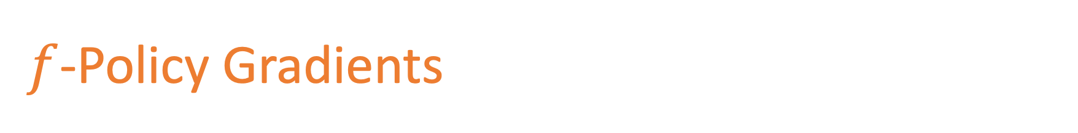
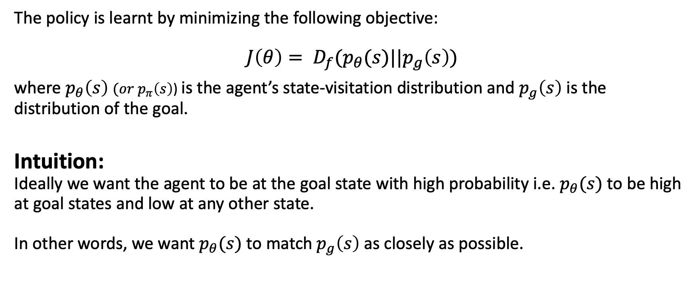
$f$-Policy Gradients
The policy is learnt by minimizing the following objective:
$$J\left(θ\right)= D_{f}(p_{θ}(s)||p_{g}\left(s\right))$$
where $p_{θ}\left(s\right)$ $(or{ p}_{π}\left(s\right)$) is the agent’s state-visitation distribution and $p_{g}\left(s\right)$ is the distribution of the goal.
Intuition:
Ideally we want the agent to be at the goal state with high probability i.e. $p_{θ}(s)$ to be high at goal states and low at any other state.
In other words, we want $p_{θ}(s)$to match $p_{g}\left(s\right)$ as closely as possible.
Siddhant Agarwal, $f$-Policy Gradients, UT Austin
Notes:
We define Goal Conditioned RL as a Distribution matching problem which is different from the conventional RL setup. We learn policies by minimizing any f-divergence between the agent’s state visitation distribution and the goal distribution. By goal distribution, we mean the distribution over states that comprise the goal.
The general intuition behind such an objective is that we want the agent to visit the goal state with high probability and the non-goal states with low probability. Note that the visitation distribution will never be able to match the goal distribution completely.

Slide 5
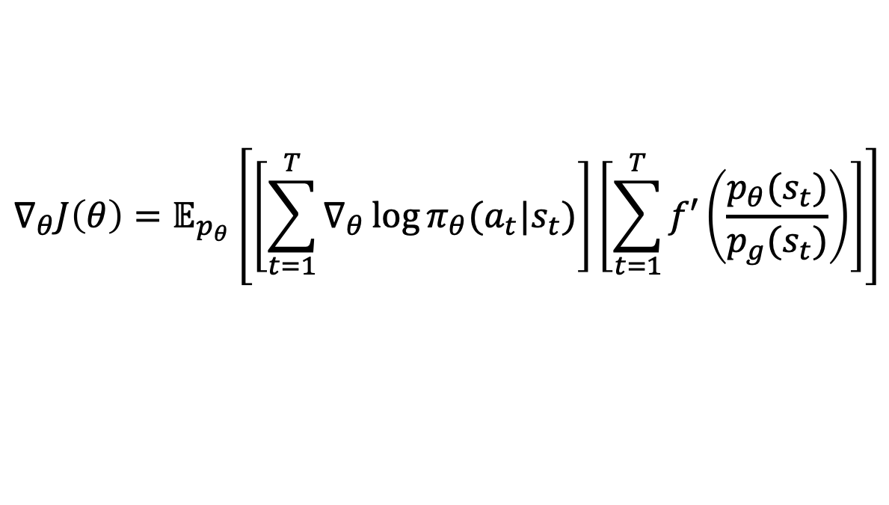
$f$-Policy Gradients
Yes
Does this objective produce the optimal policy?
How to optimize this objective?
Use gradients
$$∇_{θ}J\left(θ\right)=𝔼_{p_{θ}}\left[\left[\sum_{t=1}^{T}{∇_{θ}\log{π_{θ}(a_{t}|s_{t})}}\right]\left[\sum_{t=1}^{T}{f′\left(\frac{p_{θ}(s_{t})}{p_{g}(s_{t})}\right)}\right]\right]$$
log probabilities of policy
Dense weights (not rewards)
Siddhant Agarwal, $f$-Policy Gradients, UT Austin
Notes:
So, does this objective produce the optimal policy? Yes
We show that for f-divergences with bounded derivatives, the policy recovered is the optimal policy.
So how do we minimize the f-divergence?
Take the gradient
We derive the analytical gradient for the f-divergence and it looks very similar to a policy gradient where the gradient of log probabilities of the policy are weighed by this complex looking term. This dense weight is not a reward. Not only are these weights non-stationary, we do not wish to maximize these (or in this case, minimize these) over the trajectory.

Slide 6
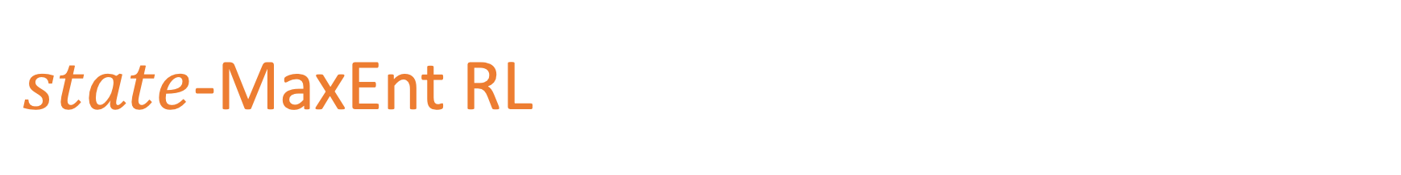
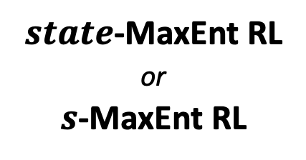
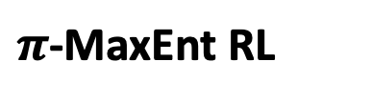
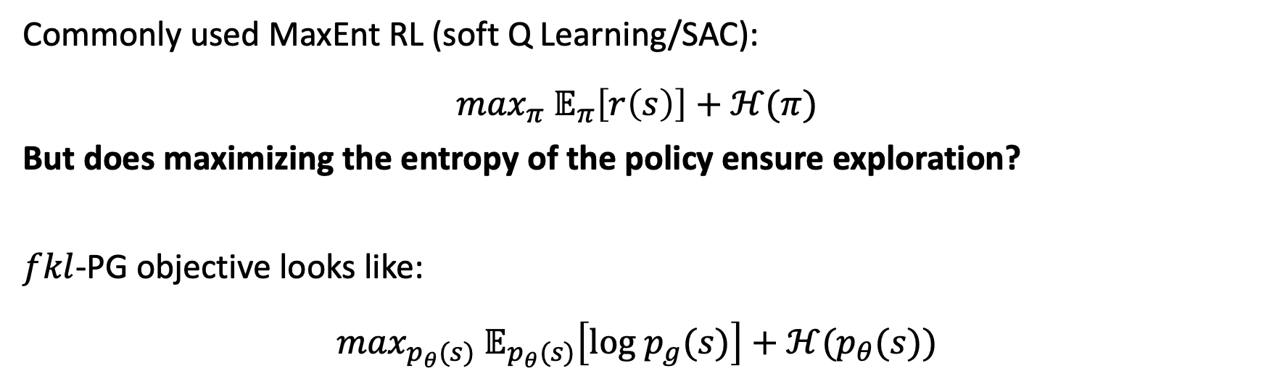
$state$-MaxEnt RL
Commonly used MaxEnt RL (soft Q Learning/SAC):
$$\max_{π} 𝔼_{π}\left[r\left(s\right)\right]+ℋ(π)$$
But does maximizing the entropy of the policy ensure exploration?
$fkl$-PG objective looks like:
$$\max_{p_{θ}(s)} 𝔼_{p_{θ}(s)}\left[log p_{g}(s)\right]+ℋ(p_{θ}(s))$$
$π$-MaxEnt RL
$state$-MaxEnt RL
or
$s$-MaxEnt RL
Can use Metric based shaping rewards
Siddhant Agarwal, $f$-Policy Gradients, UT Austin
Notes:
The commonly used MaxEnt RL in soft Q learning or Soft Actor Critic maximizes the reward under the policy along with the entropy of the policy.
But does this lead to good exploration?
A special case of f-PG, fkl-PG or forward KL policy gradient maximizes the reward under the state-visitation distribution along with the entropy of the visitation distribution providing better exploration.
The reward here is the log probability of the goal distribution which for certain goal distributions can be shown to be corresponding metric based shaping rewards.
We call the above objective as pi-MaxEnt RL and the below one as state-MaxEnt or s-MaxEnt RL.

Slide 7
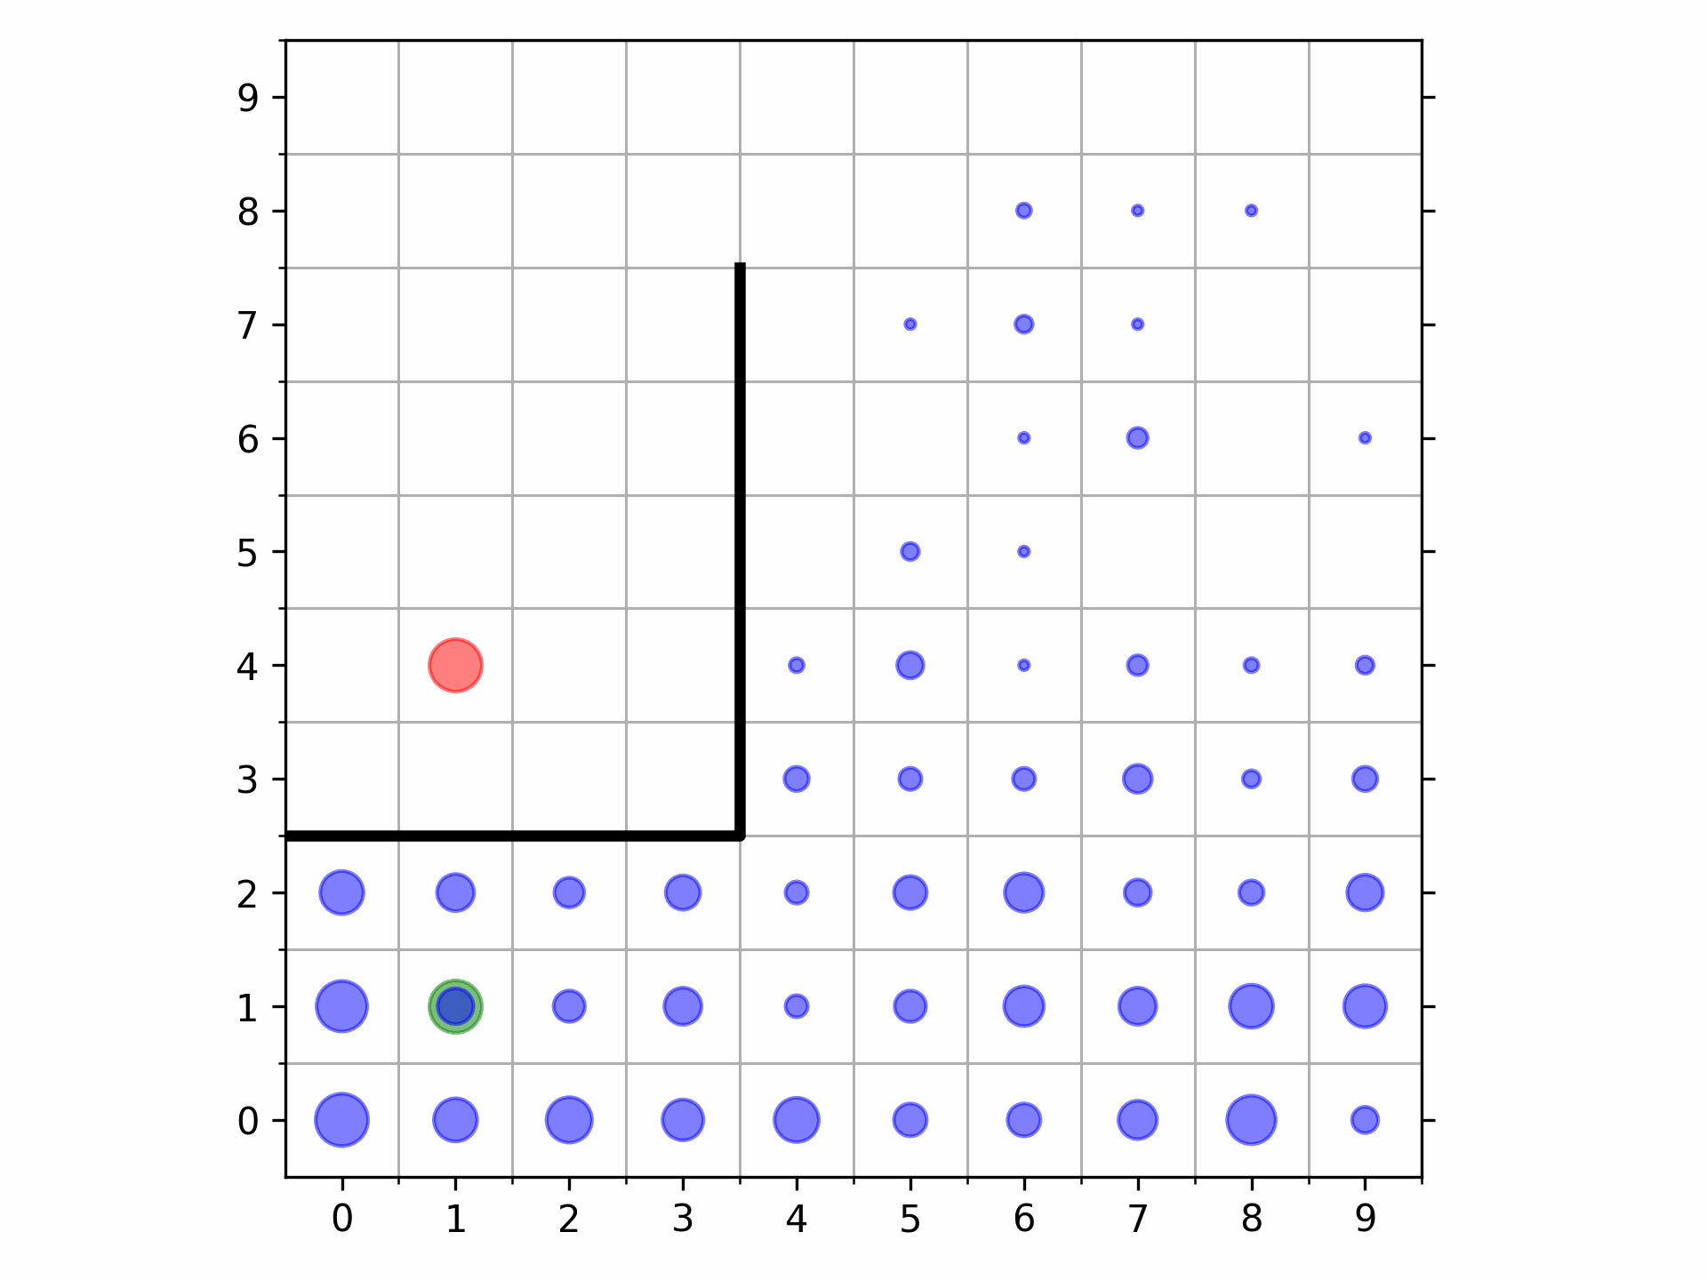
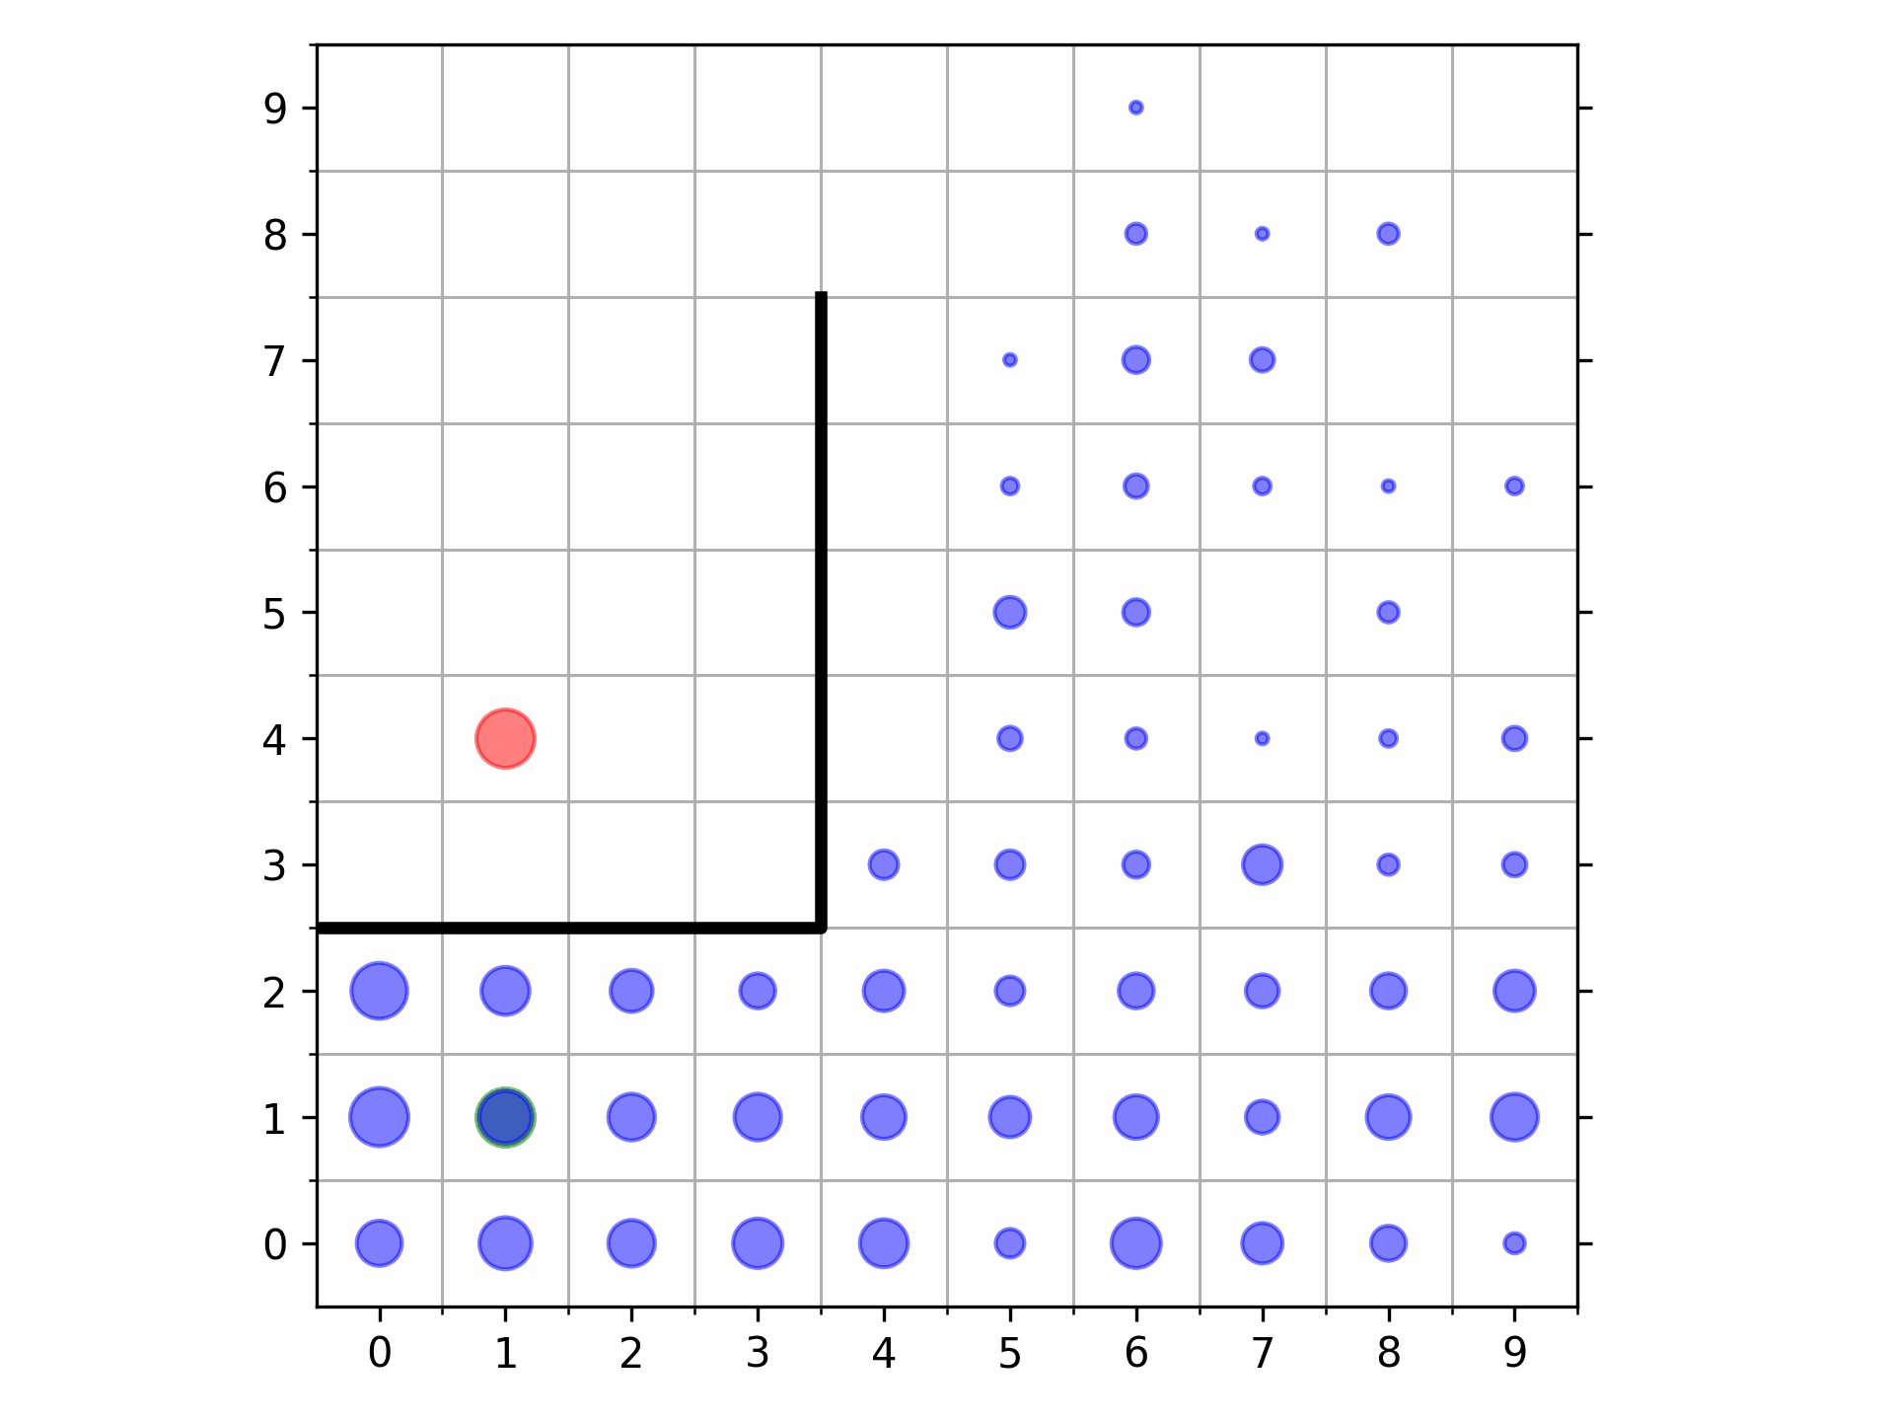
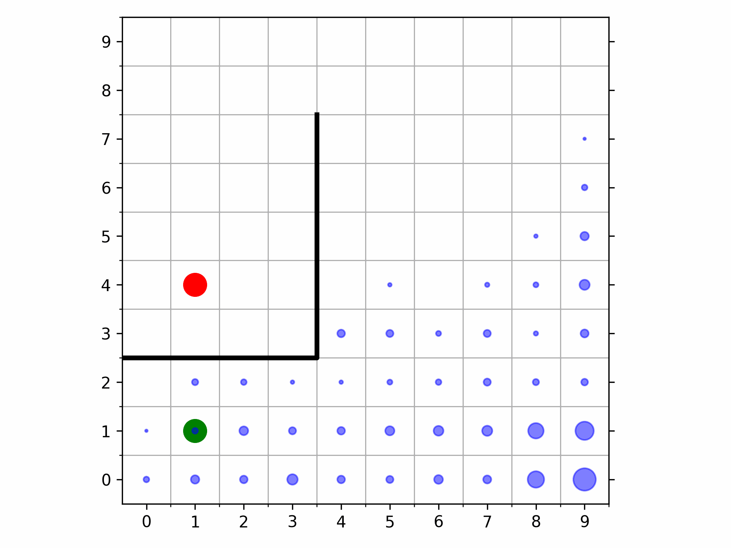
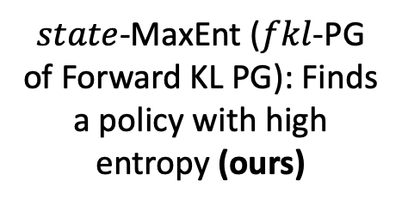
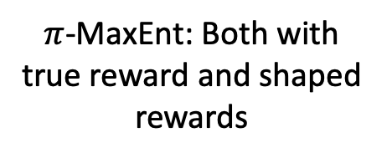
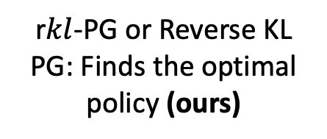
Exploration in a Gridworld
$state$-MaxEnt ($fkl$-PG of Forward KL PG): Finds a policy with high entropy (ours)
r$kl$-PG or Reverse KL PG: Finds the optimal policy (ours)
$π$-MaxEnt: Both with true reward and shaped rewards
Siddhant Agarwal, $f$-Policy Gradients, UT Austin
Notes:
Consider a gridworld where the agent needs to move from the green spot to the red spot going around the wall. The reward or goal distribution is sparse so the challenge is to explore enough to be able to move around the wall.
On this exploration task, we compare two instances of f-PG with the pi-MaxEnt RL.
forward KL -PG or state-MaxEnt RL recovers the goal but its state-visitation has a high entropy as expected.
Reverse KL-PG that does not explicitly maximize the entropy, recovers the optimal state-visitation.
While pi-MaxEnt RL when used with most of the shaped rewards (except AIM), fail to explore around the wall.

Slide 8
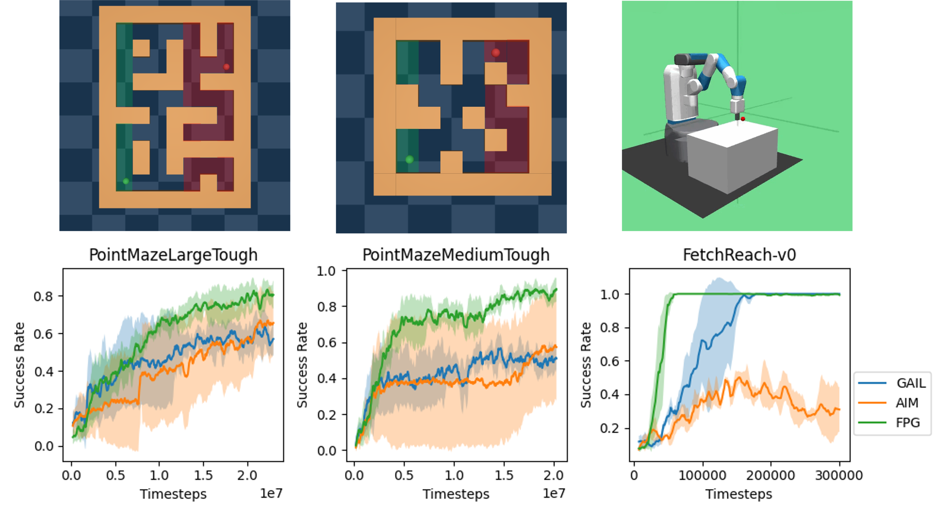
Scaling Up to Complex Domains
Siddhant Agarwal, $f$-Policy Gradients, UT Austin
Notes:
We scale our experiments to continuous domain like PointMaze and Fetch.
We modify PointMaze to create a tougher environment that ensures significant gap between the initial and goal distributions to test our method in the absence of coverage between the visitation distribution and the goal distribution.
F-PG is significantly stable and performs better compared to the discriminative methods like AIM and GAIL.

Slide 9
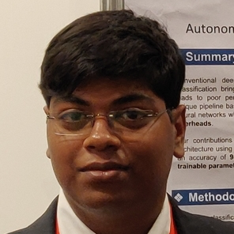



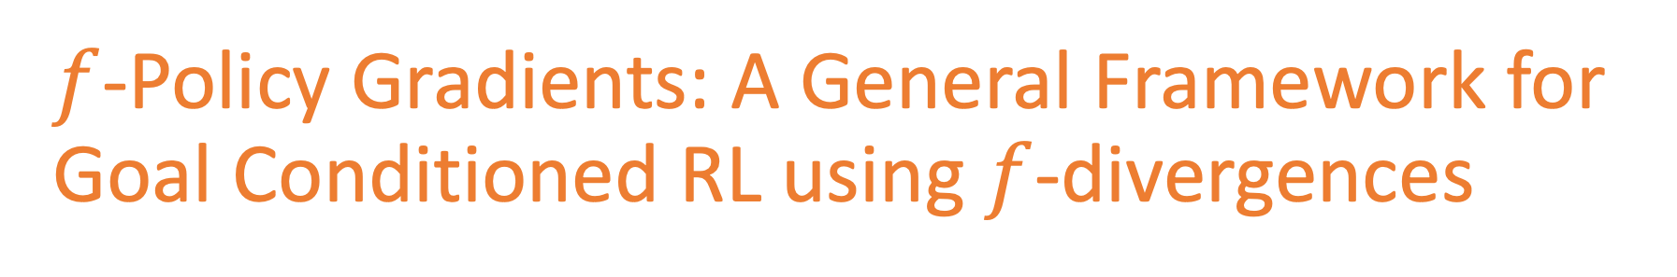
$f$-Policy Gradients: A General Framework for Goal Conditioned RL using $f$-divergences
Thank You
See you at the poster (Poster Session 3: Dec 13, Great Hall & Hall B1+B2)
Project page: https://agarwalsiddhant10.github.io/projects/fpg.html
Siddhant Agarwal
Ishan Durugkar
Peter Stone
Amy Zhang
Notes:
Thanks a lot for listening to this presentation. See you at the poster. Do visit our project page for additional information.

