Slide 1
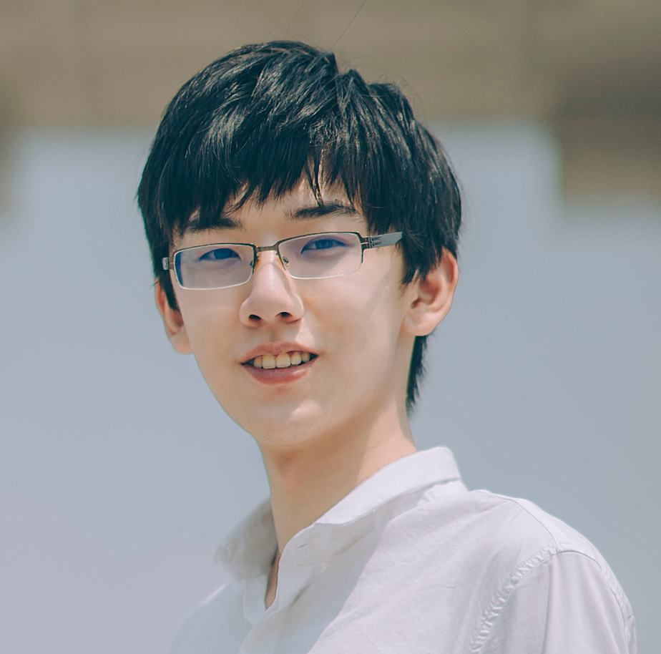
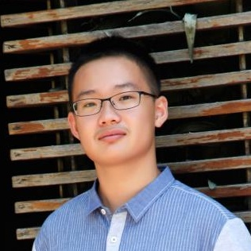
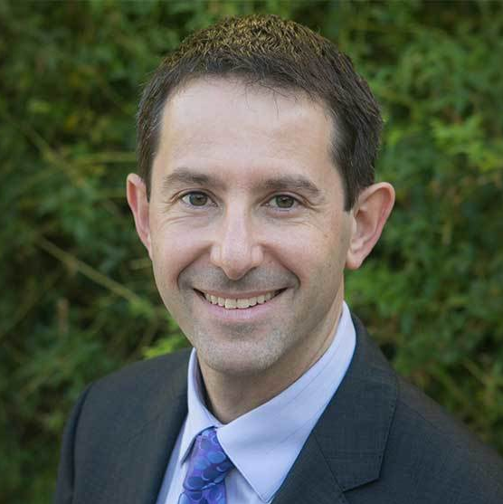
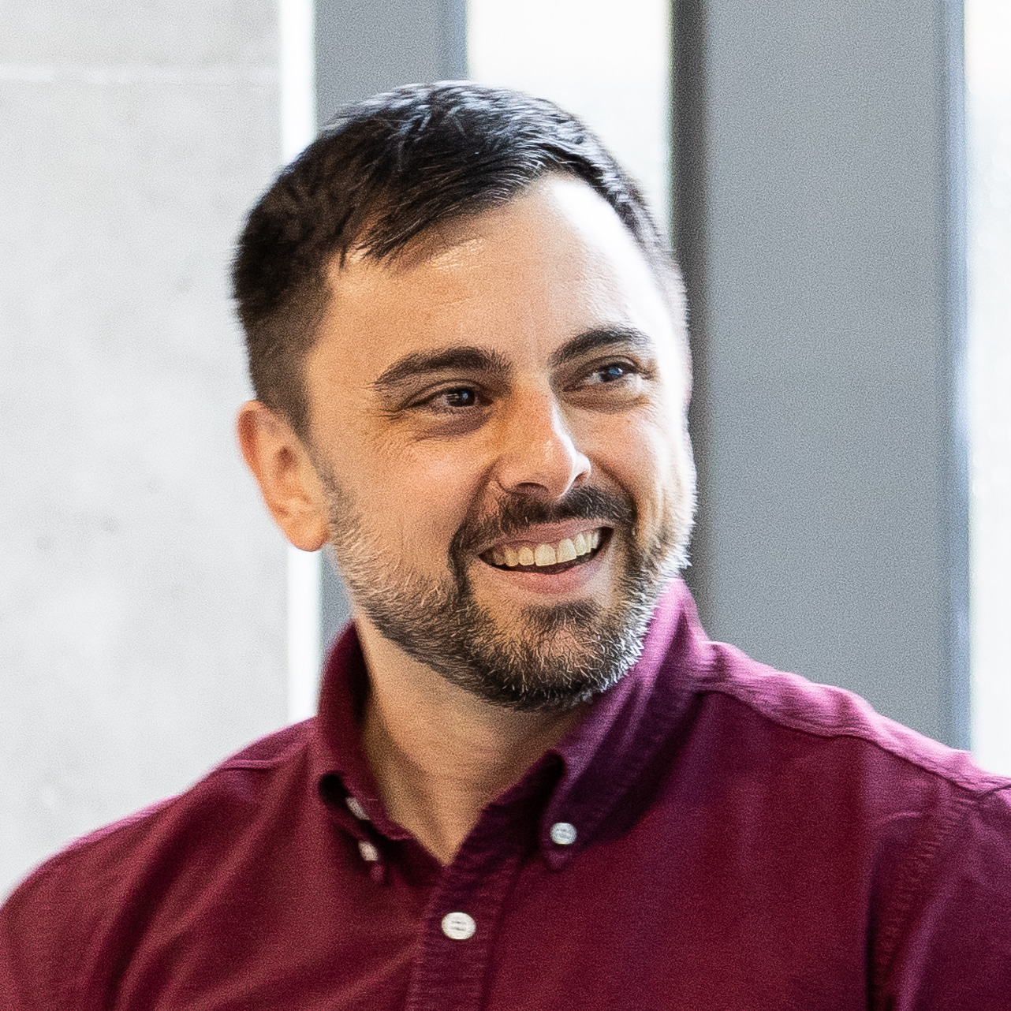



ELDEN: Exploration via
Local Dependencies
(NeurIPS 2023)
Zizhao Wang*, Jiaheng Hu*, Peter Stone⁺ and Roberto Martin-Martin⁺

Slide 2
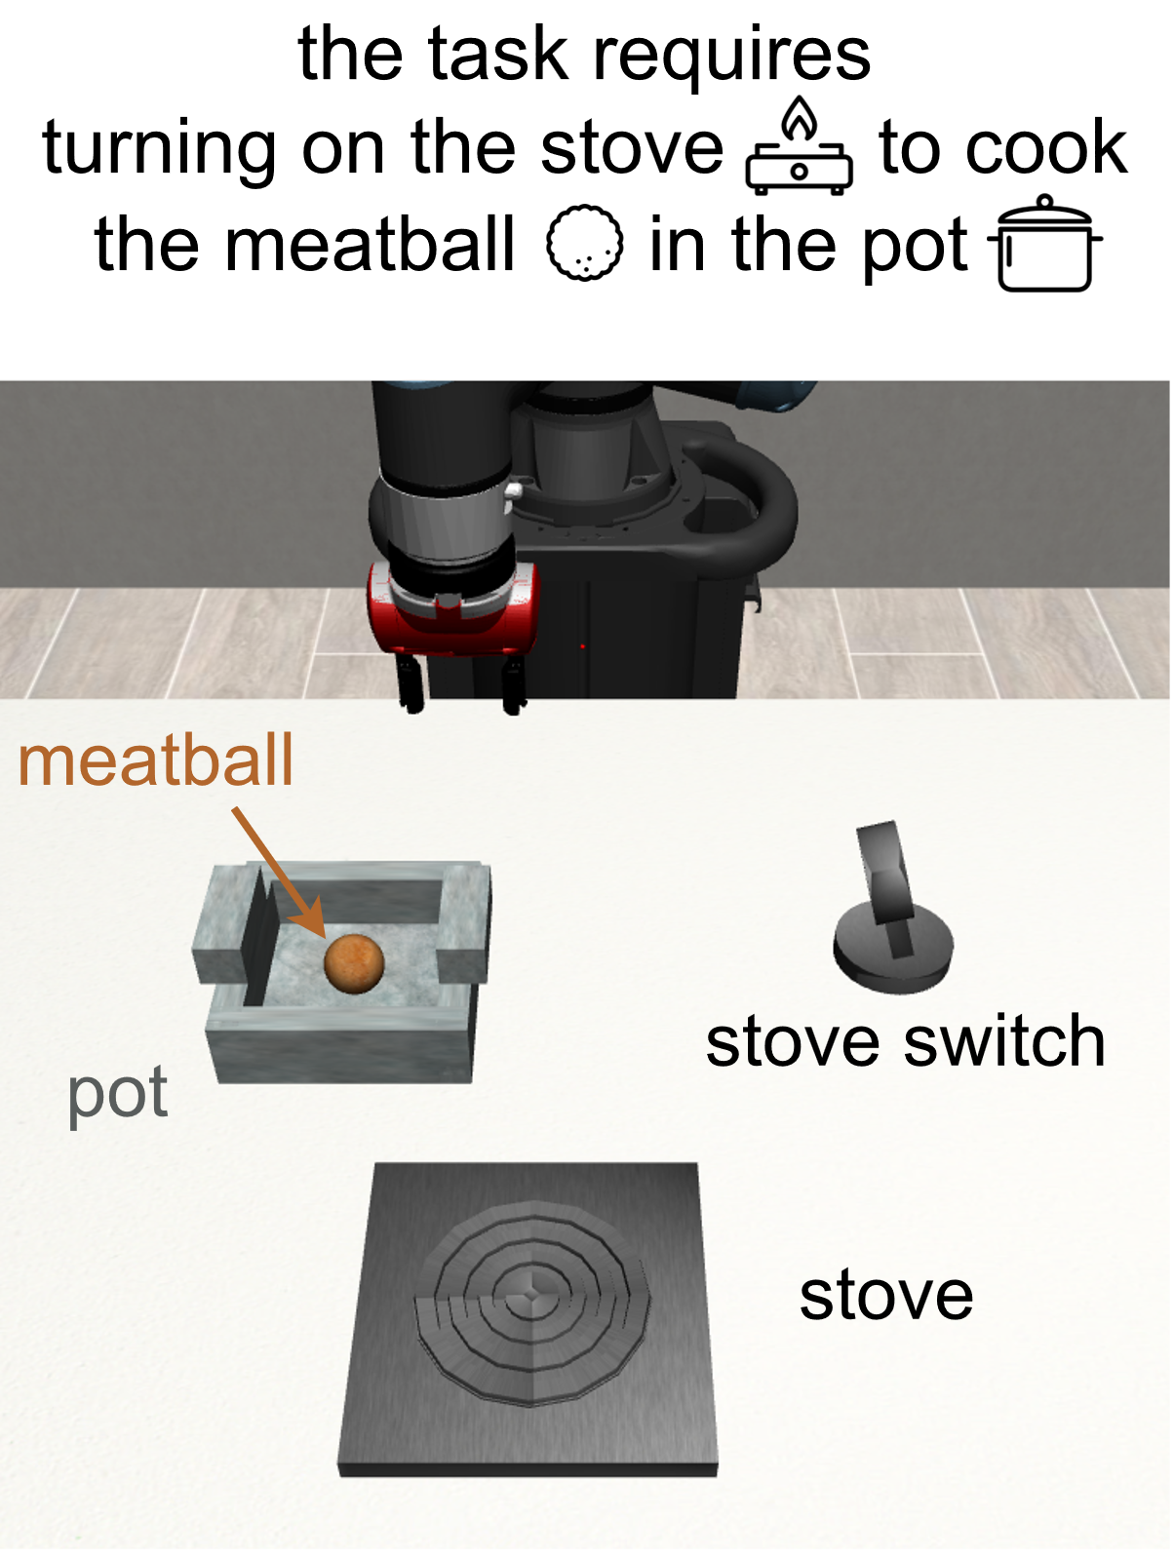
Problem Setup
The hard-exploration problem
Sparse Reward
Long horizon
Large state space
Large action space

Slide 3
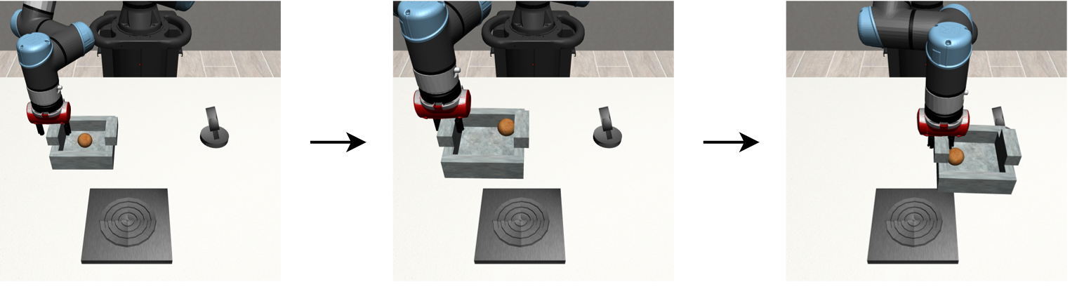

Related Work
Use intrinsic reward to augment the sparse task reward, e.g., curiosity.
However, for the cooking task, such methods will
seek high prediction error

Slide 4
Motivation
Prior Work
Only interested in new state values
Easily get lost in vast novel states
Our Insight
Focus on whether novel dependencies between state variables happen
  robot arm → pot if arm close to pot
  stove → meatball if meatball on stove
Notes:
To summarize…
Our insight is that we can avoid getting trapped with the fine-grained state details through reasoning about the interactions between state variables.
For example, xxx
By estimating the local dependencies between state entities and encouraging the agent to visit states whether novel dependencies appears, the agent can explore in a more abstract space which we show to be very helpful in object-rich tasks.

Slide 5
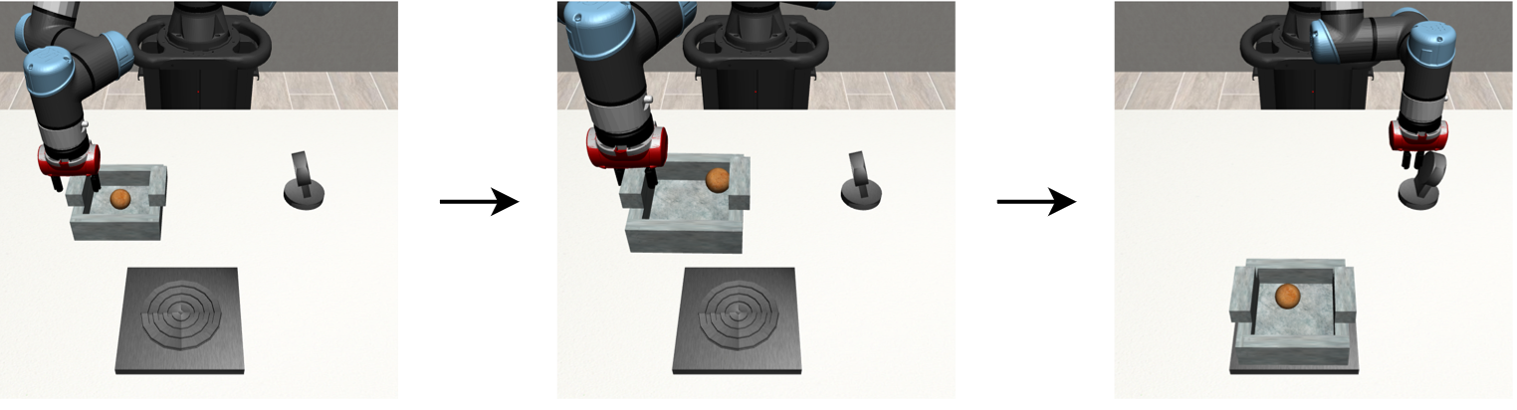
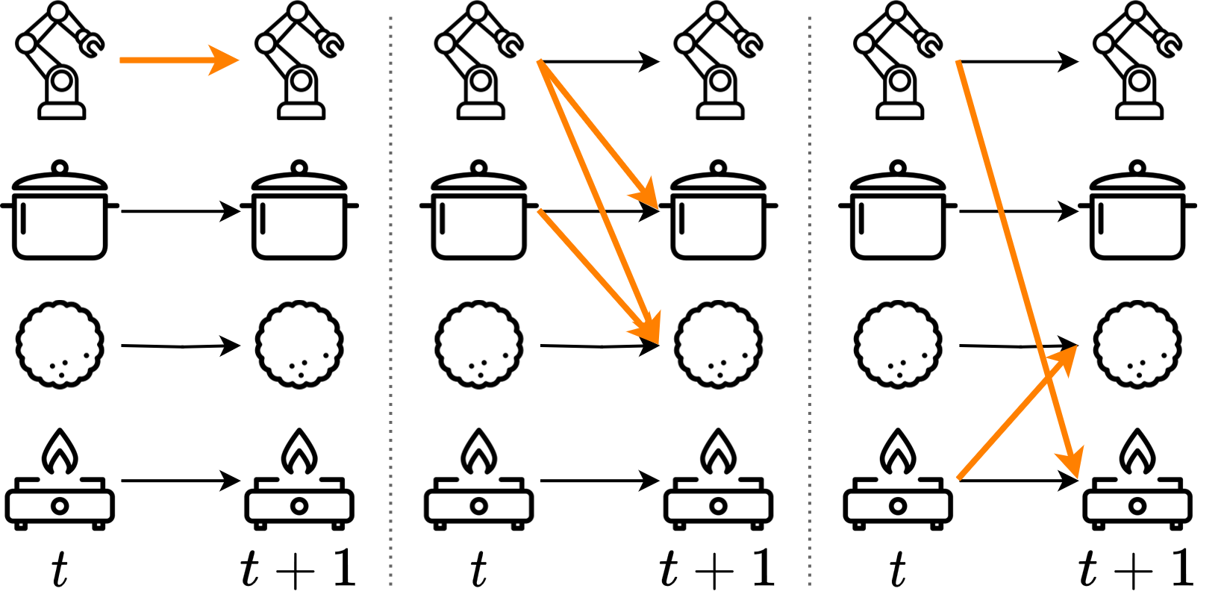
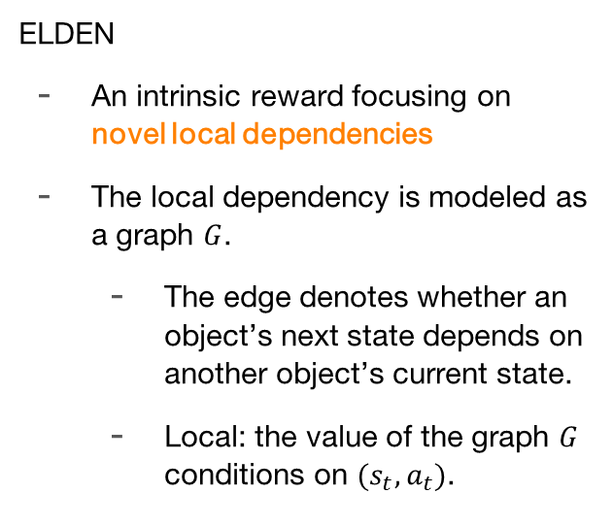
Method
ELDEN
An intrinsic reward focusing on novel local dependencies
The local dependency is modeled as a graph $G$.
  The edge denotes whether an object’s next state depends on another object’s current state.
  Local: the value of the graph $G$ conditions on $(s_{t}, a_{t})$.

Slide 6
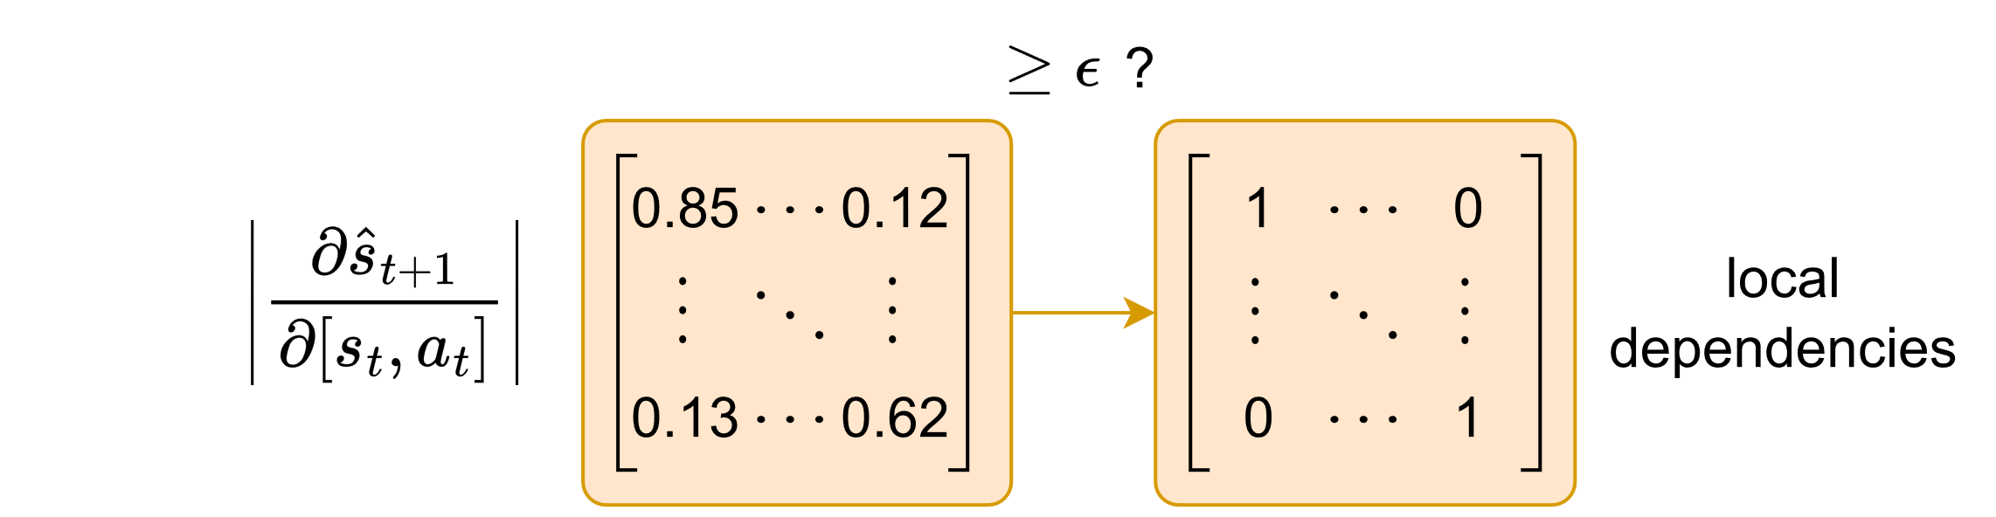

Method – local dependency computation
Causality but-for test:
The local dependency exists if $S_{t+1}^{j}=s_{t+1}^{j}$ would not have happen but for $S_{t}^{i}=s_{t}^{i}$.
Given a dynamics model $p\left(s_{t+1} | s_{t}, a_{t}\right)=f\left(s_{t}, a_{t}\right)$, ELDEN uses partial derivatives to estimate local dependencies.

Slide 7

Method

Slide 8
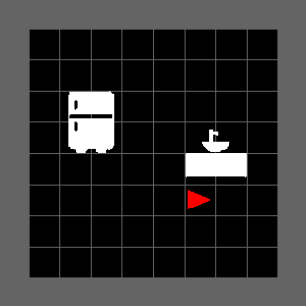
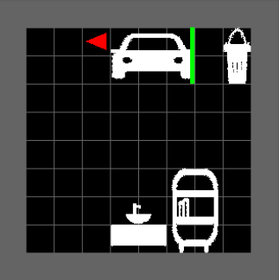
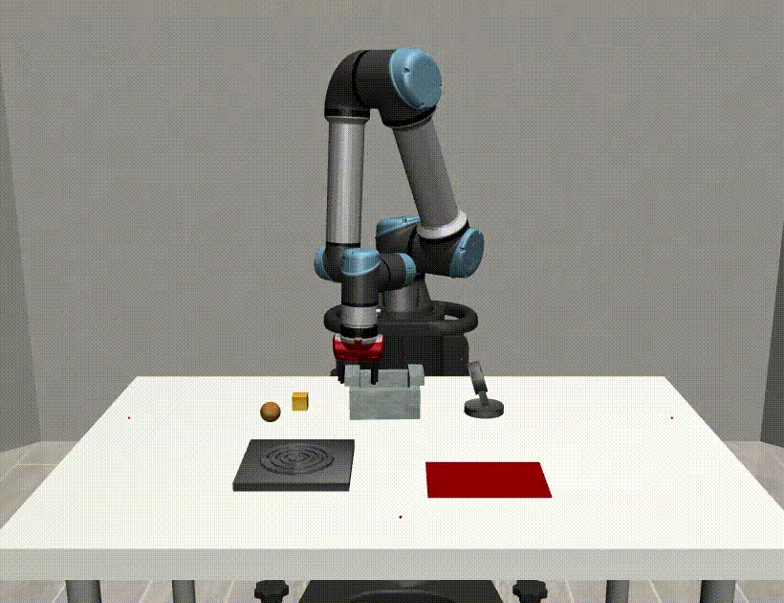
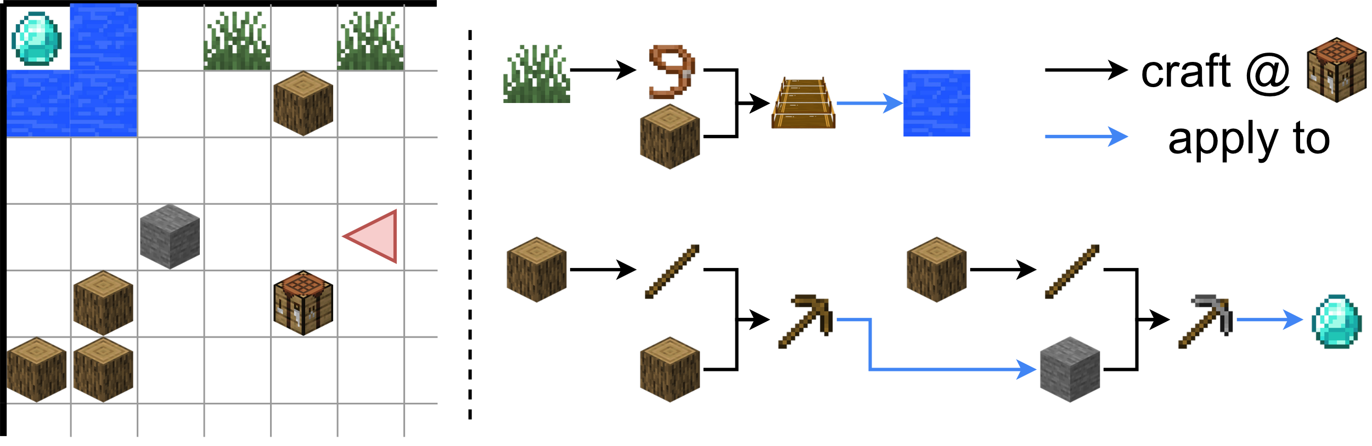
Experiments
Mini-behavior
Manipulation
(Robosuite)
2D Minecraft

Slide 9
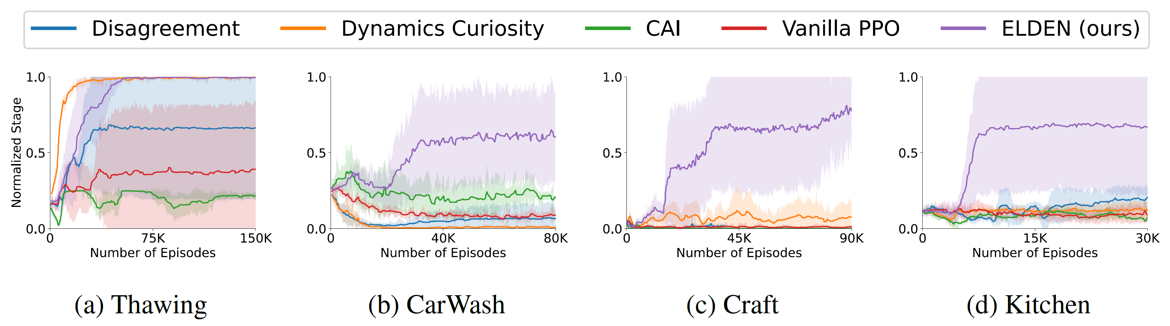
Results
Task Learning Sample Efficiency
Task Progress
ELDEN learns successful policies in all environments, and it is the only method that succeeds in the CarWash, Craft, and Kitchen environments with complex chained dependencies.

Slide 10

Thank you!
See you @ poster session 5 #1423.
ELDEN: Exploration via Local Dependencies
Zizhao Wang*, Jiaheng Hu*, Peter Stone⁺ and Roberto Martin-Martin⁺

