Slide 1
Preference-Conditioned All-Terrain Costmap Generation
Luisa Mao, Garrett Warnell, Peter Stone, Joydeep Biswas
Robotics and Automation Letters 2025
Luisa Mao
luisa.mao@utexas.edu

Slide 2
Overview
Motivation
Limitations of Previous Works
Our Algorithm
Representation of Preference
Architecture
Experimental Results
Aerial Map Experiments and Training

Slide 3
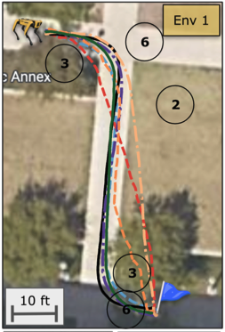
Preference-Aligned Local Planning
Navigate such that:
trajectory is aligned with operator preferences
generalizes to new preferences
generalizes to new terrains
Operator preference:
bush < marble rock < grass < mulch < pebble sidewalk = cement sidewalk
H. Karnan, E. Yang, D. Farkash, G. Warnell, J. Biswas, and P. Stone, ‘STERLING: Self-Supervised Terrain Representation Learning from Unconstrained Robot Experience’, arXiv [cs.RO]. 2023.

Slide 4
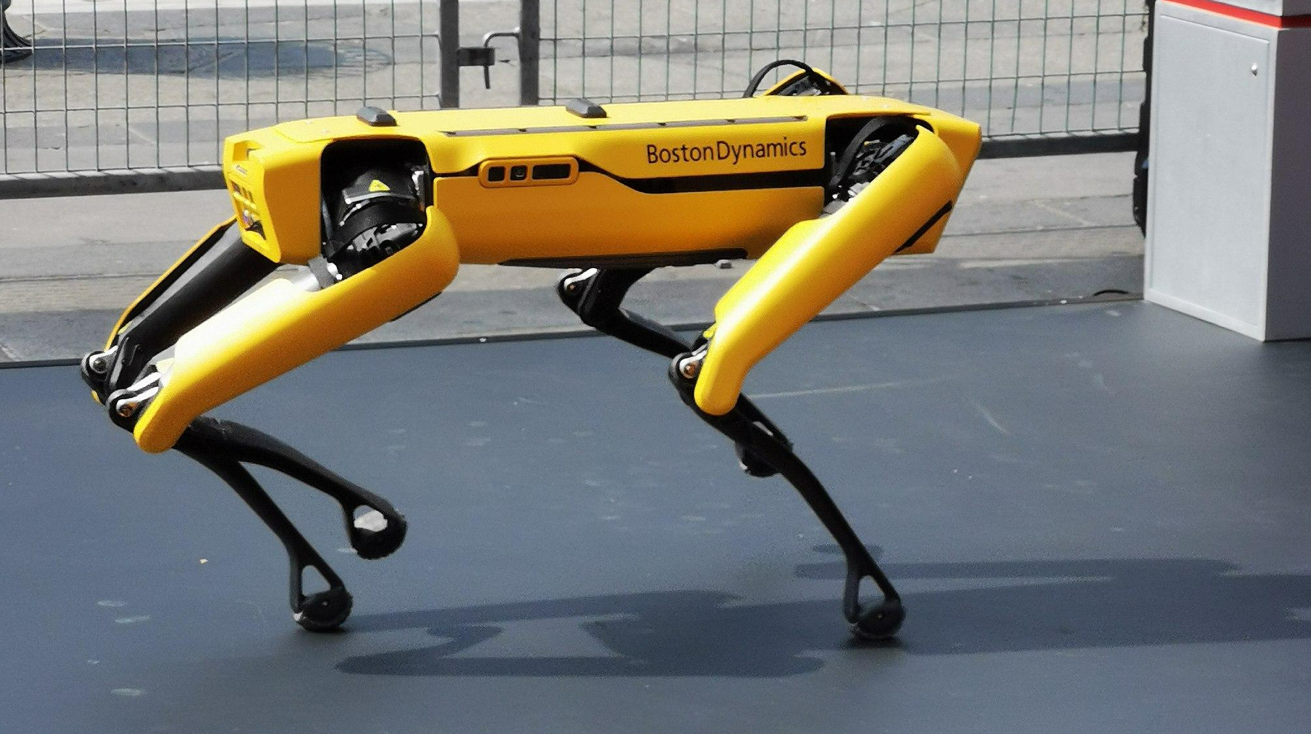
Preference-Aligned Local Planning
Local Bird’s Eye View (BEV)
Costmap Generation Method
Local Costmap
Black = low cost
White = high cost

Slide 5
Previous Work
Semantic Segmentation:
Ex. {“grass”: 0.8, “concrete”: 0.1}
Easily generalizable to new preference orderings
Not generalizable to new terrains
Segmentation Model

Slide 6
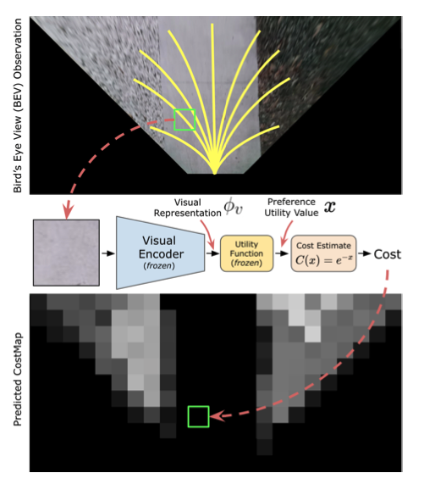
Previous Work
Continuous Representation Spaces:
Not easily generalizable to new preference orderings
Generalizable to new terrains
H. Karnan, E. Yang, D. Farkash, G. Warnell, J. Biswas, and P. Stone, ‘STERLING: Self-Supervised Terrain Representation Learning from Unconstrained Robot Experience’, arXiv [cs.RO]. 2023.

Slide 7
Problem Formulation
Input image
Costmap
H
R(I) = C
Human’s internal cost function
Costmap generator (dependent on human preferences)
R is consistent with H if the cost of the optimal path planned on R evaluated w.r.t. H is equal to the cost of the optimal path planned on H.

Slide 8
Problem Formulation
Necessary Conditions:
Terrains are assigned equivalent costs by the human iff they are assigned equivalent costs by R.
The ordering of terrain costs assigned by the human are the same as the ordering of terrain costs assigned by R.
Theorem: If R is consistent with H, then the necessary conditions hold

Slide 9
Problem Formulation
Necessary Conditions:
Terrains are assigned equivalent costs by the human iff they are assigned equivalent costs by R.
The ordering of terrain costs assigned by the human are the same as the ordering of terrain costs assigned by R.
Theorem: If R is consistent with H, then the necessary conditions hold

Slide 10
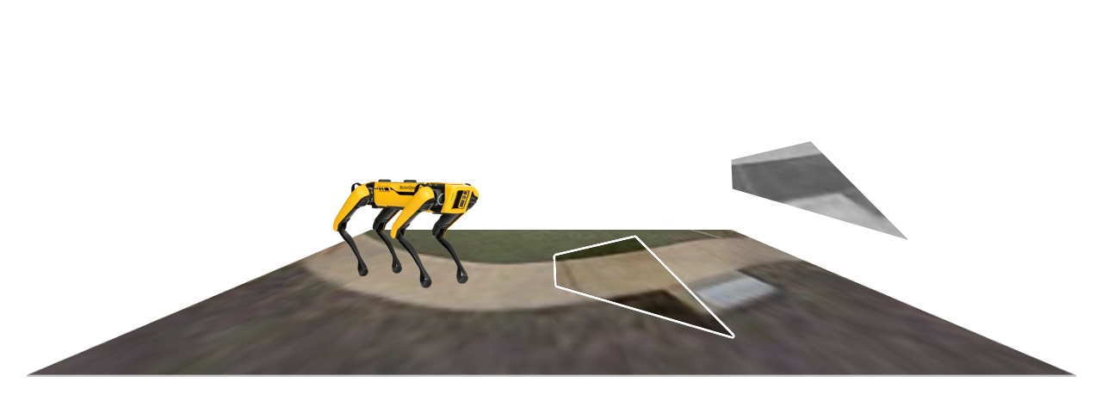
Problem Formulation
More preferred
Less preferred
C
I
x

Slide 11
Our Approach
Preference Context
>
>
>
Preference Context Encoder
Output Costmap
Decoder
BEV Image
BEV Encoder

Slide 12
Qualitative Examples
Preference Context
BEV Image
Costmap
>
>
>
Example of generated output
>
>
>
Output is conditioned on the context
>
>
>

Slide 13
Desired Properties
Realistic prior:
Defaults to realistic preferences when no informative context is given
Adherence to preference context:
Always follows preference context when it is given
Even when overriding realistic preferences
Generalizability to unseen terrains:
Handles terrains not seen in the training data

Slide 14
Experimental Setup
How well does the planned path adhere to operator preferences with:
Seen context (preferences), seen BEV (terrain)
Seen context, unseen BEV
Unseen context, seen BEV
Unseen context, unseen BEV
We evaluate with simulation and real robot deployments.

Slide 15
Experimental Setup
Desired Properties
Realistic prior
Adherence to preference context
Generalizability to unseen terrains
Experiments
Seen context, seen BEV
Seen context, unseen BEV
Unseen context, seen BEV
Unseen context, unseen BEV

Slide 16
Planning Simulation with Aerial Maps

Slide 17
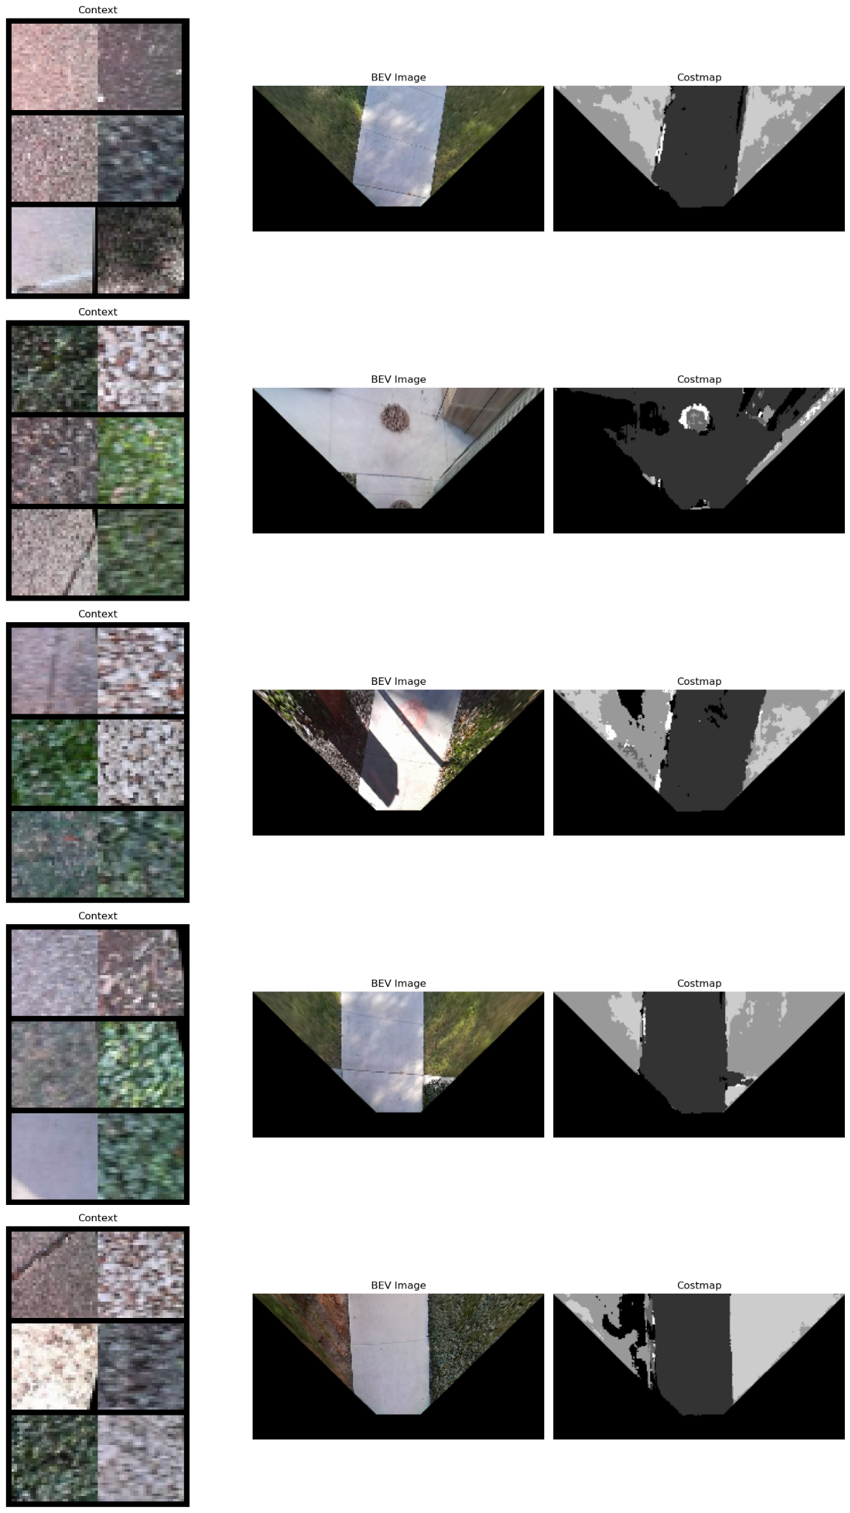
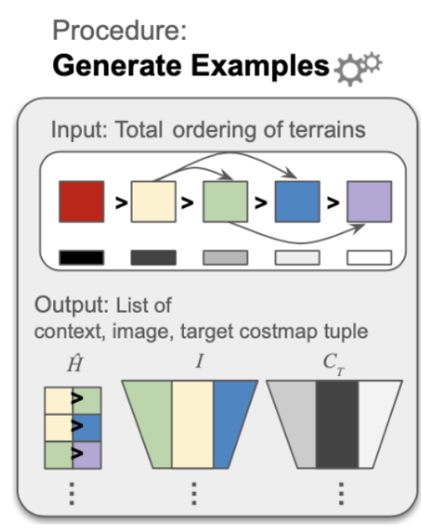
Model Training: Desired Property 1 (Realistic Prior)

Slide 18
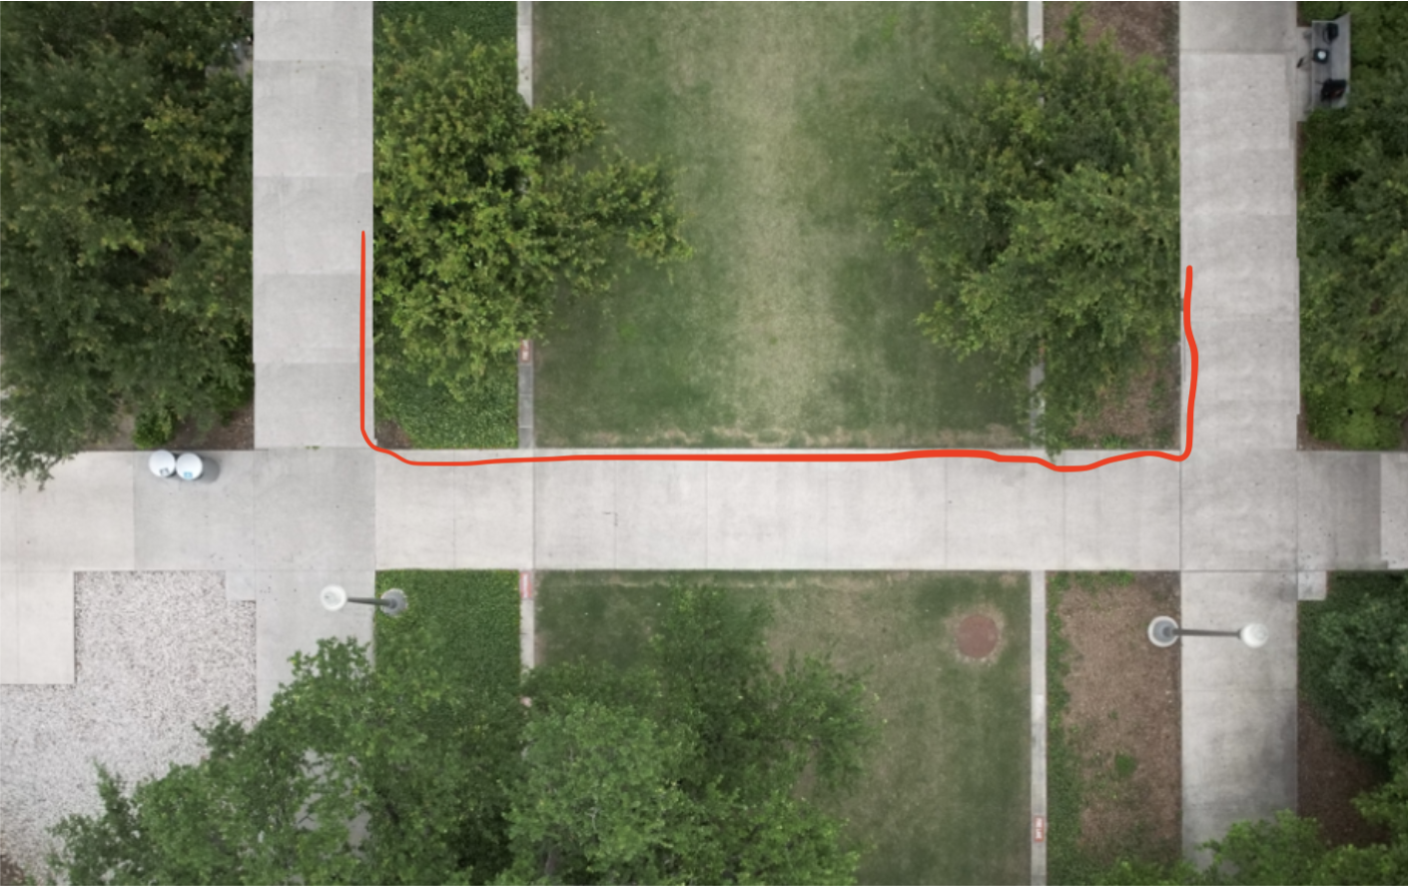
Qualitative Results: Adherence to Realistic Preferences

Slide 19
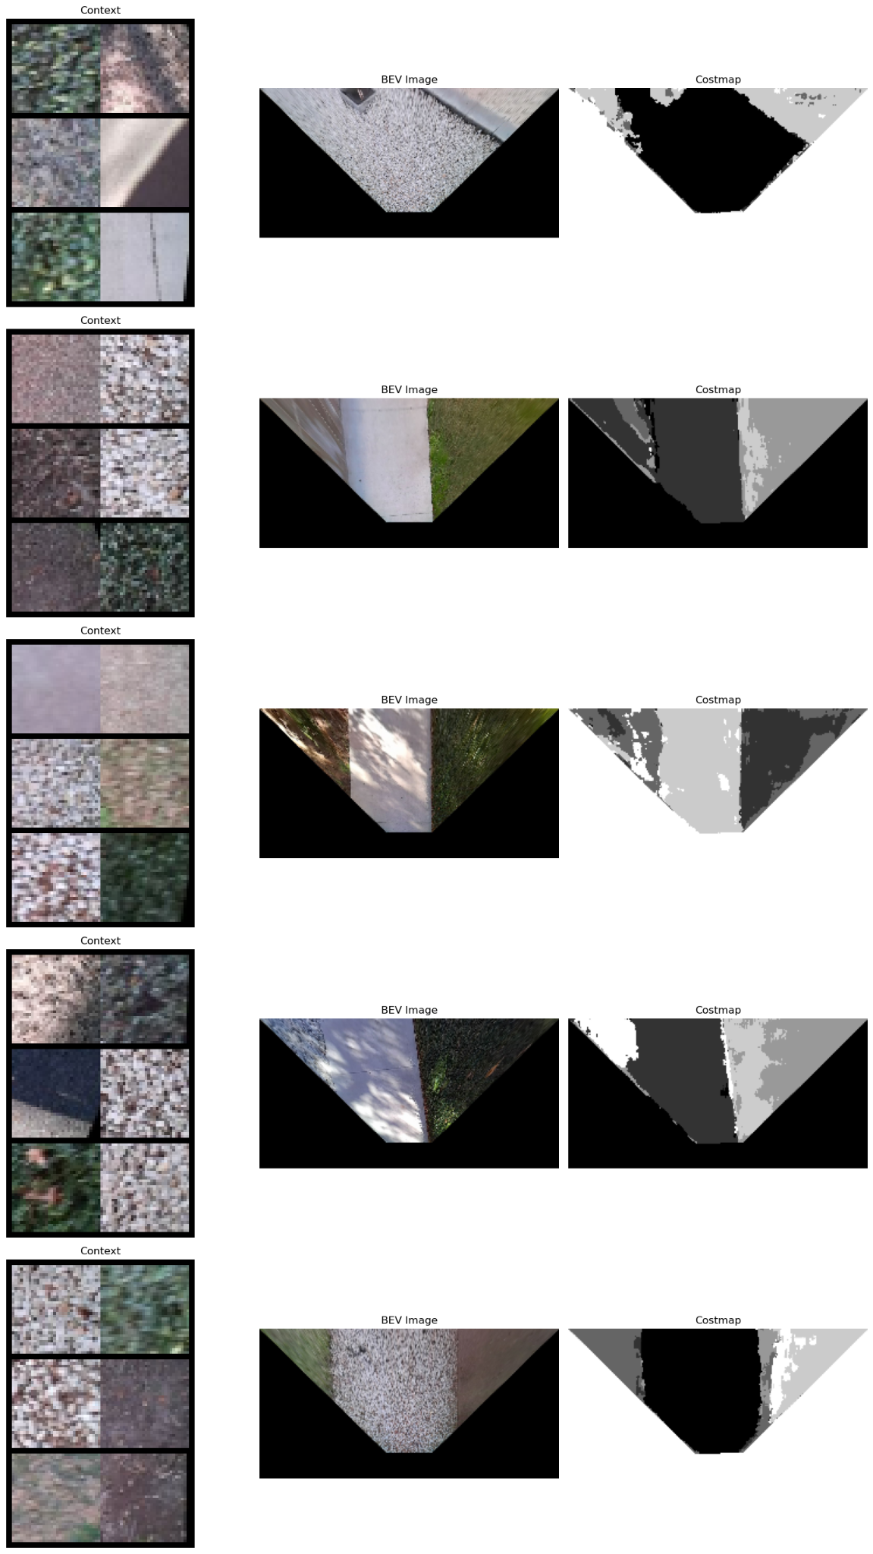
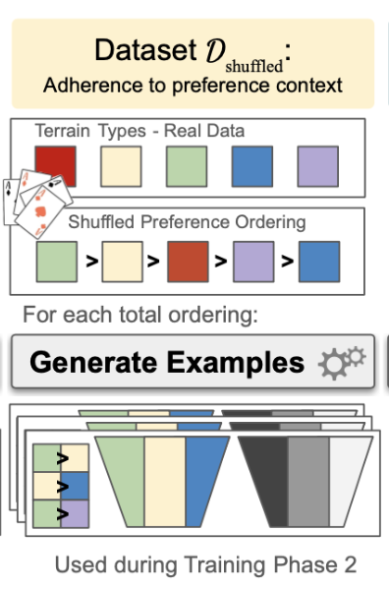
Model Training: Property 2 (Adherence to Context)

Slide 20
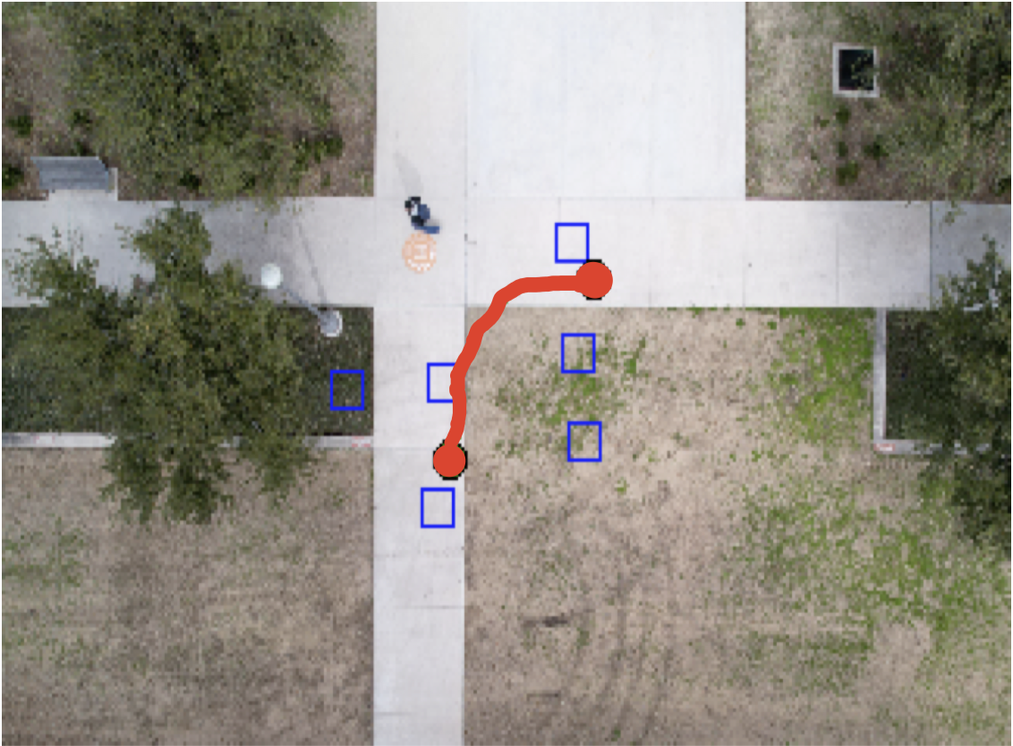
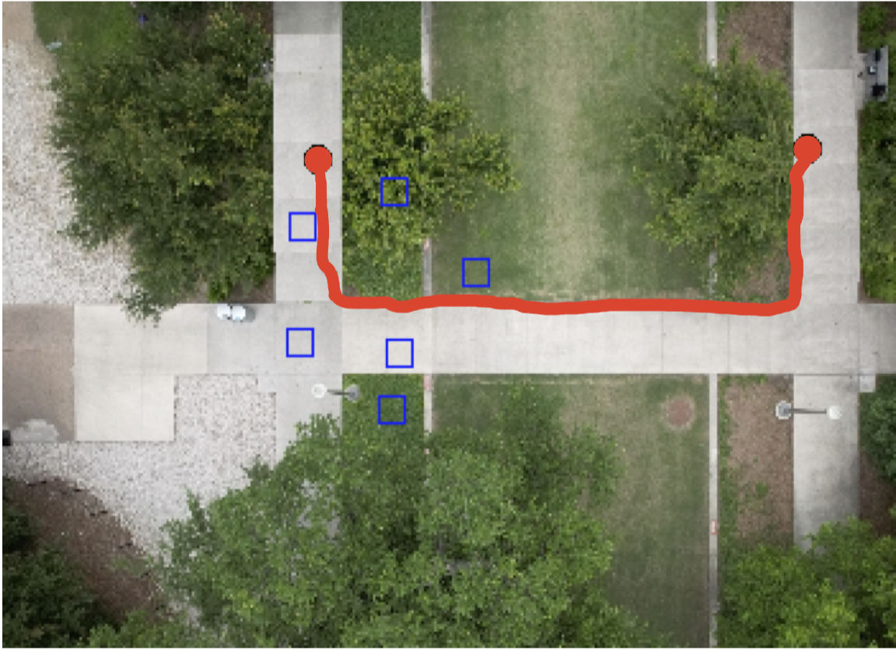
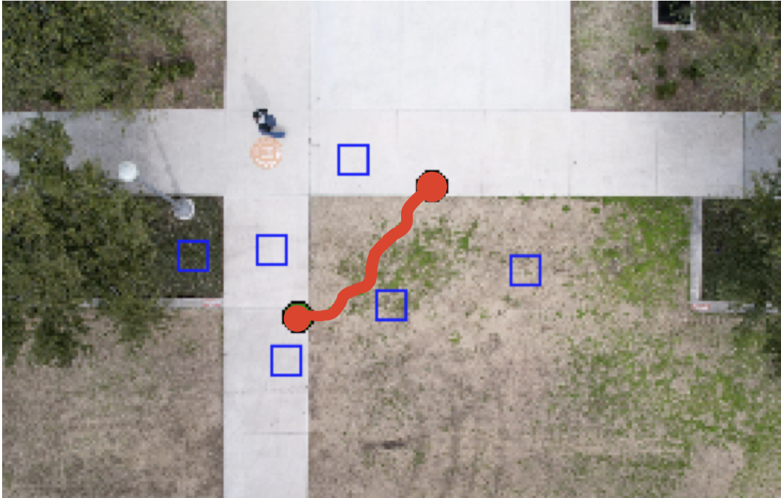
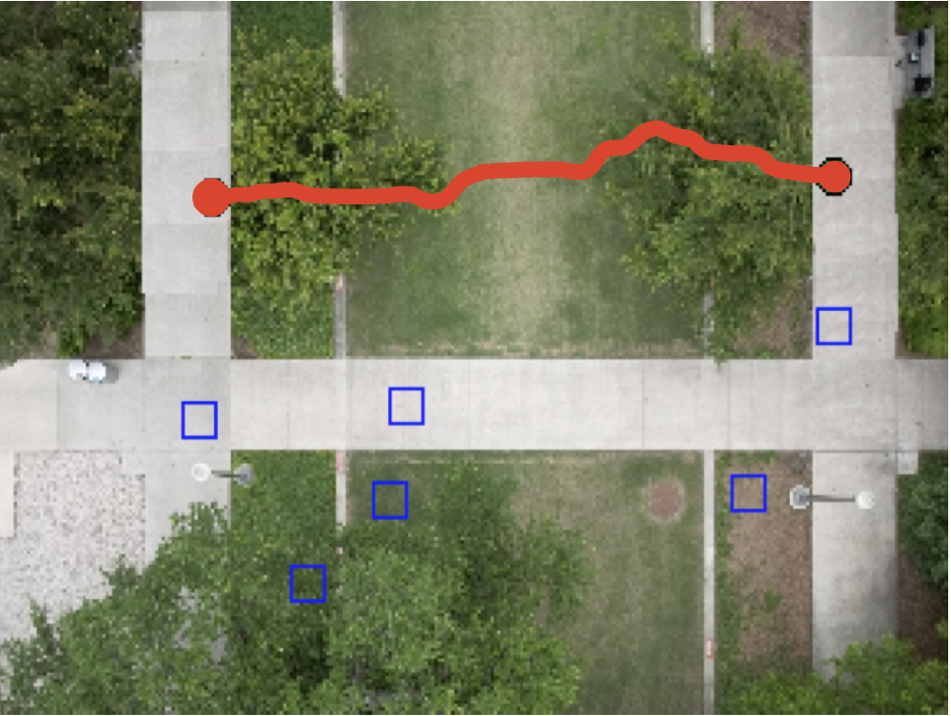
Qualitative Results: Seen Context, Seen BEV

Slide 21
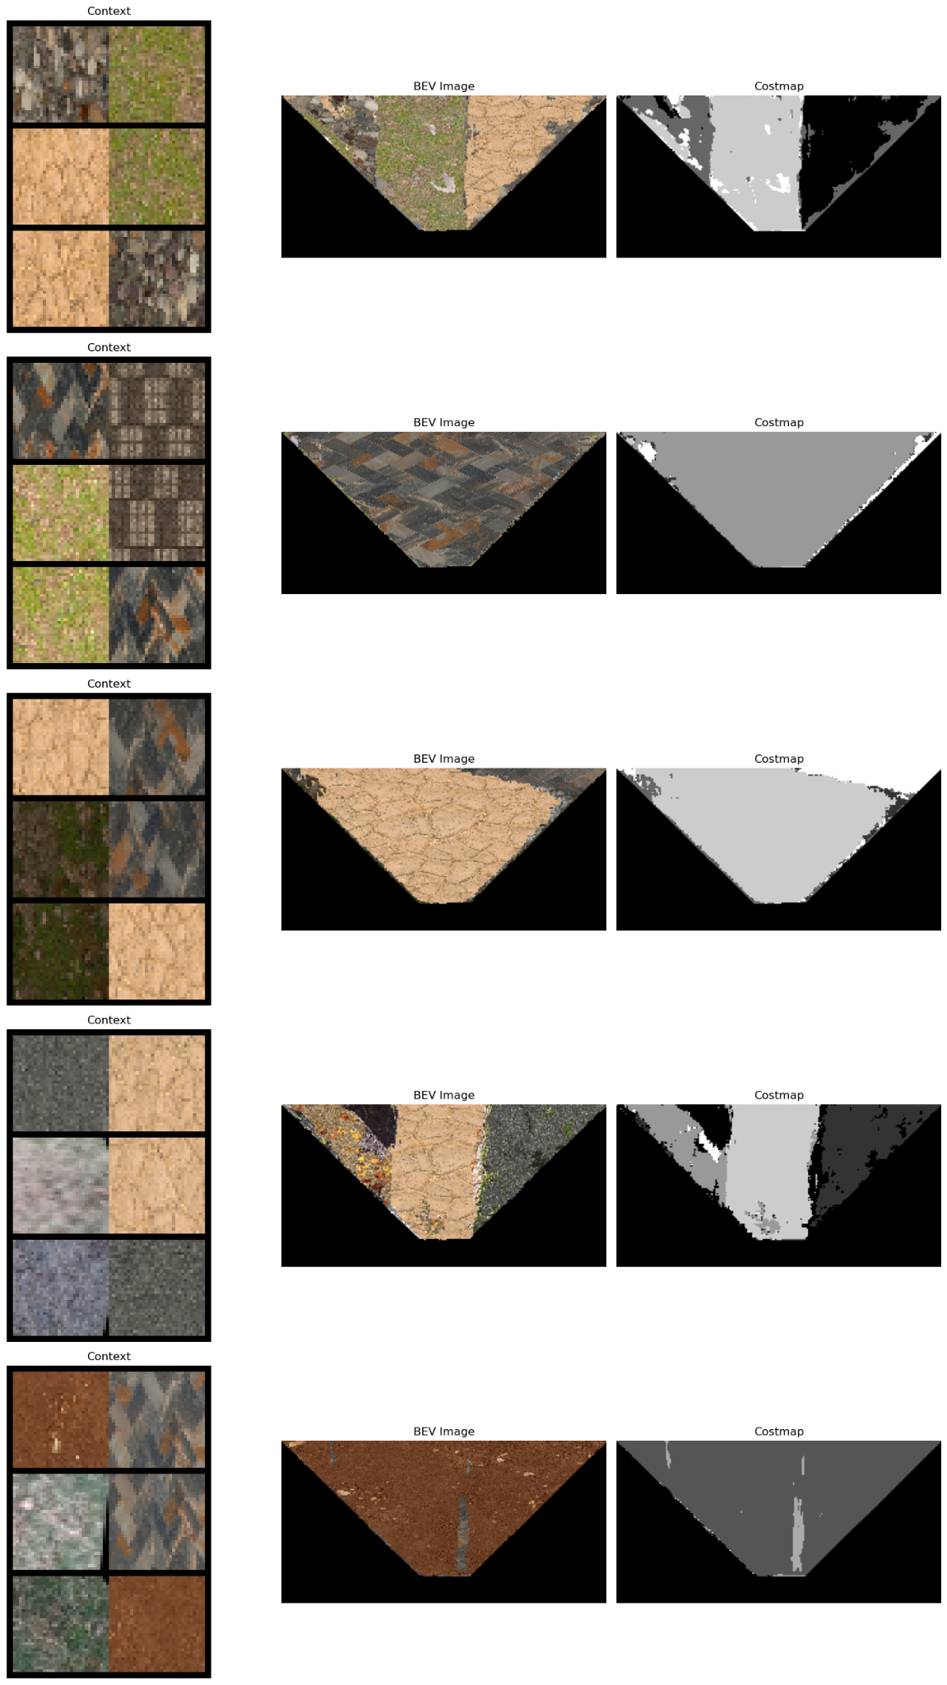
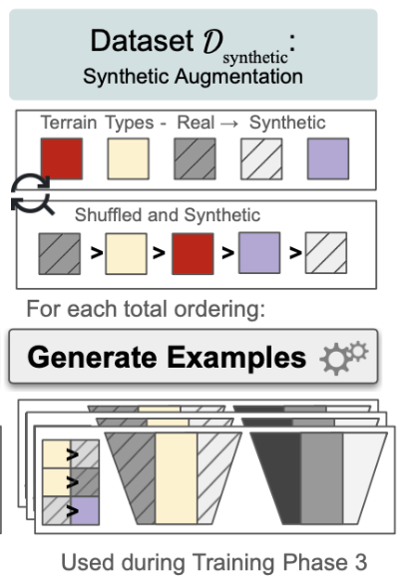
Model Training: Property 3 (Unseen Terrain)

Slide 22
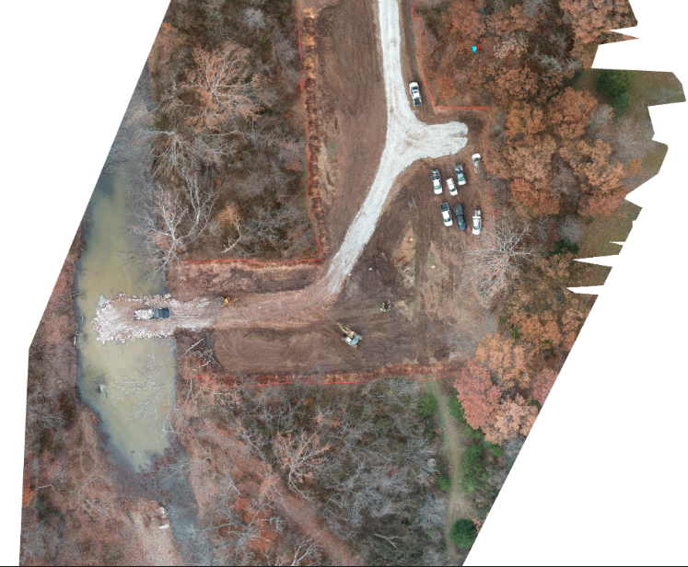
New Terrains

Slide 23
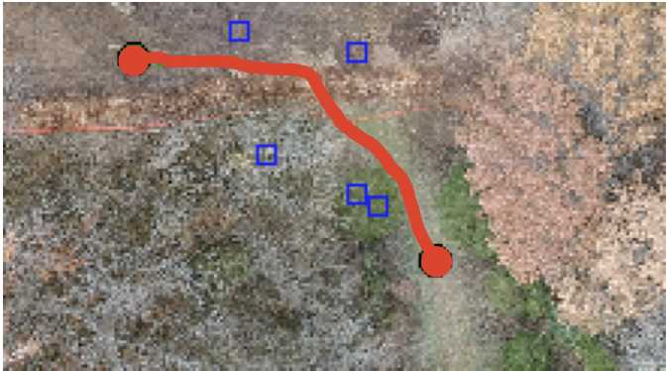
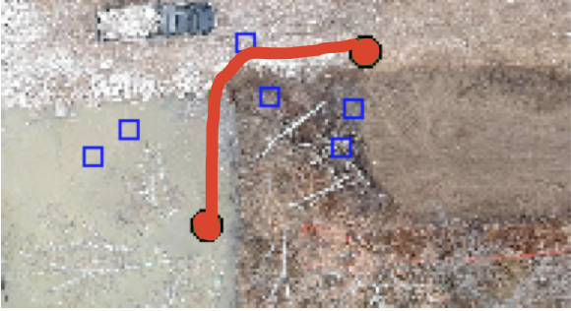
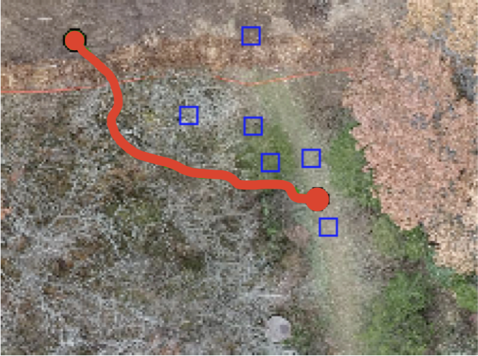
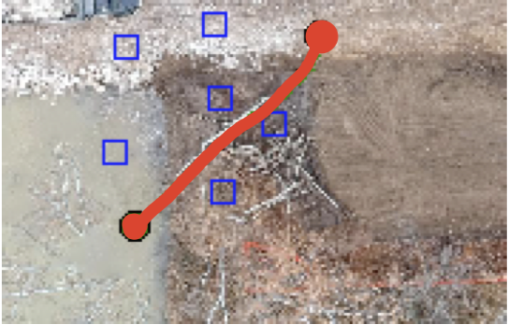
Qualitative Results: Unseen Context, Unseen BEV

Slide 24
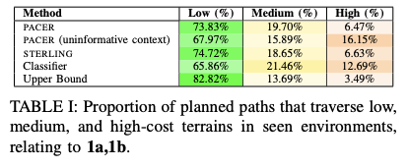
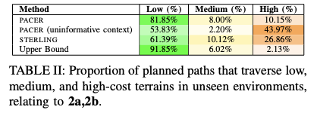
Quantitative Results

Slide 25
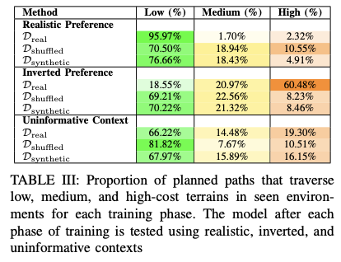
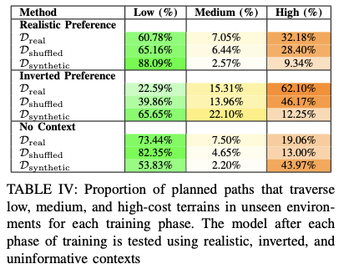
Quantitative Results: Ablation Study

Slide 26
Thanks for Listening
Collaborators
Luisa Mao
luisa.mao@utexas.edu
Paper
Joydeep Biswas
Peter Stone
Garrett Warnell

