Slide 1

Topic 15
Implementing and Using Stacks
"stack n.
The set of things a person has to do in the future. "I haven't done it yet because every time I pop my stack something new gets pushed." If you are interrupted several times in the middle of a conversation, "My stack overflowed" means
"I forget what we were talking about."
-The Hacker's Dictionary
Friedrich L. Bauer
German computer scientist
who proposed "stack method
of expression evaluation"
in 1955.

Slide 2

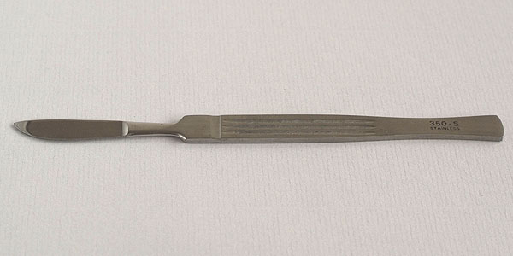

Sharper Tools
Stacks
Lists

Slide 3
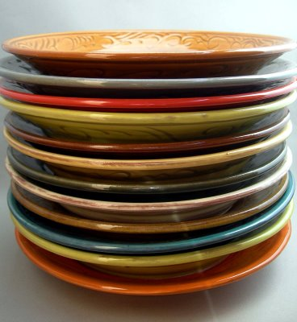
Stacks
Access is allowed only at one point of the structure, normally termed the top of the stack
  access to the most recently added item only
Operations are limited:
  push (add item to stack)
  pop (remove top item from stack)
  top (get top item without removing it)
  isEmpty
Described as a "Last In First Out"
(LIFO) data structure

Slide 4
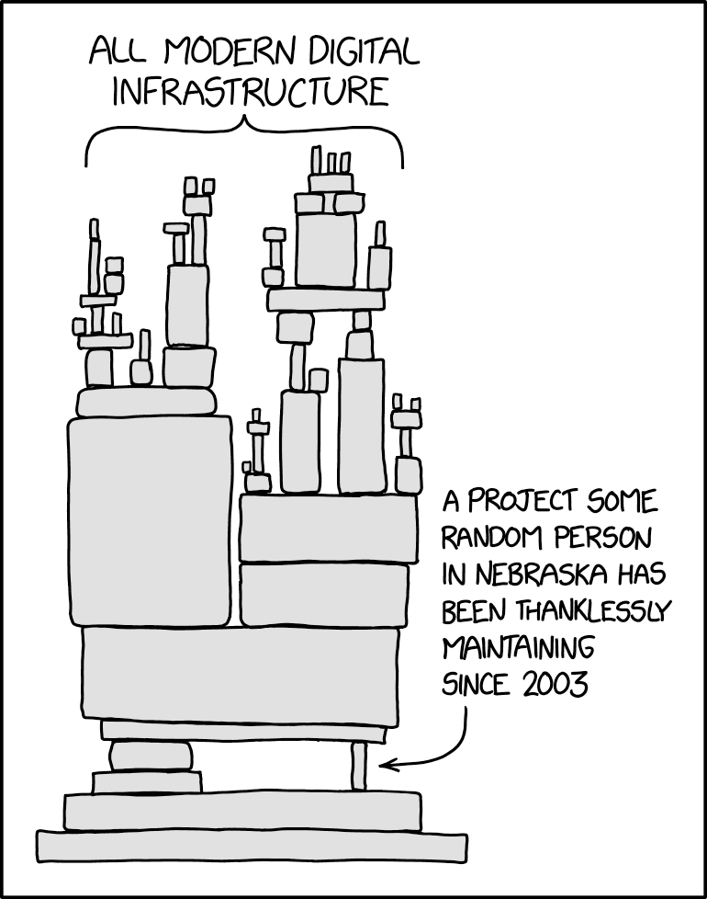
Implementing a stack
need an underlying collection to hold the elements of the stack
3 obvious choices?
  native array
  linked structure of nodes
  a list!!!
Adding a layer of abstraction.
A HUGE idea.
array implementation
linked list implementation
https://xkcd.com/2347/

Slide 5
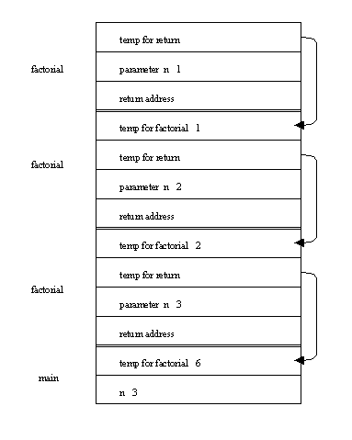
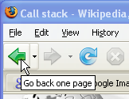
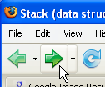

Uses of Stacks
The runtime stack used by a process (running program) to keep track of methods in progress
Search problems
Undo, redo, back, forward

Slide 6
Stack Operations
Assume a simple stack for integers.
Stack<Integer> s = new Stack<>();
s.push(12);
s.push(4);
s.push( s.top() + 2 );
s.pop();
s.push( s.top() );
//what are contents of stack?

Slide 7
Clicker 1 - What is Output?
Stack<Integer> s = new Stack<>();
// put stuff in stack
for (int i = 0; i < 5; i++)
s.push(i);
// Print out contents of stack.
// Assume there is a size method.
for (int i = 0; i < s.size(); i++)
System.out.print(s.pop() + " ");
A 0 1 2 3 4 D 2 3 4
B 4 3 2 1 0 E No output due
C 4 3 2 to runtime error

Slide 8
Corrected Version
Stack<Integer> s = new Stack<Integer>();
// put stuff in stack
for (int i = 0; i < 5; i++)
s.push(i);
// print out contents of stack
// while emptying it
final int LIMIT = s.size();
for (int i = 0; i < LIMIT; i++)
System.out.print(s.pop() + " ");
//or
// while (!s.isEmpty())
// System.out.println(s.pop());

Slide 9

Stack Operations
Write a method to print out contents of stack in reverse order.

Slide 10
Applications of Stacks

Slide 11
Mathematical Calculations
What does 3 + 2 * 4 equal?
2 * 4 + 3? 3 * 2 + 4?
The precedence of operators affects the order of operations.
A mathematical expression cannot simply be evaluated left to right.
A challenge when evaluating a program.
Lexical analysis is the process of interpreting a program.
What about 1 - 2 - 4 ^ 5 * 3 * 6 / 7 ^ 2 ^ 3

Slide 12
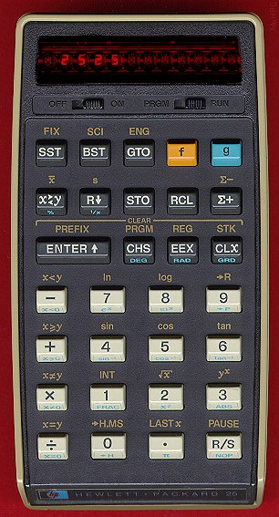
Infix and Postfix Expressions
The way we are use to writing expressions is known as infix notation
Postfix expression does not
require any precedence rules
3 2 * 1 + is postfix of 3 * 2 + 1
evaluate the following postfix expressions and write out a corresponding infix expression:
  2 3 2 4 * + * 1 2 3 4 ^ * +
  1 2 - 3 2 ^ 3 * 6 / + 2 5 ^ 1 -

Slide 13
Clicker Question 2
What does the following postfix expression evaluate to?
6 3 2 + *
11
18
24
30
36

Slide 14
Evaluation of Postfix Expressions
Easy to do with a stack
given a proper postfix expression:
  get the next token
  if it is an operand push it onto the stack
  else if it is an operator
    pop the stack for the right hand operand
    pop the stack for the left hand operand
    apply the operator to the two operands
    push the result onto the stack
  when the expression has been exhausted the result is the top (and only element) of the stack

Slide 15
Infix to Postfix
Convert the following equations from infix to postfix:
  2 ^ 3 ^ 3 + 5 * 1
  11 + 2 - 1 * 3 / 3 + 2 ^ 2 / 3
  Problems:
  Negative numbers?
  parentheses in expression

Slide 16
Infix to Postfix Conversion
Requires operator precedence parsing algorithm
  parse v. To determine the syntactic structure of a sentence or other utterance
Operands: add to expression
Close parenthesis: pop stack symbols until an open parenthesis appears
Operators:
Have an on stack and off stack precedence
Pop all stack symbols until a symbol of lower precedence appears. Then push the operator
End of input: Pop all remaining stack symbols and add to the expression

Slide 17
Simple Example
Infix Expression: 3 + 2 * 4
PostFix Expression:
Operator Stack:
Precedence Table
Symbol Off Stack On Stack
Precedence Precedence
+ 1 1
- 1 1
* 2 2
/ 2 2
^ 10 9
( 20 0

Slide 18
Simple Example
Infix Expression: + 2 * 4
PostFix Expression: 3
Operator Stack:
Precedence Table
Symbol Off Stack On Stack
Precedence Precedence
+ 1 1
- 1 1
* 2 2
/ 2 2
^ 10 9
( 20 0

Slide 19
Simple Example
Infix Expression: 2 * 4
PostFix Expression: 3
Operator Stack: +
Precedence Table
Symbol Off Stack On Stack
Precedence Precedence
+ 1 1
- 1 1
* 2 2
/ 2 2
^ 10 9
( 20 0

Slide 20
Simple Example
Infix Expression: * 4
PostFix Expression: 3 2
Operator Stack: +
Precedence Table
Symbol Off Stack On Stack
Precedence Precedence
+ 1 1
- 1 1
* 2 2
/ 2 2
^ 10 9
( 20 0

Slide 21
Simple Example
Infix Expression: 4
PostFix Expression: 3 2
Operator Stack: + *
Precedence Table
Symbol Off Stack On Stack
Precedence Precedence
+ 1 1
- 1 1
* 2 2
/ 2 2
^ 10 9
( 20 0

Slide 22
Simple Example
Infix Expression:
PostFix Expression: 3 2 4
Operator Stack: + *
Precedence Table
Symbol Off Stack On Stack
Precedence Precedence
+ 1 1
- 1 1
* 2 2
/ 2 2
^ 10 9
( 20 0

Slide 23
Simple Example
Infix Expression:
PostFix Expression: 3 2 4 *
Operator Stack: +
Precedence Table
Symbol Off Stack On Stack
Precedence Precedence
+ 1 1
- 1 1
* 2 2
/ 2 2
^ 10 9
( 20 0

Slide 24
Simple Example
Infix Expression:
PostFix Expression: 3 2 4 * +
Operator Stack:
Precedence Table
Symbol Off Stack On Stack
Precedence Precedence
+ 1 1
- 1 1
* 2 2
/ 2 2
^ 10 9
( 20 0

Slide 25
Example
11 + 2 ^ 4 ^ 3 - ((4 + 5) * 6 ) ^ 2
Show algorithm in action on above equation

Slide 26
Balanced Symbol Checking
In processing programs and working with computer languages there are many instances when symbols must be balanced
  { } , [ ] , ( )
  A stack is useful for checking symbol balance. When a closing symbol is found it must match the most recent opening symbol of the same type.
Applicable to checking html and xml tags!

Slide 27
Algorithm for Balanced Symbol Checking
Make an empty stack
read symbols until end of file
  if the symbol is an opening symbol push it onto the stack
  if it is a closing symbol do the following
    if the stack is empty report an error
    otherwise pop the stack. If the symbol popped does not match the closing symbol report an error
At the end of the file if the stack is not empty report an error

Slide 28
Algorithm in practice
list[i] = 3 * ( 44 - method( foo( list[ 2 * (i + 1) + foo( list[i - 1] ) ) / 2 * ) - list[ method(list[0])];
Complications
  when is it not an error to have non matching symbols?
Processing a file
  Tokenization: the process of scanning an input stream. Each independent chunk is a token.
Tokens may be made up of 1 or more characters

