Slide 1
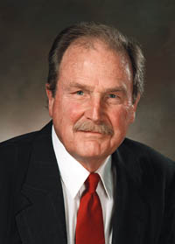
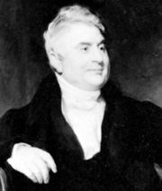
Topic 21: Huffman Coding
The author should gaze at Noah, and ... learn, as they did in the Ark, to crowd a great deal of matter into a very small compass.
Sydney Smith, Edinburgh Review

Slide 2
Agenda
Encoding
Compression
Huffman Coding

Slide 3
Encoding
UTCS
85 84 67 83
01010101 01010100 01000011 01010011
What is stored in a jpg file? A text file? A Java file? A png file? A pdf file? An mp3 file? An mp4 file? An excel spreadsheet file? A zip file?
open a bitmap in a text editor

Slide 4
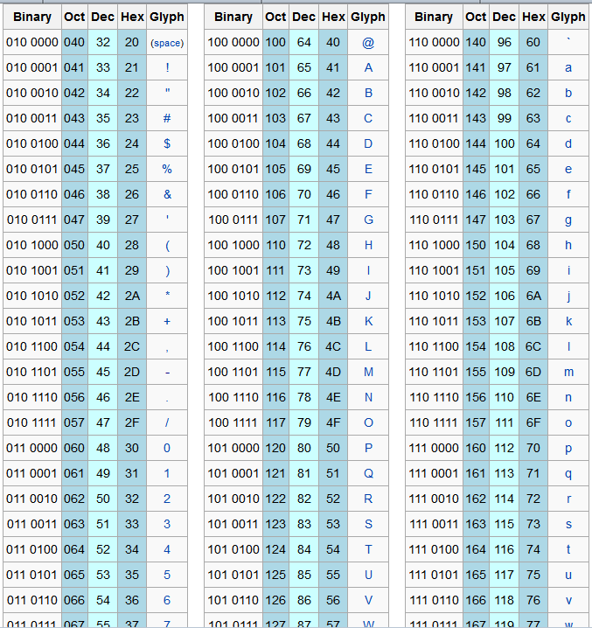
ASCII - UNICODE

Slide 5
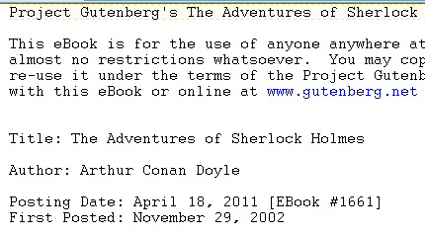
Text File

Slide 6
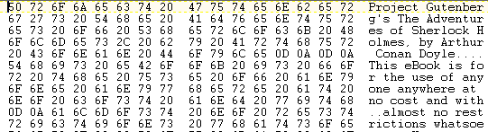
Text File???

Slide 7
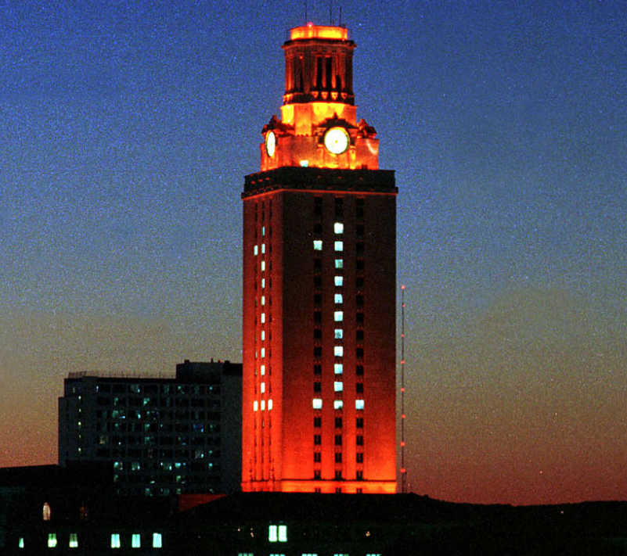
Bitmap and JPEG File

Slide 8
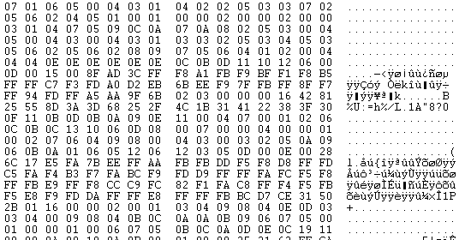
Bitmap File????

Slide 9
JPEG File

Slide 10

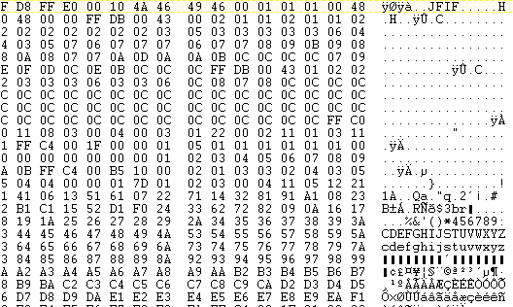
JPEG VS BITMAP
JPEG File

Slide 11

Encoding Schemes
"It's all 1s and 0s"
What do the 1s and 0s mean?
50 121 109
ASCII -> 2ym
Red Green Blue-> dark teal?

Slide 12
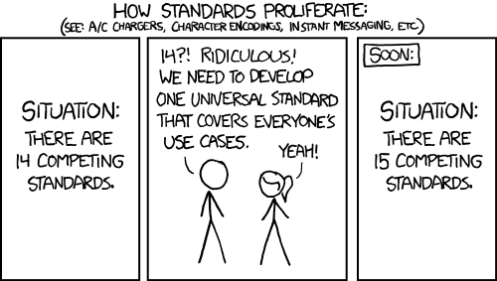
Why So Many Encoding / Decoding Schemes?
Image file formats: bmp, png, jpg, gif, tiff, svg, cgm, pgm
XKCD, Standards: https://xkcd.com/927/

Slide 13
Agenda
Encoding
Compression
Huffman Coding

Slide 14
Compression
Compression: Storing the same information but in a form that takes less memory
lossless and lossy compression
Recall:

Slide 15
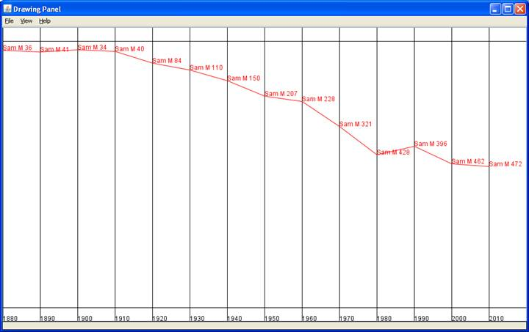
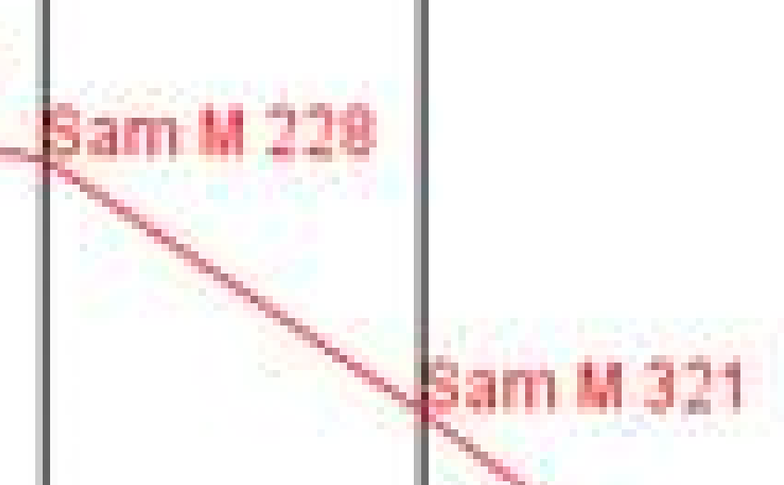
Lossy Artifacts

Slide 16
Compression
00000000000000000000000000000000 111111111111111111111111111111
0 00100000 1 00011110

Slide 17
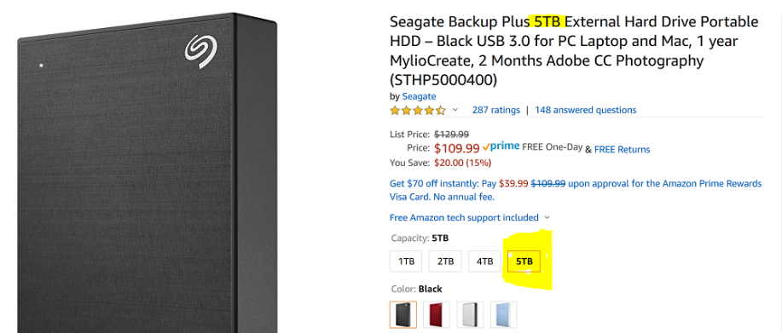
Why Bother?
Is compression really necessary?
5 Terabytes.
~5,000,000,000,0000 bytes

Slide 18
Clicker 1
With computer storage so cheap, is compression really necessary?
No
Yes
It Depends

Slide 19
Little Pipes and Big Pumps
Home Internet Access
CPU Capability
400 Mbps roughly $65 per month
12 months * 3 years * $115 =
400,000,000 bits /second = 5 * 10⁷ bytes / sec
$2,000 for a good laptop or desktop
Intel® Core™ i9-7900X
Assume it lasts 3 years.
Memory bandwidth 40 GB / sec = 4.0 * 10¹⁰ bytes / sec
on the order of 6.4 * 10¹¹ instructions / second

Slide 20
Mobile Devices?
Cellular Network
iPhone CPU
Your mileage may vary …
Mega bits per second
AT&T
17 mbps download, 7 mbps upload
T-Mobile & Verizon
12 mbps download, 7 mbps upload
17,000,000 bits per second = 2.125 x 10⁶ bytes per second
http://tinyurl.com/q6o7wan
Apple A6 System on a Chip
Coy about IPS
2 cores
Rough estimates: 1 x 10¹⁰ instructions per second

Slide 21
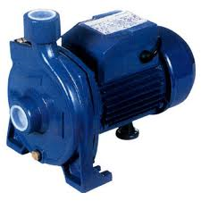
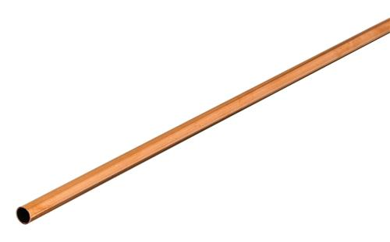
Little Pipes and Big Pumps
CPU
Data In From Network

Slide 22
Agenda
Encoding
Compression
Huffman Coding

Slide 23
Huffman Coding
Proposed by Dr. David A. Huffman
Graduate class in 1951 at MIT with Robert Fano
term paper or final
term paper: prove min bits needed for binary coding of data
A Method for the Construction of Minimum Redundancy Codes
Applicable to many forms of data transmission
Our example: text files
still used in fax machines, mp3 encoding, others

Slide 24
The Basic Algorithm
Huffman coding is a form of statistical coding
Not all characters occur with the same frequency, in typical text files. (can be true when reading raw bytes as well)
Yet in ASCII all characters are allocated the same amount of space
1 char = 1 byte, be it e or x
fixed width encoding

Slide 25
The Basic Algorithm
Any savings in tailoring codes to frequency of character?
Code word lengths are no longer fixed like ASCII or Unicode
Code word lengths vary and will be shorter for the more frequently used characters
Examples use characters for clarity, but in reality just read raw bytes from file.

Slide 26
The Basic Algorithm
1. Scan file to be compressed and determine frequency of all values.
2. Sort or prioritize values based on frequency in file.
3. Build Huffman code tree based on prioritized values.
4. Perform a traversal of tree to determine new codes for values.
5. Scan file again to create new file using the new Huffman codes

Slide 27
Building a Tree Scan the original text
Consider the following short text
Eerie eyes seen near lake.
Determine frequency of all numbers (values or in this case characters) in the text

Slide 28
Building a Tree Scan the original text
Eerie eyes seen near lake.
What characters are present?
E e r i space
y s n a r l k .

Slide 29
Building a Tree Scan the original text
Eerie eyes seen near lake.
What is the frequency of each character in the text?
Char Freq. Char Freq. Char Freq.
E 1 y 1 k 1
e 8 s 2 . 1
r 2 n 2
i 1 a 2
space 4 l 1

Slide 30
Building a Tree Prioritize values from file
Create binary tree nodes with a value and the frequency for each value
Place nodes in a priority queue
The lower the frequency, the higher the priority in the queue

Slide 31
Building a Tree
The queue after enqueueing all nodes
Null Pointers are not shown
sp = space
See slide 67 for actual PQ and tree formed by following assignment specification
front
back
E
1
i
1
k
1
l
1
y
1
.
1
a
2
n
2
r
2
s
2
sp
4
e
8

Slide 32
Building a Tree
While priority queue contains two or more nodes
Create new node
Dequeue node and make it left child
Dequeue next node and make it right child
Frequency of new node equals sum of frequency of left and right children
New node does not contain value
Enqueue new node back into the priority queue

Slide 33
Building a Tree
E
1
i
1
k
1
l
1
y
1
.
1
a
2
n
2
r
2
s
2
sp
4
e
8

Slide 34
Building a Tree
k
1
l
1
y
1
.
1
a
2
n
2
r
2
s
2
sp
4
e
8
2
E
1
i
1

Slide 35
Building a Tree
k
1
l
1
y
1
.
1
a
2
n
2
r
2
s
2
2
sp
4
e
8
E
1
i
1

Slide 36
Building a Tree
y
1
.
1
a
2
n
2
r
2
s
2
2
sp
4
e
8
E
1
i
1
2
k
1
l
1

Slide 37
Building a Tree
y
1
.
1
a
2
n
2
r
2
s
2
2
2
sp
4
e
8
k
1
l
1
E
1
i
1

Slide 38
Building a Tree
a
2
n
2
r
2
s
2
2
2
sp
4
e
8
k
1
l
1
E
1
i
1
2
y
1
.
1

Slide 39
Building a Tree
a
2
n
2
r
2
s
2
2
2
sp
4
e
8
2
E
1
i
1
k
1
l
1
y
1
.
1

Slide 40
Building a Tree
r
2
s
2
2
sp
4
e
8
2
2
E
1
i
1
k
1
l
1
y
1
.
1
4
a
2
n
2

Slide 41
Building a Tree
r
2
s
2
2
sp
4
e
8
2
2
4
E
1
i
1
k
1
l
1
y
1
.
1
a
2
n
2

Slide 42
Building a Tree
2
4
e
8
2
2
sp
4
k
1
l
1
y
1
.
1
a
2
n
2
E
1
i
1
4
r
2
s
2

Slide 43
Building a Tree
2
4
4
e
8
2
2
sp
4
k
1
l
1
y
1
.
1
a
2
n
2
r
2
s
2
E
1
i
1

Slide 44
Building a Tree
4
4
e
8
2
sp
4
y
1
.
1
a
2
n
2
r
2
s
2
4
2
2
E
1
i
1
k
1
l
1

Slide 45
Building a Tree
2
4
4
4
sp
4
e
8
2
2
y
1
.
1
a
2
n
2
r
2
s
2
E
1
i
1
k
1
l
1

Slide 46
Building a Tree
4
4
4
e
8
2
2
a
2
n
2
r
2
s
2
E
1
i
1
k
1
l
1
6
2
sp
4
y
1
.
1

Slide 47
Building a Tree
4
4
4
6
e
8
2
sp
4
a
2
n
2
r
2
s
2
2
2
y
1
.
1
E
1
i
1
k
1
l
1

Slide 48
Building a Tree
4
6
e
8
2
2
2
sp
4
E
1
i
1
k
1
l
1
y
1
.
1
8
4
4
a
2
n
2
r
2
s
2

Slide 49
Building a Tree
4
6
e
8
8
2
2
2
sp
4
4
4
E
1
i
1
k
1
l
1
r
1
.
1
a
2
n
2
r
2
s
2

Slide 50
Building a Tree
e
8
8
4
4
10
a
2
n
2
r
2
s
2
4
6
2
2
2
sp
4
E
1
i
1
k
1
l
1
y
1
.
1

Slide 51
Building a Tree
e
8
8
10
4
4
4
6
r
2
s
2
2
2
2
a
2
n
2
sp
4
E
1
i
1
k
1
l
1
y
1
.
1
Clicker 2 - What is happening to the values with a low frequency compared to values with a high freq.?
Smaller Depth B. Larger Depth C. Something else

Slide 52
Building a Tree
10
16
4
6
2
2
2
e
8
8
sp
4
E
1
i
1
k
1
l
1
y
1
.
1
4
4
a
2
n
2
r
2
s
2

Slide 53
Building a Tree
10
16
4
6
e
8
8
2
2
2
sp
4
4
4
E
1
i
1
k
1
l
1
y
1
.
1
a
2
n
2
r
2
s
2

Slide 54
Building a Tree
26
16
10
4
e
8
8
6
2
2
2
sp
4
4
4
E
1
i
1
k
1
l
1
y
1
.
1
a
2
n
2
r
2
s
2

Slide 55
Building a Tree
After enqueueing this node there is only one node left in priority queue.
26
16
10
4
e
8
8
6
2
2
2
sp
4
4
4
E
1
i
1
k
1
l
1
y
1
.
1
a
2
n
2
r
2
s
2

Slide 56
Building a Tree
Dequeue the single node left in the queue.
This tree contains the new code words for each character.
Frequency of root node should equal number of characters in text.
26
16
10
4
e
8
8
6
2
2
2
4
sp
4
4
E
1
i
1
k
1
l
1
y
1
.
1
a
2
n
2
r
2
s
2
Eerie eyes seen near lake. 4 spaces, 26 characters total

Slide 57
Encoding the File Traverse Tree for Codes
Perform a traversal of the tree to obtain new code words (sequence of 0's and 1's)
left, append a 0 to code word
right append a 1 to code word
code word is only complete when a leaf node is reached
26
16
10
4
e
8
8
6
2
2
2
4
sp
4
4
E
1
i
1
k
1
l
1
y
1
.
1
a
2
n
2
r
2
s
2

Slide 58
Encoding the File Traverse Tree for Codes
Original Value New Code
E (0100 0101) 0000
i (0110 1001) 0001
k (0110 1011) 0010
l (0110 1100) 0011
y (0111 1001) 0100
. (0010 1110) 0101
space (0010 0000) 011
e (0110 0101) 10
a (0110 0001) 1100
n (0110 1110) 1101
r (0111 0010) 1110
s (0111 0011) 1111
Prefix free codes. The code for a value in never the prefix
of another code.
26
16
10
4
e
8
8
6
2
2
2
4
sp
4
4
E
1
i
1
k
1
l
1
y
1
.
1
a
2
n
2
r
2
s
2

Slide 59
Encoding the File
Rescan original file and encode file using new code words
Eerie eyes seen near lake.
Char New Code
E 0000
i 0001
k 0010
l 0011
y 0100
. 0101
space 011
e 10
a 1100
n 1101
r 1110
s 1111
000010111000011001110 010010111101111111010 110101111011011001110 011001111000010100101

Slide 60
Encoding the File Results
Have we made things any better?
84 bits to encode the file
ASCII would take 8 * 26 = 208 bits
000010111000011001110 010010111101111111010 110101111011011001110 011001111000010100101
If modified code used 4 bits per
character are needed. Total bits
4 * 26 = 104. Savings not as great.

Slide 61
Decoding the File
How does receiver know what the codes are?
Tree constructed for each file.
Considers frequency for each file
Big hit on compression, especially for smaller files
Tree predetermined
based on statistical analysis of text files or other file types

Slide 62
Clicker 3 - Decoding the File
Once receiver has tree it scans incoming bit stream
0 ⇒ go left
1 ⇒ go right
1010001001111000111111
11011100001010
elk nay sir
eek a snake
eek kin sly
eek snarl nil
eel a snarl
26
16
10
4
e
8
8
6
2
2
2
4
sp
4
4
E
1
i
1
k
1
l
1
y
1
.
1
a
2
n
2
r
2
s
2

Slide 63
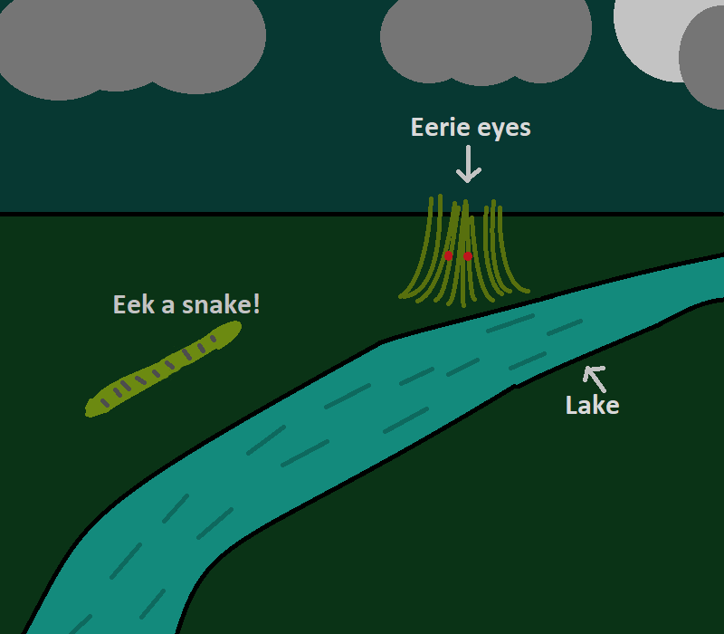
Alex Fall 2022

Slide 64
Assignment Hints
reading chunks not chars
header format
the pseudo eof value
the GUI

Slide 65
Assignment Example
"Eerie eyes seen near lake." will result in different codes than those shown in slides due to:
adding elements in order to PriorityQueue
required pseudo eof value (PEOF)

Slide 66
Assignment Example
Char Freq. Char Freq. Char Freq.
E 1 y 1 k 1
e 8 s 2 . 1
r 2 n 2 PEOF 1
i 1 a 2
space 4 l 1

Slide 67
Assignment Example
.
1
E
1
i
1
k
1
l
1
y
1
PEOF
1
a
2
n
2
r
2
s
2
SP
4
e
8

Slide 68
Assignment Example
i
1
k
1
l
1
y
1
PEOF
1
a
2
n
2
r
2
s
2
SP
4
e
8
2
.
1
E
1

Slide 69
Assignment Example
i
1
k
1
l
1
y
1
PEOF
1
a
2
n
2
r
2
s
2
2
SP
4
e
8
.
1
E
1

Slide 70
Assignment Example
l
1
y
1
PEOF
1
a
2
n
2
r
2
s
2
2
2
SP
4
e
8
i
1
k
1
.
1
E
1

Slide 71
Assignment Example
PEOF
1
a
2
n
2
r
2
s
2
2
2
2
SP
4
e
8
i
1
k
1
l
1
y
1
.
1
E
1

Slide 72
Assignment Example
n
2
r
2
s
2
2
2
2
SP
4
e
8
3
i
1
k
1
l
1
y
1
.
1
E
1
PEOF
1
a
2

Slide 73
Assignment Example
s
2
2
2
2
SP
4
3
4
e
8
i
1
k
1
l
1
y
1
.
1
E
1
PEOF
1
a
2
n
2
r
2

Slide 74
Assignment Example
2
2
SP
4
3
4
4
e
8
i
1
k
1
l
1
y
1
PEOF
1
a
2
n
2
r
2
s
2
2
.
1
E
1

Slide 75
4
4
7
e
8
4
n
2
r
2
s
2
2
2
2
3
SP
4
.
1
E
1
i
1
k
1
l
1
y
1
PEOF
1
a
2

Slide 76
7
4
e
8
8
2
2
SP
4
4
4
3
i
1
k
1
l
1
y
1
n
2
r
2
s
2
2
PEOF
1
a
2
.
1
E
1

Slide 77
e
8
8
11
4
4
4
7
n
2
r
2
s
2
2
2
2
SP
4
3
i
1
k
1
l
1
y
1
.
1
E
1
PEOF
1
a
2

Slide 78
11
16
e
8
8
4
7
2
2
4
4
SP
4
3
i
1
k
1
l
1
y
1
n
2
r
2
s
2
2
PEOF
1
a
2
.
1
E
1

Slide 79
27
11
16
e
8
8
4
7
2
2
4
4
SP
4
3
i
1
k
1
l
1
y
1
n
2
r
2
s
2
2
PEOF
1
a
2
.
1
E
1

Slide 80
Codes
value: 32, equivalent char: , frequency: 4, new code 011
value: 46, equivalent char: ., frequency: 1, new code 11110
value: 69, equivalent char: E, frequency: 1, new code 11111
value: 97, equivalent char: a, frequency: 2, new code 0101
value: 101, equivalent char: e, frequency: 8, new code 10
value: 105, equivalent char: i, frequency: 1, new code 0000
value: 107, equivalent char: k, frequency: 1, new code 0001
value: 108, equivalent char: l, frequency: 1, new code 0010
value: 110, equivalent char: n, frequency: 2, new code 1100
value: 114, equivalent char: r, frequency: 2, new code 1101
value: 115, equivalent char: s, frequency: 2, new code 1110
value: 121, equivalent char: y, frequency: 1, new code 0011
value: 256, equivalent char: ?, frequency: 1, new code 0100

Slide 81
Altering files
Tower bit map (Eclipse/Huffman/Data). Alter the first 300 characters of line 16765 to this
~00~00~00~00~00~00~00~00~00~00~00~00~00~00~00~00~00~00~00~00~00~00~00~00~00~00~00~00~00~00~00~00~00~00~00~00~00~00~00~00~00~00~00~00~00~00~00~00~00~00~00~00~00~00~00~00~00~00~00~00~00~00~00~00~00~00~00~00~00~00~00~00~00~00~00~00~00~00~00~00~00~00~00~00~00~00~00~00~00~00~00~00~00~00~00~00~00~00~00~00 xxx

Slide 82
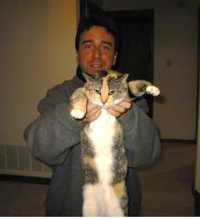
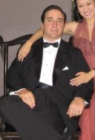
Compression - Why Bother?
Apostolos "Toli" Lerios
Facebook Engineer
Heads image storage group
jpeg images already compressed
look for ways to compress even more
1% less space = millions of dollars in savings

