Slide 1
Graphs Topic 22
" Hopefully, you've played around a bit with The Oracle of Bacon at Virginia and discovered how few steps are necessary to link just about anybody who has ever been in a movie to Kevin Bacon, but could there be some actor or actress who is even closer to the center of the Hollywood universe?.
By processing all of the almost half of a million people in the Internet Movie Database I discovered that there are currently 1160 people who are better centers than Kevin Bacon! … By computing the average of these numbers we see that the average (Sean) Connery Number is about 2.682 making Connery a better center than Bacon"
-Who is the Center of the Hollywood Universe?, University of Virginia
That was in 2001. In 2013 Harvey Keitel has become the center of the Hollywood Universe. Connery is 136th. Bacon has moved up to 370^{th.}

Slide 2
An Early Problem in Graph Theory
Leonhard Euler (1707 - 1783)
One of the first mathematicians to study graphs
The Seven Bridges of Konigsberg Problem
Konigsberg is now called Kaliningrad
A puzzle for the residents of the city
The river Pregel flows through the city
7 bridges crossed the river
Can you cross all bridges while crossing each bridge only once? An Eulerian Circuit

Slide 3
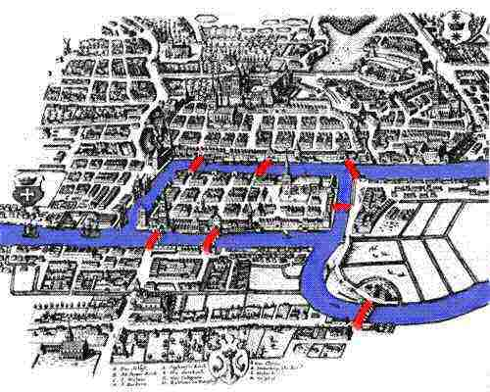
Konigsberg and the River Pregel
A
B
D
C

Slide 4
Clicker 1
How many solutions does the Seven Bridges of Konigsberg Problem have?
0
1
2
3
>= 4

Slide 5
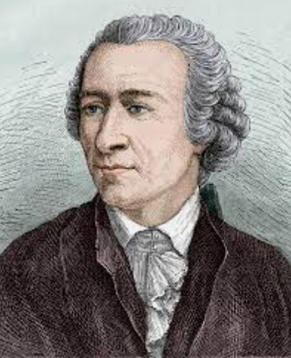
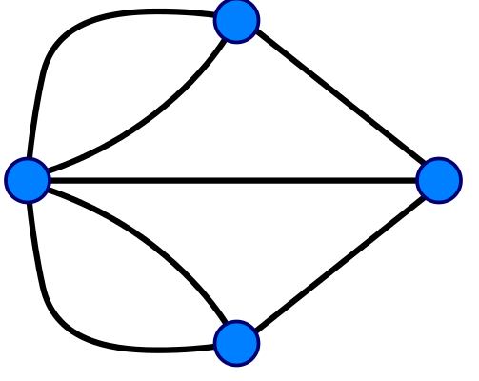
How to Solve
Brute Force?
Euler's Solution
Redraw the map as a graph (really a multigraph as opposed to a simple graph, 1 or 0 edges per pair of vertices)
a
b
d
c

Slide 6
Euler's Proposal
A connected graph has an Euler tour (cross every edge exactly one time and end up at starting node) if and only if every vertex has an even number of edges
Eulerian Circuit
Clicker 2 - What if we reduce the problem to only crossing each edge (bridge) exactly once?
Doesn't matter if we end up where we started
Eulerian Trail
A. 0 B. 1 C. 2 D. 3 E. >= 4

Slide 7
Graph Definitions
A graph is comprised of a set of vertices (nodes) and a set of edges (links, arcs) connecting the vertices
An edge connects 2 vertices
in a directed graph edges are one-way
movement allowed from first node to second, but not second to first
directed graphs also called digraphs
in an undirected graph edges are two-way
movement allowed in either direction

Slide 8
Definitions
In a weighted graph the edge has cost or weight that measures the cost of traveling along the edge
A path is a sequence of vertices connected by edges
The path length is the number of edges
The weighted path length is the sum of the cost of the edges in a path
A cycle is a path of length 1 or more that starts and ends at the same vertex without repeating any other vertices
a directed acyclic graph is a directed graph with no cycles

Slide 9
Graphs We've Seen
link
link
link
link
19
12
35
3
16
21
56
link
link
link

Slide 10
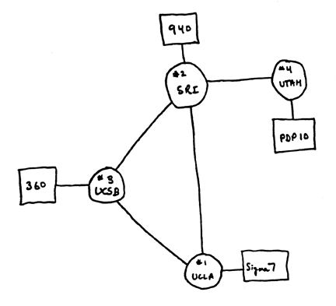
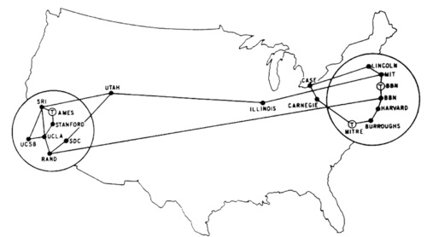
Example Graph
Scientists (and academics of ALL kinds) use graphs to model all kinds of things.
Arpanet 1969, 1971

Slide 11
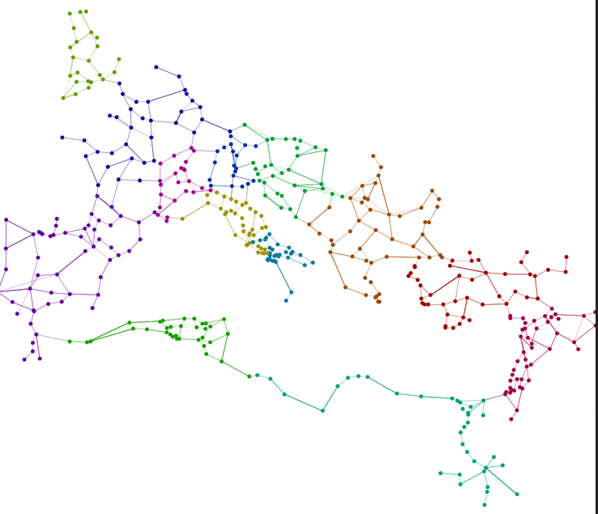
Example Graph
Roman Transportation
Network

Slide 12
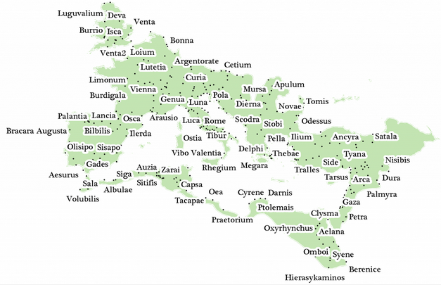
Roman Transportation Network

Slide 13
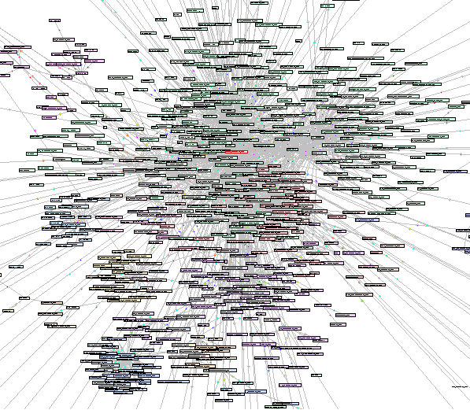
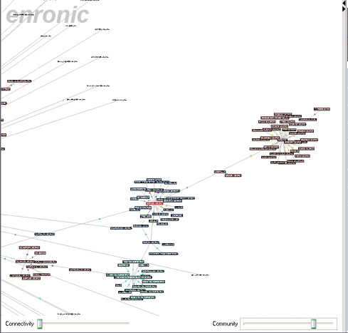
Example Graph
Enron emails 2001

Slide 14
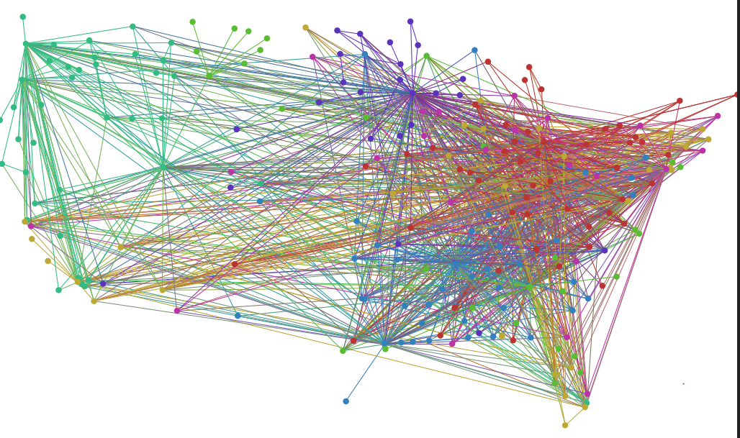
Example Graph
US Airport Network

Slide 15
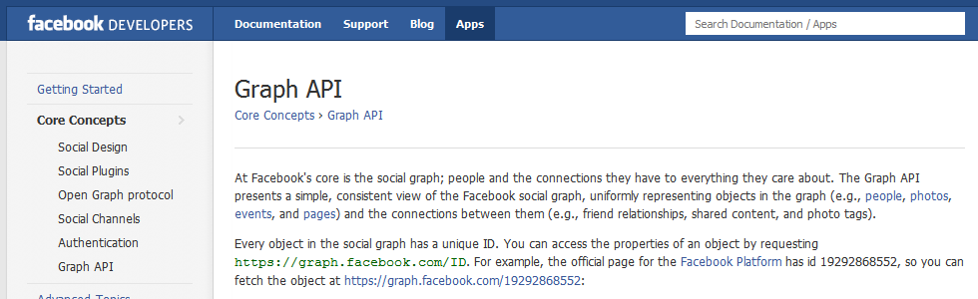
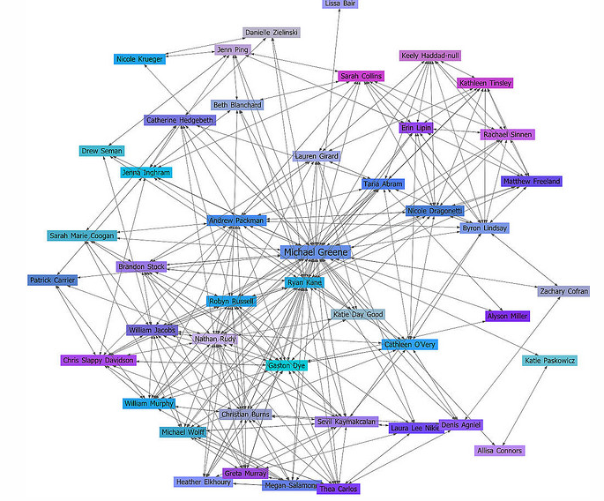
Example Graph

Slide 16
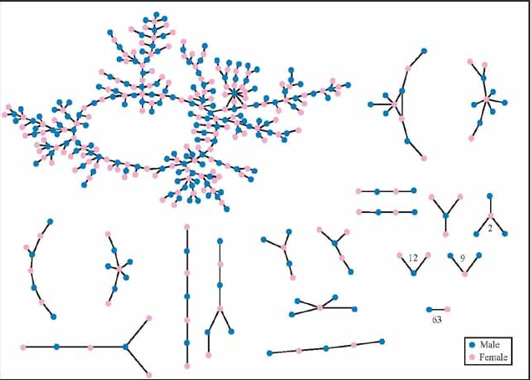
Example Graph
"Jefferson" High School, Ohio Chains of Affection: The Structure of Adolescent Romantic and Sexual Networks, 2005,

Slide 17
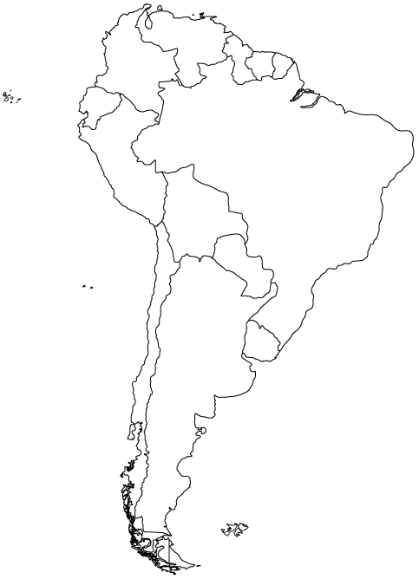
Representing Graphs
How to store a graph as a data structure?

Slide 18
Adjacency Matrix Representation
A Br Bl Ch Co E FG G Pa Pe S U V A 0 1 1 1 0 0 0 0 1 0 0 1 0 Br 1 0 1 0 1 0 1 1 1 1 1 1 1 Bl 1 1 0 1 0 0 0 0 1 1 0 0 0 Ch 1 0 1 0 0 0 0 0 0 1 0 0 0 Co 0 1 0 0 0 1 0 0 0 1 0 0 1 E 0 0 0 0 1 0 0 0 0 1 0 0 0 FG 0 1 0 0 0 0 0 0 0 0 1 0 0 G 0 1 0 0 0 0 0 0 0 0 1 0 1 Pa 1 1 1 0 0 0 0 0 0 0 0 0 0 Pe 0 1 1 1 1 1 0 0 0 0 0 0 0 S 0 1 0 0 0 0 1 1 0 0 0 0 0 U 1 1 0 0 0 0 0 0 0 0 0 0 0 V 0 1 0 0 1 0 0 1 0 0 0 0 0
Country
Code
Argentina
A
Brazil
Br
Bolivia
Bl
Chile
Ch
Colombia
Co
Ecuador
E
French Guiana
FG
Guyana
G
Paraguay
Pa
Peru
Pe
Suriname
S
Uruguay
U
Venezuela
V

Slide 19
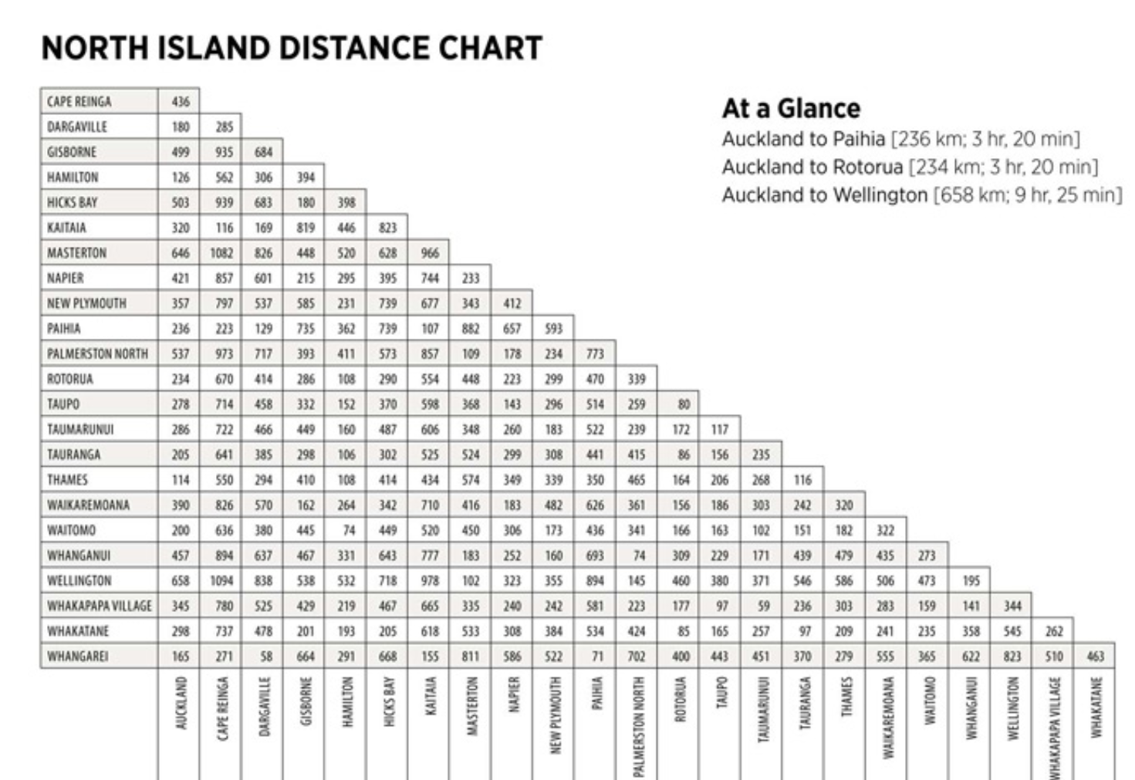
Undirected Graph?
Use a ragged 2d array to save space

Slide 20
The Map Coloring Problem
How many colors do you need to color a map, so that no 2 countries that have a common border (not a point) are colored the same?
How to solve using Brute Force?

Slide 21
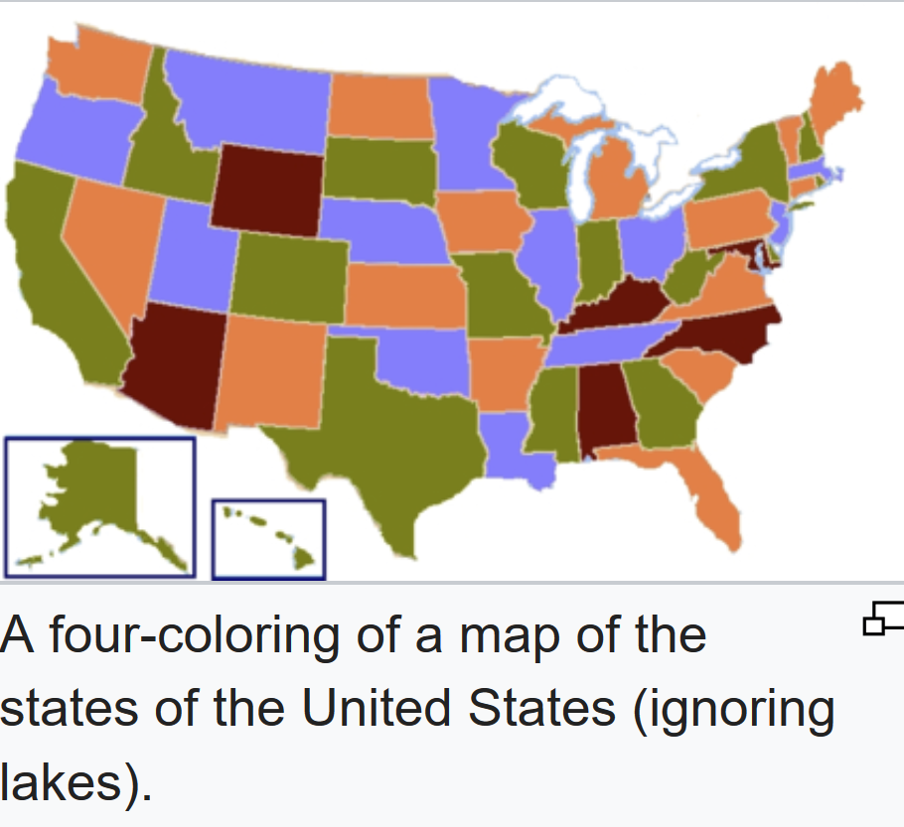
Example

Slide 22
A Solution
Blue
Blue
Yellow
Yellow
Green
Blue
Green
Yellow
Red
Green
Blue
Yellow

Slide 23
What About the Ocean?
A Br Bl Ch Co E FG G Pa Pe S U V Oc A 0 1 1 1 0 0 0 0 1 0 0 1 0 1 Br 1 0 1 0 1 0 1 1 1 1 1 1 1 1 Bl 1 1 0 1 0 0 0 0 1 1 0 0 0 0 Ch 1 0 1 0 0 0 0 0 0 1 0 0 0 1 Co 0 1 0 0 0 1 0 0 0 1 0 0 1 1 E 0 0 0 0 1 0 0 0 0 1 0 0 0 1 FG 0 1 0 0 0 0 0 0 0 0 1 0 0 1 G 0 1 0 0 0 0 0 0 0 0 1 0 1 1 Pa 1 1 1 0 0 0 0 0 0 0 0 0 0 0 Pe 0 1 1 1 1 1 0 0 0 0 0 0 0 1 S 0 1 0 0 0 0 1 1 0 0 0 0 0 1 U 1 1 0 0 0 0 0 0 0 0 0 0 0 1 V 0 1 0 0 1 0 0 1 0 0 0 0 0 1 Oc 1 1 0 1 1 1 1 1 0 1 1 1 1 0

Slide 24
Make the Ocean Blue
Red
Yellow
Yellow
Red
Green
Red
Green
Yellow
Blue
Blue
Green
Red
Blue
Yellow

Slide 25
More Definitions
A dense graph is one with a "large" number of edges
maximum number of edges?
A "sparse" graph is one in which the number of edges is "much less" than the maximum possible number of edges
No standard cutoff for dense and sparse graphs
Although a common one is more than half the possible edges

Slide 26
Graph Representation
For dense graphs the adjacency matrix is a reasonable choice
For weighted graphs change booleans to double or int
Can the adjacency matrix handle directed graphs?
Most graphs are sparse, not dense
For sparse graphs an adjacency list is an alternative that uses less space
Each vertex keeps a list of edges to the vertices it is connected to.

Slide 27
Graph Implementation
public class Graph
private static final double INFINITY = Double.MAX_VALUE;
private Map<String, Vertex> vertices;
public Graph() // create empty Graph
public void addEdge(String source,
String dest, double cost)
// find all paths from given vertex
public void findUnweightedShortestPaths
(String startName)
// called after findUnweightedShortestPath
public void printPath(String destName)

Slide 28
Graph Class
This Graph class stores vertices
Each vertex has an adjacency list
what vertices does it connect to?
shortest path method finds all paths from start vertex to every other vertex in graph
after shortest path method called queries can be made for path length from start node to destination node

Slide 29
Vertex Class (nested in Graph)
private static class Vertex
private String name;
private List<Edge> adjacent;
public Vertex(String n)
// for shortest path algorithms
private double distance;
private Vertex prev;
private int scratch;
// call before finding new paths
public void reset()

Slide 30
Edge Class (nested in Graph)
private static class Edge
private Vertex dest;
private double cost;
private Edge(Vertex d, double c)

Slide 31
Unweighted Shortest Path
Given a vertex, S (for start) find the shortest path from S to all other vertices in the graph
Graph is unweighted (set all edge costs to 1)
V₇
V₁
S
V₆
V₂
V₄
V₈
V₃
V₅

Slide 32
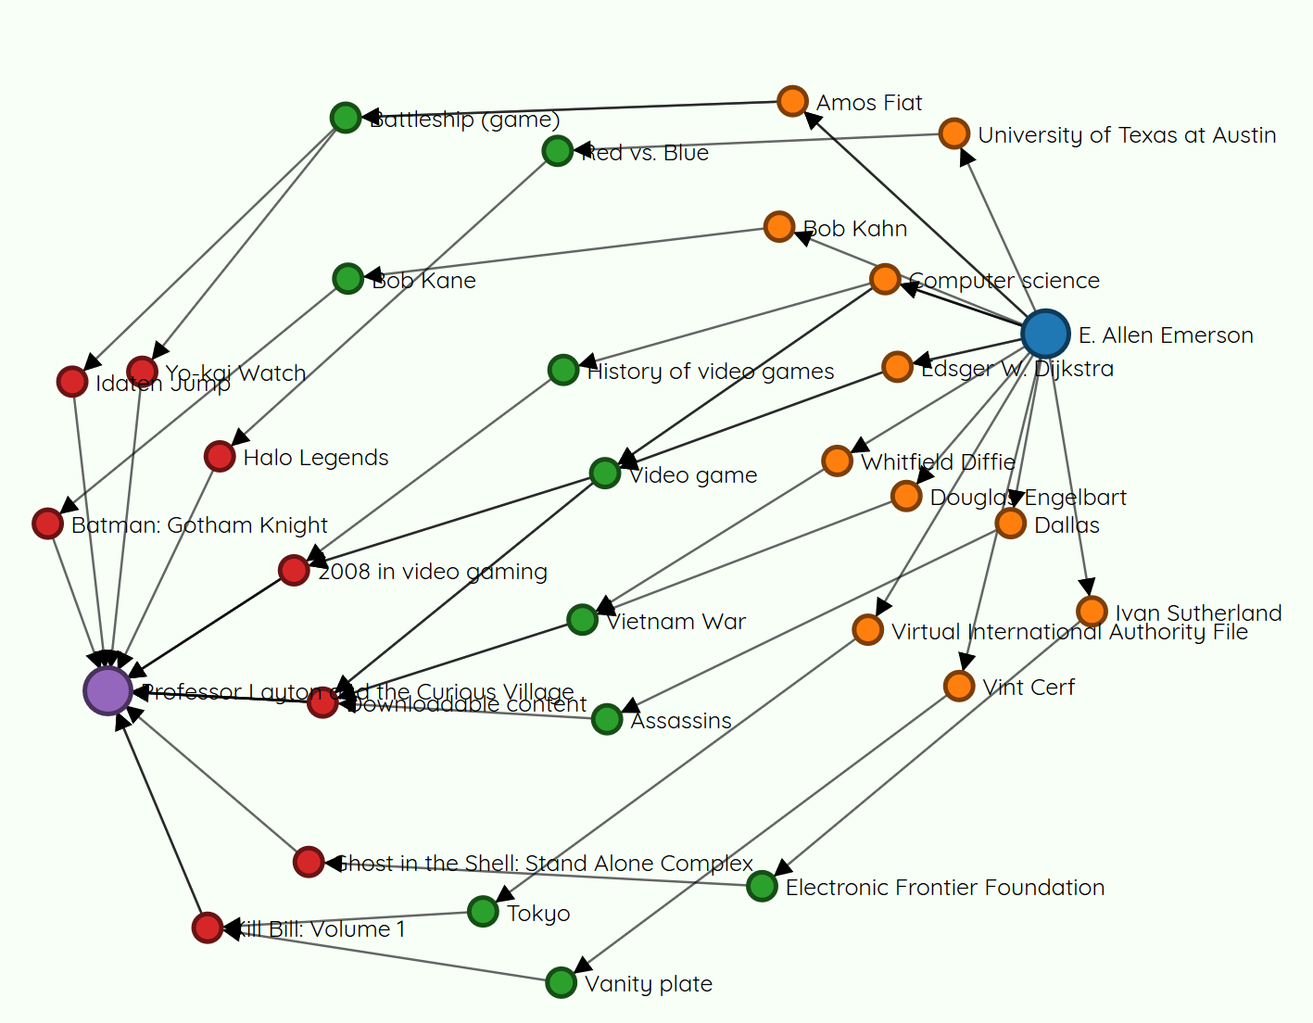
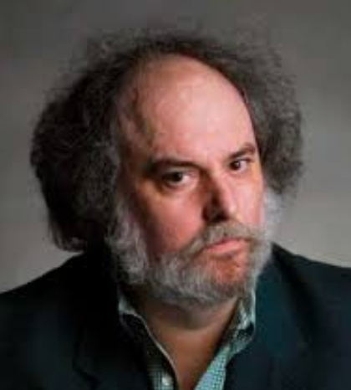

6 Degrees of Wikipedia
https://www.sixdegreesofwikipedia.com/

Slide 33
Word Ladders
Agree upon dictionary
Start word and end word of same length
Change one letter at a time to form step
Step must also be a word
Example: Start = silly, end = funny
silly
sully
sulky
hulky
hunky
funky
funny

Slide 34
Clicker 3 - Graph Representation
What are the vertices and when does an edge exist between two vertices?
Vertices Edges
Letters Words
Words Words that share one or more letters
Letters Words that share one or more letters
Words Words that differ by one letter
Words Letters

Slide 35
smarm
swart
smart
start
smalt
scart
Portion of Graph

Slide 36
Clicker 4 - Size of Graph
Number of vertices and edges depends on dictionary
Modified Scrabble dictionary, 5 letter words
Words are vertices
8660 words, 7915 words that are one letter different from at least one other word
Edge exists between words if they are one letter different
24,942 edges
Is this graph sparse or dense?
Sparse
Dense
Max number of edges = N * (N - 1) / 2 37,493,470

Slide 37
Clicker 5 - Unweighted Shortest Path Algorithm
Problem: Find the shortest word ladder between two words if one exists
What kind of search should we use?
Breadth First Search
Depth First Search
Either one

Slide 38
Unweighted Shortest Path Algorithm
Set distance of start to itself to 0
Create a queue and add the start vertex
while the queue is not empty
remove front
loop through all edges of current vertex
get vertex edge connects to
if this vertex has not been visited (have not found path to the destination of the edge)
sets its distance to current distance + 1
sets its previous vertex to current vertex
add new vertex to queue

Slide 39
smarm
swart
smart
start
smalt
scart
Portion of Graph

Slide 40
smarm
swart
smart
start
smalt
scart
Start at "smart" and enqueue it [smart]

Slide 41
smarm
swart
smart
start
smalt
scart
Dequeue (smart), loop through edges
[swart]

Slide 42
smarm
swart
smart
start
smalt
scart
Dequeue (smart), loop through edges
[swart, start]

Slide 43
smarm
swart
smart
start
smalt
scart
Dequeue (smart), loop through edges
[swart, start, scart]

Slide 44
smarm
swart
smart
start
smalt
scart
Dequeue (smart), loop through edges
[swart, start, scart, smalt]

Slide 45
smarm
swart
smart
start
smalt
scart
Dequeue (smart), loop through edges
[swart, start, scart, smalt, smarm]

Slide 46
smarm
swart
smart
start
smalt
scart
Done with smart, dequeue (swart)
[start, scart, smalt, smarm]

Slide 47
smarm
swart
smart
start
smalt
scart
loop through edges of swart (start already present)
[start, scart, smalt, smarm]

Slide 48
smarm
swart
smart
start
smalt
scart
loop through edges of swart (scart already present)
[start, scart, smalt, smarm]

Slide 49
smarm
swart
smart
swarm
start
smalt
scart
loop through edges of swart
[start, scart, smalt, smarm, swarm]

Slide 50
smarm
sware
swart
smart
swarm
start
smalt
scart
loop through edges of swart
[start, scart, smalt, smarm, swarm, sware]

Slide 51
Unweighted Shortest Path
Implement method
demo
how is path printed?
The diameter of a graph is the longest shortest past in the graph
How to find?
How to find center of graph?
many measures of centrality
ours: vertex connected to the largest number of other vertices with the shortest average path length

Slide 52
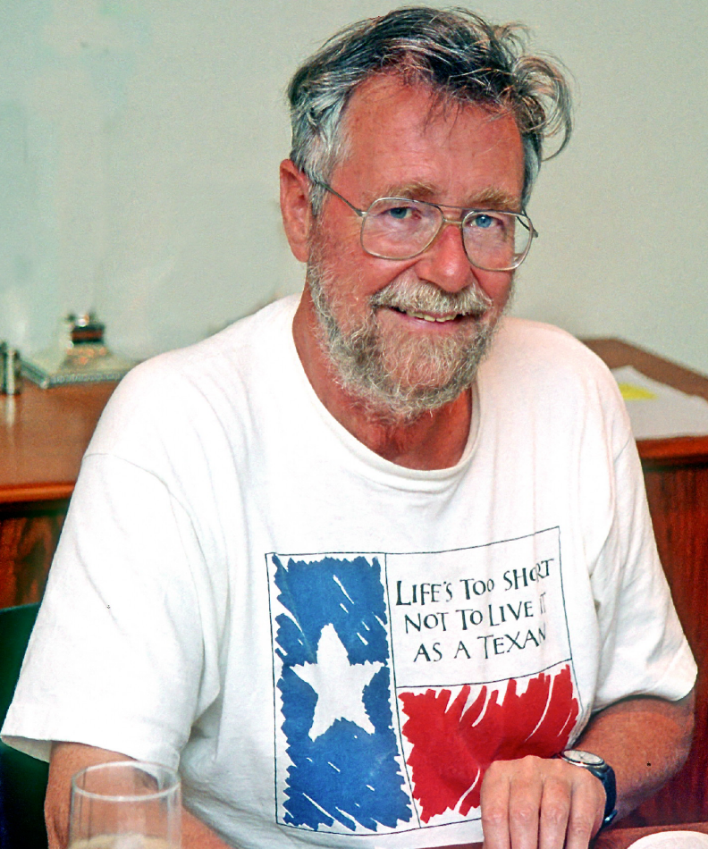
Positive Weighted Shortest Path
Edges in graph are weighted and all weights are positive
Similar solution to unweighted shortest path
Dijkstra's algorithm
Edsger W. Dijkstra, 1930–2002
UT Professor 1984 - 2000
Algorithm developed in 1956 and published in 1959.
other algorithms developed independently around this time

Slide 53
Dijkstra on Creating the Algorithm
What is the shortest way to travel from Rotterdam to Groningen, in general: from given city to given city. It is the algorithm for the shortest path, which I designed in about twenty minutes. One morning I was shopping in Amsterdam with my young fiancée, and tired, we sat down on the café terrace to drink a cup of coffee and I was just thinking about whether I could do this, and I then designed the algorithm for the shortest path. As I said, it was a twenty-minute invention. In fact, it was published in ’59, three years later. The publication is still readable, it is, in fact, quite nice. One of the reasons that it is so nice was that I designed it without pencil and paper. I learned later that one of the advantages of designing without pencil and paper is that you are almost forced to avoid all avoidable complexities. Eventually that algorithm became, to my great amazement, one of the cornerstones of my fame.
— Edsger Dijkstra, in an interview with Philip L. Frana, Communications of the ACM, 2001 (wiki page on the algorithm)

Slide 54
Vertex Class (nested in Graph)
private static class Vertex
private String name;
private List<Edge> adjacent;
public Vertex(String n)
// for shortest path algorithms
private double distance;
private Vertex prev;
private int scratch;
// call before finding new paths
public void reset()

Slide 55
Dijkstra's Algorithm
Pick the start vertex
Set the distance of the start vertex to 0 and all other vertices to INFINITY
While there are unvisited vertices:
Let the current vertex be the vertex with the lowest cost path from start to it that has not yet been visited
mark current vertex as visited
for each edge from the current vertex
if the sum of the cost of the current vertex and the cost of the edge is less than the cost of the destination vertex
update the cost of the destination vertex
set the previous of the destination vertex to the current vertex
enqueue this path (not vertex) to the priority queue
THIS IS NOT VISITING THE NEIGHBORING VERTEX

Slide 56
Dijkstra's Algorithm
Example of a Greedy Algorithm
A Greedy Algorithm does what appears to be the best thing at each stage of solving a problem
Gives best solution in Dijkstra's Algorithm
Does NOT always lead to best answer
Fair teams:
(10, 10, 8, 8, 8), 2 teams
Making change with fewest coins
(1, 5, 10) 15 cents
(1, 5, 12) 15 cents

Slide 57
7
C
3
3
F
4
B
21
1
D
6
A
E
17
5
G
Clicker 6 - What is the cost of the lowest cost path from A to E?
5
17
20
28
37

Slide 58






7
C
3
$$∞$$
3
F
$$∞$$
4
B
21
1
$$∞$$
6
D
A
$$∞$$
E
0
17
5
$$∞$$
G
A is start vertex
Set cost of A to 0, all others to INFINITY
Place A in a priority queue
$$∞$$

Slide 59







7
C
3
$$∞$$
3
F
$$∞$$
4
B
21
1
$$∞$$
6
D
A
$$∞$$
E
$$0$$
$$∞$$
17
5
G
[(A,0)] pq
dequeue (A,0)
Mark A as visited
$$∞$$

Slide 60
7
C
3
$$∞$$
3
F
$$∞$$
4
B
21
1
$$∞$$
6
D
A
$$∞$$
E
$$0$$
$$∞$$
17
5
[ ] pq
current vertex A:
loop through A's edges
if sum of cost from A to dest is less than current cost
update cost and prev
G
$$∞$$

Slide 61






7
C
3
$$7$$
3
F
$$∞$$
4
B
21
1
$$∞$$
6
D
A
$$∞$$
E
$$0$$
17
5
$$∞$$
[ ] pq
A -> C, 0 + 7 < INFINITY
[(C,7)] pq
G
$$∞$$

Slide 62





7
C
3
$$7$$
3
F
$$∞$$
4
B
21
1
$$1$$
6
D
A
$$∞$$
E
$$0$$
$$∞$$
17
5
[(C,7)] pq
A -> B, 0 + 1 < INFINITY
[(B,1), (C, 7)] pq (Note, the (B,1) jumps in front of (C,7)
G
$$∞$$

Slide 63





7
C
3
$$7$$
3
F
$$∞$$
4
B
21
1
$$1$$
6
D
A
$$∞$$
E
$$0$$
$$∞$$
17
5
[(B,1), (C, 7)] pq
A -> G, 0 + 17 < INFINITY
[(B,1), (C, 7), (G, 17)] pq
G
$$17$$

Slide 64





7
C
3
$$7$$
3
F
$$∞$$
4
B
21
1
$$1$$
6
D
A
$$∞$$
E
$$0$$
$$∞$$
17
5
[(B,1), (C, 7), (G, 17)] pq
current vertex B:
loop through B's edges
if sum of cost from B to edge is less than current cost
update cost and prev
G
$$17$$

Slide 65

7
7
C
C
3
3
$$4$$
3
3
F
F
$$∞$$
4
4
21
B
21
1
B
1
$$1$$
6
D
6
D
A
A
$$∞$$
E
E
$$0$$
$$∞$$
5
17
5
17
[(C, 7), (G, 17)] pq
B -> C, 1 + 3 < 7
update C's cost and previous
[(C, 4), (C, 7), (G, 17)] pq
G
G
$$17$$

Slide 66

7
7
C
C
3
3
$$4$$
3
3
F
F
$$∞$$
4
4
21
B
21
1
B
1
$$1$$
6
D
6
D
A
A
$$22$$
E
E
$$0$$
$$∞$$
5
17
5
17
G
G
[(C, 4), (C, 7), (G, 17)] pq
B -> D, 1 + 21 < INFINITY
[(C, 4), (C, 7), (G, 17), (D, 22)] pq
$$17$$

Slide 67
7
7
C
C
3
3
$$4$$
3
3
F
F
$$∞$$
4
4
21
B
21
1
B
1
$$1$$
6
D
6
D
A
A
$$22$$
E
E
$$0$$
$$∞$$
5
17
5
17
G
G
$$17$$
[(C, 4), (C, 7), (G, 17), (D, 22)] pq
current vertex is C, cost 4
loop through C's edges

Slide 68
7
7
C
C
3
3
$$4$$
3
3
F
F
$$∞$$
4
4
21
B
21
1
B
1
$$1$$
6
D
6
D
A
A
$$22$$
E
E
$$0$$
$$∞$$
5
17
5
17
G
G
$$17$$
[(C, 7), (G, 17), (D, 22)] pq
C -> A, 7 + 4 !< 0, skip

Slide 69
7
7
C
C
3
3
$$4$$
3
3
F
F
$$∞$$
4
4
21
B
21
1
B
1
$$1$$
6
D
6
D
A
A
$$22$$
E
E
$$0$$
$$∞$$
5
17
5
17
G
G
$$17$$
[(C, 7), (G, 17), (D, 22)] pq
C -> B, 4 + 3 !< 1, skip

Slide 70

7
7
7
C
C
C
3
3
3
$$4$$
3
3
3
F
F
F
$$7$$
4
4
4
21
21
B
21
B
1
B
1
1
$$1$$
6
6
D
6
D
D
A
A
A
$$22$$
E
E
E
$$0$$
$$∞$$
5
5
17
5
17
17
G
G
G
$$17$$
[(C, 7), (G, 17), (D, 22)] pq
C -> F, 4 + 3 < INFINITY
[(C, 7), (F, 7), (G, 17), (D, 22)] pq

Slide 71
7
7
7
C
C
C
3
3
3
$$4$$
3
3
3
F
F
F
$$7$$
4
4
4
21
21
B
21
B
1
B
1
1
$$1$$
6
6
D
6
D
D
A
A
A
$$22$$
E
E
E
$$0$$
$$∞$$
5
5
17
5
17
17
G
G
G
$$17$$
[(C, 7), (F, 7), (G, 17), (D, 22)] pq
current vertex is C
Already visited so skip

Slide 72
7
7
7
7
C
C
C
C
3
3
3
3
$$4$$
3
3
3
3
F
F
F
F
$$7$$
4
4
4
4
21
21
21
B
21
B
B
1
B
1
1
1
$$1$$
6
6
6
D
6
D
D
D
A
A
A
A
$$22$$
E
E
E
E
$$0$$
$$∞$$
5
5
5
17
5
17
17
17
G
G
G
G
$$17$$
[(F, 7), (G, 17), (D, 22)] pq
current vertex is F
loop through F's edges

Slide 73
7
7
7
7
C
C
C
C
3
3
3
3
$$4$$
3
3
3
3
F
F
F
F
$$7$$
4
4
4
4
21
21
21
B
21
B
B
1
B
1
1
1
$$1$$
6
6
6
D
6
D
D
D
A
A
A
A
$$22$$
E
E
E
E
$$0$$
$$∞$$
5
5
5
17
5
17
17
17
G
G
G
G
$$17$$
[(G, 17), (D, 22)] pq
F -> C, 7 + 3 !< 4, so skip

Slide 74

7
7
7
7
7
C
C
C
C
C
3
3
3
3
3
$$4$$
3
3
3
3
3
F
F
F
F
F
$$7$$
4
4
4
4
4
21
21
21
21
B
21
B
B
B
1
B
1
1
1
1
$$1$$
6
6
6
6
D
6
D
D
D
D
A
A
A
A
A
$$11$$
E
E
E
E
E
$$0$$
$$∞$$
5
5
5
5
17
5
17
17
17
17
G
G
G
G
[(G, 17), (D, 22)] pq
F -> D, 7 + 4 < 22
update D's cost and previous
[(D, 11), (G, 17), (D, 22)] pq
G
$$17$$

Slide 75
Aside - Implementing Dijkstra's
Create a Path class to allow for multiple paths and distances (costs) to a given vertex
private static class Path
implements Comparable<Path> {
private Vertex dest;
private double cost;
Use a priority queue of Paths to store the vertices and distances

Slide 76
Why? References!!!
Slide 74 and 78, adding new, lower cost path to Vertex D
Abstractly: [(G, 17), (D, 22)] becomes [(D, 11) (G, 17), (D, 22)]
What does priority queue store? References to Vertex Objects
[ , ]
Vertex
Vertex
name G
name D
distance 17
distance 22

Slide 77
Lower Cost Path to D
New, lower cost path to D. Alter Vertex D's distance to 11 and add to priority queue
[ , , ]
PROBLEMS?????
Abstractly [(D, 11), (G, 17), (D, 11)]
Vertex
Vertex
name G
name D
distance 17
distance 11

Slide 78
7
7
7
7
7
C
C
C
C
C
3
3
3
3
3
$$4$$
3
3
3
3
3
F
F
F
F
F
$$7$$
4
4
4
4
4
21
21
21
21
B
21
B
B
B
1
B
1
1
1
1
$$1$$
6
6
6
6
D
6
D
D
D
D
A
A
A
A
A
$$11$$
E
E
E
E
E
$$0$$
$$∞$$
5
5
5
5
17
5
17
17
17
17
G
G
G
G
G
[(D, 11), (G, 17), (D, 22)] pq
current vertex is D
loop through D's edges
$$17$$

Slide 79
7
7
7
7
7
C
C
C
C
C
3
3
3
3
3
$$4$$
3
3
3
3
3
F
F
F
F
F
$$7$$
4
4
4
4
4
21
21
21
21
B
21
B
B
B
1
B
1
1
1
1
$$1$$
6
6
6
6
D
6
D
D
D
D
A
A
A
A
A
$$11$$
E
E
E
E
E
$$0$$
$$∞$$
5
5
5
5
17
5
17
17
17
17
G
G
G
G
G
[(G, 17), (D, 22)] pq
D -> B, 11 + 21 !< 1, so skip
$$17$$

Slide 80

7
7
7
7
7
C
C
C
C
C
3
3
3
3
3
$$4$$
3
3
3
3
3
F
F
F
F
F
$$7$$
4
4
4
4
4
21
21
21
21
B
21
B
B
B
1
B
1
1
1
1
$$1$$
6
6
6
6
D
6
D
D
D
D
A
A
A
A
A
$$11$$
E
E
E
E
E
$$0$$
$$17$$
5
5
5
5
17
5
17
17
17
17
G
G
G
G
G
[(G, 17), (D, 22)] pq
D -> E, 11 + 6 < INFINITY
update E's cost and previous
[(G, 17), (E, 17), (D, 22)] pq
$$17$$

Slide 81
7
7
7
7
7
C
C
C
C
C
3
3
3
3
3
$$4$$
3
3
3
3
3
F
F
F
F
F
$$7$$
4
4
4
4
4
21
21
21
21
B
21
B
B
B
1
B
1
1
1
1
$$1$$
6
6
6
6
D
6
D
D
D
D
A
A
A
A
A
$$11$$
E
E
E
E
E
$$0$$
$$17$$
5
5
5
5
17
5
17
17
17
17
G
G
G
G
G
[ (G, 17), (E, 17), (D, 22)] pq
D -> F, 4 + 11 !< 7, so skip
$$17$$

Slide 82

7
7
7
7
7
7
C
C
C
C
C
C
3
3
3
3
3
3
$$4$$
3
3
3
3
3
3
F
F
F
F
F
F
$$7$$
4
4
4
4
4
4
21
21
21
21
21
B
21
B
B
B
B
1
B
1
1
1
1
1
$$1$$
6
6
6
6
6
D
6
D
D
D
D
D
A
A
A
A
A
A
$$11$$
E
E
E
E
E
E
$$0$$
$$17$$
5
5
5
5
5
17
5
17
17
17
17
17
G
G
G
G
G
G
[(G, 17), (E, 17), (D, 22)] pq
D -> G, 11 + 5 < 17
update G's cost and previous
[(G, 16), (G, 17), (E, 17), (D, 22)] pq
$$16$$

Slide 83
7
7
7
7
7
7
7
C
C
C
C
C
C
C
3
3
3
3
3
3
3
$$4$$
3
3
3
3
3
3
3
F
F
F
F
F
F
F
$$7$$
4
4
4
4
4
4
4
21
21
21
21
21
21
B
21
B
B
B
B
B
1
B
1
1
1
1
1
1
$$1$$
6
6
6
6
6
6
D
6
D
D
D
D
D
D
A
A
A
A
A
A
A
$$11$$
E
E
E
E
E
E
E
$$0$$
$$17$$
5
5
5
5
5
5
17
5
17
17
17
17
17
17
G
G
G
G
G
G
G
[(G, 17), (E, 17), (D, 22)] pq
current vertex is G
loop though edges, already visited all neighbors
$$16$$

Slide 84
7
7
7
7
7
7
7
C
C
C
C
C
C
C
3
3
3
3
3
3
3
$$4$$
3
3
3
3
3
3
3
F
F
F
F
F
F
F
$$7$$
4
4
4
4
4
4
4
21
21
21
21
21
21
B
21
B
B
B
B
B
1
B
1
1
1
1
1
1
$$1$$
6
6
6
6
6
6
D
6
D
D
D
D
D
D
A
A
A
A
A
A
A
$$11$$
E
E
E
E
E
E
E
$$0$$
$$17$$
5
5
5
5
5
5
17
5
17
17
17
17
17
17
G
G
G
G
G
G
G
[(E, 17), (D, 22)] pq
current vertex is E
loop though edges, already visited all neighbors
$$16$$

Slide 85
7
7
7
7
7
7
7
C
C
C
C
C
C
C
3
3
3
3
3
3
3
$$4$$
3
3
3
3
3
3
3
F
F
F
F
F
F
F
$$7$$
4
4
4
4
4
4
4
21
21
21
21
21
21
B
21
B
B
B
B
B
1
B
1
1
1
1
1
1
$$1$$
6
6
6
6
6
6
D
6
D
D
D
D
D
D
A
A
A
A
A
A
A
$$11$$
E
E
E
E
E
E
E
$$0$$
$$17$$
5
5
5
5
5
5
17
5
17
17
17
17
17
17
G
G
G
G
G
G
G
No unvisited vertices.
Each Vertex stores cost (distance) of lowest cost
path from start Vertex to itself and previous vertex
in path from start vertex to itself.
$$16$$

Slide 86
Alternatives to Dijkstra's Algorithm
A*, pronounced "A Star"
A heuristic, goal of finding shortest weighted path from single start vertex to goal vertex
Uses actual distance like Dijkstra's but also estimates remaining cost or distance
distance is set to current distance from start PLUS the estimated distance to the goal
For example when finding a path between towns, estimate the remaining distance as the straight-line (as the crow flies) distance between current location and goal.

Slide 87
Spanning Tree
Spanning Tree: A tree of edges that connects all the vertices in a graph
7
C
3
3
F
4
B
21
1
D
6
A
E
17
5
G

Slide 88
Clicker 7 - Minimum Spanning Tree
Minimum Spanning Tree: A spanning tree in a weighted graph with the lowest total cost
used in network design, taxonomy, Image registration, and more!
Cost of spanning tree shown? A. 6
B. 7 C. 29 D. 61
E. None of These Is it a MST for the graph?
7
C
3
3
F
4
B
21
1
D
6
A
E
17
5
G

Slide 89
Prim's Algorithm
Initially created by Vojtěch Jarník
Rediscovered by Prim (of Sweetwater, TX) and Dijkstra
Pick a vertex arbitrarily from graph
In other words, it doesn't matter which one
Add lowest cost edge between the tree and a vertex that is not part of the tree UNTIL every vertex is part of the tree
Greedy Algorithm, very similar to Dijkstra's

Slide 90
Prim's Algorithm
2
A
B
4
11
3
2
C
D
E
2
7
8
4
6
5
F
G
1
Pick D as root

Slide 91
Prim's Algorithm
2
A
B
4
11
3
2
C
D
E
2
7
8
4
6
5
F
G
1
Lowest cost edge from tree to vertex not in Tree? 2 from D to A (or C)

Slide 92
Prim's Algorithm
2
A
B
4
11
3
2
C
D
E
2
7
8
4
6
5
F
G
1
Lowest cost edge from tree to vertex not in Tree? 2 from D to C (OR from A to B)

Slide 93
Prim's Algorithm
2
A
B
4
11
3
2
C
D
E
2
7
8
4
6
5
F
G
1
Lowest cost edge from tree to vertex not in Tree? 2 from A to B

Slide 94
Prim's Algorithm
2
A
B
4
11
3
2
C
D
E
2
7
8
4
6
5
F
G
1
Lowest cost edge from tree to vertex not in Tree? 5 from D to G

Slide 95
Prim's Algorithm
2
A
B
4
11
3
2
C
D
E
2
7
8
4
6
5
F
G
1
Lowest cost edge from tree to vertex not in Tree? 1 from G to F

Slide 96
Prim's Algorithm
2
A
B
4
11
3
2
C
D
E
2
7
8
4
6
5
F
G
1
Lowest cost edge from tree to vertex not in Tree? 6 from G to E

Slide 97
Prim's Algorithm
7
C
3
3
F
4
B
21
1
D
6
A
E
17
5
G
Pick D as root

Slide 98
Prim's Algorithm
7
C
3
3
F
4
B
21
1
D
6
A
E
17
5
G
Lowest cost edge from tree to vertex not in Tree? 4 from D to F

Slide 99
Prim's Algorithm
7
C
3
3
F
4
B
21
1
D
6
A
E
17
5
G
Lowest cost edge from tree to vertex not in Tree?
3 from F to C

Slide 100
Prim's Algorithm
7
C
3
3
F
4
B
21
1
D
6
A
E
17
5
G
Lowest cost edge from tree to vertex not in Tree?
3 from C to B

Slide 101
Prim's Algorithm
7
C
3
3
F
4
B
21
1
D
6
A
E
17
5
G
Lowest cost edge from tree to vertex not in Tree?
1 from B to A

Slide 102
Prim's Algorithm
7
C
3
3
F
4
B
21
1
D
6
A
E
17
5
G
Lowest cost edge from tree to vertex not in Tree?
5 from D to G

Slide 103
Prim's Algorithm
7
C
3
3
F
4
B
21
1
D
6
A
E
17
5
G
Lowest cost edge from tree to vertex not in Tree?
6 from D to E

Slide 104
Prim's Algorithm
7
C
3
3
F
4
B
21
1
D
6
A
E
17
5
G
Cost of Spanning Tree?

Slide 105
Other Graph Algorithms
Lots!
http://en.wikipedia.org/wiki/Category:Graph_algorithms

