Slide 1
Topic 23
Hash Tables
"hash collision n. [from the techspeak] (var. `hash clash') When used of people, signifies a confusion in associative memory or imagination, especially a persistent one (see thinko).
True story: One of us was once on the phone with a friend about to move out to Berkeley. When asked what he expected Berkeley to be like, the friend replied: 'Well, I have this mental picture of naked people throwing Molotov cocktails, but I think that's just a collision in my hash tables.'"
-The Hacker's Dictionary

Slide 2


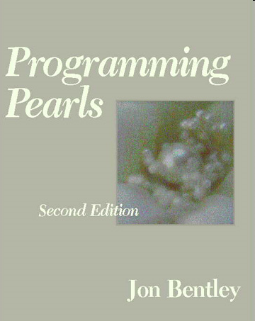
Programming Pearls by Jon Bentley
Jon was senior programmer on a large programming project.
Senior programmer spend a lot of time helping junior programmers.
Junior programmer to Jon: "I need help writing a sorting algorithm."

Slide 3
A Problem
From Programming Pearls (Jon in Italics)
  Why do you want to write your own sort at all? Why not use a sort provided by your system?
  I need the sort in the middle of a large system, and for obscure technical reasons, I can't use the system file-sorting program.
  What exactly are you sorting? How many records are in the file? What is the format of each record?
  The file contains at most ten million records; each record is a seven-digit integer.
  Wait a minute. If the file is that small, why bother going to disk at all? Why not just sort it in main memory?
  Although the machine has many megabytes of main memory, this function is part of a big system. I expect that I'll have only about a megabyte free at that point.
  Is there anything else you can tell me about the records?
  Each one is a seven-digit positive integer with no other associated data, and no integer can appear more than once.

Slide 4
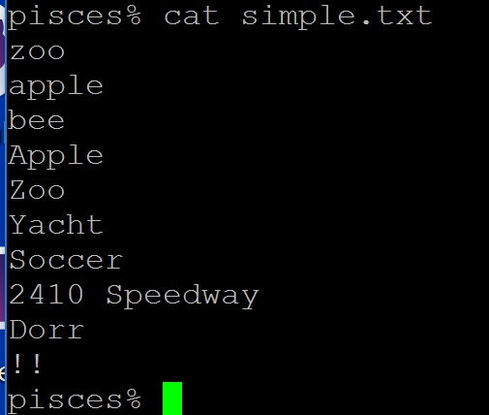
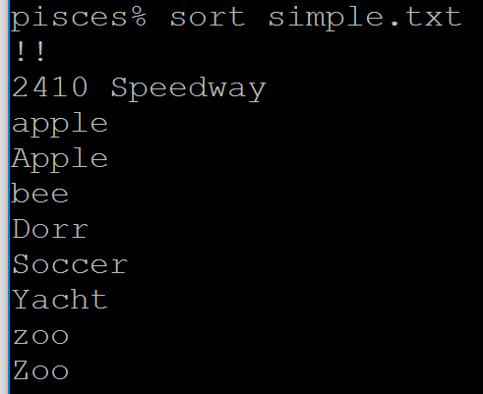
System Sort

Slide 5
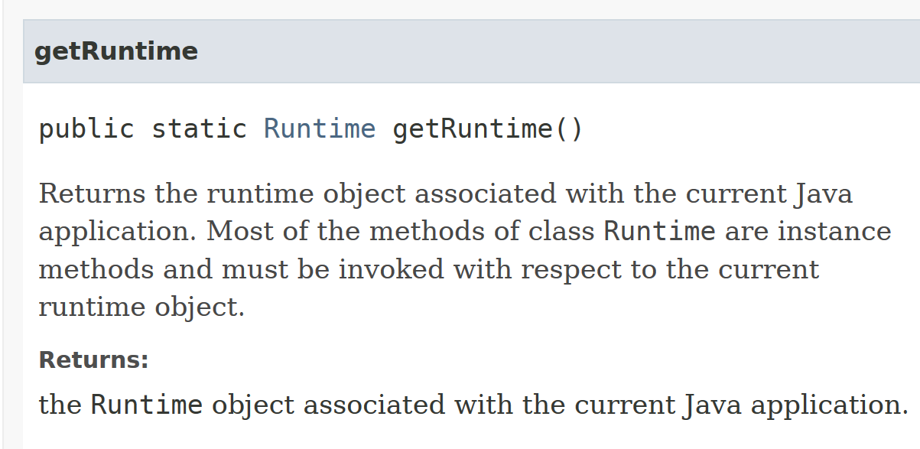
Starting Other Programs

Slide 6
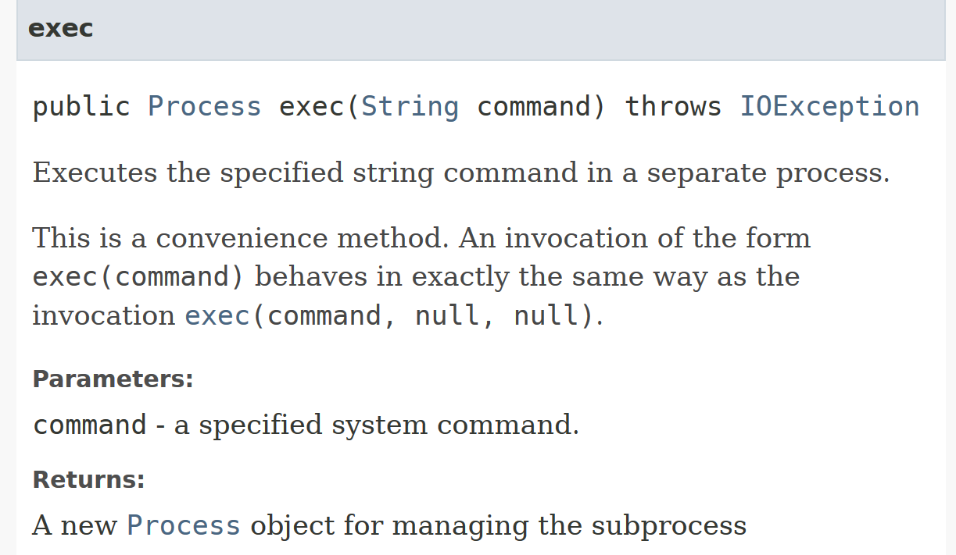
Starting Other Programs

Slide 7
Clicker 1 and 2
When did this conversation take place?
circa 1965
circa 1975
circa 1985
circa 1995
circa 2005
What were they sorting?
SSNs. B. Random values C. Street Addresses
D. Personal Incomes E. Phone Numbers

Slide 8
A Solution
  /* phase 1: initialize set to empty */
  for i = [0, n)
  bit[i] = 0
  /* phase 2: insert present elements into the set */
  for each num_in_file in the input file
  bit[num_in_file] = 1
  /* phase 3: write sorted output */
  for i = [0, n)
  if bit[i] == 1 write i on the output file

Slide 9
Some Structures so Far
ArrayLists
  O(1) access
  O(N) insertion (average case), better at end
  O(N) deletion (average case)
LinkedLists
  O(N) access
  O(N) insertion (average case), better at front and back
  O(N) deletion (average case), better at front and back
Binary Search Trees
  O(log N) access if balanced
  O(log N) insertion if balanced
  O(log N) deletion if balanced

Slide 10
Why are Binary Trees Better?
Divide and Conquer - splitting problem into smaller problems
Can we reduce the work by a bigger factor? 3? 10? More?
An ArrayList does this in a way when accessing elements
  but must use an integer value
  each position holds a single element
  given the index in an array, I can access that element rather quickly
  determining the address of the element requires a multiply op and an add op

Slide 11
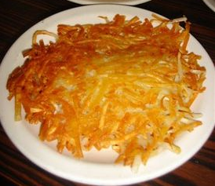
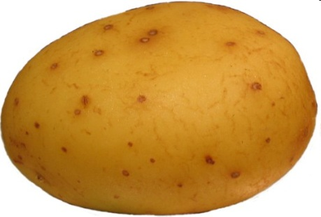
Hash Tables
Hash Tables maintaining the fast access of arrays but improve the order for insertion, and deletion compare to array based lists.
Hash tables use an array and hash functions to determine the index for each element.

Slide 12
Hash Functions
Hash: "From the French hatcher,
which means 'to chop'. "
to hash to mix randomly or shuffle (To cut up, to slash or hack about; to mangle)
Hash Function: Take a piece of data and transforms it to a different piece of data (typically smaller), usually a single integer.
  A function or algorithm
  The input need not be integers!

Slide 13

Hash Function
5/17/1971
555389085
Manchester, VT
12
"Mike Scott"
hash
function
mscott61729@gmail.com
"Kelly"
"Olivia"
"Isabelle"

Slide 14
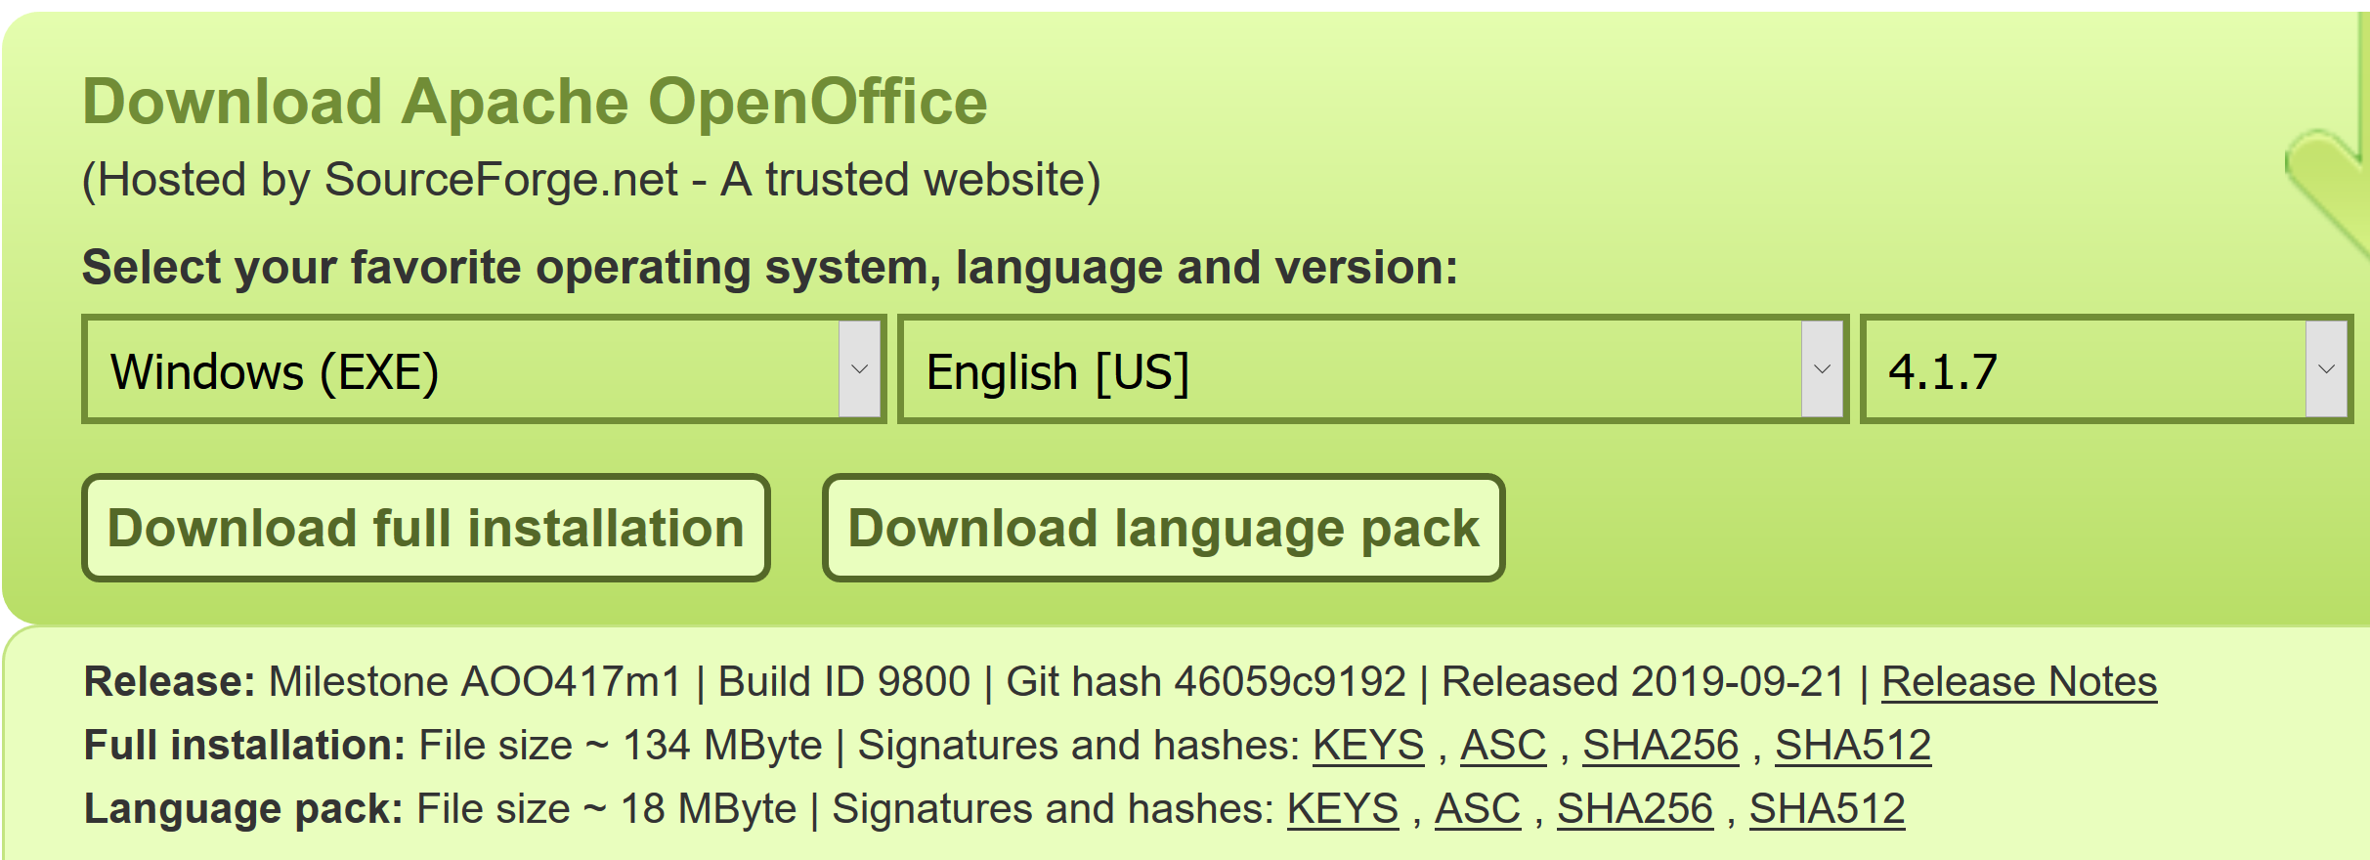
Hash Functions
Like a fingerprint
134 Megabytes

Slide 15
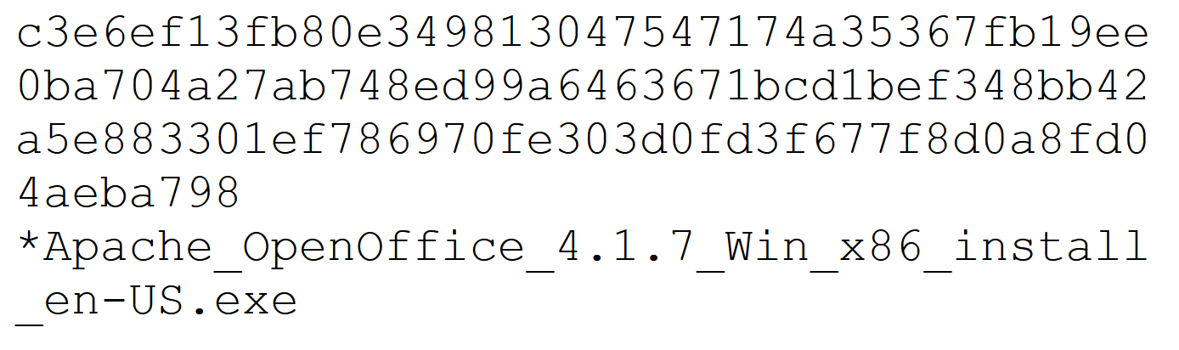
Hash Function
SHA 512 Hash code

Slide 16
Simple Example
Assume we are using names as our key
  take 3rd letter of name, take int value of letter
  (a = 0, b = 1, ...), divide by 6 and take remainder
What does "Bellers" hash to?
L -> 11 -> 11 % 6 = 5

Slide 17
Result of Hash Function
Mike = (10 % 6) = 4
Kelly = (11 % 6) = 5
Olivia = (8 % 6) = 2
Isabelle = (0 % 6) = 0
David = (21 % 6) = 3
Margaret = (17 % 6) = 5 (uh oh)
Wendy = (13 % 6) = 1
This is an imperfect hash function. A perfect hash function yields a one to one mapping from the keys to the hash values.
What is the maximum number of values this function can hash perfectly?

Slide 18
Clicker 3 - Hash Function
Assume the hash function for String adds up the Unicode value for each character.
public static int hashCode(String s) {
int result = 0;
for (int i = 0; i < s.length(); i++)
result += s.charAt(i);
return result;
}
Hashcode for "DAB" and "BAD"?
301 103
4 4
412 214
5 5
199 199

Slide 19
More on Hash Functions
transform the key (which may not be an integer) into an integer value
The transformation can use one of four techniques
  Mapping
  Folding
  Shifting
  Casting

Slide 20
Hashing Techniques
Mapping
  As seen in the example
  integer values or things that can be easily converted to integer values in key
Folding
  partition key into several parts and the integer values for the various parts are combined
  the parts may be hashed first
  combine using addition, multiplication, shifting, logical exclusive OR

Slide 21
Shifting
More complicated with shifting
  int hashVal = 0;
  int i = str.length() - 1;
  while(i > 0)
  { hashVal = (hashVal << 1) + (int) str.charAt(i);
  i--;
  }
  different answers for "dog" and "god"
Shifting may give a better range of hash values when compared to just folding
Casts
Very simple
  essentially casting as part of fold and shift when working with chars.

Slide 22
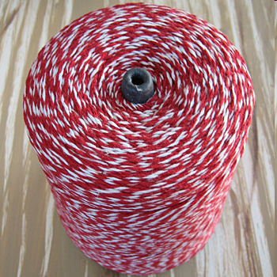
The Java String class hashCode method
public int hashCode() {
int h = hash;
if (h == 0 && value.length > 0) {
char[] val = value;
for (int i = 0; i < val.length; i++) {
h = 31 * h + val[i];
}
hash = h;
}
return h;
}

Slide 23
Mapping Results
Transform hashed key value into a legal index in the hash table
Hash table is normally uses an array as its underlying storage container
Normally get location on table by taking result of hash function, dividing by size of table, and taking remainder
  index = key mod n
  n is size of hash table
  empirical evidence shows a prime number is best
  10 element hash table, move up to 11 or 13 elements

Slide 24
Mapping Results
"Isabelle"
230492619
hashCode
method
230492619 % 997 = 177
0 1 2 3 .........177............ 996
"Isabelle"

Slide 25
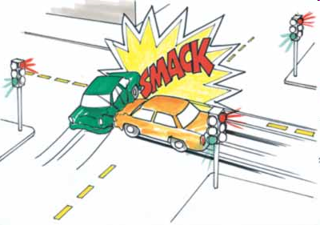
Handling Collisions
What to do when inserting an element and already something present?

Slide 26
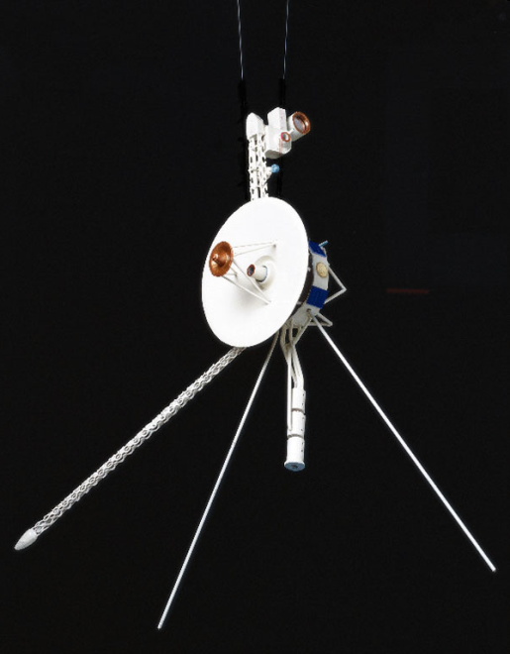
Open Addressing
Could search forward or backwards for an open space
Linear probing:
  move forward 1 spot. Open?, 2 spots, 3 spots
  reach the end?
  When removing, insert a blank
  null if never occupied, blank if once occupied
Quadratic probing
  1 spot, 2 spots, 4 spots, 8 spots, 16 spots
Resize when load factor reaches some limit

Slide 27
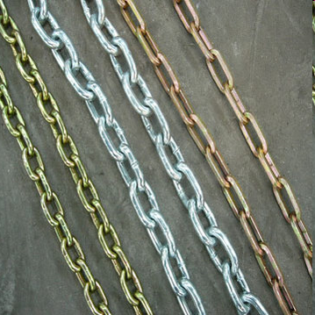
Closed Addressing: Chaining
Each element of hash table be another data structure
  linked list, balanced binary tree
  More space, but somewhat easier
  everything goes in its spot
What happens when resizing?
  Why don't things just collide again?

Slide 28
Hash Tables in Java
hashCode method in Object
hashCode and equals
  "If two objects are equal according to the equals (Object) method, then calling the hashCode method on each of the two objects must produce the same integer result. "
  if you override equals you need to override hashCode
Overriding one of equals and hashCode, but not the other, can cause logic errors that are difficult to track down if objects added to hash tables.

Slide 29
Hash Tables in Java
HashTable class
HashSet class
  implements Set interface with internal storage container that is a HashTable
  compare to TreeSet class, internal storage container is a Red Black Tree
HashMap class
  implements the Map interface, internal storage container for keys is a hash table

Slide 30
Comparison
Compare these data structures for speed:
Java HashSet
Java TreeSet
our naïve Binary Search Tree
our HashTable
Insert random ints

Slide 31
Clicker 4
What will be order from fastest to slowest?
HashSet TreeSet HashTable314 BST
HashSet HashTable314 TreeSet BST
TreeSet HashSet BST HashTable314
HashTable314 HashSet BST TreeSet
None of these

