Slide 1
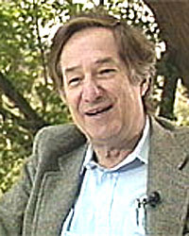
Topic 24
Tries
“In 1959, (Edward) Fredkin recommended
that BBN (Bolt, Beranek and Newman, now
BBN Technologies) purchase the very first
PDP-1 to support research projects at
BBN. The PDP-1 came with no software whatsoever.
Fredkin wrote a PDP-1 assembler called FRAP (Free of Rules Assembly Program);”
Tries were first described by René de la Briandais in File searching using variable length keys.

Slide 2
Clicker 1
How would you pronounce “Trie”
“tree”
“tri – ee”
“try”
“tiara”
something else

Slide 3
Tries aka Prefix Trees
Pronunciation:
From retrieval
Name coined by Computer Scientist
Edward Fredkin
Retrieval so “tree”
… but that is very confusing so most people pronounce it “try”

Slide 4
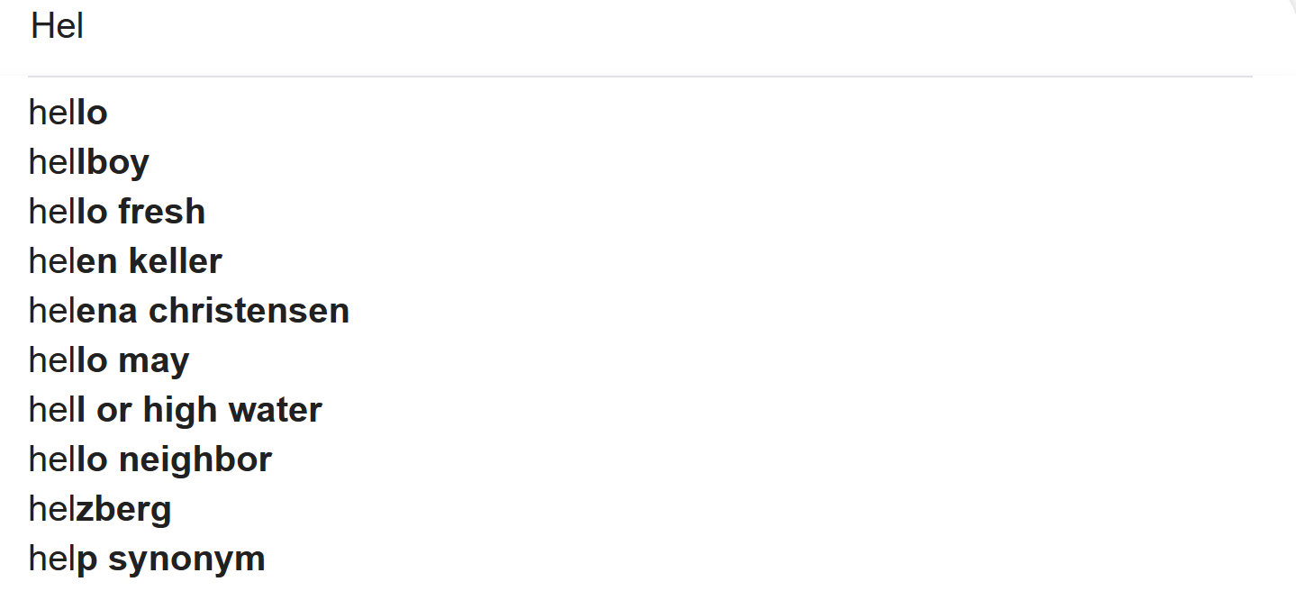
Predictive Text and AutoComplete
Search engines and texting applications guess what you want after typing only a few characters

Slide 5
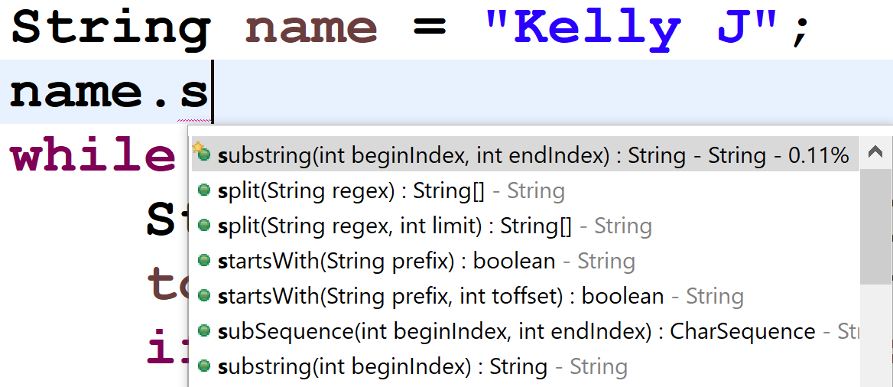
AutoComplete
So do other programs such as IDEs

Slide 6
Searching a Dictionary
How?
Could search a set for all values that start with the given prefix.
Naively O(N) (search the whole data structure).
Could improve if possible to do a binary search for prefix and then localize search to that location.

Slide 7
Tries
A general tree (more than 2 children possible)
Root node (or possibly a list of root nodes)
Nodes can have many children
  not a binary tree
In simplest form each node stores a character and a data structure (list?) to refer to its children
"Stores" all the words or phrases
in a dictionary.
How?

Slide 8
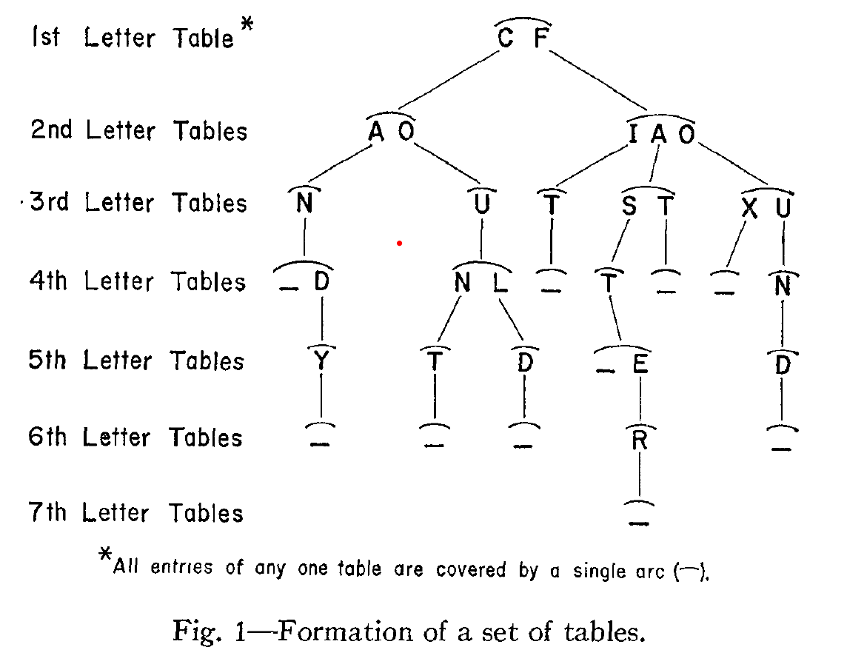
René de la Briandais Original Paper

Slide 9
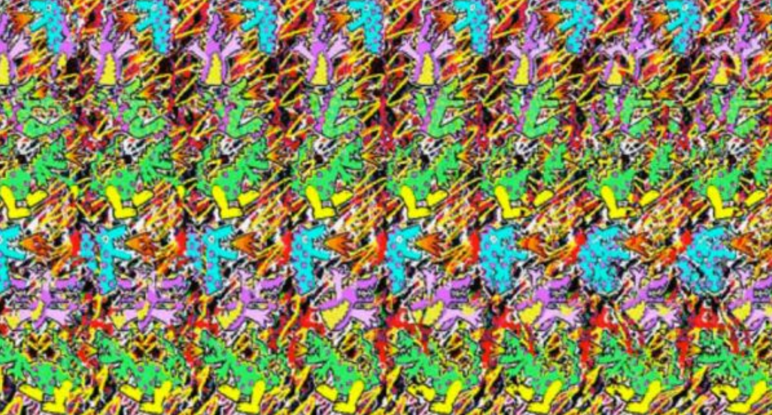
????

Slide 10
????
Picture of a Dinosaur

Slide 11

Fall 2022 - Ryan P.
Created with Procreate: https://procreate.art/

Slide 12
Can

Slide 13
Candy

Slide 14
Fox

Slide 15
Clicker 2
Is “fast” in the dictionary represented by this Trie?
No
Yes
It depends

Slide 16
Clicker 3
Is “fist” in the dictionary represented by this Trie?
No
Yes
It depends

Slide 17
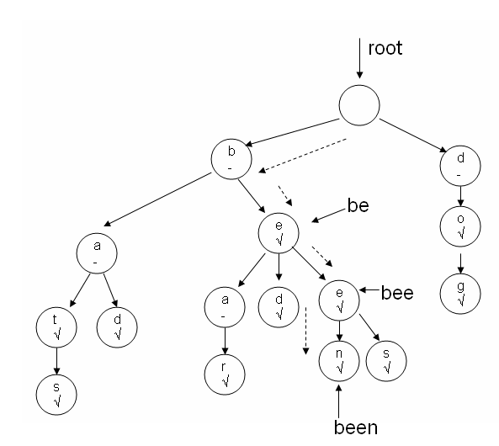
Tries
Another example of a Trie
Each node stores:
  A char
  A boolean indicating if the string ending at that node is a word
  A list of children

Slide 18
Predictive Text and AutoComplete
As characters are entered we descend the Trie
… and from the current node …
… we can descend to terminators and leaves to see all possible words based on current prefix
b, e, e -> bee, been, bees

Slide 19
Tries
Stores words and phrases.
  other values possible, but typically Strings
The whole word or phrase is not actually stored in a
single node.
… rather the path in the tree represents the word.

Slide 20
Implementing a Trie
public class Trie {
private TNode root;
private int size; // number of words
private int numNodes;
public Trie() {
root = new TNode();
numNodes = 1;

Slide 21
TNode Class
Basic implementation uses a LinkedList of TNode objects for children
Other options?
  ArrayList?
  Something more exotic?
private static class TNode {
private boolean word;
private char ch;
private LinkedList<TNode> children;

Slide 22
Basic Operations
Adding a word to the Trie
Getting all words with given prefix
Demo in IDE

Slide 23
Compressed Tries
Some words, especially long ones, lead to a chain of nodes with single child, followed by single child:
b
s
e
t
e
i
u
l
o
a
l
d
o
y
c
p
l
r
l
y
k

Slide 24
Compressed Trie
Reduce number of nodes, by having nodes store Strings
A chain of single child followed by single child (followed by single child … ) is compressed to a single node with that String
Does not have to be a chain that terminates in a leaf node
  Can be an internal chain of nodes

Slide 25
Original, Uncompressed
b
s
e
t
e
i
u
l
o
a
l
d
s
y
c
p
l
r
l
y
k

Slide 26
Compressed Version
b
s
ell
to
e
id
u
ck
p
ar
ll
sy
y
8 fewer nodes compared to uncompressed version
s – t – o – c - k

