Slide 1


Topic 25
Heaps
"You think you know when you can learn,
are more sure when you can write,
even more when you can teach,
but certain when you can program."
- Alan Perlis

Slide 2
Priority Queue
Recall priority queue
  elements enqueued based on priority
  dequeue removes the highest priority item
Options?
  List? Binary Search Tree? Clicker 1
  Array List enqueue BST enqueue
O(N) O(1)
O(N) O(logN)
O(N) O(N)
O(logN) O(logN)
O(1) O(logN)

Slide 3
Another Option
The heap data structure
  not to be confused with the runtime heap (portion of memory for dynamically allocated variables)
Typically a complete binary tree (variations with more than 2 children possible)
  all levels have maximum number of nodes except deepest where nodes are filled in from left to right
Maintains the heap order property
  in a min heap the value in the root of any subtree is less than or equal to all other values in the subtree

Slide 4
Clicker 2
In a max heap with no duplicates where is the largest value?
the root of the tree
in the left-most node
in the right-most node
a node in the lowest level
none of these

Slide 5
Example Min Heap
12
17
15
19
52
37
25
45
21

Slide 6
Add Operation
Add new element to next open spot in array
Swap with parent if new value is less
than parent
Continue back up the tree as long as the new value is less than new parent node

Slide 7
Add Example
Add 15 to heap (initially next left most node)
12
17
15
19
52
37
25
45
21
15

Slide 8
Add Example
Swap 15 and 52
12
17
15
19
15
37
25
45
21
52

Slide 9
Enqueue Example
Swap 15 and 17, then stop
12
15
15
19
17
37
25
45
21
52

Slide 10
Add Example
Insert the following values 1 at a time into a min heap:
16 9 5 8 13 8 8 5 5 19 27 9 3

Slide 11
Internal Storage
Interestingly heaps are often implemented with an array instead of nodes
for element at index i:
parent index: i / 2
left child index: i * 2
right child index: i * 2 + 1
12
17
15
19
52
37
25
45
21
0 1 2 3 4 5 6 7 8 9 10 11 12 13 14 15
12 17 15 19 52 37 25 45 21

Slide 12
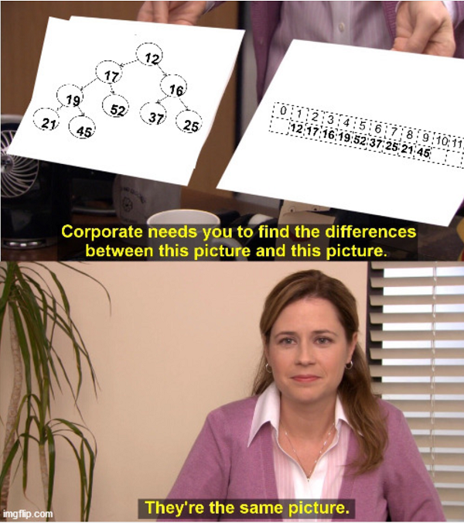
In Honor of
Elijah,
The Meme King,
Spring 2020

Slide 13
PriorityQueue Class
public class PriorityQueue<E extends Comparable<? super E>> {
private int size;
private E[] con;
public PriorityQueue() {
con = getArray(2);
}
private E[] getArray(int size) {
return (E[]) (new Comparable[size]);
}

Slide 14
PriorityQueue enqueue / add
public void enqueue(E val) {
if ( size >= con.length - 1 )
enlargeArray(con.length * 2);
size++;
int indexToPlace = size;
while ( indexToPlace > 1
&& val.compareTo( con[indexToPlace / 2] ) < 0 ) {
con[indexToPlace] = con[indexToPlace / 2]; // swap
indexToPlace /= 2; // change indexToPlace to parent
}
con[indexToPlace] = val;
}
private void enlargeArray(int newSize) {
E[] temp = getArray(newSize);
System.arraycopy(con, 1, temp, 1, size);
con = temp;
}

Slide 15
Enqueue / add Example
With Array Shown
Add 15 to heap
(initially next
left most node)
12
17
15
19
52
37
25
45
21
15
10 / 2 = 5 (index of parent)
0 1 2 3 4 5 6 7 8 9 10 11 12 13 14 15
12 17 15 19 52 37 25 45 21
15

Slide 16
Enqueue Example
With Array Shown
Swap 15 and 52
12
17
15
19
15
37
25
45
21
52
5 / 2 = 2 (index of parent)
0 1 2 3 4 5 6 7 8 9 10 11 12 13 14 15
12 17 15 19 15 37 25 45 21 52

Slide 17
Enqueue Example
With Array Shown
Swap 15 and 17
12
15
15
19
17
37
25
45
21
52
2 / 2 = 1 (index of parent)
0 1 2 3 4 5 6 7 8 9 10 11 12 13 14 15
12 15 15 19 17 37 25 45 21 52

Slide 18
Enqueue Example
With Array Shown
15 !< 12 -> DONE
12
15
15
19
17
37
25
45
21
52
2 / 1 = 1 (index of parent)
0 1 2 3 4 5 6 7 8 9 10 11 12 13 14 15
12 15 16 19 17 37 25 45 21 52

Slide 19
Remove -> remove 12
12
15
15
19
17
37
25
45
21
52

Slide 20
Remove / Dequeue
min value / front of queue is in root of tree
swap value from last node to root and move down swapping with smaller child unless values is smaller than both children

Slide 21
Dequeue Example
Swap 35
into root
(save 12
to return)
12
15
13
17
23
45
53
45
21
35
0 1 2 3 4 5 6 7 8 9 10 11 12 13 14 15
12 15 13 17 23 45 53 45 21 35

Slide 22
Dequeue Example
Swap 35
into root
(save 12
to return)
35
15
13
17
23
45
53
45
21
0 1 2 3 4 5 6 7 8 9 10 11 12 13 14 15
35 15 13 17 23 45 53 45 21

Slide 23
Dequeue Example
Min child?
1 * 2 = 2 -> 15
1 * 2 + 1 = 3 -> 13
Swap with 13
35
15
13
17
23
45
53
45
21
0 1 2 3 4 5 6 7 8 9 10 11 12 13 14 15
35 15 13 17 23 45 53 45 21

Slide 24
Dequeue Example
13
15
35
17
23
45
53
45
21
0 1 2 3 4 5 6 7 8 9 10 11 12 13 14 15
13 15 35 17 23 45 53 45 21

Slide 25
Dequeue Example
Min child?
3 * 2 = 6 -> 45
3 * 2 + 1 = 7 -> 53
Less than or equal to
both of my children!
Stop!
13
15
35
17
23
45
53
45
21
0 1 2 3 4 5 6 7 8 9 10 11 12 13 14 15
13 15 35 17 23 45 53 45 21

Slide 26
Dequeue Code
public E dequeue( ) {
E top = con[1];
int hole = 1;
boolean done = false;
while ( hole * 2 < size && ! done ) {
int child = hole * 2;
// see which child is smaller
if ( con[child].compareTo( con[child + 1] ) > 0 )
child++; // child now points to smaller
// is replacement value bigger than child?
if (con[size].compareTo( con[child] ) > 0 ) {
con[hole] = con[child];
hole = child;
}
else
done = true;
}
con[hole] = con[size];
size--;
return top;
}

Slide 27
Clicker 3 - PriorityQueue Comparison
Run a Stress test of PQ implemented with Heap and PQ implemented with BinarySearchTree
What will result be?
Heap takes half the time or less of BST
Heap faster, but not twice as fast
About the same
BST faster, but not twice as fast
BST takes half the time or less of Heap

Slide 28
Data Structures
Data structures we have studied
  arrays, array based lists, linked lists, maps, sets, stacks, queues, trees, binary search trees, graphs, hash tables, red-black trees, priority queues, heaps, tries
Most program languages have some built in data structures, native or library
Must be familiar with performance of data structures
  best learned by implementing them yourself

Slide 29
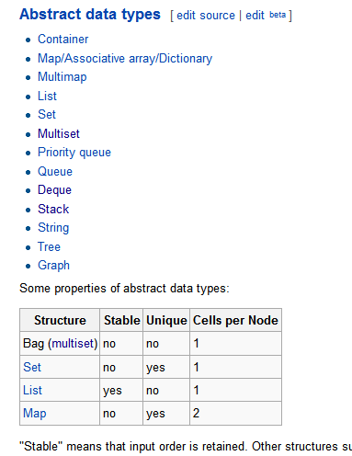
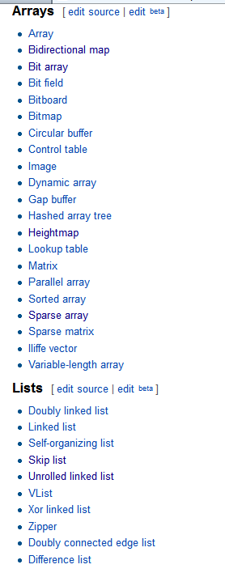
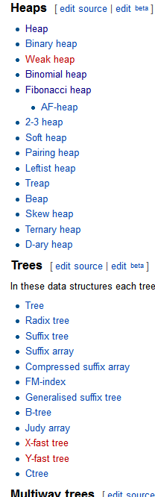
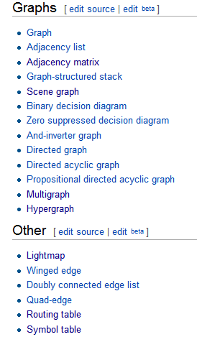
Data Structures
We have not covered every data structure
http://en.wikipedia.org/wiki/List_of_data_structures

Slide 30
Data Structures
deque, b-trees, quad-trees, binary space partition trees, skip list, sparse list, sparse matrix, union-find data structure, Bloom filters, AVL trees, 2-3-4 trees, and more!
Must be able to learn new and apply new data structures

