Slide 1
Mobile (Android) Computing CS371M
Concepts

Slide 2
Android, a mobile OS
Android is the world’s most popular mobile OS
  Controls phones, tablets, wearable

Slide 3
Working with a programming language
What does it mean to write idiomatic code?
  In Kotlin, try to avoid explicit null checks
  highScores.sortWith(compareByDescending<Score>{it.score}.thenBy{it.name})
  File("file.txt").copyTo(File("target_file.txt"));
Lateinit

Slide 4
How to succeed at programming
Start with casting spells
  Fake it till you make it
  Pattern match from other code
Manage your frustration
  Keep trying new angles
  Write notes
  Explain your problem in an email (don’t have to send it)
Am I doing things correctly and efficiently?
  Get something working quickly, then improve
  Move from one working version to the next (you can always roll back)
  Add functionality bit by bit

Slide 5
Android Project Checklist
Code up to date
Layout files up to date
Gradle file up to date, has proper dependences
AndroidManifest.xml
Drawables
Values, like strings and colors, styles, etc.

Slide 6
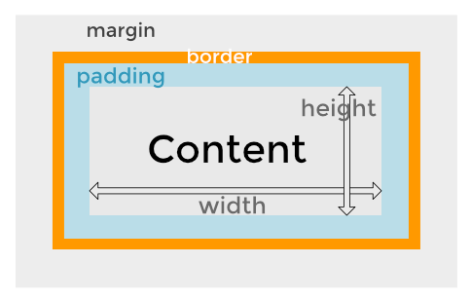
Widgets
https://kb.wpbeaverbuilder.com/article/81-margins-and-padding

Slide 7
View binding
XML layout has IDs, how do we use them?
Process is called view binding
Compiler puts IDs into a type safe structure
override fun onCreate(savedInstanceState: Bundle?) {
super.onCreate(savedInstanceState)
val activityMainBinding = ActivityMainBinding.inflate(layoutInflater)
setContentView(activityMainBinding.root)
setSupportActionBar(activityMainBinding.toolbar)
val contentMainBinding = activityMainBinding.contentMain
Inflate turns XML into objects (it is expensive)
viewBinding object has IDs from our layout

Slide 8
Starting a new Activity
Activities in Android control the screen
  Apps typically have several screens
    E.g., Game play, high scores, settings
Starting an activity > calling a function
  Android runtime constructs the new activity
    Eventually calls onCreate
  How do we pass parameters?
Returning from an activity isn’t a function return
  Where do we return to?

Slide 9
Intents: Specifying operations
An intent is an abstract description of an operation to be performed (Android docs)
  Implicit intent: abstract action (e.g., dial this number)
  Explicit intent: execute this class
Provides a mechanism to pass parameters
  Key/value bundles
Used on entry and exit of Activities
// Get the Intent that called for this Activity to open
val activityThatCalled = intent
// Get the data that was sent
val callingBundle = activityThatCalled.extras
callingTV.text = callingBundle?.getString("callingActivity")

Slide 10
Key-value stores
Key-value stores (or more generally, associative data structures)
  Bundles in Android
  Maps a key to a value
    Supports operations like lookup/get, insert/put, delete, and often iteration/scan
    They are the “index layer” of systems: they translate higher-level objects (records, blocks, metadata, sessions) into concrete locations and state.
They are everywhere, local and distributed
  Operating systems: page caches, inode/dentry caches, VM maps, routing tables.
  Storage engines/databases: indexes (e.g., by name), memtables, buffer pools.
  Distributed systems: membership/state map, metadata service, configuration store.
Example implementations
  Hash tables: fast point queries
    Strength: expected O(1) lookup/insert/delete for exact-match (key) operations.
    Key tradeoff: poor native support for ordered traversal and range queries (can be augmented).
  B-trees (and variants): ordered maps + range queries
    Strength: keys in sorted order, enabling range scans, prefix queries, ordered iteration.
    Typical use: database indexes, filesystem metadata, on-disk structures
    Key tradeoff: complex updates (splits/merges) + complex concurrency control

Slide 11
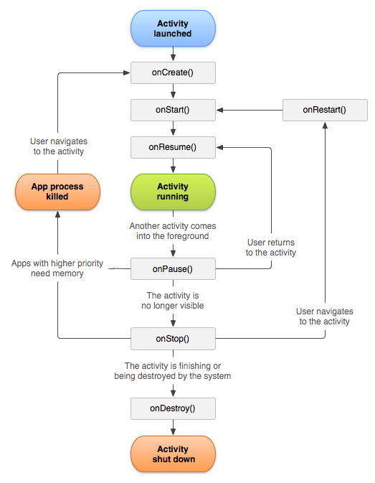
Activity lifetime
State machine for activities
  Android tells you about significant events
  Your app might want to clean up when it goes to the background
Trend away from explicit callbacks

Slide 12
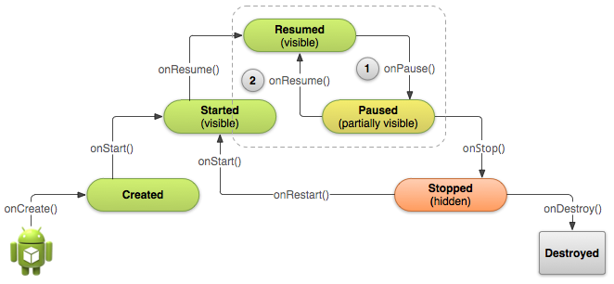
Activity lifecycle

Slide 13
Lists
Simple case: One widget == one program state
  A button has one onClickListener
  A slider is on or off
  A TextView contains a string
  Everything about these widgets is visible all the time
Lists
  Lists contain many elements
  Only some of them are on the screen at any time
  How do we deal with many items?
  How do we display lists efficiently?

Slide 14
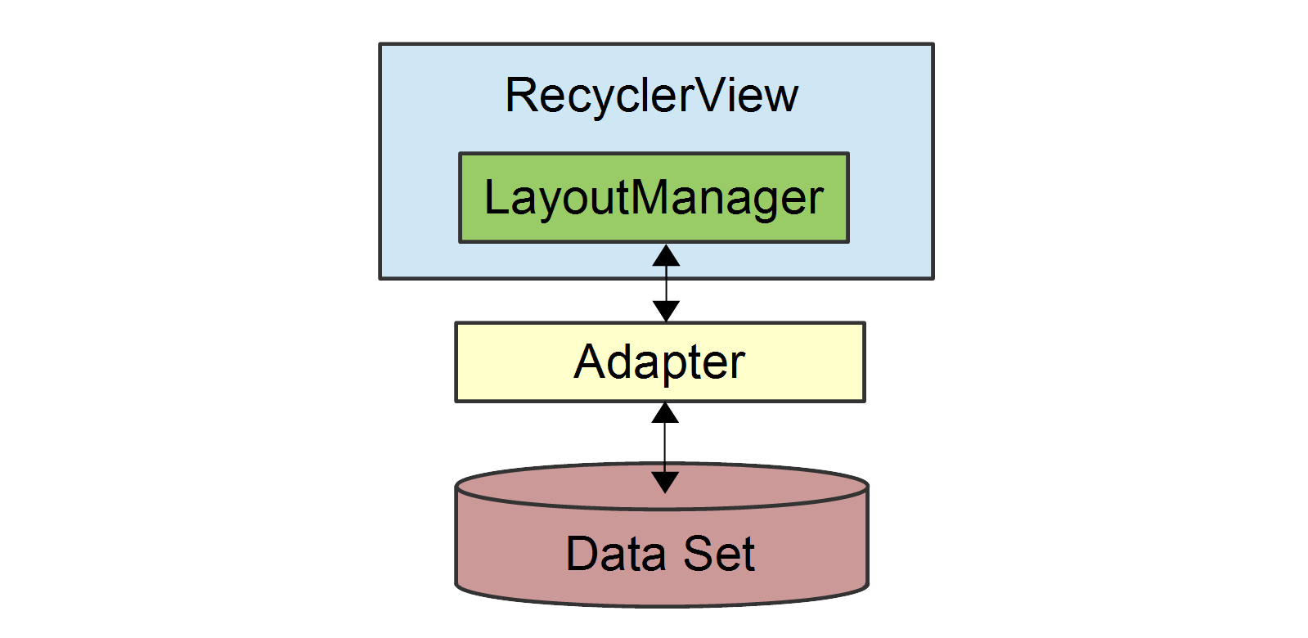
Recycler View
Recycler Views display lists
  Recycler View contains a LayoutManager
    Examples: Linear Layout, Grid Layout, etc.
    Managers can nest, e.g., horizontal layout inside a vertical
  Recycler Views only displays part of the list
    An Adapter sees the full list and the part of the list currently on screen
  Efficiency via ViewHolders
    If 6 list elements are visible on the screen at once, we have 6 ViewHolders
Many images from
https://learn.microsoft.com/en-us/xamarin/android/user-interface/layouts/recycler-view/parts-and-functionality

Slide 15
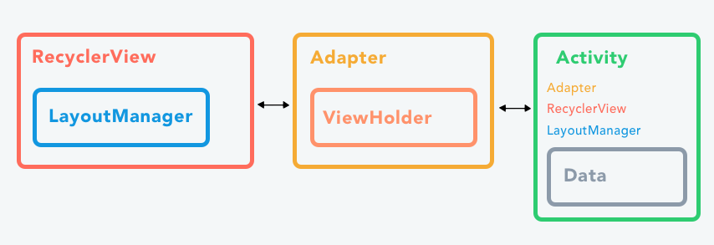
Can’t I just have a simple list?
Before Recycler View was List View
  Tried to be simple but failed
  To avoid API fatigue, we are jumping straight to RVs

Slide 16
Life is short, lists are long
Layout up to this point has been simple
  A TextView object might have some default text
  Then we change the text in our program
    textView.text = “Watch this space”
But how to we display a scrollable list of 100 items?
  recyclerView.list[1] = “Item 1” ????
  list = {“Item 0”, “Item 1”}; ???? screenView[1] = list[1] ????
Spoiler alert, not like this, but using the same concepts

Slide 17
Managing on-screen rows
What is a list on screen?
  A sequence of rows
How do I lay out a row?
  Use an XML file
How do I draw a row on screen?
  Inflate a view binding object
  E.g., row.xml becomes RowBinding
Inflation is expensive though, so recycle
  Put view binding in ViewHolder & recycle them as user scrolls

Slide 18
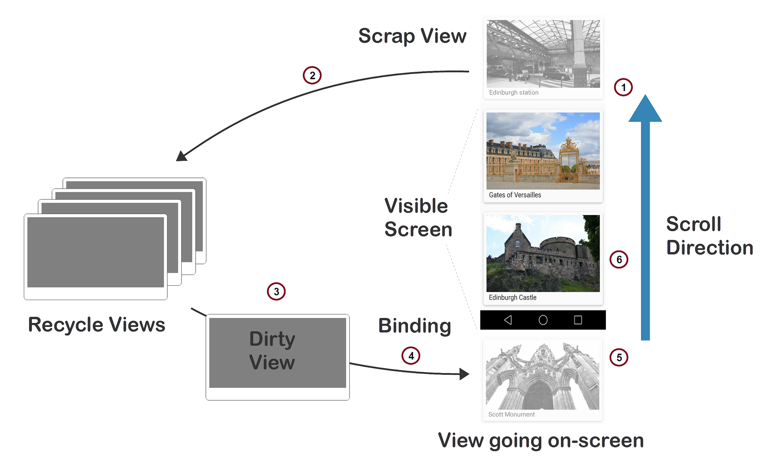
Limited pool of inflated views
Only inflate enough views to fill screen
ViewHolder

Slide 19
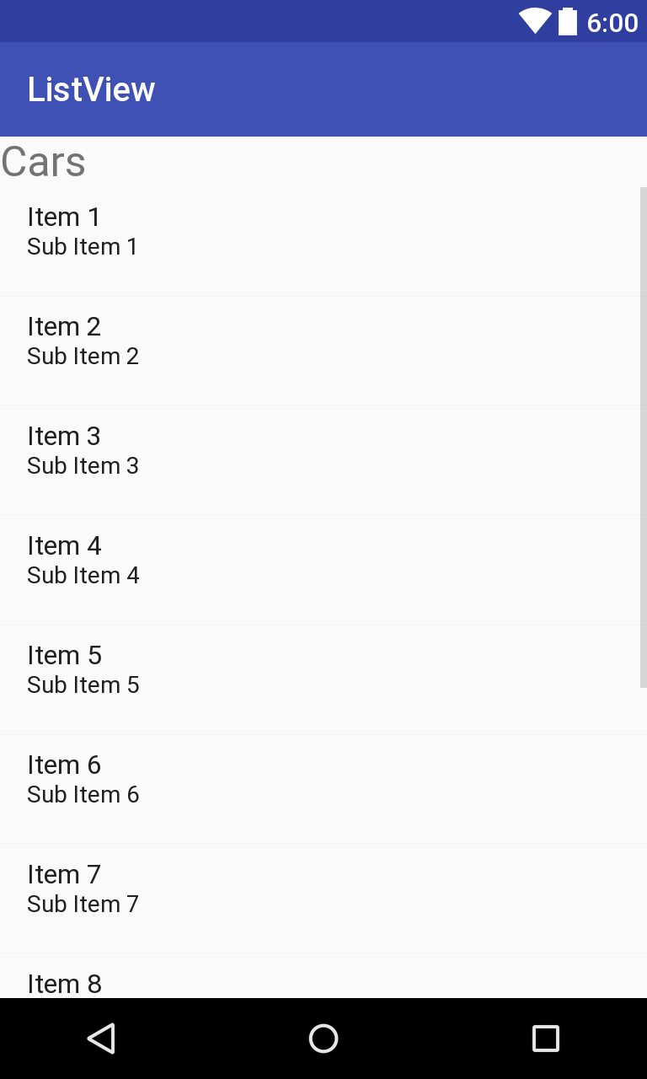
Adapting a list to your screen
The list is long and is in your code
  val list = List<Data>(100) {it}
  val list = repository.fetchData()
Some elements are on the screen
  E.g., 8 items in screen over here
The adapter marries your list to screen
  Manage 8 on-screen row views
  Inflate: create a view for an on-screen row
  Bind: Put list element 9 into a view holder
    This bind is different from view binding

Slide 20
Recycler View APIs
row.xml has the row layout
  Compiler generated RowBinding object via view binding
Inherit from RecyclerView.Adapter
  class RecyclerViewAdapter : RecyclerView.Adapter <RecyclerViewAdapter.VH>()
  But now must define inner VH class
ViewHolder holds view, which is in binding class
  inner class VH(val rowBinding: RowBinding)
  : RecyclerView.ViewHolder(rowBinding.root)
Inflate enough rows to fit on screen, no more
  onCreateViewHolder
Set holder.rowBinding to contents in list[position]
  onBindViewHolder(holder: VH, position: Int)

Slide 21
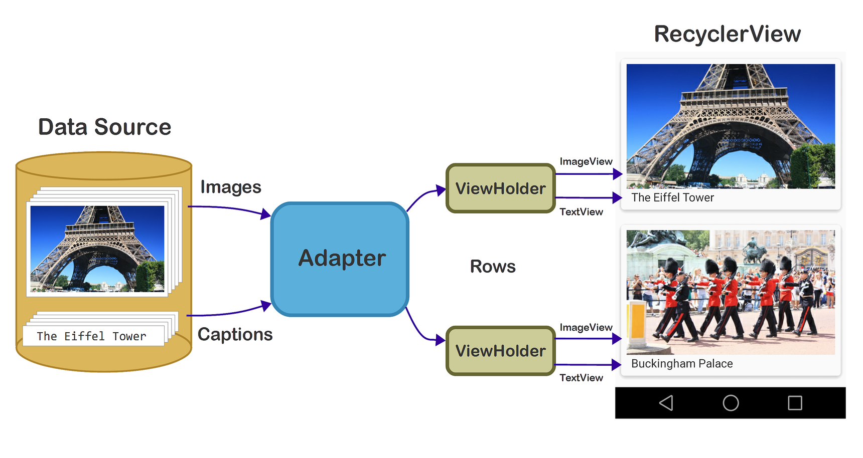
One more zoomed-out view

Slide 22
RecyclerView glossary
Row layout: XML file describing a row
Adapter: Views for on-screen rows from full list
Position: The position of a data item within the list
Inflate: XML→ View (uses view binding)
ViewHolder: View/binding for one on-screen row
Binding view holder: Put data for list element X into view holder when user scrolls to item X
Recycle: ViewHolders are reused as the user scrolls. Minimize inflation, which requires lots of CPU & memory

Slide 23
Why is activity/fragment killed?
1. You meant to navigate away permanently: The user navigates away or explicitly closes the activity — say by pushing the back button or triggering some code that calls finish(). The activity is permanently gone.
2. There is a configuration change: The user rotates the device or does some other configuration change. The activity needs to be immediately rebuilt.
3. The app is put in the background and its process is killed: This happens when the device is running low on memory and needs to quickly free some up. When the user navigates back to your app, the activity will need to be rebuilt.
https://medium.com/androiddevelopers/viewmodels-with-saved-state-jetpack-navigation-data-binding-and-coroutines-df476b78144e

Slide 24
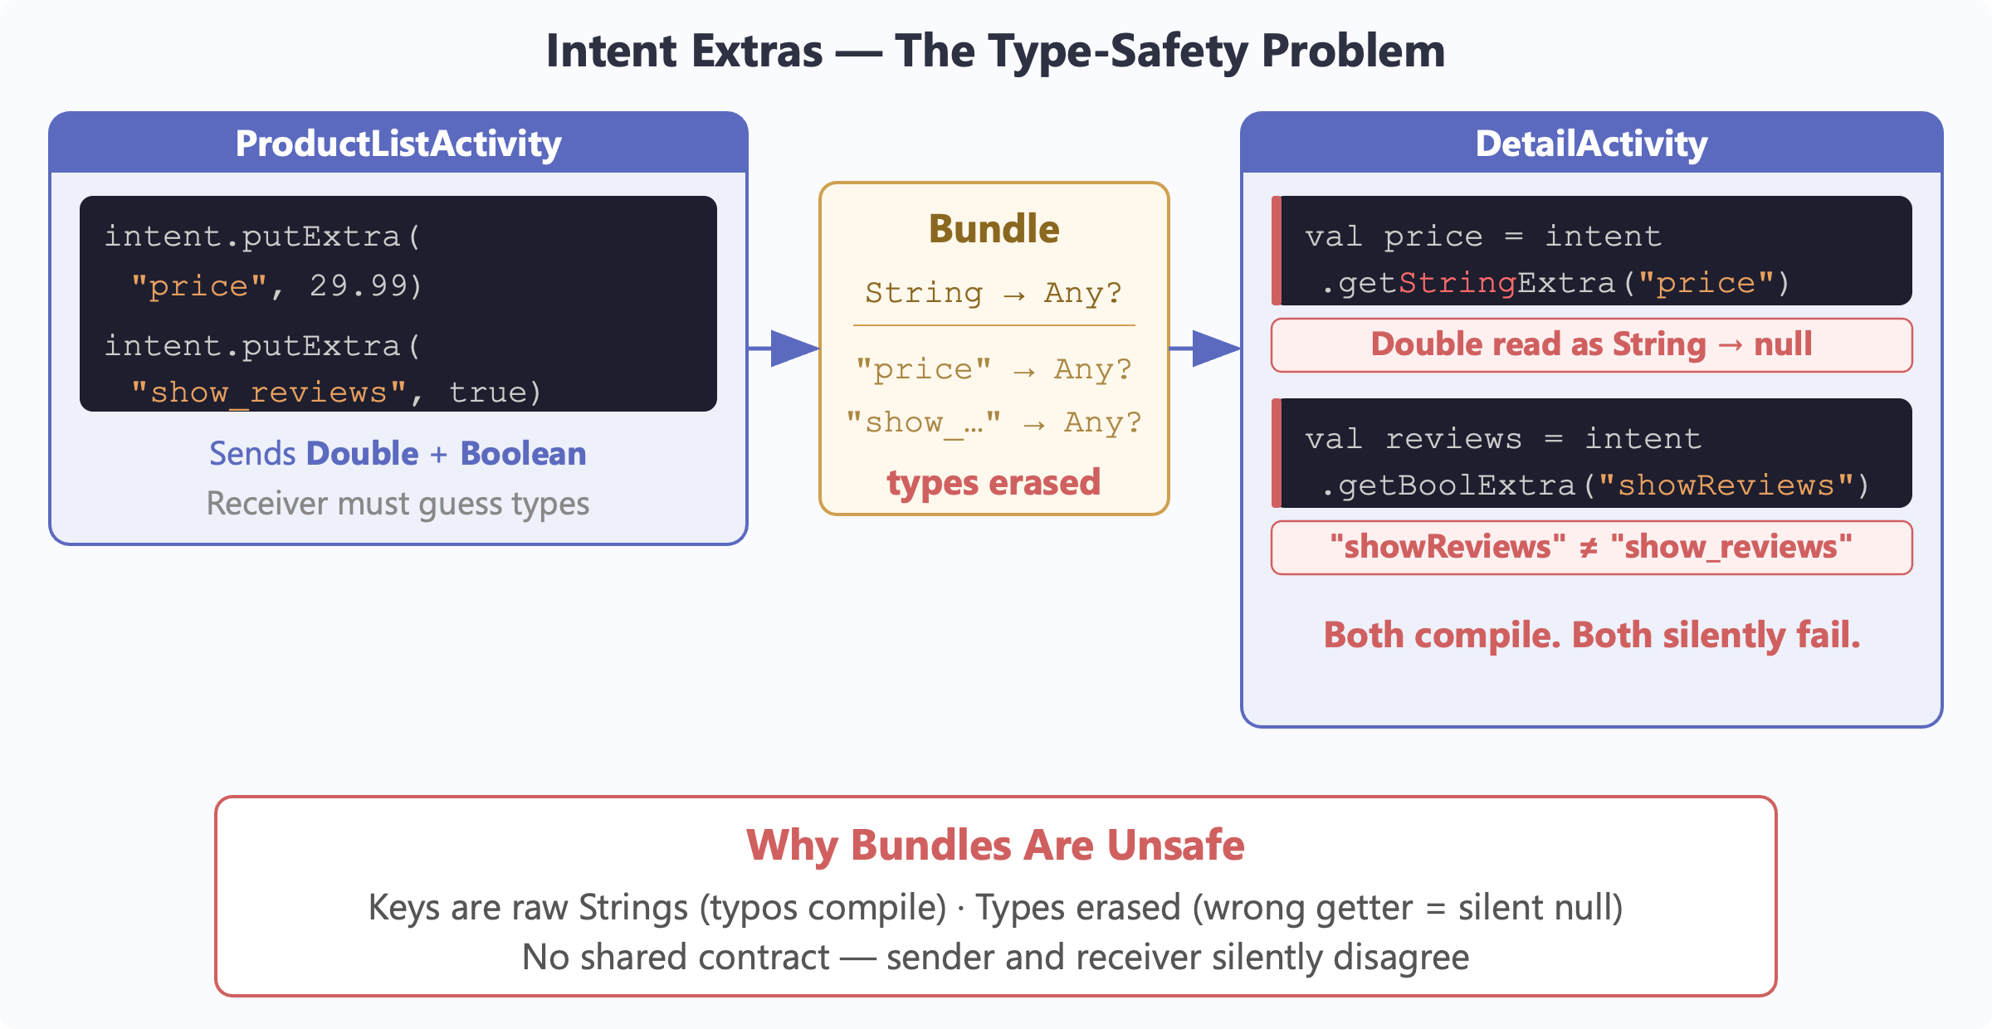
Multiple Activities
Bundles are an anti-pattern

Slide 25
Multiple Activities
High friction interface, numerous pitfalls
  Passing parameters by key/value without type checking
  Sharing data is difficult
  Screen transitions are not efficient
Surely there has got to be a better way
  Fragments!
  And while we are at it, let’s rethink the architecture

Slide 26
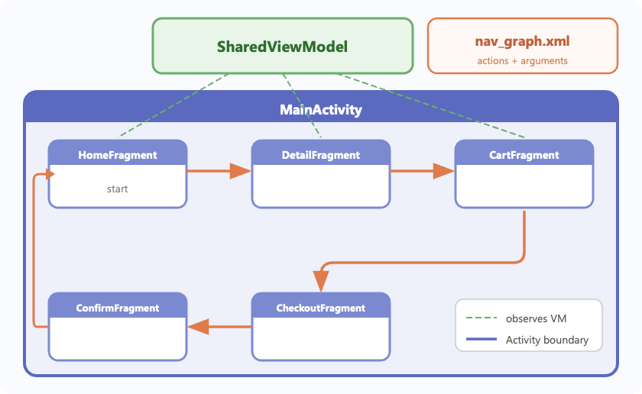
The one activity architecture
One activity
  Coordinates the entire app without messy transitions
Multiple screens
  Each one a fragment, which is like an activity-lite
  Laid out in XML, just like normal
How do we navigate across screens?
  Navigation XML that defines transitions
  Parameters, with types
How do we share state?
  One ViewModel, held in the activity

Slide 27
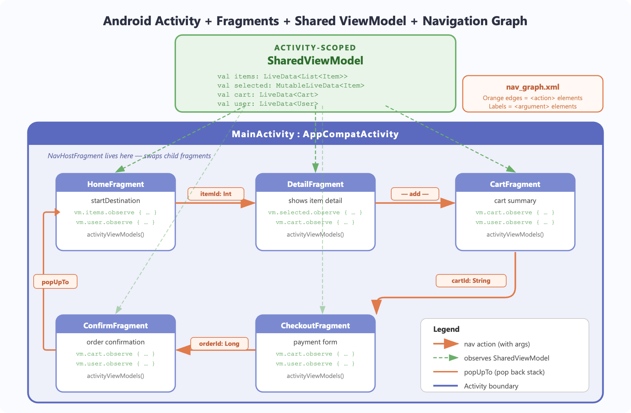

Slide 28
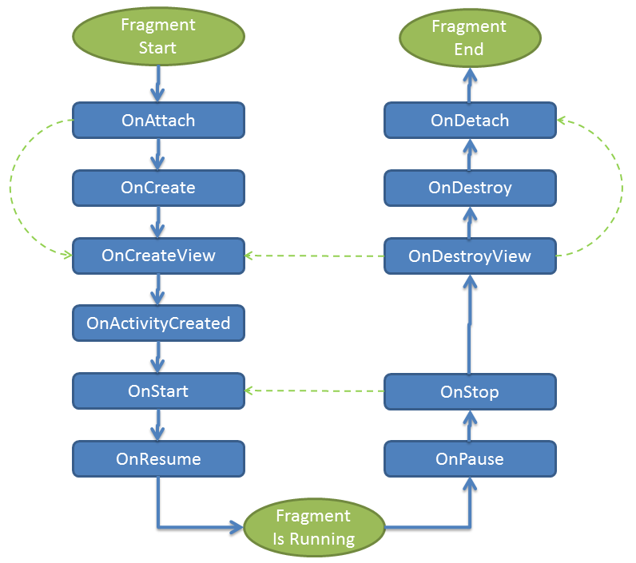
Fragments
Fragment lifetime

Slide 29
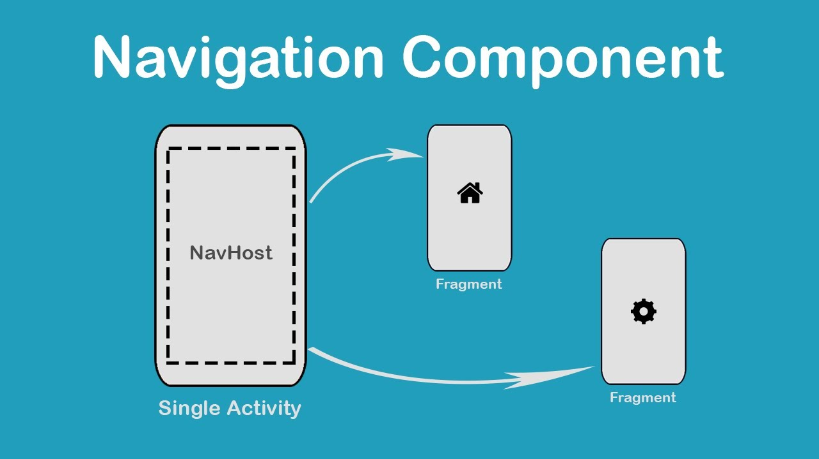
Navigation
One activity moves among fragments

Slide 30
Navigation key ideas
Fragments and actions in a single graph
  Actions transition among fragments
In a fragment: findNavController()
In an activity it is more complicated
  There can be multiple controllers
  findNavController(R.id.nav_host_fragment_activity_main)- ID of <fragment>
  view.findNavController() – use view
Exit a fragment: findNavController().popBackStack()
  All fragments form a stack

Slide 31
Navigation: moving around
To move to another fragment
  view.findNavController().navigate(R.id.targetFragment)
  findNavController(R.id.view).navigate(R.id.targetFragment)
  Where targetFragment is an id in your nav graph
  Nav graph is in navigation/nav_graph.xml
To pass arguments use a Directions objects
  Compiler generates them from nav graph—type safe!
  An action carries the parameters
  val action = SpecifyAmountFragmentDirections
  .actionSpecifyAmountFragmentToConfirmationFragment(foo)
  findNavController().navigate(action)

Slide 32
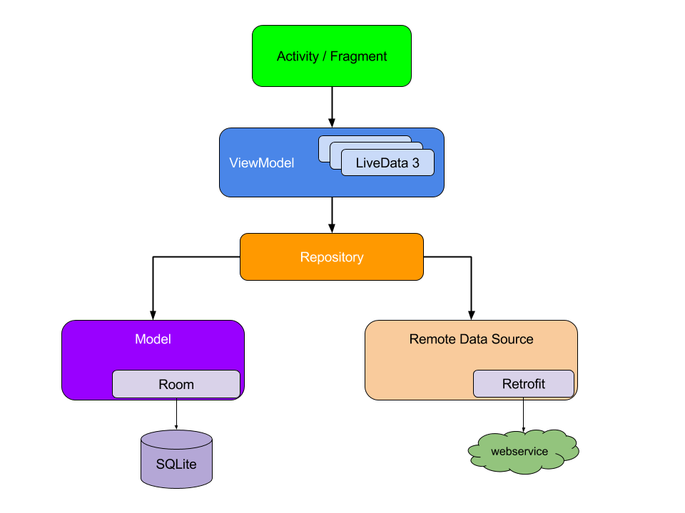
ViewModels, MVVM(model, view, viewModel)
Separate logic from display
  Display in activity/fragment (View)
  “Application logic” goes in ViewModel (ViewModel)
  Model holds the “real data” (Model)
Encourages an app style
  Raises the level of abstraction
  Enables powerful apps quickly

Slide 33
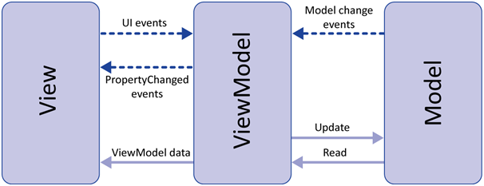
View, ViewModel, Model (MVVM)
View is your fragment
  It manages the screen, inflates XML
  Observes LiveData, reflects changes to the display
  Observes display, feeds events to ViewModel
ViewModel manages LiveData, exports it.
  Contains most of the application logic.
Model is the data
  Source from network or database/files
Might feel weird at first, but wisdom becomes clear

Slide 34
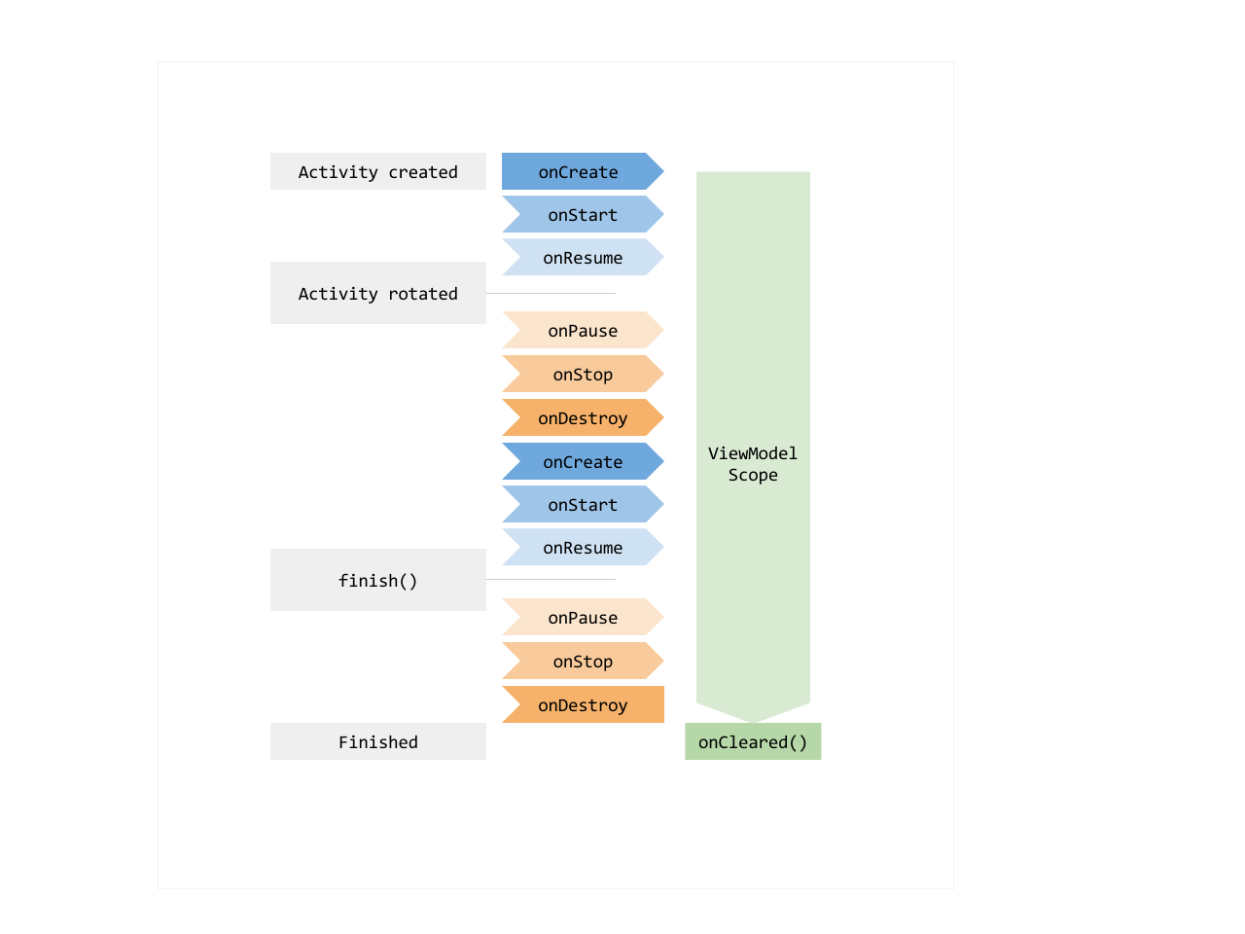
ViewModels have long lifetimes
Data in a ViewModel is in memory even if device rotates or is paused
  Fewer surprises at runtime!
  You still sometimes need onSaveInstanceState() for persistence

Slide 35
How does my app manage state?
Recall the Fragment FC
Does this feel right?
  We need data from somewhere
  We want to know when it changes
We need data that feels alive…like LiveData
class MainActivity : AppCompatActivity() {
companion object {
var showText = true
var immersiveMode = true
}

Slide 36
Live data
View models contain the state of your app
Views get the state from view model
What is the problem?
  How does the view know when state changes?
  Could provide explicit callbacks
  But what happens if view listening to changes dies?
  Register callback on create, degregister on destroy
  Bugs!

Slide 37
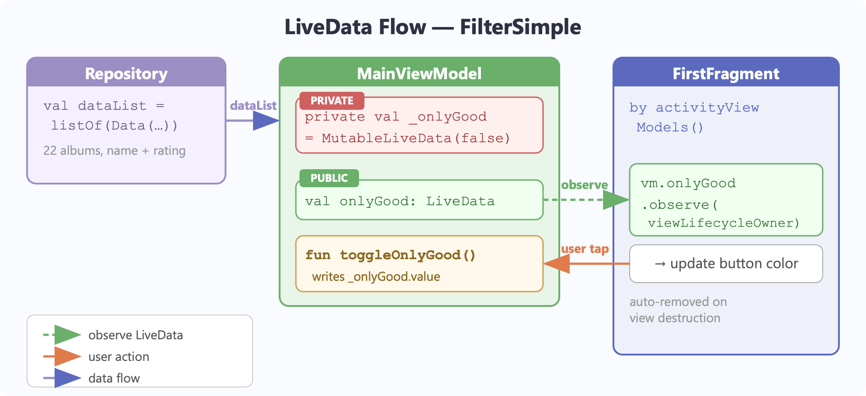
LiveData in FilterSimple

Slide 38
Live data (from FilterSimple)
// In the view model
private val _onlyGood=MutableLiveData(false)
// This is the publicly visible LiveData val onlyGood: LiveData<Boolean> = _onlyGood
// In the view (fragment)
viewModel.onlyGood.observe(viewLifecycleOwner) {
if(it) {
binding.onlyGood.backgroundTintList = ColorStateList.valueOf(Color.GREEN)
} else {
binding.onlyGood.backgroundTintList = ColorStateList.valueOf(Color.RED)
}
}

Slide 39
Kotlin getters and setters can help
Properties in Kotlin
  Look like data, but are really code!
  Each has an implicit getter (for reads) and setter (for writes) that we can override
Getters and setters are very useful for LiveData where .value can be null
  val displayName: String get() = _name.value ?: "Unknown”
  returns the LiveData's value or a fallback every time it's read
var currentIndex: Int
get() = _currentIndex.value ?: 0
set(value) { _currentIndex.value = value }

Slide 40
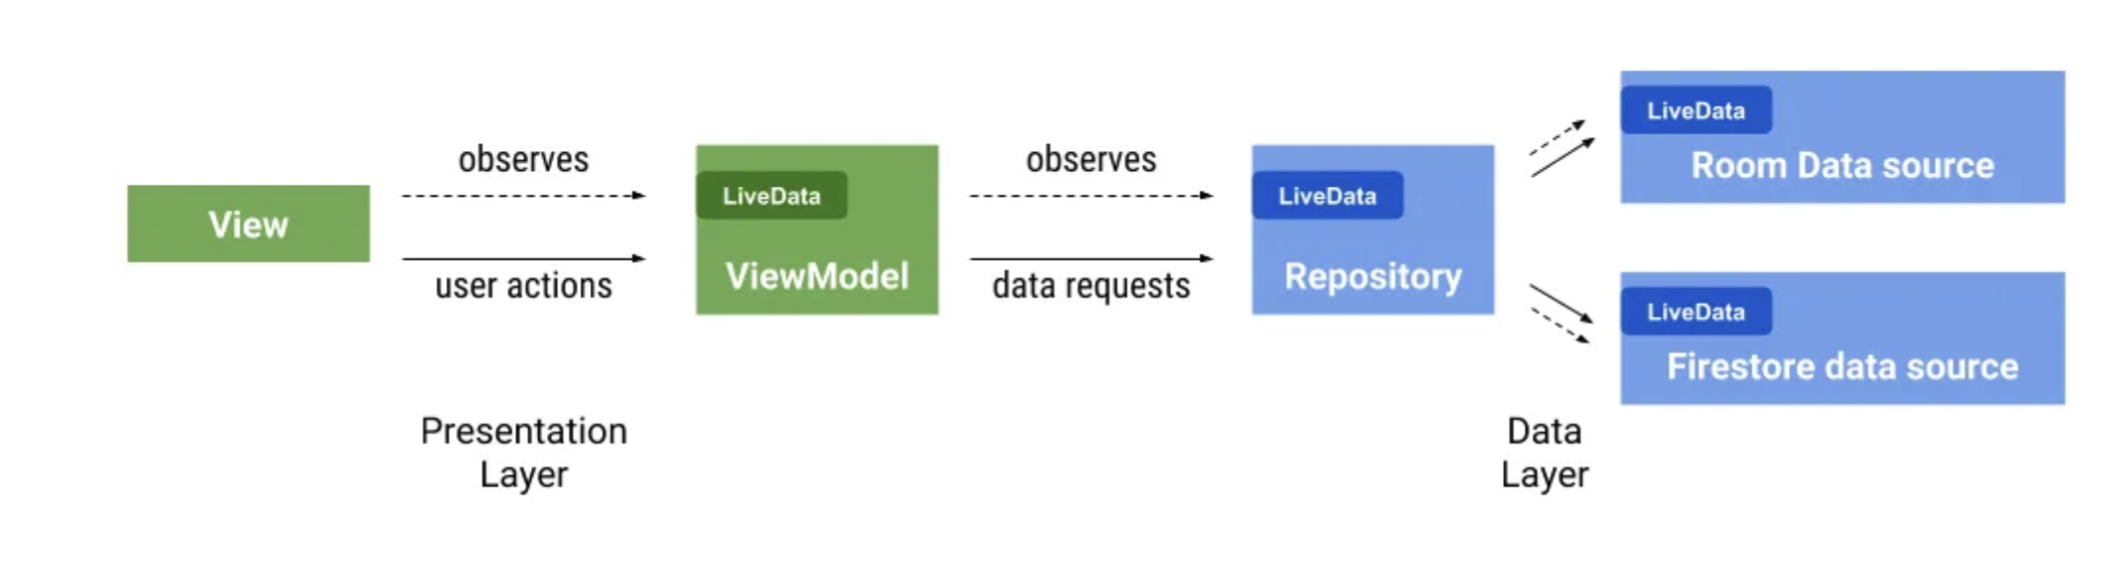
Live data
Live data lives in view model
View observes live data
  Modifies view model state based on user actions
Repository/model also has live data
  View model updates its data from repository
App responds to data changes minimal coupling

Slide 41
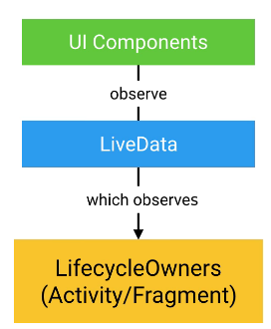
MVVM, lifetime and scope
LiveData allows communication without dependence
  Multiple observers ok
  Observers can die, be reborn, no code changes
ViewModels live as long as application
  Fragment (can die when goes off screen)
  Activity (longer than fragment, but can die off screen)
  Application (activities can share state and communicate)

Slide 42
Coroutine dispatchers
Dispatcher.Main
  Main thread
  Must be quick: required if you have to update the UI
Dispatcher.Default
  Background thread, possibly on other processor
  For background work, like diffing lists, image filters
Dispatcher.IO
  Background thread, possibly on other processor
  For network access or file system access

Slide 43
Where Do Coroutines Execute?
Coroutine A
Coroutine B
Coroutine C
Coroutine D
Each coroutine can suspend and resume independently
Coroutine Dispatcher (Scheduler)
Main Thread
Worker 1
Worker 2
Worker 3
I/O Pool 1
I/O Pool 2
CPU Core 0
CPU Core 1
CPU Core 2
CPU Core 3
Key: Coroutines are not bound to any specific thread - they can suspend on one core and resume on another.

Slide 44
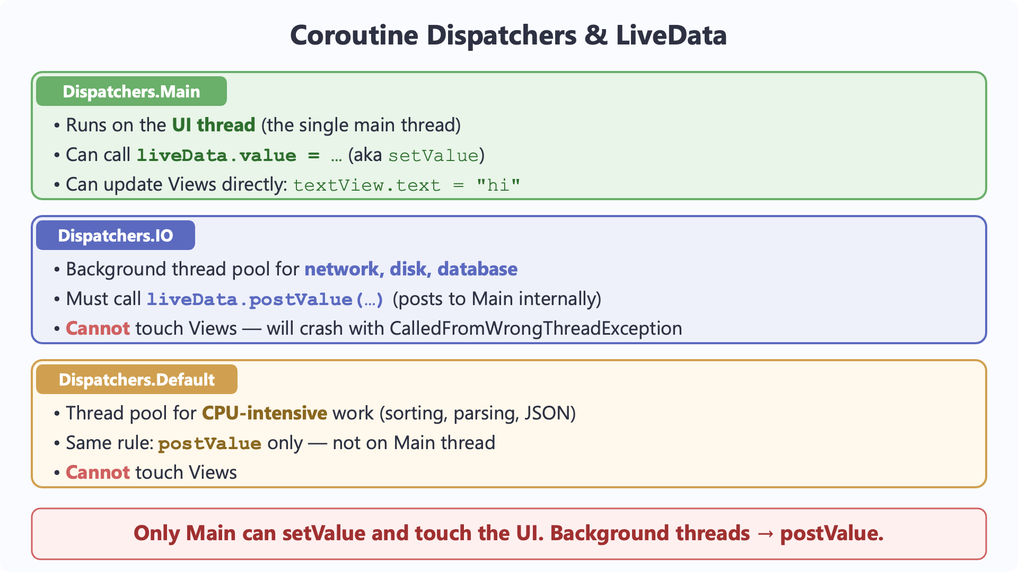

Slide 45
Networking(!)
What “language” do we speak with servers?
  Representational state transfer (REST)
  Use text (JSON)
  Servers are “stateless”
    Requests give them all the context they need
What tools do we need in Android
  Retrofit2: Talk to servers
  Gson: parse JSON
  Coroutines & Dispatchers: Fetch on background thread
  Glide: display & cache images given a URL
    Glide is independent, but fetching images is common

Slide 46
Specifying coroutine dispatchers
withContext – allows you to switch dispatchers
  withContext(Dispatchers.Main) {
  textView.text = “hi there” }
  This also works!
  runOnUiThread {...}
Launch with scope
Live data works with threads
  Main thread can use setValue or .value
    Advantage is that subsequent reads have the new value
  Background threads must use postValue
viewModelScope.launch(Dispatchers.IO) {

Slide 47
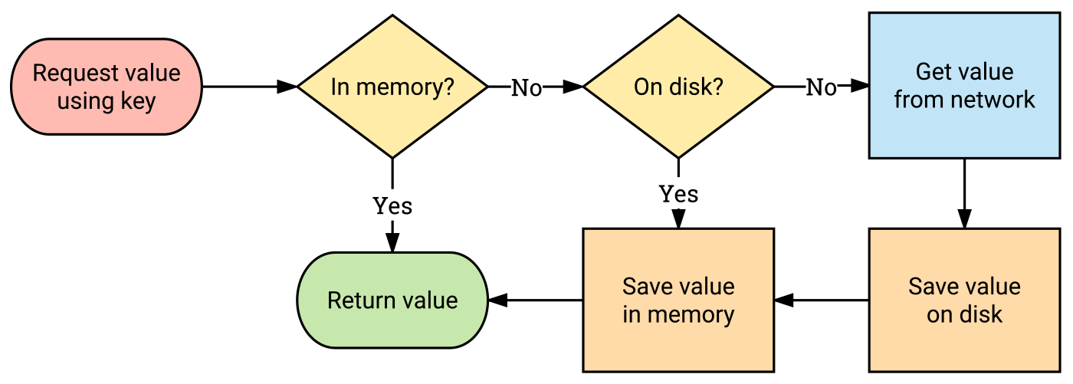
Glide for caching images
Use a key, like the image URL
Library handles storing images locally

Slide 48
Retrofit2 for web services
Retrofit2 turns your HTTP API into a Kotlin interface.
interface GitHubApi {
  @GET("users/{user}/repos") listRepos(@Path("user") String user) : List<Repo>
Retrofit2 generates the implementation of listRepos (not you!)
  Bridge between Kotlin interface (listRepos)
  And http call (https://api.github.com/users/octocat/repos)

Slide 49
Retrofit2 for web services
interface GitHubApi {
  @GET("users/{user}/repos&sort=updated")
  listRepos(@Path("user") String user) : List<Repo>
@GET
  Defines the path of the URL
    Retrofit2 can plug in values (user, above)
    String can contain parameters (sort=updated, above)
@Path fills in path component from parameter
You need to define return type
  Look at JSON given by the web service

Slide 50
Retrofit2 for web services
interface GitHubApi{
@GET("users/{user}/repos&sort=updated")
listRepos(@Path("user") String user) : List<Repo>
companion object Factory {
fun create(): GitHubApi {
val retrofit: Retrofit = Retrofit.Builder()
.addConverterFactory(GsonConverterFactory.create())
// Must end in /!
.baseUrl("https://api.github.com/")
.build()
return retrofit.create(GitHubApi::class.java)
}
}

Slide 51
JSON (JavaScript Object Notation) Example
{
"Title": "The Cuckoo's Calling",
"Author": "Robert Galbraith",
"Detail": { "Pages": 494 },
"Price": [
{ "type": "Hardcover",
"price": 16.65 },
{ "type": "Kidle Edition",
"price": 7.03 }
]
}
http://www.w3resource.com/JSON/introduction.php

Slide 52
Elements of JSON
Four basic and built-in data types in JSON.
  Strings, numbers, Booleans (i.e true and false) and null.
  These can be used as values
Two structured data types
Objects are wrapped within '{' and '}'.
  Objects are list of label-value pairs.
Arrays are enclosed by '[' and ']'.
  Arrays are list of values.
Both objects and arrays can be nested.

Slide 53
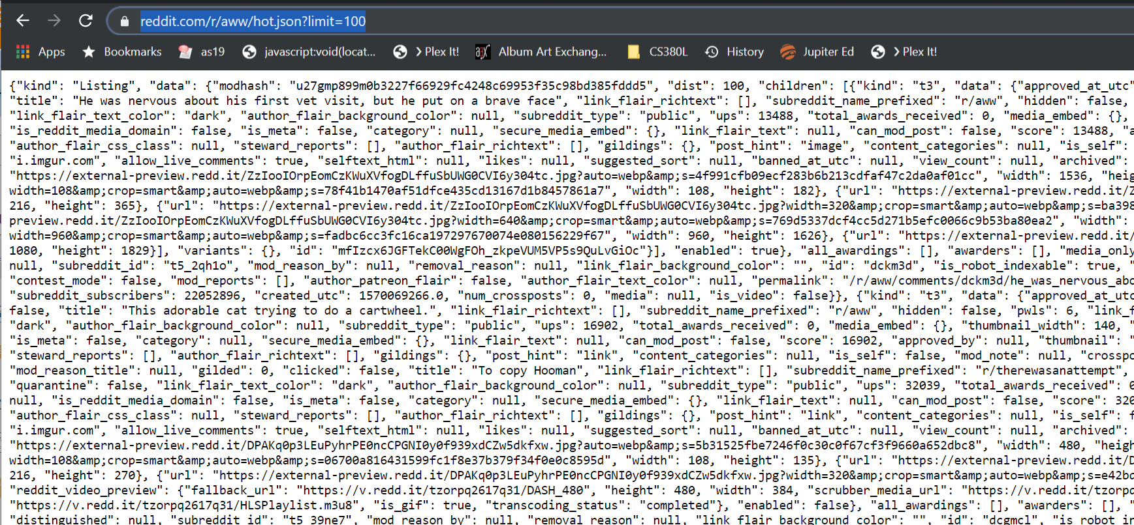
Web services often return JSON

Slide 54
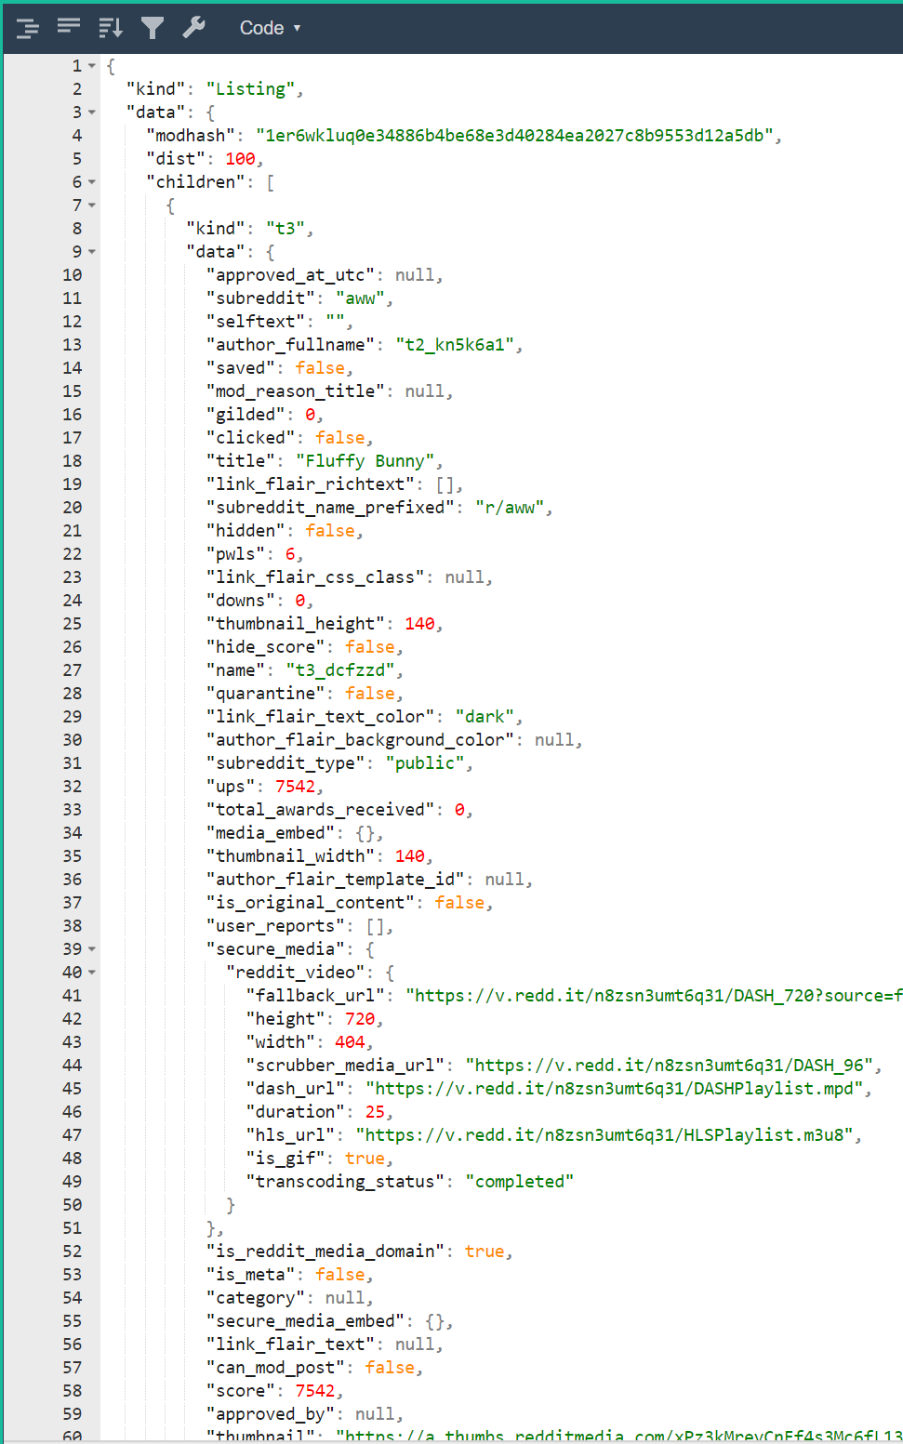
Web pretty-printers
https://jsonformatter.org/json-pretty-print

Slide 55
Network services for mobile
User authentication
  Anonymous users
  Email/Password
  Google/facebook/phone number,…
Storage
  Files (e.g., images, video)
  Structured data (e.g., documents, collections)
  Access control
Cloud functions (not in this class)
  Code executes on your behalf in the cloud. No VMs

Slide 56
Authentication
How do you prove you are who you say you are?
  Know a secret (e.g., password)
  Possess a token (e.g., phone number)
  Vouched for by third party (e.g., goole or facebook)
Firebase authentication
  Manages multiple users without a server
  Configure a web-based console
  Open source activity that does best practices login

Slide 57
Google firestore
Store data in a flexible format in the cloud
  No server, web console
Collections and documents
  Documents are key/value pairs and sub-collections
  Alternate collection/document/collection/document…
  https://firebase.google.com/docs/firestore/data-model
Real-time updates!
  Cool for features like chat
  Works well with live data

Slide 58
Working with a database
Know what parts of your model are written by client code and what by the db/server
  E.g., timestamps, ids are often db/server only
Expose fetched data via your viewModel
  LiveData super useful if update is asynchronous
Understand how items are cached/modified
Generalize your notion of pointer
  A pathname to an image is a “pointer.”
    If pathname is in database, file better exist (referential integrity)
  A foreign key points from one table to row of another

Slide 59
Taking pictures
Your app can control the camera
  Lots of control (filters, etc.)
  Complex code
You can launch an intent to take a picture
  Much like an implicit intent
  Input: URI location to store picture
    File name must end in .jpg
  Output: success Boolean
Problem: Output callback does not know location!
  If you have other metadata, like a tag, that is lost

Slide 60
Taking pictures, problems
private val tag: String = “”
private val location: String = “”
private val cameraLauncher = registerForActivityResult(
ActivityResultContracts.TakePicture()) { success ->
// use tag and location freely
// Here we use the above declarations
tag = “funny”
location = “foobar.jpg”
cameraLauncher.launch(uri)
What is the problem here?
  Our code probably in fragment (view) that can be killed
  Especially because we are launching a camera activity
  If killed, we lose tag and location!

Slide 61
Taking pictures, solutions
private val cameraLauncher = registerForActivityResult(
ActivityResultContracts.TakePicture()) { success ->
// use viewModel.tag and viewModel.location freely
// Here we use the above declarations
viewModel.tag = “funny”
viewModel.location = “foobar.jpg”
cameraLauncher.launch()
Store state in the view model
  Safe even if camera activity kills our fragment
  View model holds strings—simple data type

Slide 62
Taking pictures, details
Just remember the last component of the file name
  timestamp in Notebook
  Universally unique identifier (UUID) for cloud database
  We call it fileName and it is a string
Useful functions
  fileNameToFile(fileName: String): File
  There is a way to create a URI from a File object
Application manages permissions via URI
  Each app gets its own area to write for security
Example (fileName, absolute path, URI)
  35751550-1edd-4738-afd1-fbf41cc918a7
  /storage/emulated/0/Pictures/35751550-1edd-4738-afd1-fbf41cc918a7.jpg
  content://edu.utap.firechat/my_images/Pictures/35751550-1edd-4738-afd1-fbf41cc918a7.jpg

Slide 63
Notes: dealing with dependences
Consider a simple note.
  text: String
  imageFiles: List<String>
imageFiles is a list of path names
  Each path name refers to an image
  Image might be a local file (sqlite)
  Image might be a cloud file (firebase)
Note depends on images
  Danger: a note that refers to a non-existent image

Slide 64
How to create/edit a note (sqlite)
In-memory note has list of image files (newList)
In-DB note has list of image files (oldList)
Algorithm to modify image table
  Leave members shared between oldList & newList
  In oldList and not in newList -> delete file
  In newList and not in oldList -> add row

Slide 65
How to create a note (firestore)
For list of image files -> start upload
Write note
What is wrong with this picture?
  note.pictureUUIDs = [ffjsjsjsj-sjfjfj]
  storage/images/ffjsjsjsj-sjfjfj does not exist
  Violates referential integrity!
  Error when displaying new note (via live data)

Slide 66
How to create a note (firestore)
Take a picture
Start file upload
When file successfully uploaded…
  Delete local file
  Update note to have new pictureUUID
  Write note to server
    Maintains referential integrity!
    Write data before writing pointers to it
  Might be user-visible delay for their picture to show up

