Slide 1
An Implementation of GEMM for DMA-enabled Architectures
Devangi Parikh
Will Leven
Sep 19, 2016
TI / Embedded Processing / Processors / Silicon Development / Machine Learning Lab
TI Information – Selective Disclosure

Slide 2
Outline
TI Information – Selective Disclosure
TI Embedded Processors
TI LINALG Library
Application Use Case
GEMM On C66x
Performance

Slide 3
TI Embedded Processors
TI Information – Selective Disclosure

Slide 4
5 Generations of TI Multicore Processors
TI Information – Selective Disclosure
Keystone architecture
  Lowers development effort
  Speeds time to market
  Leverages TI’s investment
  Optimal software reuse

Slide 5
TI 66AK2H12 SoC
TI Information – Selective Disclosure
Keystone II architecture
Cores
  4 ARM A15s at 1.0 GHz
    4 MB shared L2 cache
    32 Gflops single precision
    8 Gflops double precision
  8 C66x DSPs at 1.0 GHz
    32 kB L1 scratch / cache each
    1 MB L2 scratch / cache each
    128 Gflops single precision
    32 Gflops double precision
Memory
  8 GB DDR3 DRAM (external)
  6 MB shared SRAM/L3
Interfaces

Slide 6
TI LINALG Library
TI Information – Selective Disclosure

Slide 7
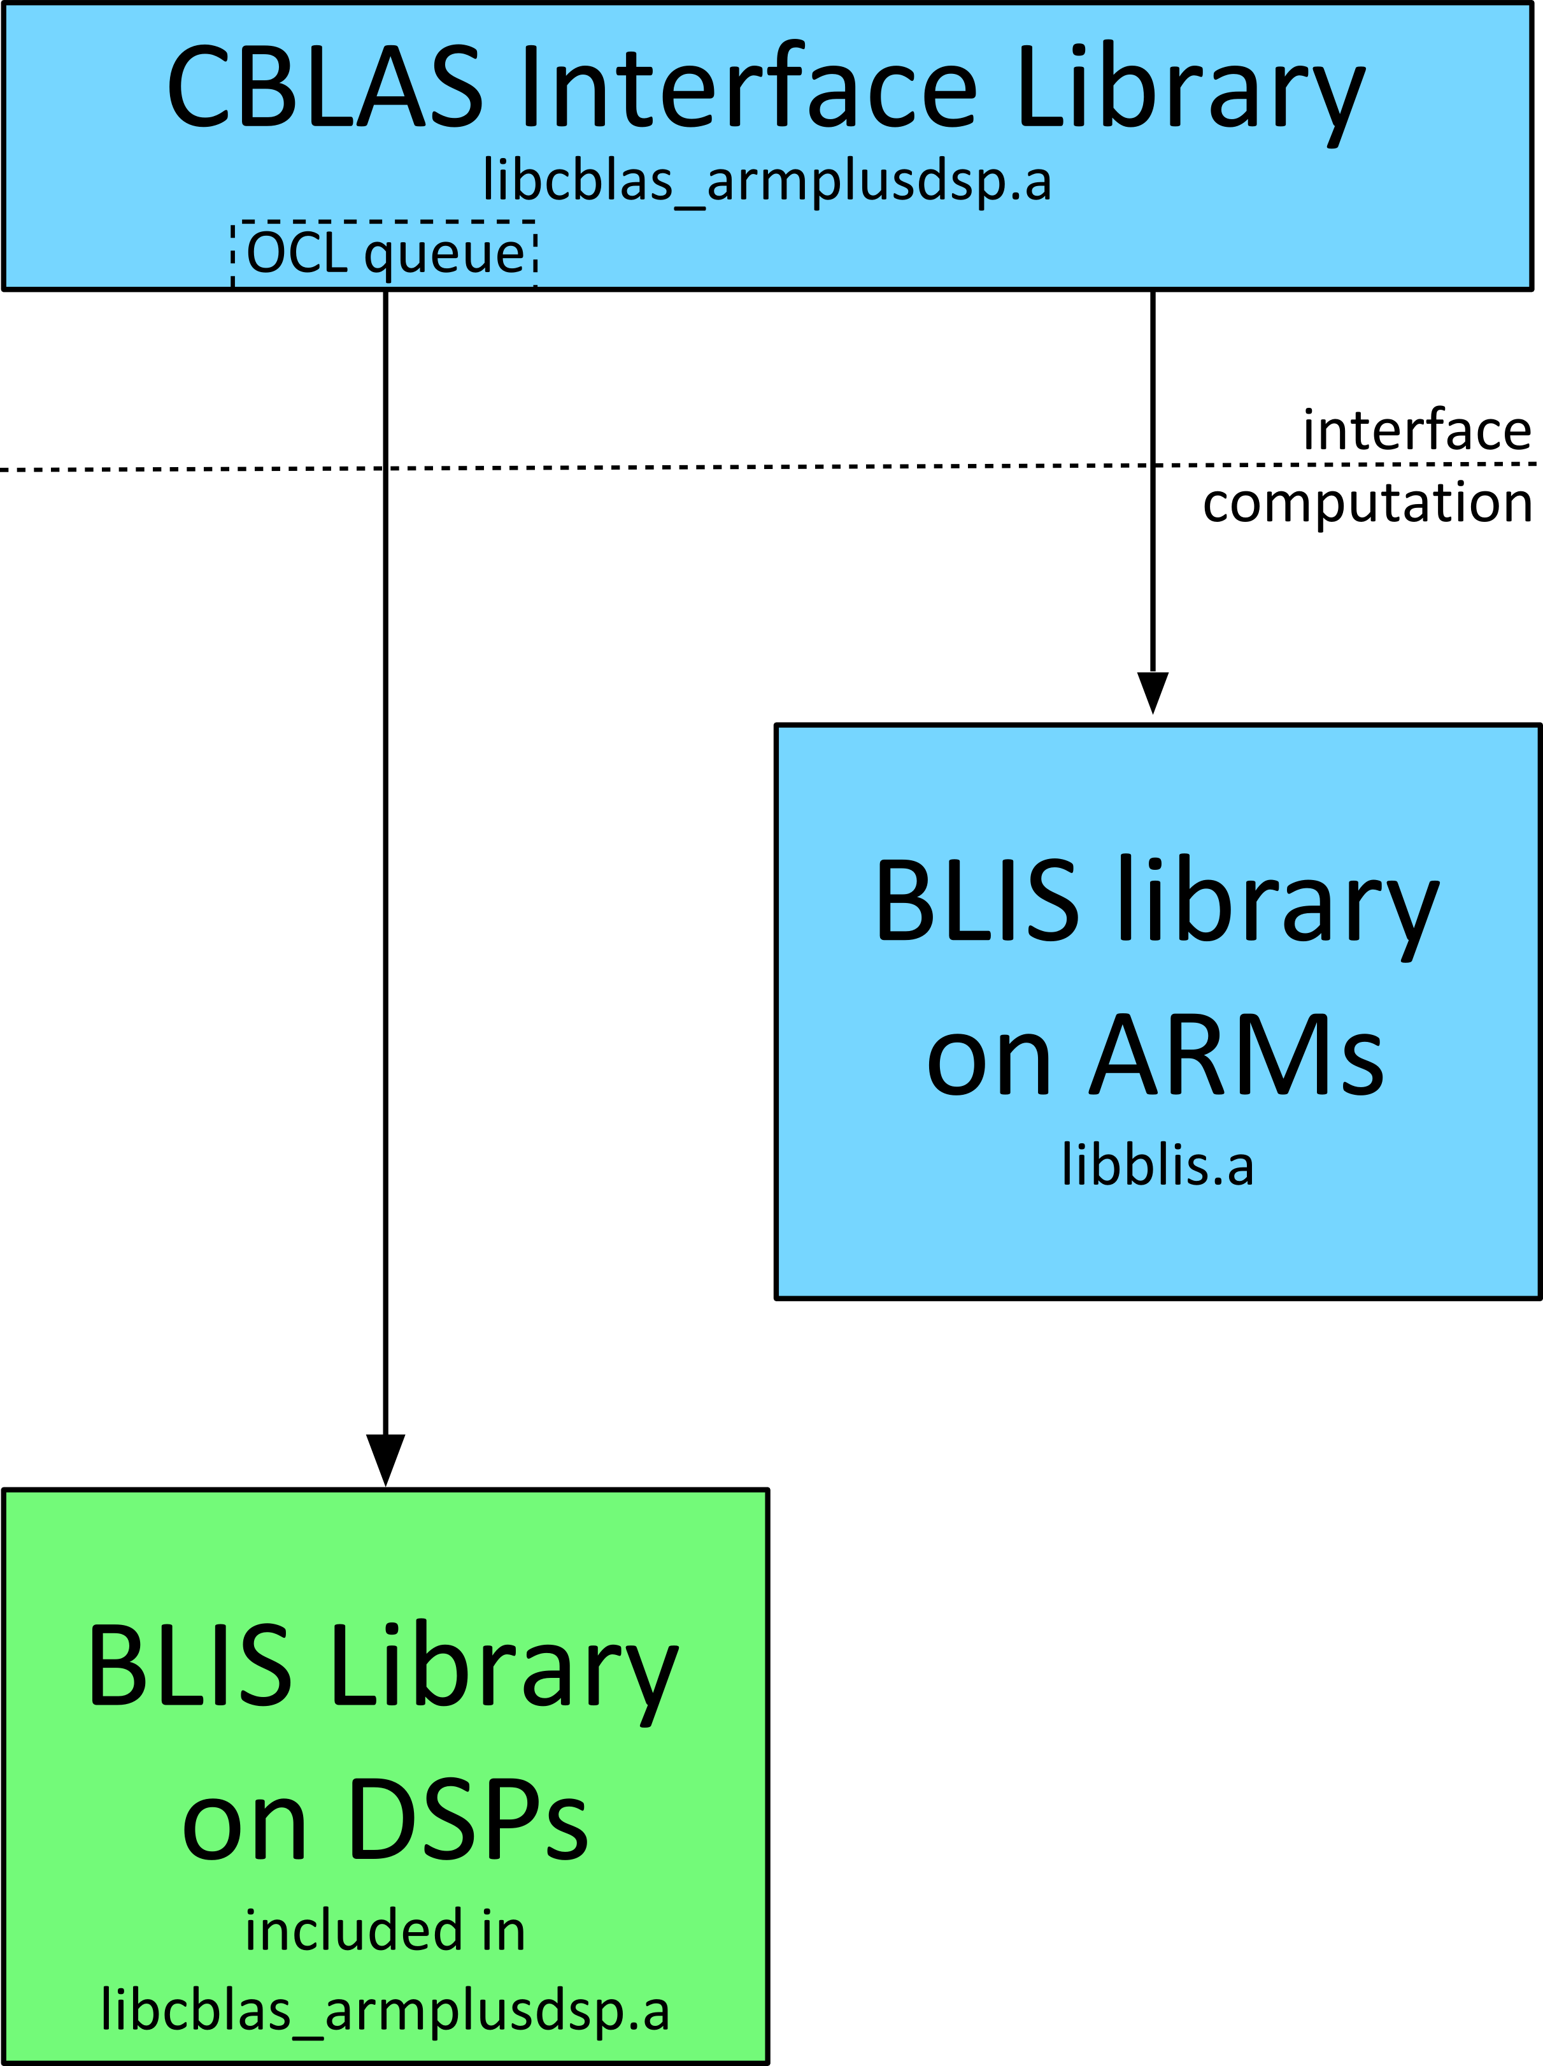
Dense Linear Algebra
TI Information – Selective Disclosure
LINALG
  Support for the standard CBLAS and CLAPACK APIs
  CBLAS runs on either the available ARM or DSP cores
  Uses BLIS (BLAS-like Library Instantiation Software) for underlying BLAS computations

Slide 8
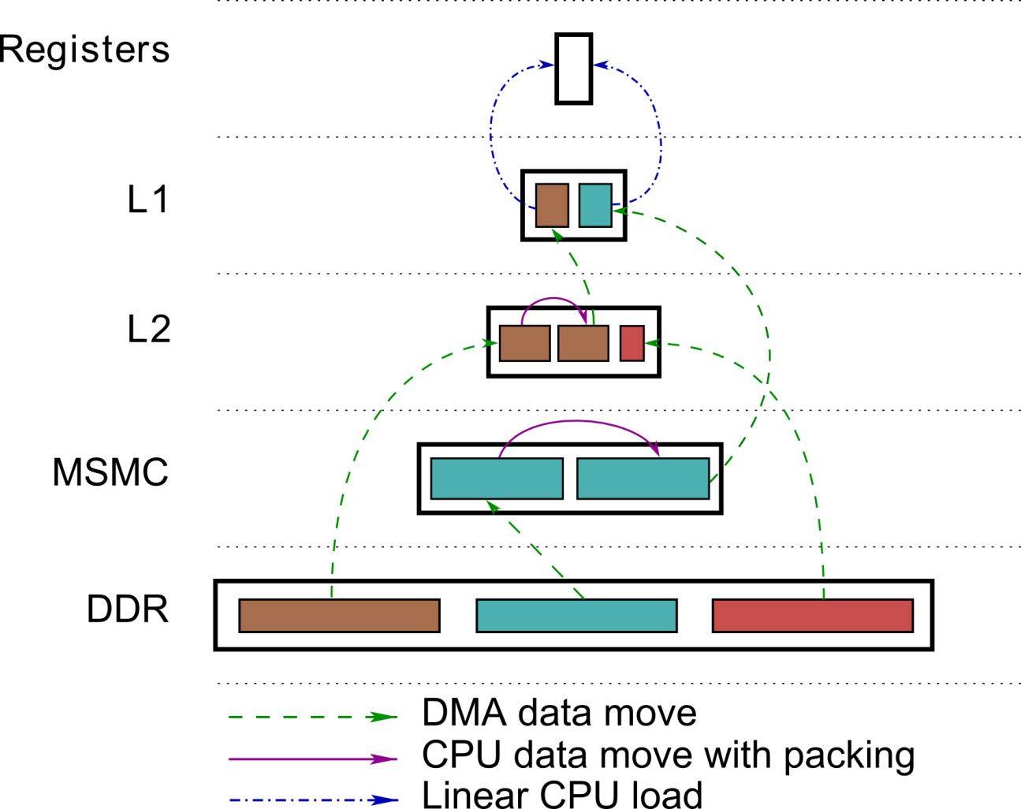
Data Movement for Level 3 BLAS on C66x
TI Information – Selective Disclosure
Efficiently moves the input and output matrices through the different levels of memory using DMA, and packing routines to ensure efficient computations
Level 3 BLAS computations require
  4.5 MB MSMC memory
  768 KB L2 Scratchpad memory
  28 KB L1D Scratchpad memory
A
B
C

Slide 9
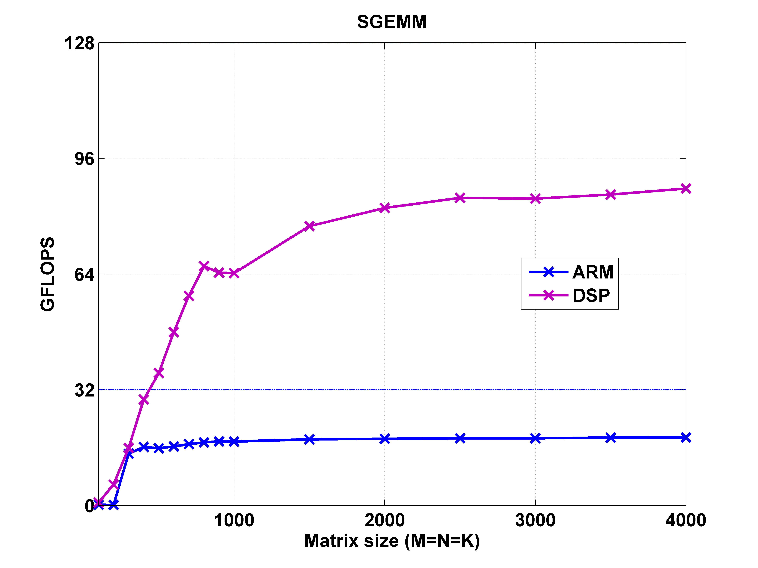
Single Precision GEMM Performance
TI Information – Selective Disclosure
Single precision general matrix-matrix multiplication
Obtained using a TI 66AK2H12 SoC at a 1 GHz clock
Theoretical peak DSP performance = 128 GFLOPS
Theoretical peak ARM performance = 32 GFLOPS

Slide 10
Application Use Case
TI Information – Selective Disclosure

Slide 11
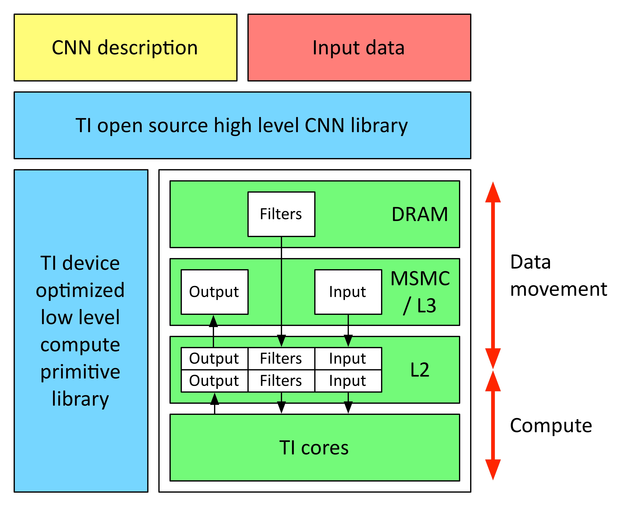
CNN Applications
TI Information – Selective Disclosure

Slide 12
Extended BLAS for TIML
TI Information – Selective Disclosure
Input and output final locations (any permutation for the parameters can be provided)
  DRAM
  MSMC / L3
  L2
Fuse GEMM/GEMV with other operations
  Fully connected layer (with or without H pre packed / stored optimally, with or without V special structure)
  Y = ReLU(H*X + V)
  y = ReLU(H*x + v)
  Convolutional layer (with or without H pre packed / stored optimally, with or without V special structure, need to form Xfilter)
  Y = ReLU(H*Xfilter + V)
  Y = pool(ReLU(H*Xfilter + V))
Data movement
  EDMA
Working space
  May assume only L1 is available for scratchpad buffers

Slide 13
GEMM On C66x
TI Information – Selective Disclosure

Slide 14
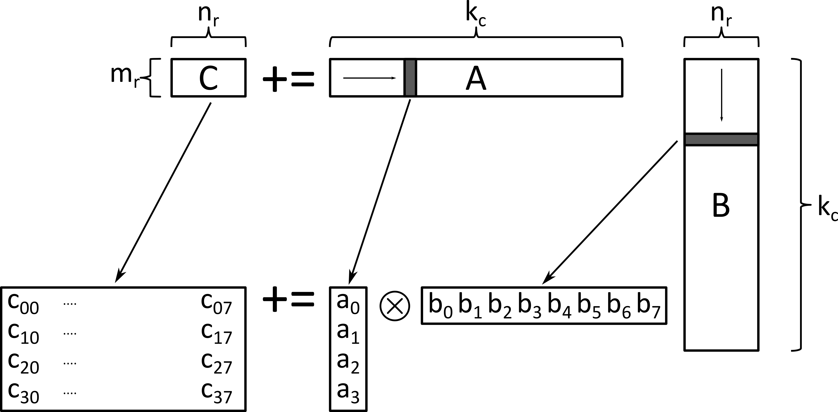
GEMM Building Blocks
TI Information – Selective Disclosure
C66x SGEMM ukernel
  MR_S = 4
  NR_S = 8
  KC_S > 384 (to get > 90% performance from the ukernel)
Packing Routines
  8xK to pack Matrix B
  4xK to pack Matrix A
Memory required for packing
  Available working space 28 KB of L1
  1 micro-panel of B = 12 KB
  1 micro-panel of A = 6 KB

Slide 15
Performance Analysis
TI Information – Selective Disclosure
  Performance Limitations
    MC and NC have to be very small to fit panels of A and B in L1
    KC has to be reduced to fit more micro-panels of A and B
    Expensive loops (5th loop and 3rd loop around ukernel) iterate large number of times
  Custom Implementation
    GEMM building blocks
      Ukernel (> 90% performance)
    Streamlined Implementation
      Aim to reduce functions calls, and other code generalization
    Use DMA to pack A
      Pack the next micro-panel while computing on current micro-panel
Operations | % of total cycles
Ukernel | ~42.5
Packing A | ~17.2
Packing B | ~2.0
Overhead | ~38.3
M | 256 | MC | 16
N | 256 | NC | 16
K | 198 | KC | 198
 |  | MR | 4
 |  | NR | 8

Slide 16
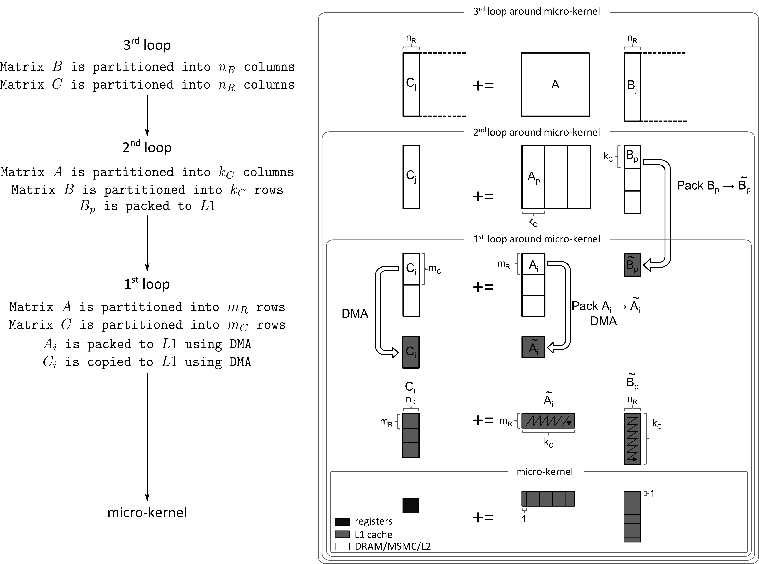
GEMM on C66x
TI Information – Selective Disclosure

Slide 17
Single Precision GEMM Performance
TI Information – Selective Disclosure
Preliminary Results:
Performance (Clock 983 MHz)
  L2 – 11.03 GFLOPS (70 %)
  MSMC – 9.49 GFLOPS (59 %)
Operations | % of total cycles
Ukernel | ~84.0
Packing A | ~7.7
Packing B | ~2.7
Overhead | ~5.6
M | 224 | KC | 398
N | 224 | MR | 4
K | 398 | NR | 8

Slide 18
Thank you!
TI Information – Selective Disclosure

Slide 19
Backup
TI Information – Selective Disclosure

Slide 20
Summary
TI Information – Selective Disclosure
Our previous implementation of Dense Linear Algebra libraries for TI DSP processors assumes all on-chip memory is available as working space to efficiently move data through the various levels of memory using DMA and packing routines. However, this assumption prevents applications from using any on-chip memory to store data that the application may be using frequently. In this talk, we will describe an implementation of GEMM that uses a limited amount of working space, and DMAs to pack matrices freeing up most of the on-chip memory for the applications’ use.

