Slide 1
Compositional Reasoning Gotchas in Practice
CHIRAG AGGARWAL, OSKI TECHNOLOGY
PAUL HYLANDER, IKANOS
YOGESH MAHAJAN, NVIDIA
JON MICHELSON, NVIDIA
VIGYAN SINGHAL, OSKI TECHNOLOGY

Slide 2
Formal Property Verification on Large Designs
S
Environment
Constraints
M₁
M₂
+
Properties to check on S
Large designs; typically involving the work of multiple designers
Large number of properties to be checked
Compositional assume-guarantee reasoning fits naturally
Divide-and-conquer addresses some tool capacity concerns
© 2015 OSKI TECHNOLOGY, INC. ALL RIGHTS RESERVED.

Slide 3
Compositional Reasoning
{
S
}
Environment
Constraints
M₁
M₂
+
Properties to check on S
decomposition
inference rule
{
}
,
M₁
M₁ Unit level
constraints
M₂
M₂ Unit level
constraints
+
+
Properties to check on M₁
Properties to check on M₂
© 2015 OSKI TECHNOLOGY, INC. ALL RIGHTS RESERVED.

Slide 4
ARM® AMBA® AXI4 WSTRB Interface
AR (Read Address)
AXI4 Master
AXI4 Slave
AW (Write Address)
W (Write Data)
R (Read Data)
B (Write Response)
© 2015 OSKI TECHNOLOGY, INC. ALL RIGHTS RESERVED.

Slide 5
R and B Channels
RVALID
BVALID
64
RDATA
2
BRESP
RLAST
BREADY
M
RREADY
S
M
S
R Channel (Read Response)
  Supports reads of multiple beats (cycles)
  RVALID asserted on every cycle of data
  RLAST indicates last beat
  RREADY acknowledges receipt
B Channel (Write Response)
  Always 1 beat
  BVALID asserted with BRESP
  BREADY acknowledges receipt
© 2015 OSKI TECHNOLOGY, INC. ALL RIGHTS RESERVED.

Slide 6
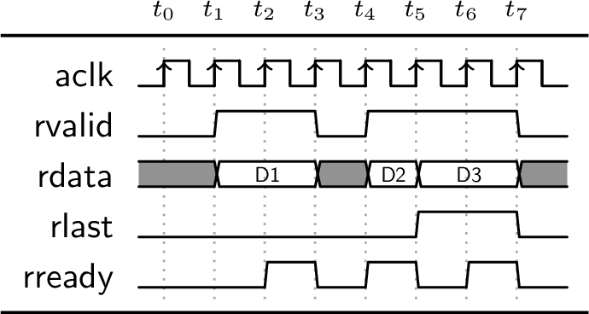
R and B Channels
RVALID
64
RDATA
RLAST
M
RREADY
S
© 2015 OSKI TECHNOLOGY, INC. ALL RIGHTS RESERVED.

Slide 7
Simplified Version of a Real Master-Slave Design
Master RTL
  Single FIFO to store R and B Responses
  FIFO sized to twice the length of longest R burst length
  R beats not dequeued until after RLAST arrive
  Once RLAST arrives, all R beats and B responses dequeued
  When the FIFO is full, RTL back-pressures BVALID
Slave RTL
  Single FIFO to store R and B Responses
  FIFO is 2-deep
  R beats or B responses dequeued as Master receives previous transactions
M
R1.1
R1.1
R1.1
R1.1
B1
R1.1
R1.1
B2
R1.1
R1.1
R1.L
R1.1
B3
R1.1
S
© 2015 OSKI TECHNOLOGY, INC. ALL RIGHTS RESERVED.

Slide 8
Deadlock in a Real System
Master RTL
  Single FIFO to store R and B Responses
  FIFO sized to twice the length of longest R burst length
  R beats not dequeued until after RLAST arrive
  Once RLAST arrives, all R beats and B responses dequeued
  When the FIFO is full, RTL back-pressures BVALID
Slave RTL
  Single FIFO to store R and B Responses
  FIFO is 2-deep
  R beats or B responses dequeued as Master receives previous transactions
M
R1.1
R1.1
R1.1
B1
R1.1
B2
R1.1
B3
B4
R1.1
R1.2
S
© 2015 OSKI TECHNOLOGY, INC. ALL RIGHTS RESERVED.

Slide 9
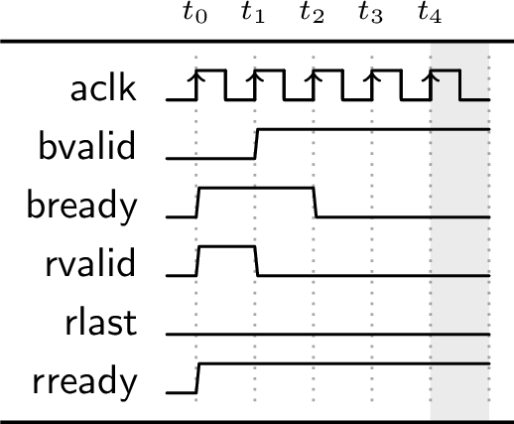
Deadlock in a Real System
R1.1
M
R1.1
R1.1
B1
B2
R1.1
R1.2
S
If either M or S is “fixed”, system M ⊗ S will work!
© 2015 OSKI TECHNOLOGY, INC. ALL RIGHTS RESERVED.

Slide 10
But Will We Catch It with Formal Verification?
Master Property m1:
  Once the master receives BVALID, eventually it must assert BREADY
Slave property s1:
  Once the slave sends an accepted RVALID with no RLAST, eventually the slave must send RVALID with RLAST asserted
property master_liveness_bready;
@(posedge aclk) disable iff (!aresetn)
(bvalid && !bready) |->
s_eventually bready;
endproperty
property slave_liveness_rlast;
@(posedge aclk) disable iff (!aresetn)
(rvalid && !rlast && rready) |->
s_eventually (rvalid && rlast);
endproperty
© 2015 OSKI TECHNOLOGY, INC. ALL RIGHTS RESERVED.

Slide 11
But Will We Catch It with Formal Verification?
Master Property m1: Once the master receives BVALID, eventually it must assert BREADY
Slave property s1: Once the slave sends an accepted RVALID with no RLAST, eventually the slave must send RVALID with RLAST
DUT
DUT
% assume s1
% prove m1
% assume m1
% prove s1
M
S
Both pass!!!
User concludes m1 and s1 are each true on the system M ⊗ S!
© 2015 OSKI TECHNOLOGY, INC. ALL RIGHTS RESERVED.

Slide 12
Compositional Reasoning
{
S
}
Environment
Constraints
M₁
M₂
+
Properties to check on S
decomposition
inference rule
{
}
,
M₁
M₁ Unit level
constraints
M₂
M₂ Unit level
constraints
+
+
Properties to check on M₁
Properties to check on M₂
© 2015 OSKI TECHNOLOGY, INC. ALL RIGHTS RESERVED.

Slide 13
Compositional Reasoning Concerns
Soundness is a major concern!
  Nobody wants to use an unsound approach …
  Do not want to burden end-users with potential soundness issues
Cost of deployment is a concern
  Methodology impact
  Property decomposition effort
  Capturing Interface Properties and Invariants
Completeness is a lesser concern
  So long as it is cheap to detect these cases, a determined user can figure out some other approach
Should be tool-agnostic
  No quirky tool-specific semantics that make it hard to reason about compositional proofs
© 2015 OSKI TECHNOLOGY, INC. ALL RIGHTS RESERVED.
Notes:
Soundness : will we make incorrect claims about S based on results seen on M1 and M2?
Completeness: can every property of interest on S be proven using reasoning which fits the schema of the rule?

Slide 14





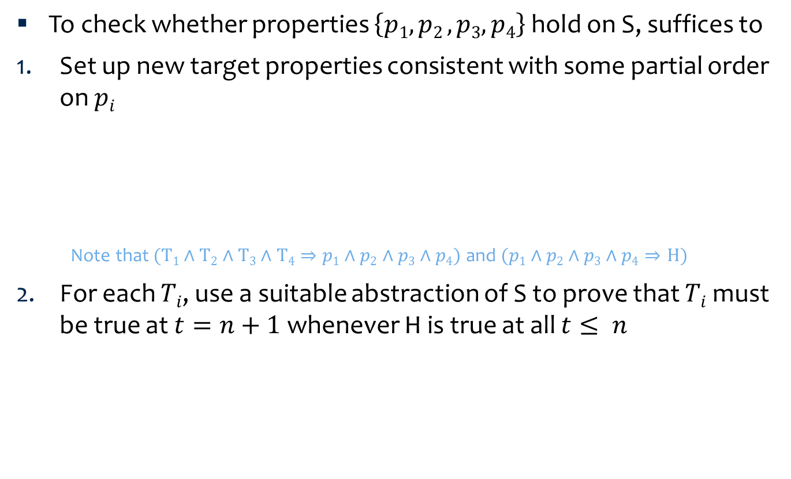








Simplified McMillan’s Compositional Reasoning Rule
To check whether properties $\left\{p1, p2 , p3,p4\right\}$ hold on S, suffices to
Set up new target properties consistent with some partial order on $pi$
  Note that $(T1∧T2∧T3∧T4⇒p1∧p2∧p3∧p4)$ and $(p1∧p2∧p3∧p4⇒H)$
For each $Ti$, use a suitable abstraction of S to prove that $Ti$ must be true at $t=n+1$whenever H is true at all $t≤ n$
$$T1: p2⇒p1$$
$$p2$$
$$p4$$
$$p3$$
$$T2: p2$$
$$T3:\left(p1∧p4\right)⇒p3$$
$$p1$$
$$T4: p2⇒p4$$
$$H:p1∧p2∧p3∧p4$$
$H$ $⊳Ti$
$$…$$
$$…$$
$$∞$$
0
1
2
n
n+1
© 2015 OSKI TECHNOLOGY, INC. ALL RIGHTS RESERVED.

Slide 15






McMillan’s Rule: It is Sound and It Works!
This is a sound rule!
Can be used with both liveness and safety properties
For the AXI example, we have
  2 properties: the master property $M$ and slave property $S$
  2 possible orderings of {$M$,$S$} to consider
  2 abstractions to consider : either AXI master or AXI slave is blackboxed
For each possible application of McMillan’s rule, at least one of the checks $H$ $⊳Ti$fails for the AXI example
$$m1$$
$$s1$$
$$T1:m1$$
$$T2:m1⇒s1$$
$$H:m1∧s1$$
$H$ $⊳T1$ fails with slave blackboxed, proven with master blackboxed
$H$ $⊳T2$ fails with either master or slave blackboxed
© 2015 OSKI TECHNOLOGY, INC. ALL RIGHTS RESERVED.
Notes:
Mention which property does not hold for the AXI system

Slide 16
McMillan’s Rule: Some Concerns
Takes effort to explicitly order the properties
  for a large number of properties
  maintaining that order throughout RTL development
… and to detect/handle cases for which no ordering works
  The rule is incomplete with liveness properties [see Trefler2000 for an example]
It’s a complicated rule – how can the end-user confirm that the rule has been applied soundly?
  User might not be intimately familiar with the language semantics (e.g. SVA)
  Tools must obey the semantics of the language
  User might not be aware of all the assumptions under which the rule is valid
    e.g. Does the rule apply when reasoning about finite traces? Under what semantics?
© 2015 OSKI TECHNOLOGY, INC. ALL RIGHTS RESERVED.
Notes:
There are cheaper alternative rules that can be used profitably ...

Slide 17
An “Unsound” Approach (a Common Practice)
{
A
}
B
Naming convention to manage assumes/asserts
Unsound for liveness
Unsound for safety in some cases
A_foo: assert p1;
B_foo: assert p2;
infer proof results for asserts after
factoring in bounded proof depths
{
,
B
}
A
A_foo: assert p1;
B_foo: assume p2;
A_foo: assume p1;
B_foo: assert p2;
© 2015 OSKI TECHNOLOGY, INC. ALL RIGHTS RESERVED.

Slide 18
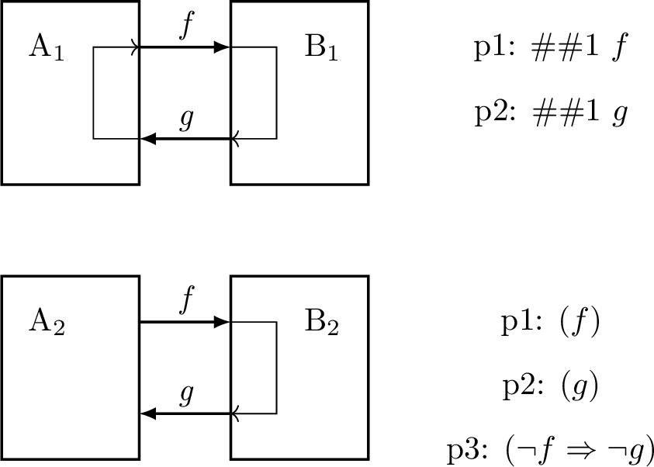
An “Unsound” Approach: It Works!
No need to explicitly order the properties
Minimal methodology impact with use of naming convention
Focus on safety properties
Users need to watch out for the pitfalls (!)
Circularity is at its heart
  Combinational loop in A₁ and B₁ is reported by most tools
  p₁ gets proven on A₂ after assuming p₂ and p₃ (with suitable reset state)
  p₂ and p₃ get proven on B₂ after assuming p₁
  Most tools do not complain about this latter case
© 2015 OSKI TECHNOLOGY, INC. ALL RIGHTS RESERVED.

Slide 19
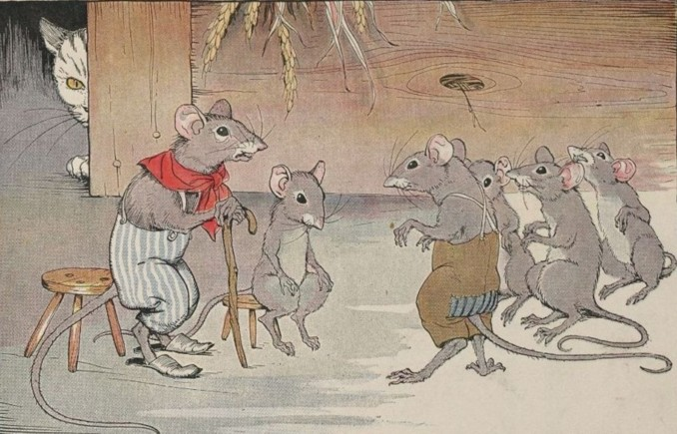
Who Will Check for Soundness?
I prowl in the dark and make no sound!
http://www.gutenberg.org/files/19994/19994-h/19994-h.htm#Page_15
"But let me ask one question: Who will bell the Cat?"
© 2015 OSKI TECHNOLOGY, INC. ALL RIGHTS RESERVED.
Notes:
Just something funny … this is the last talk of the session, after all.

Slide 20
Dead-ends: Infinite Traces in a DUT
∞
∞
∞
∞
. . .
. . .
2
2
. . .
. . .
2
2
1
∞
. . .
1
2
. . .
∞
2
1
1
R
R
R
1
1
2
2
1
1
. . .
. . .
2
2
∞
. . .
∞
. . .
2
2
Every trace
is infinite!
∞
. . .
. . .
∞
∞
∞
© 2015 OSKI TECHNOLOGY, INC. ALL RIGHTS RESERVED.
Notes:
[[Measuring coverage in formal: Checkers, Constraints, Complexity and Abstractions ]]

Slide 21
Dead-ends: Constraints Eliminate Partial Traces
∞
∞
Traces dropped
∞
∞
. . .
. . .
2
2
. . .
. . .
2
2
1
∞
. . .
1
2
. . .
∞
2
1
1
R
R
R
1
1
2
2
1
1
. . .
Traces dropped
. . .
2
2
∞
. . .
∞
. . .
2
2
∞
. . .
. . .
∞
∞
∞
© 2015 OSKI TECHNOLOGY, INC. ALL RIGHTS RESERVED.
Notes:
[[Measuring coverage in formal: Checkers, Constraints, Complexity and Abstractions ]]

Slide 22
… Sometimes Causing Dead-Ends
∞
∞
∞
∞
. . .
. . .
2
2
. . .
. . .
2
2
1
∞
. . .
1
2
. . .
∞
2
1
1
R
R
R
1
1
Level 2 dead-end
2
2
1
1
. . .
. . .
2
2
∞
. . .
∞
. . .
2
2
∞
. . .
. . .
∞
Level 1 dead-end
∞
∞
© 2015 OSKI TECHNOLOGY, INC. ALL RIGHTS RESERVED.
Notes:
[[Measuring coverage in formal: Checkers, Constraints, Complexity and Abstractions ]]

Slide 23
Dead-end in a Sequence Detector
Constraints
C1: b should not be high in back to back cycles
C2: b should be high at most 2 times in a window of 6 cycles
C3: b should be high at least 3 times in a window of 12 cycles
 | 1 | 2 | 3 | 4 | 5 | 6 | 7 | 8 | 9 | 10 | 11 | 12
 | 0 | 0 | 0 | 0 | 0 | 0 | 0 | 0 | 0 | 0 | 1
 | ✓ | ✓ | ✓ | ✓ | ✓ | ✓ | ✓ | ✓ | ✓ | ✓ | ✓
 | ✓ | ✓ | ✓ | ✓ | ✓ | ✓ | ✓ | ✓ | ✓ | ✓ | ✓
cycle
b
C1
C3
Dead-end starts from here
Can be avoided with constraint:
C4: b should be high at least once in a window of 6 cycles
For satisfying C1, b should be 0
For satisfying C3, b should be 1
Conflicting constraints cause dead-end!
© 2015 OSKI TECHNOLOGY, INC. ALL RIGHTS RESERVED.

Slide 24
Intentional Dead-ends
Constraint: never assert or de-assert a for 3 consecutive cycles
a
a
B
D
a
!a
ERR
A
no_ERR_c: assume property (
@(posedge clk) disable iff (!rstn)
(sm != ERR)
);
a
!a
a
!a
!a
C
E
!a
Some tools trim dead-ends, others do not!
We prefer constraints that avoid dead-ends, e.g.:
no_D_c: assume property (
@(posedge aclk) disable iff (!aresetn)
(sm == D) |-> (!a)
);
no_E_c: assume property (
@(posedge aclk) disable iff (!aresetn)
(sm == E) |-> a
);
© 2015 OSKI TECHNOLOGY, INC. ALL RIGHTS RESERVED.

Slide 25
Dead-end Trimming Results in a Missed Bug
logic [3:0] ctr;
always @(posedge clk or negedge rstn) begin
if (!rstn) ctr <= 0;
else ctr <= ctr + push - pop;
end
A_no_overflow: assert property(
@(posedge clk) disable iff(!rstn)
ctr <= 4’h8
);
B_no_underflow: assert property(
@(posedge clk) disable iff(!rstn)
pop <= ctr
);
A
push
B
data
7
6
5
pop
4
3
2
1
0
ctr
TB
Bug: B sends pop when ctr is 0, but this bug occurs only when push is 0
For the failing scenarios of B_no_undeflow:
  ctr wraps around to 15 and will cause violation of assumption A_no_overflow
If formal tool trims this dead-end, bug escapes!
  Compositional semantics with dead-end trimming are suspect!
Caught if constraints written to avoid dead-ends:
A_no_overflow: assert property(
@(posedge clk) disable iff(!rstn)
(ctr == 8) |-> !push
);
© 2015 OSKI TECHNOLOGY, INC. ALL RIGHTS RESERVED.

Slide 26
Verifying our AXI System with Safety Properties
Master Property m1s:
  Once the master receives BVALID, eventually it must assert BREADY (within B_TIMEOUT cycles)
Slave property s1s:
  Once the slave sends an accepted RVALID with no RLAST, eventually the slave must send RVALID with RLAST asserted (within R_TIMEOUT cycles)
RVALID
property master_safety_bready;
@(posedge aclk) disable iff (!aresetn)
(bvalid && (!bready)) |->
##[1:‘B_TIMEOUT] bready;
endproperty
property slave_safety_rlast;
@(posedge aclk) disable iff (!aresetn)
(rvalid && (!rlast) && rready) |->
##[1:‘R_TIMEOUT] (rvalid && rlast);
endproperty
RLAST
RREADY
BVALID
M
BREADY
S
© 2015 OSKI TECHNOLOGY, INC. ALL RIGHTS RESERVED.

Slide 27
But Will We Catch It with Formal Verification?
Master Property m1s: Once the master receives BVALID, eventually it must assert BREADY
Slave property s1: Once the slave sends an accepted RVALID with no RLAST, eventually the slave must send RVALID with RLAST
DUT
DUT
% assume s1s
% prove m1s
% assume m1
% prove s1
M
S
Both pass!!!
User concludes m1 and s1 are each true on the system M ⊗ S!
© 2015 OSKI TECHNOLOGY, INC. ALL RIGHTS RESERVED.

Slide 28
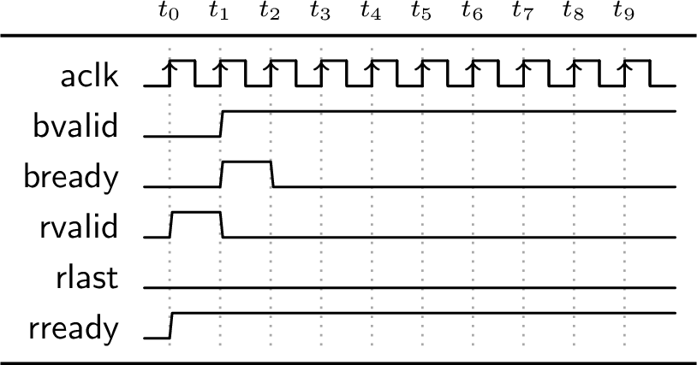
Verifying Slave DUT
DUT
For B_TIMEOUT = 8
  Fails if R_TIMEOUT <= 11
% assume m1s
% prove s1s
S
R_TIMEOUT = 8
© 2015 OSKI TECHNOLOGY, INC. ALL RIGHTS RESERVED.

Slide 29
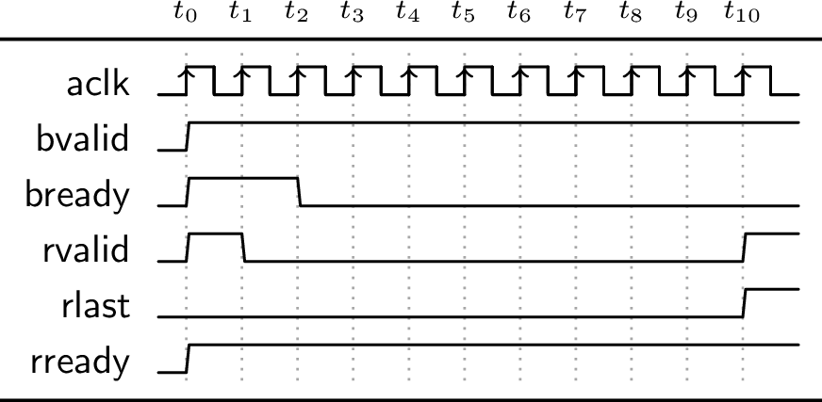
Verifying Master DUT
DUT
For B_TIMEOUT = 8
  Fails if R_TIMEOUT >= 10
% assume s1s
% prove m1s
M
R_TIMEOUT = 12
© 2015 OSKI TECHNOLOGY, INC. ALL RIGHTS RESERVED.

Slide 30
Different Combinations of Safety Time-outs
For each combination of B_TIMEOUT and R_TIMEOUT, either master or slave testbench fails
B_TIMEOUT | R_TIMEOUT | Master Testbench | Slave Testbench
8 | <= 9 | Pass | Fail
8 | 10 or 11 | Fail | Fail
8 | >= 12 | Fail | Pass
Deadlock bug is exposed
Safety is safer for the naïve user!
McMillan’s approach also works, but tedious – see paper
Simplified AXI example (both safety and liveness versions) available at:
http://www.oskitechnology.com/wp-content/uploads/2015/09/fmcad15.tar.gz
© 2015 OSKI TECHNOLOGY, INC. ALL RIGHTS RESERVED.

Slide 31
Who Will Check for Soundness?
Can tool developers create a safer methodology?
  End-users focus on writing quality properties and the tools handle the rest?
  Warn users about vacuous proofs
  Warn users about non-standard semantics caused by tool settings
Meanwhile, end-users use safer coding practices
  Coding guidelines related to coding constraints to avoid dead-ends
  Examine formal testbench for unexpected dead-end traces
  Use an appropriate rule for compositional reasoning with liveness properties
    Encourage less sophisticated users to use safety properties instead
© 2015 OSKI TECHNOLOGY, INC. ALL RIGHTS RESERVED.
Notes:
Concluding slide

Slide 32
Thank you!

Slide 33
Verifying Slave DUT
Checker: master_safety_bready
Constraint: slave_safety_rlast
With B_TIMEOUT = 8 and R_TIMEOUT = 8, no failure
For B_TIMEOUT = 8 and R_TIMEOUT = 12, failed with following waveform
S
Master
Slave Constraints
Master
Checkers

Slide 34
Decomposition: Slave Verification
Checker: slave_safety_rlast
Constraint: master_safety_bready
Failed with following waveform
S
Slave
Master
Constraints
Slave
Checkers
Root case: master is not accepting second BVALID
Increase the R_TIMEOUT value relative to B_TIMEOUT
  For B_TIMEOUT = 8 and R_TIMEOUT = 12, failure is gone

Slide 35
Running on Composed System
With B_TIMEOUT = 8 and R_TIMEOUT = 8, system with Master as well as Slave gave show deadlock

Slide 36
Links and References
Download the toy AXI example with both safety and liveness versions of the checks from
http://www.oskitechnology.com/wp-content/uploads/2015/09/fmcad15.tar.gz
[McMillan99]
  K. L. McMillan, “Circular compositional reasoning about liveness”, CHARME 99
[Trefler2000]
  K. S. Namjoshi & R. J. Trefler, “On the completeness of compositional reasoning”, CAV 2000

