Slide 1


Classifying Race Conditions in Web Applications
Lu Zhang
Chao Wang
1
Notes:
Hi everyone, thanks for the introduction, today I am going to talk about my recent work, which is Classifying Race Conditions in Web Applications.

Slide 2
Outline
Overview
Our method
Experiments
Notes:
First, I will give an overview.

Slide 3


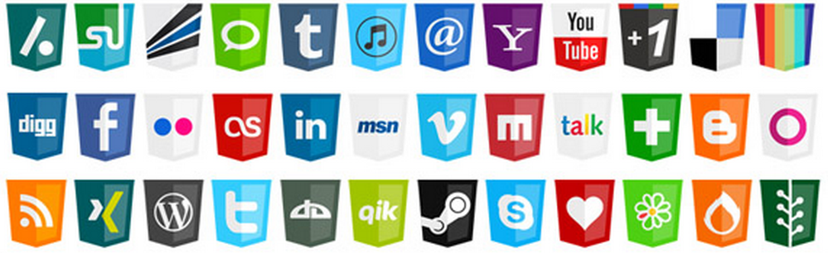
Overview
Notes:
Web applications have been extremely popular in the recent years, they are widely used in our daily life. However, web applications are not perfect, various kinds of problems can come from JavaScript, html and so on.

Slide 4
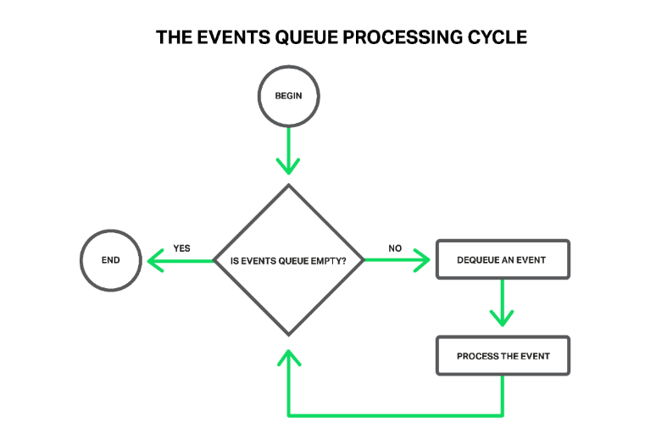
Web Applications
Event-driven model
Event sources:
  Parsing
  User mouse/keyboard actions
  Asynchronous resource loading
  Ajax callbacks
  Timer callbacks
  …
Not free of race conditions, due to the extensive use of asynchronous events -> to be fast!
Notes:
Web applications are built based on the event-driven model.
The events can be parsing, user actions, asynchronous resource loading, ajax call backs, timer and so on.
Although all these event will be executed by the looping thread in a single threaded manner, web application are not free of race conditions due to the extensive use of asynchrony, in order to let the users see the web page faster.

Slide 5
HTML
onload
Async JS
Ajax
Timer
onclick
f1()
<image src=… onload = “f1()”>
a.js
<script src=“a.js” async = “true”>
<script>
Ajax(url , f2)
</script>
f2()
<script>
setTimeOut(f3, 1000);
</script>
f3()
f4()
<button onclick= “f4()”>
Notes:
Suppose in the web application there defines many different types of events in the html, and there will be implicit timelines for those events once they are initiated. And the exact time that those events happen can be anywhere in the time line. Which means the total order of all the events are non-deterministic.

Slide 6


Buggy interleaving
HTML
onclick
f1()
<image src=… onload = “f1()”>
a.js:
function f4(){…}
<script src=“a.js” async = “true”>
<script>
Ajax(url , f2)
</script>
f2()
<script>
setTimeOut(f3, 1000);
</script>
f3()
f4()
<button onclick= “f4()”>
wire you 5 million dollars
Notes:
you may think why do we even care about race conditions in web applications? Suppose in this example, a.js defines function f4, which is called when the button is clicked. Clicking the button before a.js is loaded will just do nothing, and the users probably won’t even notice such exceptions anyway because the browser will just silently tolerate it. But from the user’s point of view, what if the event is important, let’s say wire you 5 million dollars? You definitely don’t want to lose your money just because the web application is behaving differently by itself.

Slide 7
Motivation
Race conditions are hard to detect and diagnose
  Race condition:
    Two events access the same shared variable
    Can be re-ordered
    At least one is a write operation
Existing tools report too many warnings, most of them are false positives
  Counter productive
  Filtered through heuristics
  Lack of proof
Our new method: to help!
  Automatically classify the race conditions as harmful or harmless
Notes:
So our motivation is that , the race condition, by definition, involves two events that can be re-ordered, and at least one is a write.

Slide 8
Outline
Overview
Our method
Experiments

Slide 9
Contributions
RClassify Library
  Deterministically replay the web application with race conditions
  Automatically classify the race conditions to be harmful or harmless
Implementation
  As a JavaScript library embedded into the web applications
  Browser/platform independent
Experiments
  Benchmarks from race detection tools
  70 web sites from the Fortune 500 companies

Slide 10

Why do we do?
HTML
onclick
f1()
<image src=… onload = “f1()”>
a.js:
function f4(){
//wire you 5 million dollars
}
Execution 1
<script src=“a.js” Async = “true”>
Compare
Execution 2
<script>
Ajax(url , f2)
</script>
f2()
<script>
setTimeOut(f3, 1000);
</script>
f3()
f4()
<button onclick= “f4()”>
Notes:
We know these two events are run in different ways, we will just let them run in both ways and see if they will lead to different results.

Slide 11
Challenges
How to monitor difference kinds of events
How to monitor them in time
How to delay them without blocking others
How to record the program states
What’s the rules to classify the race conditions?
How to filter the irrelevant fields?
…
Notes:
Although the approach seems to be straightforward, we still encountered many technical challenges we have encountered, such as
We had to handle all the challenges in order to achieve our goal.

Slide 12
Outline
Overview
Our method
Experiments

Slide 13
Implementation
RClassify.js library
  jQuery-like library, providing racing events monitoring and controlling, program state serialization and race classification mechanisms.
Jsoup
  HTML scanning and source-to-source rewriting
WebKit+EventRacer
  Provide races as our input
  Racing events processing and transforming

Slide 14
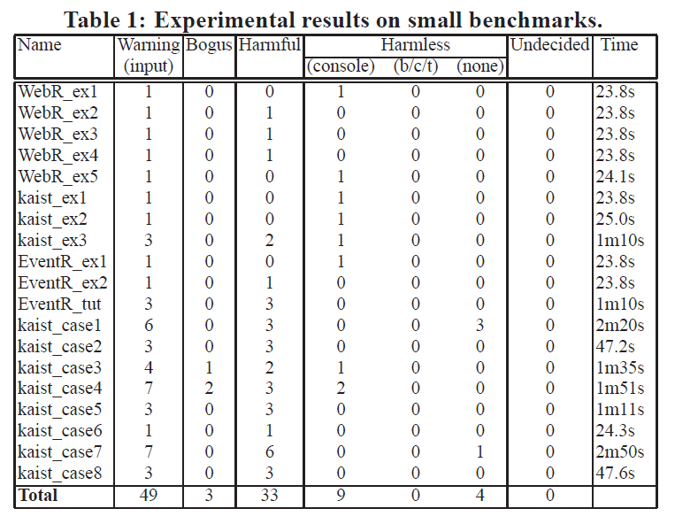
Experiments
Notes:
We tested on the benchmarks from existing race detection tools for web applications and correctly classified all the race conditions.

Slide 15
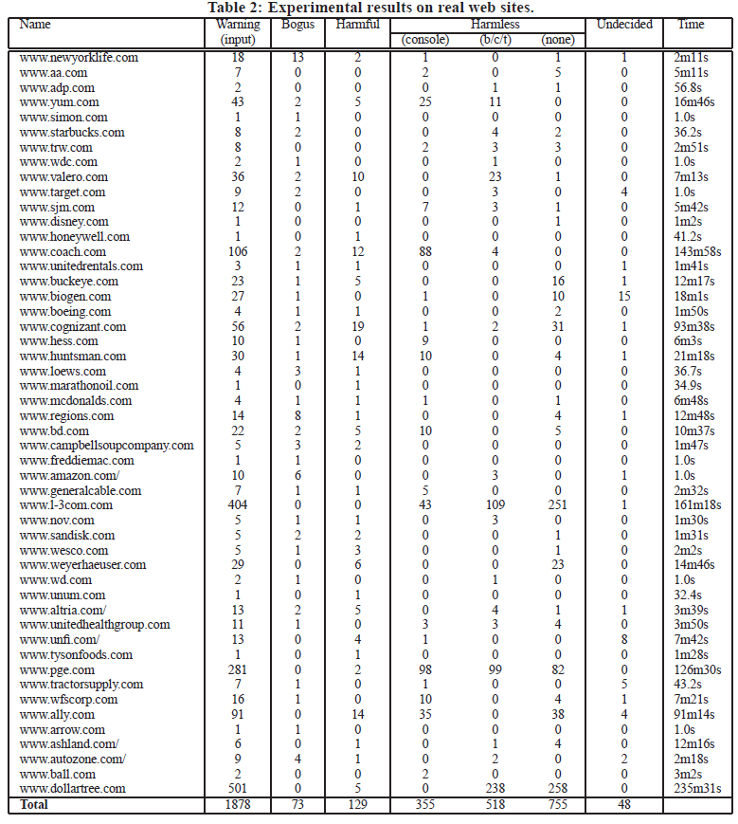
Experiments
70 websites,
50 with races
1878 races
129 harmful races(7%)
1.5-2x slowdown depending on websites

Slide 16
Takeaways
Web applications suffer from concurrency errors
Existing methods often report too many race warnings, which is counter-productive
We propose an automatic method to classify harmful and harmless races using deterministically re-execution
Tested on benchmarks and real-world websites
Effective and efficient

Slide 17

Thank You!
Notes:
Thank you all, if you are interested in more details or want to have a discussion, please find me in the poster session and I would be happy to talk with you.

Slide 18
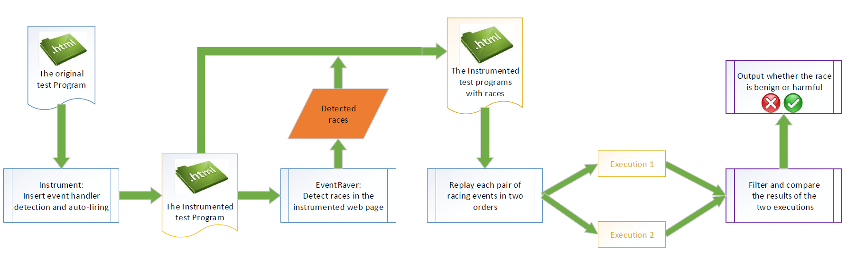
Overall Flow
Phase 1: race detection
Phase 2: race replay and classification

