Slide 1
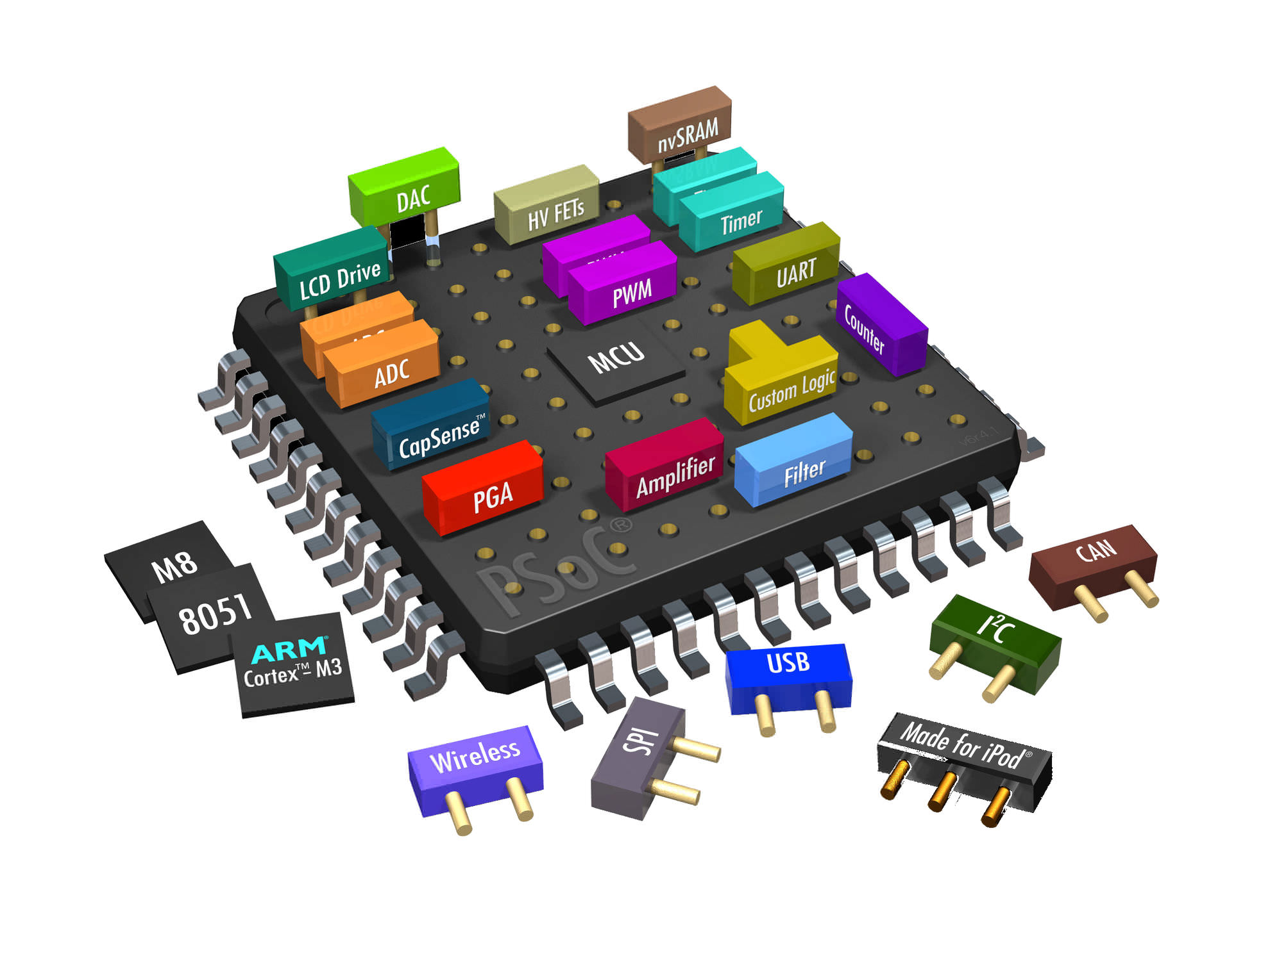


Specification and Scalable Verification of Security Properties in Contemporary SoCs
Pramod Subramanyan
This work was supported in part by CFAR, one of the six SRC STARTnet centers, sponsored by MARCO and DARPA

Slide 2
Bird’s Eye View of an SoC
CPU
GPU
Camera
Touch
Flash
Microcontroller
On-chip Interconnect
Memory
DMA
MMU+
DRAM
WiFi/3G
SCIP
…
HW accelerators
…
SoC functionality is implemented by a combination of hardware and firmware
NoC interface

Slide 3
SoC Verification is Challenging
CPU
GPU
Camera
Touch
Flash
On-chip Interconnect
DMA
MMU+
DRAM
WiFi/3G
SCIP
…
Complete verification is not scalable
FW
Separate verification misses bugs!

Slide 4
Constructing an ILA
Insight: Treat MMIO reads/writes as part of an extended ISA aka ILA
; start AES state machine
MOV ACC, #01
MOV DPTR, #0xFF00
MOVX @DPTR, ACC
; poll for completion
wait_finish:
MOV DPTR, #0xFF01
MOVX ACC, @DPTR
CMPI ACC, #00
JNZ wait_finish
IDLE
READ
WRITE
ENC
Instruction-Level Model of HW accelerators
Instruction-Level Model of µc ISA
Instruction-Level Abstraction (ILA) of SoC

Slide 5

Synthesizing an ILA
[FMCAD’15]
It’s too hard to manually construct an ILA so synthesize it instead!
FW verification
Template abstraction
Synthesis Algorithm
Instruction-Level Abstraction
Golden Model
Simulator
RTL
Model Checker
Refinement Relations
Bugs/counter examples

Slide 6
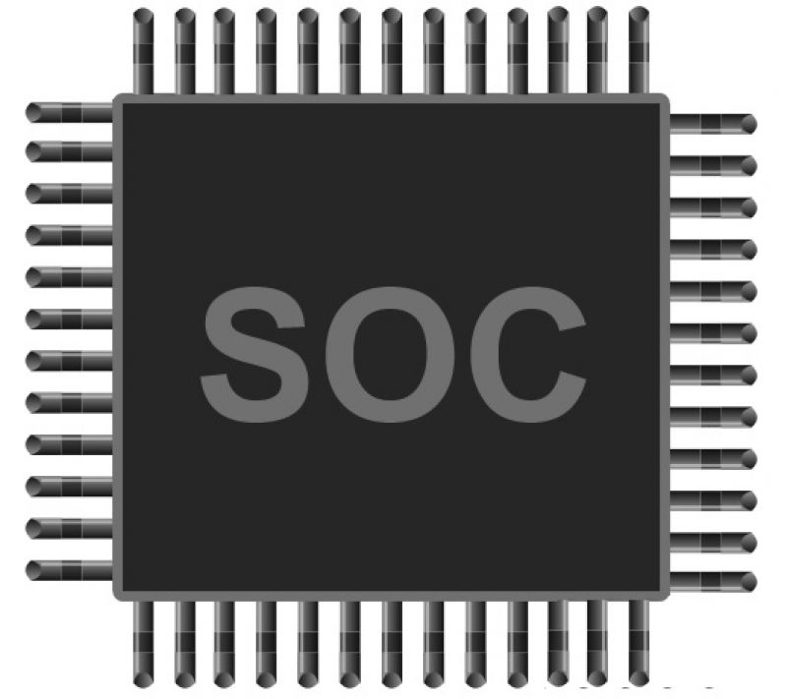
Security Verification is Harder!
Confidentiality: HW/FW secrets must not leak to untrusted entities
SoC
secret
Integrity: Untrusted entities must not influence sensitive registers
reg
Specifying these in LTL is hard!
Not predicates of state, instead these properties refer to information flow!

Slide 7
Specifying Information Flow Properties
Information flow property specifies that src cannot influence dst
src
dst
Properties
Specified on an augmented ILA
High-level system state such as user/su mode, current thread and VM ids, and son
Convert events such as user/su state-transitions into state variables
HW
model
HW
model
FW
model
aux
state
FW
model
Original System Model
Augmented System Model

Slide 8
Proving Information Flow Properties
In the security community: static and dynamic taint analysis
T
Can different values at the source result in different values at the destination?
src1
dst1
inp
T’
src2
dst2
Can we do better with a taint+CEGAR hybrid?

Slide 9
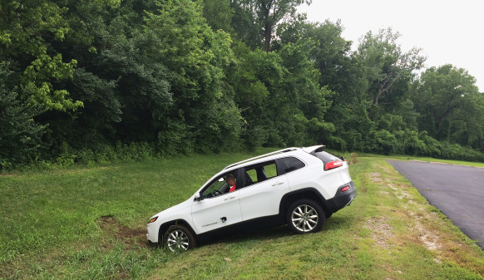
HW/FW Security Concerns are an Important and Exciting Research Area
http://www.wired.com/2015/07/hackers-remotely-kill-jeep-highway/
Come to the poster to talk more!

