Slide 1
Probabilistic Model Checking of Systems with a Large State Space: A Stratified Approach
Shou-pon Lin
Advisor: Nicholas F. Maxemchuk
Department of Electrical Engineering, Columbia University, New York, NY 10027

Slide 2
Model checking probabilistic system
Problem:
Markov decision process or Markov chain with exceedingly large state space
Check if the Markov decision process or Markov chain satisfies a given probabilistic safety property
Solution:
Not completely traverse all states, but prioritize state traversal on those states that are more likely to be reached during system execution; stop when using up all the memory
Compute probability bound by considering the uncertainty contributed by unexplored states
Notes:
The problem we’re looking at is …
We do not attempt to explore all states, but only focus on those states that are more likely to be reached during system execution
We explore those states first before using up the memory.
When using up all the memory, the unexplored states contribute uncertainty to the probability bound

Slide 3
Probabilistic safety properties
A probabilistic safety property combines a regular safety property and a probability bound between 0 and 1
For all adversary , the probability for to satisfy should be greater than or equal to
Notes:
We prove probabilistic safety property, which combines a regular safety property and a probability bound

Slide 4
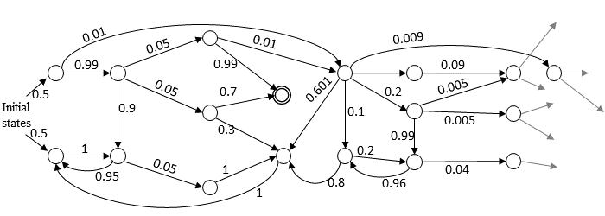
Reachability analysis
Normally it can be done by taking the product , find the set of acceptance states , and solve a linear program to find
Notes:
To find the minimum probability for M to satisfy A, that is, 1 minus the maximum probability for ending up in acceptance state of the DFA Aerr
But sometimes the state space is too large…

Slide 5
Discretized levels of probabilistic choices
Given a layering parameter , probabilistic choices are categorized into several discretization levels
If → level-0 (high probability choices)
If → level-1 low probability choices
If → level-2 low probability choices
etc.
Notes:
To deal with this, we assign discretized levels to transitions with probability distributions

Slide 6
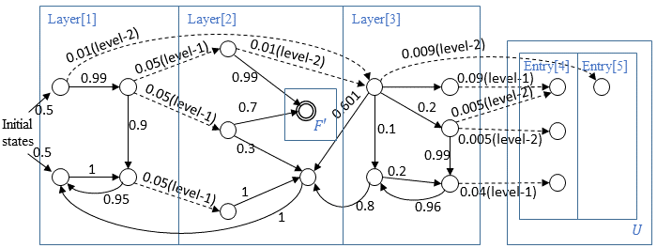
Stratified traversal
Assign discretized levels to probabilistic transitions
Notes:
The discretized levels of transitions create layers in the Markov decision process. We can think of that in general, the deeper a layer is, the states it contains are less likely to be reached during system execution

Slide 7
Stratified traversal
Prioritize traversal of more probable states

Slide 8
Stratified traversal
Prioritize traversal of more probable states

Slide 9
Stratified traversal
Prioritize traversal of more probable states

Slide 10
Stratified traversal
The unexplored states are the less likely ones to be reached during system execution
Notes:
Suppose we have to stop after explored three layers, we now determine the probability for regular safety property A to hold. The set U are the frontier of unexplored states

Slide 11
Stratified traversal
The unexplored states are the less likely ones to be reached during system execution
Notes:
Suppose we have to stop after explored three layers, we now determine the probability for regular safety property A to hold. The set U are the frontier of unexplored states, which lead to yet more unexplored states. The states circles here will contribute to the uncertainty later

Slide 12
Determine if the property holds
Let
Suppose the procedure stops when finishing layer k
If , holds
If , is violated
Otherwise, whether holds or not is uncertain
Notes:
How do we determine if a property holds? We assume conservatively that all unexplored states are acceptance states that represent violation of property A
How do we determine if a property is violated? As long as
The unexplored states leave some uncertainty, but as long as we explore the state space in layers, we attempt to reduce that uncertainty

Slide 13
Determine if the property holds
Let
Suppose the procedure stops when finishing layer k
If , holds
If , is violated
Otherwise, whether holds or not is uncertain
Notes:
How do we determine if a property holds

Slide 14
Preliminary results
We applied stratified verification to the lock protocol that resolves conflicting reqs in our automobile application.
Stratified method is able to compute the upper-bound of error probability while PRISM terminates when running out of memory
Notes:
It is applied to a 7-vehicle scenario in which there are 5 conflicting merge requests Stratified verification is compared with the explicit engine of PRISM under limited memory constraints. It should be pointed out that we are comparing to the explicit engine of PRISM model checker, because the method presented here is based on explicit traversal.

Slide 15
Future works
Feasibility of integrating this method into currently available model checkers and state-of-art techniques
Notes:
For instance, symbolic approach

Slide 16
Future works
Feasibility of integrating this method into currently available model checkers and state-of-art techniques
Thank you for your attention!
Contact: shouponlin@ee.columbia.edu
Notes:
For instance, symbolic approach

Slide 17
Thank you for your attention!
Contact: shouponlin@ee.columbia.edu
Notes:
Finally, I would like to thank Prof. Nick Maxemchuk and our funding agency NSF.

