Slide 1
Learning Natural Language from its Perceptual Context
Ray Mooney
Department of Computer Science
University of Texas at Austin
Joint work with
David Chen
Joohyun Kim

Slide 2
Machine Learning and
Natural Language Processing (NLP)
Manual software development of robust NLP systems was found to be very difficult and time-consuming.
Most current state-of-the-art NLP systems are constructed by using machine learning methods trained on large supervised corpora.

Slide 3
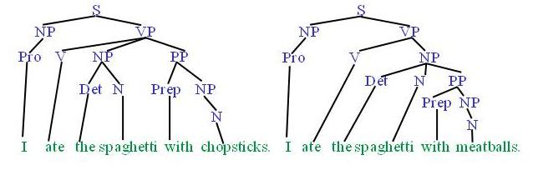
Syntactic Parsing of Natural Language
Produce the correct syntactic parse tree for a sentence.
Train and test on Penn Treebank with tens of thousands of manually parsed sentences.

Slide 4
Word Sense Disambiguation (WSD)
Determine the proper dictionary sense of a word from its sentential context.
  Ellen has a strong interest_{sense1} in computational linguistics.
  Ellen pays a large amount of interest_{sense4} on her credit card.
Train and test on Senseval corpora containing hundreds of disambiguated instances of each target word.

Slide 5
Semantic Parsing
A semantic parser maps a natural-language (NL) sentence to a complete, detailed formal semantic representation: logical form or meaning representation (MR).
For many applications, the desired output is computer language that is immediately executable by another program.

Slide 6
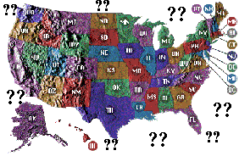
Database Query Application
Query application for U.S. geography database [Zelle & Mooney, 1996]
How many states does the Mississippi run through?
User
Semantic Parsing
Query
answer(A, count(B,
(state(B),
C=riverid(mississippi),
traverse(C,B)),
A))
DataBase
10

Slide 7

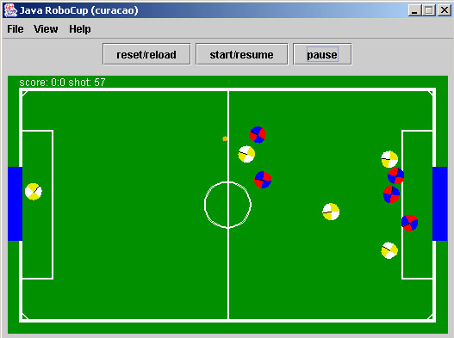
CLang: RoboCup Coach Language
In RoboCup Coach competition teams compete to coach simulated soccer players.
The coaching instructions are given in a formal language called Clang.
If the ball is in our penalty area, then all our players except player 4 should stay in our half.
Simulated soccer field
Semantic Parsing
((bpos (penalty-area our))
(do (player-except our{4}) (pos (half our)))
CLang

Slide 8
Learning Semantic Parsers
Semantic parsers can be learned automatically from sentences paired with their logical form.
NL→MR
Training Exs
Semantic-Parser
Learner
Natural
Language
Meaning
Rep
Semantic
Parser

Slide 9
Limitations of Supervised Learning
Constructing supervised training data can be difficult, expensive, and time consuming.
For many problems, machine learning has simply replaced the burden of knowledge and software engineering with the burden of supervised data collection.

Slide 10
Learning Language from
Perceptual Context
Children do not learn language from annotated corpora.
Neither do they learn language from just reading the newspaper, surfing the web, or listening to the radio.
  Unsupervised language learning is difficult and not an adequate solution since much of the requisite information is not in the linguistic signal.
The natural way to learn language is to perceive language in the context of its use in the physical and social world.
This requires inferring the meaning of utterances from their perceptual context.
10
Notes:
10

Slide 11
Language Grounding
The meanings of many words are grounded in our perception of the physical world: red, ball, cup, run, hit, fall, etc.
  Symbol Grounding: Harnad (1990)
Even many abstract words and meanings are metaphorical abstractions of terms grounded in the physical world: up, down, over, in, etc.
  Lakoff and Johnson’s Metaphors We Live By
    Its difficult to put my ideas into words.
Most NLP work represents meaning without any connection to perception; circularly defining the meanings of words in terms of other words or meaningless symbols with no firm foundation.
11
Notes:
11

Slide 12
Sample Circular Definitions from WordNet
sleep (v)
  “be asleep”
asleep (adj)
  “in a state of sleep”

Slide 13
Initial Challenge Problem:
Learn to Be a Sportscaster
Goal: Learn from realistic data of natural language used in a representative context while avoiding difficult issues in computer perception (i.e. speech and vision).
Solution: Learn from textually annotated traces of activity in a simulated environment.
Example: Traces of games in the Robocup simulator paired with textual sportscaster commentary.

Slide 14

Grounded Language Learning in Robocup
Robocup Simulator
Simulated
Perception
Perceived Facts
Sportscaster
Score!!!!
Grounded
Language Learner
Language
Generator
SCFG
Score!!!!
Semantic
Parser

Slide 15
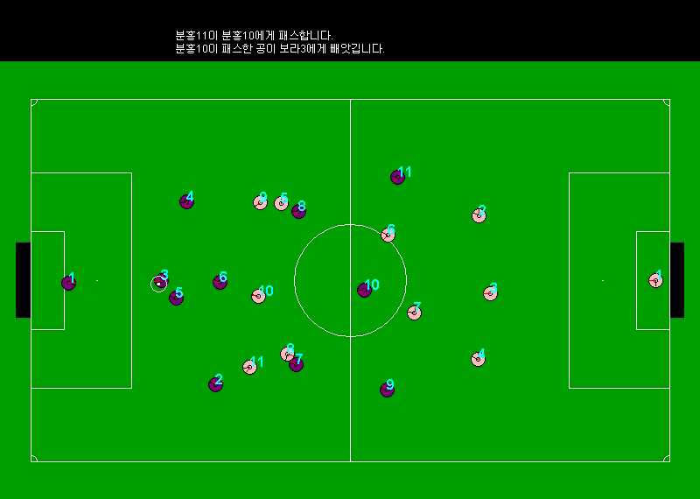
Sample Human Sportscast in Korean

Slide 16
Robocup Sportscaster Trace
Natural Language Commentary
Meaning Representation
badPass ( Purple1, Pink8 )
turnover ( Purple1, Pink8 )
Purple goalie turns the ball over to Pink8
kick ( Pink8)
pass ( Pink8, Pink11 )
Purple team is very sloppy today
kick ( Pink11 )
Pink8 passes the ball to Pink11
Pink11 looks around for a teammate
kick ( Pink11 )
ballstopped
kick ( Pink11 )
Pink11 makes a long pass to Pink8
pass ( Pink11, Pink8 )
kick ( Pink8 )
pass ( Pink8, Pink11 )
Pink8 passes back to Pink11
Notes:
16

Slide 17
Robocup Sportscaster Trace
Natural Language Commentary
Meaning Representation
badPass ( Purple1, Pink8 )
turnover ( Purple1, Pink8 )
Purple goalie turns the ball over to Pink8
kick ( Pink8)
pass ( Pink8, Pink11 )
Purple team is very sloppy today
kick ( Pink11 )
Pink8 passes the ball to Pink11
Pink11 looks around for a teammate
kick ( Pink11 )
ballstopped
kick ( Pink11 )
Pink11 makes a long pass to Pink8
pass ( Pink11, Pink8 )
kick ( Pink8 )
pass ( Pink8, Pink11 )
Pink8 passes back to Pink11
Notes:
17

Slide 18
Robocup Sportscaster Trace
Natural Language Commentary
Meaning Representation
badPass ( Purple1, Pink8 )
turnover ( Purple1, Pink8 )
Purple goalie turns the ball over to Pink8
kick ( Pink8)
pass ( Pink8, Pink11 )
Purple team is very sloppy today
kick ( Pink11 )
Pink8 passes the ball to Pink11
Pink11 looks around for a teammate
kick ( Pink11 )
ballstopped
kick ( Pink11 )
Pink11 makes a long pass to Pink8
pass ( Pink11, Pink8 )
kick ( Pink8 )
pass ( Pink8, Pink11 )
Pink8 passes back to Pink11
Notes:
18

Slide 19
Robocup Sportscaster Trace
Natural Language Commentary
Meaning Representation
P6 ( C1, C19 )
P5 ( C1, C19 )
Purple goalie turns the ball over to Pink8
P1( C19 )
P2 ( C19, C22 )
Purple team is very sloppy today
P1 ( C22 )
Pink8 passes the ball to Pink11
Pink11 looks around for a teammate
P1 ( C22 )
P0
P1 ( C22 )
Pink11 makes a long pass to Pink8
P2 ( C22, C19 )
P1 ( C19 )
P2 ( C19, C22 )
Pink8 passes back to Pink11
Notes:
19

Slide 20
Strategic Generation
(Content Selection)
Generation requires not only knowing how to say something (tactical generation) but also what to say (strategic generation).
For automated sportscasting, one must be able to effectively choose which events to describe.

Slide 21
Example of Strategic Generation
pass ( purple7 , purple6 )
ballstopped
kick ( purple6 )
pass ( purple6 , purple2 )
ballstopped
kick ( purple2 )
pass ( purple2 , purple3 )
kick ( purple3 )
badPass ( purple3 , pink9 )
turnover ( purple3 , pink9 )

Slide 22
Example of Strategic Generation
pass ( purple7 , purple6 )
ballstopped
kick ( purple6)
pass ( purple6 , purple2 )
ballstopped
kick ( purple2)
pass ( purple2 , purple3 )
kick ( purple3 )
badPass ( purple3 , pink9 )
turnover ( purple3 , pink9 )

Slide 23
Robocup Data
Collected human textual commentary for the 4 Robocup championship games from 2001-2004.
  Avg # events/game = 2,613
  Avg # English sentences/game = 509
  Avg # Korean sentences/game = 499
Each sentence matched to all events within previous 5 seconds.
  Avg # MRs/sentence = 2.5 (min 1, max 12)
Notes:
Mention Korean data collected by JooHyun, but results not shown

Slide 24
Algorithm Outline
Use EM-like iterative retraining with an existing supervised semantic-parser learner to resolve the ambiguous training data.
See journal paper for details:
  Chen, Kim, & Mooney (JAIR, 2010)
Let each possible NL-MR pair be a (noisy) positive training ex.
Until parser converges do:
Train supervised parser on current (noisy) training exs.
Use current trained parser to pick the best MR for each NL.
Create new training exs based on these assignments.

Slide 25
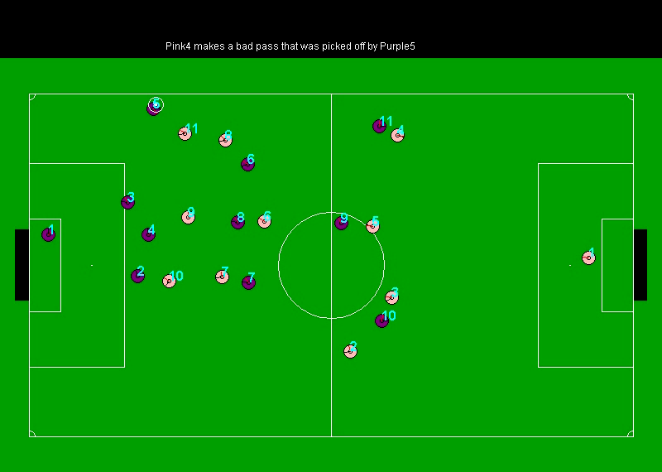
Machine Sportscast in English

Slide 26
Experimental Evaluation
Evaluated ability of the system to accurately:
  Match sentences to their correct meanings
  Parse sentences into formal meanings
  Generate sentences from formal meanings
  Pick which events are worth talking about
See journal paper for details:
  Chen, Kim, & Mooney (JAIR, 2010)

Slide 27
Human Evaluation of Sportscasts
“Pseudo Turing Test”
Used Amazon’s Mechanical Turk to recruit human judges (36 English, 7 Korean judges per video)
8 commented game clips
  4 minute clips randomly selected from each of the 4 games
  Each clip commented once by a human, and once by the machine
Judges were not told which ones were human or machine generated

Slide 28
Human Evaluation Metrics
Score | English Fluency | Semantic Correctness | Sportscasting Ability
5 | Flawless | Always | Excellent
4 | Good | Usually | Good
3 | Non-native | Sometimes | Average
2 | Disfluent | Rarely | Bad
1 | Gibberish | Never | Terrible
Human?
Also asked human judge to predict if a human or machine generated
the sportscast, knowing there was some of each in the data.
Notes:
28

Slide 29
Pseudo-Turing-Test Results
English
Commentator | Fluency | Semantic Correctness | Sportscasting Ability | Human?
Human | 3.86 | 4.03 | 3.34 | 24.31%
Machine | 3.94 | 4.03 | 3.48 | 26.76%
Korean
Commentator | Fluency | Semantic Correctness | Sportscasting Ability | Human?
Human | 3.66 | 4.10 | 3.76 | 62.07%
Machine | 2.93 | 3.41 | 2.97 | 31.03%
Notes:
29

Slide 30
Challenge Problem #2:
Learning to Follow Directions in a Virtual World
Learn to interpret navigation instructions in a virtual environment by simply observing humans giving and following such directions (Chen & Mooney, AAAI-11).
Eventual goal: Virtual agents in video games and educational software that automatically learn to take and give instructions in natural language.

Slide 31


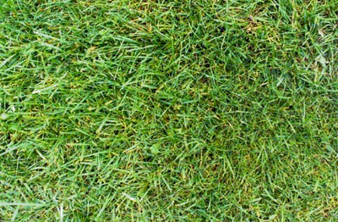


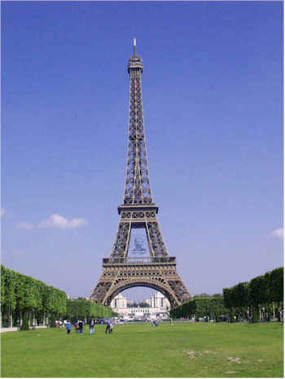






Sample Environment
(MacMahon, et al. AAAI-06)
H
H – Hat Rack
L – Lamp
E – Easel
S – Sofa
B – Barstool
C - Chair
L
E
E
C
S
S
C
B
H
L

Slide 32


Sample Instructions
Take your first left. Go all the way down until you hit a dead end.
Go towards the coat hanger and turn left at it. Go straight down the hallway and the dead end is position 4.
Walk to the hat rack. Turn left. The carpet should have green octagons. Go to the end of this alley. This is p-4.
Walk forward once. Turn left. Walk forward twice.
Start
3
End
H
4

Slide 33
Sample Instructions
Take your first left. Go all the way down until you hit a dead end.
Go towards the coat hanger and turn left at it. Go straight down the hallway and the dead end is position 4.
Walk to the hat rack. Turn left. The carpet should have green octagons. Go to the end of this alley. This is p-4.
Walk forward once. Turn left. Walk forward twice.
Start
3
End
H
4
Observed primitive actions:
Forward, Left, Forward, Forward

Slide 34
Instruction Following Demo
Navigation Demo Applet

Slide 35
Formal Problem Definition
Given:
{ (e₁, a₁, w₁), (e₂, a₂, w₂), … , (e_{n}, a_{n}, w_{n}) }
e_{i} – A natural language instruction
a_{i} – An observed action sequence
w_{i} – A world state
Goal:
Build a system that produces the correct a_{j} given a previously unseen (e_{j}, w_{j}).

Slide 36
Observation
World State
Action Trace
Instruction
Training

Slide 37
Learning system for parsing
navigation instructions
Observation
World State
Navigation Plan Constructor
Action Trace
Instruction
Training

Slide 38
Learning system for parsing
navigation instructions
Observation
World State
Navigation Plan Constructor
Action Trace
Instruction
Semantic Parser Learner
Training

Slide 39
Learning system for parsing
navigation instructions
Observation
World State
Navigation Plan Constructor
Action Trace
Instruction
Plan Refinement
Semantic Parser Learner
Training

Slide 40
Learning system for parsing
navigation instructions
Observation
World State
Navigation Plan Constructor
Action Trace
Instruction
Plan Refinement
Semantic Parser Learner
Training
Testing
Instruction
World State

Slide 41
Learning system for parsing
navigation instructions
Observation
World State
Navigation Plan Constructor
Action Trace
Instruction
Plan Refinement
Semantic Parser Learner
Training
Testing
Instruction
Semantic Parser
World State

Slide 42
Learning system for parsing
navigation instructions
Observation
World State
Navigation Plan Constructor
Action Trace
Instruction
Plan Refinement
Semantic Parser Learner
Training
Testing
Instruction
Semantic Parser
World State
Execution Module (MARCO)
Action Trace

Slide 43
Evaluation Data Statistics
3 maps, 6 instructors, 1-15 followers/direction
Hand-segmented into single sentence steps
 | Paragraph | Single-Sentence
# Instructions | 706 | 3236
Avg. # sentences | 5.0 (±2.8) | 1.0 (±0)
Avg. # words | 37.6 (±21.1) | 7.8 (±5.1)
Avg. # actions | 10.4 (±5.7) | 2.1 (±2.4)

Slide 44
End-to-End Execution Evaluation
Test how well the system follows novel directions.
Leave-one-map-out cross-validation.
Strict metric: Only correct if the final position exactly matches goal location.
Lower baseline: Simple probabilistic generative model of executed plans w/o language.
Upper baselines:
  Semantic parser trained on human annotated plans
  Human followers

Slide 45
End-to-End Execution Accuracy
 | Single-Sentence | Complete
Simple Generative Model | 11.08 | 2.15
Landmarks Plans | 21.95 | 2.66
Refined Landmarks Plans | 54.40 | 16.18
Human Annotated Plans | 58.29 | 26.15
Human Followers | N/A | 69.64

Slide 46
Sample Successful Parse
Instruction: | “Place your back against the wall of the ‘T’ intersection. Turn left. Go forward along the pink-flowered carpet hall two segments to the intersection with the brick hall. This intersection contains a hatrack. Turn left. Go forward three segments to an intersection with a bare concrete hall, passing a lamp. This is Position 5.”
Parse: | Turn ( ), Verify ( back: WALL ), Turn ( LEFT ), Travel ( ), Verify ( side: BRICK HALLWAY ), Turn ( LEFT ), Travel ( steps: 3 ), Verify ( side: CONCRETE HALLWAY )

Slide 47
Future Challenge Area:
Learning for Language and Vision
Natural Language Processing (NLP) and Computer Vision (CV) are both very challenging problems.
Machine Learning (ML) is now extensively used to automate the construction of both effective NLP and CV systems.
Generally uses supervised ML and requires difficult and expensive human annotation of large text or image/video corpora for training.

Slide 48
Cross-Supervision of
Language and Vision
Use naturally co-occurring perceptual input to supervise language learning.
Use naturally co-occurring linguistic input to supervise visual learning.
Supervision
Input
Language
Learner
Vision
Learner
Input
Supervision
Blue cylinder on top of a red cube.

Slide 49
Conclusions
Current language-learning approaches uses expensive, unrealistic training data.
We have developed language-learning systems that learn from sentences paired with an ambiguous, naturally-occurring perceptual environment.
We have explored 2 challenge problems:
  Learning to sportscast simulated Robocup games
    Able to commentate games about as well as humans.
  Learning to follow navigation directions
    Able to accurately follow 55% of instructional sentences for a novel environment.

