Slide 1
Recent Advances in Imitation Learning from Observation
Faraz Torabi*, Garrett Warnell^, Peter Stone*
*University of Texas at Austin,
^Army Research Laboratory

Slide 2
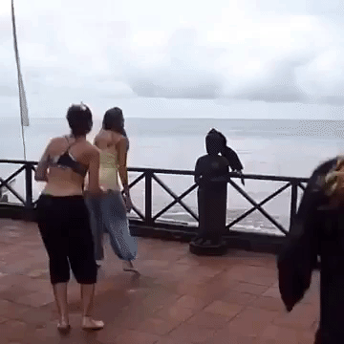
What is Imitation from Observation?

Slide 3
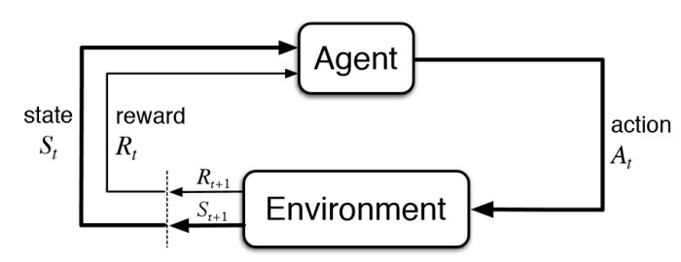
Reinforcement Learning (RL)

Slide 4

Markov Decision Process (MDP)
Formally, we model agent interaction as an MDP i.e.
Where,
  S is the state space of the agent
  A is the action space of the agent
  T is transition probabilities i.e.
  R is the scalar reward i.e.
  is the discount factor
Goal:
  where we want to find policy,
Drawback:
  Requires extensive explorations
  Designing reward functions are requires domain knowledge

Slide 5
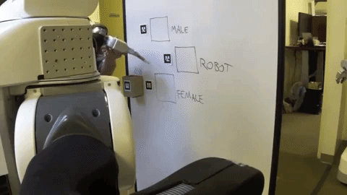
Imitation Learning
Goal:
  Learn how to make decisions by trying to imitate another agent.
Observations of other agent (demonstrations) consist of state-action pairs.
Limitation:
  Precludes using a large amount of demonstration data where action sequences are not given (e.g. YouTube videos).

Slide 6
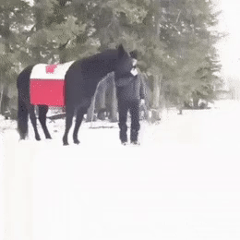
Imitation from Observation
Goal:
  Learn how to perform a task given state-only demonstrations (visual demonstration).

Slide 7
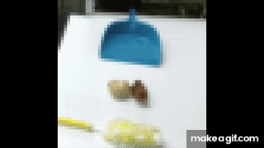
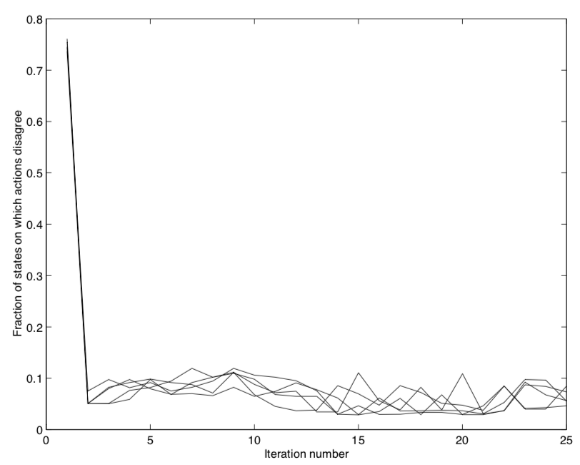
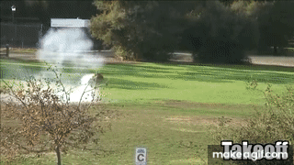
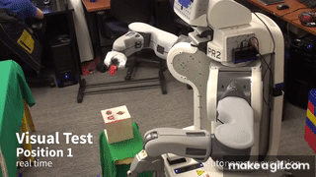
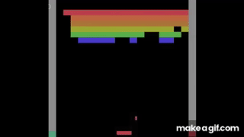
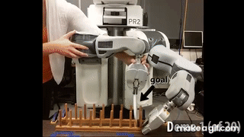
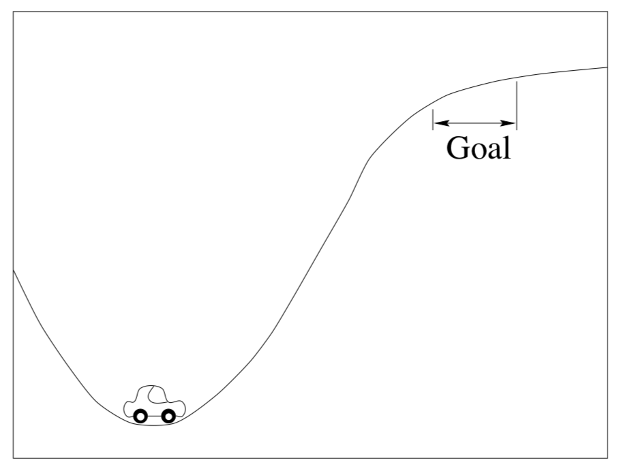
Timeline
Imitation Learning from Observation
Inverse Reinforcement Learning
Inverse Reinforcement Learning
Real World Application: End-to-End Training of Deep Visuomotor Policies
Human-level control through deep RL from pixels
Deep Learning in Imitation Learning
Liu et al 2018
Finn et al 2016
Levine et al 2016
Mnih et al 2015
Abbeel et al 2004
Ng et al 1998

Slide 8
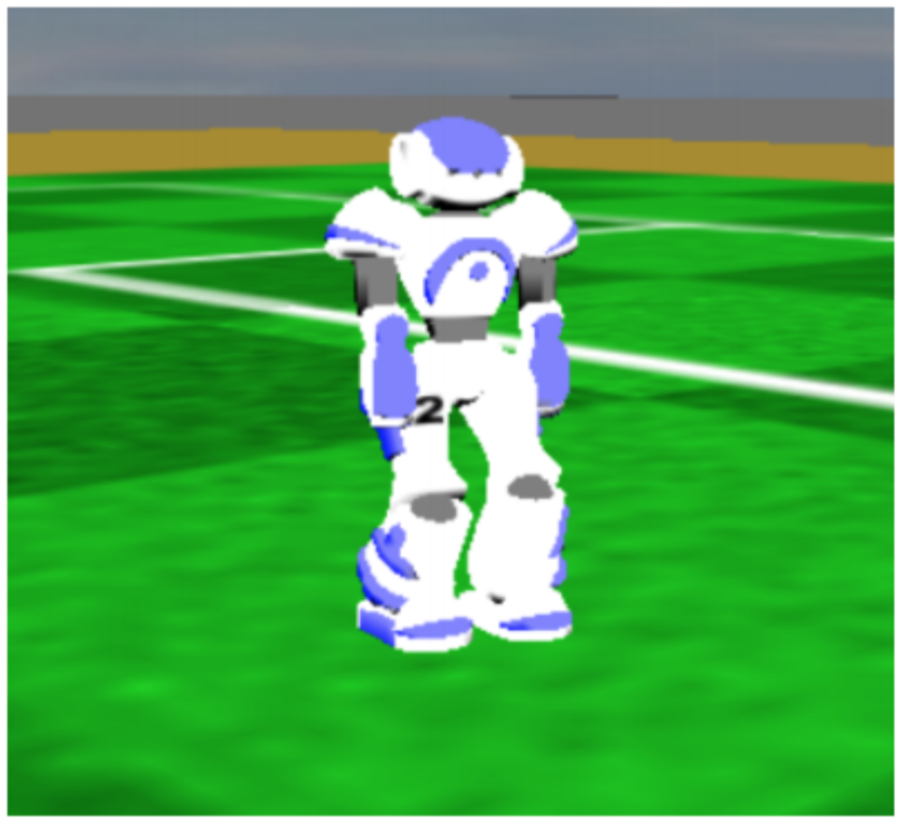
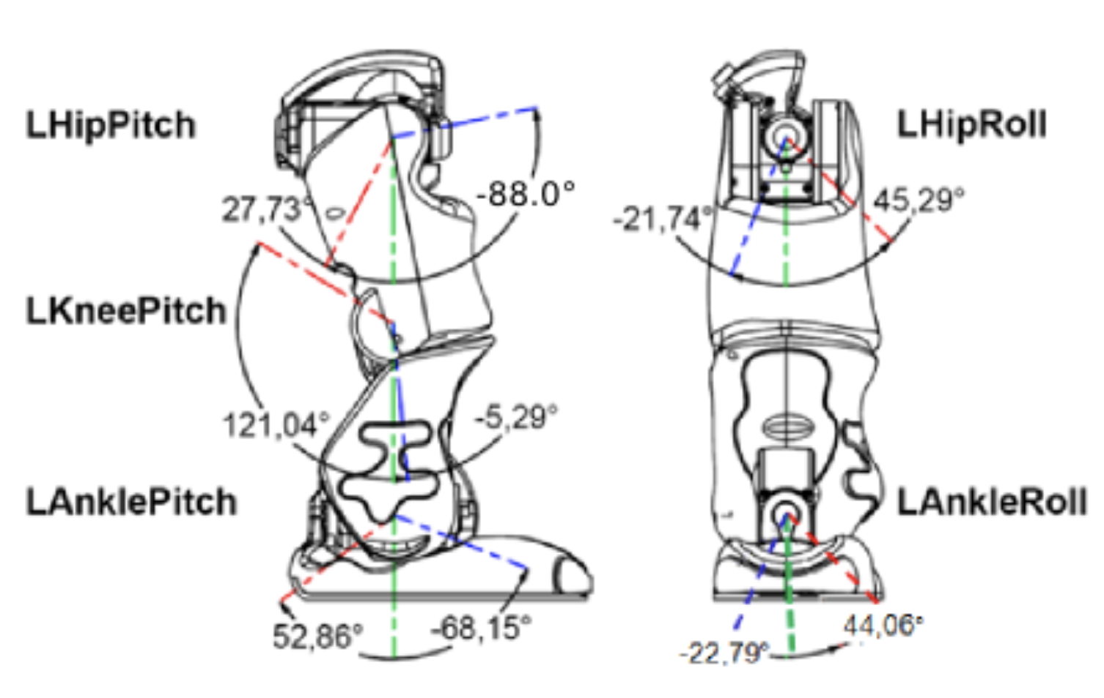
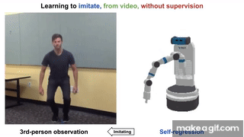
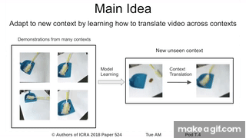
Challenges in Imitation from Observation
Perception
  Simplified condition: Demos are a set of low-level features such as Joint angles (No need for perception)
  General Condition: Demos comprise visual information
    Embodiment mismatch
    Viewpoint difference
http://doc.aldebaran.com/2-1/family/robots/joints_robot.html
Sermanet, Pierre, et al. "Time-contrastive networks: Self-supervised learning from video." 2018 IEEE International Conference on Robotics and Automation (ICRA). IEEE, 2018. APA
Liu, YuXuan, et al. "Imitation from observation: Learning to imitate behaviors from raw video via context translation." 2018 IEEE International Conference on Robotics and Automation (ICRA). IEEE, 2018.

Slide 9
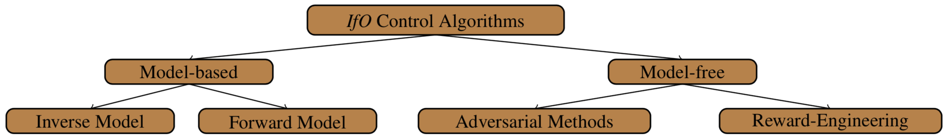
Challenges in Imitation from Observation
Control
  Formulation:
    Given: the low-level features,
    Learn: an imitation policy,
Algorithms

Slide 10
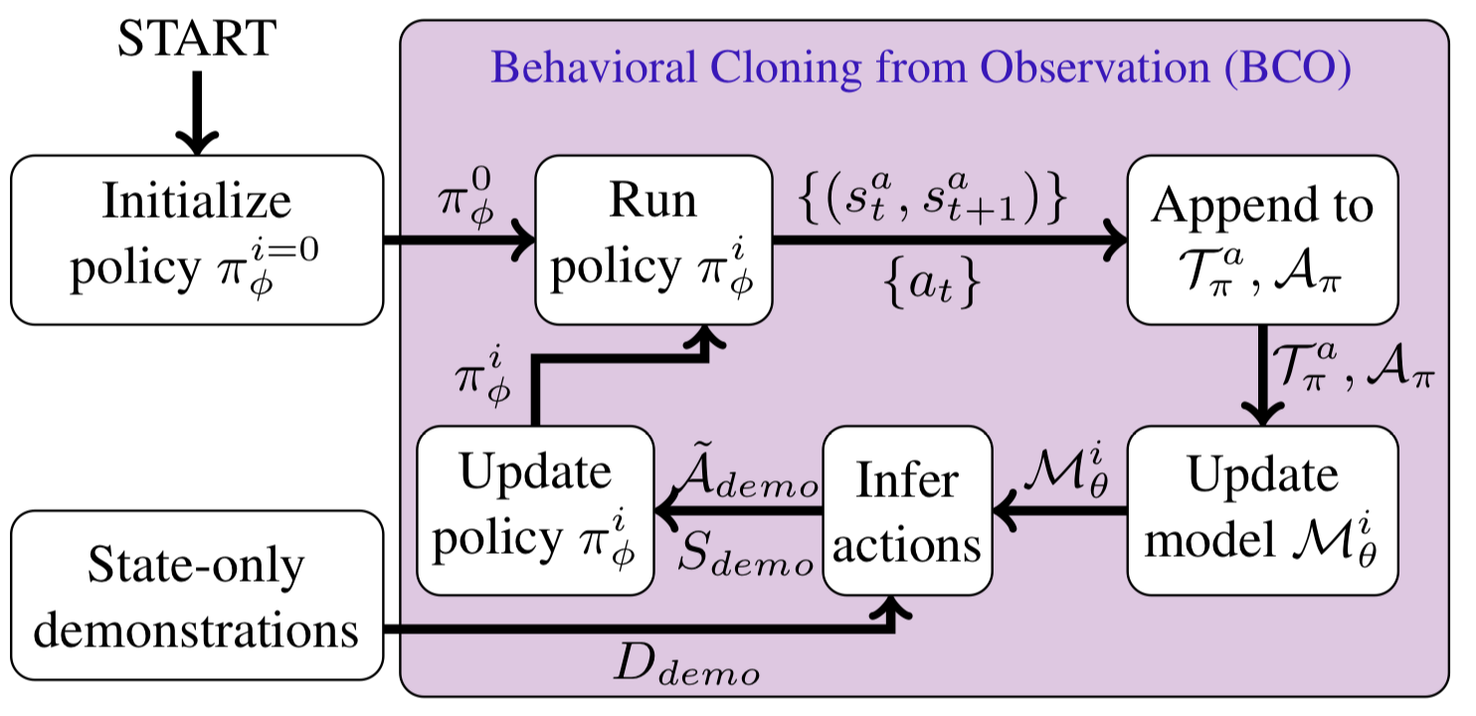
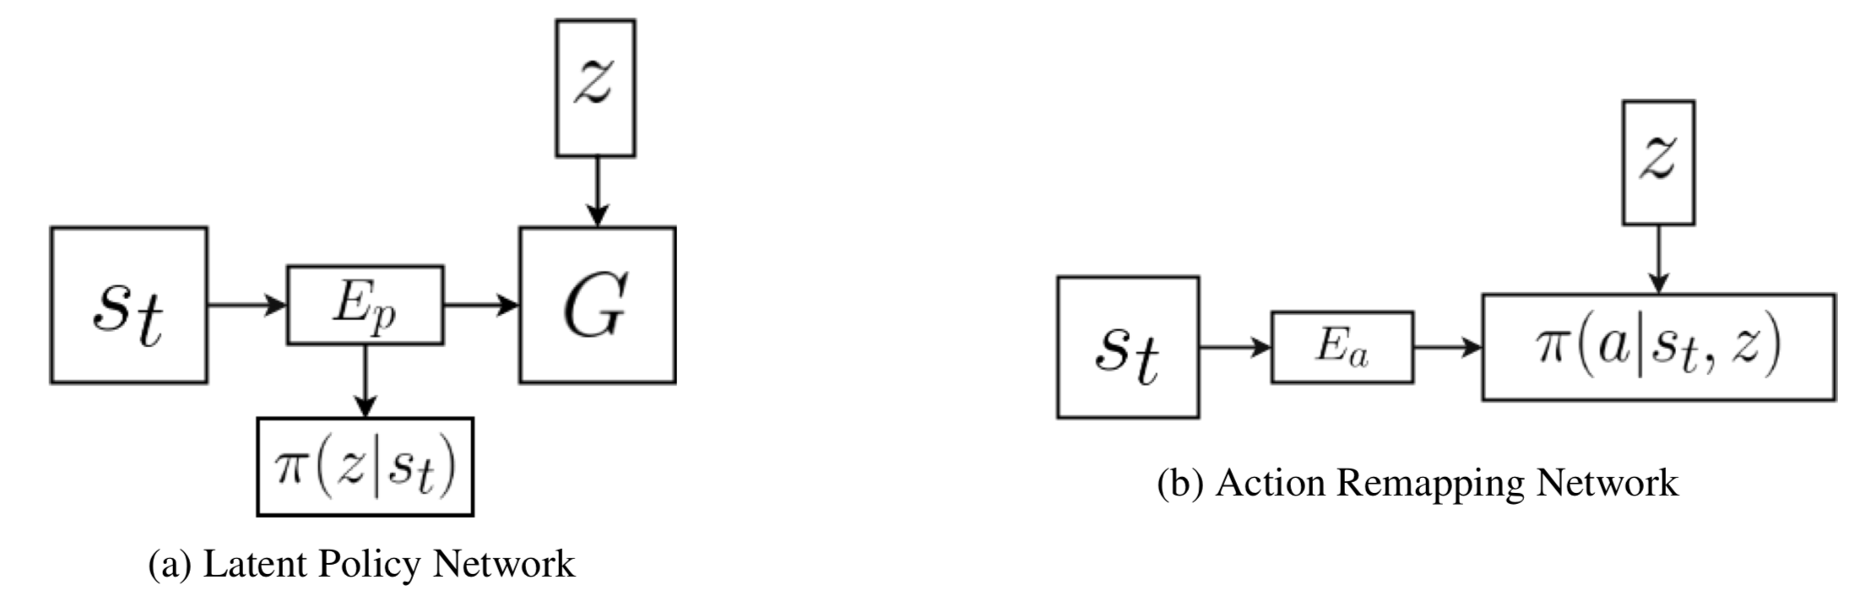
Control
Model-based
  Learn a model of the environment in the process.
    Inverse Model:
    Forward Model:
Torabi, Faraz, Garrett Warnell, and Peter Stone. "Behavioral cloning from observation." Proceedings of the 27th International Joint Conference on Artificial Intelligence. AAAI Press, 2018.
Edwards, Ashley, et al. "Imitating Latent Policies from Observation." International Conference on Machine Learning. 2019.

Slide 11
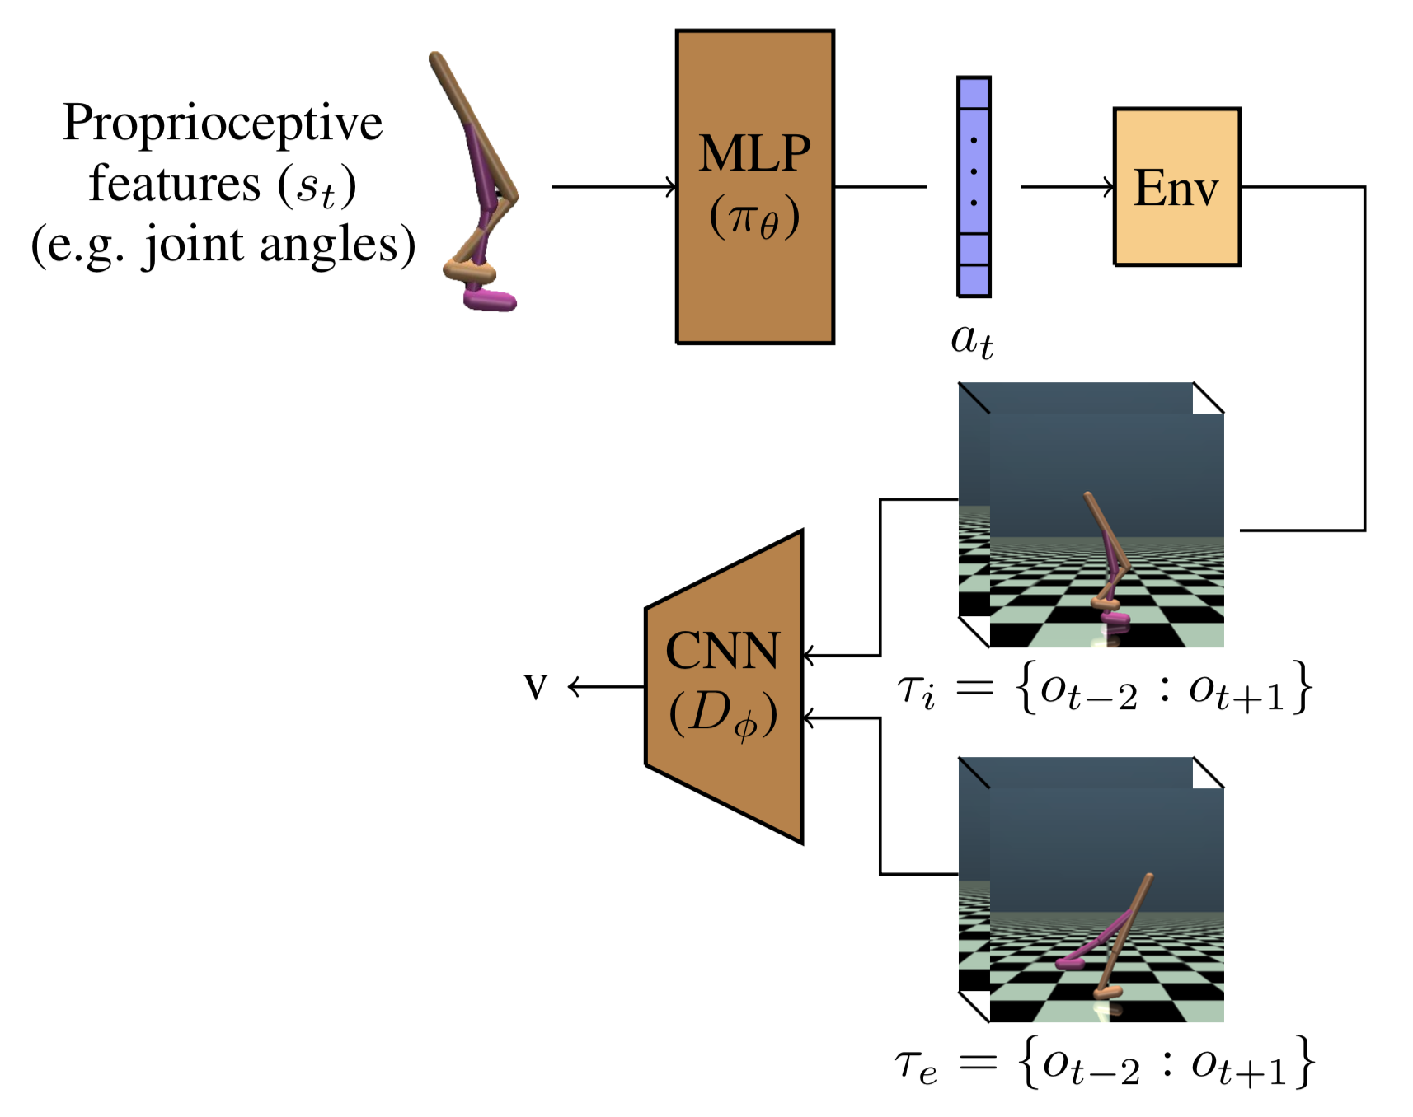
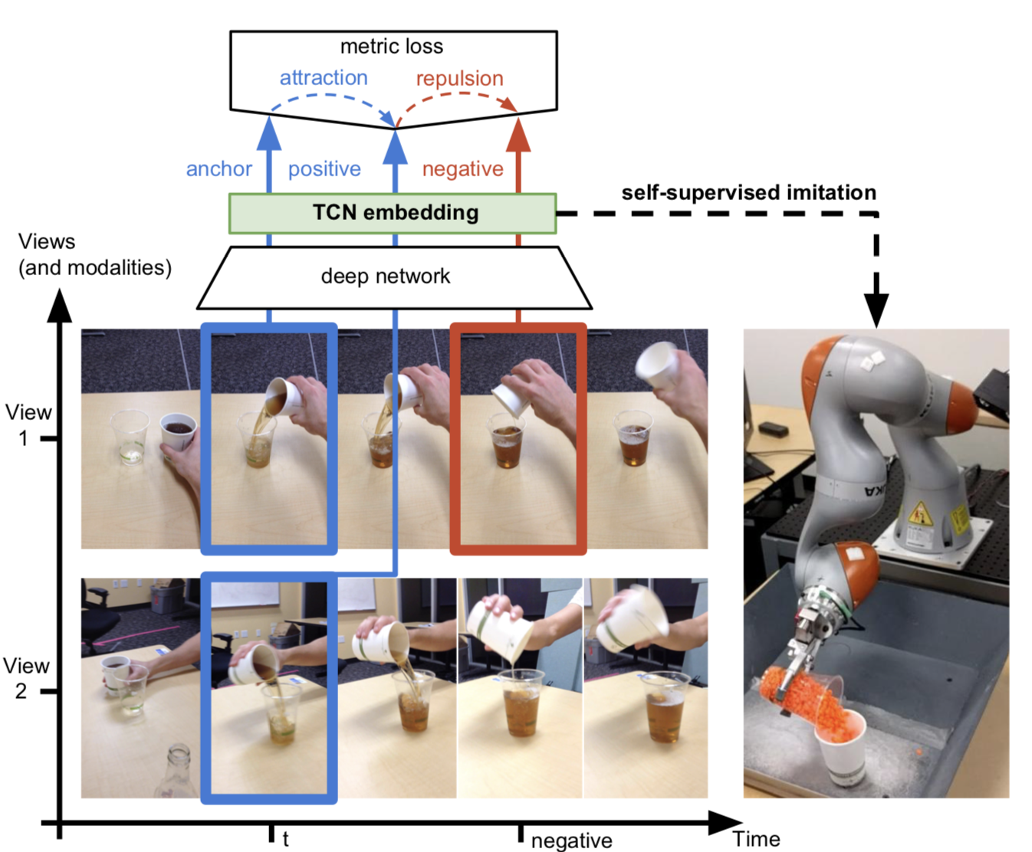
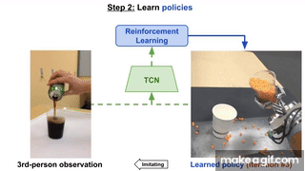

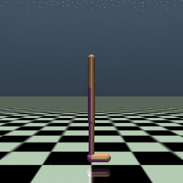
Control
Model-free
  Learn the imitation policy without learning any models
    Adversarial Methods
    Reward Engineering
Demonstration
Learned Policy
Torabi, Faraz, Garrett Warnell, and Peter Stone. "Imitation Learning from Video by Leveraging Proprioception." Proceedings of the 28th International Joint Conference on Artificial Intelligence. AAAI Press, 2019.
Sermanet, Pierre, et al. "Time-contrastive networks: Self-supervised learning from video." 2018 IEEE International Conference on Robotics and Automation (ICRA). IEEE, 2018.

Slide 12
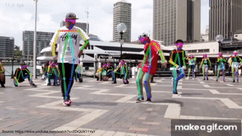

Future Directions
Perception
  Pose Estimation
  Domain Adaptation
Application to Physical Robots
  Adversarial algorithms have very high sample complexity
Integration
  To develop full intelligent agents: Integrate all learning paradigms.
Cao, Zhe, et al. "Realtime multi-person 2d pose estimation using part affinity fields." Proceedings of the IEEE Conference on Computer Vision and Pattern Recognition. 2017.
Zhu, Jun-Yan, et al. "Unpaired image-to-image translation using cycle-consistent adversarial networks." Proceedings of the IEEE international conference on computer vision. 2017.

Slide 13
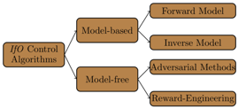
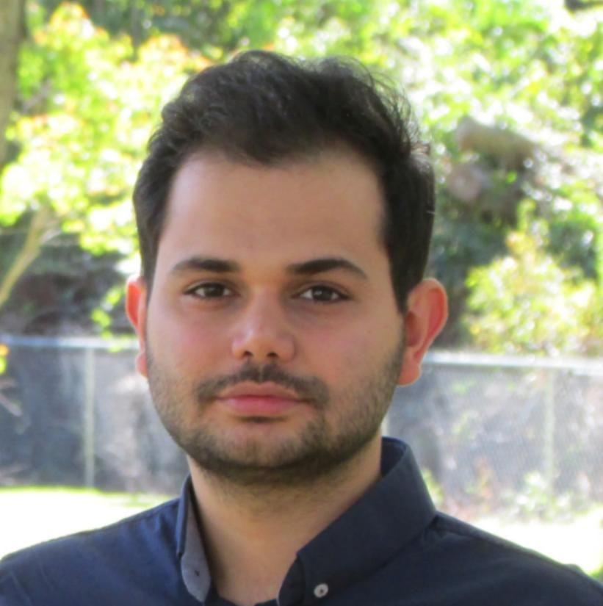
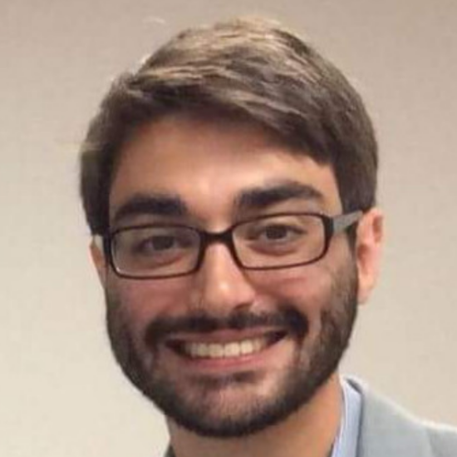
Summary
We surveyed and organized work that addresses the problem of Imitation from Observation.
Methods are being developed to address the two most important challenges in IfO:
  Perception
  Control
Collaborators
Faraz Torabi
Garrett Warnell

